Slide 1


A Global-Local Probsparse Self-Attention Transformer for LEO Satellite Orbit Prediction
Guan Huang and Tao Shu
ICMLA 2024
December 20, 2024
Presenter: Guan Huang

Slide 2
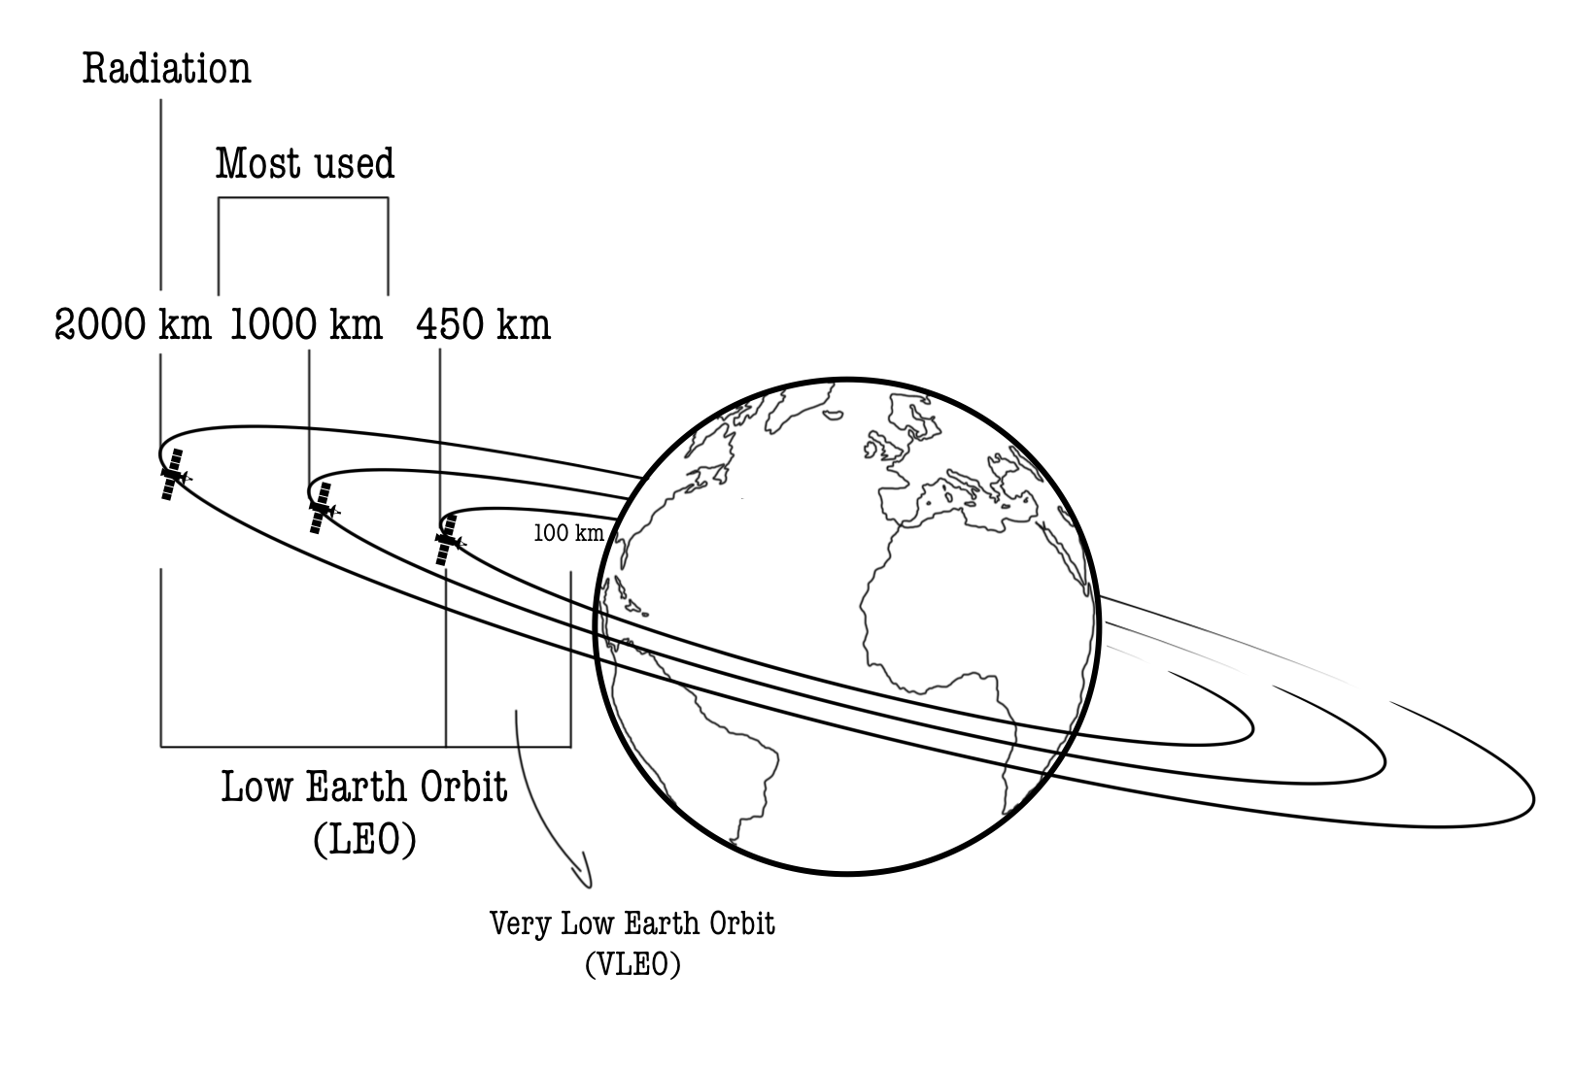
Introduction and Motivation
What are LEO Satellites?
LEO Satellites: Low-Earth Orbit (LEO) satellites operate at altitudes below 2,000 km.
Applications: Used for terrestrial surveillance, global communication, navigation, and ecological assessment.
Why is Precise Orbit Prediction Essential?
Increased Satellite Density in LEO: Projects like Starlink are increasing the number of active satellites, with plans to expand from 5,800 to 42,000.
Limitations of Traditional Methods: The orbit prediction accuracy of physics-based models (e.g., SGP4/8) is inadequate for collision avoidance. Their typical accuracy is 1-2 km, and it can go worse to several kilometers over time due to unmodeled forces such as atmospheric drag, solar radiation pressure, and satellite maneuvers.
Image Source: "Low Earth Orbit and Very Low Earth Orbit altitudes diagram." Retrieved [12/9, 2024]. https://www.deepinsecurity.com/low-earth-orbit/

Slide 3
Related Work (1): ML-based Satellite Orbit Prediction
Mainstream Methods
Physics-Enhancing Approaches
ML models are used to represent the unmodeled variables in physics-based models or serve as solvers for motion-related differential equations.
Error-Correction Approaches
ML models are designed to reduce errors in physics-based predictions.
Key Drawbacks
Most of the existing methods rely on synthetic datasets, which lack dynamic complexities of real orbits.

Slide 4
Related Work (2) : Transformer-based LSTF Models
Advancements in Transformer Architectures
Models like Informer and ETSformer have introduced novel attention mechanisms for long-sequence time-series forecasting and shown exceptional promise for long-sequence forecasting.
Challenges in Capturing Global and Local Context
Many existing transformer-based methods focus only on global context or local context, limiting their effectiveness in satellite orbit prediction, where both long-term and short-term data are crucial.

Slide 5
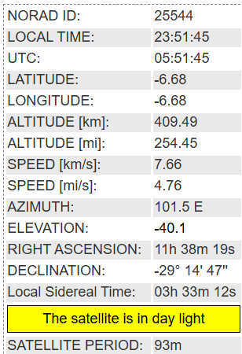
N2YO-crawler--- A Real-time Satellite Orbit Tracking Data Collection Tool
Data Collection
Develop a web crawler (N2YO-crawler) to collect data for any specified satellites at one-second intervals over a designated period from N2YO.com.
Data Selection and Augmentation
Focused on five core features to capture essential satellite trajectory details.
Additional attributes (e.g., time-related features) are computed to aid in model learning.
Image Source: Screenshot from N2YO.com. Retrieved [12/9, 2024].

Slide 6
Key Datasets for Accurate Orbit Prediction
Real Orbit Tracking Dataset (D_{Real})
Contains detailed real-world satellite orbit tracking data at one-second intervals.
It is collected by using the N2YO-crawler.
TLE Dataset (D_{TLE})
Contains Two-Line Element sets, representing standard satellite orbital parameters.
The data is downloaded from Space-Track.com.
SGP4-based Orbit Prediction Dataset (D_{SGP4})
It contains SGP4-model-based predicted satellite orbits.
It is generated using the SGP4 model applied to the TLE dataset.

Slide 7
Proposed Method: GloLoSAT
Prediction Task Overview
Focus on predicting the positional errors introduced by the SGP4 model.
Model training aims to improve the accuracy of SGP4-based orbit predictions by learning the differences between real orbit data and SGP4-predicted orbit data and applying error corrections to refine these predictions.
Framework Overview
The GloLoSAT model employs a three-stage process:
Data Preprocessing: Preparing data and calculating positional discrepancies.
Error-Correction Model Training: Using multi-range self-attention to enhance error prediction.
Final Orbit Prediction: Combining error corrections with SGP4 predictions to generate the final orbit predictions.

Slide 8
Dataset Preprocessing
Generate SGP4 Prediction Error Dataset
It takes the datasets D_{Real} and D_{SGP4} as input and subsequently constructs the SGP4-based prediction error dataset by calculating the positional discrepancies between D_{Real} and D_{SGP4.}
Dataset Partitioning
Training, validation, and testing subsets were created to support effective model evaluation.

Slide 9
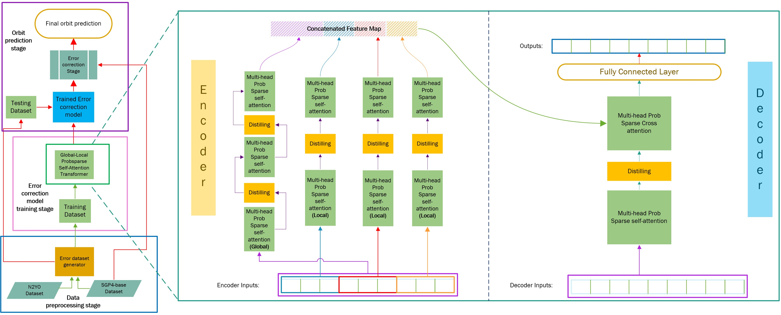
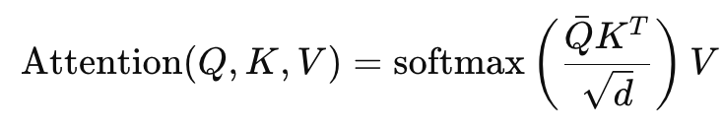
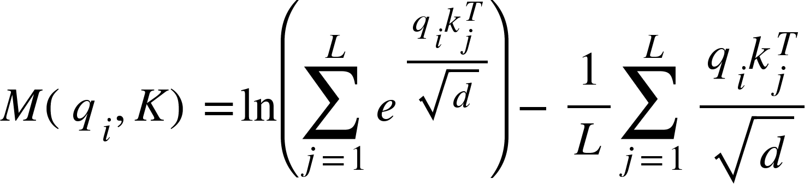
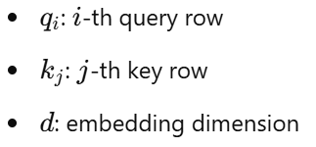

Core Architecture of The Error-Correction Model: Global-Local Probsparse Self-Attention Mechanism
Probsparse Self-Attention Formula [1](general):
$Q​, K​, and V$represent queries, keys, and values for the corresponding input sequence.
$d$ is the dimension of the query/key vectors, used for scaling.
$\overline{Q}​$is a sparse matrix derived from$Q$, containing only the the top 𝑢 sparse elements in $Q$ selected based on the following sparsity measurement formula:
Global self-attention module
Local self-attention modules
[1] Zhou, H., et al. Informer: Beyond Efficient Transformer for Long Sequence Time-Series Forecasting. Proceedings of the AAAI, 2021.

Slide 10
Model Variants for Enhanced Accuracy
GloLoSAT-OF(Orbital Features Focused)
Optimized to focus on key orbital features, refining predictions for specific parameters.
GloLoSAT-TL (Triple Independent)
Employs a triple independent approach to predict latitude, longitude, and altitude separately, improving model accuracy through specialized attention on each feature.

Slide 11
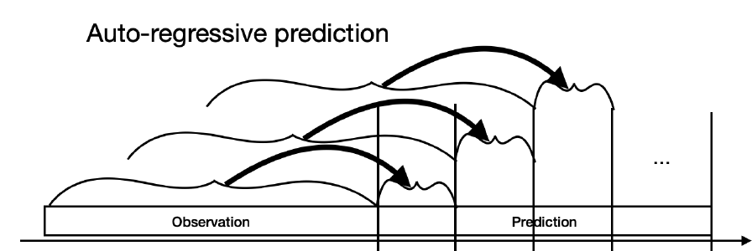
Experiment settings: Prediction Scenarios
Short-Term Prediction(60 seconds)
Uses the previous 300 seconds of data to forecast the next 60 seconds in 1-second intervals. (collision avoidance)
Long-Term Prediction(720 seconds)
Uses 300 seconds of prior data to predict the next 720 seconds, at 1-second intervals. (scheduling ground station passes)
Extended Long-Term Prediction(720 minutes)
Uses 60 minutes of historical data, sampled at 1-minute intervals, to forecast 720 minutes ahead. (proactive orbit management)
Image Source: Alesiani, F., Takamoto, M., Kamiya, T., & Etou, D. LEO Satellite Orbit Prediction with Physics-Informed Machine Learning. Retrieved [12/9, 2024]. https://neurips.cc/virtual/2023/76259

Slide 12
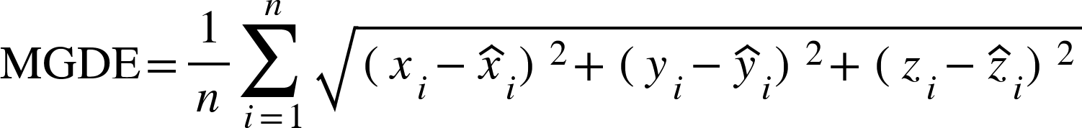
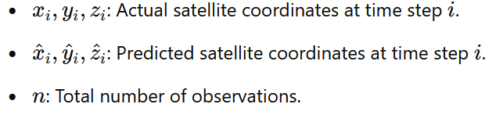
Baselines and Evaluation Metrics
Comparison Models
SGP4: Standard physics-based orbit prediction.
LSTM, Informer, and Informer(stack): Advanced time-series models.
Evaluation Metrics
MAE (Mean Absolute Error), RMSE (Root Mean Square Error), and MGDE (Mean Geocentric Distance Error) used to assess prediction accuracy.
Where:

Slide 13
Summary of Experiment Results
Prediction Scenario | Maximum MGDE Improvement(%)
Short-Term Prediction (60 seconds) | 22.3
Long-Term Prediction (720 seconds) | 23.2
Extended Long-Term Prediction (720 mins) | 18.9

Slide 14
Summary of Contributions
N2YO-crawler
Developed an efficient tool for real-time satellite data collection, enhancing the quality of training data for orbit prediction models.
GloLoSAT Framework
Introduced a novel three-stage framework for satellite orbit prediction that leverages a Global-Local Probsparse self-attention mechanism.
Experimental Validation
Extensive experiments confirm the model’s effectiveness in reducing prediction errors across multiple scenarios.

Slide 15

Thank you.
Questions?

Slide 16
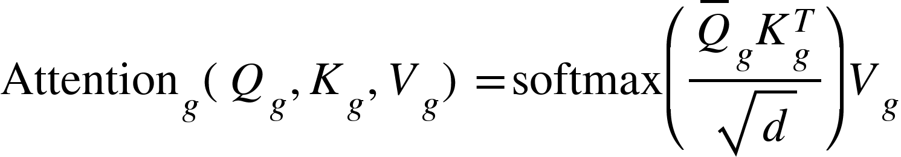
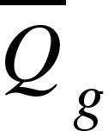
Core Architecture of GloLoSAT: Global-Local Probsparse Self-Attention Mechanism
Global Probsparse Self-Attention
Captures the entire sequence, enabling a broader contextual understanding of the data.
Formula:
Q _{g}​ , 𝐾_{𝑔}​ , and 𝑉_{𝑔}​ represent queries, keys, and values for the entire sequence.
represents a filtered sparse matrix comprising the top 𝑢 sparse elements in 𝑄_{𝑔} selected based on the following sparsity measurement formula:

Slide 17
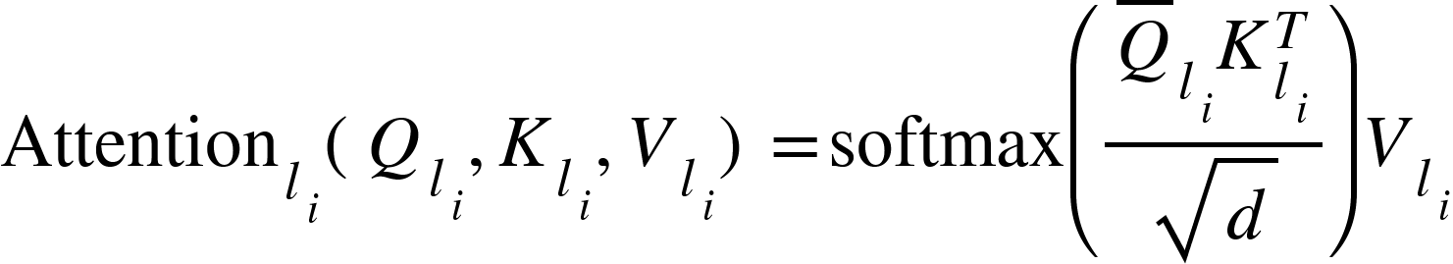
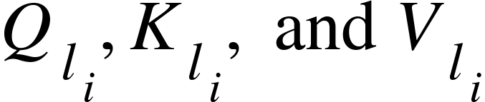
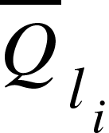

Core Architecture of GloLoSAT: Global-Local Probsparse Self-Attention Mechanism
Local Probsparse Self-Attention
Divides the input into smaller segments to focus on local contexts within the sequence, capturing fine-grained details.
Formula:
are the queries, keys, and values for each local segment of the sequence.
represents a filtered sparse matrix comprising the top 𝑢 sparse elements in selected based on the following sparsity measurement formula:

Slide 18
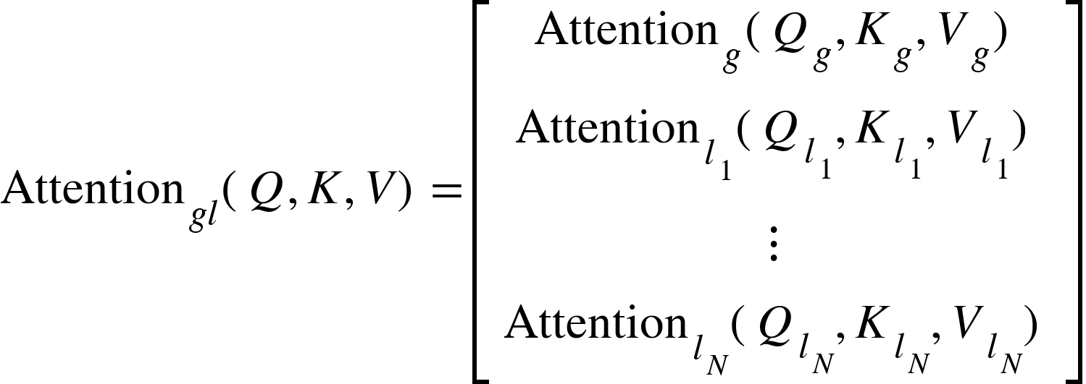
Core Architecture of GloLoSAT: Global-Local Probsparse Self-Attention Mechanism
Global-Local Probsparse Self-Attention
Combines global and local attention mechanisms to capture context at both large and small scales, improving overall prediction accuracy.
Formula:

Slide 19
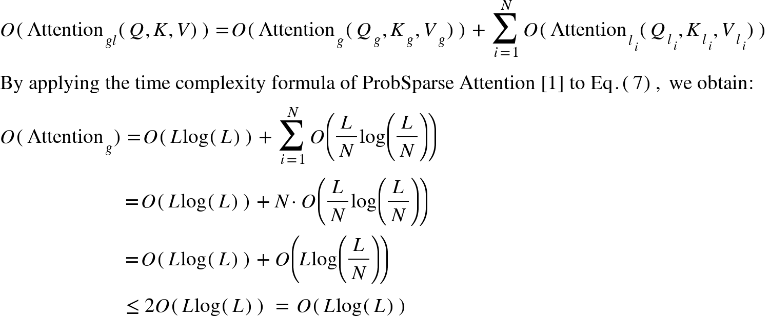
Computational Complexity and Proof
1. Computational Complexity Formula:
The computational complexity of the Global-Local Probsparse Self-Attention mechanism is:
2. Proof of Computational Complexity:
[1] H. Zhou, S. Zhang, J. Peng, S. Zhang, J. Li, H. Xiong, and W. Zhang, “Informer: Beyond efficient transformer for long sequence time-series forecasting,” in Proceedings of the AAAI conference on artificial intelligence, vol. 35, no. 12, 2021, pp. 11 106–11 115.

