Slide 1
组合数学习题课
第10次作业

Slide 2
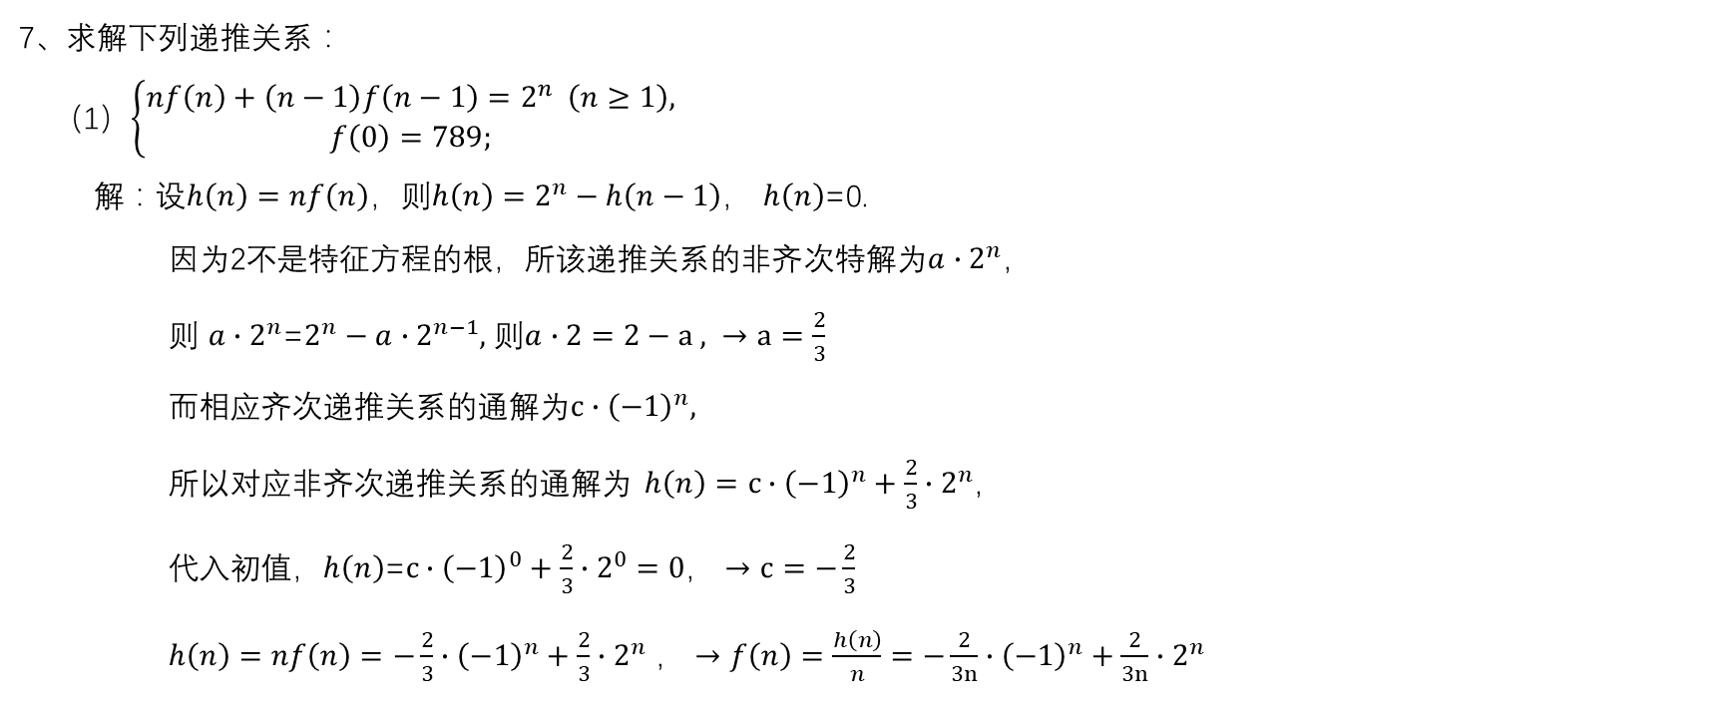
Ch6
7、求解下列递推关系：
（1）$\left\{\begin{aligned}nf\left(n\right)+\left(n−1\right)f\left(n−1\right)=2^{n} \left(n≥1\right), \\ f\left(0\right)=789;\end{aligned}\right.$
解：设$h\left(n\right)=nf\left(n\right)，则h\left(n\right)=2^{n}−h\left(n−1\right)$， $h\left(n\right)$=0.
因为2不是特征方程的根，所该递推关系的非齐次特解为${a∙2}^{n}，$
则 ${a∙2}^{n}$=$2^{n}−{a∙2}^{n−1},$ 则$a∙2=2−a , →a=\frac{2}{3}$
而相应齐次递推关系的通解为${c∙\left(−1\right)}^{n},$
所以对应非齐次递推关系的通解为 $h\left(n\right)={c∙\left(−1\right)}^{n}+\frac{2}{3}∙2^{n}$，
代入初值，$h\left(n\right)$=${c∙\left(−1\right)}^{0}+\frac{2}{3}∙2^{0}=0，→c=−\frac{2}{3}$
$h\left(n\right)=nf\left(n\right)={−\frac{2}{3}∙\left(−1\right)}^{n}+\frac{2}{3}∙2^{n}$ $，→f\left(n\right)=\frac{h\left(n\right)}{n}={−\frac{2}{3n}∙\left(−1\right)}^{n}+\frac{2}{3n}∙2^{n}$

Slide 3

Ch6
8、求解下列递推关系：
（1）$\left\{\begin{aligned}f\left(n\right)=\left(n+2\right)f\left(n−1\right) \left(n≥1\right), \\ f\left(0\right)=1;\end{aligned}\right.$
解：$f\left(n\right)=\left(n+2\right)f\left(n−1\right)$
$=\left(n+2\right)\left(n+1\right)f\left(n−2\right)$
$=\left(n+2\right)\left(n+1\right)n(n−1)⋯(1+2)f\left(0\right)$
$=\frac{\left(n+2\right)!}{2}$

Slide 4

Ch6
8、求解下列递推关系：
（2）$\left\{\begin{aligned}f\left(n\right)=f\left(n−1\right)+\frac{1}{n(n+1)} \left(n≥1\right), \\ f\left(0\right)=1;\end{aligned}\right.$
解：$f\left(n\right)=\frac{1}{n(n+1)}+\frac{1}{(n−1)n}+⋯+\frac{1}{1\left(1+1\right)}+1$
$=\left(\frac{1}{n}−\frac{1}{n+1}\right)+\left(\frac{1}{n−1}−\frac{1}{n}\right)+(\frac{1}{n−2}−\frac{1}{n−1})⋯+\left(1−\frac{1}{2}\right)+1$
$=1−\frac{1}{n+1}+1$
$=2−\frac{1}{n+1}$

Slide 5
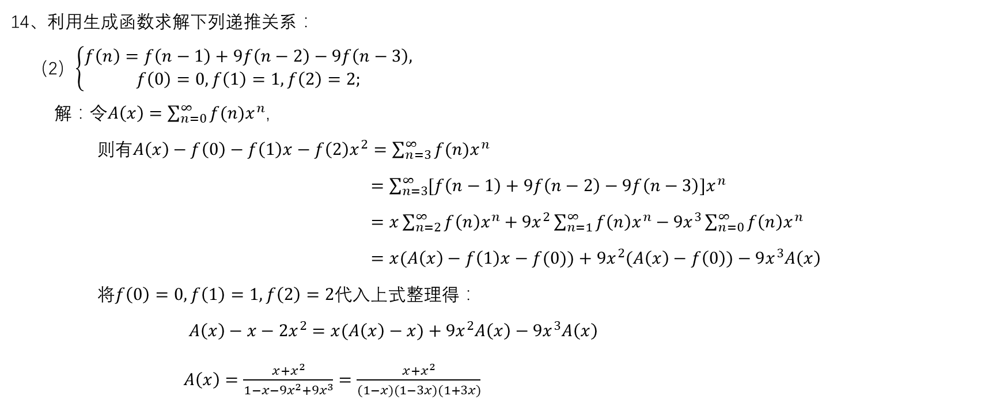
Ch6
14、利用生成函数求解下列递推关系：
（2）$\left\{\begin{aligned}f\left(n\right)=f\left(n−1\right)+9f\left(n−2\right)−9f\left(n−3\right), \\ f\left(0\right)=0,f\left(1\right)=1,f\left(2\right)=2;\end{aligned}\right.$
解：令$A\left(x\right)=\sum_{n=0}^{∞}{f(n)x^{n}}$,
则有$A\left(x\right)−f\left(0\right)−f\left(1\right)x−f\left(2\right)x^{2}=\sum_{n=3}^{∞}{f(n)x^{n}}$
$=\sum_{n=3}^{∞}{[f\left(n−1\right)+9f\left(n−2\right)−9f\left(n−3\right)]x^{n}}$
$=x\sum_{n=2}^{∞}{f\left(n\right)x^{n}}+9x^{2}\sum_{n=1}^{∞}{f\left(n\right)x^{n}}−9x^{3}\sum_{n=0}^{∞}{f\left(n\right)x^{n}}$
$=x(A\left(x\right)−f\left(1\right)x−f(0))+9x^{2}(A\left(x\right)−f\left(0\right))−9x^{3}A\left(x\right)$
将$f\left(0\right)=0,f\left(1\right)=1,f\left(2\right)=2$代入上式整理得：
$A\left(x\right)−x−2x^{2}=x(A\left(x\right)−x)+9x^{2}A\left(x\right)−9x^{3}A\left(x\right)$
$A\left(x\right)=\frac{x+x^{2}}{1−x−9x^{2}+9x^{3}}=\frac{x+x^{2}}{(1−x)(1−3x)(1+3x)}$

Slide 6
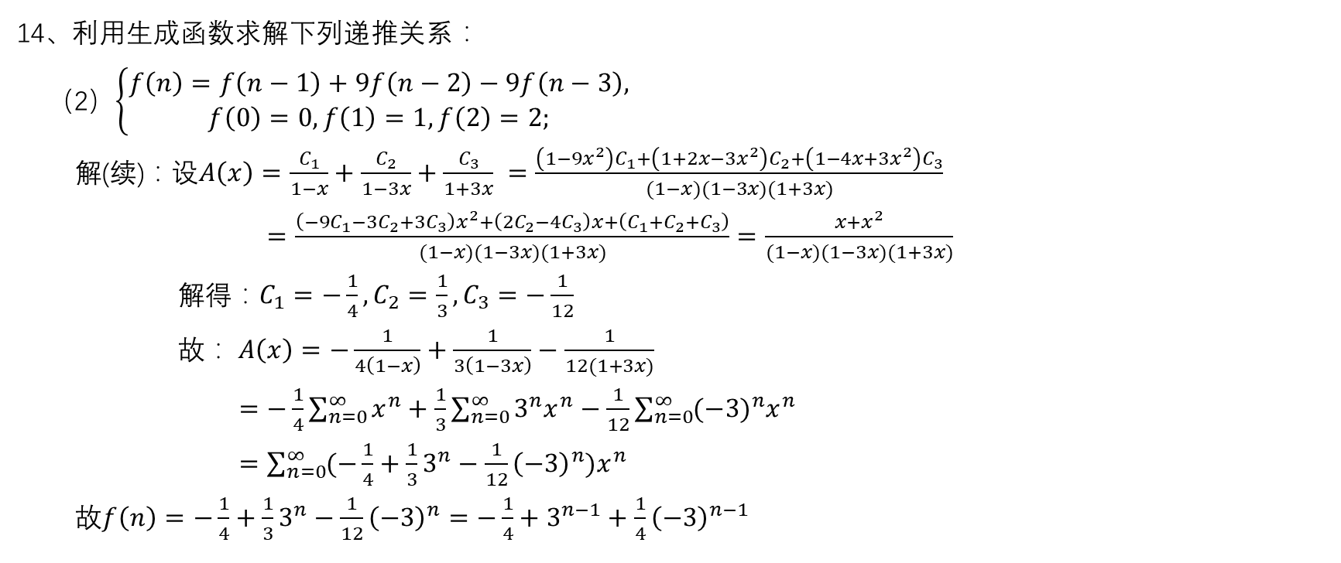
Ch6
14、利用生成函数求解下列递推关系：
（2）$\left\{\begin{aligned}f\left(n\right)=f\left(n−1\right)+9f\left(n−2\right)−9f\left(n−3\right), \\ f\left(0\right)=0,f\left(1\right)=1,f\left(2\right)=2;\end{aligned}\right.$
解(续)：设$A\left(x\right)=\frac{C_{1}}{1−x}+\frac{C_{2}}{1−3x}+\frac{C_{3}}{1+3x} =\frac{\left(1−9x^{2}\right)C_{1}+\left(1+2x−3x^{2}\right)C_{2}+\left(1−4x+3x^{2}\right)C_{3}}{(1−x)(1−3x)(1+3x)}$
$=\frac{\left(−9C_{1}−3C_{2}+3C_{3}\right)x^{2}+\left({2C}_{2}−4C_{3}\right)x+\left({C_{1}+C}_{2}+C_{3}\right)}{(1−x)(1−3x)(1+3x)}=\frac{x+x^{2}}{(1−x)(1−3x)(1+3x)}$
解得：$C_{1}=−\frac{1}{4}, C_{2}=\frac{1}{3},C_{3}=−\frac{1}{12}$
故：$A\left(x\right)=−\frac{1}{4\left(1−x\right)}+\frac{1}{3\left(1−3x\right)}−\frac{1}{12(1+3x)}$
$=−\frac{1}{4}\sum_{n=0}^{∞}{x^{n}}+\frac{1}{3}\sum_{n=0}^{∞}{3^{n}x^{n}}−\frac{1}{12}\sum_{n=0}^{∞}{{(−3)}^{n}x^{n}}$
$=\sum_{n=0}^{∞}{{(−\frac{1}{4}+\frac{1}{3}3^{n}−\frac{1}{12}{\left(−3\right)}^{n})x}^{n}}$
故$f\left(n\right)=−\frac{1}{4}+\frac{1}{3}3^{n}−\frac{1}{12}{\left(−3\right)}^{n}=−\frac{1}{4}+3^{n−1}+\frac{1}{4}{\left(−3\right)}^{n−1}$

Slide 7
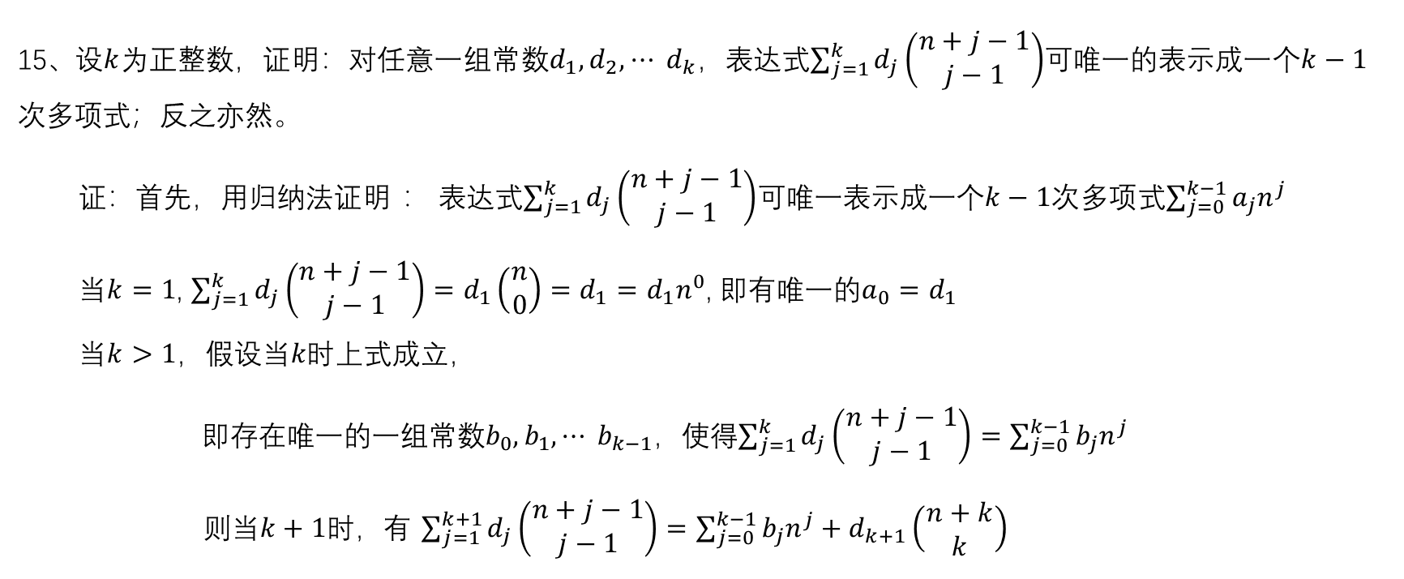
Ch6
15、设$k$为正整数，证明：对任意一组常数$d_{1},d_{2},⋯$ $d_{k}$，表达式$\sum_{j=1}^{k}{d_{j}\left(\begin{aligned}n+j−1 \\ j−1\end{aligned}\right)}$可唯一的表示成一个$k−1$次多项式；反之亦然。
证：首先，用归纳法证明 ： 表达式$\sum_{j=1}^{k}{d_{j}\left(\begin{aligned}n+j−1 \\ j−1\end{aligned}\right)}$可唯一表示成一个$k−1$次多项式$\sum_{j=0}^{k−1}{a_{j}n^{j}}$
当$k=1$, $\sum_{j=1}^{k}{d_{j}\left(\begin{aligned}n+j−1 \\ j−1\end{aligned}\right)}=d_{1}\left(\begin{aligned}n \\ 0\end{aligned}\right)=d_{1}=d_{1}n^{0}$, 即有唯一的$a_{0}=d_{1}$
当$k>1，$假设当$k时$上式成立，
即存在唯一的一组常数$b_{0},b_{1},⋯$ $b_{k−1}$，使得$\sum_{j=1}^{k}{d_{j}\left(\begin{aligned}n+j−1 \\ j−1\end{aligned}\right)}=\sum_{j=0}^{k−1}{b_{j}n^{j}}$
则当$k+1$时，有 $\sum_{j=1}^{k+1}{d_{j}\left(\begin{aligned}n+j−1 \\ j−1\end{aligned}\right)}=\sum_{j=0}^{k−1}{b_{j}n^{j}}+d_{k+1}\left(\begin{aligned}n+k \\ k\end{aligned}\right)$

Slide 8
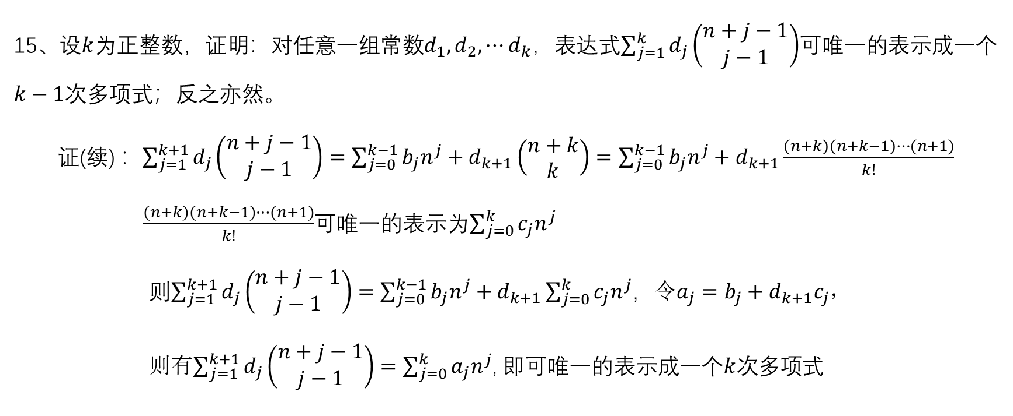
Ch6
15、设$k$为正整数，证明：对任意一组常数$d_{1},d_{2},⋯$ $d_{k}$，表达式$\sum_{j=1}^{k}{d_{j}\left(\begin{aligned}n+j−1 \\ j−1\end{aligned}\right)}$可唯一的表示成一个$k−1$次多项式；反之亦然。
证(续) ：$\sum_{j=1}^{k+1}{d_{j}\left(\begin{aligned}n+j−1 \\ j−1\end{aligned}\right)}=\sum_{j=0}^{k−1}{b_{j}n^{j}}+d_{k+1}\left(\begin{aligned}n+k \\ k\end{aligned}\right)=\sum_{j=0}^{k−1}{b_{j}n^{j}}+d_{k+1}\frac{(n+k)(n+k−1)⋯(n+1)}{k!}$
$\frac{(n+k)(n+k−1)⋯(n+1)}{k!}$可唯一的表示为$\sum_{j=0}^{k}{c_{j}n^{j}}$
则$\sum_{j=1}^{k+1}{d_{j}\left(\begin{aligned}n+j−1 \\ j−1\end{aligned}\right)}=\sum_{j=0}^{k−1}{b_{j}n^{j}}+d_{k+1}\sum_{j=0}^{k}{c_{j}n^{j}}$，令$a_{j}=b_{j}+d_{k+1}c_{j}$，
则有$\sum_{j=1}^{k+1}{d_{j}\left(\begin{aligned}n+j−1 \\ j−1\end{aligned}\right)}=\sum_{j=0}^{k}{a_{j}n^{j}}$, 即可唯一的表示成一个$k$次多项式

Slide 9
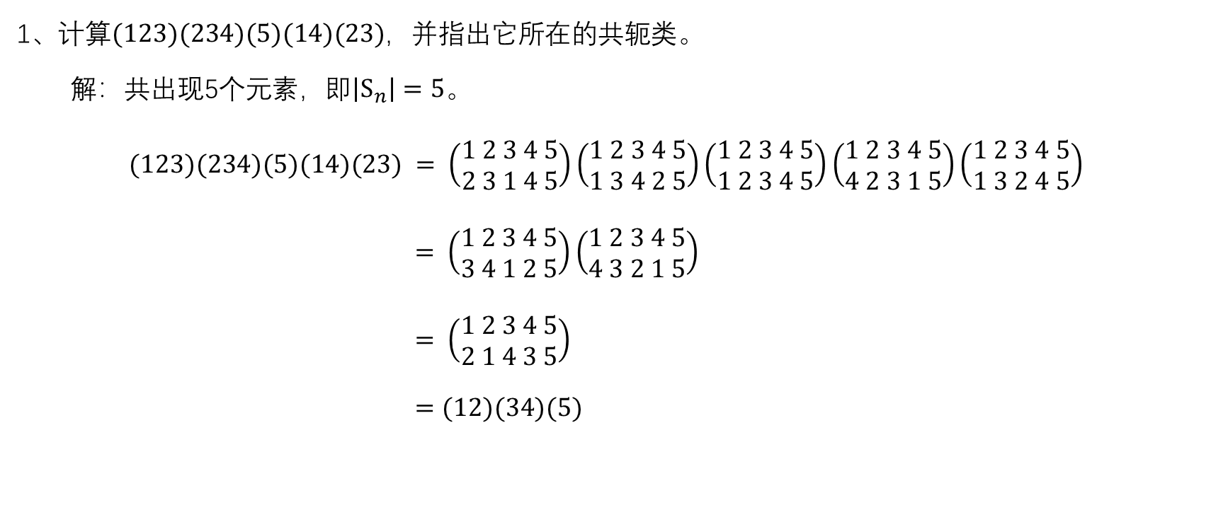
Ch8
1、计算$(123)(234)(5)(14)(23)$，并指出它所在的共轭类。
解：共出现5个元素，即$\left|S_{n}\right|=5$。
$(123)(234)(5)(14)(23) = \left(\begin{aligned}1 2 3 4 5 \\ 2 3 1 4 5\end{aligned}\right)\left(\begin{aligned}1 2 3 4 5 \\ 1 3 4 2 5\end{aligned}\right)\left(\begin{aligned}1 2 3 4 5 \\ 1 2 3 4 5\end{aligned}\right)\left(\begin{aligned}1 2 3 4 5 \\ 4 2 3 1 5\end{aligned}\right)\left(\begin{aligned}1 2 3 4 5 \\ 1 3 2 4 5\end{aligned}\right)$
$= \left(\begin{aligned}1 2 3 4 5 \\ 3 4 1 2 5\end{aligned}\right)\left(\begin{aligned}1 2 3 4 5 \\ 4 3 2 1 5\end{aligned}\right)$
$= \left(\begin{aligned}1 2 3 4 5 \\ 2 1 4 3 5\end{aligned}\right)$
$=(12)(34)(5)$

Slide 10
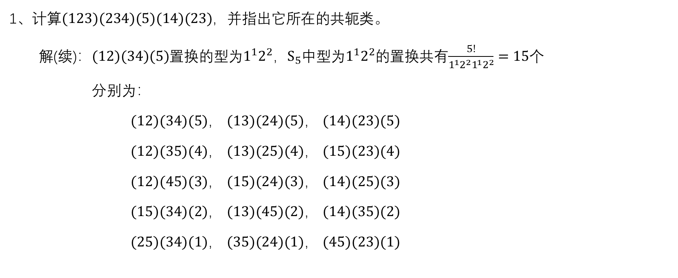
Ch8
1、计算$(123)(234)(5)(14)(23)$，并指出它所在的共轭类。
解(续)：$(12)(34)(5)$置换的型为$1^{1}2^{2}$，$S_{5}$中型为$1^{1}2^{2}$的置换共有$\frac{5!}{1^{1}2^{2}1^{1}2^{2}}=15个$
分别为：
$(12)(34)(5)$， $(13)(24)(5)$， $(14)(23)(5)$
$(12)(35)(4)$， $(13)(25)(4)$， $(15)(23)(4)$
$(12)(45)(3)$， $(15)(24)(3)$， $(14)(25)(3)$
$(15)(34)(2)$， $(13)(45)(2)$， $(14)(35)(2)$
$(25)(34)(1)$， $(35)(24)(1)$， $(45)(23)(1)$

Slide 11
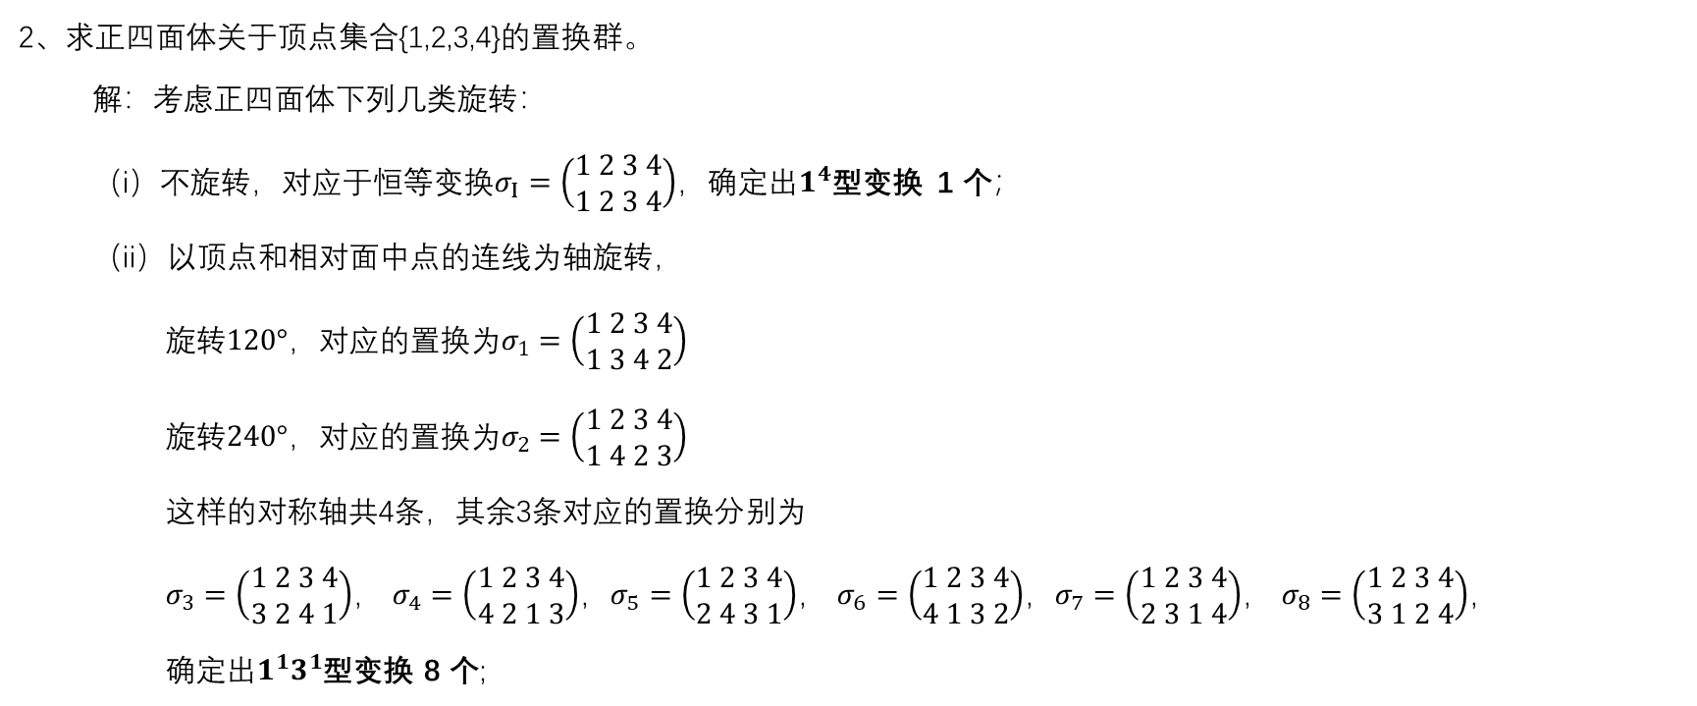
Ch8
2、求正四面体关于顶点集合{1,2,3,4}的置换群。
解：考虑正四面体下列几类旋转：
（i）不旋转，对应于恒等变换$σ_{I}=\left(\begin{aligned}1 2 3 4 \\ 1 2 3 4\end{aligned}\right)$，确定出$1^{4}$型变换 1 个；
（ii）以顶点和相对面中点的连线为轴旋转，
旋转$120°$，对应的置换为$σ_{1}=\left(\begin{aligned}1 2 3 4 \\ 1 3 4 2\end{aligned}\right)$
旋转$240°$，对应的置换为$σ_{2}=\left(\begin{aligned}1 2 3 4 \\ 1 4 2 3\end{aligned}\right)$
这样的对称轴共4条，其余3条对应的置换分别为
$σ_{3}=\left(\begin{aligned}1 2 3 4 \\ 3 2 4 1\end{aligned}\right)$， $σ_{4}=\left(\begin{aligned}1 2 3 4 \\ 4 2 1 3\end{aligned}\right)$，$σ_{5}=\left(\begin{aligned}1 2 3 4 \\ 2 4 3 1\end{aligned}\right)$， $σ_{6}=\left(\begin{aligned}1 2 3 4 \\ 4 1 3 2\end{aligned}\right)$，$σ_{7}=\left(\begin{aligned}1 2 3 4 \\ 2 3 1 4\end{aligned}\right)$， $σ_{8}=\left(\begin{aligned}1 2 3 4 \\ 3 1 2 4\end{aligned}\right)$，
确定出$1^{1}3^{1}$型变换 8 个;
1
4
2
3

Slide 12
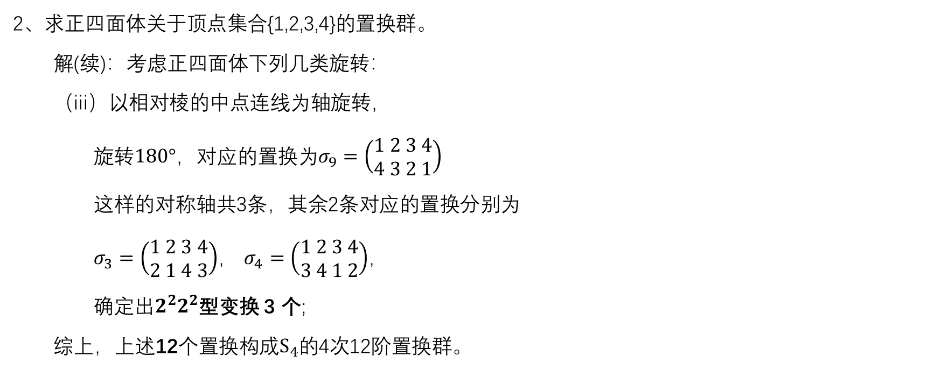
Ch8
2、求正四面体关于顶点集合{1,2,3,4}的置换群。
解(续)：考虑正四面体下列几类旋转：
（iii）以相对棱的中点连线为轴旋转，
旋转$180°$，对应的置换为$σ_{9}=\left(\begin{aligned}1 2 3 4 \\ 4 3 2 1\end{aligned}\right)$
这样的对称轴共3条，其余2条对应的置换分别为
$σ_{3}=\left(\begin{aligned}1 2 3 4 \\ 2 1 4 3\end{aligned}\right)$， $σ_{4}=\left(\begin{aligned}1 2 3 4 \\ 3 4 1 2\end{aligned}\right)$，
确定出$2^{2}2^{2}$型变换 3 个;
综上，上述12个置换构成$S_{4}$的4次12阶置换群。
1
4
2
3

