Slide 2
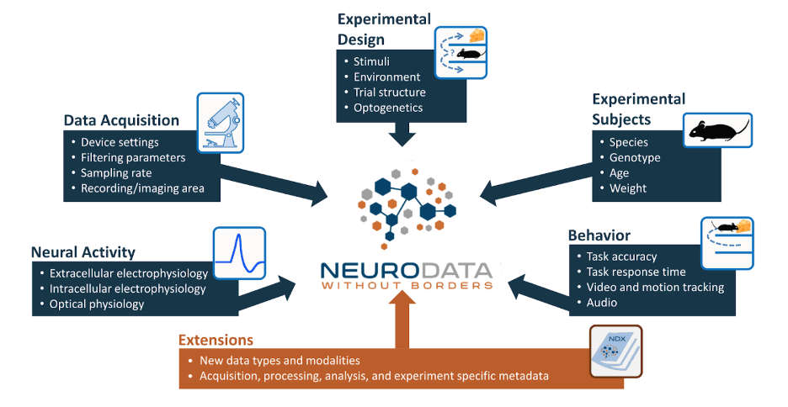
https://nwb-overview.readthedocs.io/en/latest/intro_to_nwb/2_file_structure.html

Slide 3
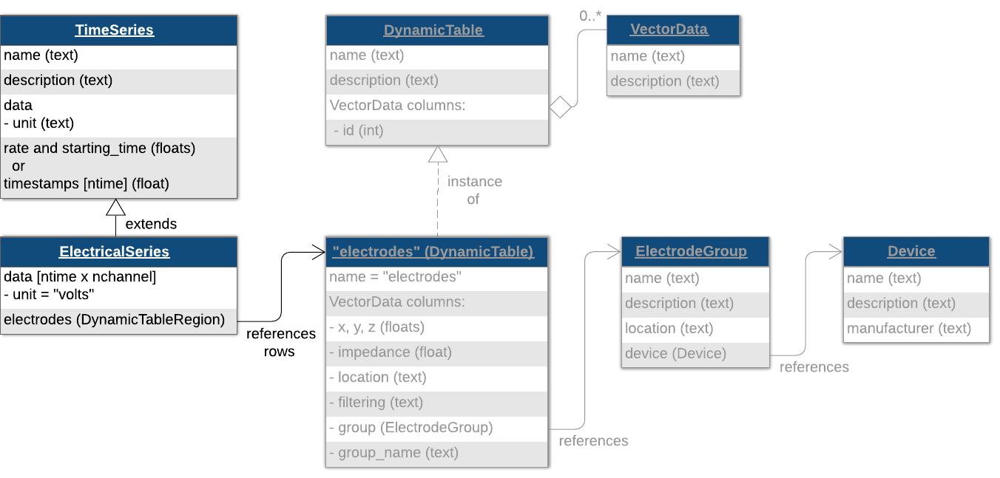
UDLP
Utah Array
Channel 1

Slide 4
NWB file for electrode/device related field
general_extracellular_ephys
Electrode_group_*
nwb.general_extracellular_ephys.set('electrode_group_STN', eg);
nwb.general_extracellular_ephys.set('electrode_group_GP', eg);
nwb.general_extracellular_ephys.set('electrode_group_STN', eg);
general_devices
nwb.general_devices.set(‘TDT’, types.core.Device())
nwb.general_devices.set(‘MA’, types.core.Device())
nwb.general_devices.set(‘EyeTracking’, types.core.Device())
nwb.general_devices.set(‘DLC’, types.core.Device())

Slide 5
Class ElectrodeGroup
electrode group, e.g DBSS, DBSG, UDLP
Parameters:
name
description
device: the device that was used to record from this electrode group (e.g TDT)
location: the location of this electrode group (e.g STN, GP, DLP et.al)
position: stereotaxic position of this electrode group (x, y, z), ignore now

Slide 6
Functions related to electrode
device
list_all_deviceName()

Slide 7
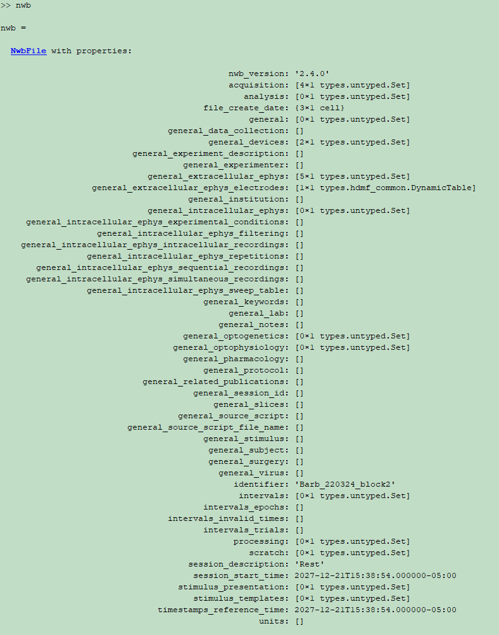
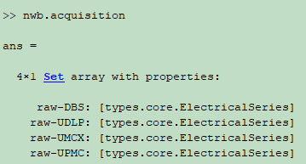
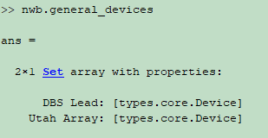
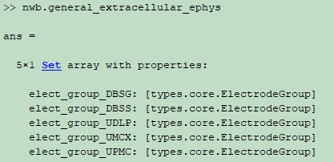
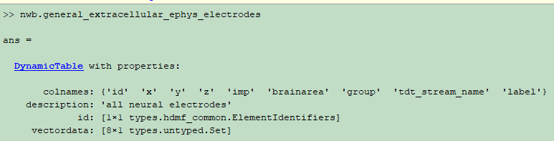
raw-DBS
raw-utahArray
UDLP(9272996), UMCX/UPMC(9272995) DBS*(9271296)

Slide 8
UDLP
Utah Array
Channel 1

Slide 9
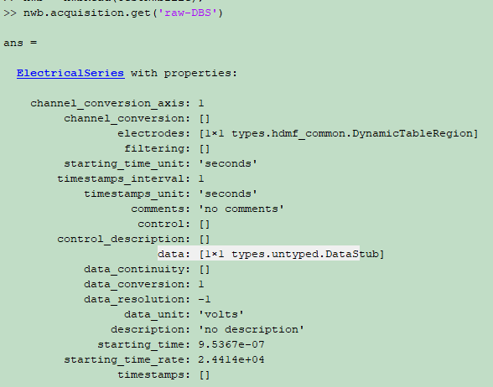
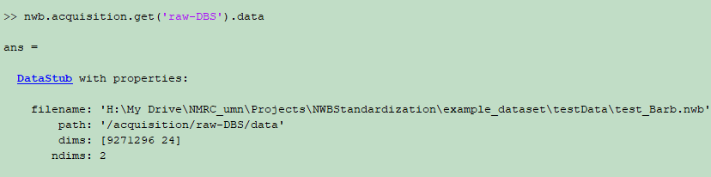
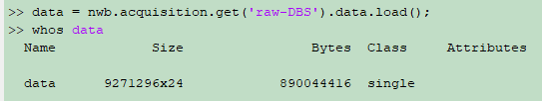
ElectricalSeries
data [ntimes, nchannels]
electrodes

Slide 10
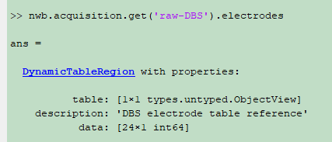
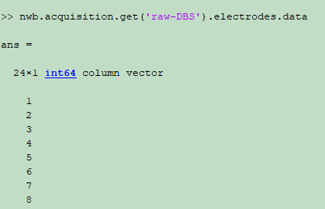
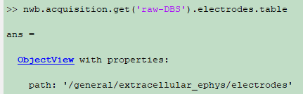
Row number of
actual electrode table
ElectricalSeries
data [ntimes, nchannels]
electrodes
DynamicTableRegion
name=“electrodes”
table
id

Slide 11
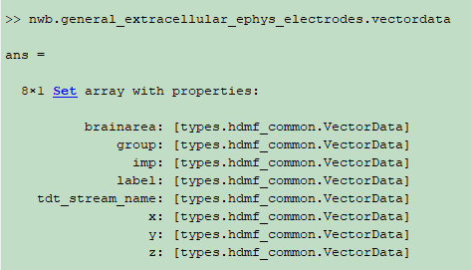
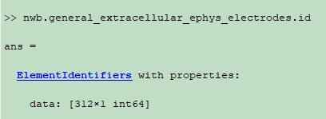

Slide 12
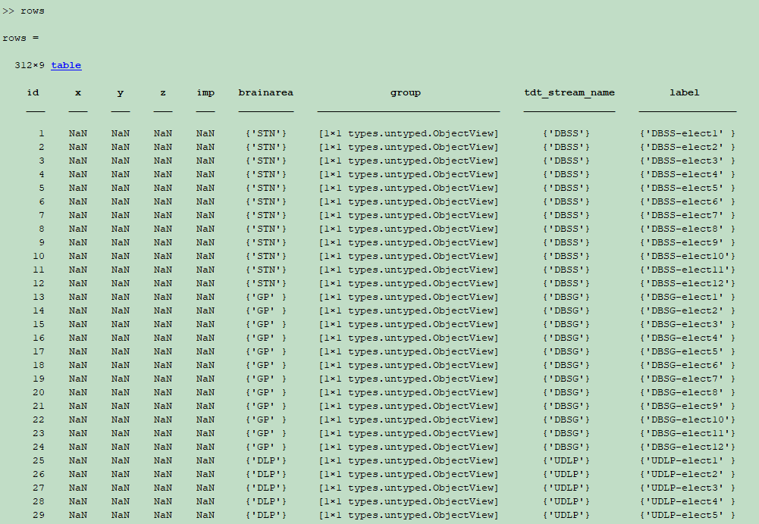

Slide 13
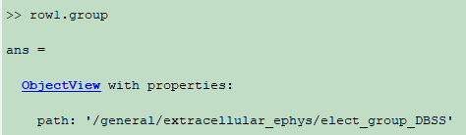
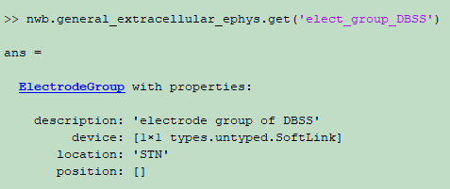
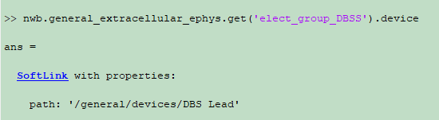
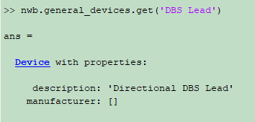
Notes:
DBS Lead: Heraeus
Utah Array: Blackrock
GrayMatter: gray matter research

Slide 14
Time for various functions
379.89s, 312 electrodes(UDLP96+UMCX96+UPMC96+DBSS12+DBSG12), 11.2G, rawTDT\Barb-220324\Block-2
TDTbin2mat | 687.283583 seconds
convraw_tdt2nwb | 8.932317 seconds.
nwbExport | 25.347252 seconds.
nwbRead | 5.856116 seconds

Slide 15
Apr.22 1pm
Install the NMRCNWB code based on the documentation
Marked the places where not clear
Basic idea about how to create a NWB file
How to store video into NWB
Download the current code and learn a bit of the git commands

Slide 16
May 3 9am
Shared the example NWB dataset with Ashwini today
Next step
Have some materials for storing video to NWB
prepared ahead
Paragraphs, documentations, online things,
can copied into the slides if wanted
If have time, write some codes
Have one or two slides to show what has been done

Slide 17
May 10 9am
Implement convraw_video2nwb function and the description/guideline
Use the nwb2.4.0.0 version

Slide 18
May 20 1pm
Implement convraw_video2nwb function using pair parameter format

Slide 19
May 27 1pm
convraw_video2nwb function
Nwb for an optional parameter
Starting readnwb_video function
(next next) deeplabcut processed x,y, z trajectory data
Processed subfield

Slide 20
June 13 2pm
convraw_video2nwb function& readnwb_video function
push a pull request as soon as possible
Will test it.
deeplabcut processed x,y, z trajectory data
Processed subfield
using the class SpatialSeries
convert, and read functions

Slide 21
July 11 with Jingyi
deeplabcut processed x,y, z trajectory data
Get familiar with the current NWBNMRC codes using the NWB test data.
Ask Ziling or Kai for processed x, y, z trajectory data as sample data
Read the NWB official documentation and especially the class SpatialSeries
Understanding the idea of the class SpatialSeries
How to use it for the x, y,z trajectory data

