Slide 2
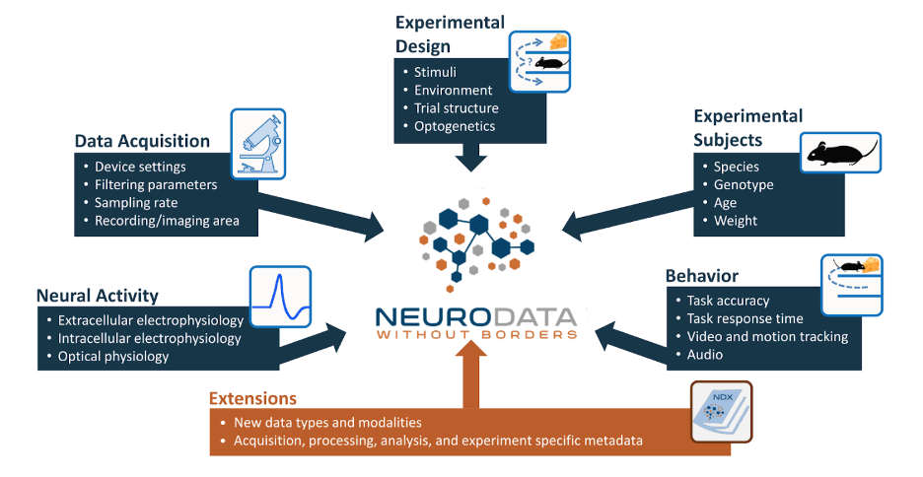
https://nwb-overview.readthedocs.io/en/latest/intro_to_nwb/2_file_structure.html

Slide 3
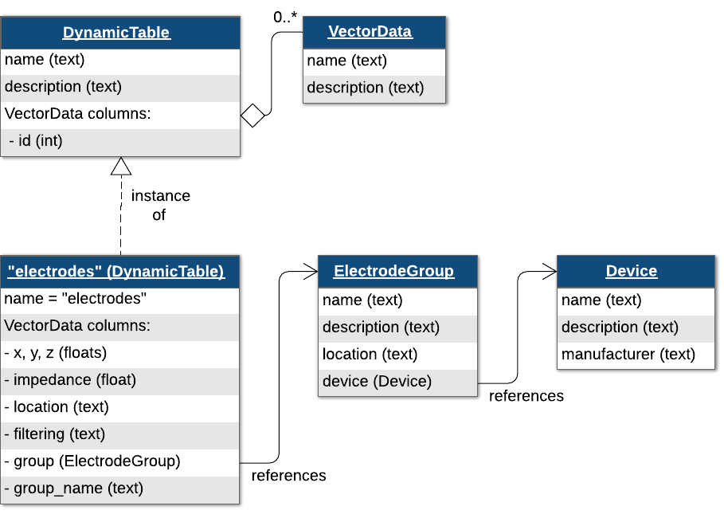
https://neurodatawithoutborders.github.io/matnwb/tutorials/html/ecephys.html#H_83ADFE4C

Slide 4
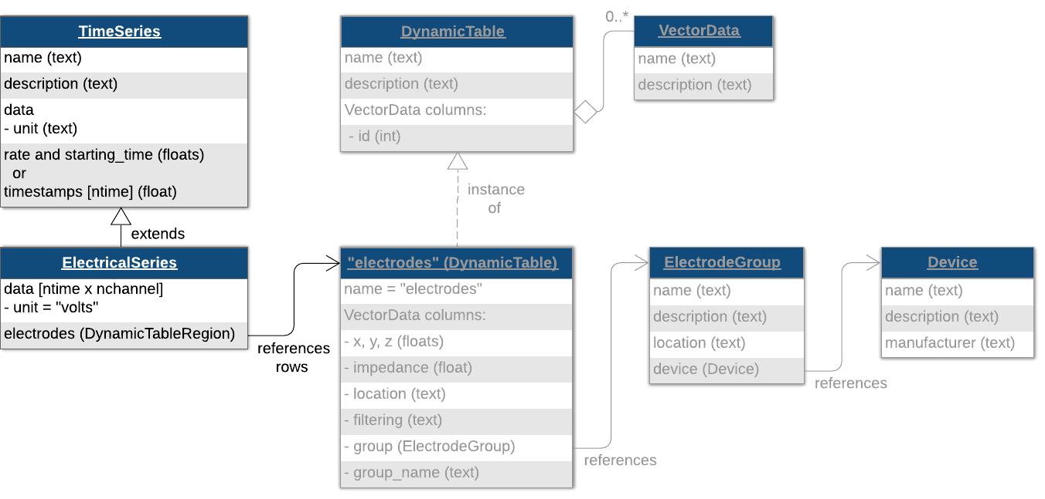
UDLP
Utah Array
Channel 1

Slide 5
NWB file for electrode/device related field
general_extracellular_ephys
Electrode_group_*
nwb.general_extracellular_ephys.set('electrode_group_STN', eg);
nwb.general_extracellular_ephys.set('electrode_group_GP', eg);
nwb.general_extracellular_ephys.set('electrode_group_STN', eg);
general_devices
nwb.general_devices.set(‘TDT’, types.core.Device())
nwb.general_devices.set(‘MA’, types.core.Device())
nwb.general_devices.set(‘EyeTracking’, types.core.Device())
nwb.general_devices.set(‘DLC’, types.core.Device())

Slide 6
Class ElectrodeGroup
electrode group, e.g DBSS, DBSG, UDLP
Parameters:
name
description
device: the device that was used to record from this electrode group (e.g TDT)
location: the location of this electrode group (e.g STN, GP, DLP et.al)
position: stereotaxic position of this electrode group (x, y, z), ignore now

Slide 7
Functions related to electrode
device
list_all_deviceName()

Slide 8
Apr.22 1pm
Install the NMRCNWB code based on the documentation
Marked the places where not clear
Basic idea about how to create a NWB file
How to store video into NWB
Download the current code and learn a bit of the git commands

