Slide 2
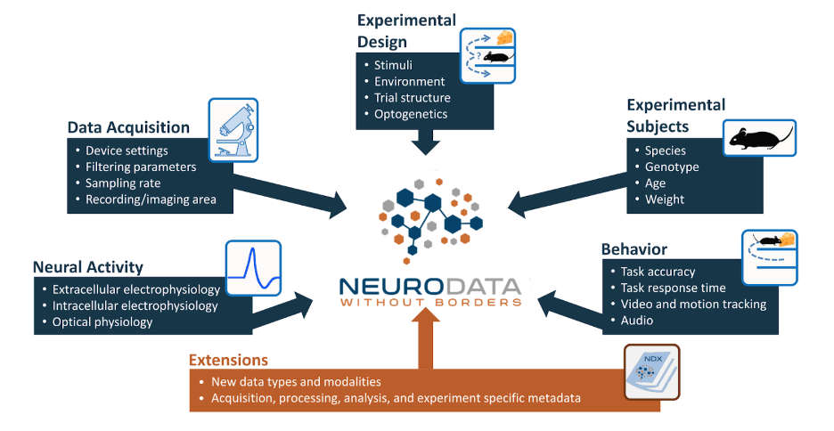
https://nwb-overview.readthedocs.io/en/latest/intro_to_nwb/2_file_structure.html

Slide 3
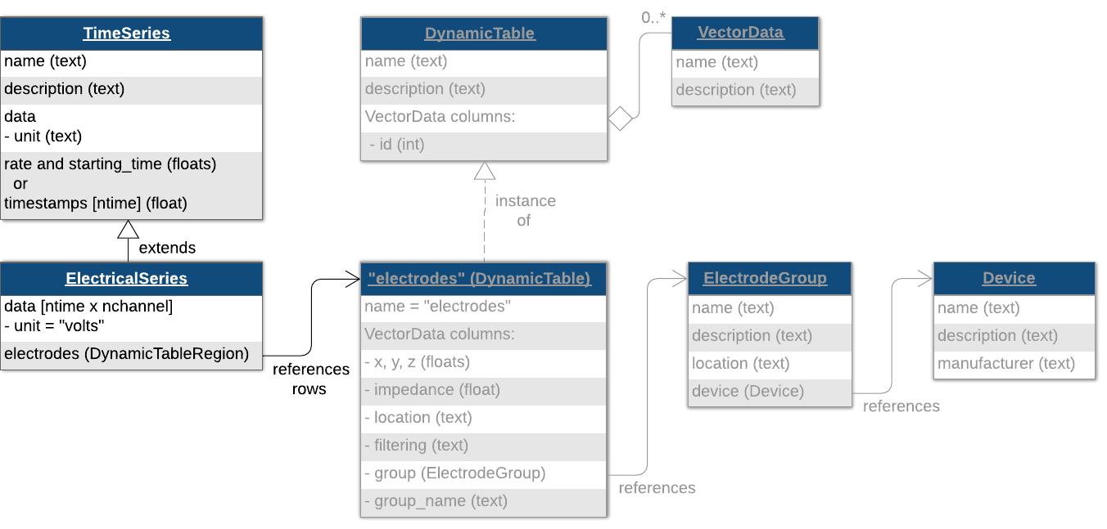
UDLP
Utah Array
Channel 1

Slide 4
NWB file for electrode/device related field
general_extracellular_ephys
Electrode_group_*
nwb.general_extracellular_ephys.set('electrode_group_STN', eg);
nwb.general_extracellular_ephys.set('electrode_group_GP', eg);
nwb.general_extracellular_ephys.set('electrode_group_STN', eg);
general_devices
nwb.general_devices.set(‘TDT’, types.core.Device())
nwb.general_devices.set(‘MA’, types.core.Device())
nwb.general_devices.set(‘EyeTracking’, types.core.Device())
nwb.general_devices.set(‘DLC’, types.core.Device())

Slide 5
Class ElectrodeGroup
electrode group, e.g DBSS, DBSG, UDLP
Parameters:
name
description
device: the device that was used to record from this electrode group (e.g TDT)
location: the location of this electrode group (e.g STN, GP, DLP et.al)
position: stereotaxic position of this electrode group (x, y, z), ignore now

Slide 6
Functions related to electrode
device
list_all_deviceName()

Slide 7
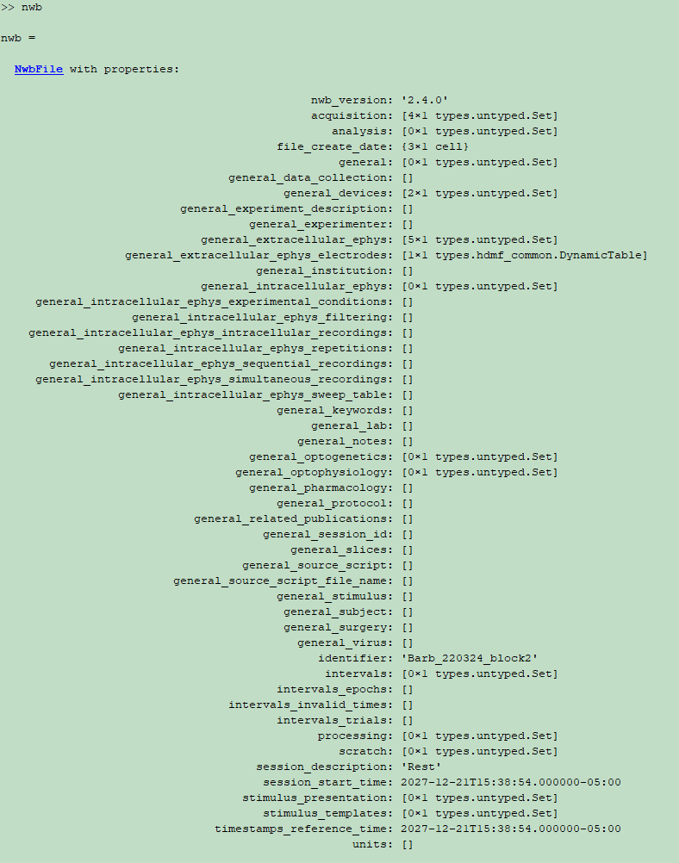
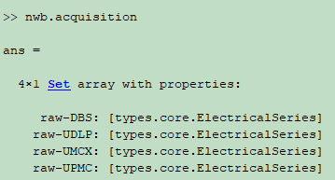
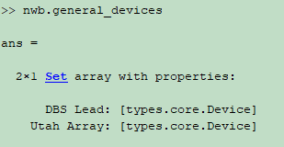
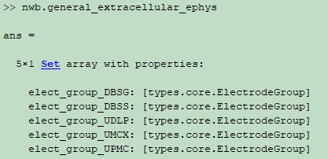
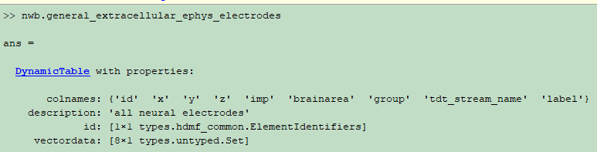
raw-DBS
raw-utahArray
UDLP(9272996), UMCX/UPMC(9272995) DBS*(9271296)

Slide 8
UDLP
Utah Array
Channel 1

Slide 9
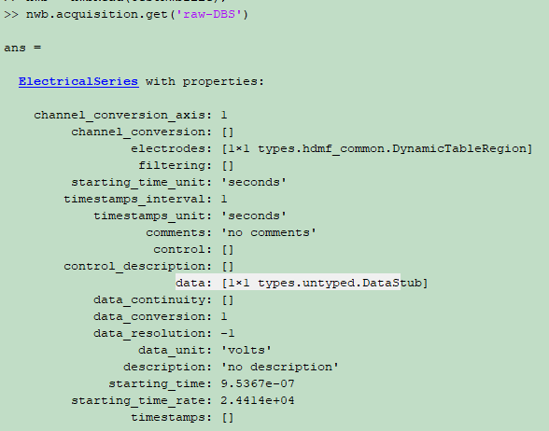
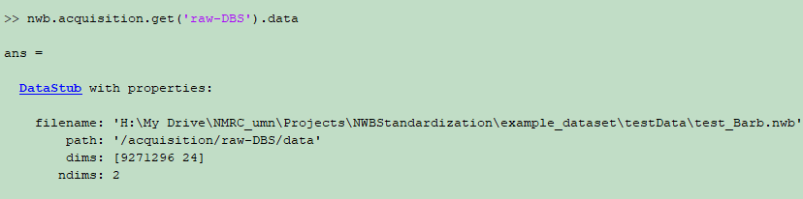
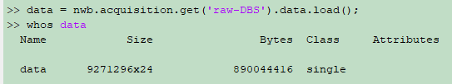
ElectricalSeries
data [ntimes, nchannels]
electrodes

Slide 10
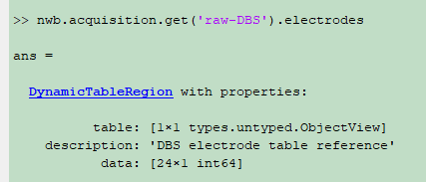
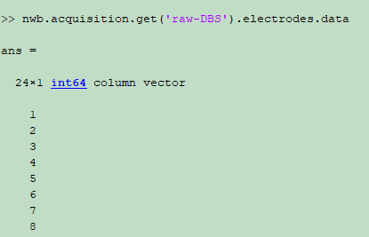
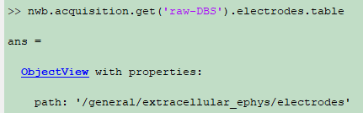
Row number of
actual electrode table
ElectricalSeries
data [ntimes, nchannels]
electrodes
DynamicTableRegion
name=“electrodes”
table
id

Slide 11
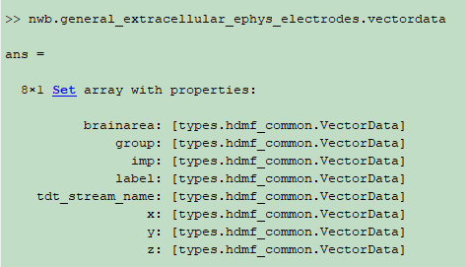
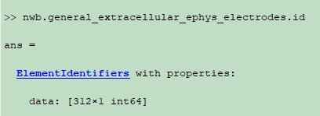

Slide 12
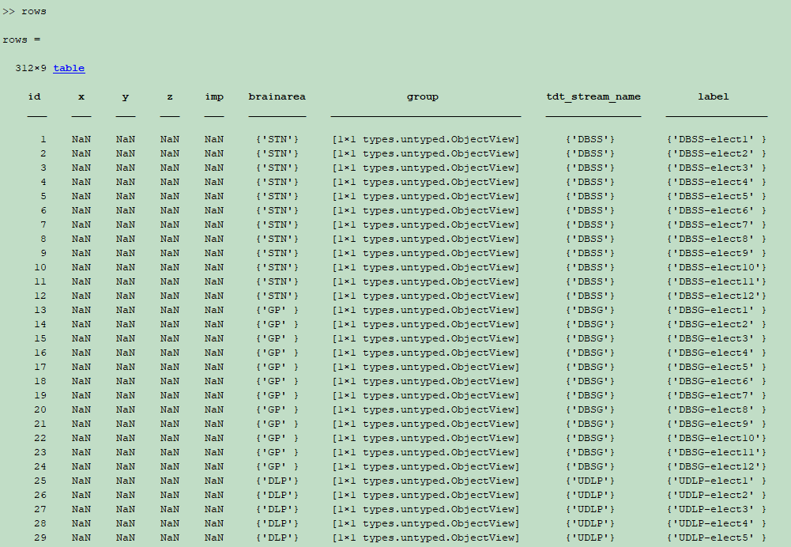

Slide 13
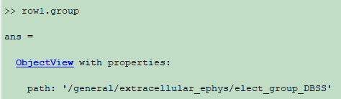
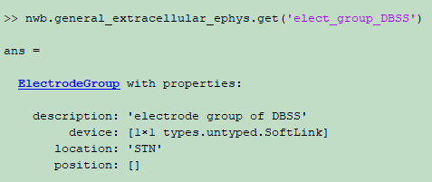
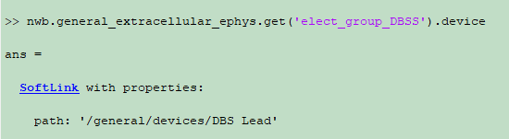
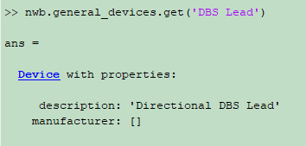
Notes:
DBS Lead: Heraeus
Utah Array: Blackrock
GrayMatter: gray matter research

Slide 14
Time for various functions
379.89s, 312 electrodes(UDLP96+UMCX96+UPMC96+DBSS12+DBSG12), 11.2G, rawTDT\Barb-220324\Block-2
TDTbin2mat | 687.283583 seconds
convraw_tdt2nwb | 8.932317 seconds.
nwbExport | 25.347252 seconds.
nwbRead | 5.856116 seconds

Slide 15
Apr.22 1pm
Install the NMRCNWB code based on the documentation
Marked the places where not clear
Basic idea about how to create a NWB file
How to store video into NWB
Download the current code and learn a bit of the git commands

