Slide 2
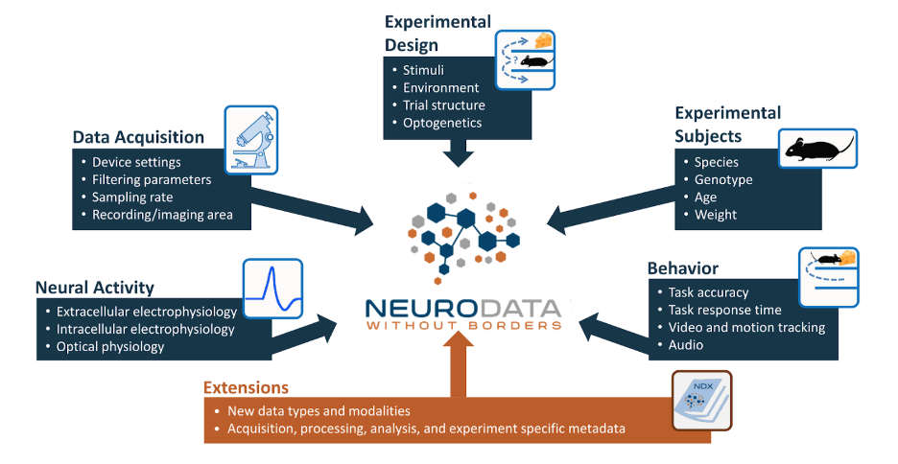
https://nwb-overview.readthedocs.io/en/latest/intro_to_nwb/2_file_structure.html

Slide 3
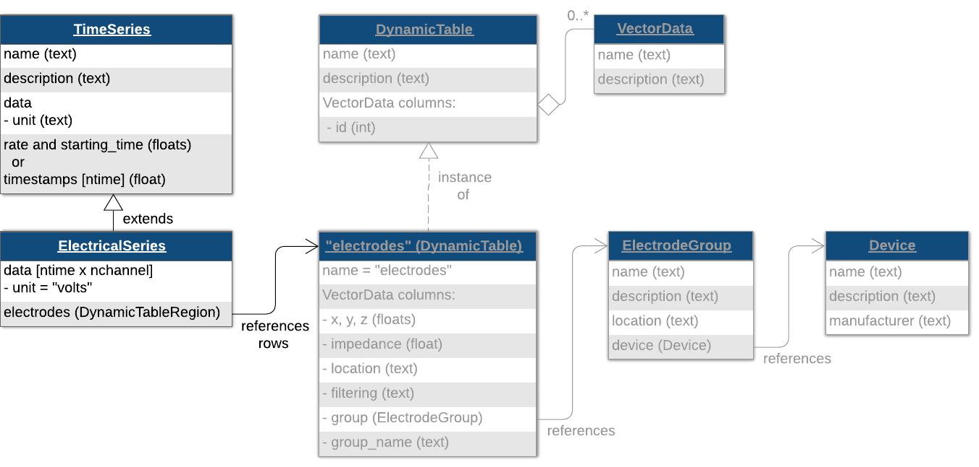
UDLP
Utah Array
Channel 1

Slide 4
NWB file for electrode/device related field
general_extracellular_ephys
Electrode_group_*
nwb.general_extracellular_ephys.set('electrode_group_STN', eg);
nwb.general_extracellular_ephys.set('electrode_group_GP', eg);
nwb.general_extracellular_ephys.set('electrode_group_STN', eg);
general_devices
nwb.general_devices.set(‘TDT’, types.core.Device())
nwb.general_devices.set(‘MA’, types.core.Device())
nwb.general_devices.set(‘EyeTracking’, types.core.Device())
nwb.general_devices.set(‘DLC’, types.core.Device())

Slide 5
Class ElectrodeGroup
electrode group, e.g DBSS, DBSG, UDLP
Parameters:
name
description
device: the device that was used to record from this electrode group (e.g TDT)
location: the location of this electrode group (e.g STN, GP, DLP et.al)
position: stereotaxic position of this electrode group (x, y, z), ignore now

Slide 6
Functions related to electrode
device
list_all_deviceName()

Slide 7
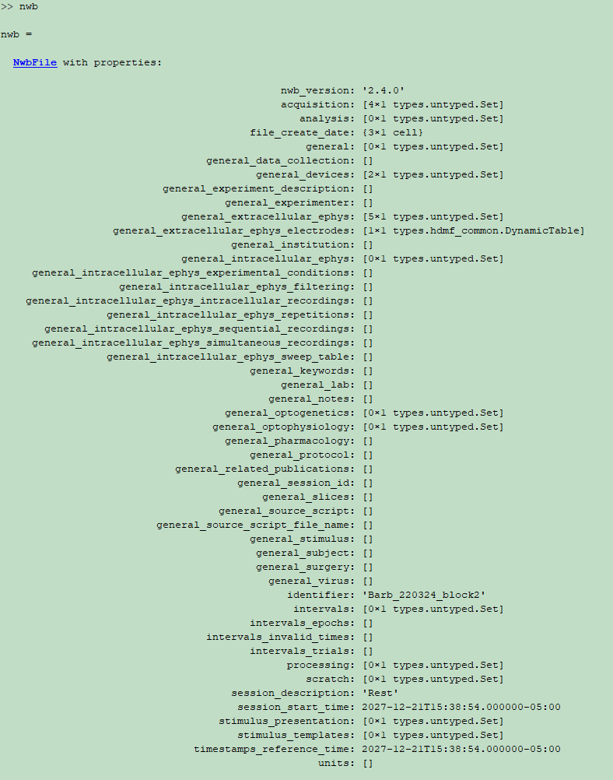
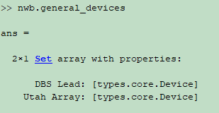
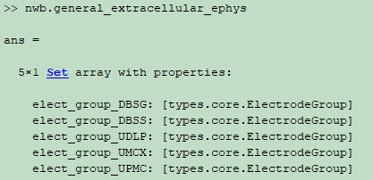
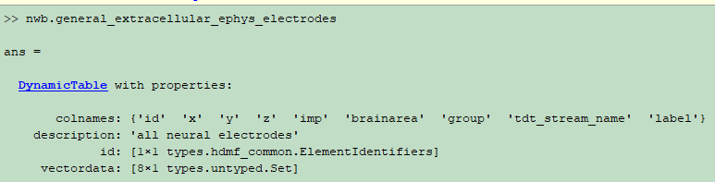
Notes:
The date is stored in UTC with local timezone offset as ISO 8601 extended formatted strings: 2018-09-28T14:43:54.123+02:00. Dates stored in UTC end in "Z" with no timezone offset. Date accuracy is up to milliseconds. The file can be created after the experiment was run, so this may differ from the experiment start time. Each modification to the nwb file adds a new entry to the array.

Slide 8
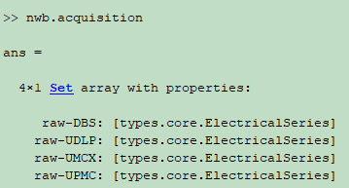
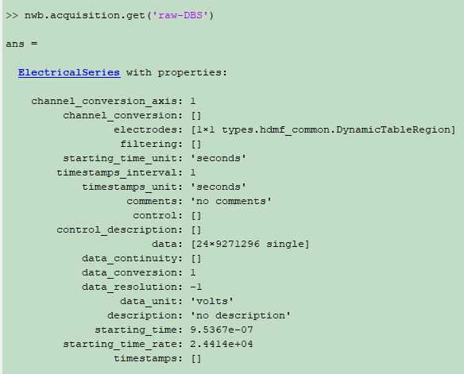
raw-DBS
raw-utahArray
UDLP(9272996), UMCX/UPMC(9272995)
DBS*(9271296)

Slide 9
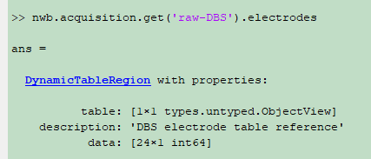
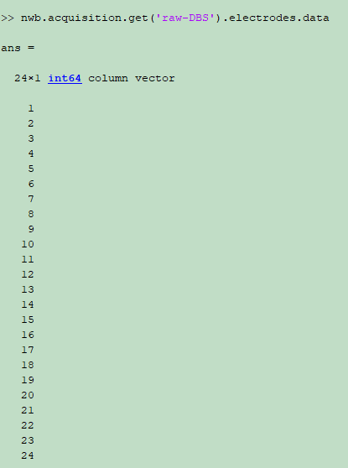
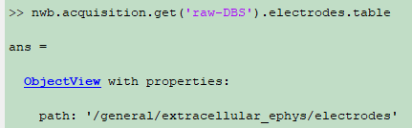
Row number of
actual electrode table

Slide 10
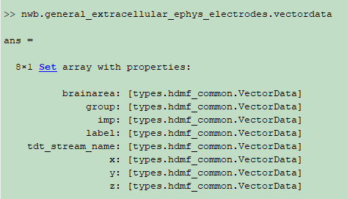
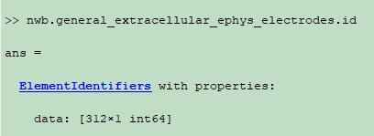

Slide 11
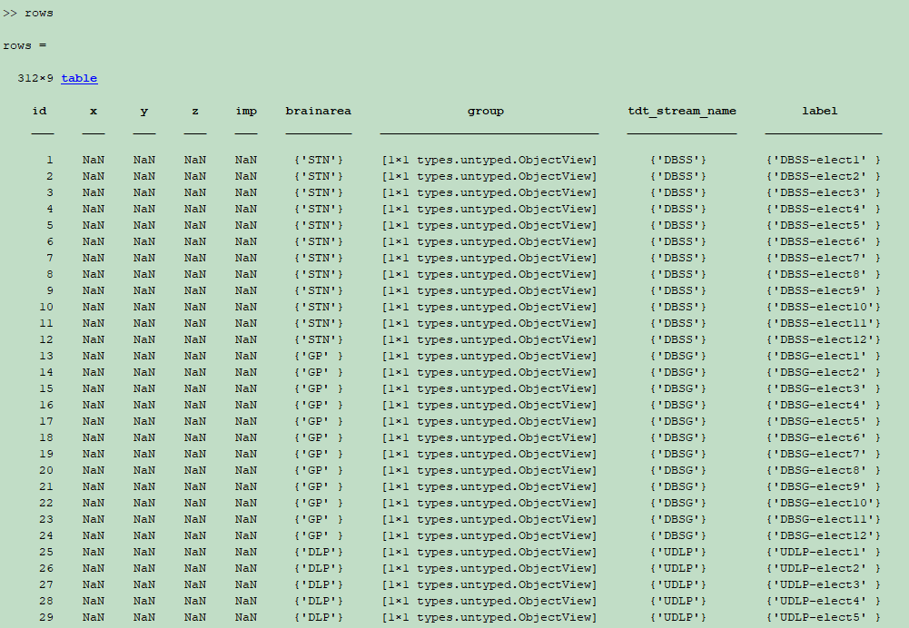

Slide 12
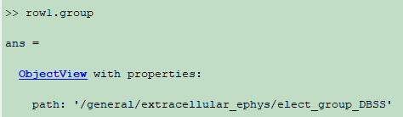
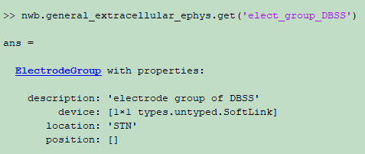
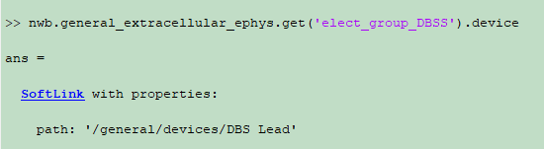
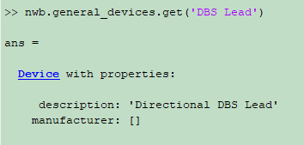

Slide 13
Time for various functions
379.89s, 321 electrodes(UDLP96+UMCX96+UPMC96+DBSS12+DBSG12), 11.2G, rawTDT\Barb-220324\Block-2
TDTbin2mat | 687.283583 seconds
convraw_tdt2nwb | 8.932317 seconds.
nwbExport | 25.347252 seconds.
nwbRead | 5.856116 seconds

Slide 14
Apr.22 1pm
Install the NMRCNWB code based on the documentation
Marked the places where not clear
Basic idea about how to create a NWB file
How to store video into NWB
Download the current code and learn a bit of the git commands

