Slide 1
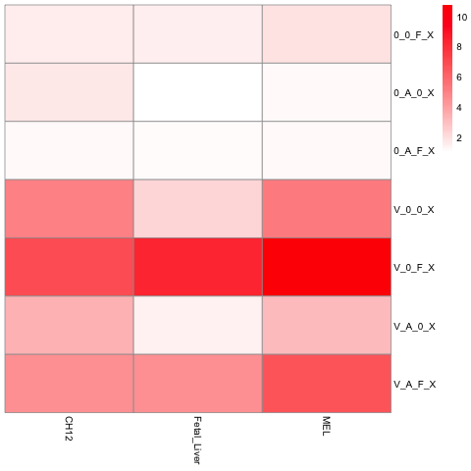
VISION & iChIP & FL DHS
VISION
75546
EP300 enrichment
28695
iChIP
27991
9141
72787
13798
FL DHS
FL iChIP intersect: 1120
However, it cannot be shown in this figure

Slide 2
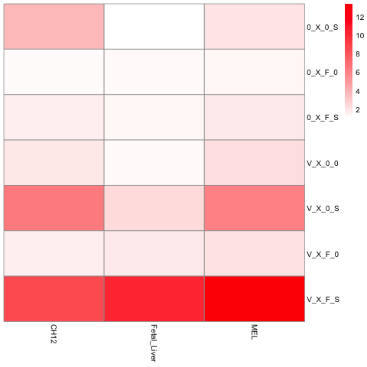
VISION & FL DHS & SCREEN
VISION
41224
EP300 enrichment
SCREEN
63017
90473
10305
261444
6064
10331
FL DHS

