Slide 1
Raw data 210000 * 5, each of them has a 0_1 label (0_1 cluster < 100 -> X_X label)Raw signal add -0.1~0.1 random noise
Iteration 0:
Assign 210000 peaks into 20 clusters based on 0_1 label
For each cluster get the mean_vec & cov_mat & prior_p = num_cluster/210000
Add identity_mat
Split cov_mat into std_vec & corr_mat
std_vec[std_vec<0.1] = 0.1
std_vec[std_vec>sqrt(3.0)] = sqrt(3.0)
cov_mat_adj = corr_mat* np.outer(std_vec)
cov_mat [cov_mat ==na] = 0.0
Mvn_log_p_j = -1/2*log(det(data_sig_cov_j)) - sum(dot((data_sig_matrix-data_sig_mean_j), inv(data_sig_cov_j)) * (data_sig_matrix-data_sig_mean_j), axis=1) + log(data_sig_prior_ij)
Mvn_p_ij=exp(mvn_log_p_ij) / sum(exp(mvn_log_p_ij…) )
### If Mvn_p_ij<0.5, assign the sample with label 0_0_0_0_0
Assign each peak to the cluster with the max Mvn_p_ij .
For new clusters with less than 100 peak, relabel them as X_X_X_X_X
Iteration 1-99:
Update the mean_vec & cov_mat & prior_p
For the cluster with no peak: mean_vec = repeat(2.0, 5); cov_mat = identity_mat
Redo step 5,6,7,8,9,10,11,12, 14,15

Slide 2
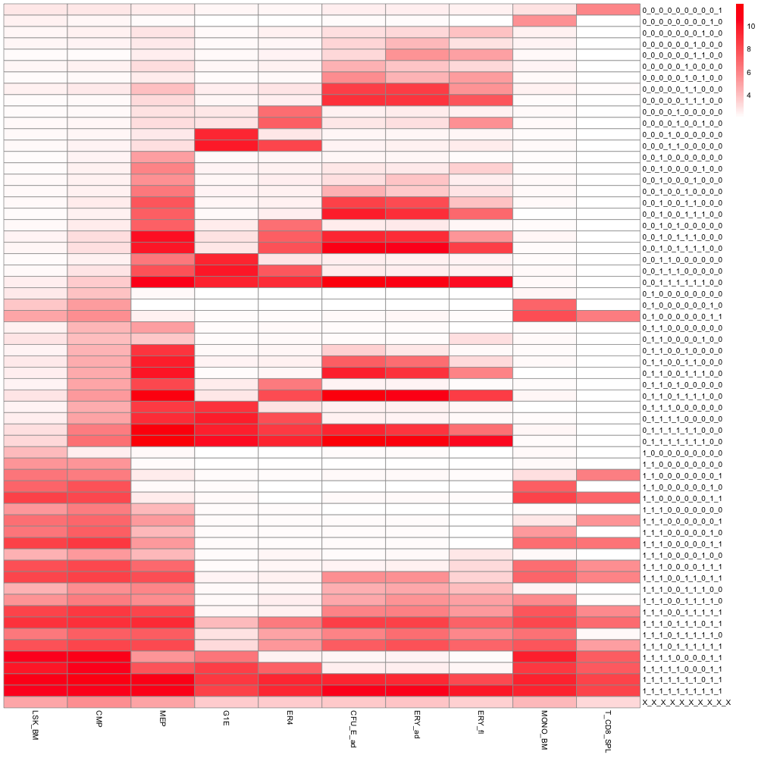
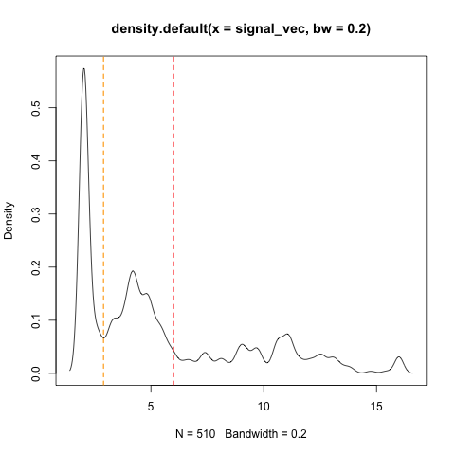
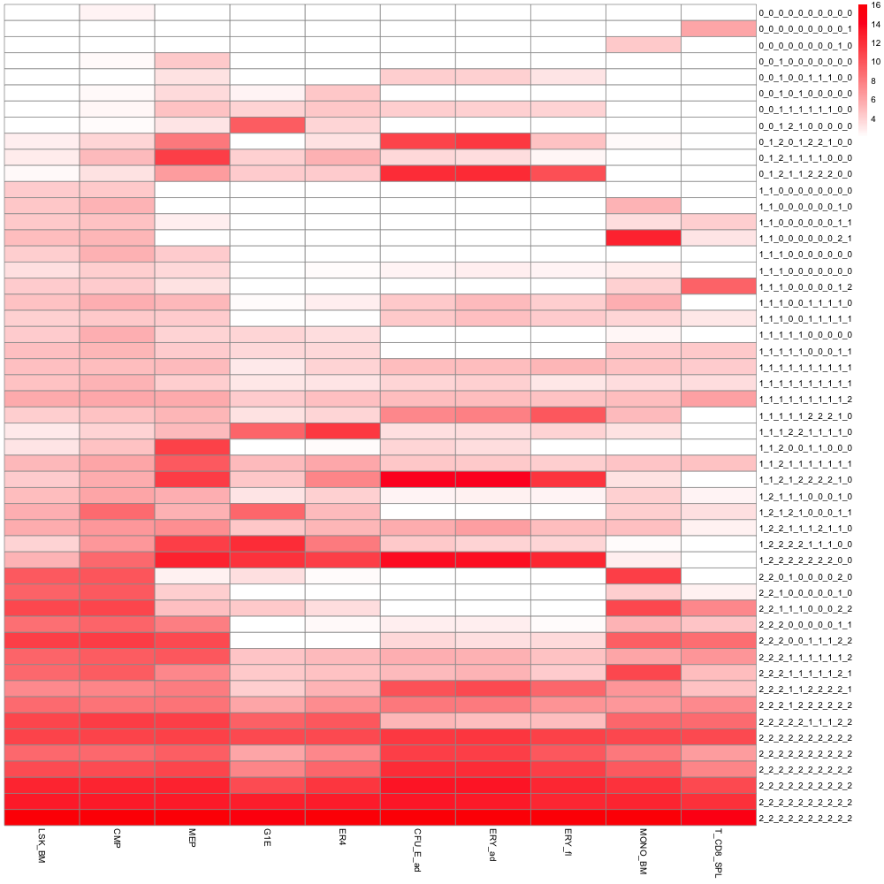
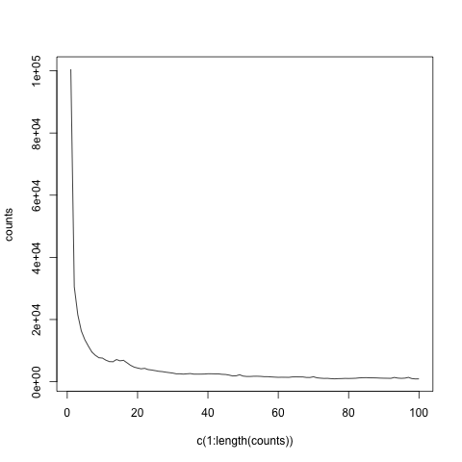
New label is based on the mean signal of each cell in the new heatmap.
Use Homer peak calling label (PKnorm signal) (10 cell types)
Reassign labels based on MVN
62 index-sets
51 index-sets
The Number of peaks that change labels in each iteration.

Slide 3
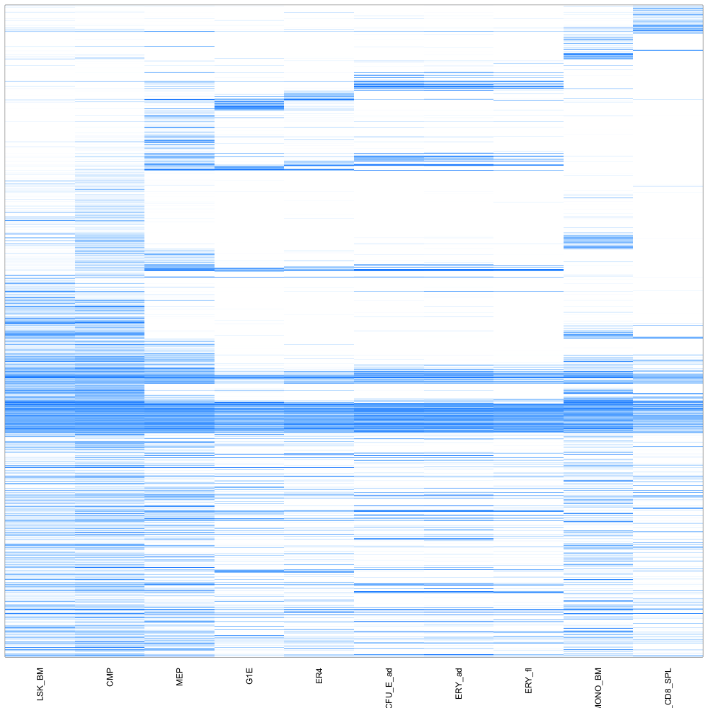
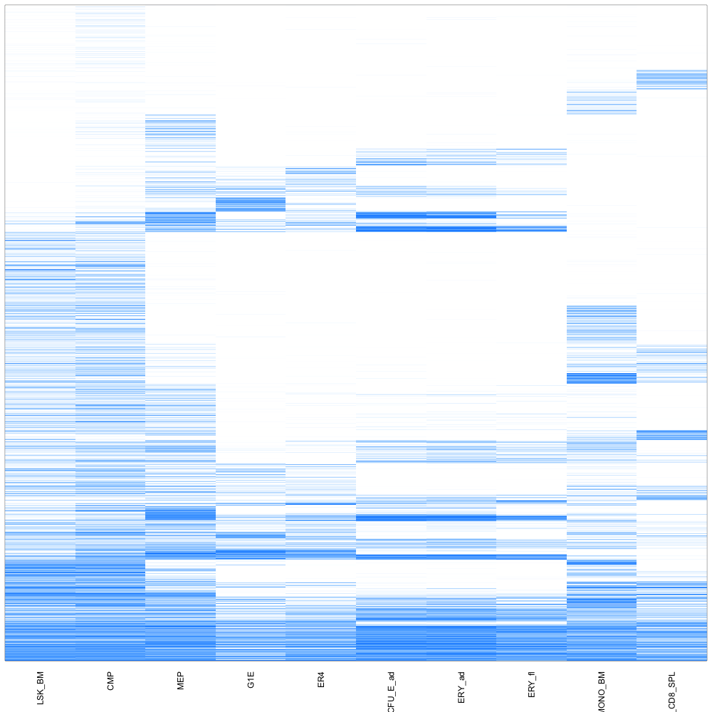
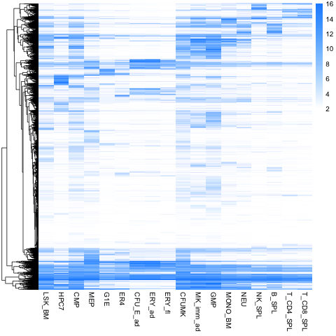

Slide 4
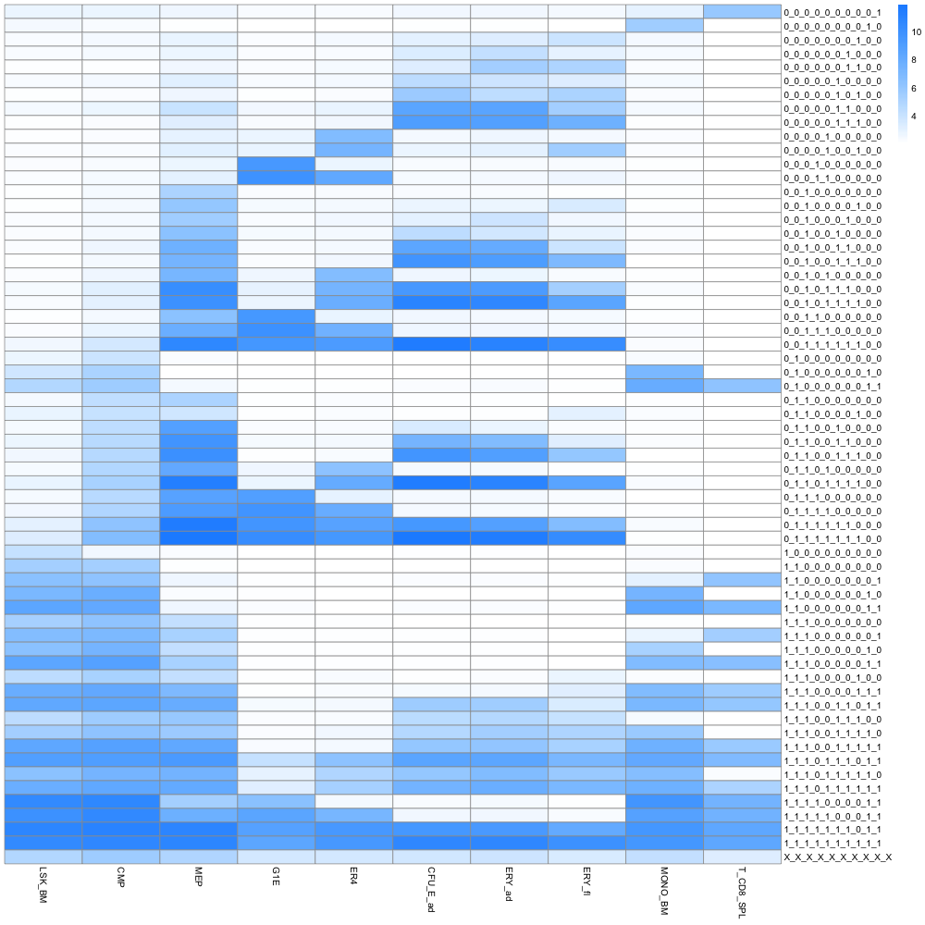
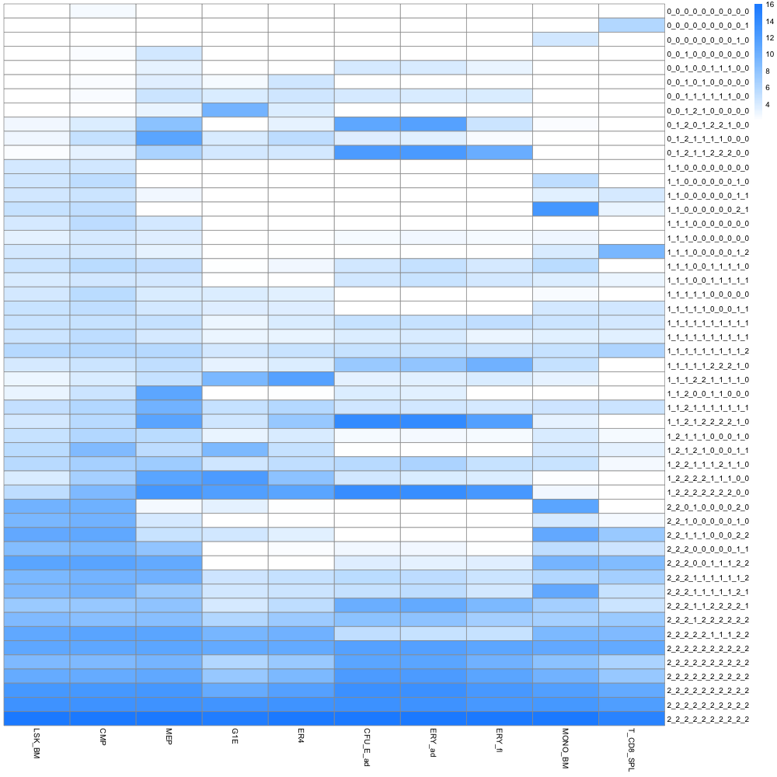

Slide 5
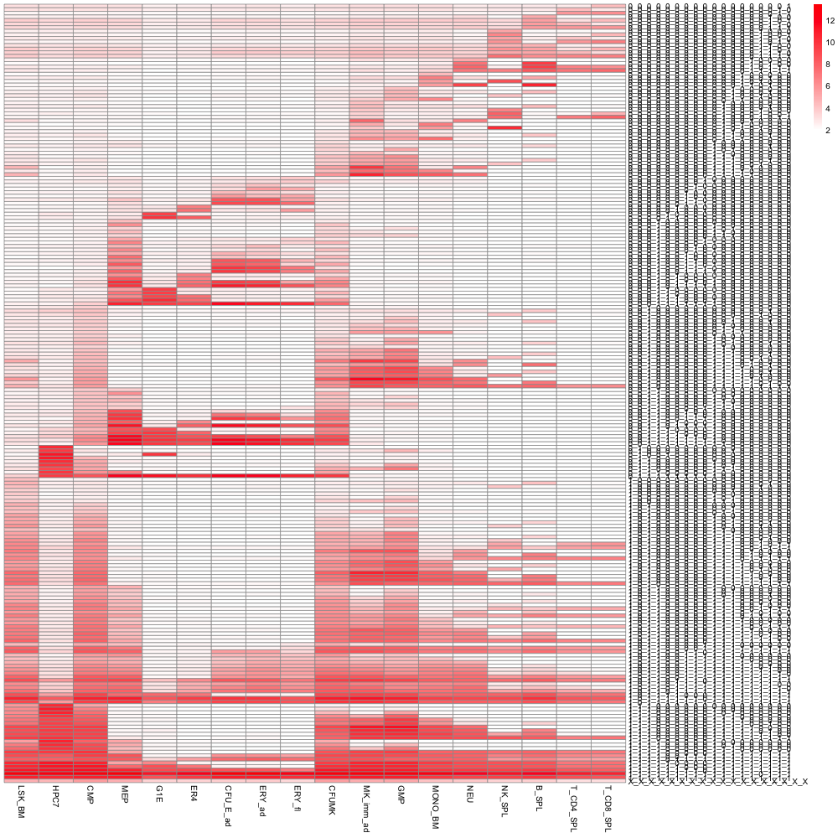
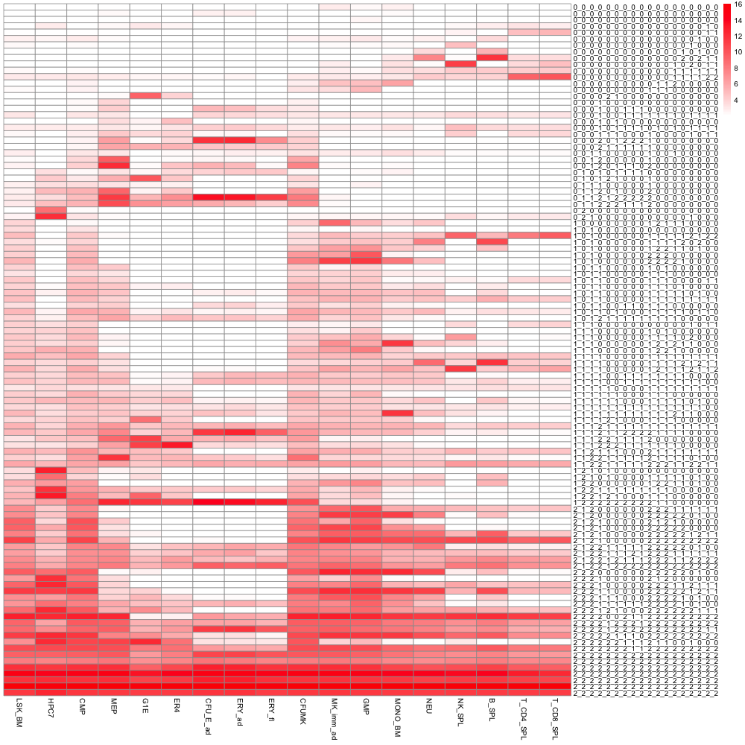
Use Homer peak calling label (PKnorm signal) (18 cell types)
Reassign labels based on MVN
217 index-sets
109 index-sets

