Slide 1
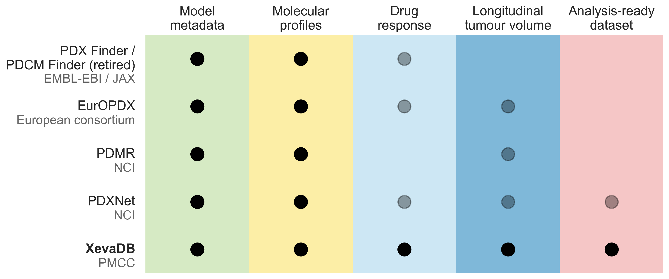
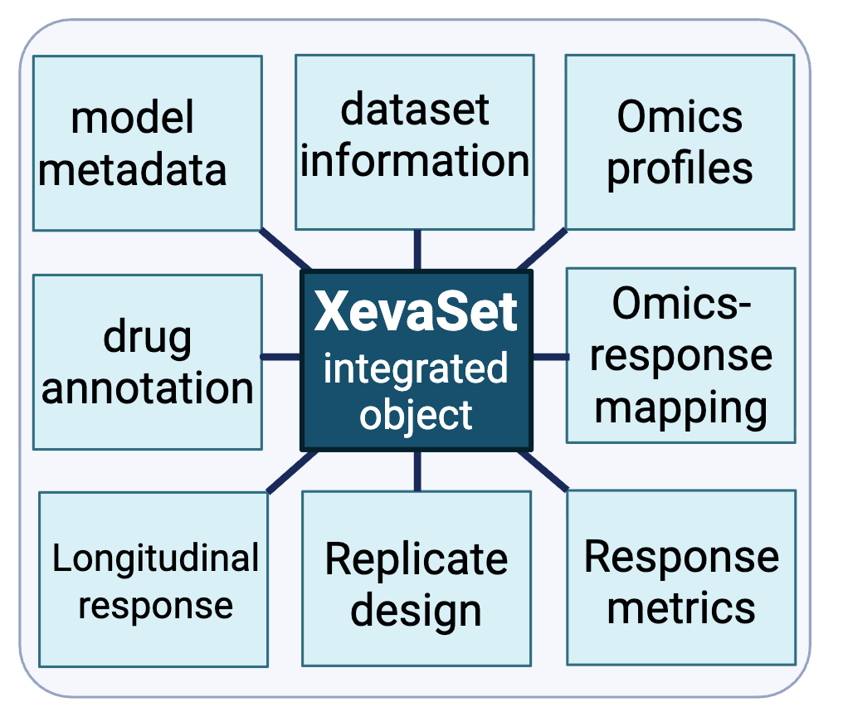
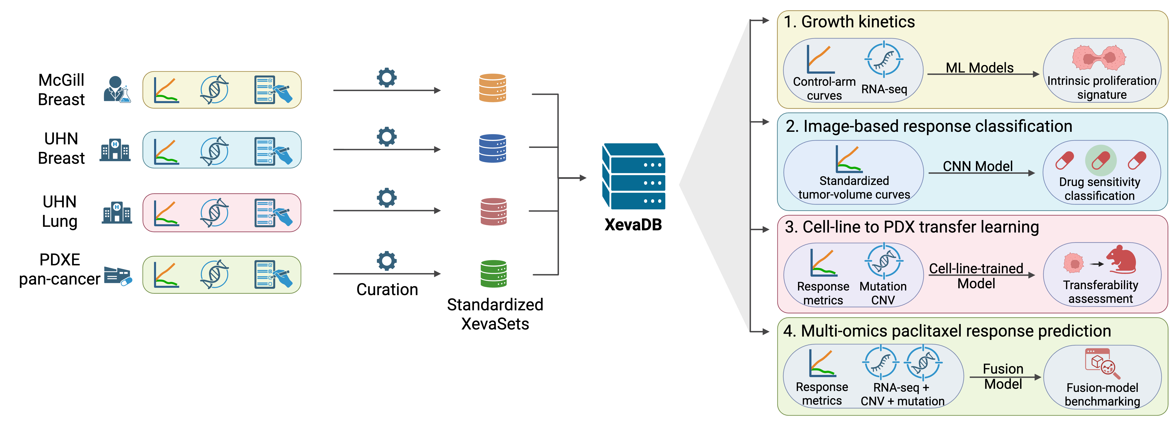
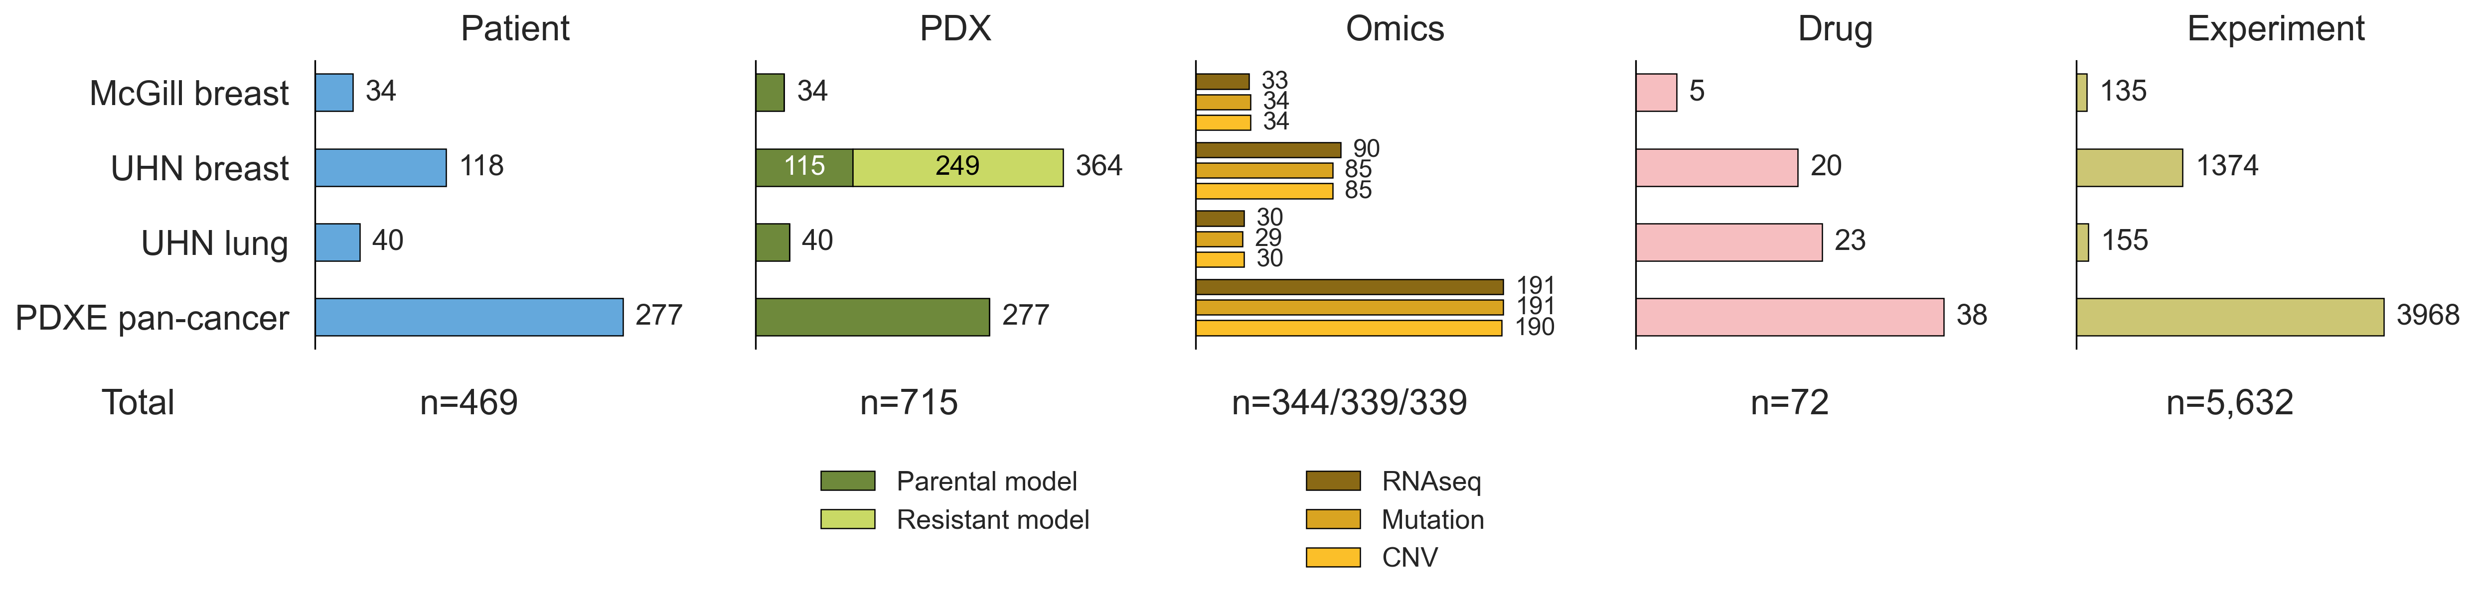
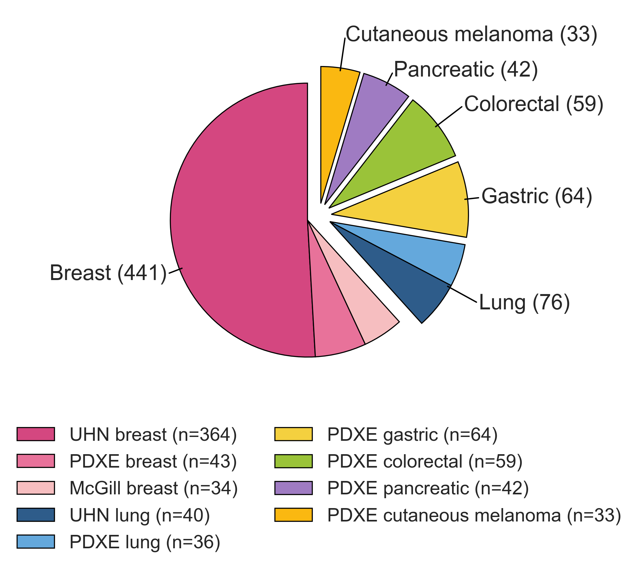
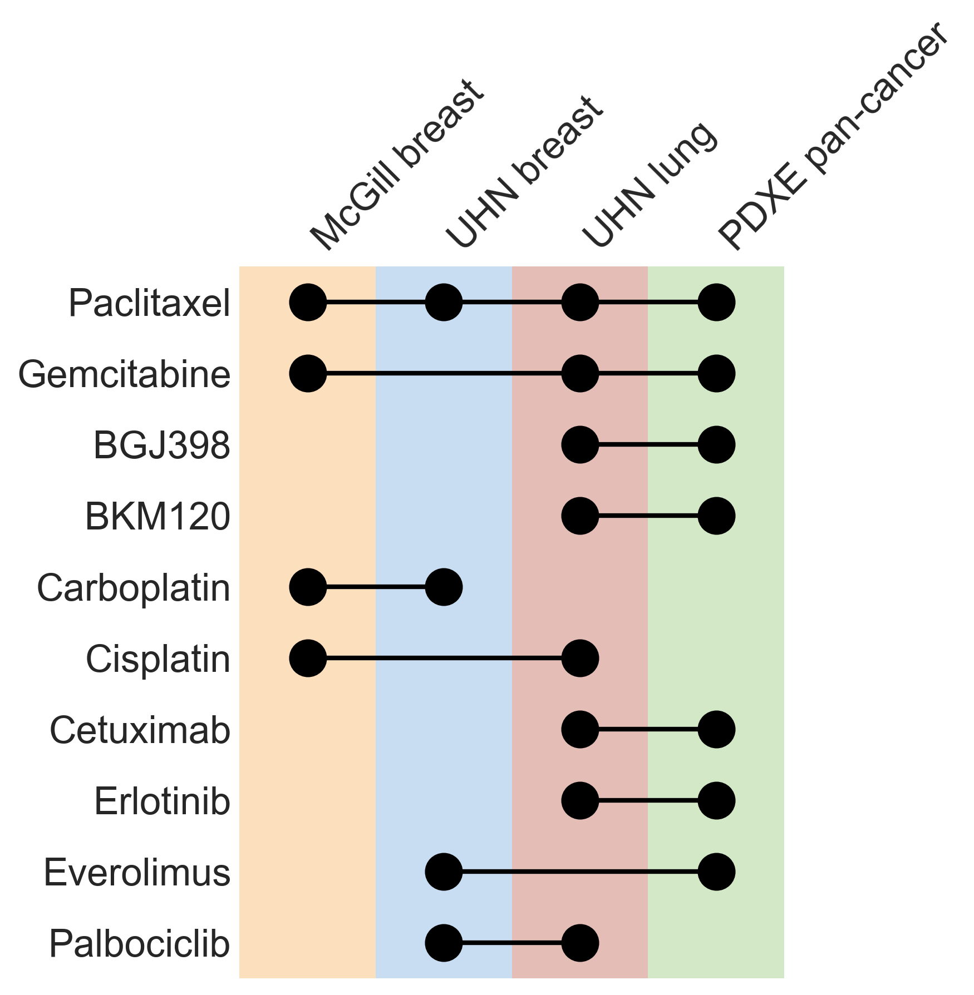
a
b
c
d
e
f

Slide 2
Figure 1. Overview of XevaDB, a standardized longitudinal PDX pharmacogenomic resource.
(a) Comparison of XevaDB with four existing PDX-related resources — PDX Finder/PDCM Finder (retired), EurOPDX, PDMR, and PDXNet — across five data-availability capabilities: model metadata, molecular profiles, drug response, longitudinal tumour volume, and analysis-ready dataset. Solid dots indicate full availability, semi-transparent dots indicate limited/partial availability, and the absence of a dot indicates the capability is not available. The organization or consortium responsible for each resource is shown below its name (EMBL-EBI, European Molecular Biology Laboratory–European Bioinformatics Institute; JAX, The Jackson Laboratory; NCI, National Cancer Institute; PMCC, Princess Margaret Cancer Centre). (b) XevaDB's internal data architecture. The XevaSet integrated object unifies model metadata, dataset information, omics profiles, drug annotation, omics-response mapping, longitudinal response, replicate design, and response metrics within a single standardized structure. (c) Data curation and analysis pipeline. Raw longitudinal response, omics, and clinical metadata from four source cohorts (McGill Breast, UHN Breast, UHN Lung, PDXE pan-cancer) are curated into standardized XevaSets and integrated into XevaDB, which supports four downstream case studies: (1) growth-kinetics modeling from control-arm curves and RNA-seq, (2) image-based drug-response classification from standardized tumour-volume curves, (3) cell-line-to-PDX transfer learning using response metrics and mutation/CNV data, and (4) multi-omics prediction of paclitaxel response. (d) Summary counts across the four cohorts for patients (n=469), PDX models (n=715; parental and resistant models shown separately), matched omics profiles (RNA-seq/mutation/CNV; n=344/339/339), drugs (n=72), and treatment-control experiments (n=5,632). (e) Distribution of PDX models by cancer type (n=715 total across six tumour types), with each wedge group further broken down by contributing dataset (shown in the legend); slice groups are radially separated to indicate cancer type. (f) Drugs shared across more than one dataset (10 of 72 total drugs), shown as a dot-matrix across the four cohorts; connected dots indicate the same drug tested in multiple datasets.

