Slide 1
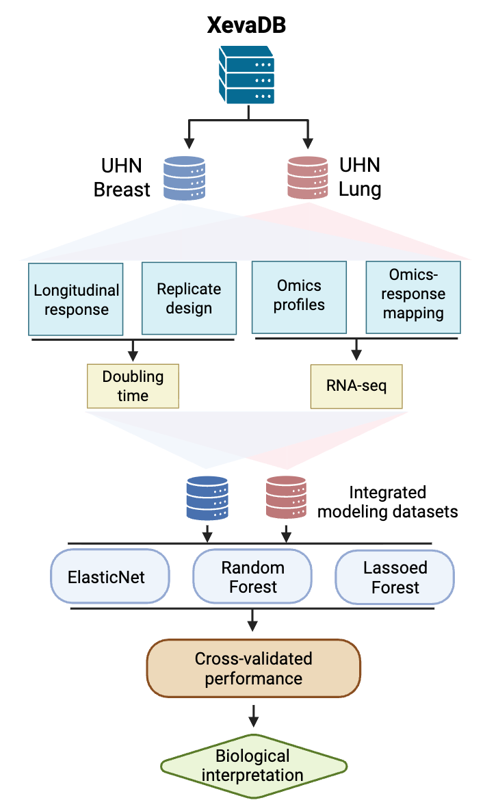
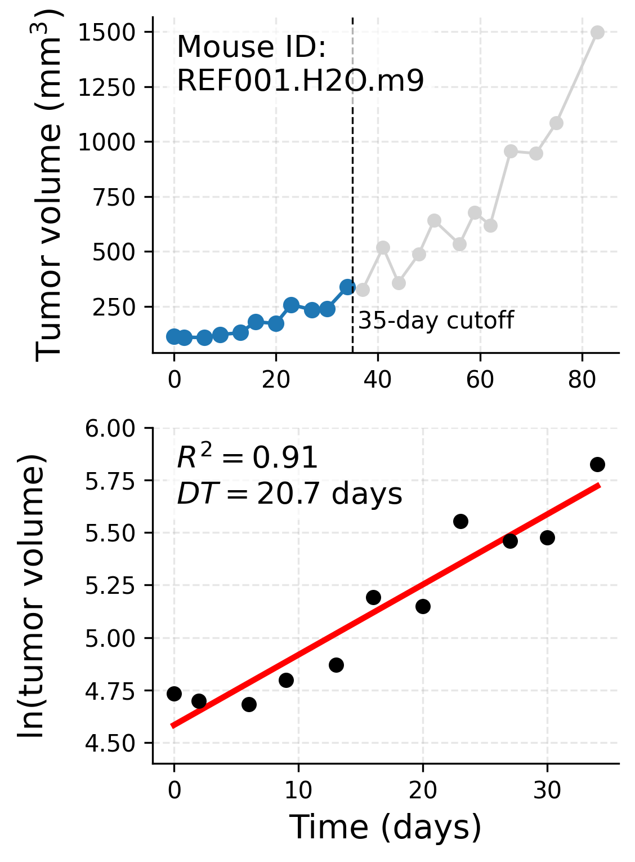
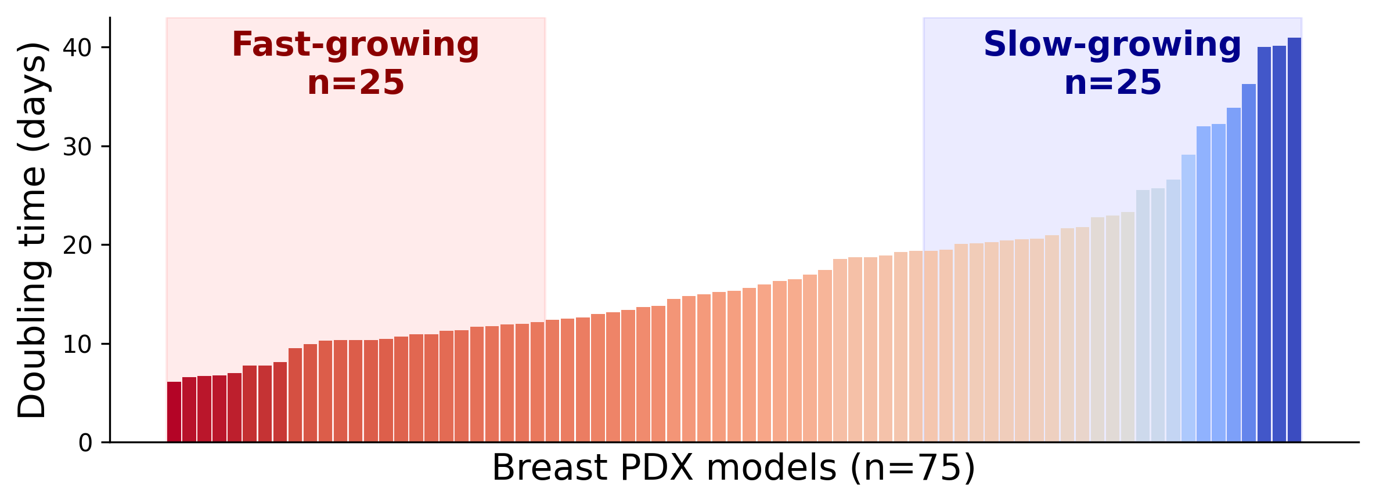
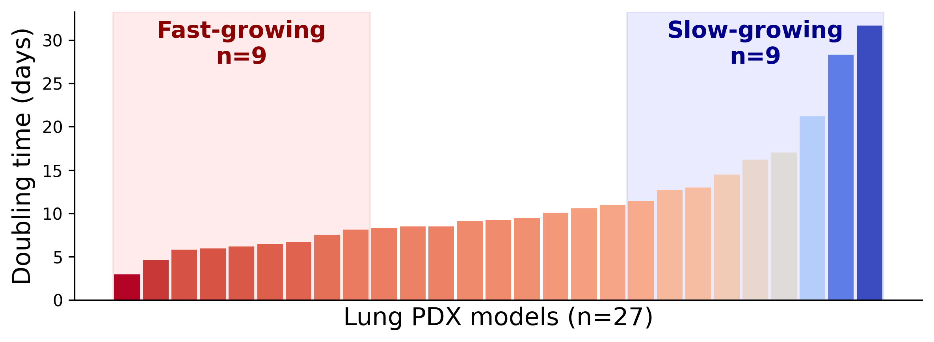
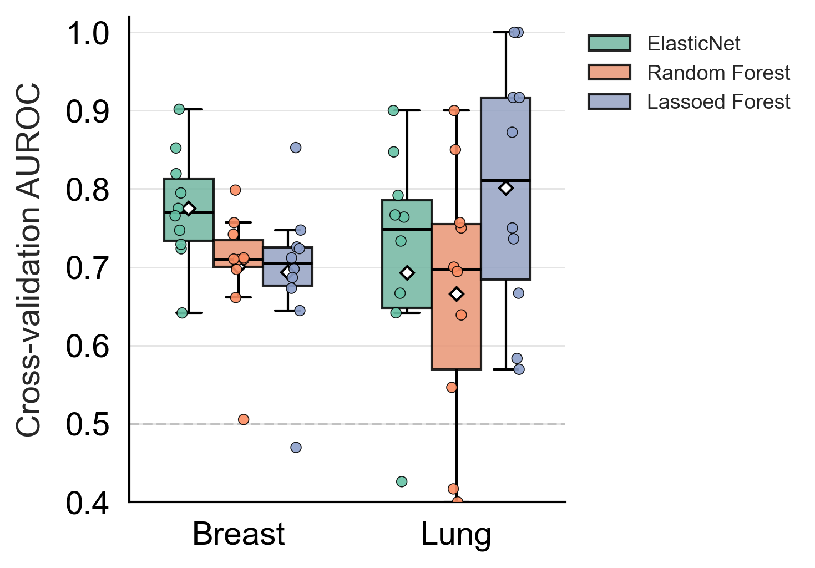
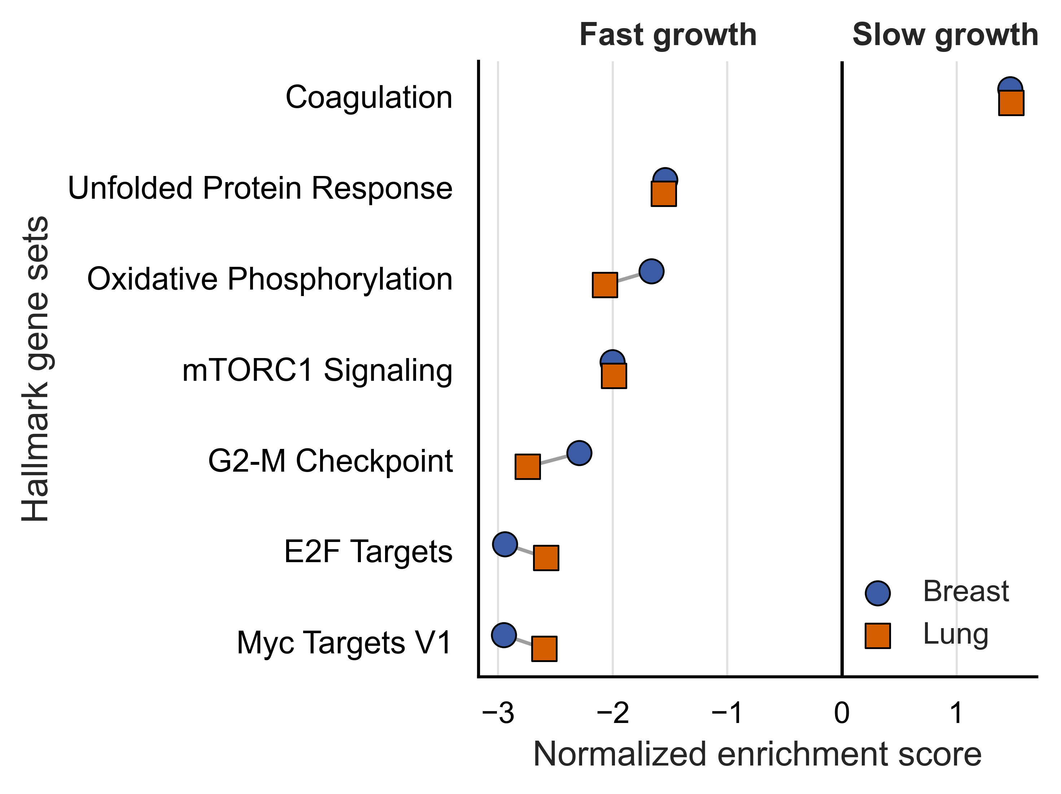
a
b
c
d
e
Figure 2. Transcriptomic modeling of intrinsic PDX growth kinetics.
(a) Case study one workflow: control-arm longitudinal tumour-volume curves and matched RNA-seq from breast and lung PDX cohorts are used to estimate model-level doubling time, modeled by ElasticNet, Random Forest, and Lassoed Forest classifiers under repeated cross-validation. (b) Representative doubling-time estimation for one control-arm mouse (REF001.H2O.m9): raw tumour-volume trajectory (top; points within the 35-day fitting window in blue, excluded points in gray) and the corresponding exponential-growth fit (ln(tumour volume) vs. time, bottom), with goodness-of-fit (R² = 0.91) and doubling time (DT = 20.7 days) annotated. (c) Distribution of estimated doubling times across breast (n = 75) and lung (n = 27) PDX models (intetrated modeling datasets shown in a), with the fastest- and slowest-growing tertiles used to define the classification task highlighted (breast: n = 25/25; lung: n = 9/9). (d) Cross-validated AUROC of ElasticNet, Random Forest, and Lassoed Forest classifiers distinguishing fast- from slow-growing models, breast and lung; dashed line, chance performance. (e) Cross-cohort comparison of Hallmark gene-set enrichment (GSEA NES) associated with fast- vs. slow-growing tumours in the breast and lung cohorts.

