Slide 1
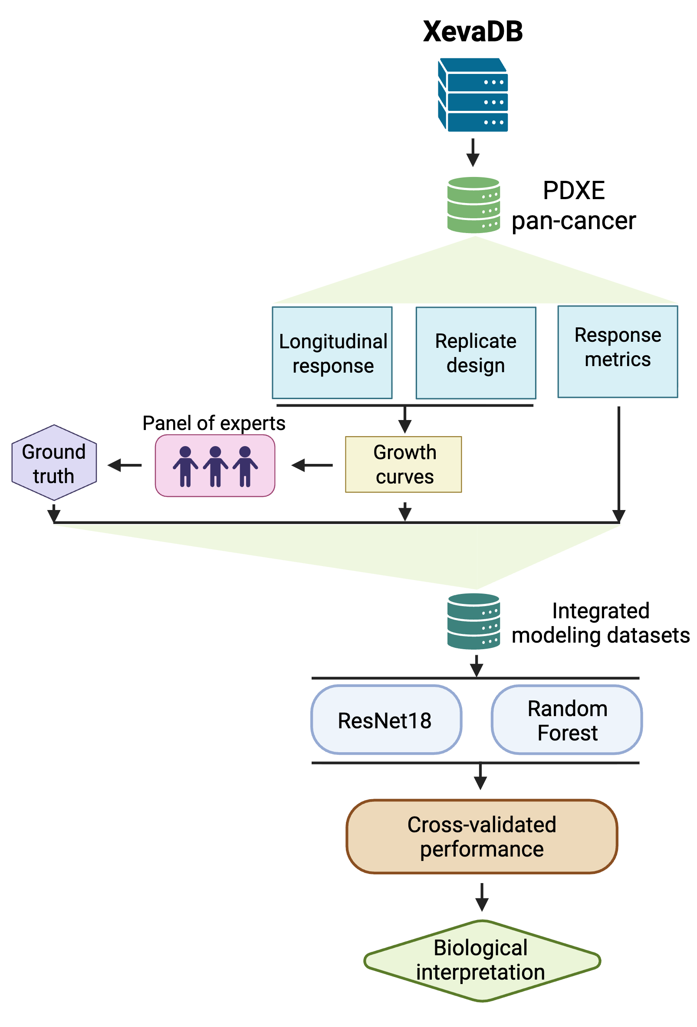
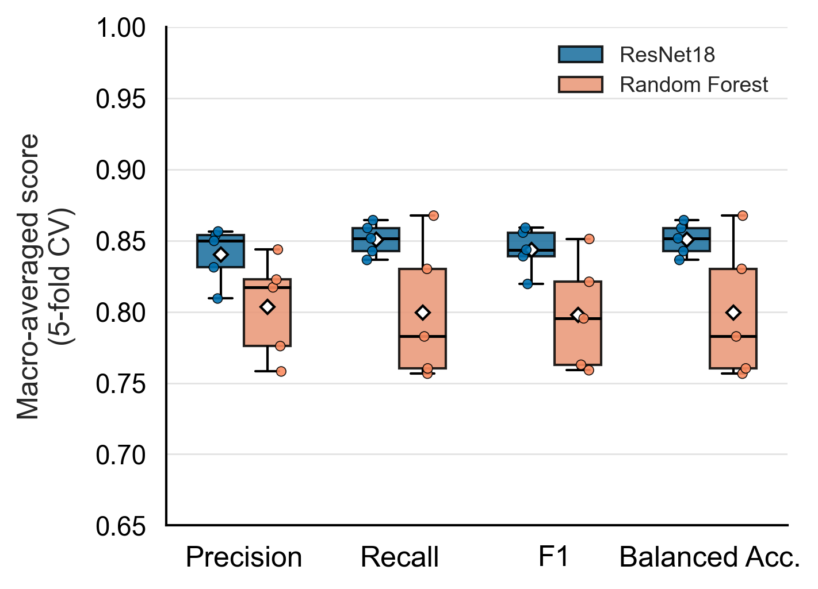
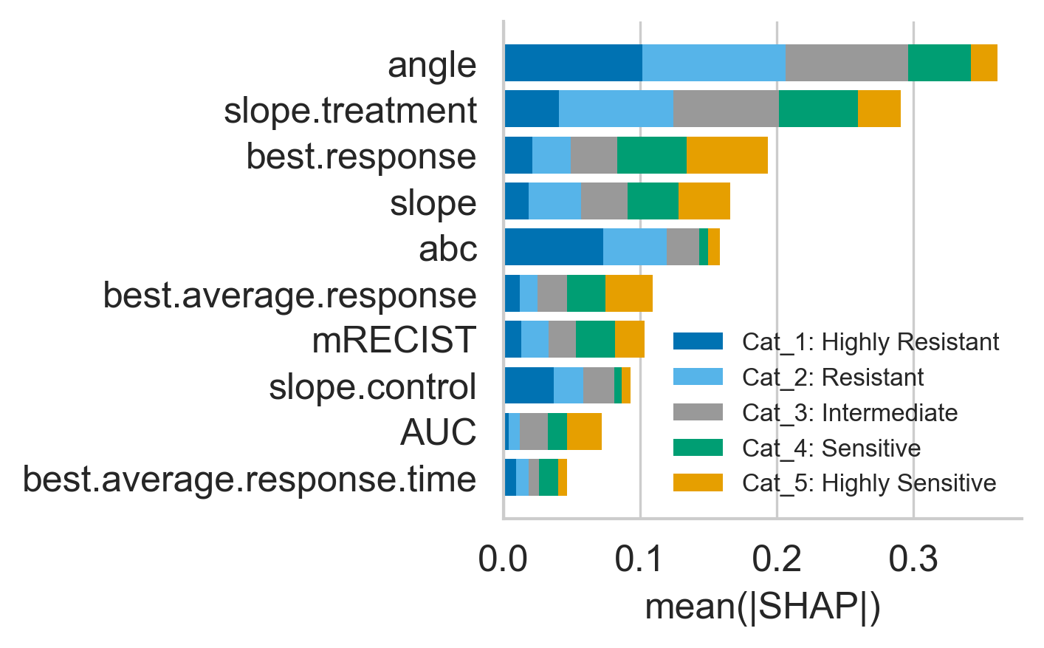
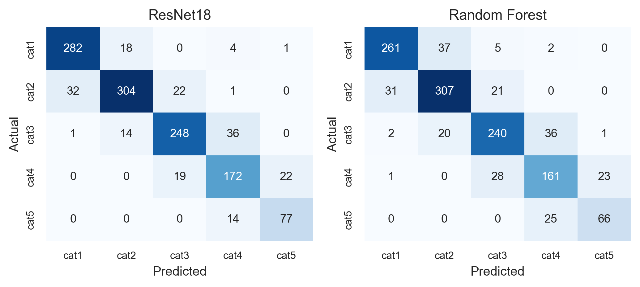
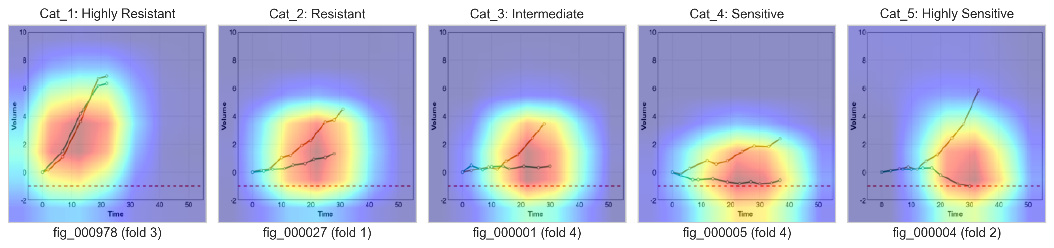
a
b
c
d
e
Figure 3. Image-based deep learning captures non-linear drug-response dynamics.
(a) Case study two workflow: tumour-volume growth curves for model-drug batches from the PDXE pan-cancer cohort are rendered as standardized images, scored by a three-rater expert panel into five ordinal response categories, and used to train and compare an image-based ResNet18 classifier against a feature-based Random Forest classifier under matched 5-fold cross-validation. (b) Cross-validated performance (macro-averaged precision, recall, F1-score, and balanced accuracy) of ResNet18 versus Random Forest across 5 outer folds. (c) Random Forest feature importance (mean absolute SHAP value, stacked by response category) for the top 10 of thirteen engineered response features, ranked by total mean absolute SHAP across categories. (d) Pooled out-of-fold confusion matrices for ResNet18 and Random Forest across all 1,267 curves. (e) Representative Grad-CAM visualizations for one correctly classified, held-out example per response category.

