Slide 1
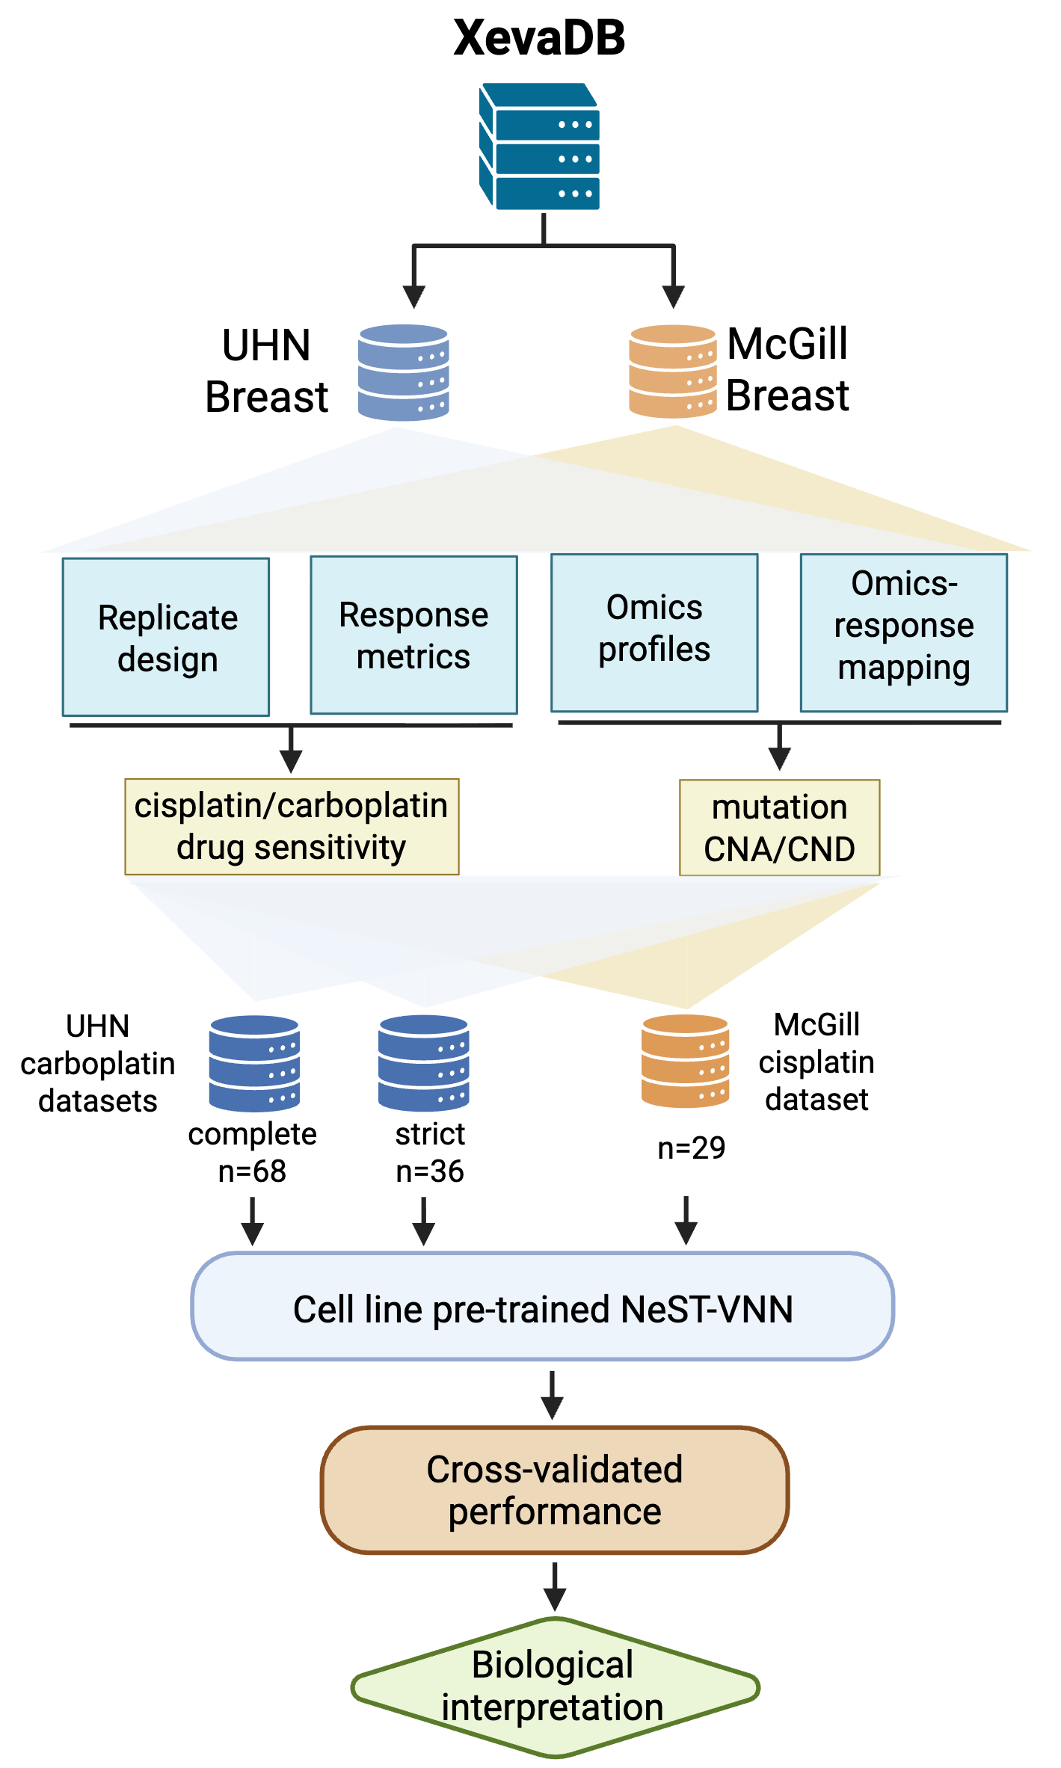
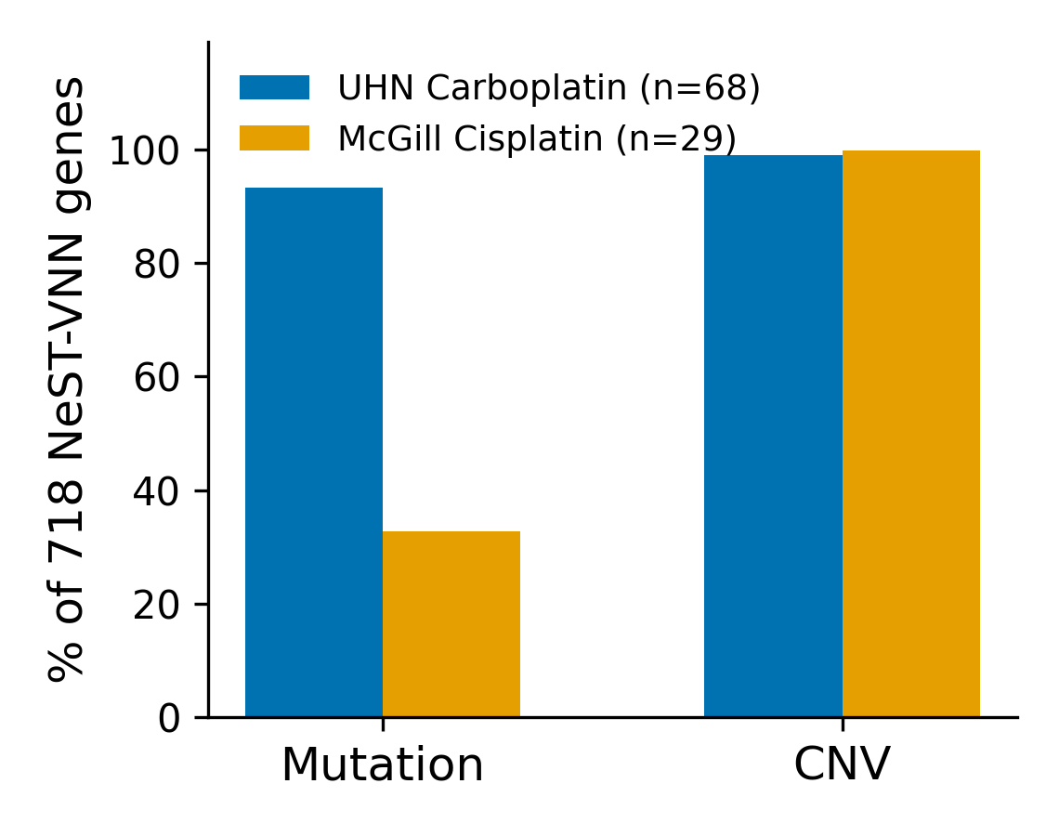
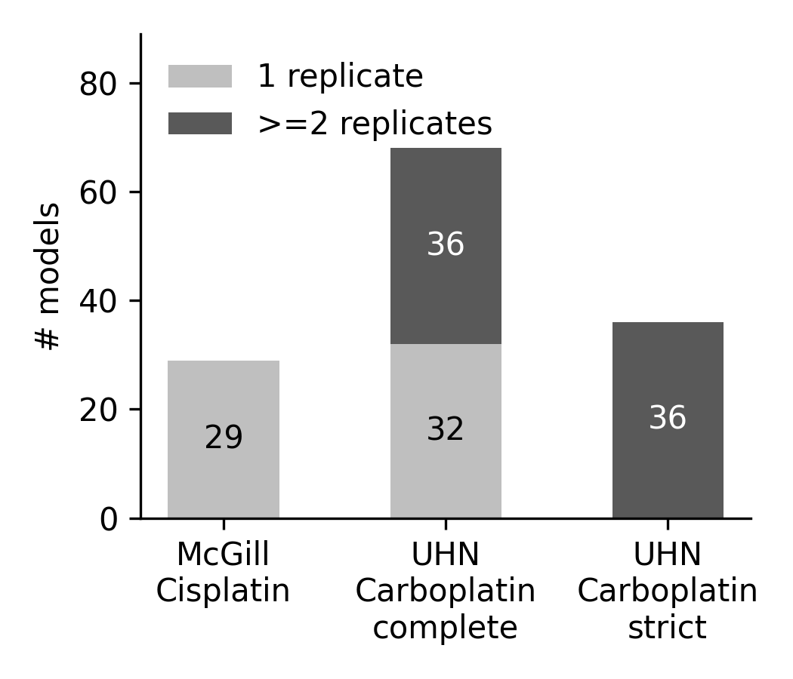
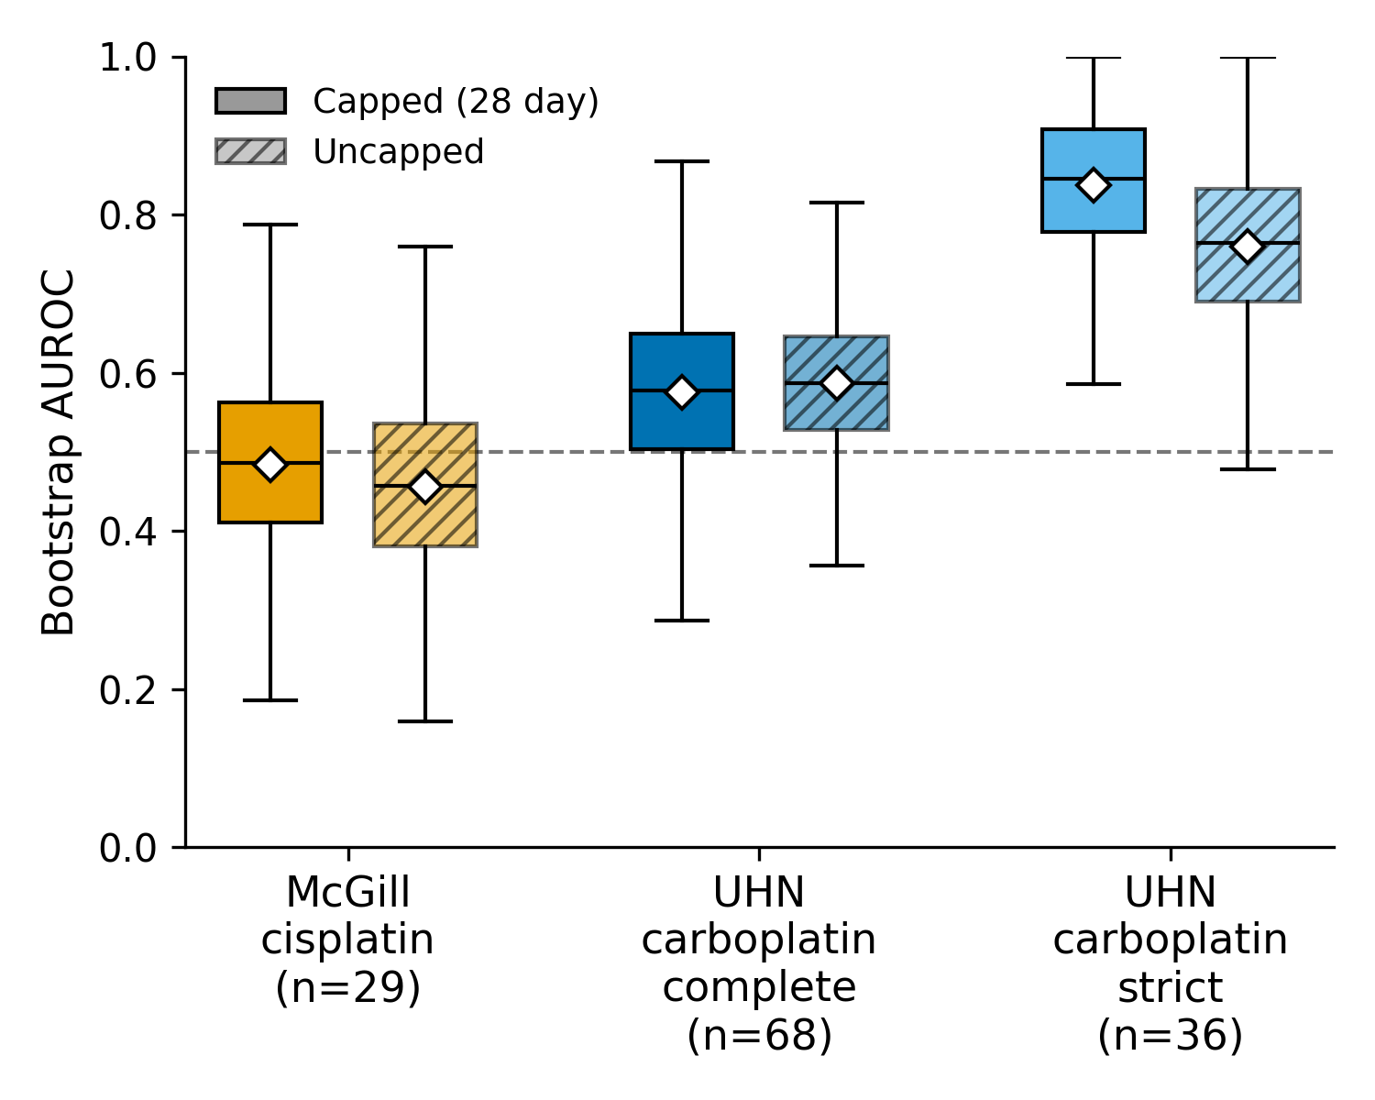
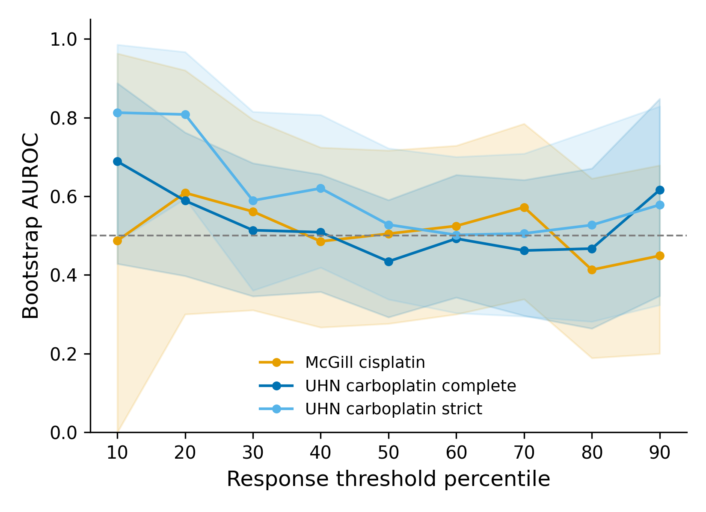
a
b
c
d
e
Figure 4. Cross-platform validation of NeST-VNN on independent PDX cohorts.
(a) Case study three workflow: drug-response, mutation, and copy-number data from the McGill (cisplatin, n = 29) and UHN (carboplatin; complete cohort n = 68, replicate-supported "strict" cohort n = 36) breast PDX cohorts are used as external input to a cell-line-pretrained NeST-VNN ensemble, validated against a growth-curve response label. (b) Number of models with exactly one versus two or more treatment-arm replicate mice, for each cohort/cohort definition. (c) Fraction of the 718-gene NeST-VNN input panel with recorded mutation and copy-number (CNV) calls in each cohort's raw molecular profiles. (d) Bootstrap 95% confidence intervals for NeST-VNN's AUROC under the capped (28 day window, primary) and uncapped (full observed duration) response-label definitions, for each of the three cohort definitions; dashed line, chance performance. (e) NeST-VNN performance across alternative response definitions. AUROC was evaluated across cohort-specific treatment-arm slope percentile cutoffs, with models below each cutoff classified as sensitive. Lines represent the McGill cisplatin, UHN carboplatin complete and UHN carboplatin strict cohorts, shaded regions indicate bootstrap 95% confidence intervals, and the dotted line indicates chance performance (AUROC = 0.5).
Notes:
Figure 3. Systematic evaluation of NeST-VNN model generalizability and performance. a. Case study workflow. b. Oncoplot illustrating the mutational landscape of the University Health Network (UHN) carboplatin and McGill cisplatin datasets. c. Distribution of drug responses across both cohorts based on modified Response Evaluation Criteria in Solid Tumors (mRECIST). CR, complete response; PR, partial response; SD, stable disease; PD, progressive disease. d. Density comparison of 718 NeST-VNN features between datasets. Statistical significance was determined using a two-sided Mann–Whitney U test. **** p < 0.0001; *** p < 0.001; ** p < 0.01; * p < 0.05; ns, not significant. e. Model transferability. Bar plot summarizing the mean Area Under the Receiver Operating Characteristic Curve (AUC) across fivefold cross-validation, demonstrating model robustness across institutional cohorts. f. NeST-VNN model performance. Receiver Operating Characteristic (ROC) curves and corresponding ensemble AUC values for the UHN carboplatin and McGill cisplatin validation sets.

