Slide 1
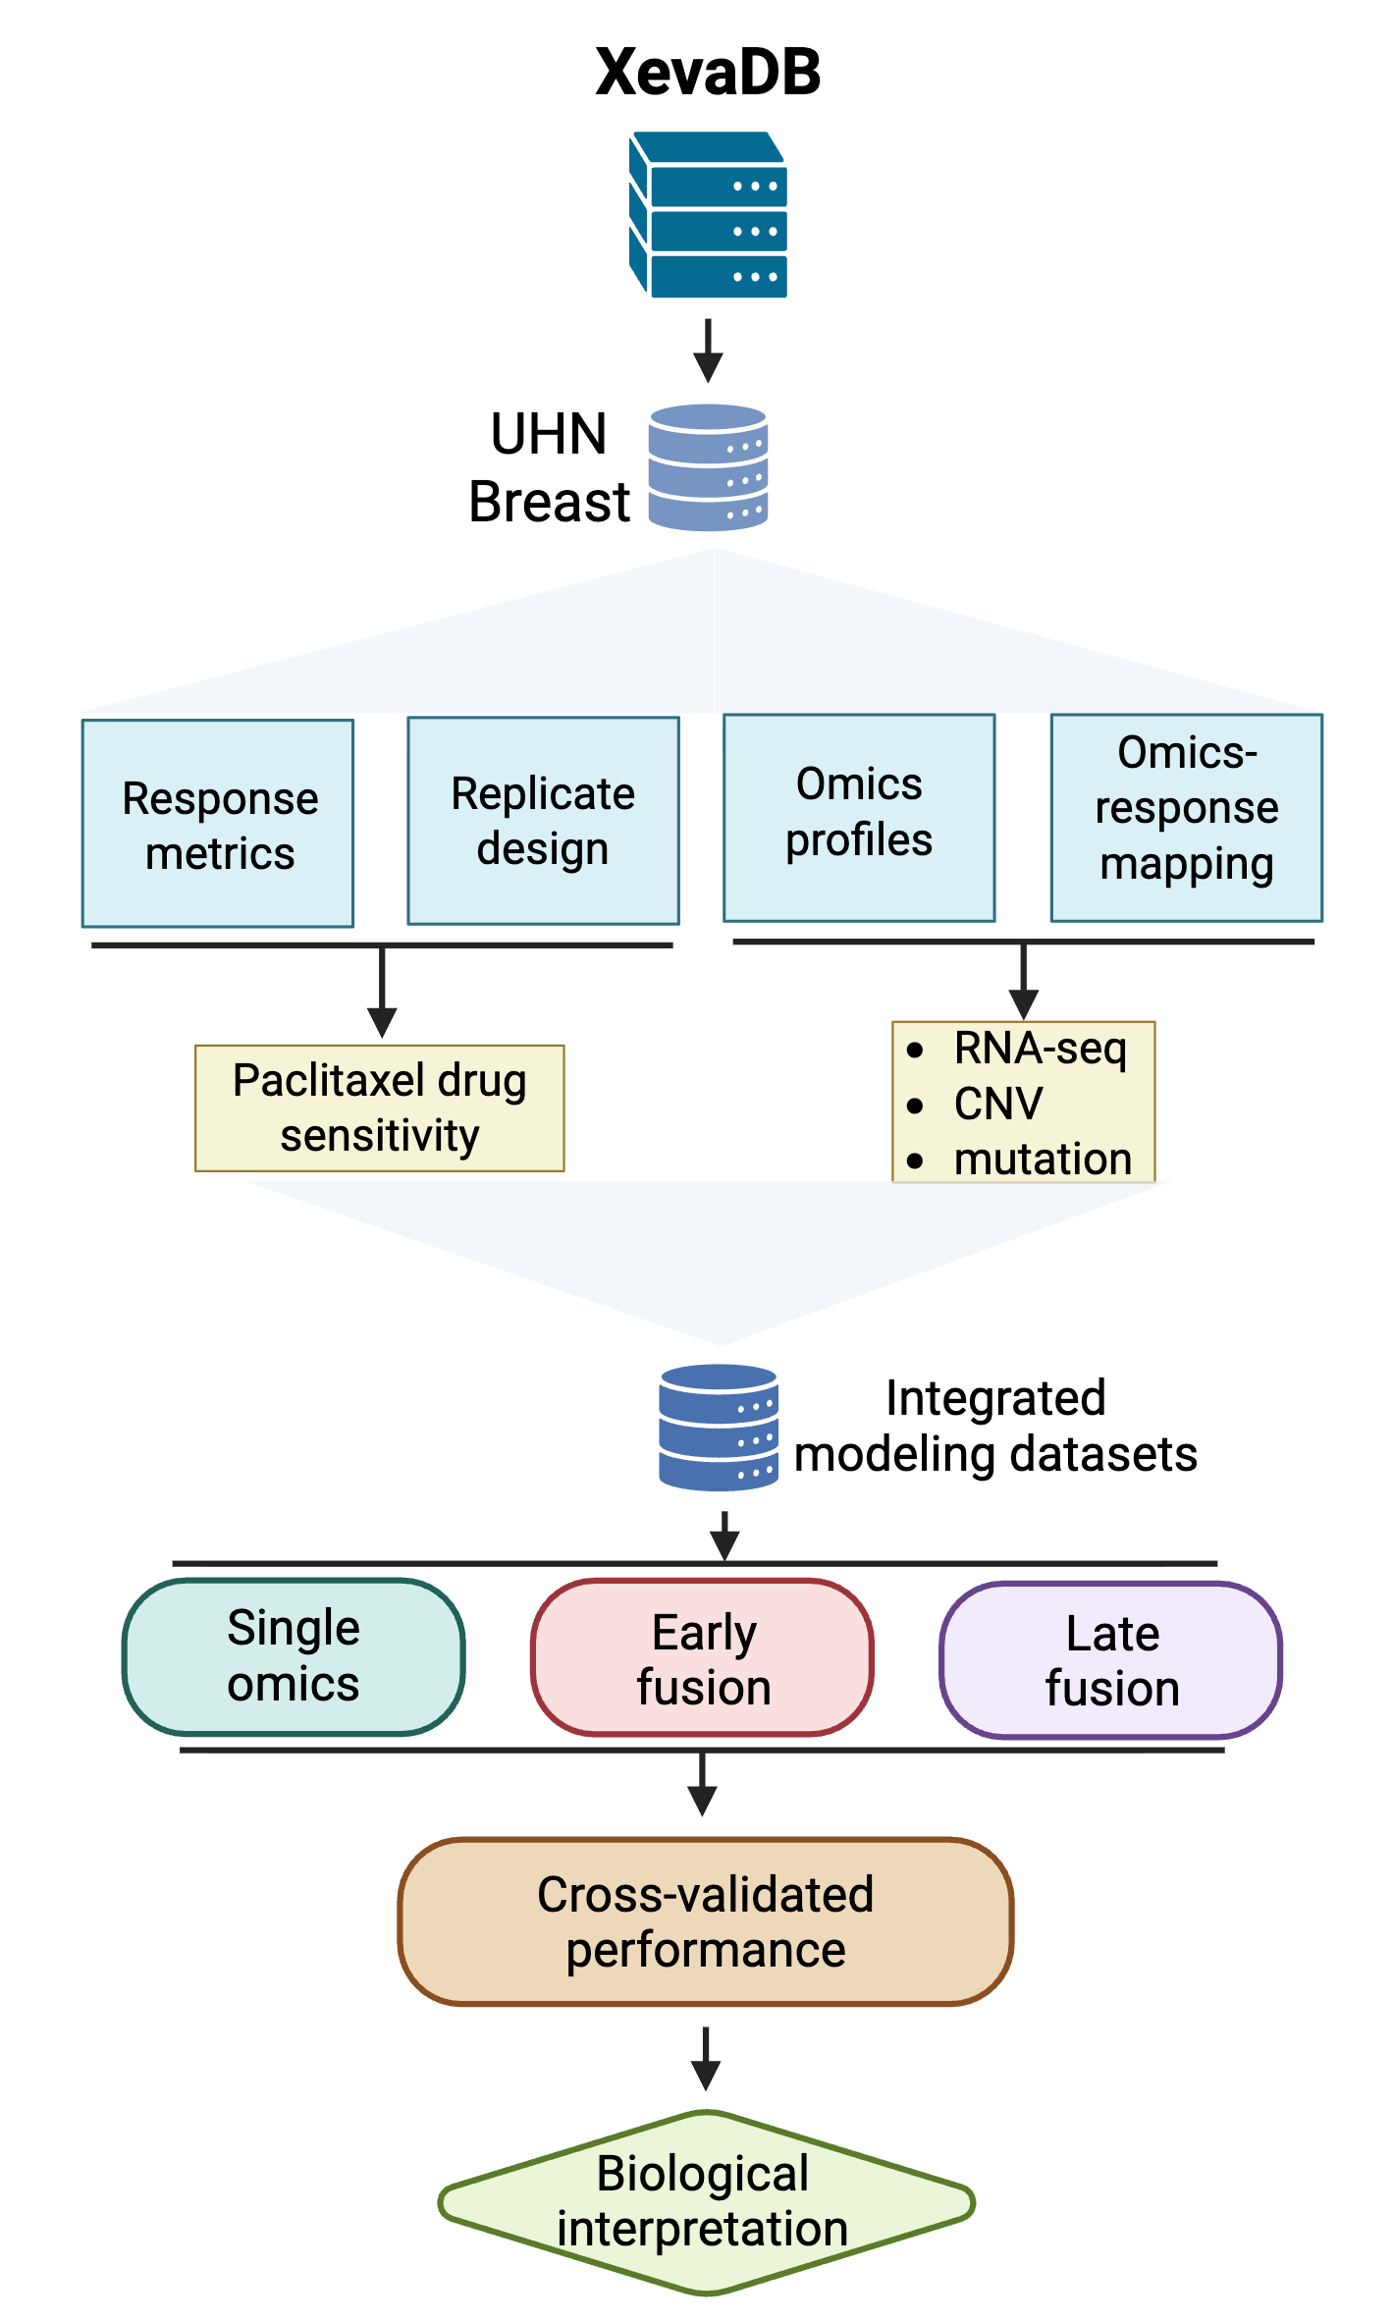
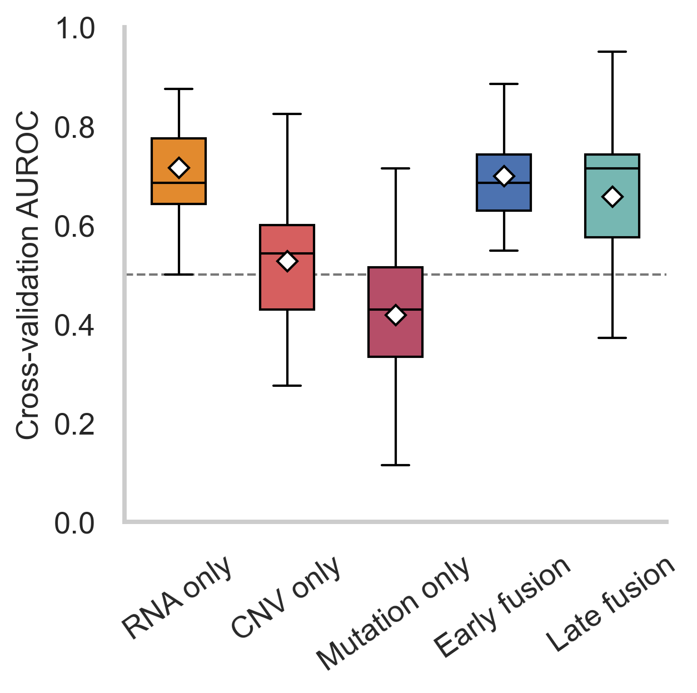
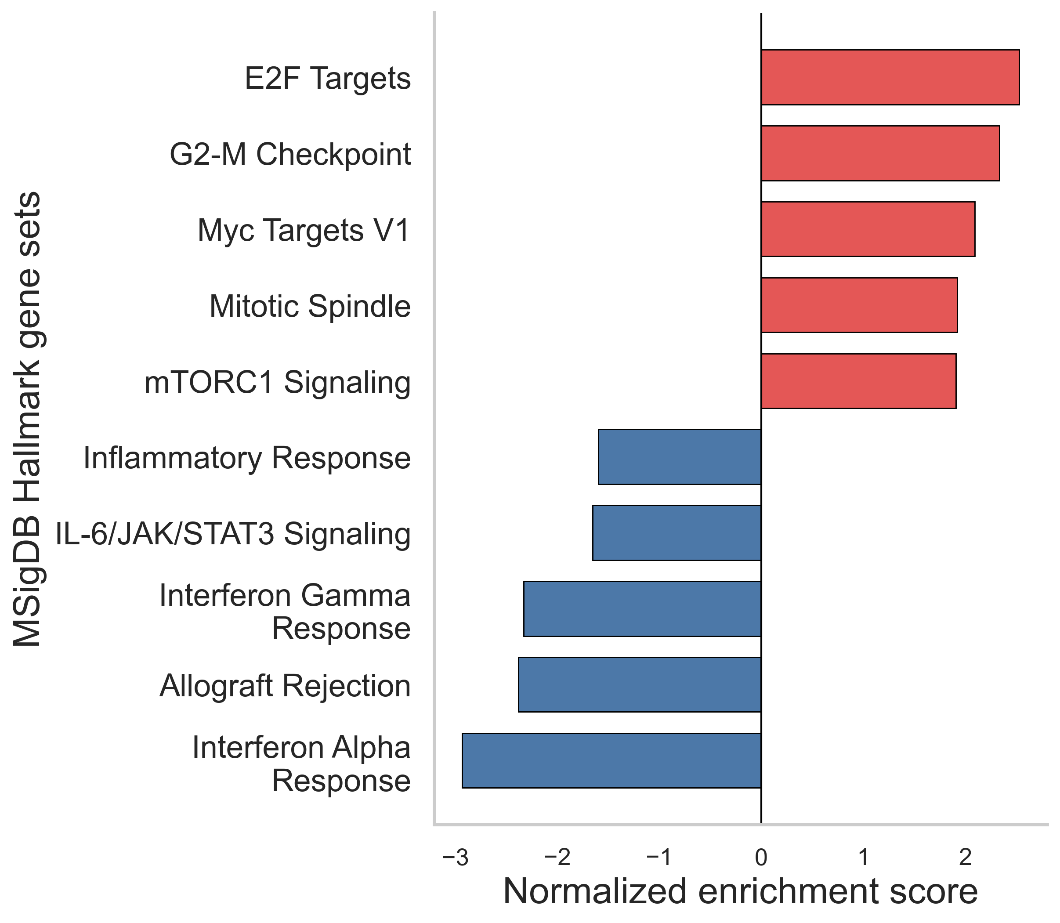
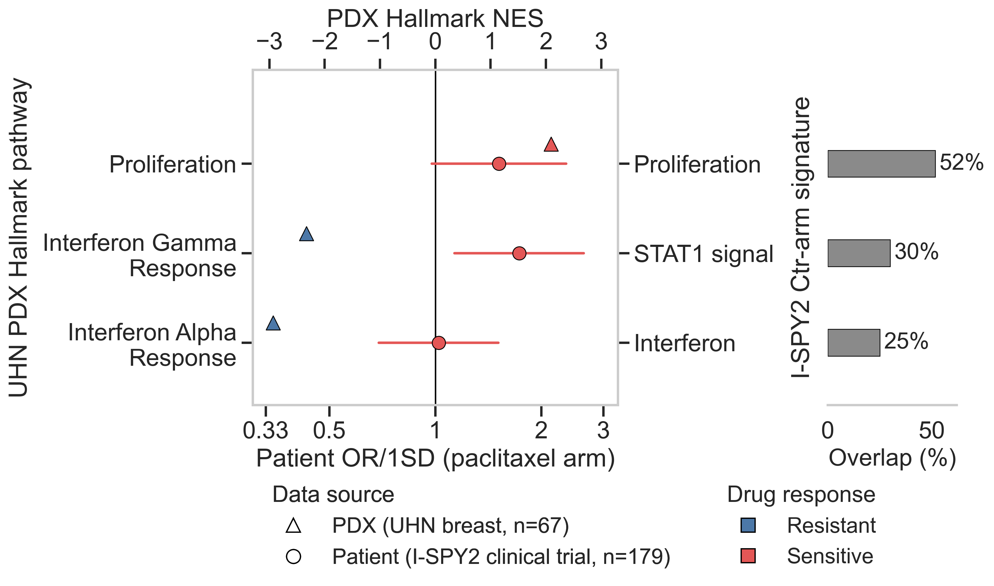
a
b
c
d
Figure 5. XevaDB-based multi-omics prediction of paclitaxel response in breast cancer PDX models.
(a) Case study four workflow: drug-sensitivity metrics and RNA-seq/CNV/mutation profiles for the UHN breast paclitaxel cohort are extracted from XevaDB and assembled into single-omics, early-fusion, and late-fusion modeling datasets, evaluated by cross-validation. (b) Cross-validation AUROC of the random forest classifier across single-omics (RNA-only, CNV-only, mutation-only) and multi-omics (early fusion, late fusion) feature sets; boxes show median/IQR and whiskers across repeated CV folds, diamonds mark the mean, dashed line marks chance (AUROC = 0.5). (c) Pre-ranked GSEA of the full RNA transcriptome against MSigDB Hallmark gene sets; top 6 significant pathways per direction shown (FDR q < 0.05). Positive NES: enriched in Sensitive models; negative NES: enriched in Resistant models. (d) Cross-cohort comparison of transcriptomic programmes associated with paclitaxel response in UHN PDXs (n=67) and pathological complete response (pCR) in the I-SPY2 paclitaxel control arm (n=179 patients). Triangles, PDX normalized enrichment scores (NES) for MSigDB Hallmark pathways; circles, patient odds ratios (OR) for pCR per one-standard-deviation (1SD) increase in the corresponding predefined I-SPY2 signature, with 95% confidence intervals (refit from patient-level I-SPY2 data; see Methods). Markers are colored by their own direction of association (blue, Resistant; red, Sensitive), so a row is concordant when both markers share a color and discordant when they differ. Positive PDX NES indicates enrichment in sensitive PDXs, whereas patient OR values above 1 indicate higher odds of pCR. "Proliferation" reflects the median NES across five Hallmark gene sets significantly enriched in sensitive PDXs (E2F Targets, G2-M Checkpoint, Mitotic Spindle, Myc Targets V1, Myc Targets V2). Percentages indicate gene overlap between each I-SPY2 signature and its corresponding Hallmark gene set. Not all pathways shown in (c) are evaluated here: mTORC1 Signaling, Allograft Rejection, IL-6/JAK/STAT3 Signaling and Inflammatory Response lacked an I-SPY2 signature with adequate gene-level overlap and are not shown.
Notes:
Figure 2. Systematic evaluation of NeST-VNN model generalizability and performance. a. Case study workflow. b. Oncoplot illustrating the mutational landscape of the University Health Network (UHN) carboplatin and McGill cisplatin datasets. c. Distribution of drug responses across both cohorts based on modified Response Evaluation Criteria in Solid Tumors (mRECIST). CR, complete response; PR, partial response; SD, stable disease; PD, progressive disease. d. Density comparison of 718 NeST-VNN features between datasets. Statistical significance was determined using a two-sided Mann–Whitney U test. **** p < 0.0001; *** p < 0.001; ** p < 0.01; * p < 0.05; ns, not significant. e. Model transferability. Bar plot summarizing the mean Area Under the Receiver Operating Characteristic Curve (AUC) across fivefold cross-validation, demonstrating model robustness across institutional cohorts. f. NeST-VNN model performance. Receiver Operating Characteristic (ROC) curves and corresponding ensemble AUC values for the UHN carboplatin and McGill cisplatin validation sets.

