Slide 1
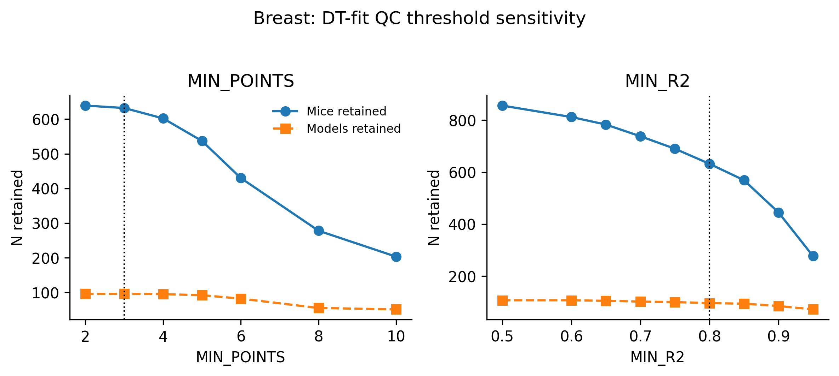
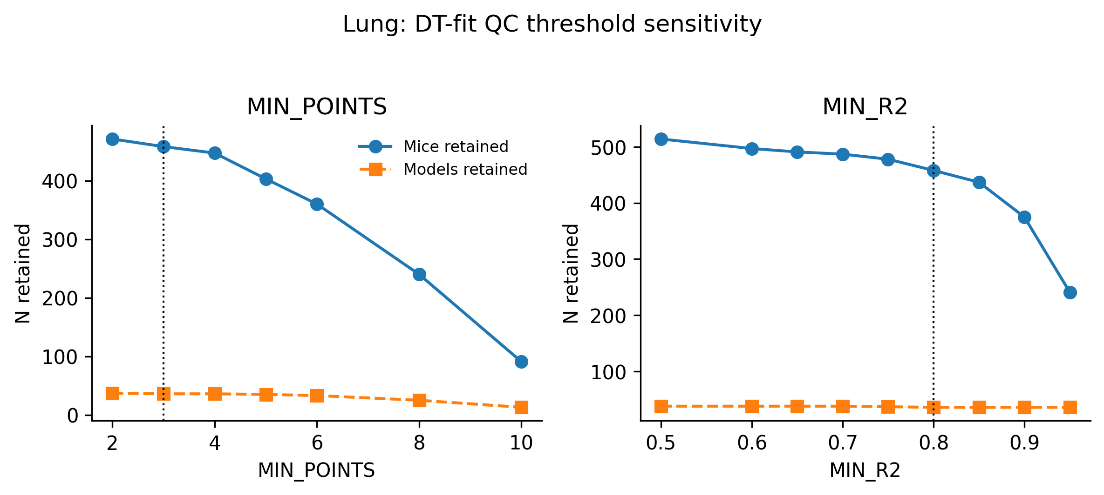
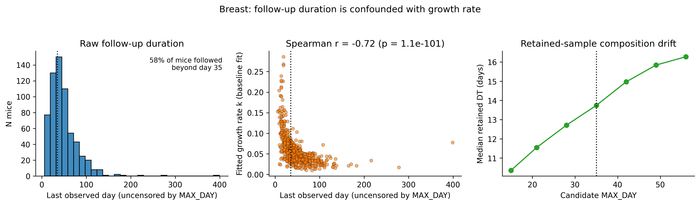
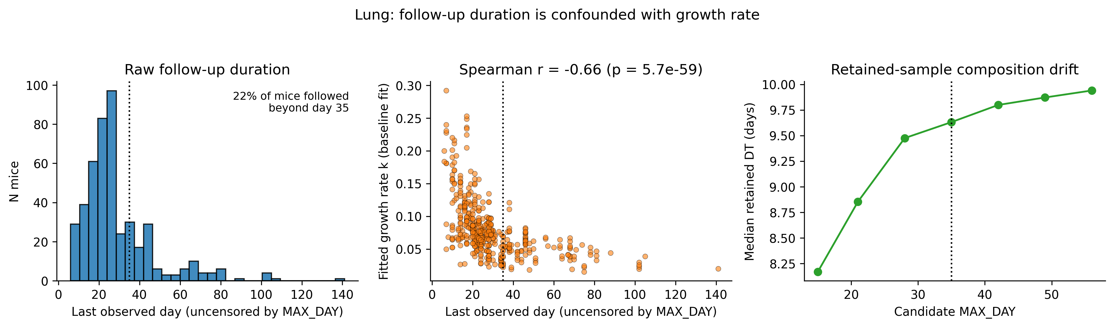
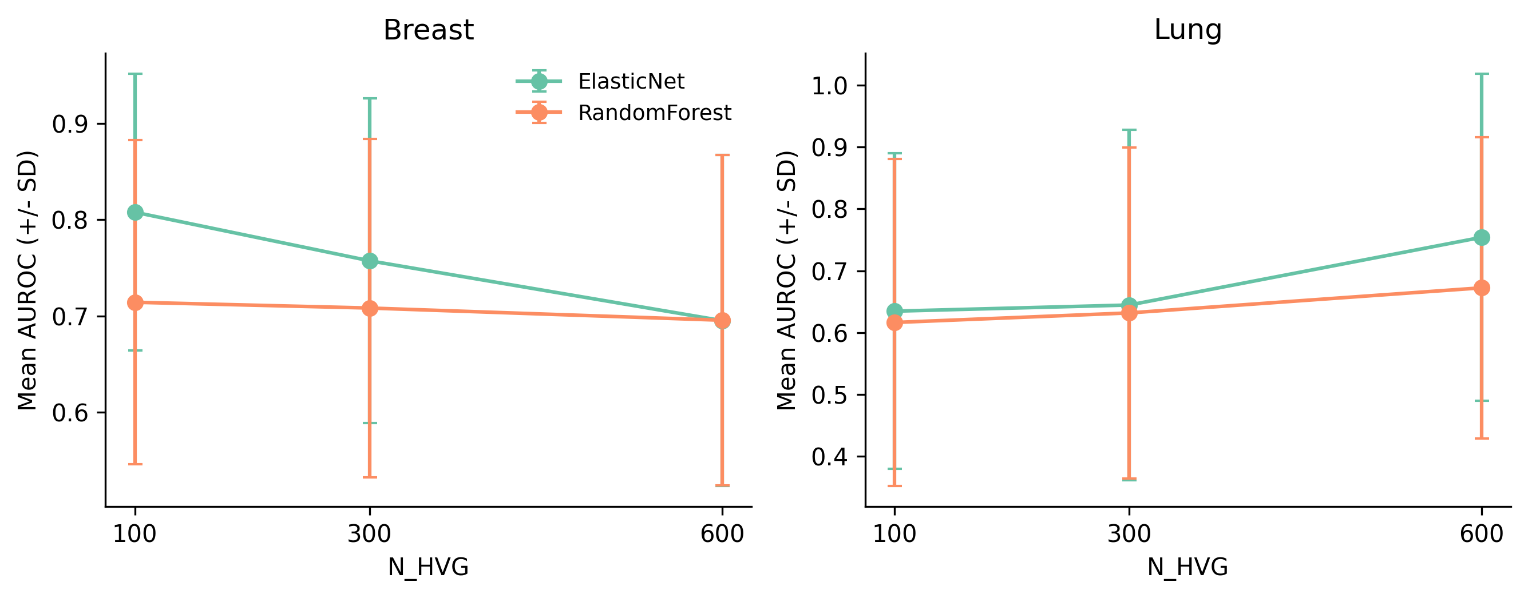
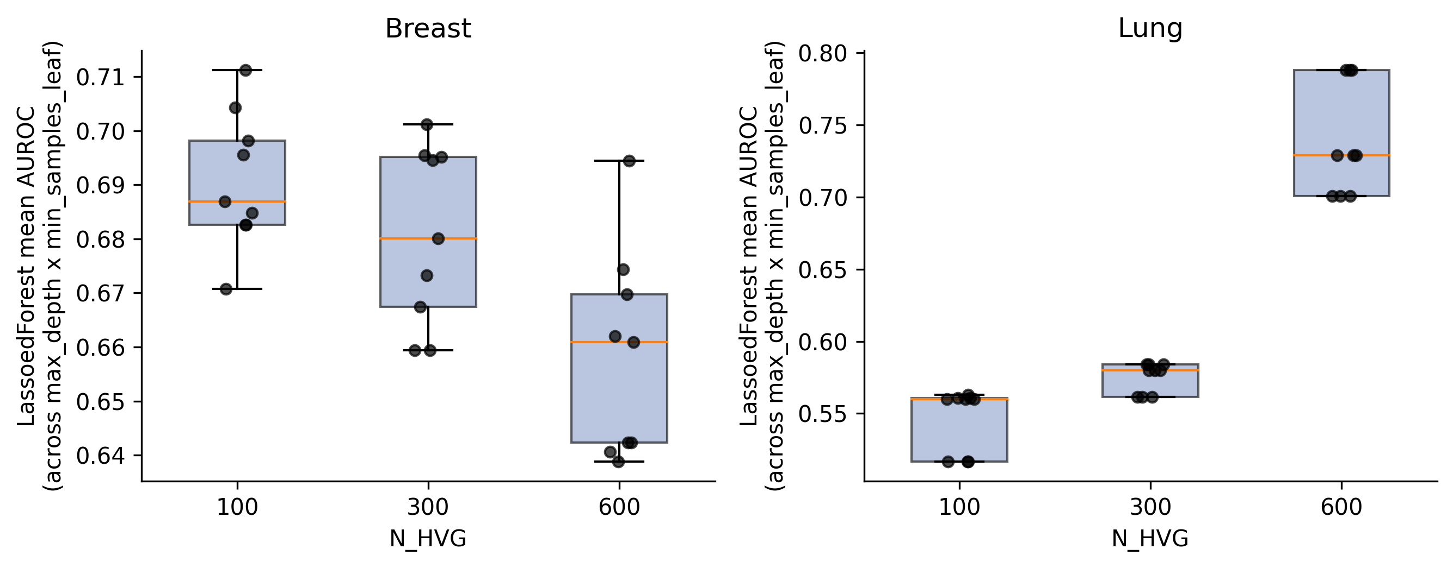
a
b
c
d

Slide 2
Supplemental Figure 1. Sensitivity of the growth-kinetics analysis (case study 1) to quality-control thresholds, follow-up window, and highly-variable-gene count.
(a) Number of mice and PDX models retained across a grid of candidate MIN_POINTS (minimum tumour-volume measurements per mouse) and MIN_R2 (minimum goodness-of-fit) thresholds, for the breast (left) and lung (right) cohorts; dotted lines indicate the thresholds used in the primary analysis (MIN_POINTS = 3, MIN_R2 = 0.8). (b) For the breast (top) and lung (bottom) cohorts: distribution of raw, uncensored follow-up duration per mouse (left); correlation between fitted growth-rate coefficient k and follow-up duration (two-sided Spearman r annotated; middle); and drift in median retained doubling time as a function of the candidate follow-up-window cutoff, MAX_DAY (right). Dotted line, the 35-day cutoff used in the primary analysis. (c) Cross-validated AUROC (mean ± SD) for ElasticNet and Random Forest across a grid of candidate highly-variable-gene (HVG) counts, breast (left) and lung (right). (d) Distribution of Lassoed Forest mean AUROC across the max_depth × min_samples_leaf hyperparameter grid, across the same HVG-count grid, breast (left) and lung (right).

Slide 3
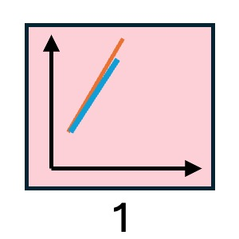
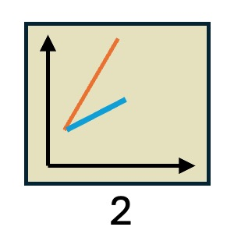
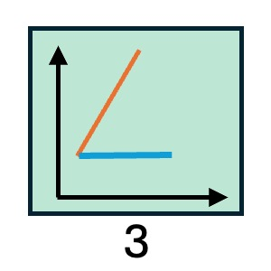
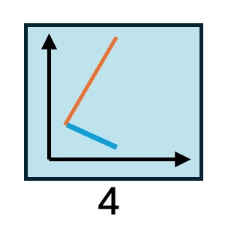
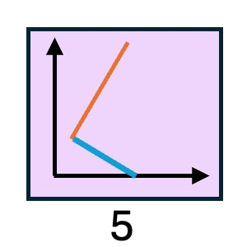
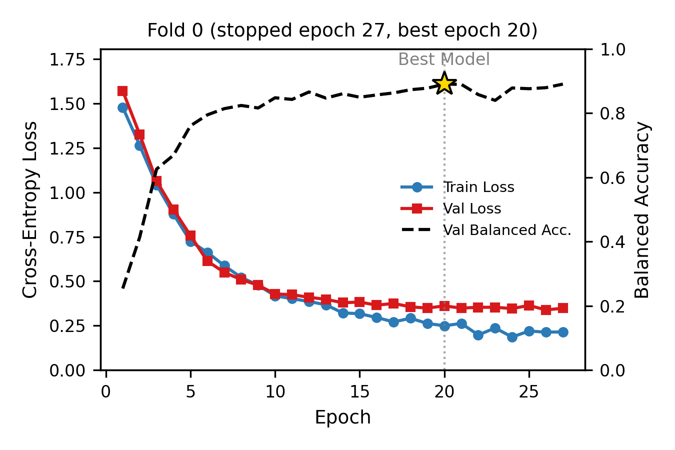
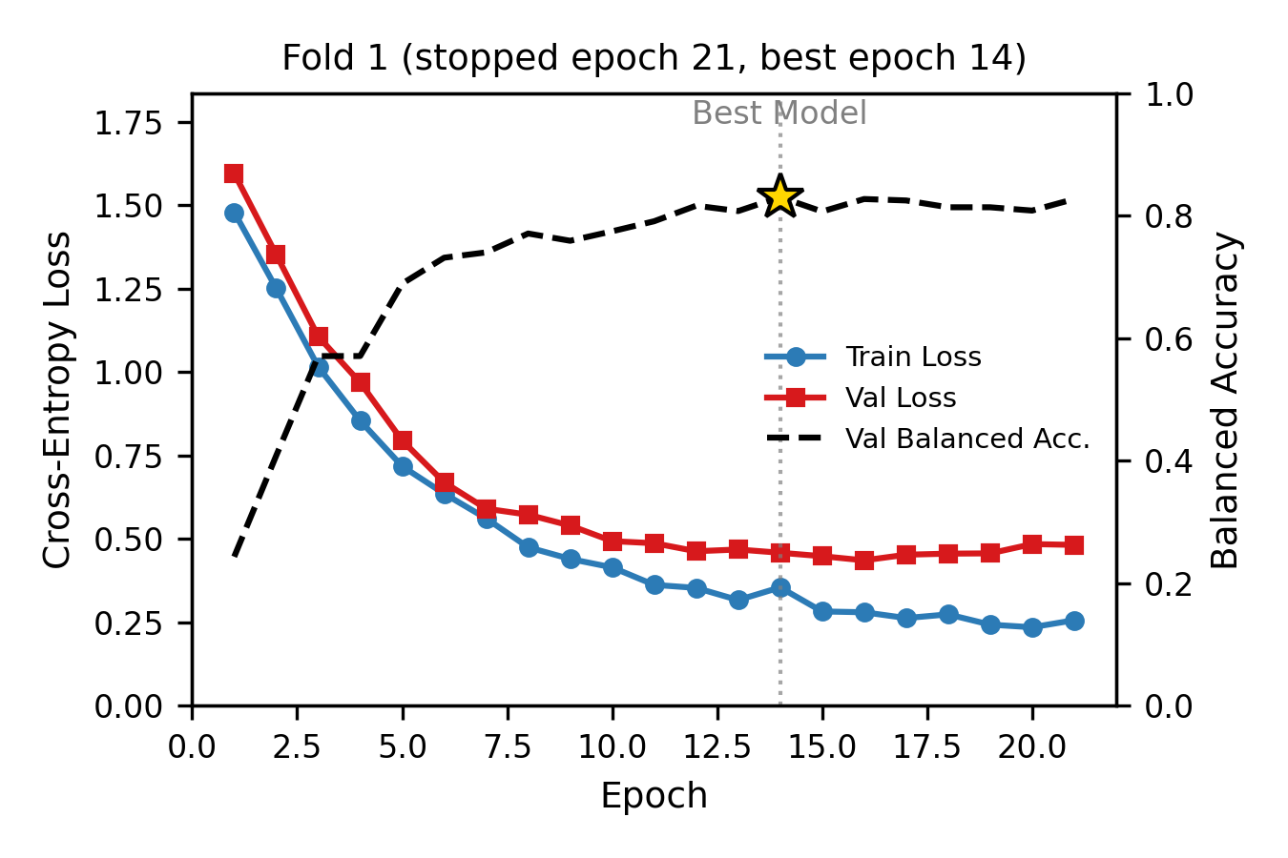
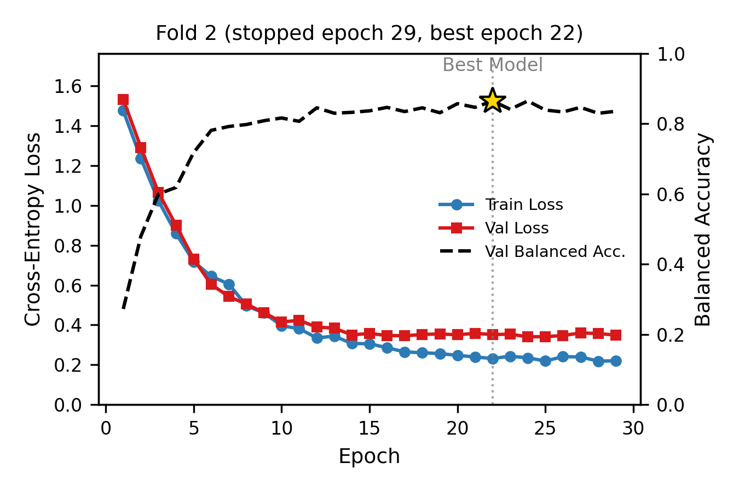
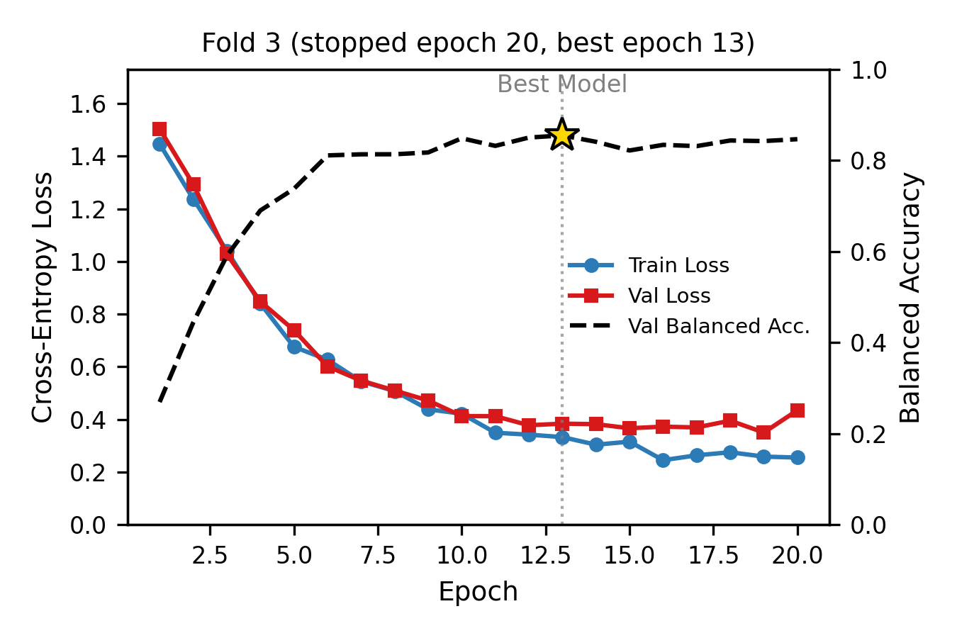
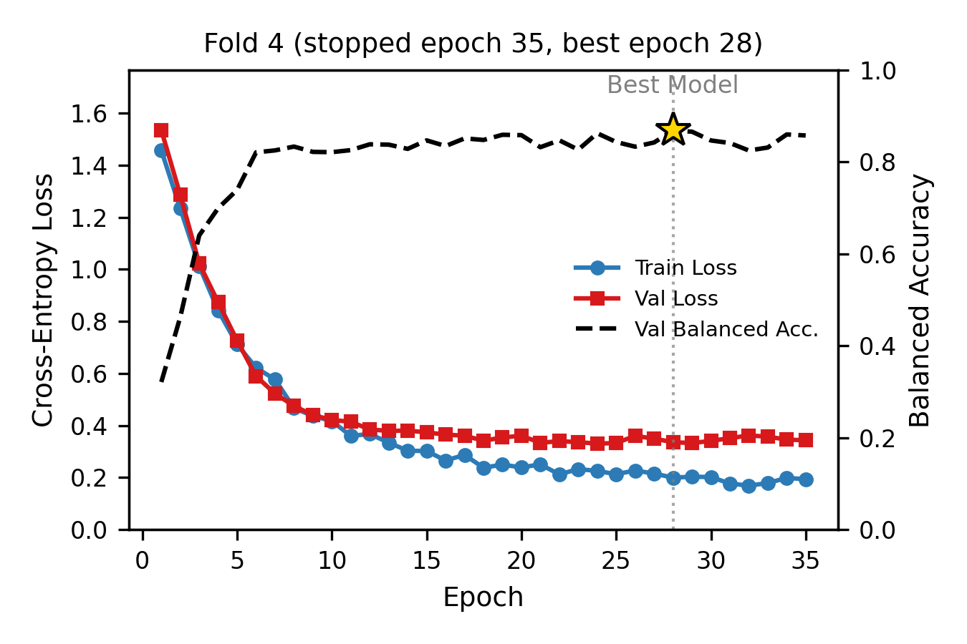
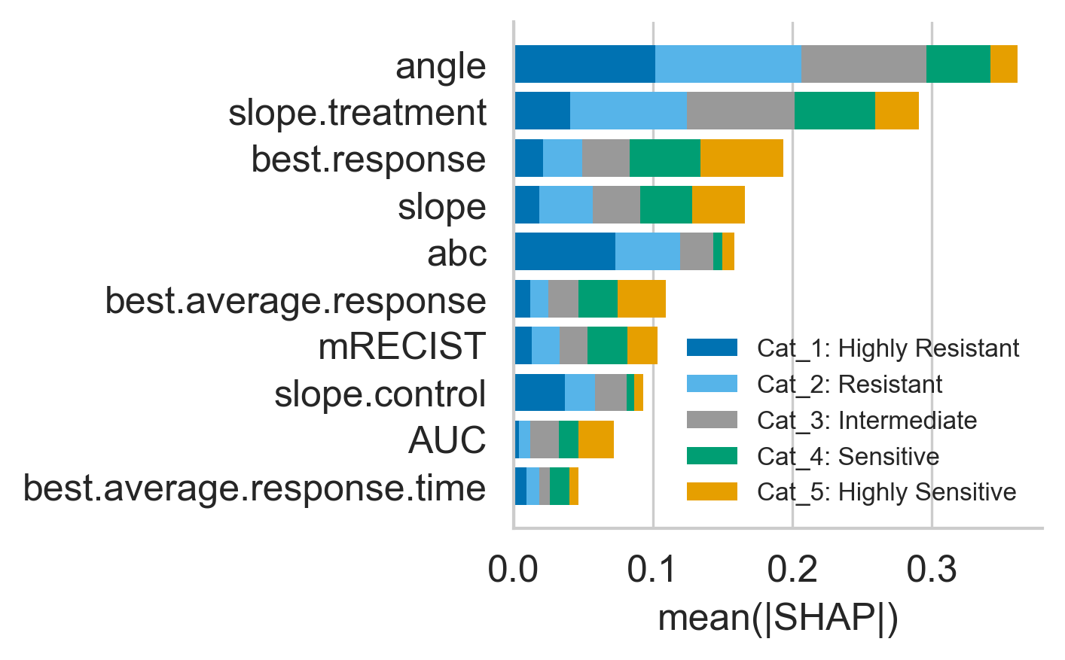
a
Drug sensitivity categorization criteria provided to panel of experts
    Category 1: tumour growth similar to control.
    Category 2: tumour growth is inhibited compared to control, but tumour is still enlarging compared to time 0.
    Category 3: tumour growth is inhibited compared to control, and tumour volume stays stable.
    Category 4: tumour growth is inhibited compared to control, and tumour volume is shrinking.
    Category 5: tumour growth is inhibited compared to control, and tumour disappeared during treatment.
b
Drug Sensitivity
 | Cat_1 | Cat_2 | Cat_3 | Cat_4 | Cat_5 | Total
Expert 1 | 233 | 435 | 282 | 250 | 100 | 1300
Expert 2 | 255 | 423 | 362 | 233 | 24 | 1300
Expert 3 | 387 | 289 | 300 | 174 | 139 | 1300
Consensus | 305 | 359 | 299 | 213 | 91 | 1267
c
d

Slide 4
Supplemental Figure 2. ResNet18 training curves across cross-validation folds (case study 2).
(a) Drug sensitivity categorization criteria provided to panel of experts. (b) Rating from expert 1-3, and the consensus (majority voting) for each drug category. (c) Training/validation cross-entropy loss (left axis) and validation balanced accuracy (right axis) across epochs for each of the five outer cross-validation folds (Fold 0–4) used in the image-based drug-response classification; the checkpoint with the best validation balanced accuracy (star) in each fold was reloaded and used for evaluation on that fold's held-out test partition. (d) Random Forest feature importance (mean absolute SHAP value, stacked by response category) for the top 10 of thirteen engineered response features, ranked by total mean absolute SHAP across categories.

Slide 5
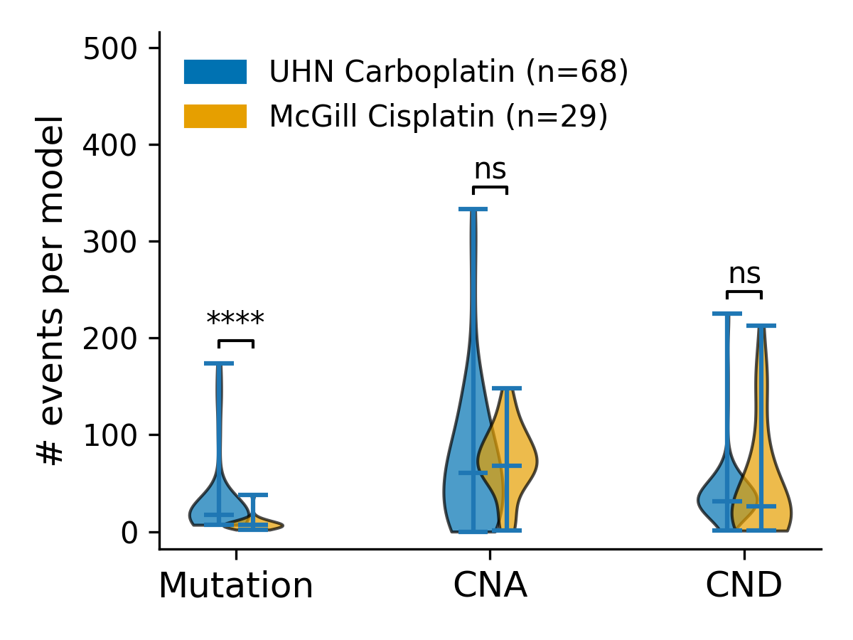
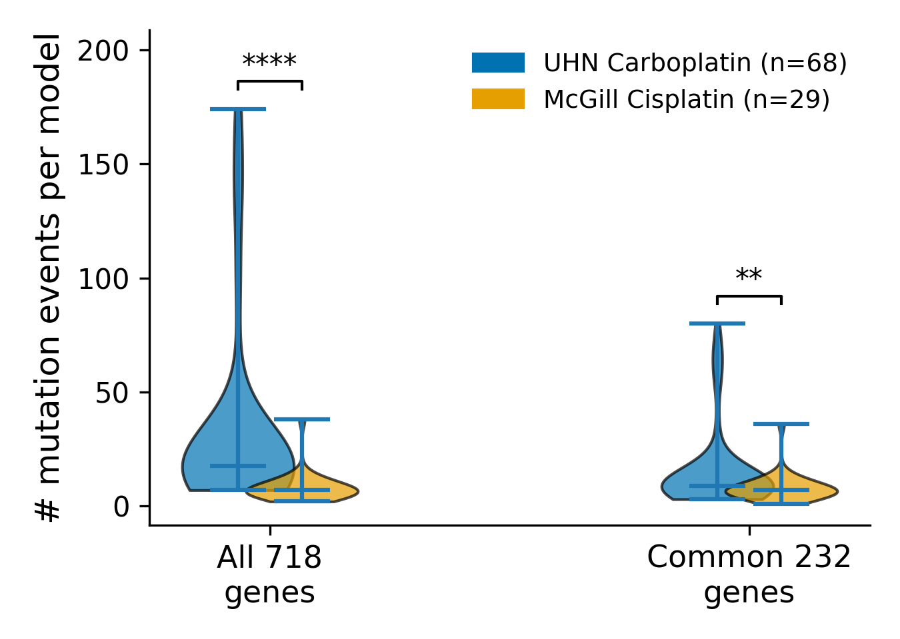
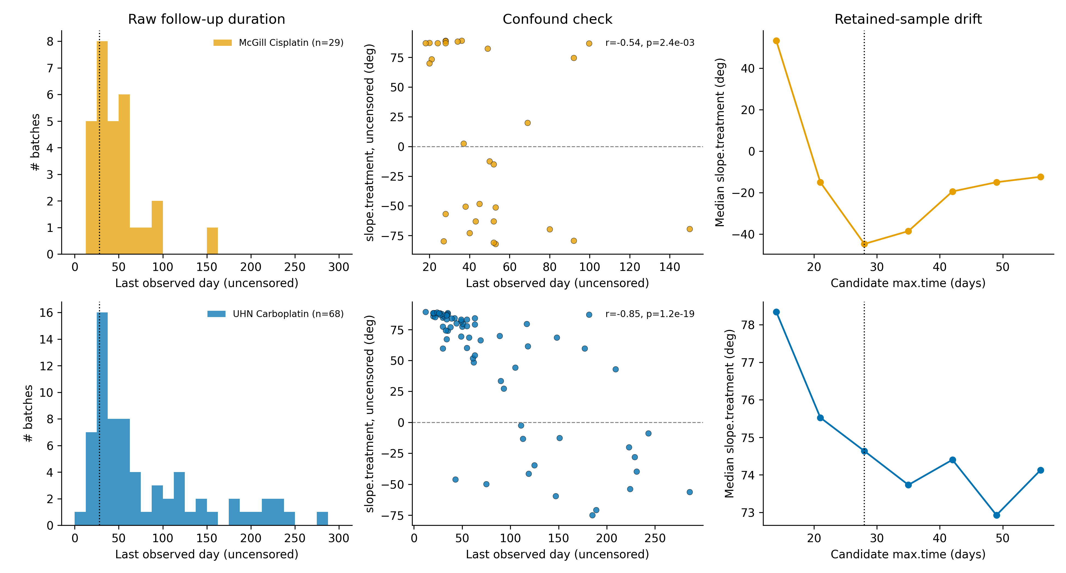
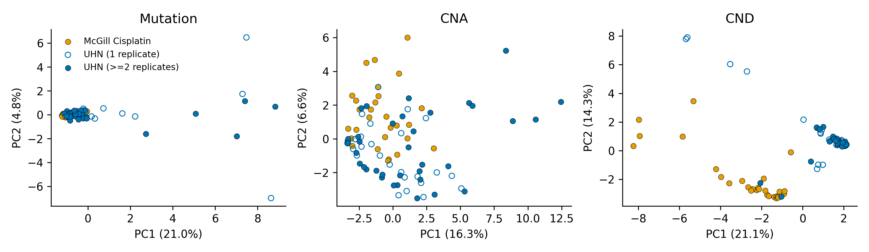
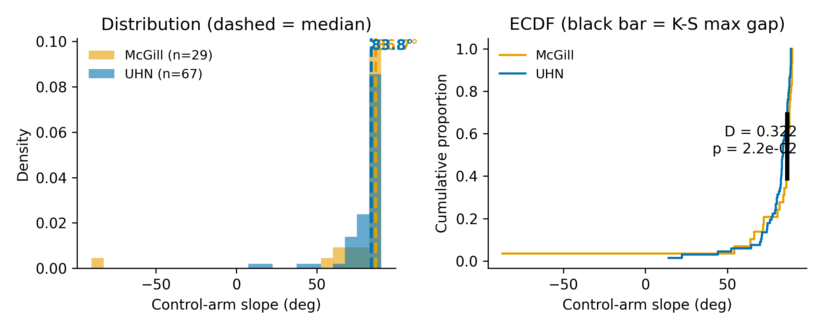
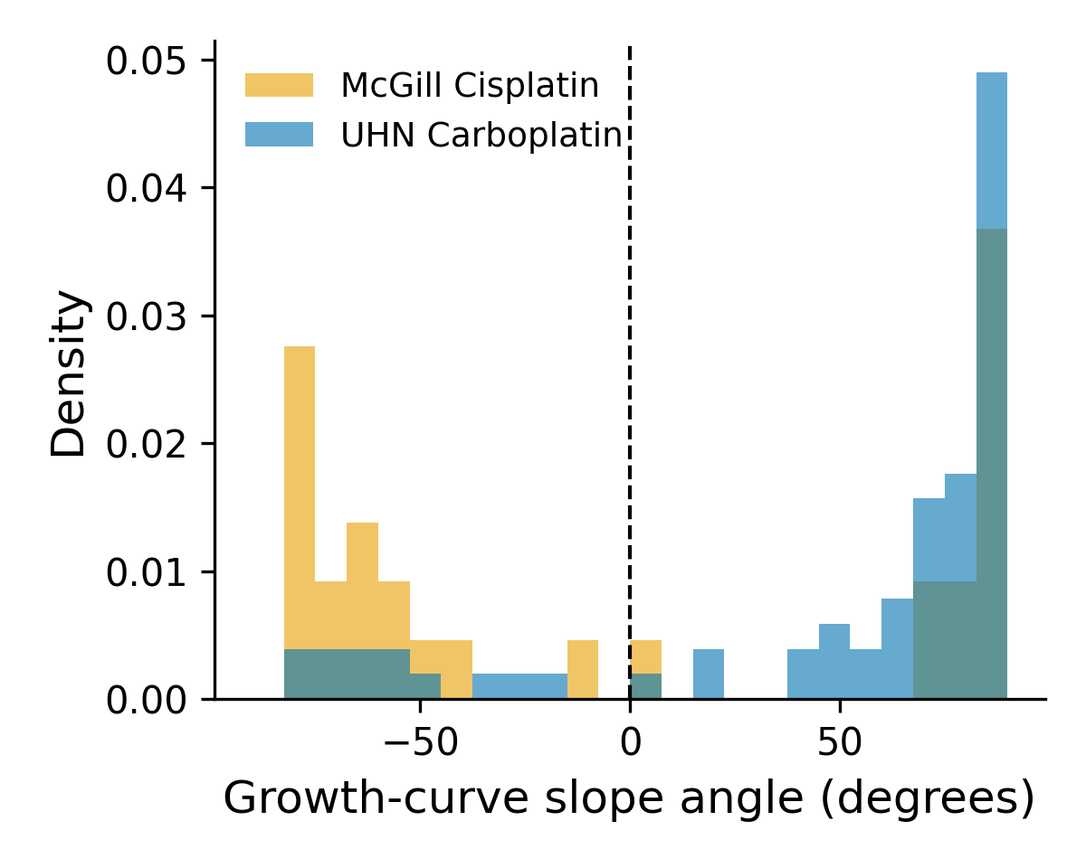
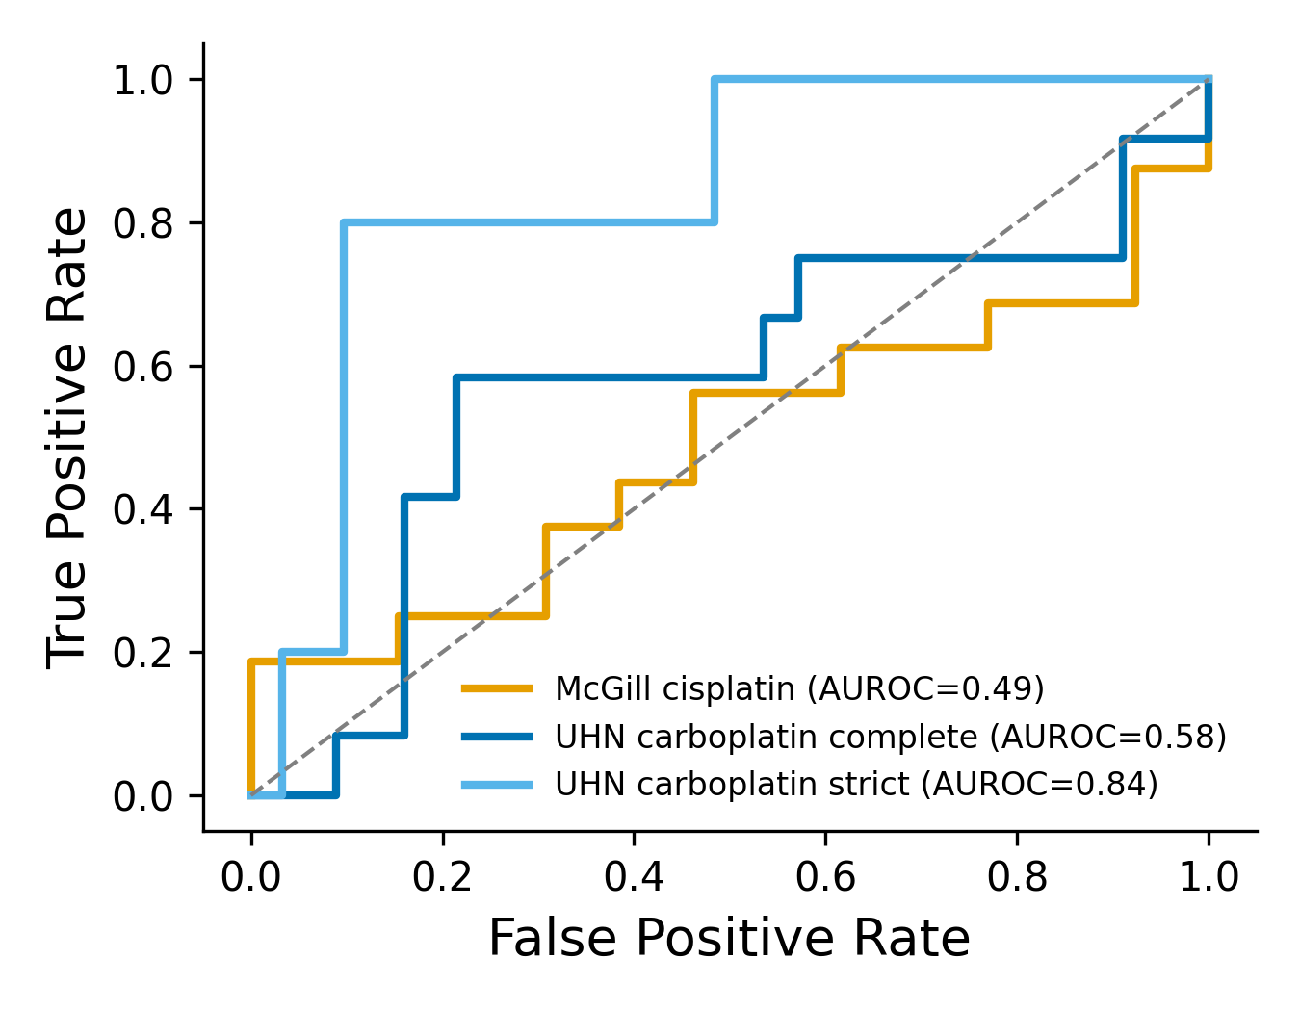
a
b
c
d
e
f

Slide 6
Supplemental Figure 3. Cohort-comparability and robustness analyses for NeST-VNN cross-cohort validation (case study 3).
(a) Per-model event burden across the full 718-gene NeST-VNN panel: number of mutation, copy-number-amplification (CNA), and copy-number-deletion (CND) events per model, UHN carboplatin vs. McGill cisplatin (left; two-sided Mann–Whitney U test; ****, p < 0.0001; ns, not significant). Right, sensitivity check for the Mutation comparison: the same test repeated on only the 232 genes with recorded mutation data in both cohorts, alongside the original all-718-gene comparison (****, p = 3.8×10⁻¹¹; **, p = 4.2×10⁻³) — the cohort gene-coverage gap (Fig. 4c) inflates the difference but does not fully explain it. (b) For the McGill cisplatin (top) and UHN carboplatin (bottom) cohorts: distribution of raw, uncensored treatment-arm follow-up duration per batch (left); correlation between the uncensored treatment-arm slope and follow-up duration (two-sided Spearman r annotated; middle); and drift in median treatment-arm slope as a function of the candidate response-window cutoff, max.time (right). Dotted line, the 28-day cutoff used in the primary analysis. (c) Principal component analysis (PC1 vs. PC2) of binarized mutation, copy-number-amplification (CNA), and copy-number-deletion (CND) feature matrices, McGill cisplatin vs. UHN carboplatin (open circles, one replicate; filled circles, ≥2 replicates). (d) Control-arm growth-curve slope distribution (left) and empirical CDF with Kolmogorov–Smirnov statistic (right), McGill vs. UHN. (e) Treatment-arm growth-curve slope distribution, McGill cisplatin vs. UHN carboplatin; dashed line, the 0° growth/regression threshold used to define response in the primary analysis. (f) ROC curves for the pretrained 5-fold NeST-VNN ensemble (fold-averaged prediction) against sensitive/resistant status (slope.treatment < 0), per cohort; AUROC annotated per curve. Related to Fig. 4a–e.

Slide 7
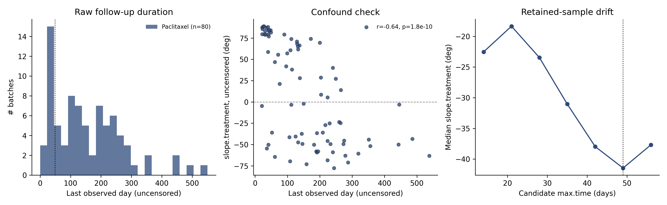
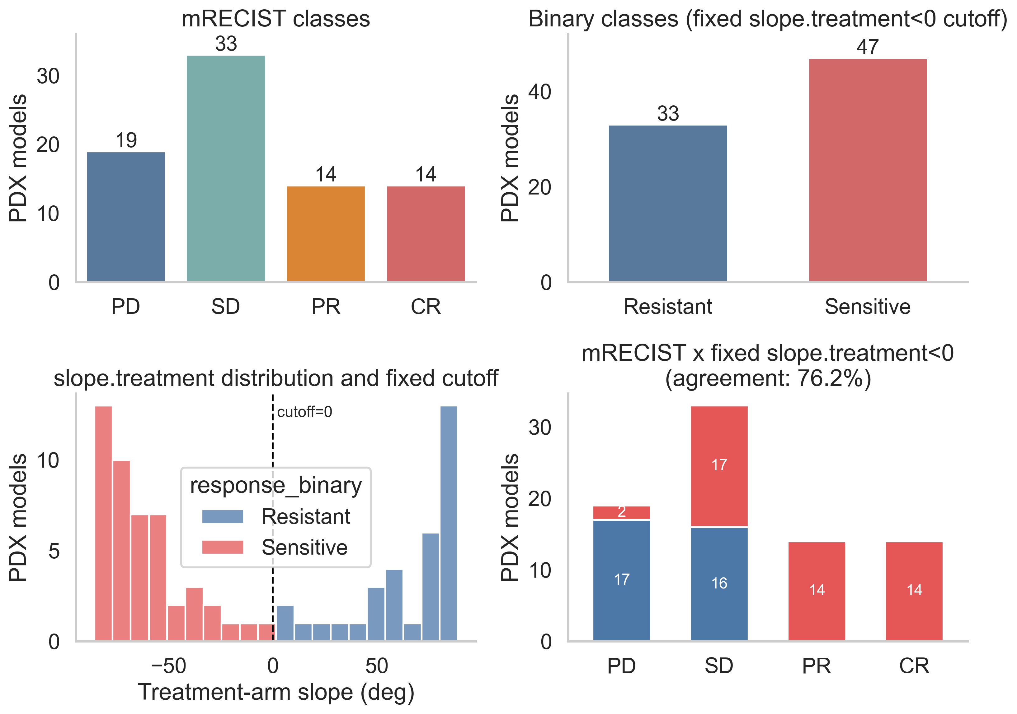
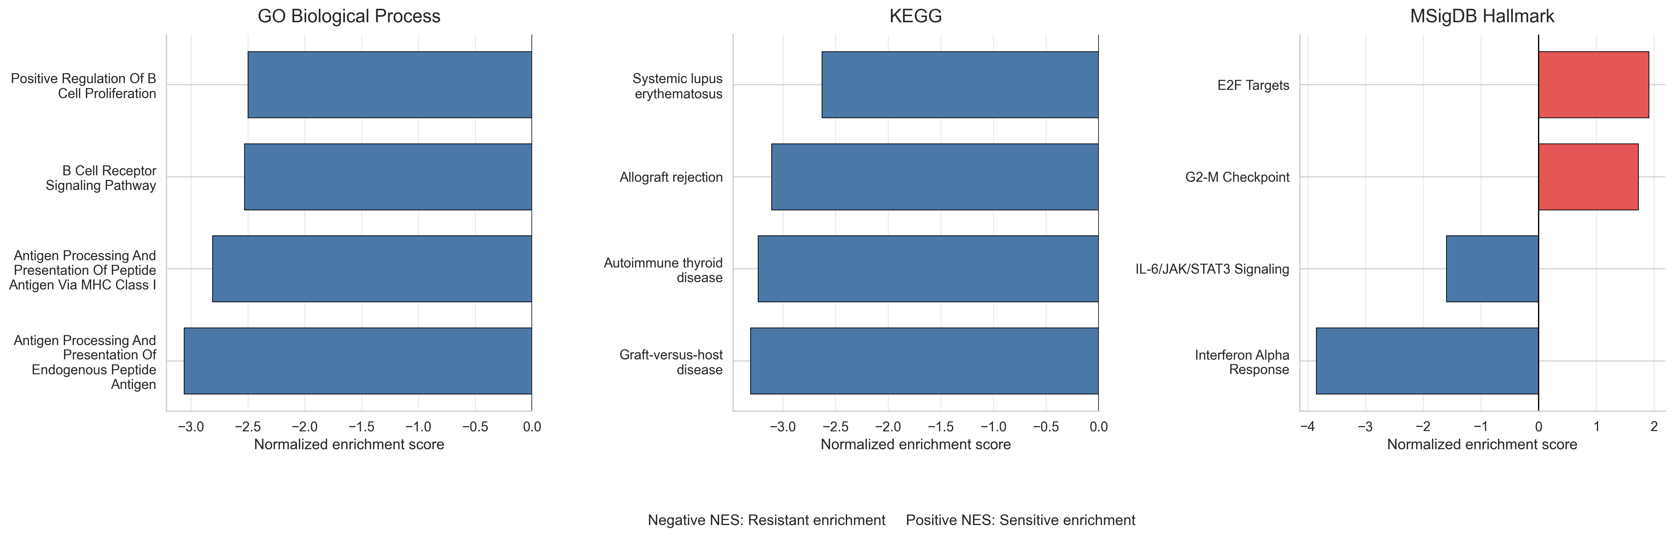
a
b
c
Supplemental Figure 4. Follow-up window selection and full pathway-enrichment detail for the paclitaxel case study (case study 4).
(a) Justification for the max.time = 49-day follow-up window used to compute slope.treatment. Left, distribution of raw (uncensored) last-observed day across the 80 paclitaxel batches; dotted line marks the chosen max.time = 49-day cutoff. Middle, uncensored slope.treatment vs. last-observed day, showing a significant negative correlation (r = −0.64, p = 1.8×10⁻¹⁰) — batches followed longer trend toward more negative (regressing) slopes, so an uncapped follow-up window confounds duration with apparent response. Right, median slope.treatment among the retained sample as a function of candidate max.time cutoffs (14–56 days, the same sweep range used in case study 3); the deepest point (most negative median) occurs at day 49 (dotted line), the value chosen for the analysis. (b) Definition of the binary response endpoint used for classification. Left, number of PDX models called Resistant vs. Sensitive under the fixed slope.treatment < 0° cutoff (n = 33 vs. 47). Middle, distribution of treatment-arm slope colored by the resulting binary call; dashed line, the 0° cutoff — the two groups separate by construction, since the label is defined directly from this threshold. Right, cross-tabulation against the categorical mRECIST call (PD/SD/PR/CR; PD and SD collapsed to Resistant, PR and CR to Sensitive for comparison); the two response definitions agree for 76.2% of models (61/80). (c) GSEA results against GO Biological Process, KEGG, and MSigDB Hallmark gene sets, ranked by limma moderated t-statistics (Sensitive vs. Resistant, fixed slope.treatment<0 cutoff, full rna_all transcriptome). Positive NES: enriched in Sensitive models; negative NES: enriched in Resistant models (FDR q < 0.05) .

