Slide 1
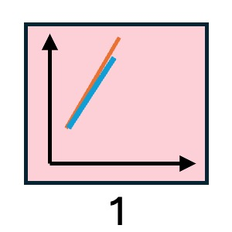
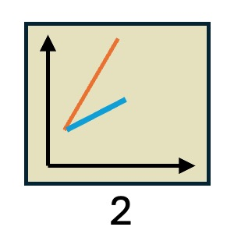
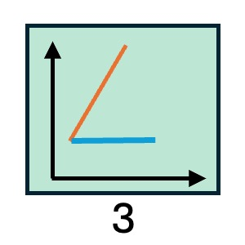
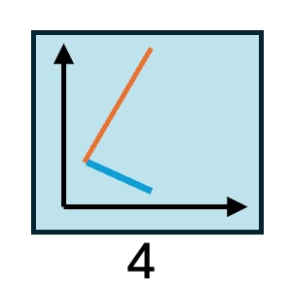
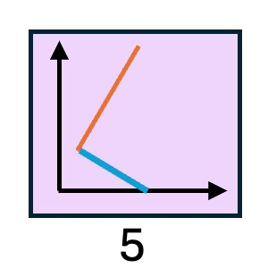
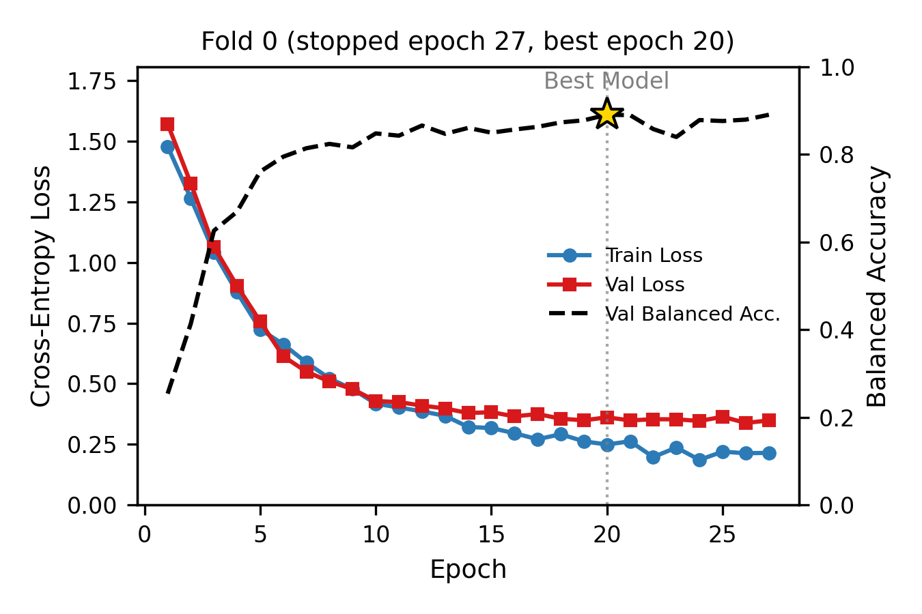
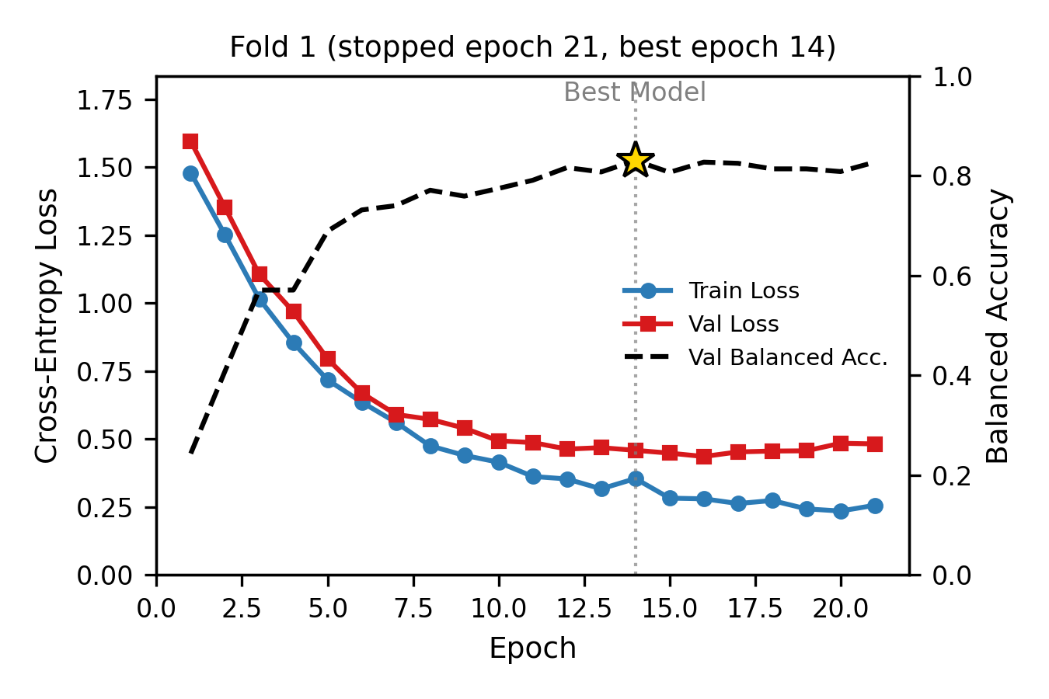
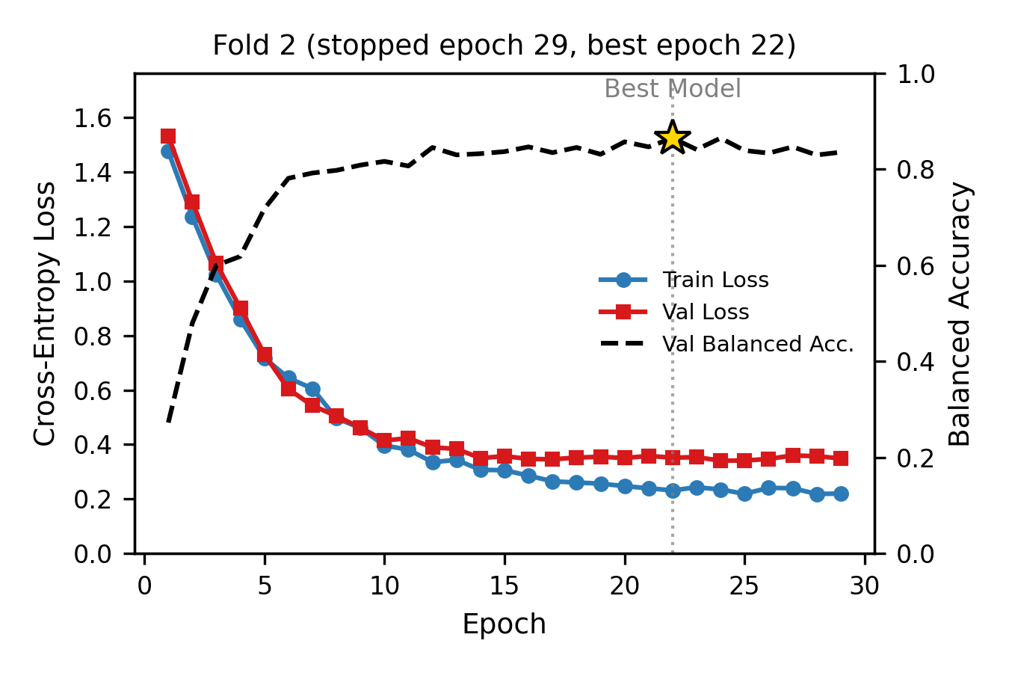
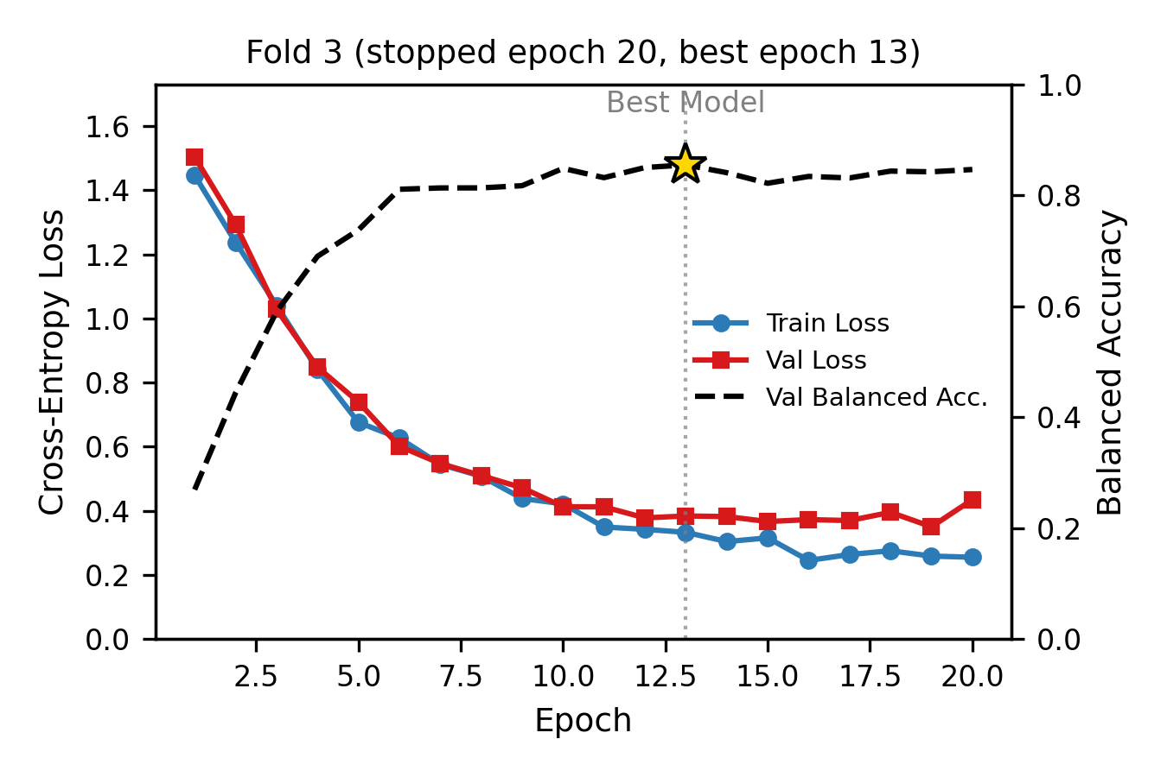
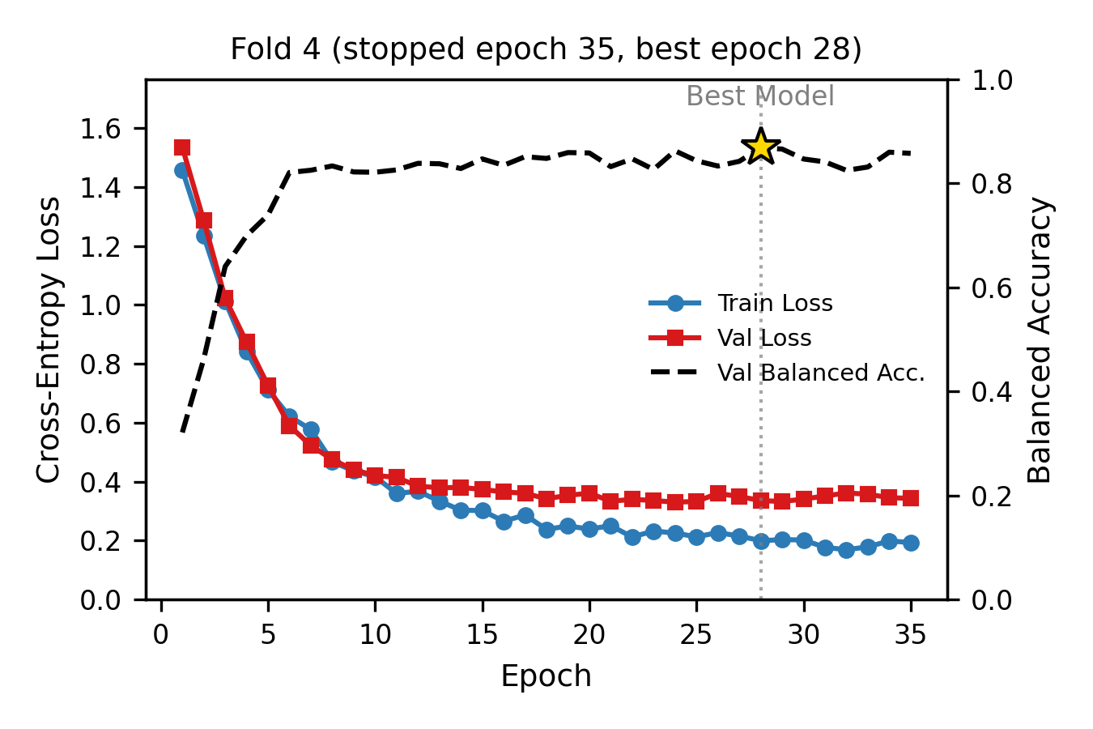
a
Drug sensitivity categorization criteria provided to panel of experts
    Category 1: tumour growth similar to control.
    Category 2: tumour growth is inhibited compared to control, but tumour is still enlarging compared to time 0.
    Category 3: tumour growth is inhibited compared to control, and tumour volume stays stable.
    Category 4: tumour growth is inhibited compared to control, and tumour volume is shrinking.
    Category 5: tumour growth is inhibited compared to control, and tumour disappeared during treatment.
b

