Slide 1
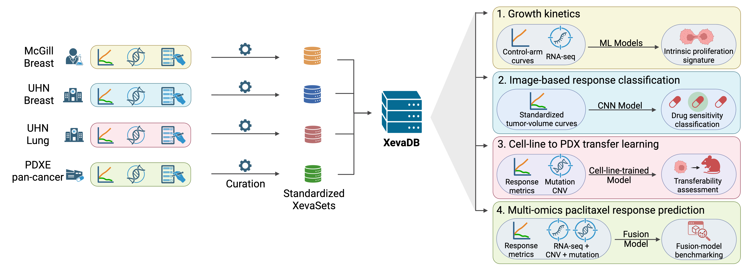
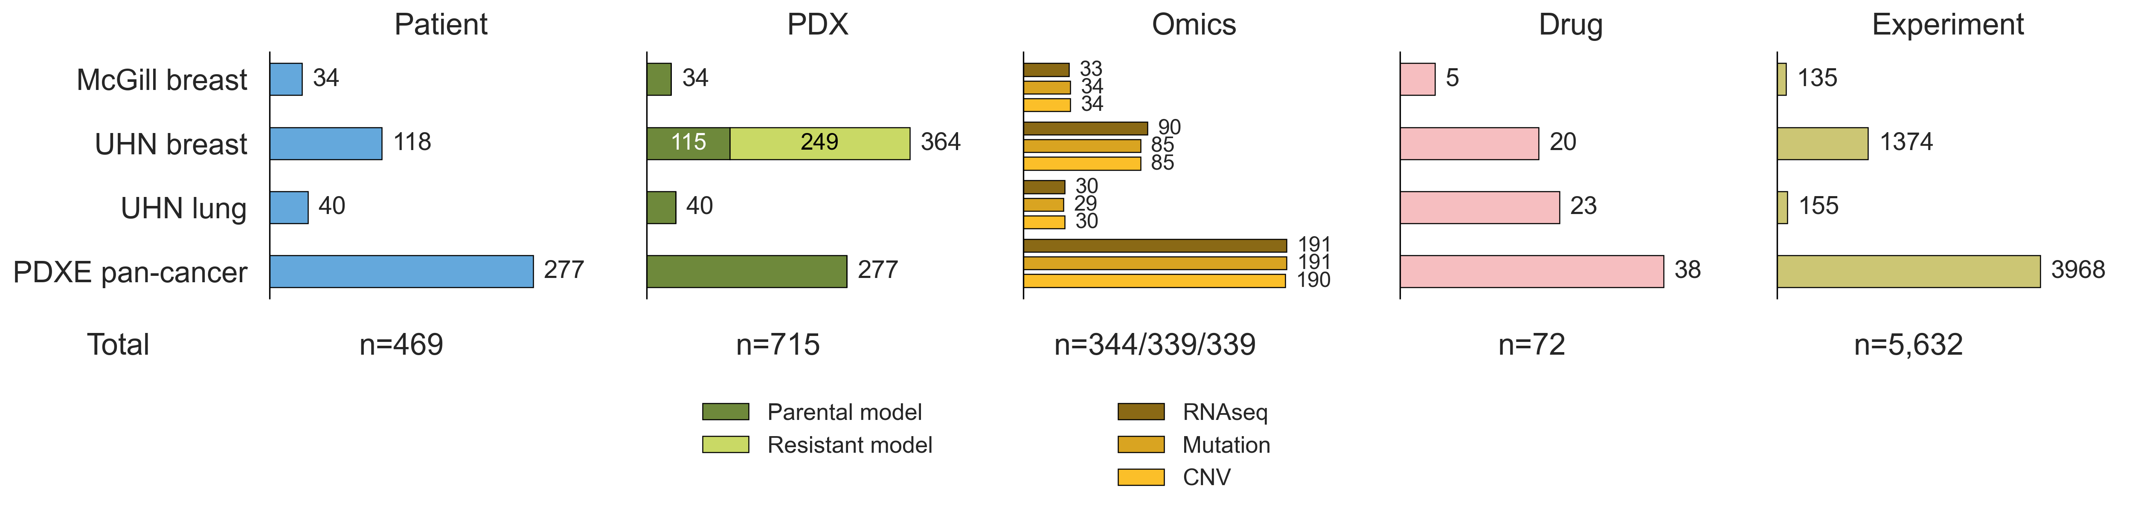
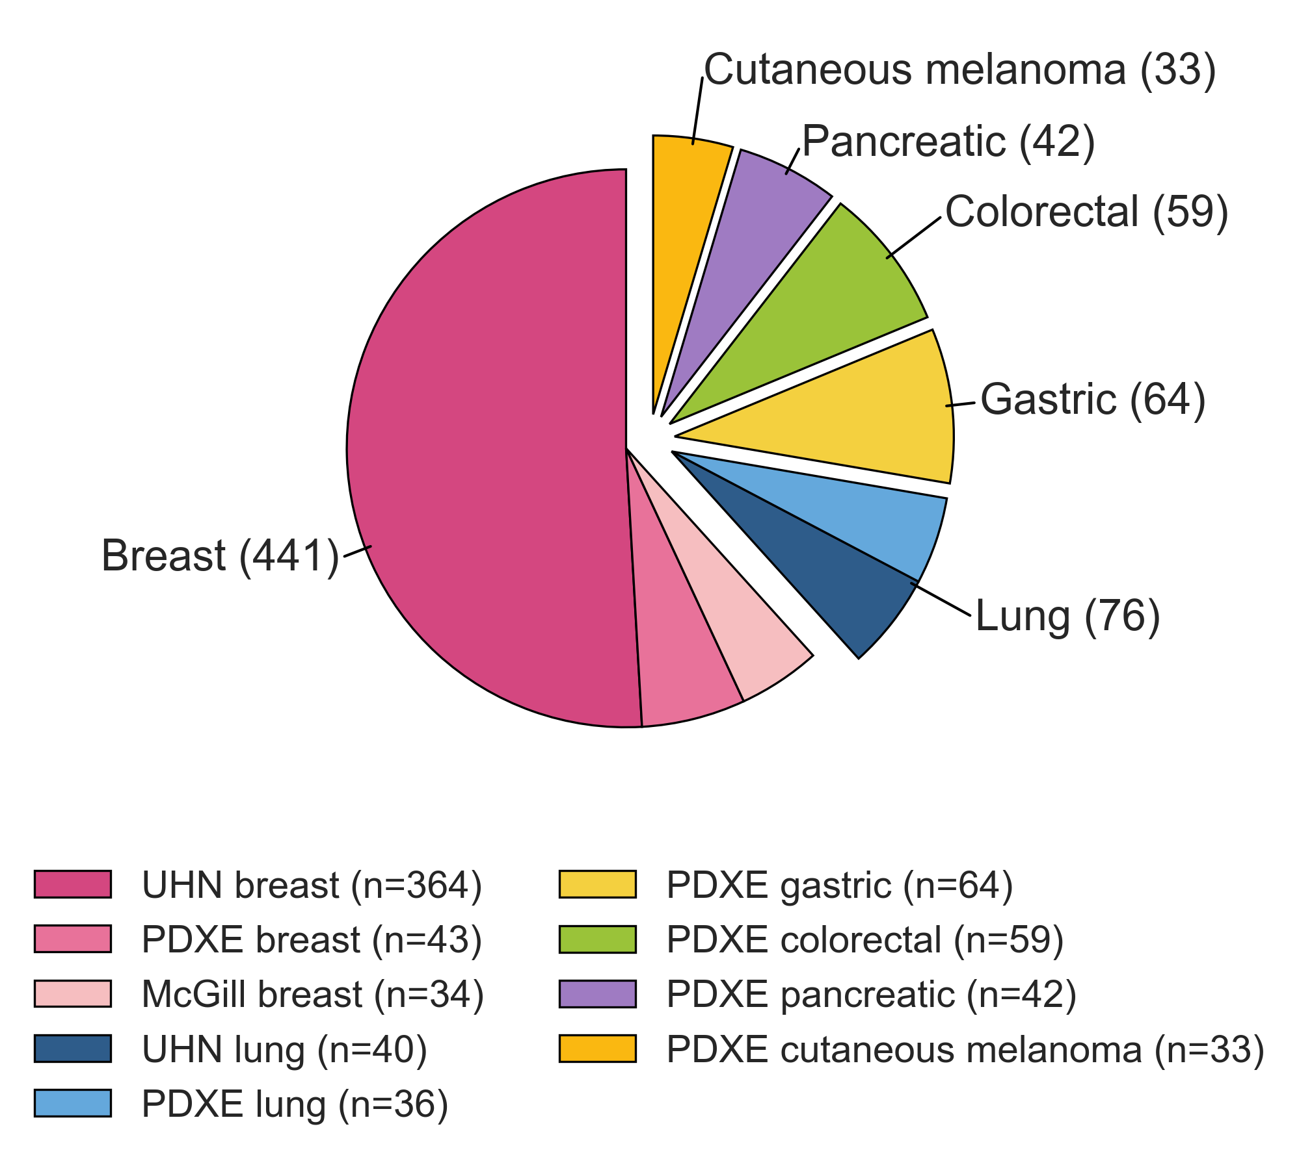
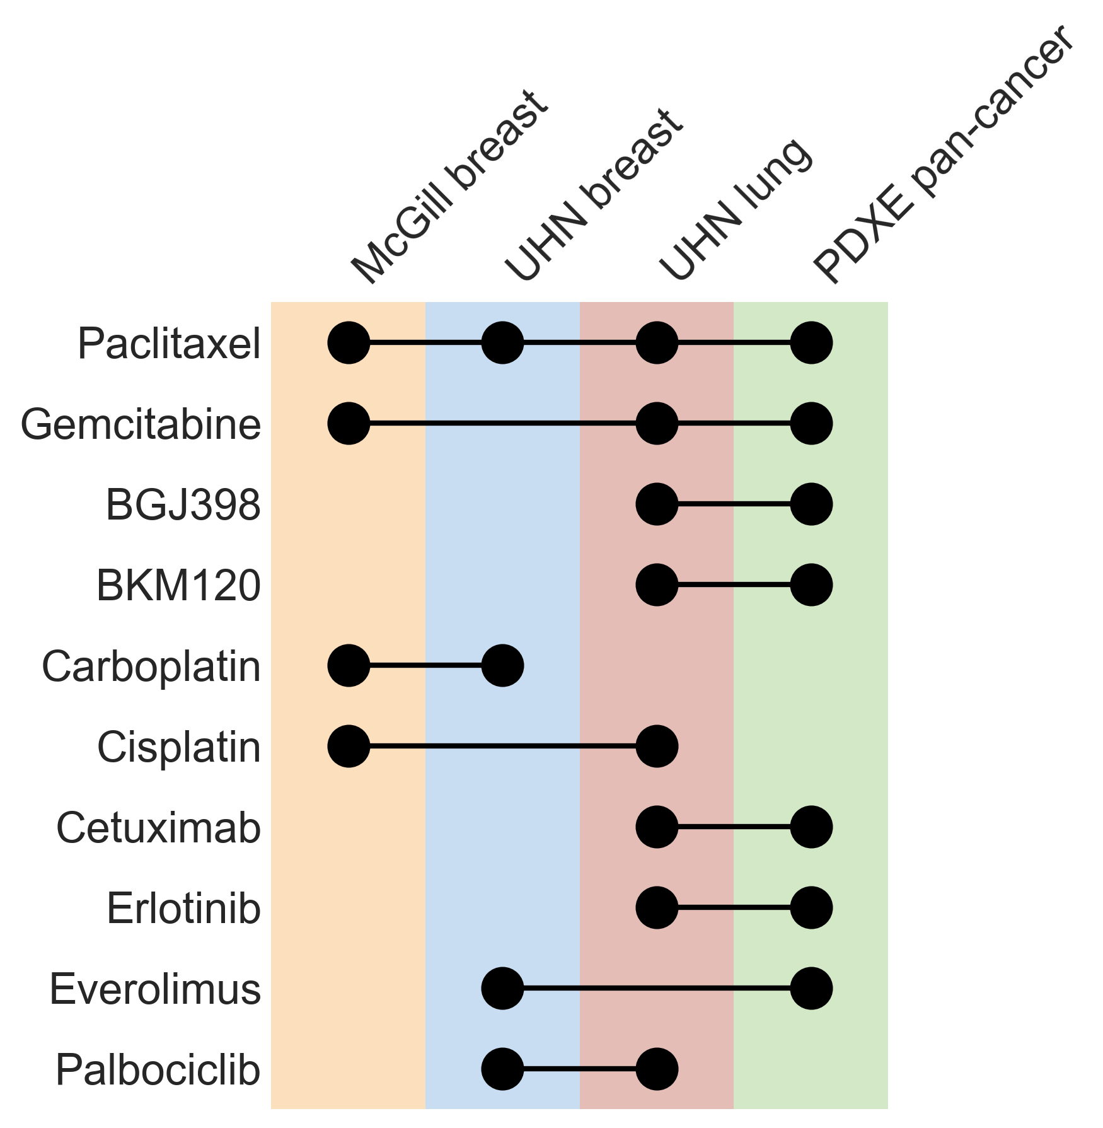
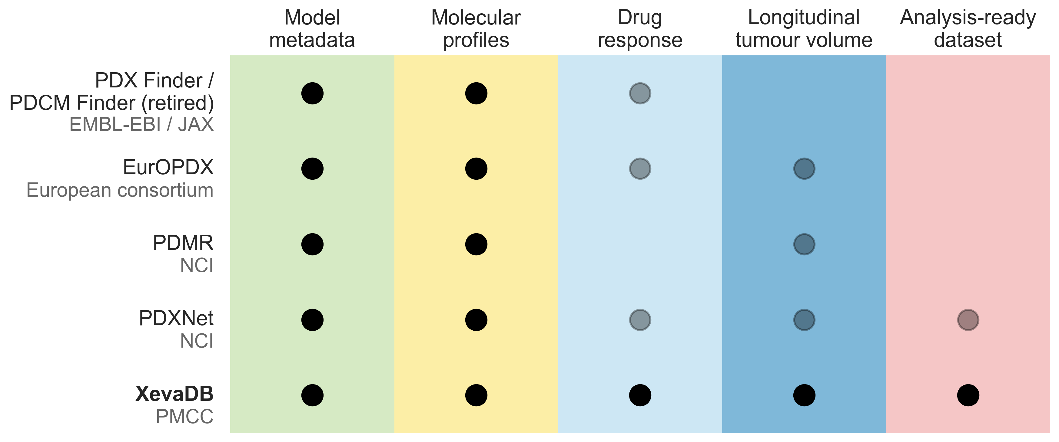
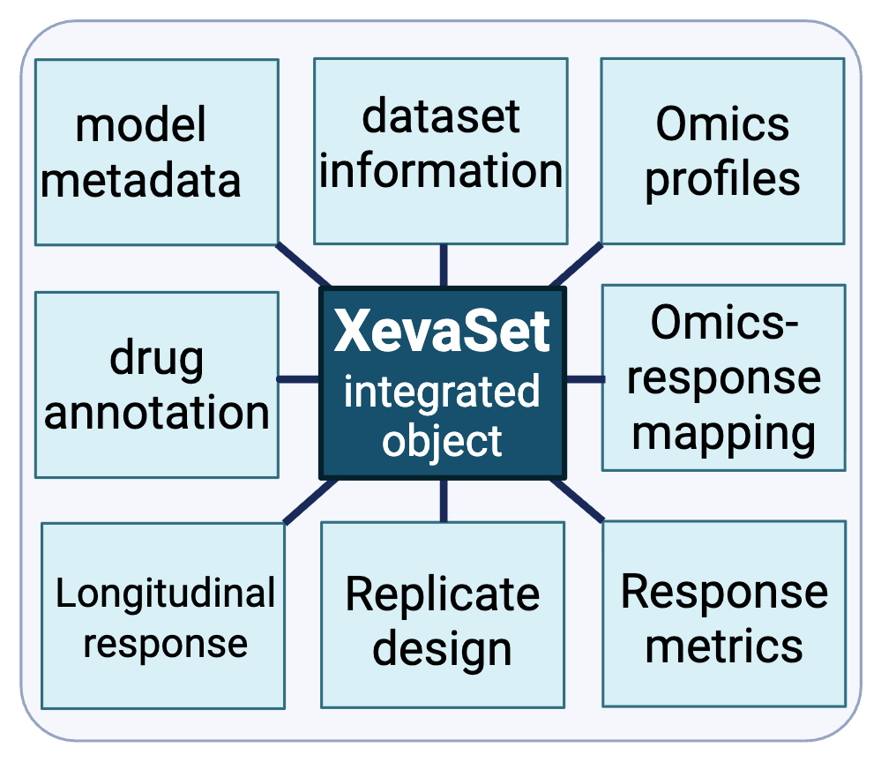
a
b
c
d
e
f

Slide 2
Figure 1. Overview of XevaDB, a standardized longitudinal PDX pharmacogenomic resource.
(a) Comparison of XevaDB with four existing PDX-related resources — PDX Finder/PDCM Finder (retired), EurOPDX, PDMR, and PDXNet — across five data-availability capabilities: model metadata, molecular profiles, drug response, longitudinal tumour volume, and analysis-ready dataset. Solid dots indicate full availability, semi-transparent dots indicate limited/partial availability, and the absence of a dot indicates the capability is not available. The organization or consortium responsible for each resource is shown below its name (EMBL-EBI, European Molecular Biology Laboratory–European Bioinformatics Institute; JAX, The Jackson Laboratory; NCI, National Cancer Institute; PMCC, Princess Margaret Cancer Centre). (b) XevaDB's internal data architecture. The XevaSet integrated object unifies model metadata, dataset information, omics profiles, drug annotation, omics-response mapping, longitudinal response, replicate design, and response metrics within a single standardized structure. (c) Data curation and analysis pipeline. Raw longitudinal response, omics, and clinical metadata from four source cohorts (McGill Breast, UHN Breast, UHN Lung, PDXE pan-cancer) are curated into standardized XevaSets and integrated into XevaDB, which supports four downstream case studies: (1) growth-kinetics modeling from control-arm curves and RNA-seq, (2) image-based drug-response classification from standardized tumour-volume curves, (3) cell-line-to-PDX transfer learning using response metrics and mutation/CNV data, and (4) multi-omics prediction of paclitaxel response. (d) Summary counts across the four cohorts for patients (n=469), PDX models (n=715; parental and resistant models shown separately), matched omics profiles (RNA-seq/mutation/CNV; n=344/339/339), drugs (n=72), and treatment-control experiments (n=5,632). (e) Distribution of PDX models by cancer type (n=715 total across six tumour types), with each wedge group further broken down by contributing dataset (shown in the legend); slice groups are radially separated to indicate cancer type. (f) Drugs shared across more than one dataset (10 of 72 total drugs), shown as a dot-matrix across the four cohorts; connected dots indicate the same drug tested in multiple datasets.

Slide 3
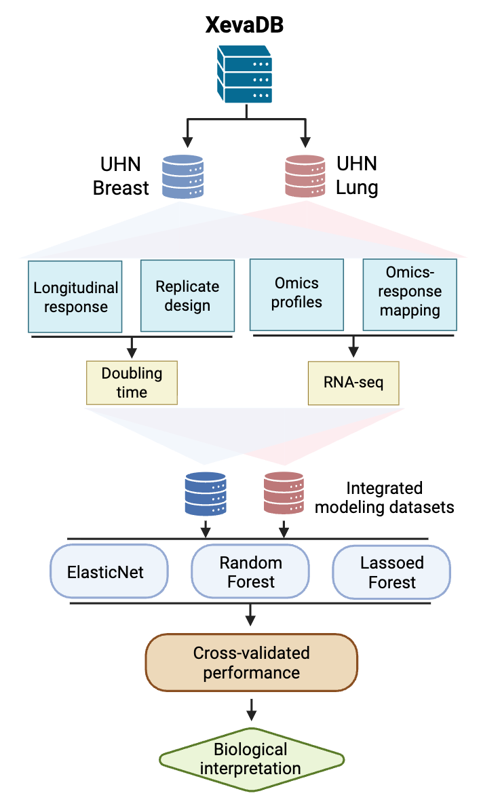
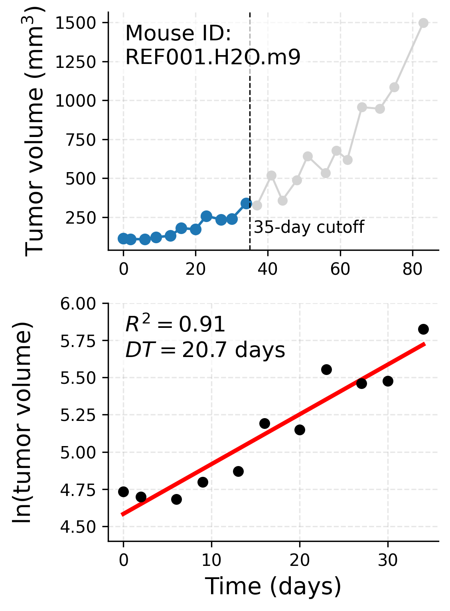
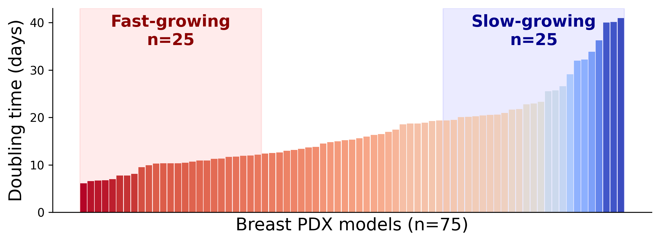
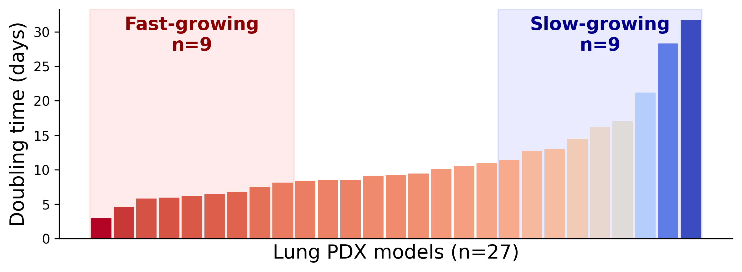
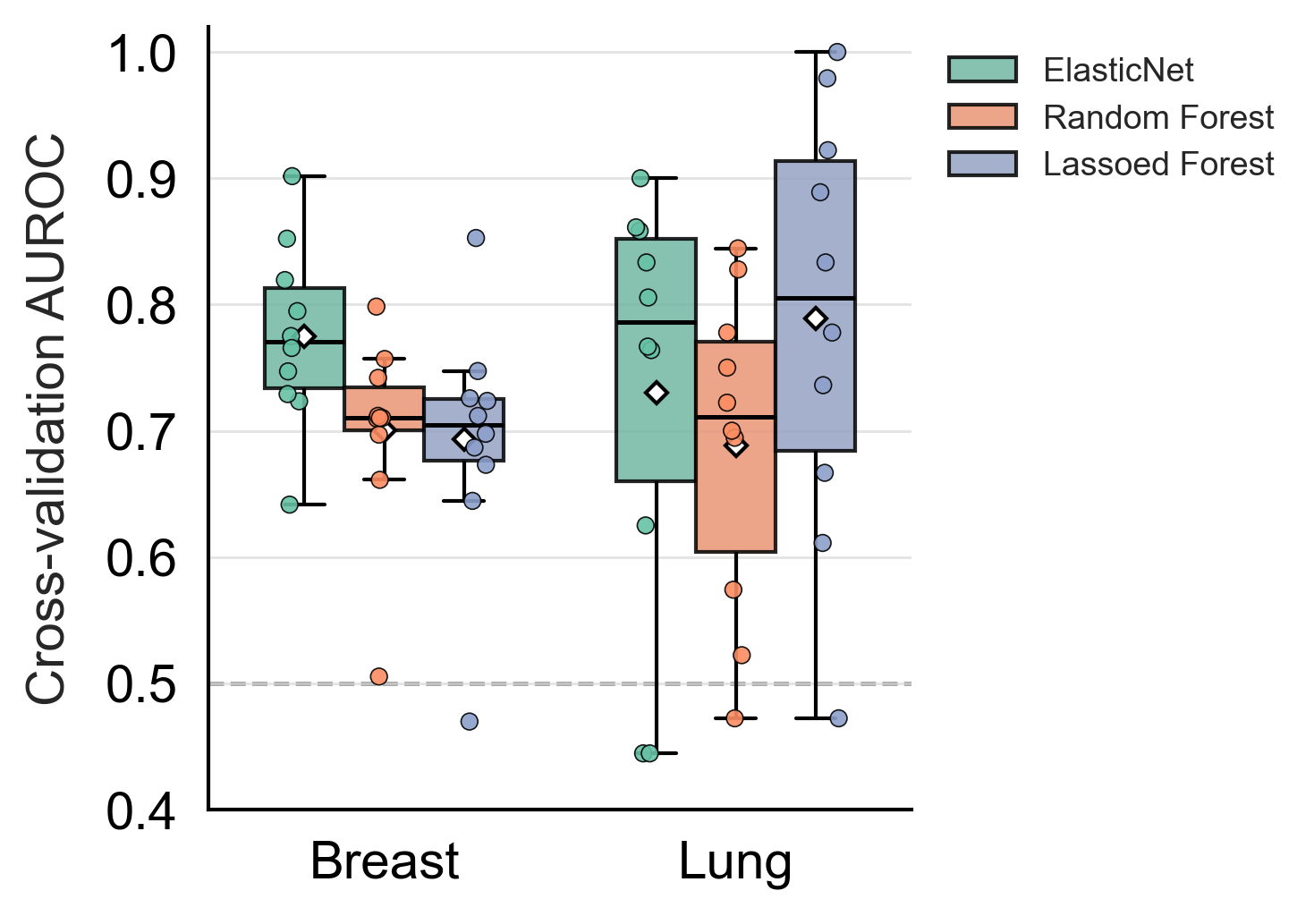
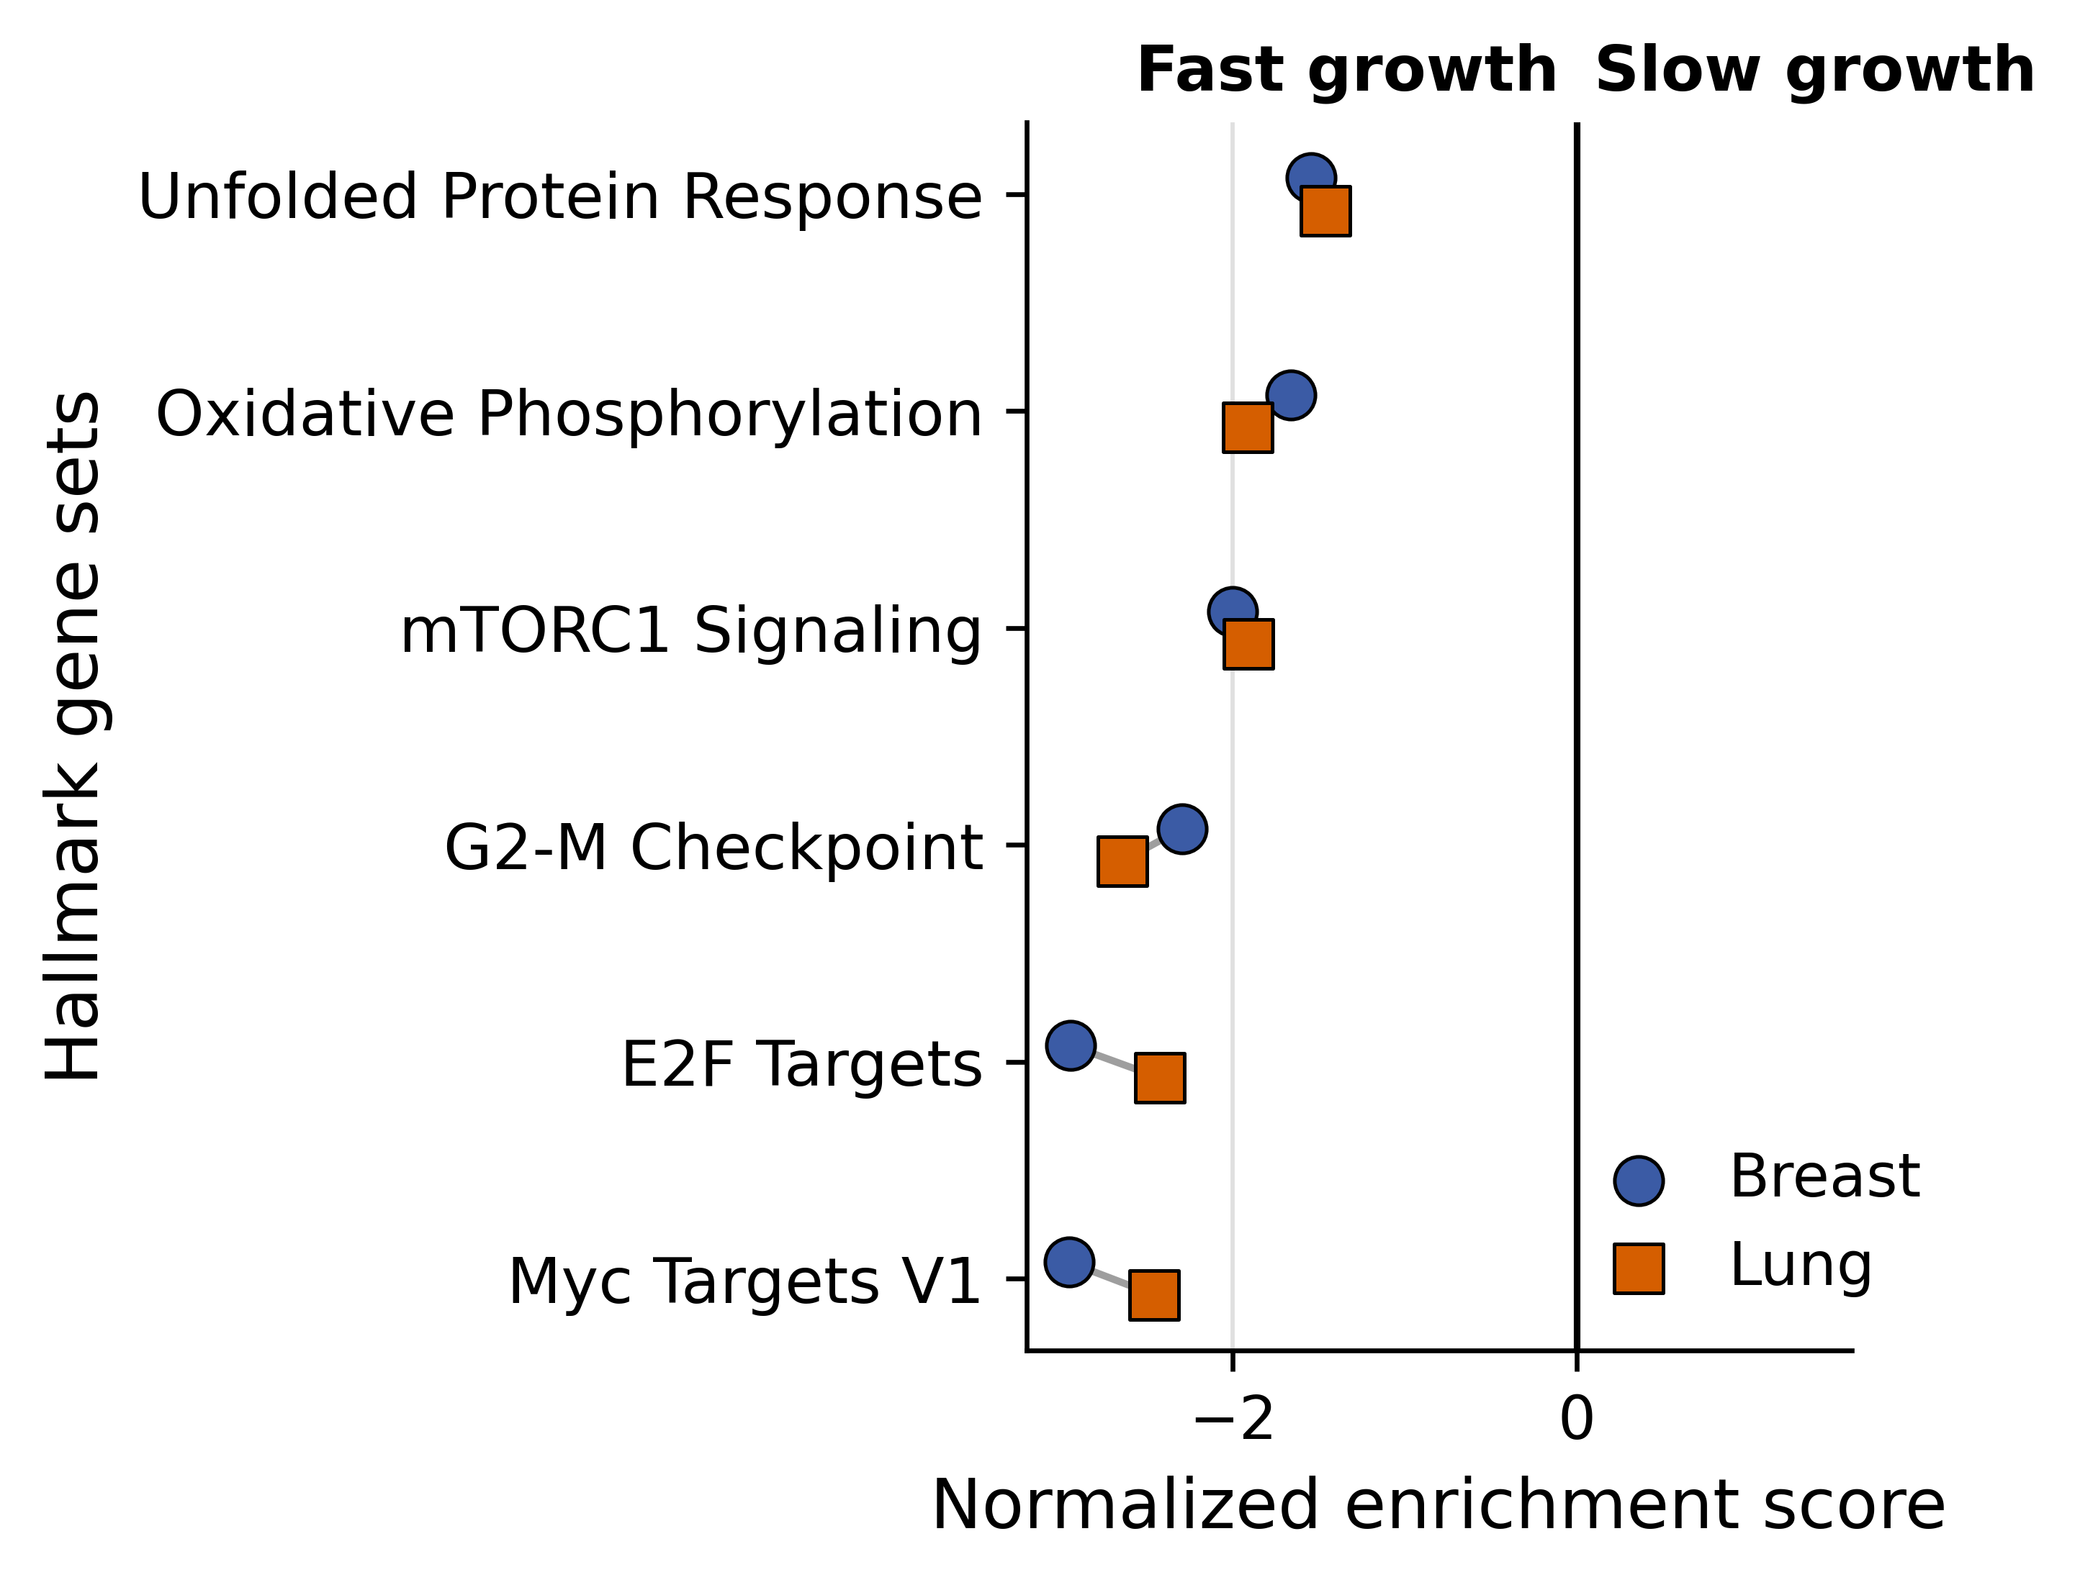
a
b
c
d
e
Figure 2. Transcriptomic modeling of intrinsic PDX growth kinetics.
(a) Case study one workflow: control-arm longitudinal tumour-volume curves and matched RNA-seq from breast and lung PDX cohorts are used to estimate model-level doubling time, modeled by ElasticNet, Random Forest, and Lassoed Forest classifiers under repeated cross-validation. (b) Representative doubling-time estimation for one control-arm mouse (REF001.H2O.m9): raw tumour-volume trajectory (top; points within the 35-day fitting window in blue, excluded points in gray) and the corresponding exponential-growth fit (ln(tumour volume) vs. time, bottom), with goodness-of-fit (R² = 0.91) and doubling time (DT = 20.7 days) annotated. (c) Distribution of estimated doubling times across breast (n = 75) and lung (n = 27) PDX models (intetrated modeling datasets shown in a), with the fastest- and slowest-growing tertiles used to define the classification task highlighted (breast: n = 25/25; lung: n = 9/9). (d) Cross-validated AUROC of ElasticNet, Random Forest, and Lassoed Forest classifiers distinguishing fast- from slow-growing models, breast and lung; dashed line, chance performance. (e) Cross-cohort comparison of Hallmark gene-set enrichment (GSEA NES) associated with fast- vs. slow-growing tumours in the breast and lung cohorts.

Slide 4
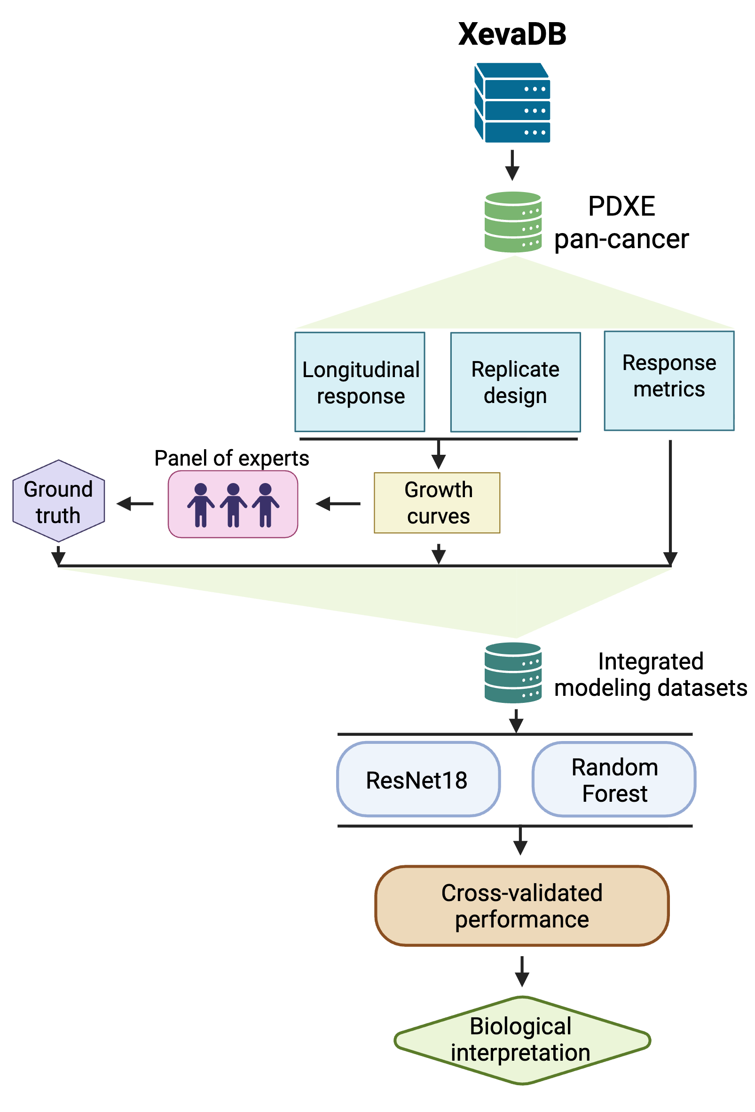
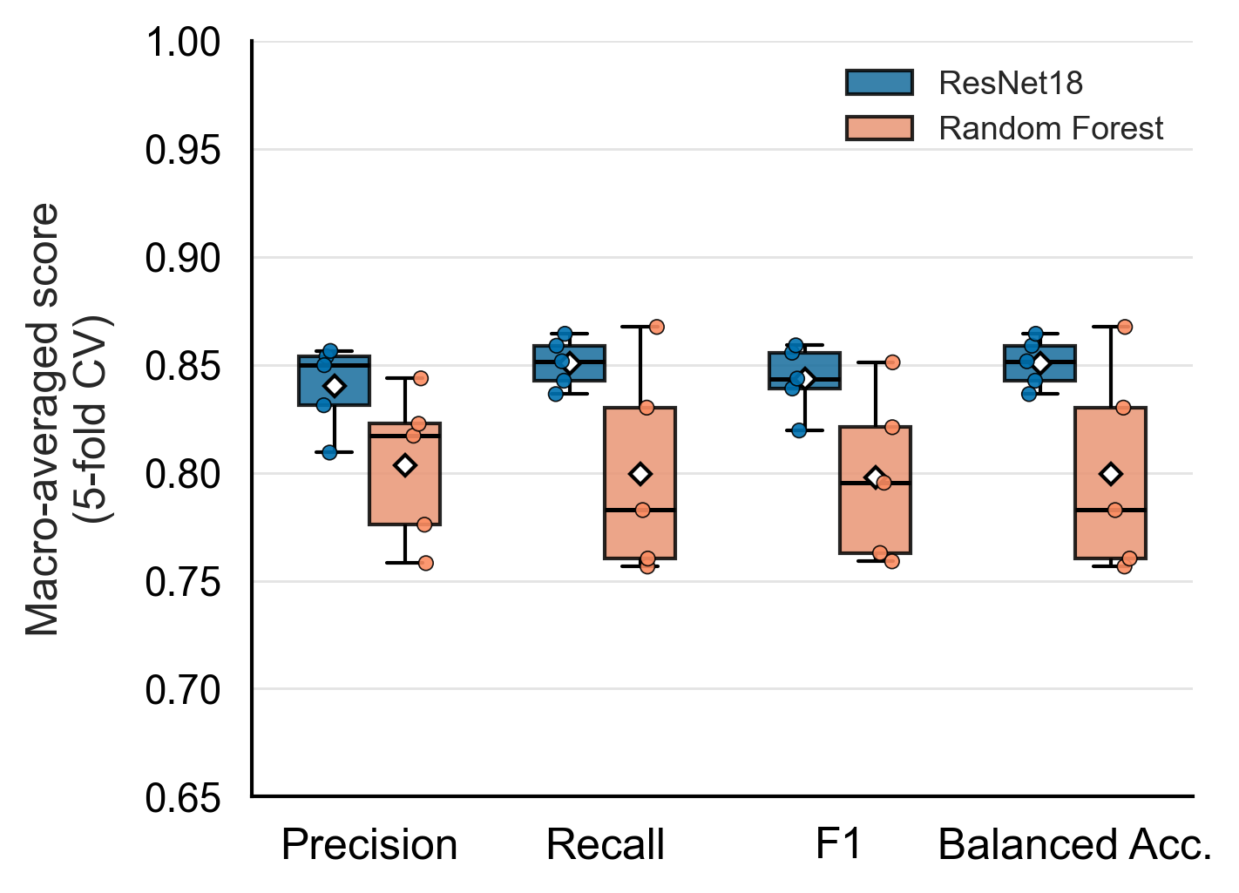
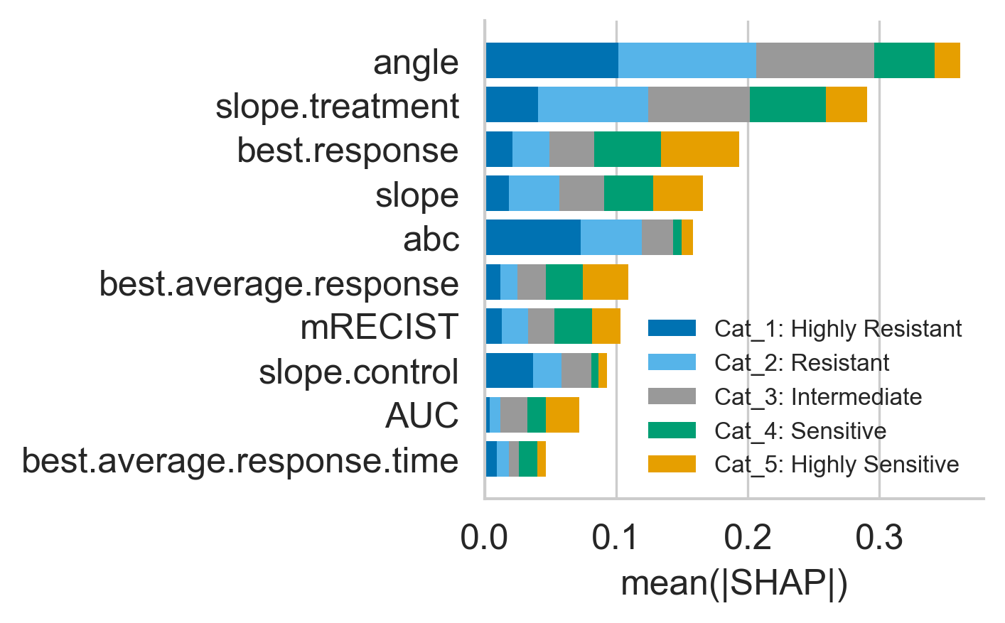
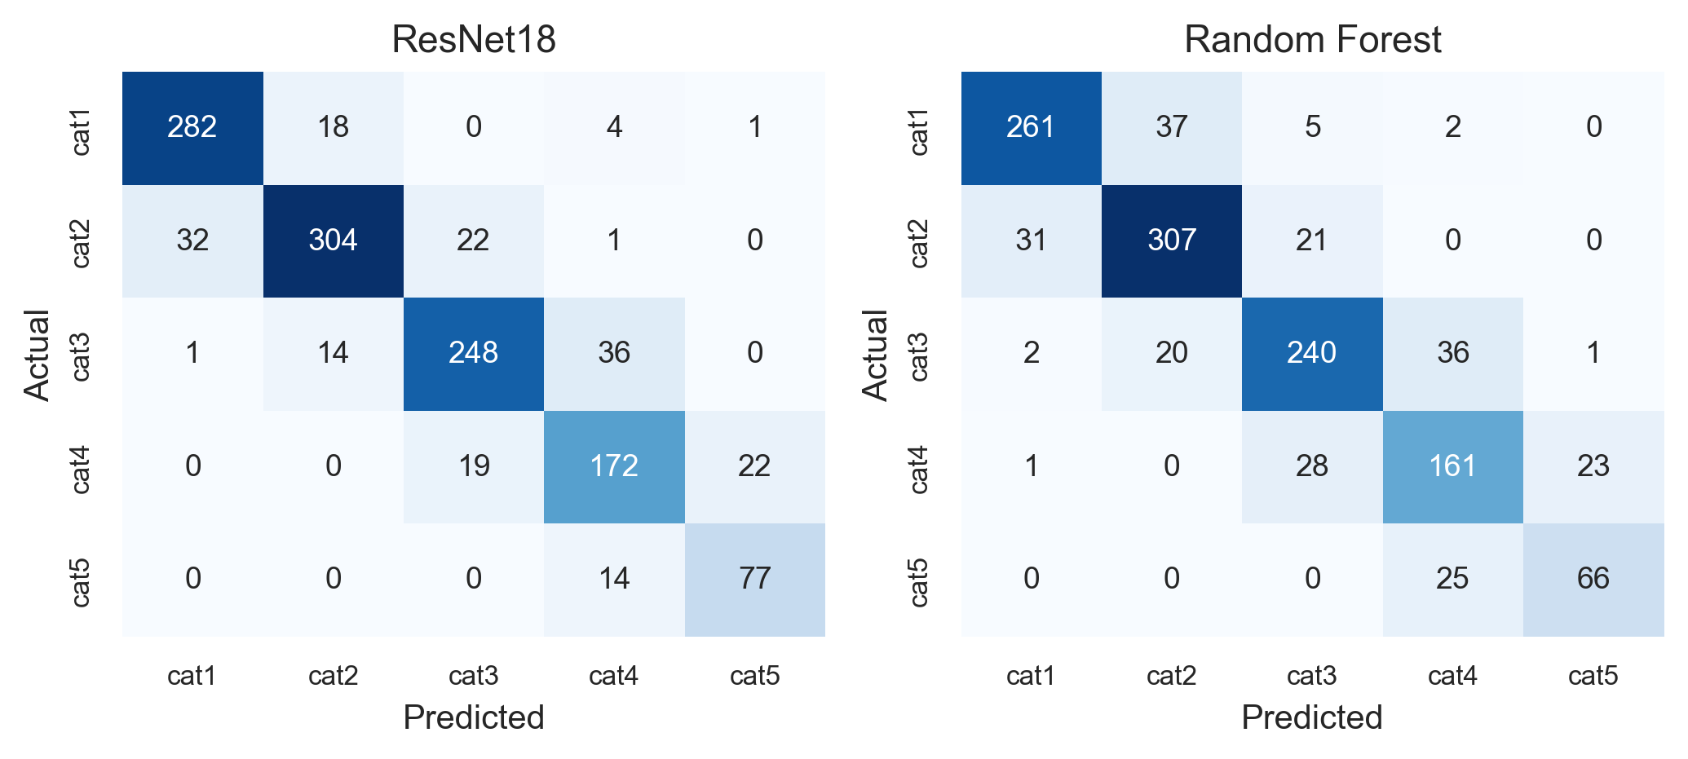
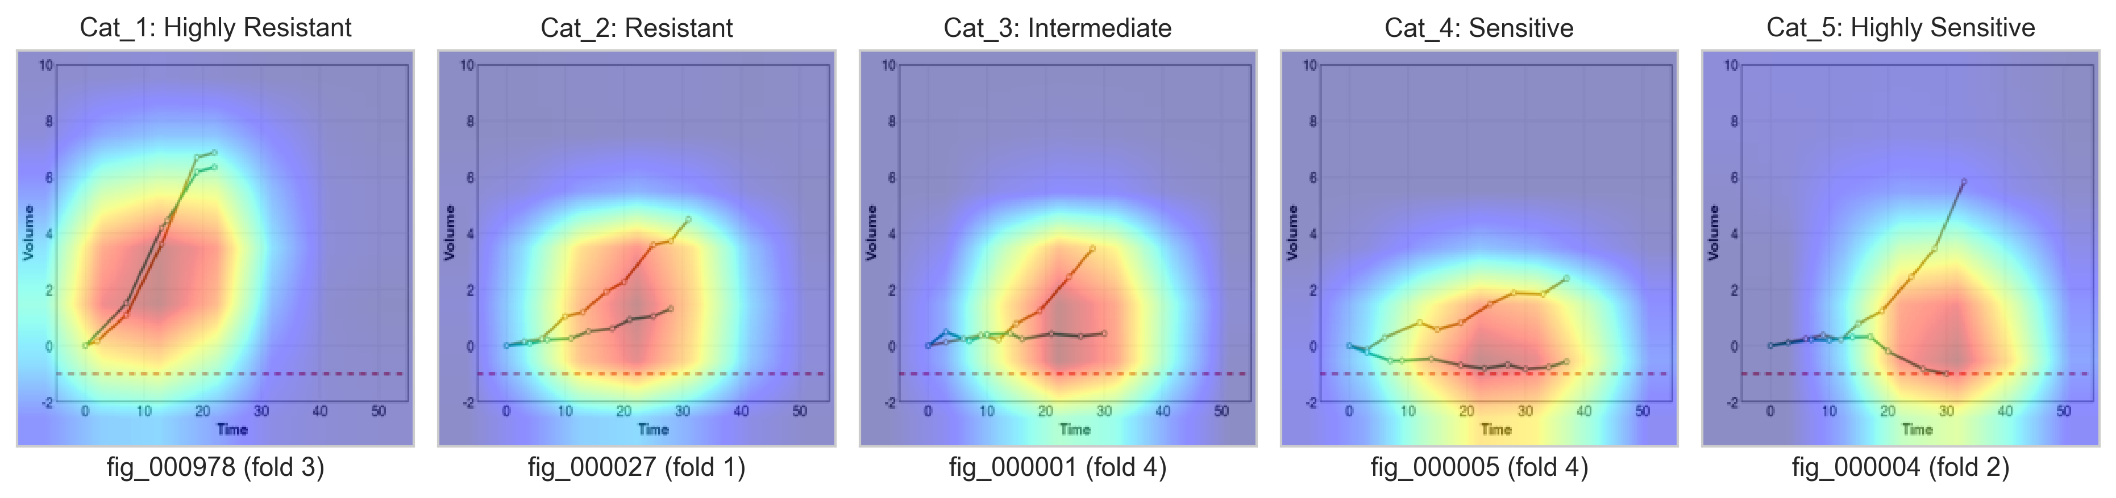
a
b
c
d
e
Figure 3. Image-based deep learning captures non-linear drug-response dynamics.
(a) Case study two workflow: tumour-volume growth curves for model-drug batches from the PDXE pan-cancer cohort are rendered as standardized images, scored by a three-rater expert panel into five ordinal response categories, and used to train and compare an image-based ResNet18 classifier against a feature-based Random Forest classifier under matched 5-fold cross-validation. (b) Cross-validated performance (macro-averaged precision, recall, F1-score, and balanced accuracy) of ResNet18 versus Random Forest across 5 outer folds. (c) Random Forest feature importance (mean absolute SHAP value, stacked by response category) for the top 10 of thirteen engineered response features, ranked by total mean absolute SHAP across categories. (d) Pooled out-of-fold confusion matrices for ResNet18 and Random Forest across all 1,267 curves. (e) Representative Grad-CAM visualizations for one correctly classified, held-out example per response category.

Slide 5
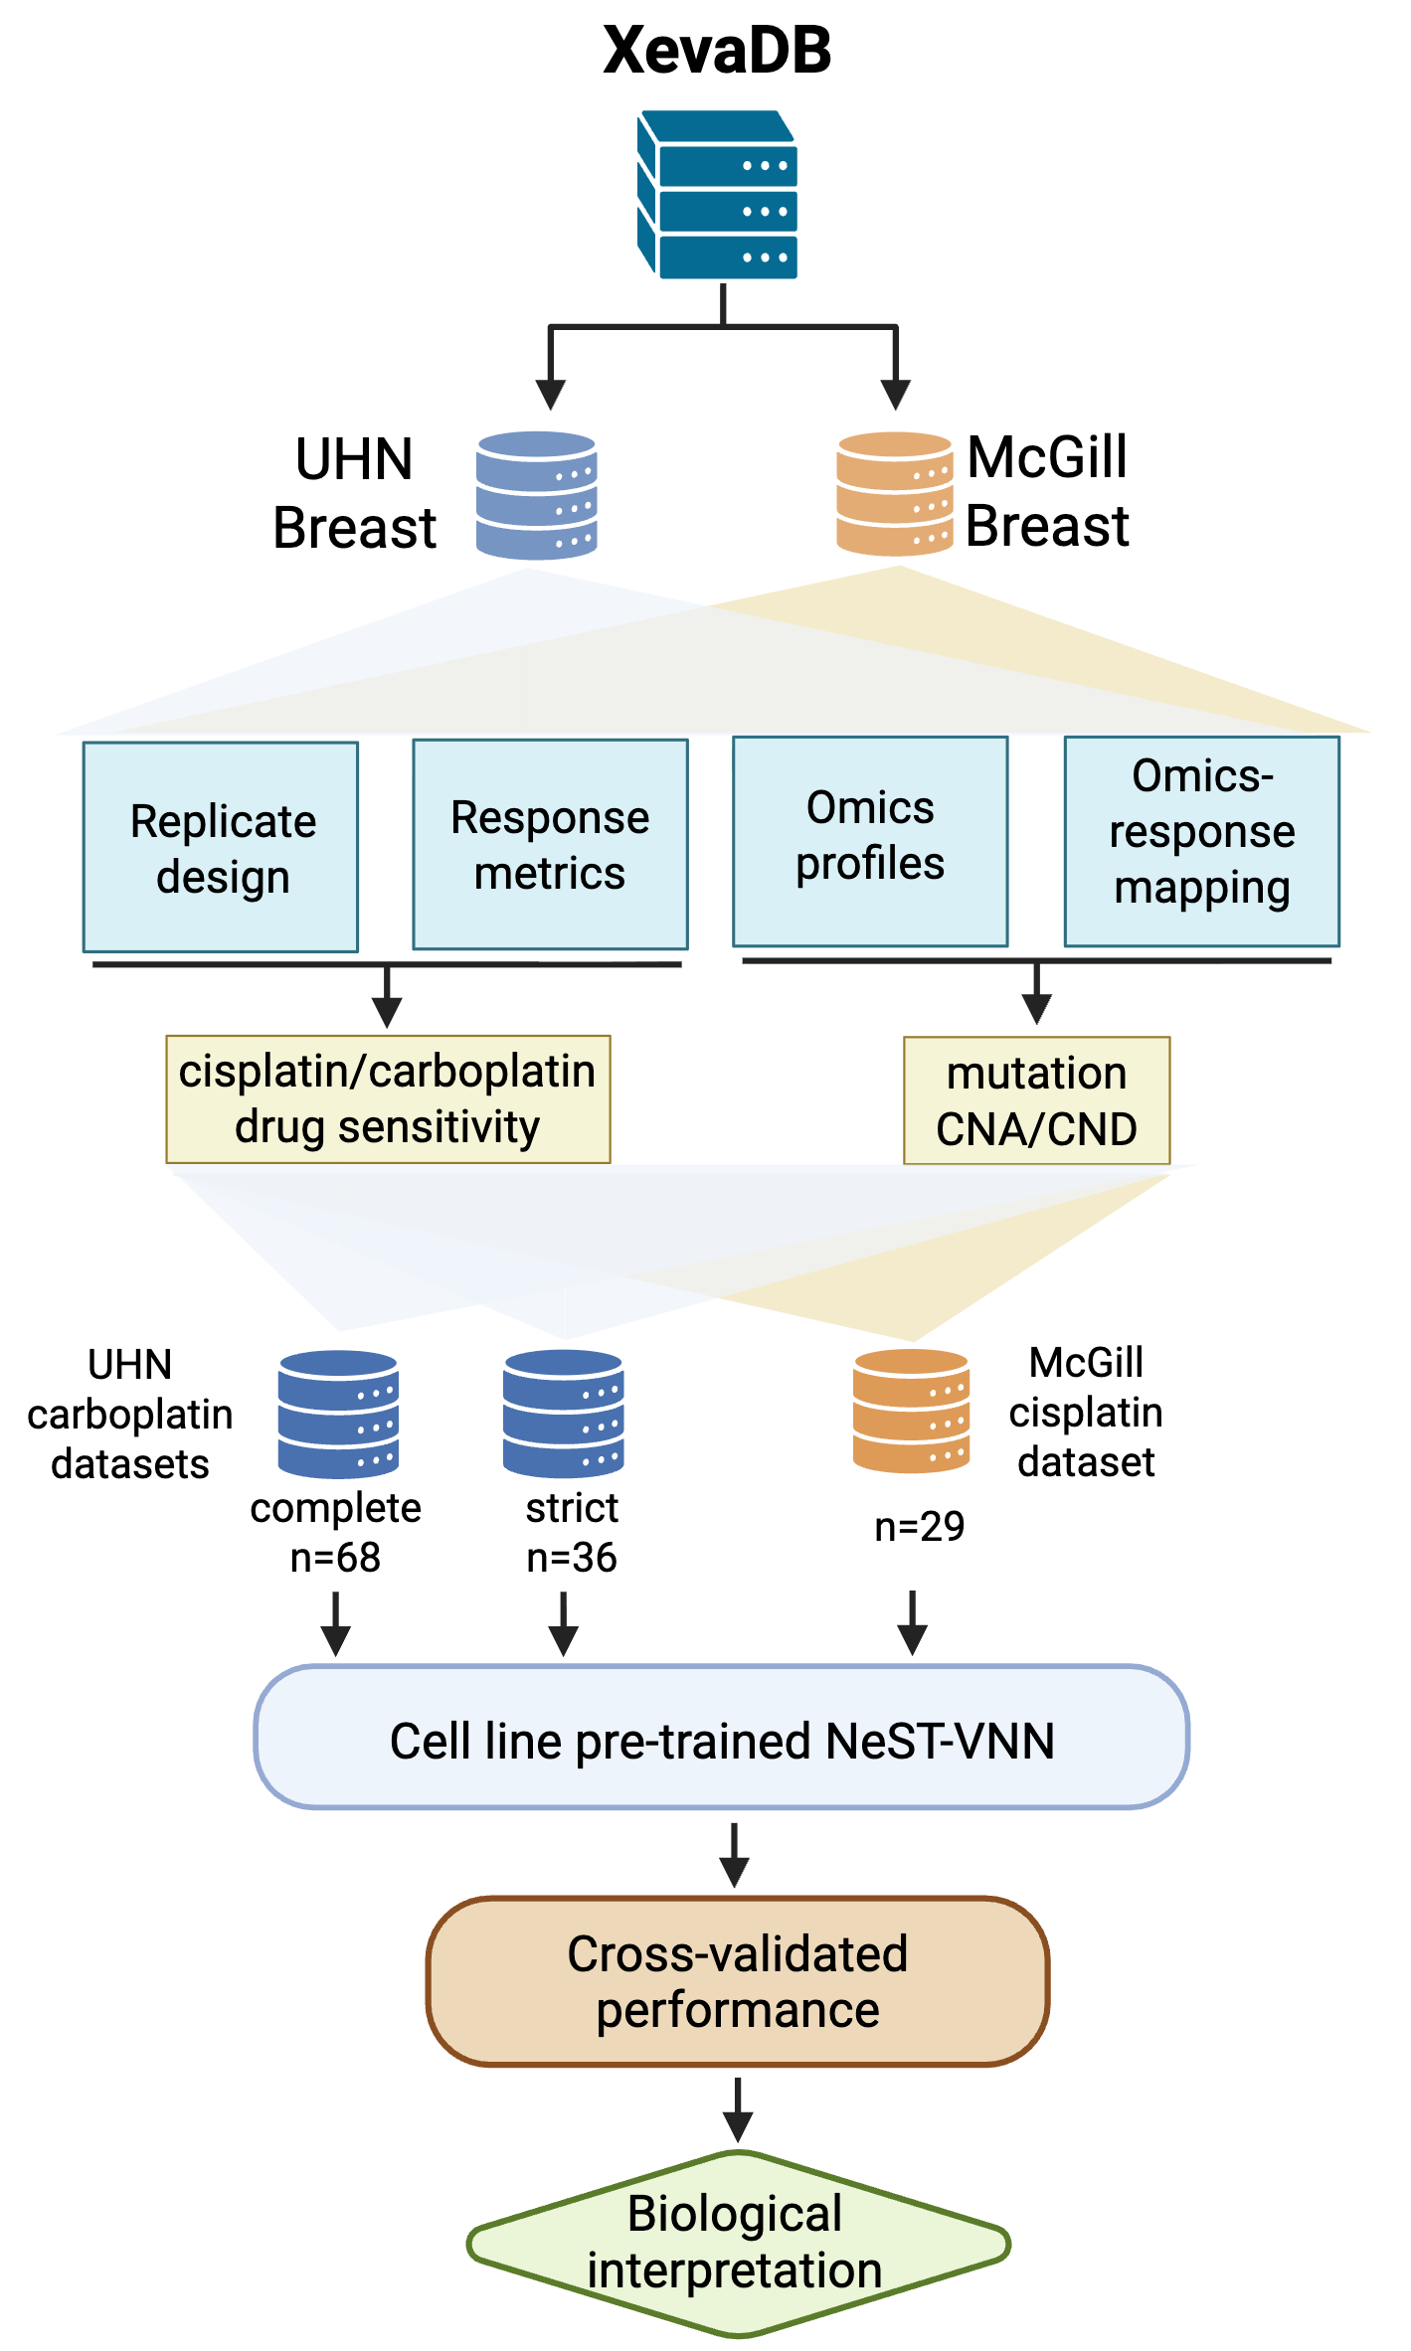
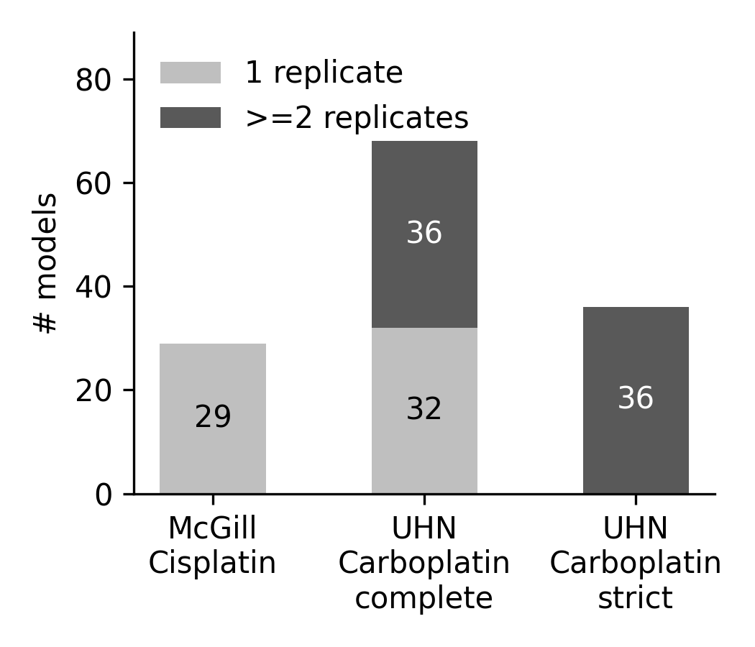
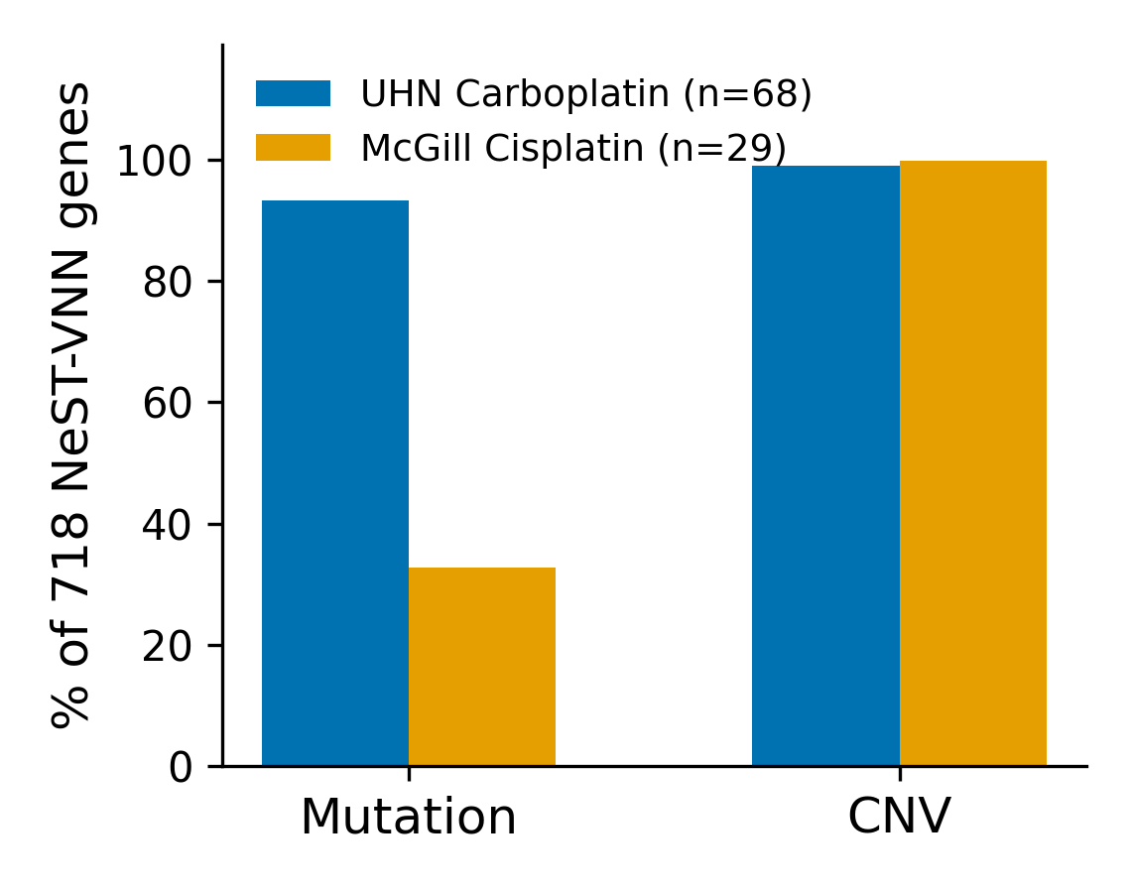
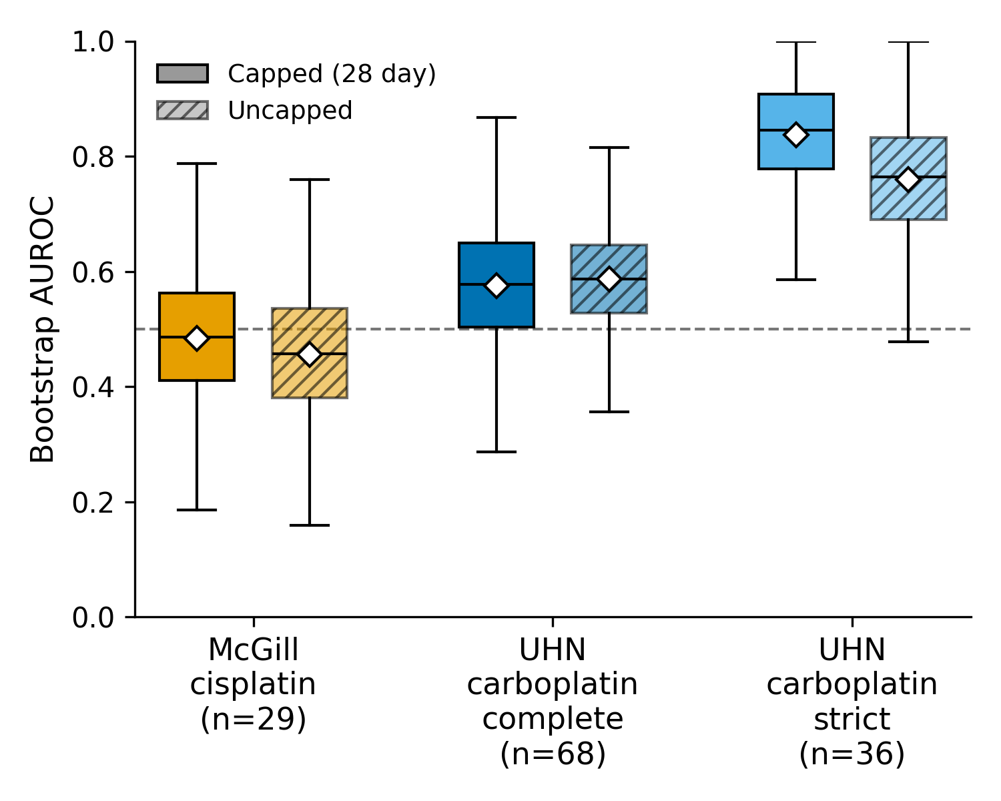
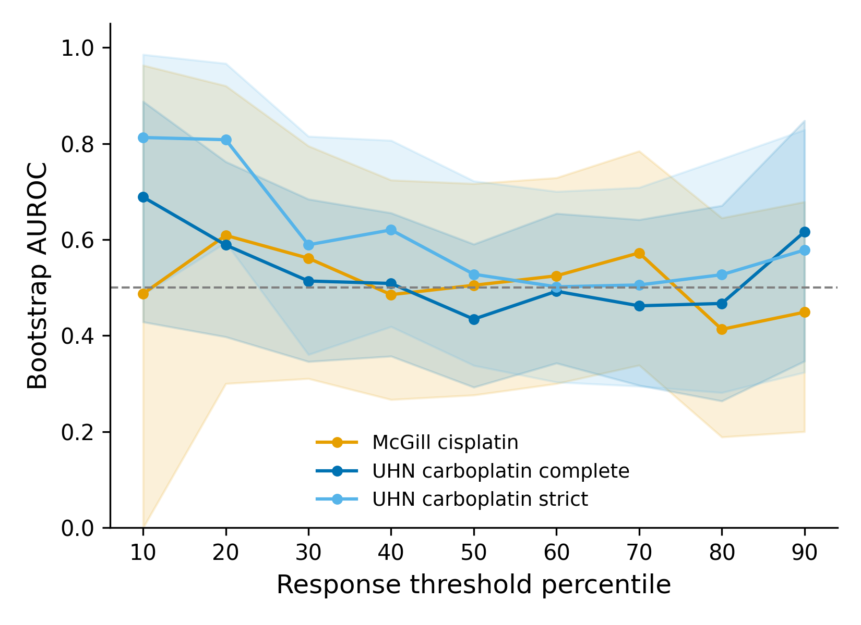
a
b
c
d
e
Figure 4. Cross-platform validation of NeST-VNN on independent PDX cohorts.
(a) Case study three workflow: drug-response, mutation, and copy-number data from the McGill (cisplatin, n = 29) and UHN (carboplatin; complete cohort n = 68, replicate-supported "strict" cohort n = 36) breast PDX cohorts are used as external input to a cell-line-pretrained NeST-VNN ensemble, validated against a growth-curve response label. (b) Number of models with exactly one versus two or more treatment-arm replicate mice, for each cohort/cohort definition. (c) Fraction of the 718-gene NeST-VNN input panel with recorded mutation and copy-number (CNV) calls in each cohort's raw molecular profiles. (d) Bootstrap 95% confidence intervals for NeST-VNN's AUROC under the capped (28 day window, primary) and uncapped (full observed duration) response-label definitions, for each of the three cohort definitions; dashed line, chance performance. (e) NeST-VNN performance across alternative response definitions. AUROC was evaluated across cohort-specific treatment-arm slope percentile cutoffs, with models below each cutoff classified as sensitive. Lines represent the McGill cisplatin, UHN carboplatin complete and UHN carboplatin strict cohorts, shaded regions indicate bootstrap 95% confidence intervals, and the dotted line indicates chance performance (AUROC = 0.5).
Notes:
Figure 3. Systematic evaluation of NeST-VNN model generalizability and performance. a. Case study workflow. b. Oncoplot illustrating the mutational landscape of the University Health Network (UHN) carboplatin and McGill cisplatin datasets. c. Distribution of drug responses across both cohorts based on modified Response Evaluation Criteria in Solid Tumors (mRECIST). CR, complete response; PR, partial response; SD, stable disease; PD, progressive disease. d. Density comparison of 718 NeST-VNN features between datasets. Statistical significance was determined using a two-sided Mann–Whitney U test. **** p < 0.0001; *** p < 0.001; ** p < 0.01; * p < 0.05; ns, not significant. e. Model transferability. Bar plot summarizing the mean Area Under the Receiver Operating Characteristic Curve (AUC) across fivefold cross-validation, demonstrating model robustness across institutional cohorts. f. NeST-VNN model performance. Receiver Operating Characteristic (ROC) curves and corresponding ensemble AUC values for the UHN carboplatin and McGill cisplatin validation sets.

Slide 6
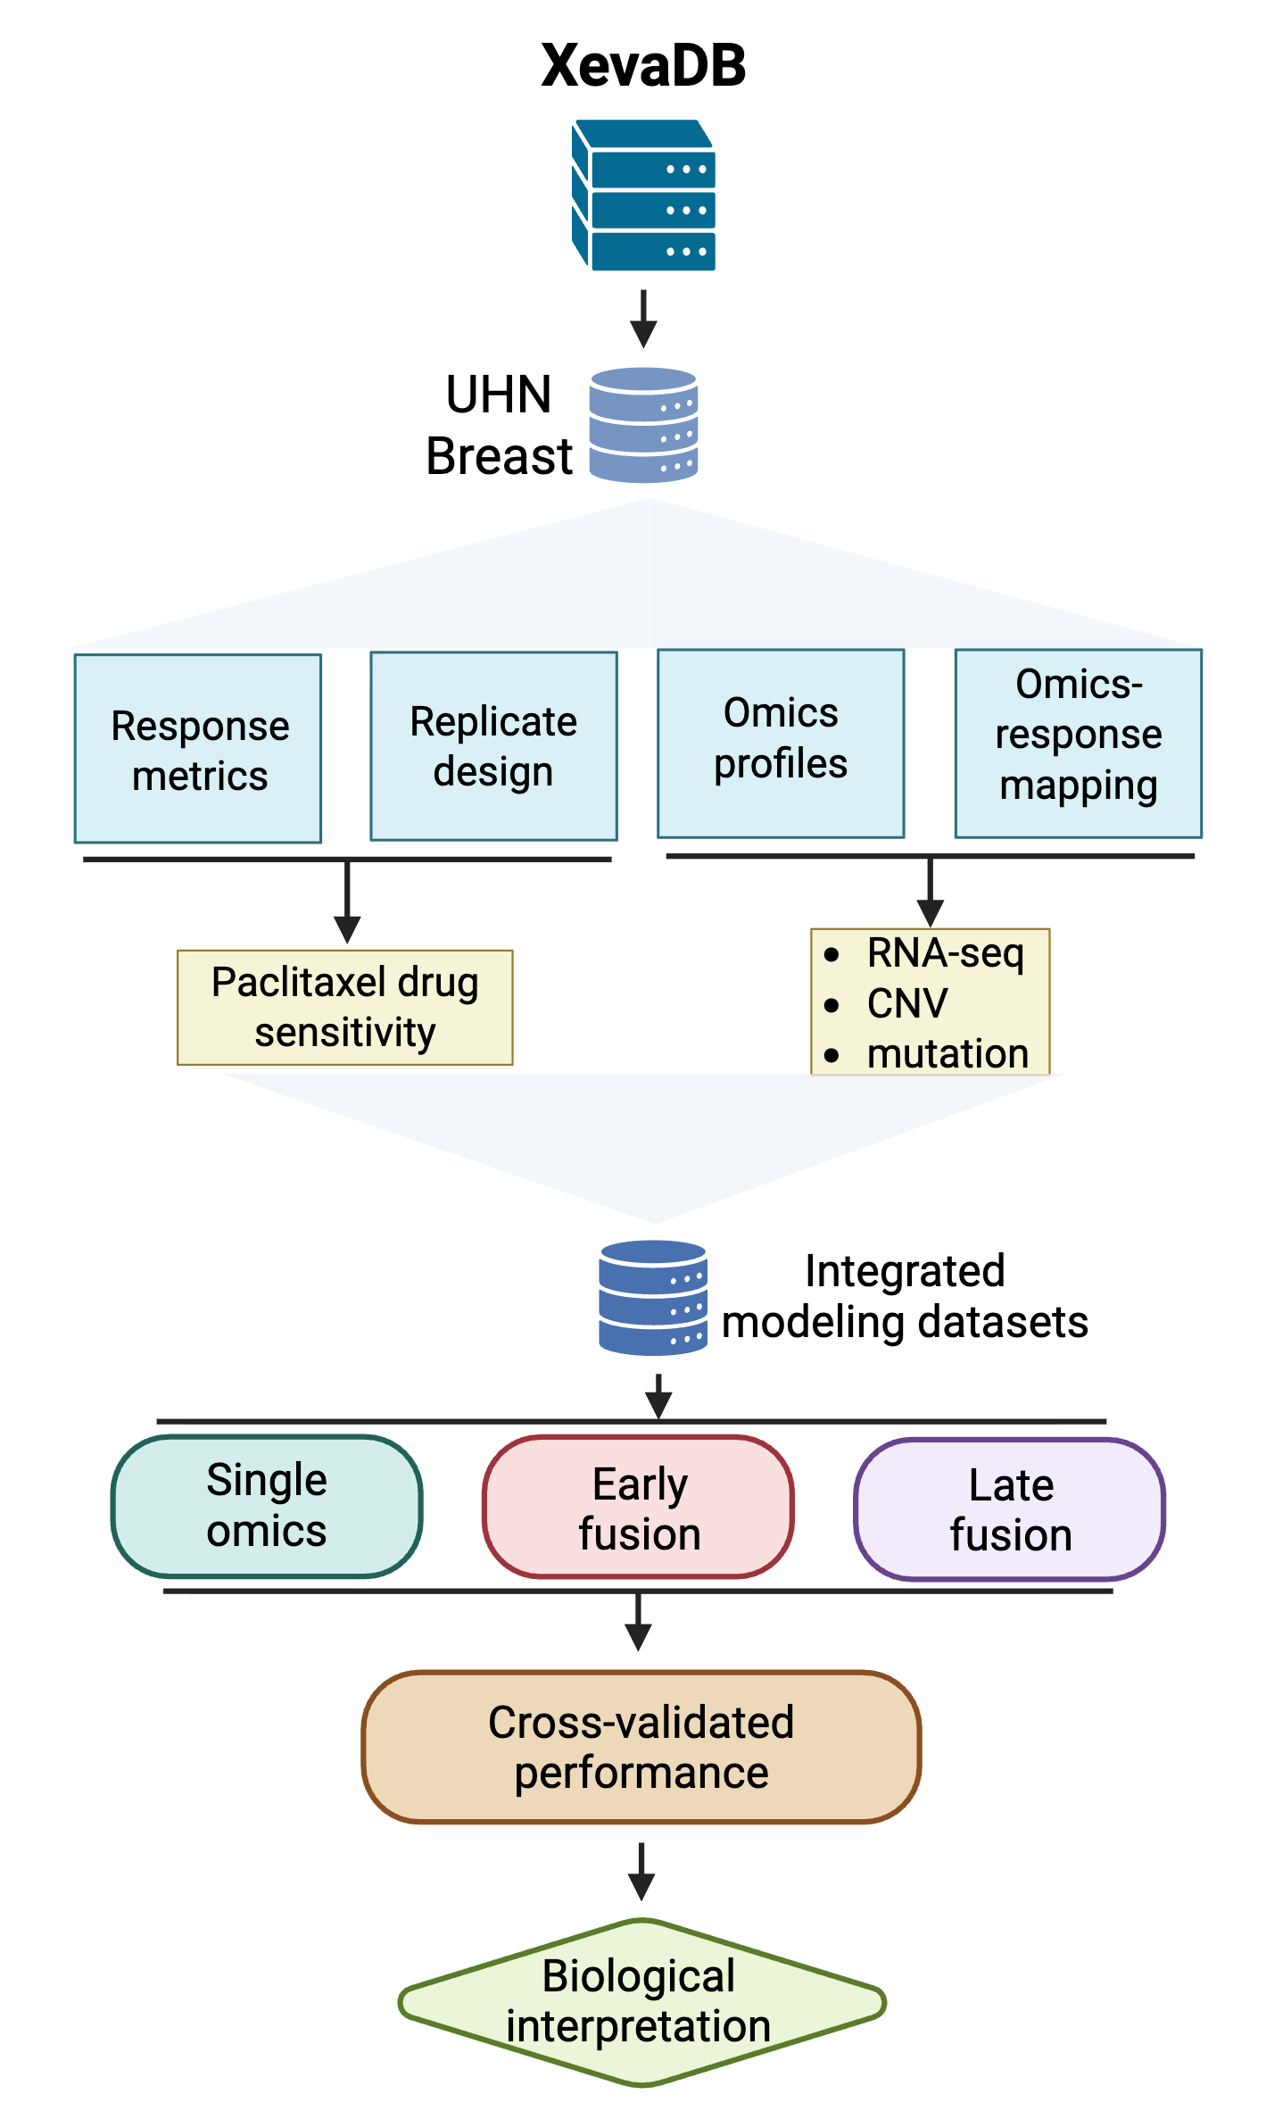
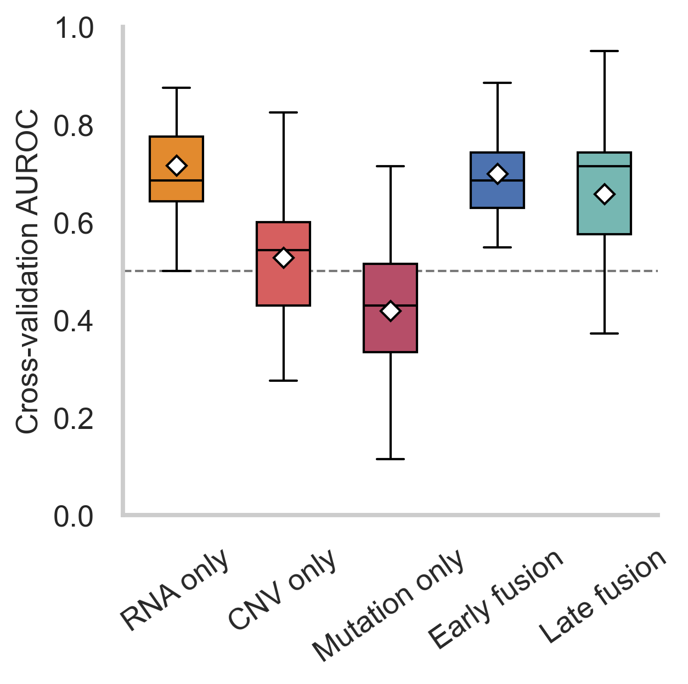
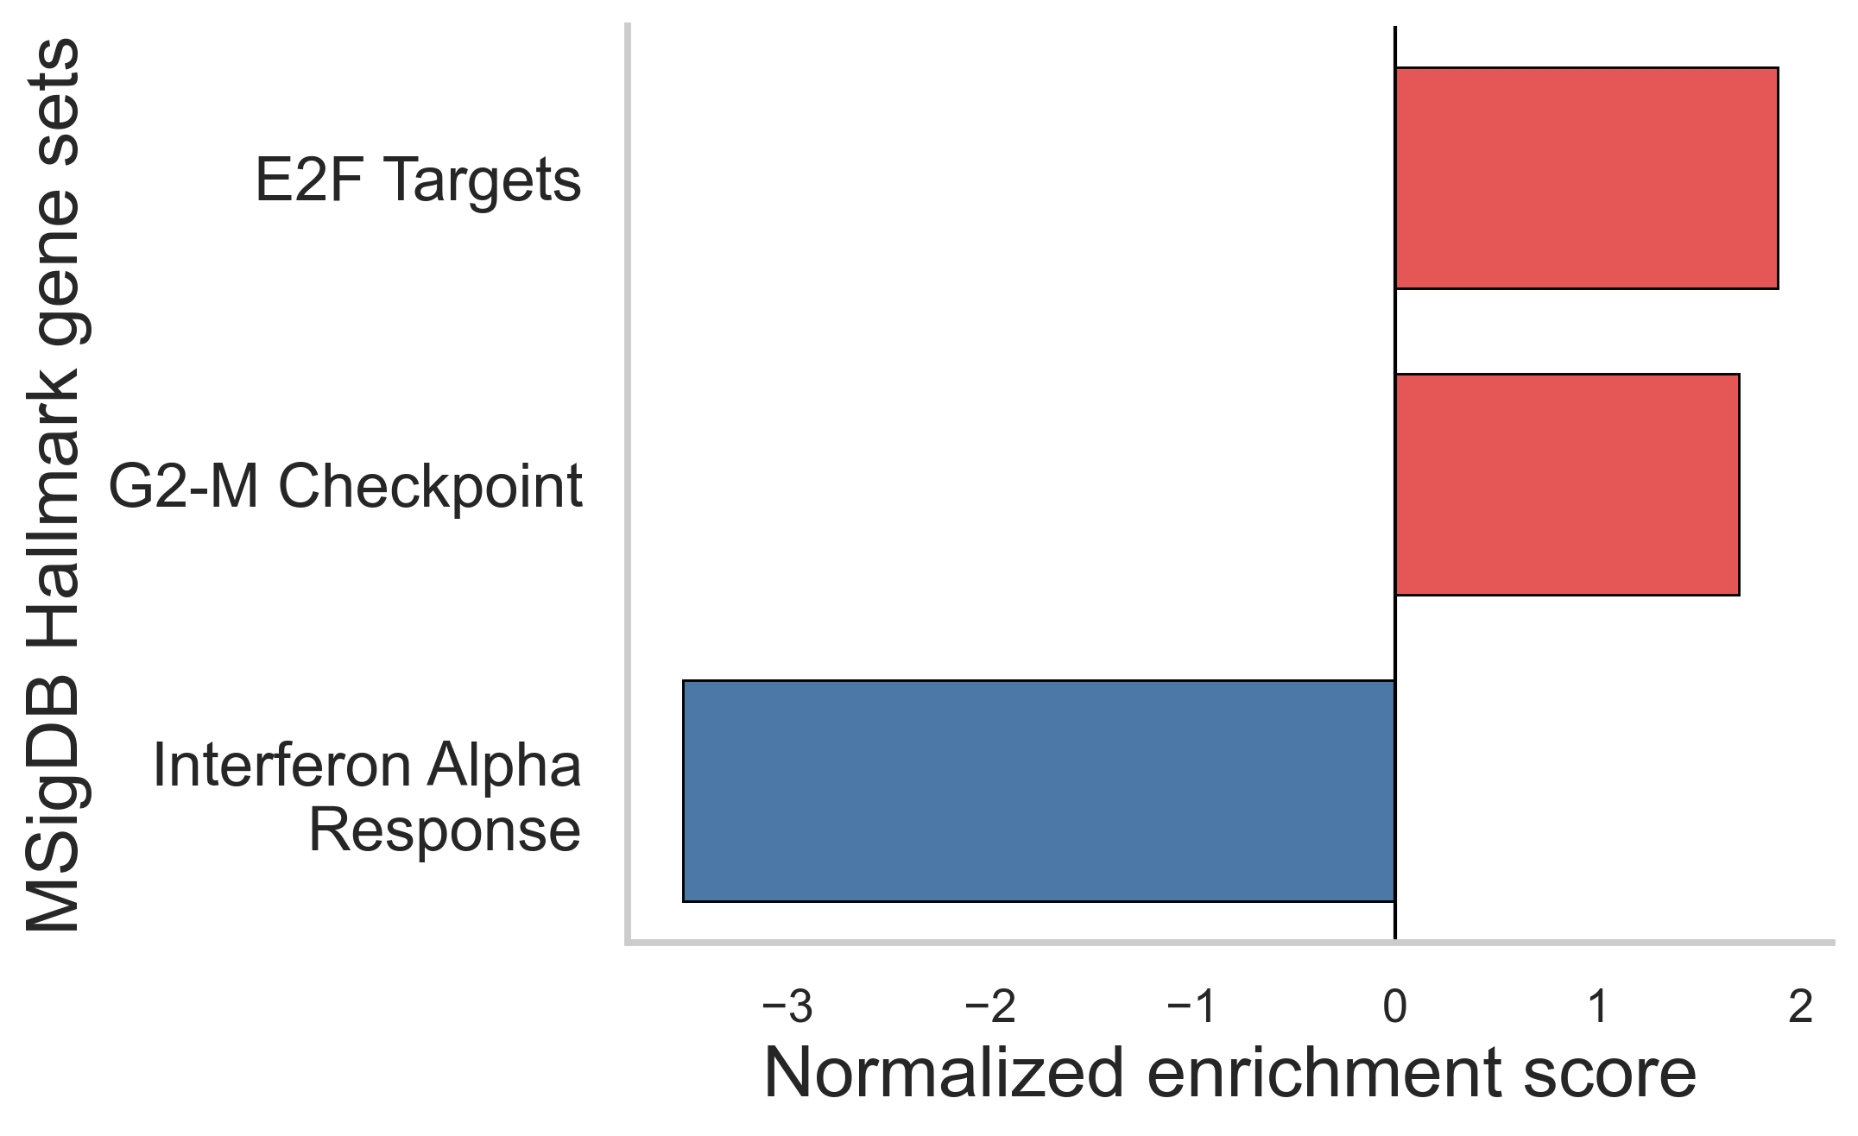
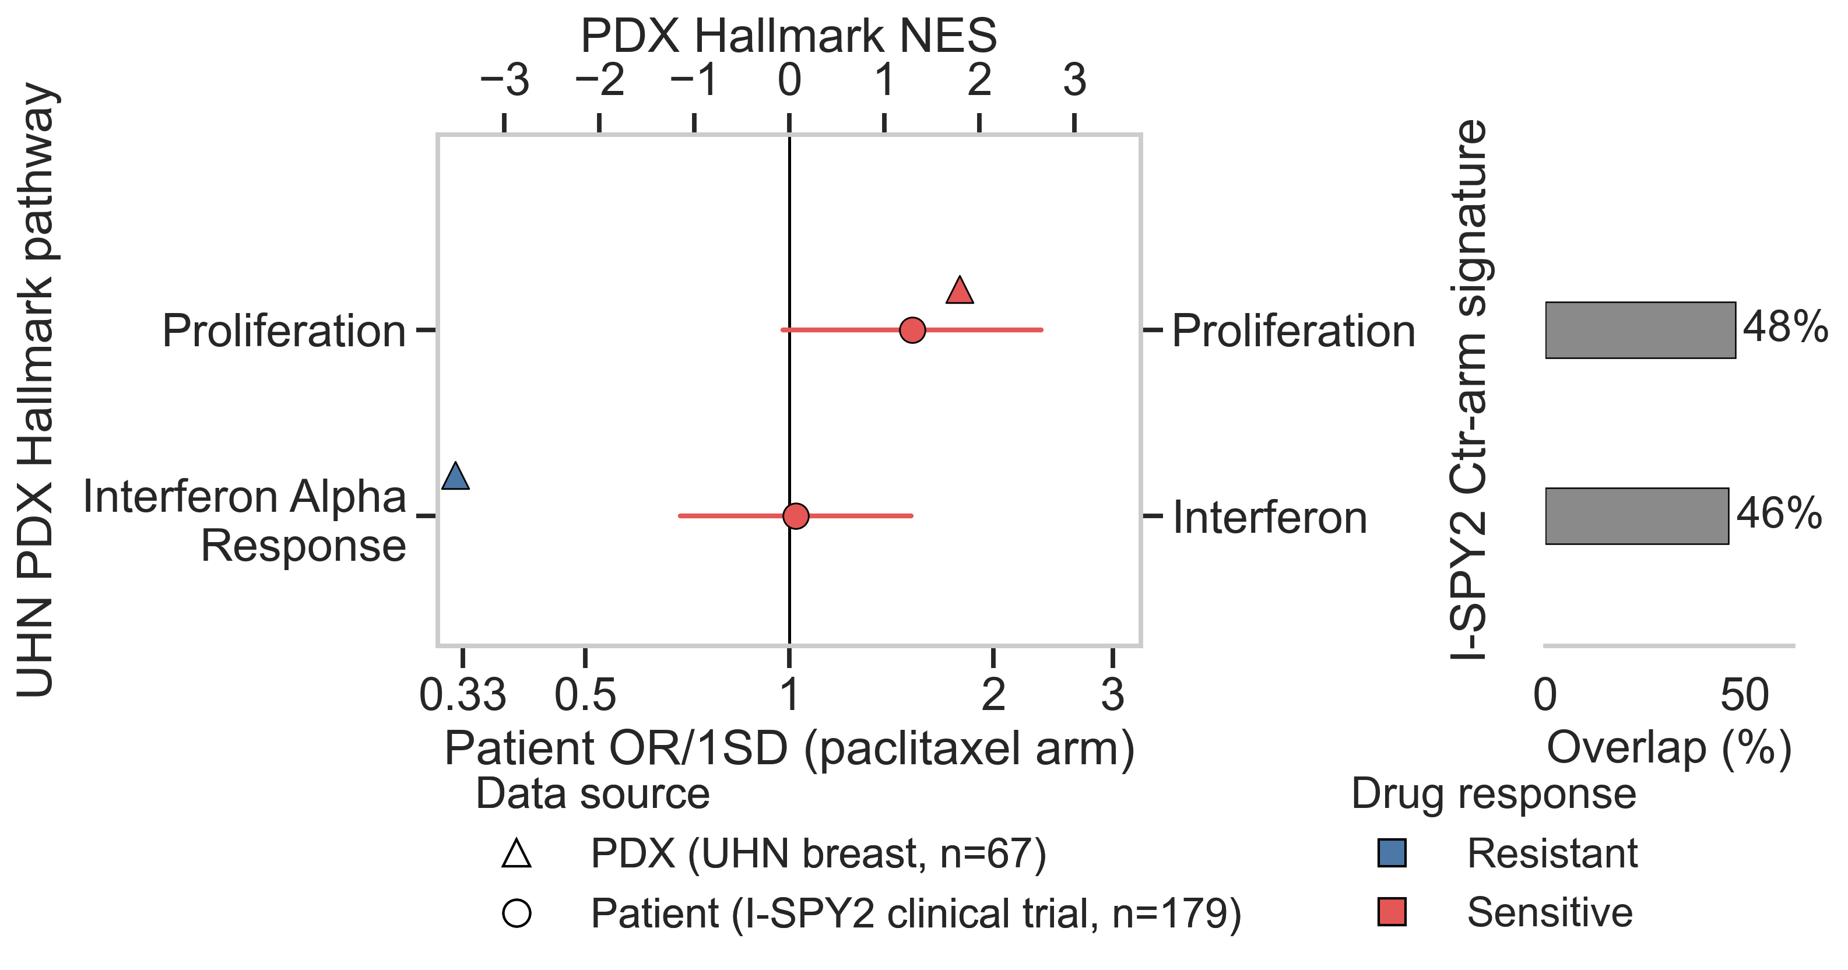
a
b
c
d
Figure 5. XevaDB-based multi-omics prediction of paclitaxel response in breast cancer PDX models.
(a) Case study four workflow: drug-sensitivity metrics and RNA-seq/CNV/mutation profiles for the UHN breast paclitaxel cohort are extracted from XevaDB and assembled into single-omics, early-fusion, and late-fusion modeling datasets, evaluated by cross-validation. (b) Cross-validation AUROC of the random forest classifier across single-omics (RNA-only, CNV-only, mutation-only) and multi-omics (early fusion, late fusion) feature sets; boxes show median/IQR and whiskers across repeated CV folds, diamonds mark the mean, dashed line marks chance (AUROC = 0.5). (c) Pre-ranked GSEA of the full RNA transcriptome against MSigDB Hallmark gene sets; top 3 significant pathways per direction shown (FDR q < 0.05). Positive NES: enriched in Sensitive models; negative NES: enriched in Resistant models. (d) Cross-cohort comparison of transcriptomic programmes associated with paclitaxel response in UHN PDXs (n=67) and pathological complete response (pCR) in the I-SPY2 paclitaxel control arm (n=179 patients). Triangles, PDX normalized enrichment scores (NES) for MSigDB Hallmark pathways; circles, patient odds ratios (OR) for pCR per one-standard-deviation (1SD) increase in the corresponding predefined I-SPY2 signature, with 95% confidence intervals (refit from patient-level I-SPY2 data; see Methods). Markers are colored by their own direction of association (blue, Resistant; red, Sensitive), so a row is concordant when both markers share a color and discordant when they differ. Positive PDX NES indicates enrichment in sensitive PDXs, whereas patient OR values above 1 indicate higher odds of pCR. "Proliferation" reflects the median NES across five Hallmark gene sets significantly enriched in sensitive PDXs (E2F Targets, G2-M Checkpoint). Percentages indicate gene overlap between each I-SPY2 signature and its corresponding Hallmark gene set.
Notes:
Figure 2. Systematic evaluation of NeST-VNN model generalizability and performance. a. Case study workflow. b. Oncoplot illustrating the mutational landscape of the University Health Network (UHN) carboplatin and McGill cisplatin datasets. c. Distribution of drug responses across both cohorts based on modified Response Evaluation Criteria in Solid Tumors (mRECIST). CR, complete response; PR, partial response; SD, stable disease; PD, progressive disease. d. Density comparison of 718 NeST-VNN features between datasets. Statistical significance was determined using a two-sided Mann–Whitney U test. **** p < 0.0001; *** p < 0.001; ** p < 0.01; * p < 0.05; ns, not significant. e. Model transferability. Bar plot summarizing the mean Area Under the Receiver Operating Characteristic Curve (AUC) across fivefold cross-validation, demonstrating model robustness across institutional cohorts. f. NeST-VNN model performance. Receiver Operating Characteristic (ROC) curves and corresponding ensemble AUC values for the UHN carboplatin and McGill cisplatin validation sets.

