Slide 1
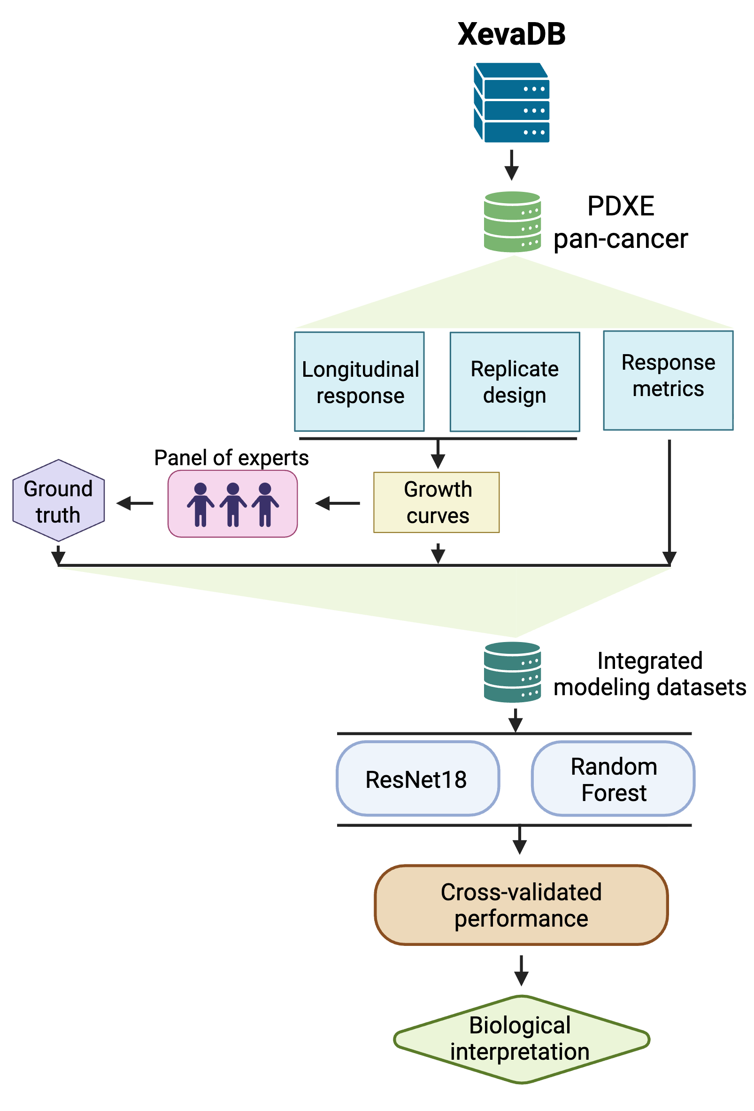
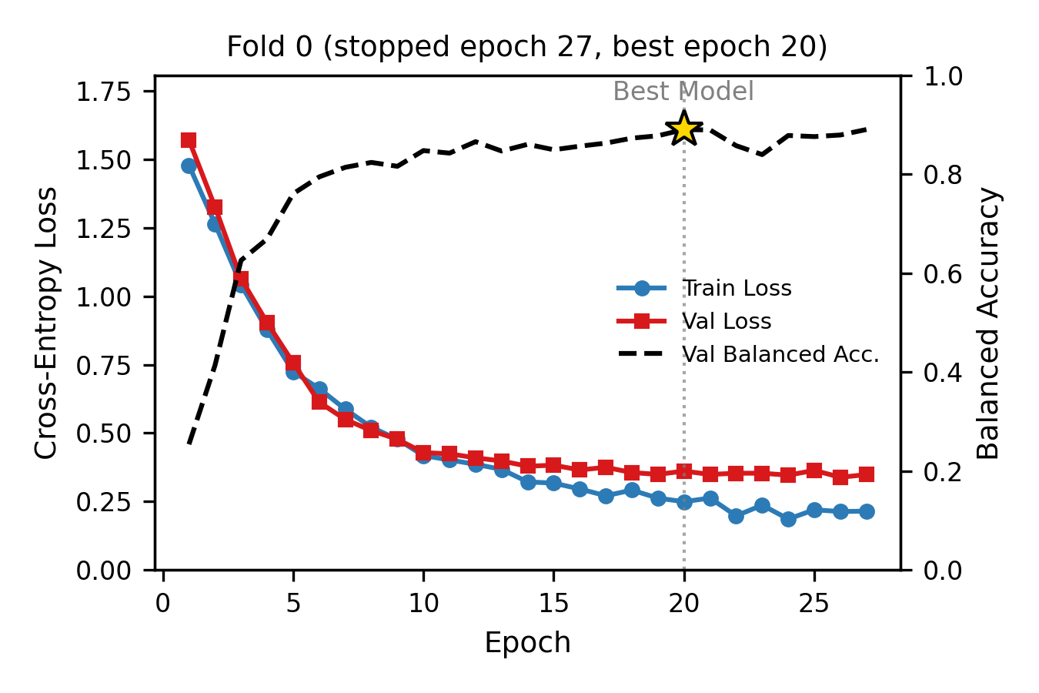
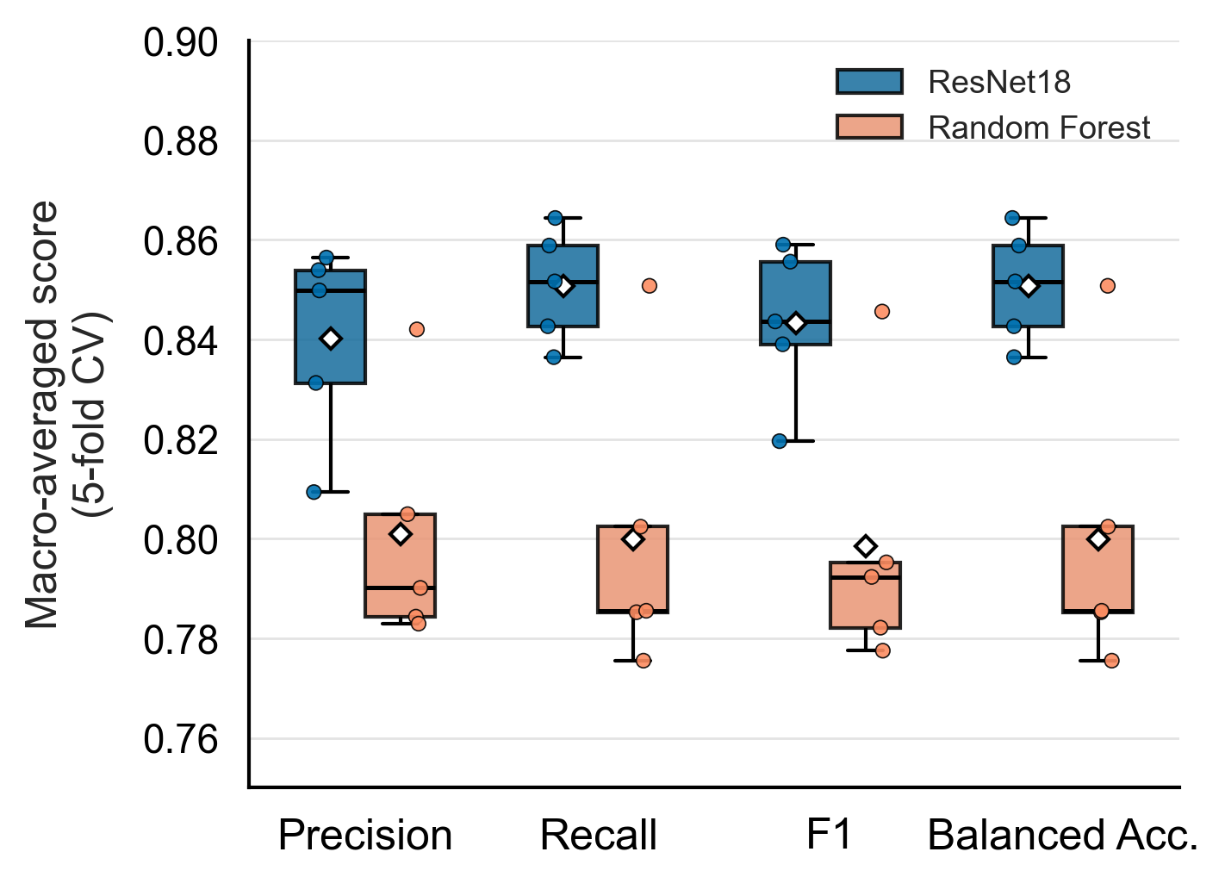
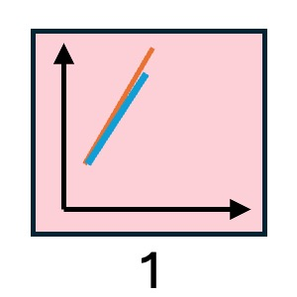
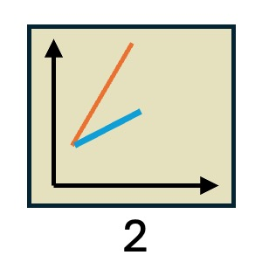
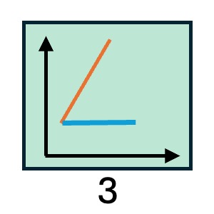
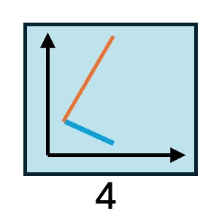
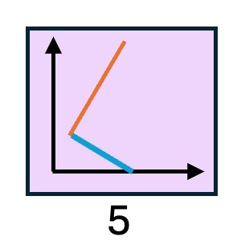
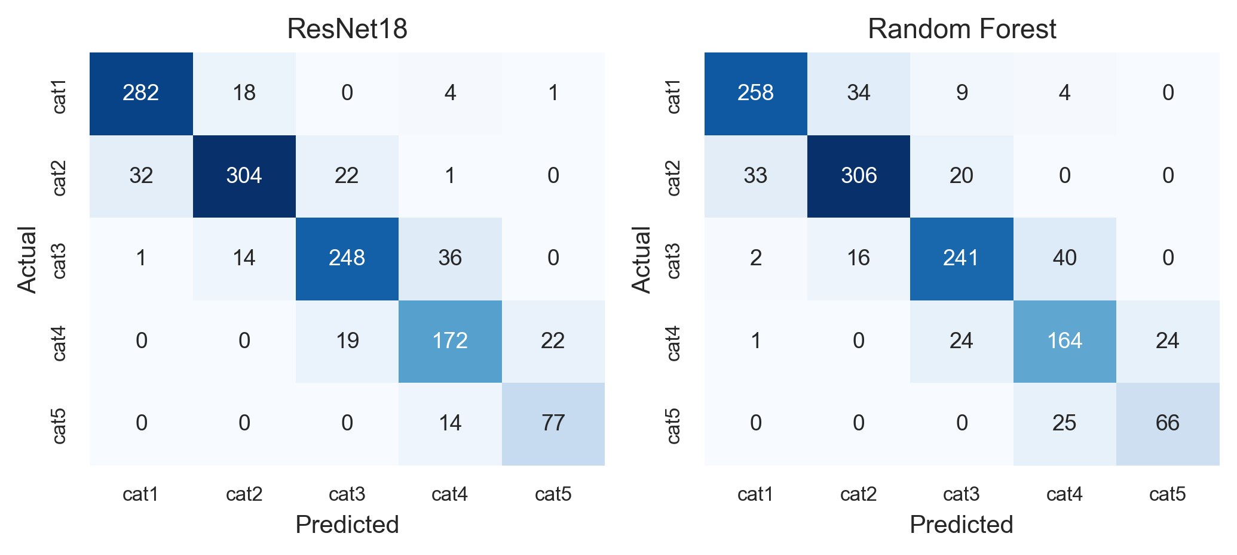
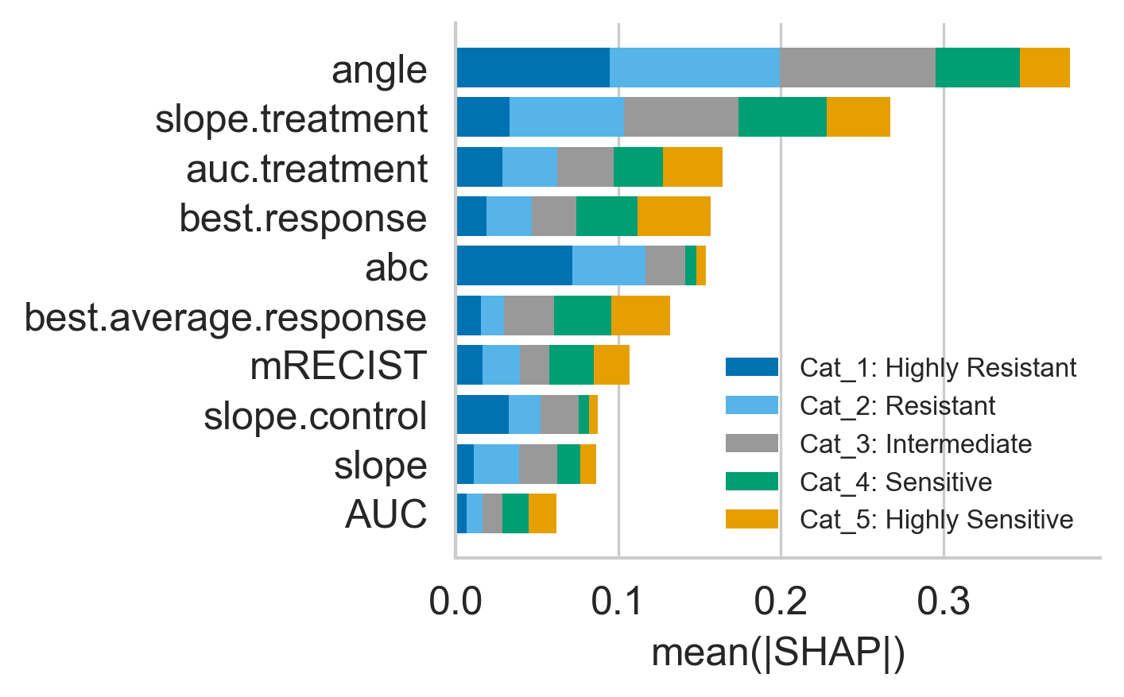
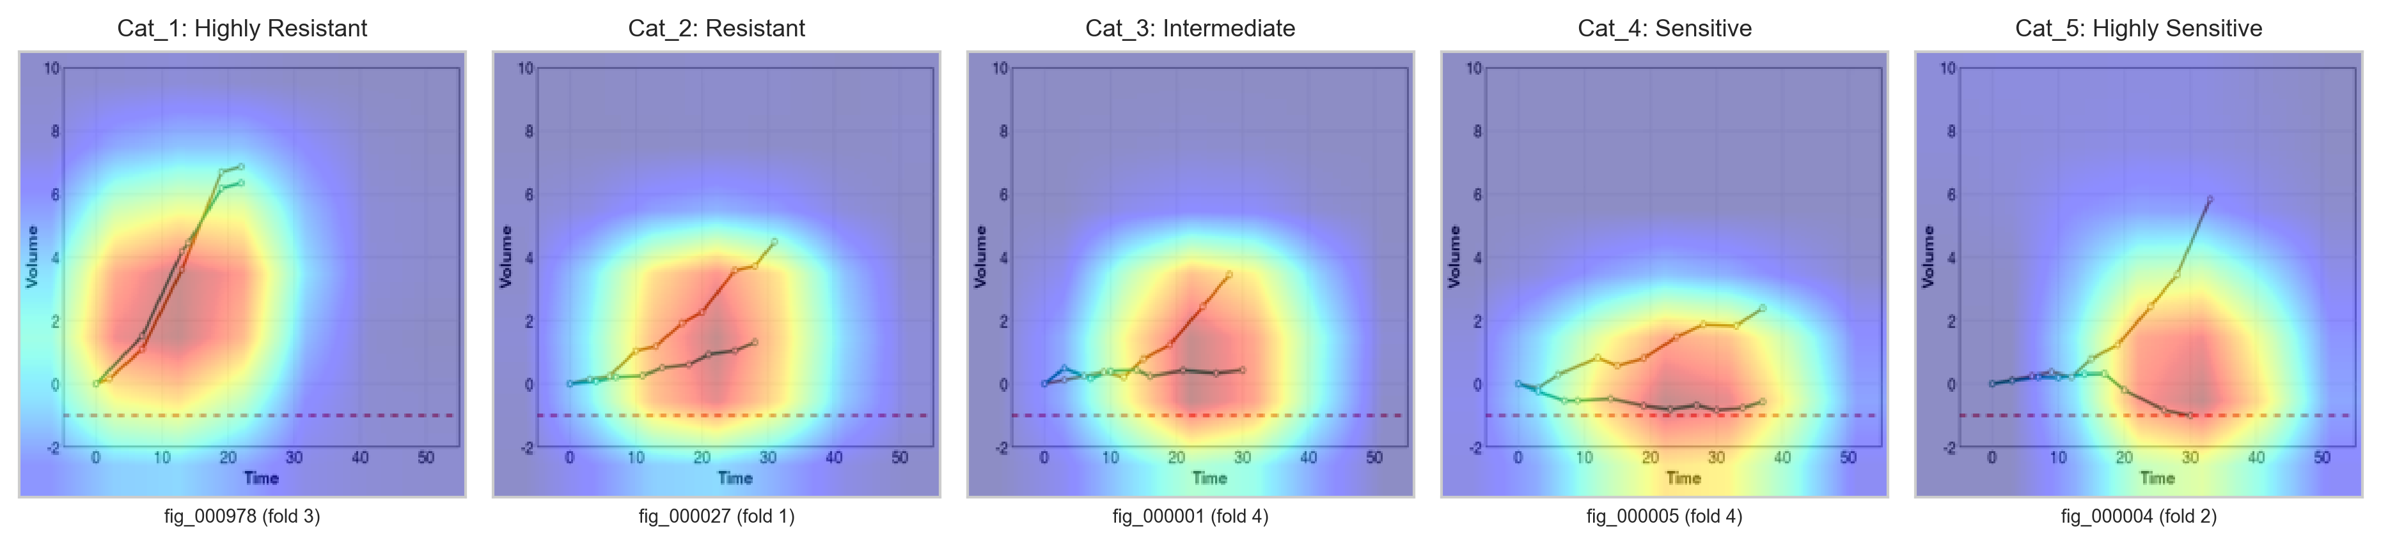
a
b
c
d
Drug Sensitivity
 | Cat_1 | Cat_2 | Cat_3 | Cat_4 | Cat_5 | Total
Expert 1 | 233 | 435 | 282 | 250 | 100 | 1300
Expert 2 | 255 | 423 | 362 | 233 | 24 | 1300
Expert 3 | 387 | 289 | 300 | 174 | 139 | 1300
Consensus | 305 | 359 | 299 | 213 | 91 | 1267
e
f
g

