Slide 1
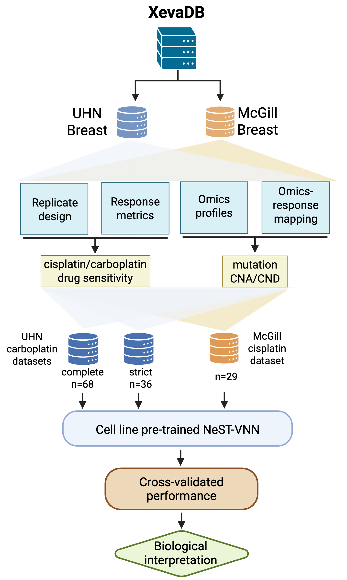
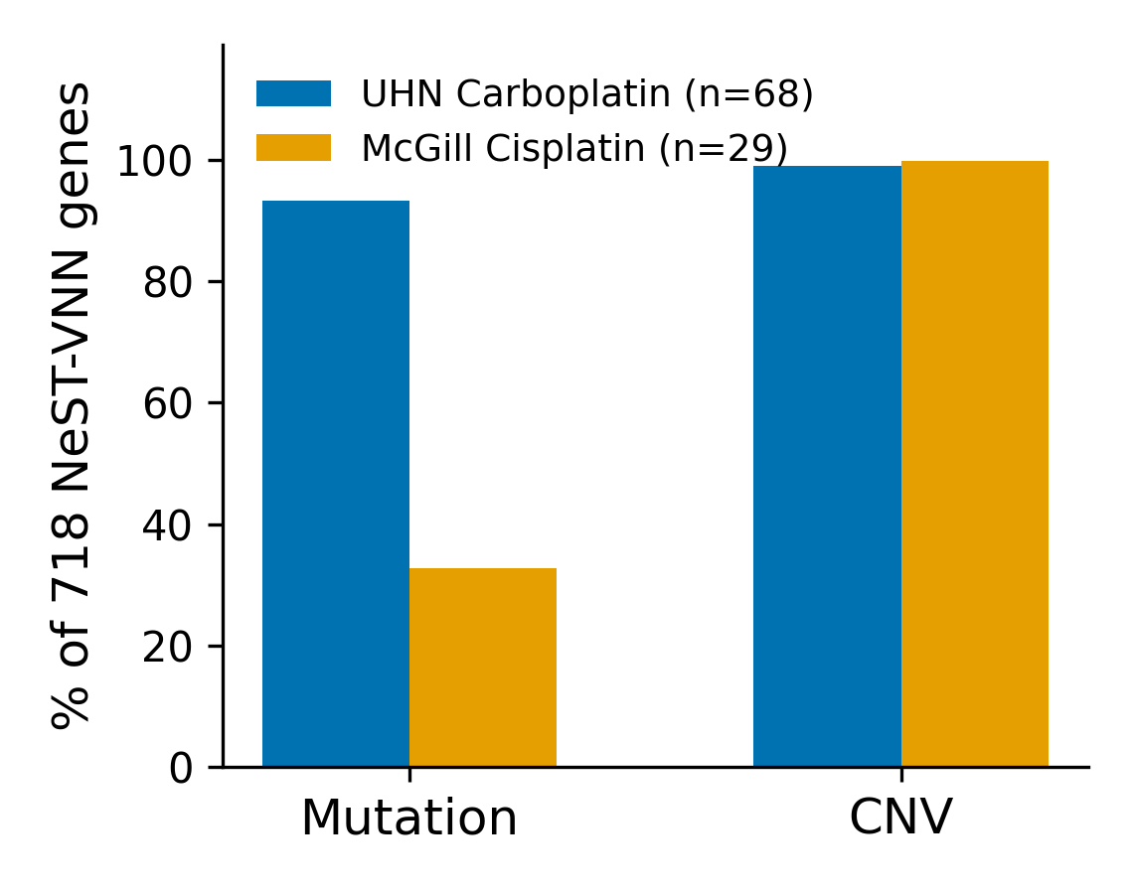
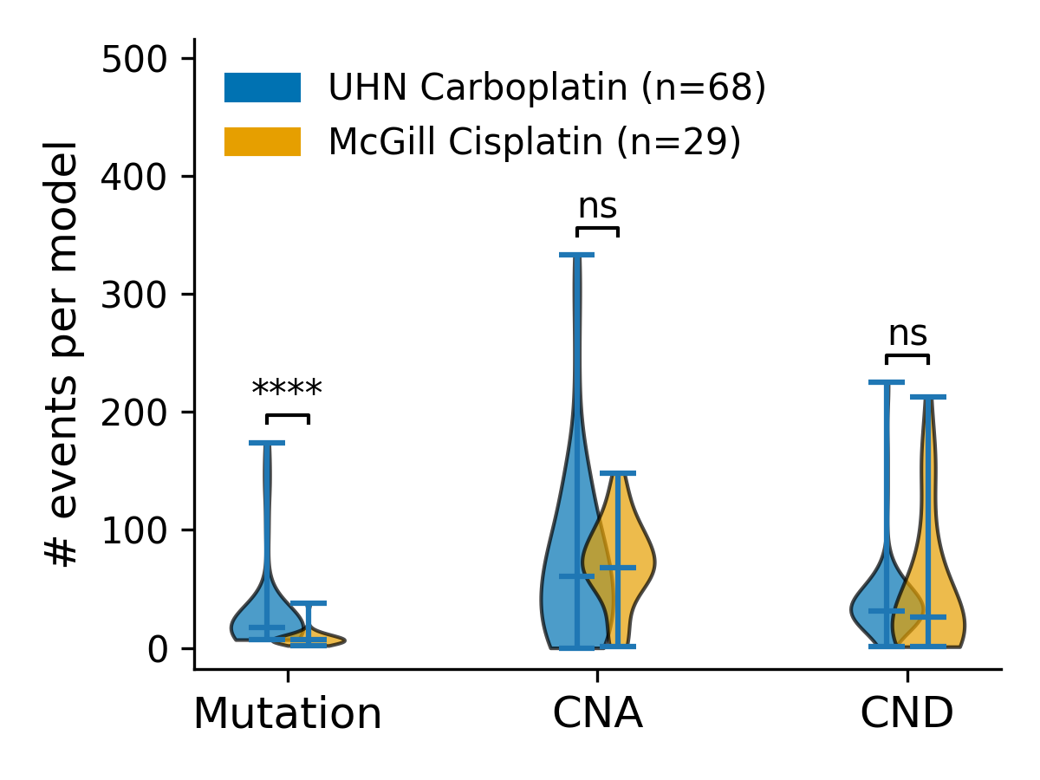
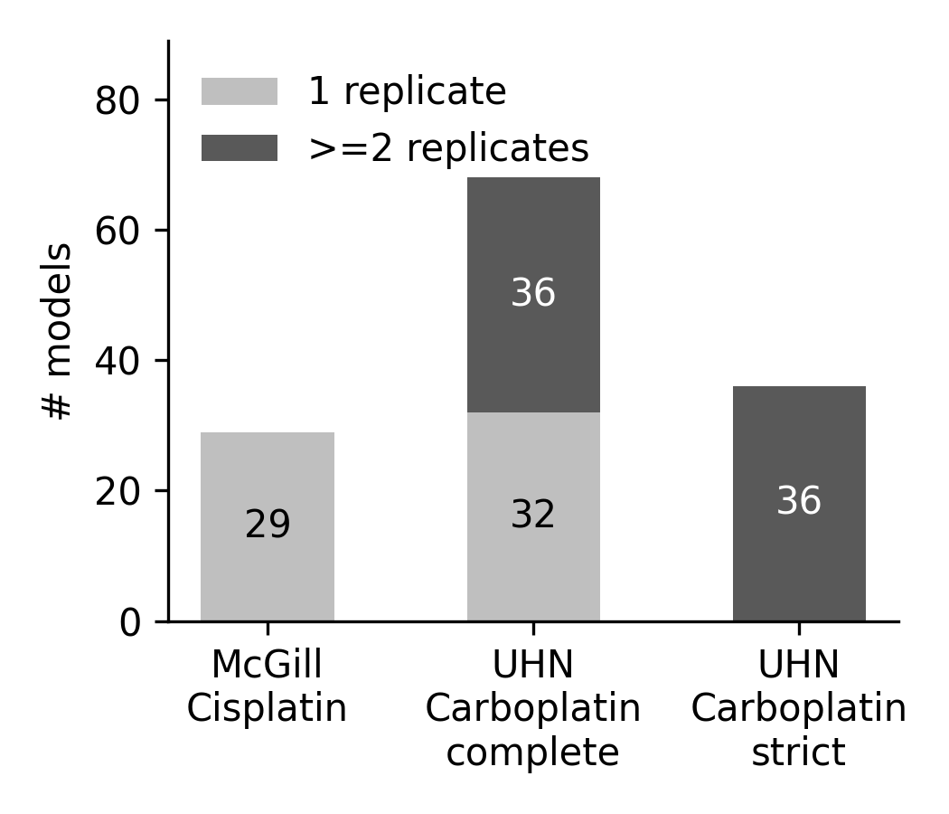
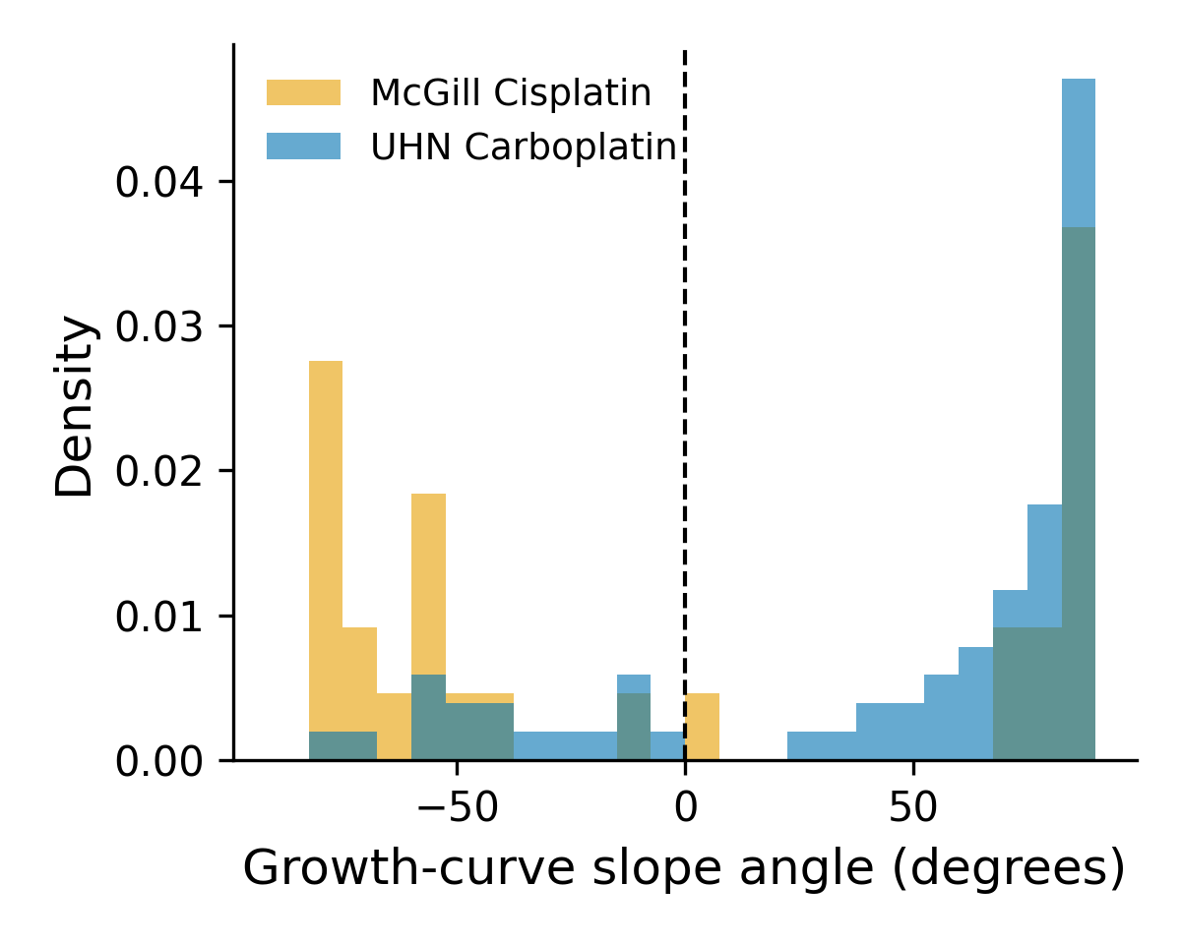
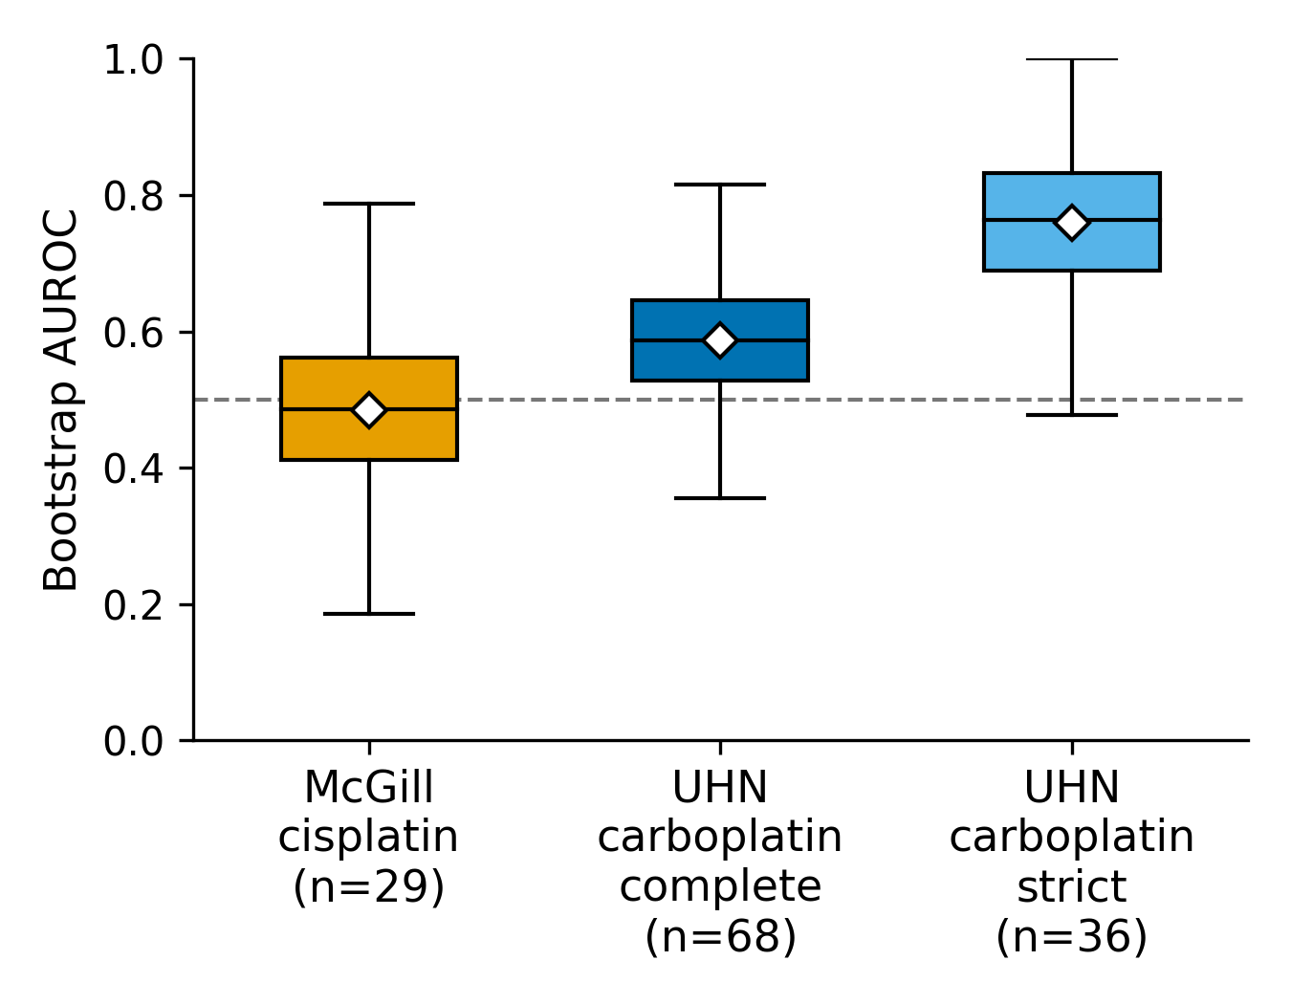
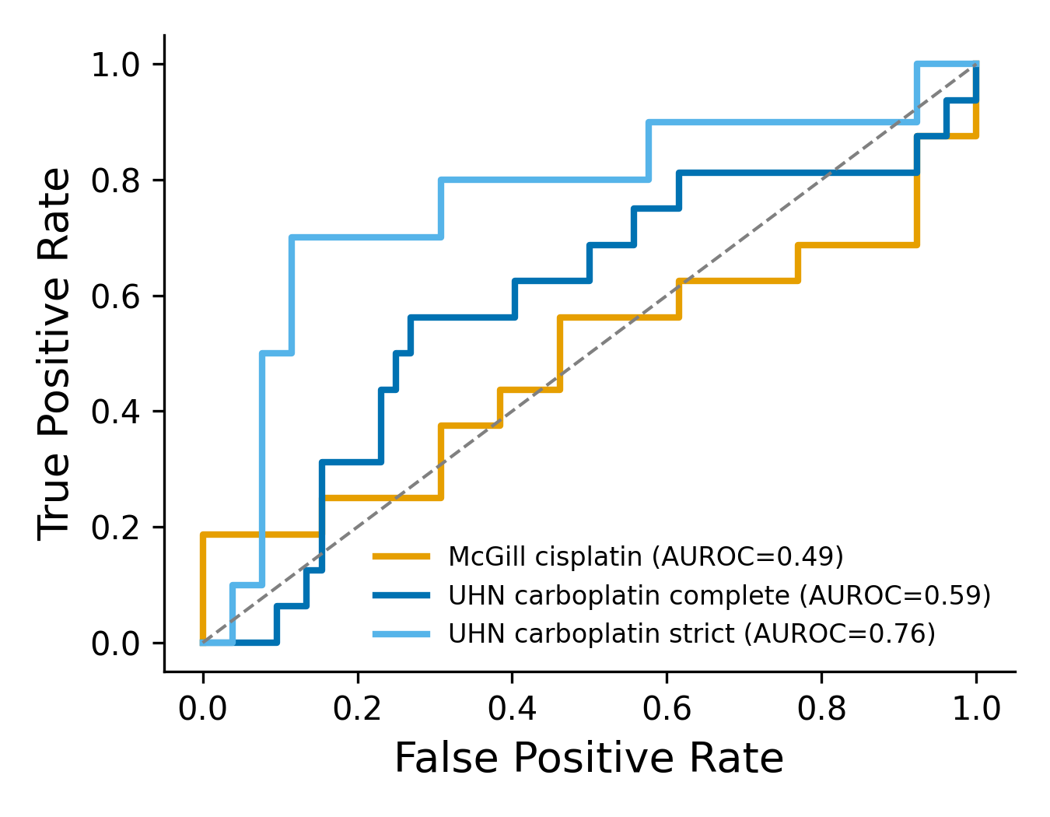
a
b
c
d
e
f
g
Notes:
Figure 3. Systematic evaluation of NeST-VNN model generalizability and performance. a. Case study workflow. b. Oncoplot illustrating the mutational landscape of the University Health Network (UHN) carboplatin and McGill cisplatin datasets. c. Distribution of drug responses across both cohorts based on modified Response Evaluation Criteria in Solid Tumors (mRECIST). CR, complete response; PR, partial response; SD, stable disease; PD, progressive disease. d. Density comparison of 718 NeST-VNN features between datasets. Statistical significance was determined using a two-sided Mann–Whitney U test. **** p < 0.0001; *** p < 0.001; ** p < 0.01; * p < 0.05; ns, not significant. e. Model transferability. Bar plot summarizing the mean Area Under the Receiver Operating Characteristic Curve (AUC) across fivefold cross-validation, demonstrating model robustness across institutional cohorts. f. NeST-VNN model performance. Receiver Operating Characteristic (ROC) curves and corresponding ensemble AUC values for the UHN carboplatin and McGill cisplatin validation sets.

