Slide 1
2016.10.27
SNU Data Mining Lab Seminar
Automatic Classification of Securities using Hierarchical Clustering of 10-Ks
Hoseong Yang, Hye Jin Lee, Eugene Cho, Sungzoon Cho

Slide 2
Contents
1. Introduction
Background & Motivation
An Overview of Industry Classification Schemes (ICS)
2. Proposed Methods
Document Embedding
Hierarchical clustering
3. Experiment
Data Description & Experiment settings
Classification Results
4. Evaluation
Qualitative evaluation: Exploration of the resulting clusters and word vector similarities
Quantitative evaluation: intra- and inter industry homogeneity tests
5. Discussion
Contributions & Future work

Slide 3
Introduction
What is an “Industry Classification Scheme” (ICS)?
Methods to cluster financial entities into distinct bundles
Intra-Industry Homogeneity: Each bundle should contain entities that are “similar” types of business given their market activities
Inter-Industry Homogeneity: Each bundle’s power of representation should be similar from one another
In equity market, these bundles represents industry-wise segments of the market with distinct financial characteristics
ICS facilitate a broad range of cluster-level analysis [1]
Sector-wise identification of market competitors
Benchmarking company activities and performances
Measuring economic indicators
Setting up market share
Note! Although the term “classification” is used as a convention, it actually is a clustering process!

Slide 4
Introduction
Currently, there exists a variety of industrial classification system†
Abbreviation | Full name | Sponsor |  | Criterion/ Unit | Node count by level | Issued
SIC | Standard Industrial Classification | US |  | production/ establishment | 4 digits 1004 categories | 1937–1987 (superseded by NAICS, but still used in some applications)
NAICS | North American Industry Classification System | Statistical bureaus of US, Canada, and Mexico |  | production/ establishment | 6 digits 17/99/313/724/1175 (/19745)¹ | 1997, 2002, (2012)
GICS | Global Industry Classification Standard | Standard & Poor's, Morgan Stanley Capital International |  | market/ company | 2-8 digits 10/24/68/154
ISIC | International Standard Industrial Classification of All Economic Activities | United Nations Statistics Division |  | production/ establishment | 4 digits 21/88/238/419 | 1948–present (Rev. 4, 2008)
NACE | Statistical Classification of Economic Activities in the European Community | European Community |  | production/ establishment | 6 digits
ANZSIC | Australian and New Zealand Standard Industrial Classification
ICB | Industry Classification Benchmark | FTSE |  | market/ company | 10/20/41/114[2]
UKSIC | United Kingdom Standard Industrial Classification of Economic Activities
TRBC | Thomson Reuters Business Classification | Thomson Reuters | market/ company |  | 10/25/52/124[2]
SNI | Swedish Standard Industrial Classification
† https://en.wikipedia.org/wiki/Industry_classification

Slide 5
Introduction
Most widely used industrial classification nowadays: SIC and ICB.
SIC: Standard Industrial Classification [2]
Established by the U.S. government in 1937
Currently used by SEC and U.S. Government agencies
VERY outdated, while rarely updated
In transition to NAICS since 1997
GICS: Global Industry Classification Standard [3]
Developed by MSCI and S&P in 1999
One of the most frequently updated classification standards
10 sectors, 24 industry groups, 67 industries and 256 sub-industries.
continuously updated by S&P Dow Jones Indices and MSCI.

Slide 6
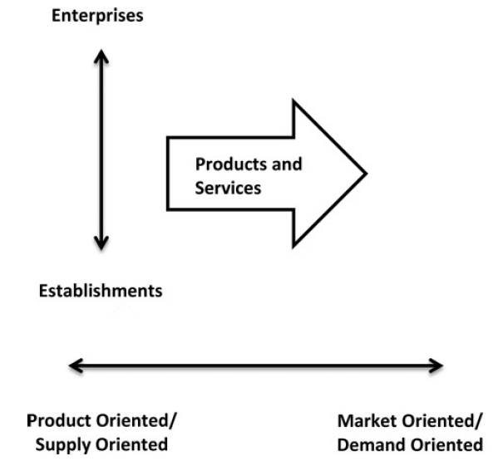
Introduction
Industry classification scheme can be divided into two categories:
A product-oriented method, and; a market-oriented method.
Orientation refers to the underlying perspective used to aggregate and classify companies and their operations [1].
Production-oriented classification
Classifying companies into industries by identifying similar processes used to produce goods or services.
Production processes and product output are key variables.
Example) SIC
Market-oriented classification
Companies are classified by the source of revenues, earnings analysis, and market perception.
It focuses on consumers and markets a company serves.
Example) GICS

Slide 7
Introduction
Example 1: Netflix
Current classification system groups vastly different companies together
SIC classifies Netflix into a “Services” sector, along with Wynn Resorts
Services
Netflix (7841) | Wynn Resorts (7780)
Level 1
Service | Service
Level 2
Employment activities | Rental and leasing activities
Level 3
Other human resources division | Other reservation service and related activities
Netflix
Wynn Resorts
Form 10-Ks, Netflix and Wynn Resorts, 2016

Slide 8
Introduction
Example 1: Netflix
Current classification system groups vastly different companies together
SIC classifies Netflix into a “Services” sector, along with Wynn Resorts
Netflix
Netflix, Inc. (“Netflix”, “the Company”, “we”, or “us”) is the world’s leading Internet television network with over 75 million streaming members in over 190 countries enjoying more than 125 million hours of TV shows and movies per day, including original series, documentaries and feature films. Our members can watch as much as they want, anytime, anywhere, on nearly any Internet-connected screen. Members can play, pause and resume watching, all without commercials or commitments. Additionally, in the United States ("U.S."), our members can receive DVDs delivered quickly to their homes.
We are a pioneer in the Internet delivery of TV shows and movies, launching our streaming service in 2007. Since this launch, we have developed an ecosystem for Internet-connected screens and have added increasing amounts of content that enable consumers to enjoy TV shows and movies directly on their Internet-connected screens. As a result of these efforts, we have experienced growing consumer acceptance of, and interest in, the delivery of TV shows and movies directly over the Internet.
Wynn Resorts
Wynn Resorts, Limited, ("Wynn Resorts," or together with its subsidiaries, "we" or the "Company"), led by Chairman and Chief Executive Officer, Stephen A. Wynn, is a leading developer, owner and operator of destination casino resorts (integrated resorts) that integrate hotel accommodations and a wide range of amenities, including fine dining outlets, premium retail offerings, distinctive entertainment theaters and large meeting complexes.
Wynn Resorts currently owns 72% of Wynn Macau, Limited, which operates an integrated resort in the Macau Special Administrative Region of the People's Republic of China ("Macau"). Wynn Resorts also owns 100% of and operates an integrated resort in Las Vegas, Nevada.
We are currently constructing Wynn Palace, an integrated resort in the Cotai area of Macau, which we expect to open in the first half of 2016; however, potential construction delays could push the opening date into the second half of 2016. We have begun site preparation and pre-construction activities for the development and construction of an integrated resort in Everett, Massachusetts, adjacent to Boston.
Form 10-Ks, Netflix and Wynn Resorts, 2016

Slide 9
Introduction
Example 2: Amazon
The company structure of Amazon has changed over the course of years
The “self-identity” of Amazon has evolved from a “bookstore” to multi-branch online retailer
Amazon.com, Inc. ("Amazon.com" or the "Company") is the leading online retailer of books. Since opening for business as "Earth's Biggest Bookstore" in July 1995, Amazon.com has become one of the most widely known, used and cited commerce sites on the World Wide Web (the "Web"). Amazon.com strives to offer its customers compelling value through innovative use of technology, broad selection, high-quality content, a high level of customer service, competitive pricing and personalized services.
1998
We serve consumers through our retail websites and focus on selection, price, and convenience. We design our websites to enable millions of unique products to be sold by us and by third parties across dozens of product categories. Customers access our websites directly and through our mobile websites and apps. We also manufacture and sell electronic devices, including Kindle e-readers, Fire tablets, Fire TVs, and Echo. We strive to offer our customers the lowest prices possible through low everyday product pricing and shipping offers, and to improve our operating efficiencies so that we can continue to lower prices for our customers. We also provide easy-to-use functionality, fast and reliable fulfillment, and timely customer service.
2016
Form 10-Ks, Amazon, 1998 and 2016

Slide 10
Introduction
Example 2: Amazon
The market structure in which Amazon competes has changed over the course of years
The “self-identified” market competitors of Amazon now include a set of entities vastly different from the past
The Company's current or potential competitors include (i) various online booksellers and vendors of other information-based products such as CDs and videotapes, including entrants into narrow specialty niches, (ii) a number of indirect competitors that specialize in online commerce or derive a substantial portion of their revenues from online commerce, through which retailers other than the Company may offer products and (iii) publishers, distributors and retail vendors of books, music and videotapes, including Barnes & Noble, Inc., Bertelsmann AG and other large specialty booksellers and integrated media corporations, many of which possess significant brand awareness, sales volume and customer bases.
1998
Our current and potential competitors include: (1) online, offline, and multichannel retailers, publishers, vendors, distributors, manufacturers, and producers of the products we offer and sell to consumers and businesses; (2) publishers, producers, and distributors of physical, digital, and interactive media of all types and all distribution channels; (3) web search engines, comparison shopping websites, social networks, web portals, and other online and app-based means of discovering, using, or acquiring goods and services, either directly or in collaboration with other retailers; (4) companies that provide e-commerce services, including website development, advertising, fulfillment, customer service, and payment processing; (5) companies that provide fulfillment and logistics services for themselves or for third parties, whether online or offline; (6) companies that provide information technology services or products, including on-premises or cloud-based infrastructure and other services; and (7) companies that design, manufacture, market, or sell consumer electronics, telecommunication, and electronic devices.
2016
Form 10-Ks, Amazon, 1998 and 2016

Slide 11
Introduction
Limitations of previous Industry classification schemes
Limitations
Terrible cases of between-class homogeneity, due to the emphasis on how firms do what they do, as opposed to the purpose for which they do it.
Consequence of innovation and technological change that has resulted in products and services that are more complex, and means of production that vary over time.
All existing classification system requires human input at some point, which can be very costly and time-consuming (especially for information updates).
(Example 1:Netflix)
(Example 2:Amazon)

Slide 12
Introduction
Previous limitations call for new approach
We aim to tackle them by exploiting the business section of the Form 10-K
We address these issues by exploiting the business section of the Form 10-Ks and cluster securities whose content of the text appear similar
The Form 10-K is a comprehensive summary of a company’s business operations and market performances, filed annually as required by the U.S. Securities and Exchange Commission
Its business section provides a finely detailed description of the company’s business operations, organizational structure, risk factors, and market competitors
We use define these textual information as the firm’s self-identity and use it as the new standards for clustering securities

Slide 13
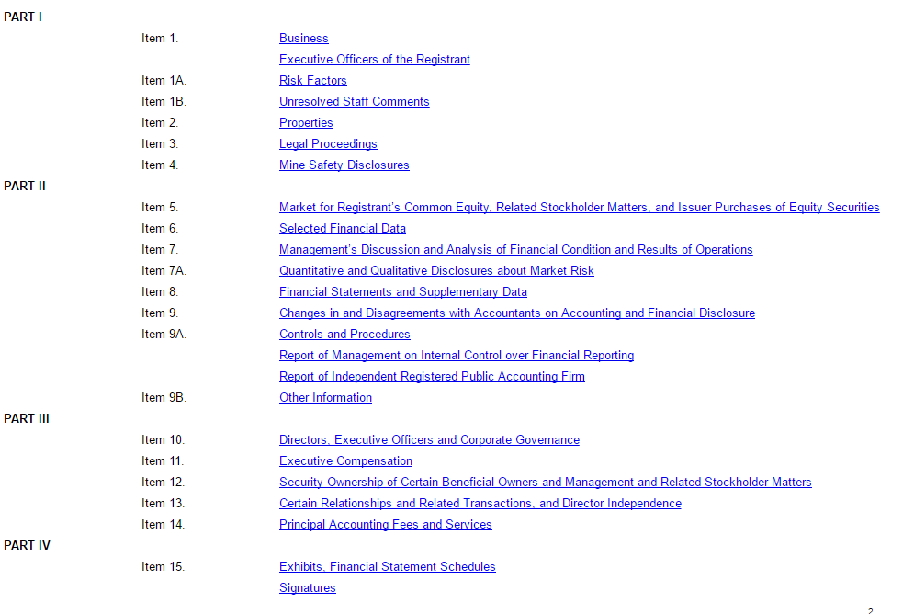
Data Source
Items typically reported in the Form 10-Ks
Form 10-K Example
Table of Contents
Microsoft 10-K (2016)

Slide 14
Introduction
Our newly developed ICS, Business Text Industry Classification (BTIC), is designed to outperform the existing classification system in four aspects
By employing doc2vec and hierarchical clustering on the business section of the Form 10-Ks, we develop a new ICS, Business Text Industry Classification (BTIC)
Given that it performs just as well as SIC or GICS, BTIC outperforms the existing schemes in four aspects:
Process automation – Once business section is extracted, the remaining steps are automated
Objectivity – Clustering is entirely data-driven
Flexibility – Organizational structure of BTIC is easily modified, fit to the user’s research needs
Result Interpretability – BTIC provides a list of words that “represent” each cluster created, thus helping the user’s understanding of the clustering process and results

Slide 15
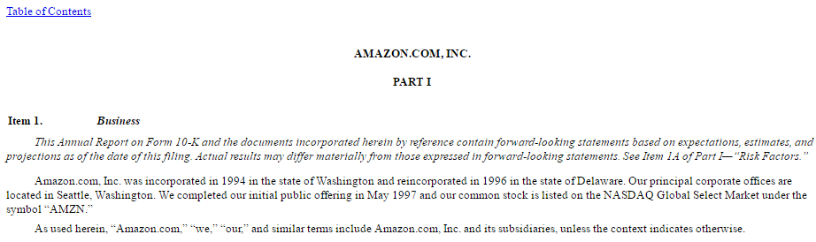
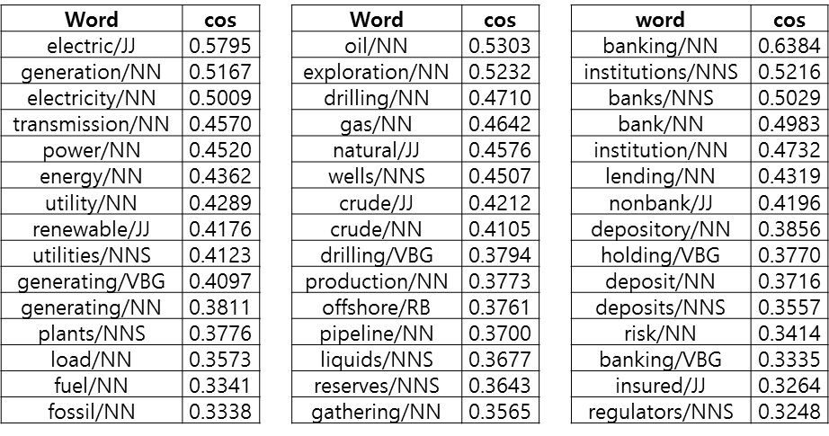
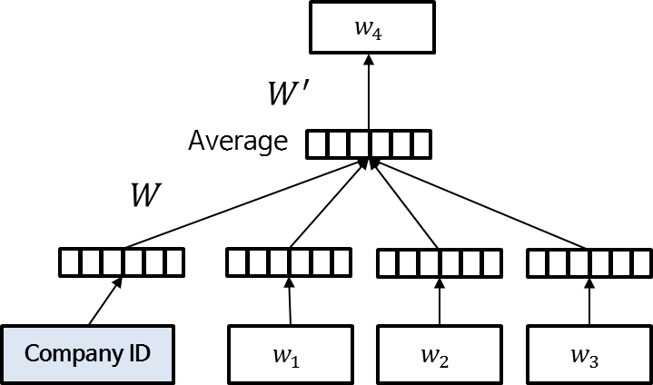
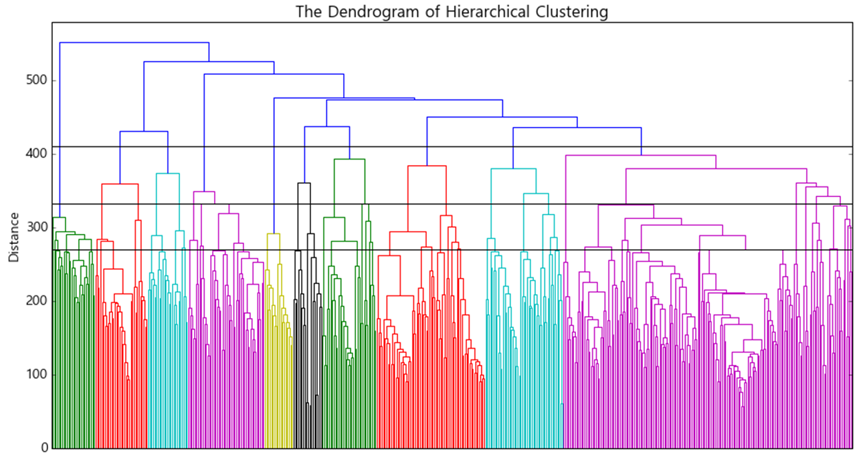

Introduction
Proposed Method
1
Data collection: Extract Business section (item 1) of Form10-Ks using regular expressions
4
Evaluation: computing $R^{2}$ of 12 financial variables
$$var_{i,t}=α+β∙var_{ind,t}+ε_{i,t}$$
2
Modeling: Document embedding, hierarchical Clustering
3
Clustering Exploration

Slide 16




Proposed Methods
We employ Doc2vec [4] modelling,
Embedding Form 10-K documents and words appearing in the reports on to a continuous space
Word2vec captures semantic, and syntactic relationships between words, sentences, and documents
experience
$$w_{10}$$
Doc2vec is very similar to word2vec. Document vector is trained with word vectors.
Dimension
Average/concatenate
Compared to Bag-of-Words(BoW) approach, we can consider the word orders, with low-dimensional vectors, in our analysis
Company ID
$$w_{1}$$
$$w_{2}$$
…
$$w_{9}$$
APPL
The
Company
…
user
Performs well in document sentiment classification
Can also use for information retrieval

Slide 17


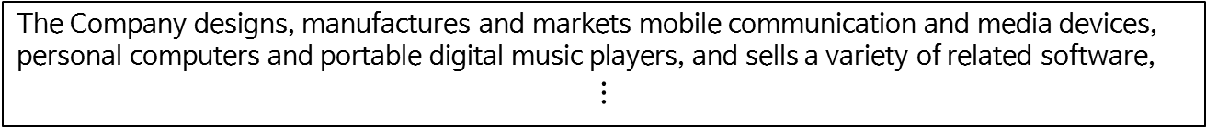








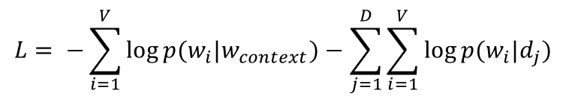

Methods
We employ Doc2vec [4] modelling,
The process of training
manufactures
Objective function
(Max likelihood = Min negative likelihood)
$$w_{4}$$
$$L= −\sum_{i=1}^{V}{\log{p(w_{i}|w_{context})}−\sum_{j=1}^{D}{\sum_{i=1}^{V}{\log{p(w_{i}|d_{j})}}}}$$
$$W^{′}$$
$$h$$
$$W$$
$w_{i}$: word vector, $d_{j}$ : company vector
Training $w_{i}$, $d_{j}$ using backpropagation
$$w_{i}^{(new)}=w_{i}^{(old)}−η∙e_{i}∙h$$
Company ID
$$w_{1}$$
$$w_{2}$$
$$w_{3}$$
$$d_{APPL}^{(new)}=d_{APPL}^{(old)}−η∙e_{i}∙h$$
APPL
The
Company
designs
$η:$learning rage$, e_{i}=\frac{∂L}{∂w_{i}^{′}}$ , $h$ =$\frac{1}{4}(w_{1}+w_{2}+w_{3}+d_{APPL})$
APPL
The Company designs, manufactures and markets mobile communication and media devices, personal computers and portable digital music players, and sells a variety of related software,
$$⋮$$

Slide 18





Methods
We employ Doc2vec [4] modelling,
The process of training
and
Objective function
(Max likelihood = Min negative likelihood)
$$w_{4}$$
$$L= −\sum_{i=1}^{V}{\log{p(w_{i}|w_{context})}−\sum_{j=1}^{D}{\sum_{i=1}^{V}{\log{p(w_{i}|d_{j})}}}}$$
$$W^{′}$$
$$h$$
$$W$$
$w_{i}$: word vector, $d_{j}$ : company vector
Training $w_{i}$, $d_{j}$ using backpropagation
$$w_{i}^{(new)}=w_{i}^{(old)}−η∙e_{i}∙h$$
Company ID
$$w_{1}$$
$$w_{2}$$
$$w_{3}$$
$$d_{APPL}^{(new)}=d_{APPL}^{(old)}−η∙e_{i}∙h$$
APPL
Company
designs
manufactures
$η:$learning rage$, e_{i}=\frac{∂L}{∂w_{i}^{′}}$ , $h$ =$\frac{1}{4}(w_{1}+w_{2}+w_{3}+d_{APPL})$
APPL
The Company designs, manufactures and markets mobile communication and media devices, personal computers and portable digital music players, and sells a variety of related software,
$$⋮$$

Slide 19

Methods
We employ Doc2vec (Le and Mikolov, 2014) modelling,
The process of training
markets
Objective function
(Max likelihood = Min negative likelihood)
$$w_{4}$$
$$L= −\sum_{i=1}^{V}{\log{p(w_{i}|w_{context})}−\sum_{j=1}^{D}{\sum_{i=1}^{V}{\log{p(w_{i}|d_{j})}}}}$$
$$W^{′}$$
$$h$$
$$W$$
$w_{i}$: word vector, $d_{j}$ : company vector
Training $w_{i}$, $d_{j}$ using backpropagation
$$w_{i}^{(new)}=w_{i}^{(old)}−η∙e_{i}∙h$$
Company ID
$$w_{1}$$
$$w_{2}$$
$$w_{3}$$
$$d_{APPL}^{(new)}=d_{APPL}^{(old)}−η∙e_{i}∙h$$
APPL
designs
manufactures
and
$η:$learning rage$, e_{i}=\frac{∂L}{∂w_{i}^{′}}$ , $h$ =$\frac{1}{4}(w_{1}+w_{2}+w_{3}+d_{APPL})$
APPL
The Company designs, manufactures and markets mobile communication and media devices, personal computers and portable digital music players, and sells a variety of related software,
$$⋮$$

Slide 20
Methods
We employ Doc2vec (Le and Mikolov, 2014) modelling,
The process of training
mobile
Objective function
(Max likelihood = Min negative likelihood)
$$w_{4}$$
$$L= −\sum_{i=1}^{V}{\log{p(w_{i}|w_{context})}−\sum_{j=1}^{D}{\sum_{i=1}^{V}{\log{p(w_{i}|d_{j})}}}}$$
$$W^{′}$$
$$h$$
$$W$$
$w_{i}$: word vector, $d_{j}$ : company vector
Training $w_{i}$, $d_{j}$ using backpropagation
$$w_{i}^{(new)}=w_{i}^{(old)}−η∙e_{i}∙h$$
Company ID
$$w_{1}$$
$$w_{2}$$
$$w_{3}$$
$$d_{APPL}^{(new)}=d_{APPL}^{(old)}−η∙e_{i}∙h$$
APPL
manufactures
and
markets
$η:$learning rage$, e_{i}=\frac{∂L}{∂w_{i}^{′}}$ , $h$ =$\frac{1}{4}(w_{1}+w_{2}+w_{3}+d_{APPL})$
APPL
The Company designs, manufactures and markets mobile communication and media devices, personal computers and portable digital music players, and sells a variety of related software,
$$⋮$$

Slide 21
Methods
We employ Doc2vec (Le and Mikolov, 2014) modelling,
The process of training
communication
Objective function
(Max likelihood = Min negative likelihood)
$$w_{4}$$
$$L= −\sum_{i=1}^{V}{\log{p(w_{i}|w_{context})}−\sum_{j=1}^{D}{\sum_{i=1}^{V}{\log{p(w_{i}|d_{j})}}}}$$
$$W^{′}$$
$$h$$
$$W$$
$w_{i}$: word vector, $d_{j}$ : company vector
Training $w_{i}$, $d_{j}$ using backpropagation
$$w_{i}^{(new)}=w_{i}^{(old)}−η∙e_{i}∙h$$
Company ID
$$w_{1}$$
$$w_{2}$$
$$w_{3}$$
$$d_{APPL}^{(new)}=d_{APPL}^{(old)}−η∙e_{i}∙h$$
APPL
and
markets
mobile
$η:$learning rage$, e_{i}=\frac{∂L}{∂w_{i}^{′}}$ , $h$ =$\frac{1}{4}(w_{1}+w_{2}+w_{3}+d_{APPL})$
APPL
The Company designs, manufactures and markets mobile communication and media devices, personal computers and portable digital music players, and sells a variety of related software,
$$⋮$$

Slide 22
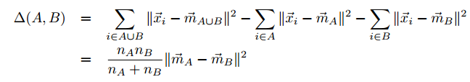


Proposed Methods
We employ Ward’s hierarchical clustering [5] to resemble the organizational structure of the existing classification schemes
Industry classification schemes group entities in a hierarchical manner
BTIC employs a Ward’s hierarchical clustering [4] method to resemble the organizational structure of the existing ICS
At each iteration, Ward’s method finds a pair of clusters that leads to the minimum increase in total within cluster variance after merging the clusters
Uses Euclidean distance to cluster entities
Studies have shown that the distributed vectors are correlated with the semantic similarity [6, 7]
$\vec{m_{j}}$ : center of cluster $j$
$n_{j}$ : number of points in cluster $j$

Slide 23
Experiment
Data Summary
Form 10-Ks
Used web crawling to collect Form 10-Ks of 504 S&P500 companies, published around January 1, 2016
Broadcom Corp.(BRCM) has been merged with Avago tech, hence its last Form 10-K was published in January 2015
Coca-Cola Enterprises(CCE) was established and began being publicly traded in August 2015, hence no Form 10-K to refer to
ACE Limited has changed its name to Chubb Limited(CB) in January 19, 2016, hence no Form 10-k
Ultimately, our experiment data includes 501 S&P500 companies
Financial market ratios
Matched collected companies to 12 market ratios from January 1, 2015, to December 31, 2015
Raw data was retrieved from the Center for Research in Security Prices (CRSP) and Compustat databases, which were later used to calculate representative market ratios

Slide 24
Experiment
Doc2vec modeling
1) Doc2vec modeling
Vector size : 500 dimension
Window size : 8
Number of training epochs : 30
Training time : about 20 min
2) Hierarchical clustering using Ward’s method
Number of level 1 categories: 10
Number of level 2 categories: 24
Number of level 3 categories: 68

Slide 25
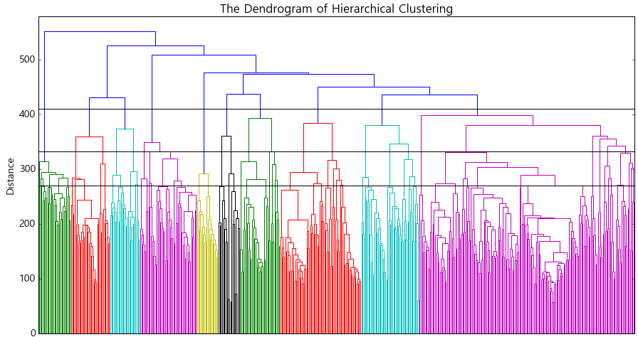
Experiment
Clustering Result: Represent each company as a vector, then run hierarchical clustering
Set different threshold values to create various groupings
410
332
270

Slide 26
Experiment
Clustering Result: Cluster Investigation (Top 5 Market Cap Firms)
Now placements of Netflix and Amazon make sense!

Slide 27
Evaluation
Qualitative Evaluation: Cluster Investigation (20 groups)
Example: Netflix
Netflix, originally classified into the Services sector, is now grouped together with other media companies
Our Methods
Traditional Methods

Slide 28
Evaluation
Qualitative Evaluation: Cluster Investigation (20 groups)
Example: Amazon
Amazon
Our Methods
Traditional Methods

Slide 29
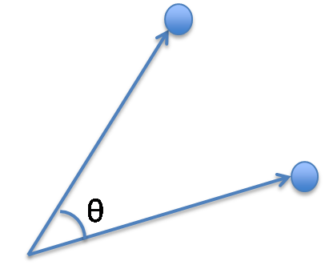

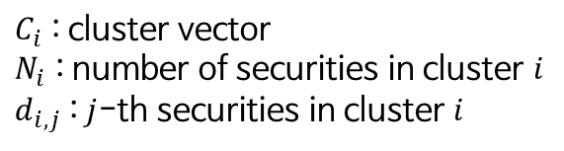
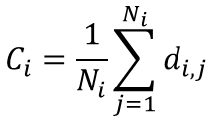
Evaluation
Qualitative Evaluation Interpretability (20 groups)
We can get interpretability by calculating similarities between securities and words
Visualization of Security vectors and word vectors using t-SNE
Calculate the cosine similarities between cluster vectors and
word vectors
$$C_{i}=\frac{1}{N_{i}}\sum_{j=1}^{N_{i}}{d_{i,j}}$$
$C_{i}$ : cluster vector
$N_{i}$ : number of securities in cluster $i$
$d_{i,j}$ : $j$-th securities in cluster $i$
$$sim\left(C, W\right)=\frac{C∙W}{\left\|C\right\|\left\|W\right\|}$$
Security vectors in cluster 6
Word vectors

Slide 30
Evaluation
Qualitative Evaluation: 특정 keyword 와 유사한 security vector를 추출할 수 있음.
이를 사용하여 theme 혹은 특정 산업에 대한 portfolio를 구성하는데도 활용할 수 있을 것으로 기대
Visualization of Security vectors and word vectors using t-SNE
Top 10 security vectors similar to word vector “Solar/NN”
Ticker | Sim
FSLR | 0.25399
PCG | 0.211587
XOM | 0.188723
AES | 0.185579
PPL | 0.183146
NKE | 0.138655
ARG | 0.129446
TRIP | 0.126007
DUK | 0.125552
CF | 0.124175
Solar/NN 라는 단어 주변의 공간을 살펴보면 왼쪽과 같이 여러 word, security vectors가 있음.
XOM(Exxon), DUK(Duke Energy)FSLR(First Solar) 등 Energy 회사를 추출할 수 있음
Security vectors
Seed word vector
Word vectors

Slide 31
Evaluation
Qualitative Evaluation: Interpretability (20 groups)

Slide 32
Evaluation
Qualitative Evaluation: Interpretability (20 groups)

Slide 33
Evaluation
Quantitative Evaluation: Inter- and Intra-Industry Tests of Homogeneity
We follow Bhojraj et al. (2003) as the benchmark [8]
Following Bhojraj et al. (2003) as the benchmark, we propose to evaluate BTIC quantitatively across 12 variables commonly used in capital market research

Slide 34
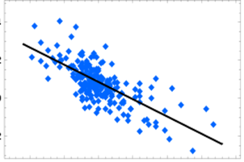
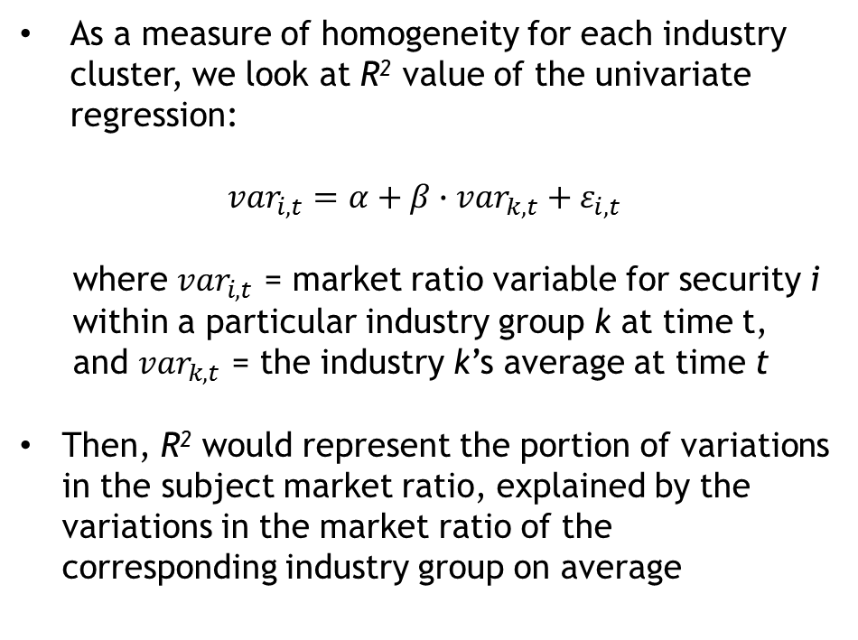
Evaluation
Quantitative Evaluation: Inter- and Intra-Industry Tests of Homogeneity
We follow Bhojraj et al. (2003) as the benchmark [8]
As a measure of homogeneity for each industry cluster, we look at R² value of the univariate regression:
$${var}_{i, t}=α+β∙{var}_{k, t}+ε_{i, t}$$
where ${var}_{i, t}$ = market ratio variable for security i within a particular industry group k at time t, and ${var}_{k, t}$ = the industry k’s average at time t
Then, R² would represent the portion of variations in the subject market ratio, explained by the variations in the market ratio of the corresponding industry group on average
Calendar Quarter-End Returns
Real Estate
Market ratio value at time t
Jan Jun Dec
Jan Mar May Jul Sep Nov
Average market ratio at time t

Slide 35
Evaluation
Quantitative Evaluation: Inter- and Intra-Industry Tests of Homogeneity
We follow Bhojraj et al. (2003) as the benchmark [8]

Slide 36
Discussion
Contribution : Four main contributions
1) Objectivity
We cluster companies based on their self-identification as disclosed on the Form 10-Ks
Data-driven, and requires no human effort in the process
2) Interpretability
Clustering based on simple market numerics (stock prices, etc.) offer not much interpretability
Our clusters offer “stories” from which one can tell “why” select companies are clustered together
3) Flexibility
Our clustering methodology allows users to change the number of clusters flexibly according to their needs, simply by controlling threshold values
4) Automation
We collect and process hundreds and thousands of corporate documents automatically and can cluster companies on real-time basis

Slide 37
Discussion
Future Work & Limitations & Expected Work
Expand text corpus to include greater number of firms in the analysis
Include market conception index when calculating similarities between the securities
Employ other means of clustering techniques and compare the results
Multiple membership
Trajectory analysis

Slide 38
Reference
[1] Phillips, R. L., and R. Ormsby. "Industry classification schemes: An analysis and
review." Journal of Business & Finance Librarianship. Vol. 21, No. 1. (2016) pp:1-25.
[2] United States Department of Labor. “SIC Divions Structure.” Occupational Safety
and Health Administration. http://www.osha.gov/pls/imis/sic_manual.html (2016)
[3] MSCI Inc. “Global Industry Classification Standard (GICS).” (2016)
[4] Le, Q. V., and T. Mikolov. “Distributed representations of sentences and documents.”
ICML. Vol. 14. (2013) pp: 1188 – 2296.
[5] Ward Jr., J. H. “Hierarchical Grouping To Optimize an Objective Function.” Journal
of the American Statistical Association. Vol. 58, No. 301. (1963) pp: 236-244.
[6] Collobert, R., and J. Weston. “A Unified Architecture for Natural Language Processing: Deep Neural Networks with Multitask Learning.” Proceedings of the 25th International Conference on Machine Learning. (2008) pp: 160-167.

Slide 39
Reference
[7] Das, R., M. Zaheer, and C. Dyer/ “Gaussian LDA for Topic Models with Word Embeddings.” Proceedings of the 53rd Annual Meeting of the Association for Computational Linguistics. (2015)
[8] Bhojraj, S., C. Lee, and D. K. Oler. "What's My Line? A Comparison of Industry
Classification Schemes for Capital Market Research." Journal of Accounting Research. Vol.
41, No. 5. (2003) pp: 745-774.

