Slide 1
Lab Seminar 2016 Fall
Neural Variational Document Model
Yishu Miao, Lei Yu, and Phill Blunsom. 2015. Neural variational inference for text processing.
arXiv preprint arXiv:1511.06038
임진배 | 2016.11.03

Slide 2
1. Introduction
2. Details of the Deep Neural Network Structures
3. Experiments & Results
4. NVDM on Latent Aspect Rating Analysis
5. References
INDEX
Lab Seminar 2016 Fall

Slide 3
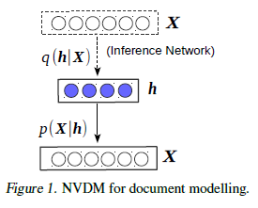
Introduction
01
02
Neural Variational Document Model (NVDM)
03
04
05
- Unsupervised generative text model
- Extract a continuous semantic latent variable for each document
Lab Seminar 2016 Fall

Slide 4
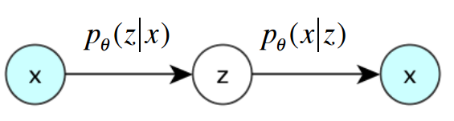

Introduction
01
02
Neural Variational Document Model (NVDM)
03
04
$$h$$
MLP encoder
Softmax decoder
05
NVDM can be interpreted as a Variational auto-encoder - MLP encoder(inference network) → compresses the bag-of-words document representation into a continuous latent distribution
- Softmax decoder(generative model) → reconstructs the document by generating the words independently
Each word is generated directly from a dense continuous document representation instead of the more common binary semantic vector
Lab Seminar 2016 Fall

Slide 5

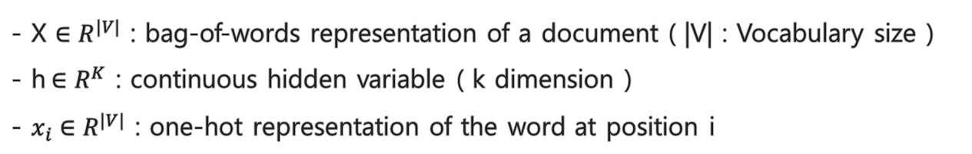

Details of the Deep Neural Network Structures
01
02
NVDM
03
04
05
h
$$q_{φ}(h|X)$$
$$p_{θ}(X|h)$$
X
X’
- X $∈R^{|V|}$ : bag-of-words representation of a document ( |V| : Vocabulary size )
- h$∈R^{K}$ : continuous hidden variable ( k dimension ) - $x_{i}∈R^{|V|}$ : one-hot representation of the word at position i
Lab Seminar 2016 Fall

Slide 6

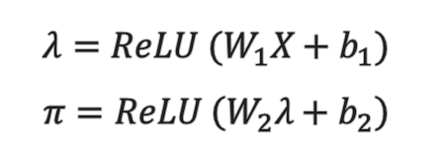

Details of the Deep Neural Network Structures
01
02
MLP encoder
03
①
②
③
04
h
05
$$q_{φ}(h|X)$$
X
①
$$λ=ReLU (W_{1}X+b_{1})$$
$$π=ReLU \left(W_{2}λ+b_{2}\right)$$
②
$$μ= W_{3}λ+b_{3}$$
$$\log{σ}=W_{4}λ+b_{4}$$
$$h \sim N(μ\left(X\right), diag\left(σ^{2}\left(X\right)\right))$$
③
→ compresses document representations into continuous hidden vectors (X -> h)
Lab Seminar 2016 Fall

Slide 7


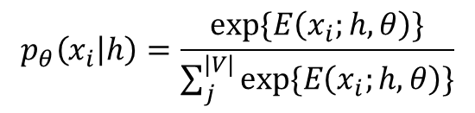
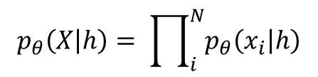
Details of the Deep Neural Network Structures
01
02
Softmax decoder
03
04
h
$$p_{θ}(X|h)$$
05
X’
$$E\left(x_{i};h,θ\right)= h^{T}Rx_{i}+b_{x_{i}}$$
$$p_{θ}\left(x_{i} | h\right)=\frac{exp⁡\{E\left(x_{i};h,θ\right)\}}{\sum_{j}^{|V|}{exp⁡\{E\left(x_{i};h,θ\right)\}}}$$
$$p_{θ}\left(X | h\right)= \prod_{i}^{N}{p_{θ}\left(x_{i} | h\right)}$$
$$R^{K ×|V|}:semantic word embeddings { b}_{x_{i}} :bias term$$
→ Reconstructs the documents by independently generating the words (h -> ${\{x}_{i}\}$)
Lab Seminar 2016 Fall

Slide 8

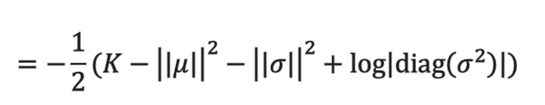

Details of the Deep Neural Network Structures
01
02
Variational lower bound
03
04
05
$$≈\sum_{l=1}^{L}{\sum_{i=1}^{N}{log⁡p_{θ}(x_{i}|h^{\left(l\right)})}}$$
$$=−\frac{1}{2}(K−{\left|\left|μ\right|\right|}^{2}−{\left|\left|σ\right|\right|}^{2}+log\left|diag\left(σ^{2}\right)\right|)$$
→ Based on the samples $h \sim q_{∅}(h|X)$ , the lower bound can be optimised by back-
propagating the stochastic gradients w.r.t. $θ$ and $∅$
Lab Seminar 2016 Fall

Slide 9
Experiments & Results
01
02
Dataset
- 20NewsGroups : a collection of 20 newsgroup documents → 11,314 training and 7,531 test articles [vocabulary size = 2,000] - Reuters RCV1-v2 : a large collection from Reuters newswire stories → 794,414 training and 10,000 test cases [vocabulary size = 10,000]
03
04
05
Preprocessing
- Removing common stopwords - Stemming - Only considering the 2,000 (10,000) most frequent words
Lab Seminar 2016 Fall

Slide 10
Experiments & Results
01
02
Setup for document modelling
03
- Dimension of Latent space : 50 and 200 - MLP with 2 layers and 500 dimensional ReLUs - During training, carry out stochastic estimation by taking one sample In prediction, use 20 samples for predicting document perplexity
- Adam optimizer - Tuned by hold-out validation perplexity - Alternately optimise the generative model and the inference network by fixing the parameters of one while updating the parameters of the other
04
05
Lab Seminar 2016 Fall

Slide 11
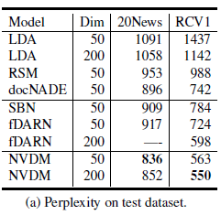

Experiments & Results
01
02
Results
03
- Document perplexity → : log prob of the words in the document NVDM 에선 intractable 하기에 이를 variational lower bound로 대체하여 사용
04
D : # of documents $N_{d}$ : length of the dth document
05
Lab Seminar 2016 Fall

Slide 12
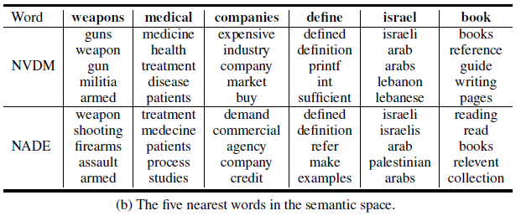
Experiments & Results
01
02
Results
03
- The five nearest words in the semantic space
04
05
Lab Seminar 2016 Fall

Slide 13
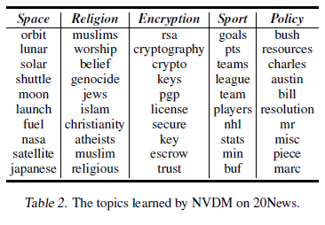
Experiments & Results
01
Results
02
- Topic modeling
03
04
05
→ Latent space의 each dimension이 topic을 나타낸다고 가정 → 5 randomly selected topics with 10 words that have the strongest positive connection with the topic
→ Although the model does not impose independent interpretability on the latent representation dimensions, NVDM learns locally interpretable structure
Lab Seminar 2016 Fall

Slide 14
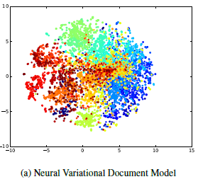
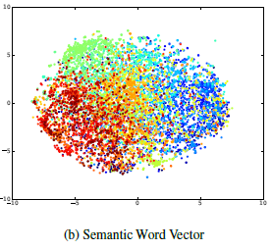
Experiments & Results
01
Results
02
- t-SNE visualisation of the document representations
03
04
05
→ achieved by held-out test dataset of 20NewsGroups → 20 different news groups correspond to the points with different color
Lab Seminar 2016 Fall

Slide 15
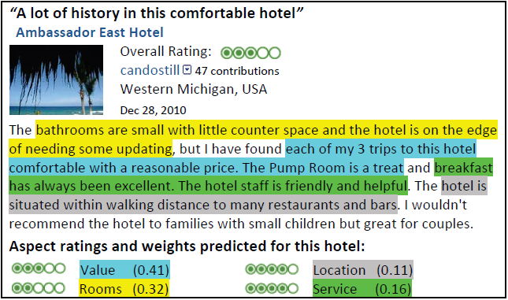
NVDM on Latent Aspect Rating Analysis
01
Latent Aspect Rating Analysis
02
03
04
05
Input : Overall Rating & Review text
Output : Topical Aspects & Aspect weights & Aspect ratings
Lab Seminar 2016 Fall

Slide 16
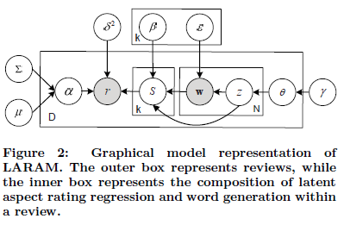
NVDM on Latent Aspect Rating Analysis
01
Latent Aspect Rating Analysis without Aspect Keyword Supervision (Wang et al., 2011)
02
03
04
05
LDA에 기반한 모델
Bag-of-words representation을 사용하여 sentence boundary와 단어 사이의 proximity 정보가 고려되지 않음
Aspect segmentation capability에 악영향을 미쳐 부정확한 segments가 rating analysis에 사용되면서 좋지 않은 성능
Lab Seminar 2016 Fall

Slide 17
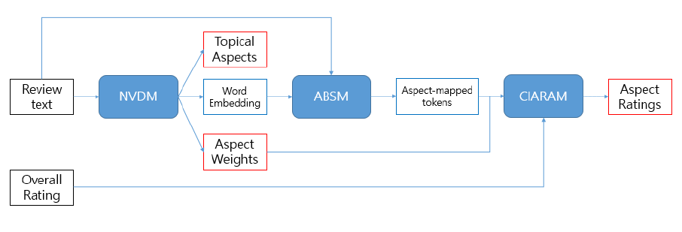
NVDM on Latent Aspect Rating Analysis
01
Latent Aspect Rating Analysis using Variational Auto Encoder
02
03
04
05
NVDM (Neural variational document model)
ABSM (Aspect based sentiment model)
CIARAM (CNN-Integrated Aspect Rating Analysis Model)
Lab Seminar 2016 Fall

Slide 18

NVDM on Latent Aspect Rating Analysis
01
NVDM on Latent Aspect Rating Analysis
02
03
$$h$$
04
MLP encoder
Softmax decoder
[Document]
[Latent space]
05
[Review text]
[Latent Aspect]
Review text의 document term vector, word vector가 latent space에 embedding
Latent space의 each dimension이 Latent Aspect를 나타낸다고 가정
NVDM : Latent space의 dimension(Latent Aspects의 개수)이 적절히 선택되었을 때, Aspect 항목과 Aspect weights를 구하는 모델
Lab Seminar 2016 Fall

Slide 19
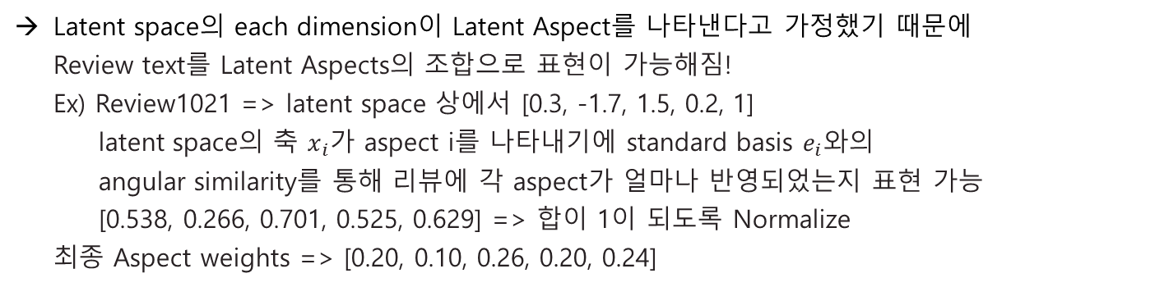
NVDM on Latent Aspect Rating Analysis
01
NVDM on Latent Aspect Rating Analysis
02
03
Latent space의 each dimension이 Latent Aspect를 나타낸다고 가정했기 때문에 Review text를 Latent Aspects의 조합으로 표현이 가능해짐! Ex) Review1021 => latent space 상에서 [0.3, -1.7, 1.5, 0.2, 1] latent space의 축 $x_{i}가$ aspect i를 나타내기에 standard basis $e_{i}$와의 angular similarity를 통해 리뷰에 각 aspect가 얼마나 반영되었는지 표현 가능 [0.538, 0.266, 0.701, 0.525, 0.629] => 합이 1이 되도록 Normalize 최종 Aspect weights => [0.20, 0.10, 0.26, 0.20, 0.24]
04
05
Aspect weights가 [Value 20%, Location 10%, Rooms 26%, Service 20%, Cleanness 24%] 와 같이 의미를 나타내도록 해야함
Latent space의 dimension을 바꾸어 보면서 each dimension이 리뷰에 영향을 주는 latent aspects로서 의미를 갖는지에 대해 확인하는 프로파일링 작업을 수행
프로파일링 작업을 통해 적절한 dimension을 선택하고 각 aspects에 이름을 붙여 [Value 20%, Location 10%, Rooms 26%, Service 20%, Cleanness 24%] 형태로 output 생성
Lab Seminar 2016 Fall

Slide 20
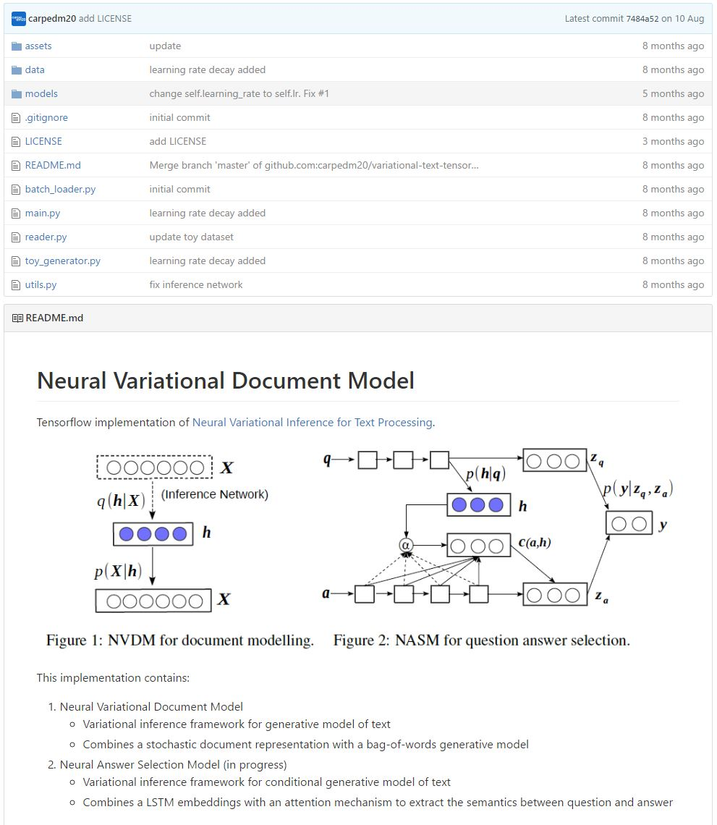
NVDM on Latent Aspect Rating Analysis
01
NVDM Tensorflow python code (https://github.com/carpedm20/variational-text-tensorflow)
02
03
04
05
Lab Seminar 2016 Fall

Slide 21
REFERENCES
01
[1] Yishu Miao, Lei Yu, and Phil Blunsom. 2015. Neural variational inference for text processing. arXiv preprint arXiv:1511.06038 .
02
03
[2] Hongning Wang, Yue Lu, and ChengXiang Zhai. 2011. Latent aspect rating analysis without aspect keyword supervision. In Proceedings of KDD, pages 618–626.
04
05
[3] Tensorflow implementation of Neural Variational Inference for Text Processing https://github.com/carpedm20/variational-text-tensorflow
Lab Seminar 2016 Fall

