Slide 1
Computer Organization Lab1 MIPS Simulator - SPIM
ICES Lab

Slide 2
QtSPIM
QtSPIM 是個簡易的MIPS Simulator
擁有Assembler，可將MIPS code轉換成machine code並執行
可output 編過的machine code file
介面含三個部分:
Register File
Text Segment
Data Segment

Slide 3
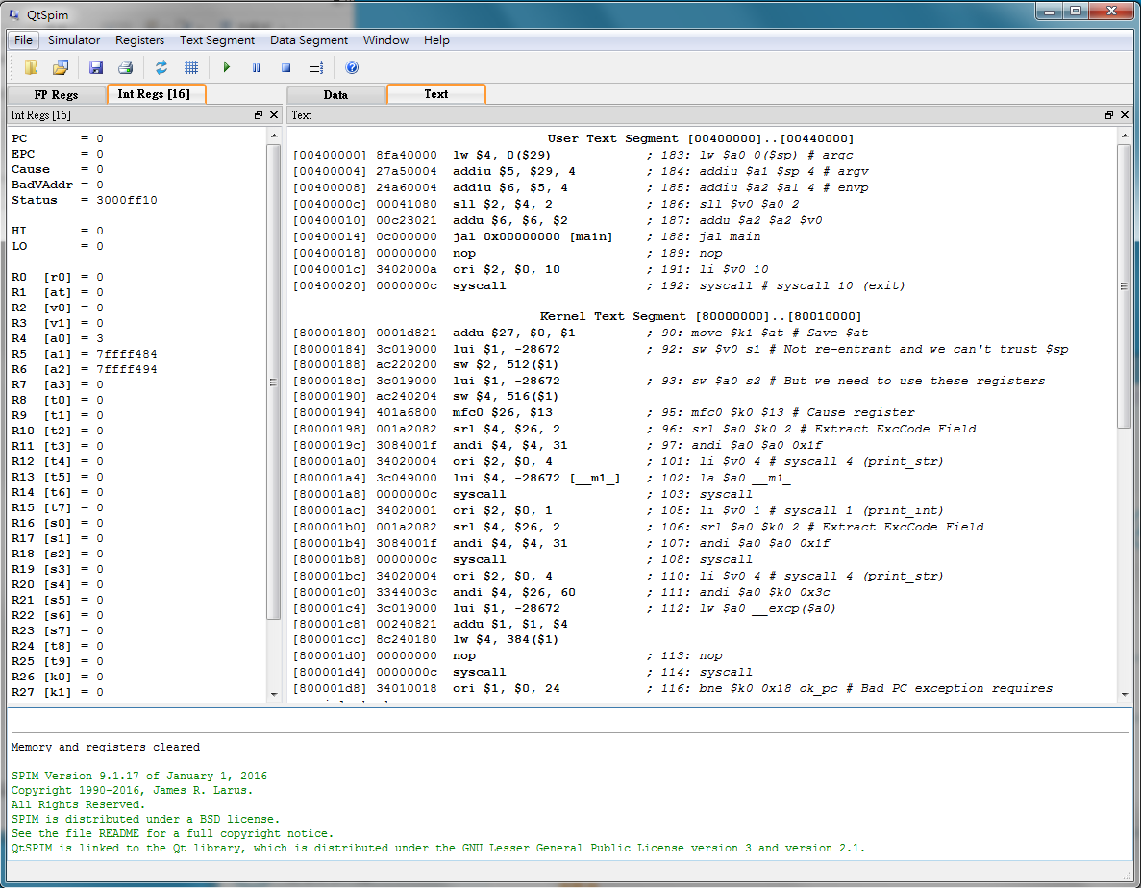
QtSPIM
Register file
Text Segment

Slide 4
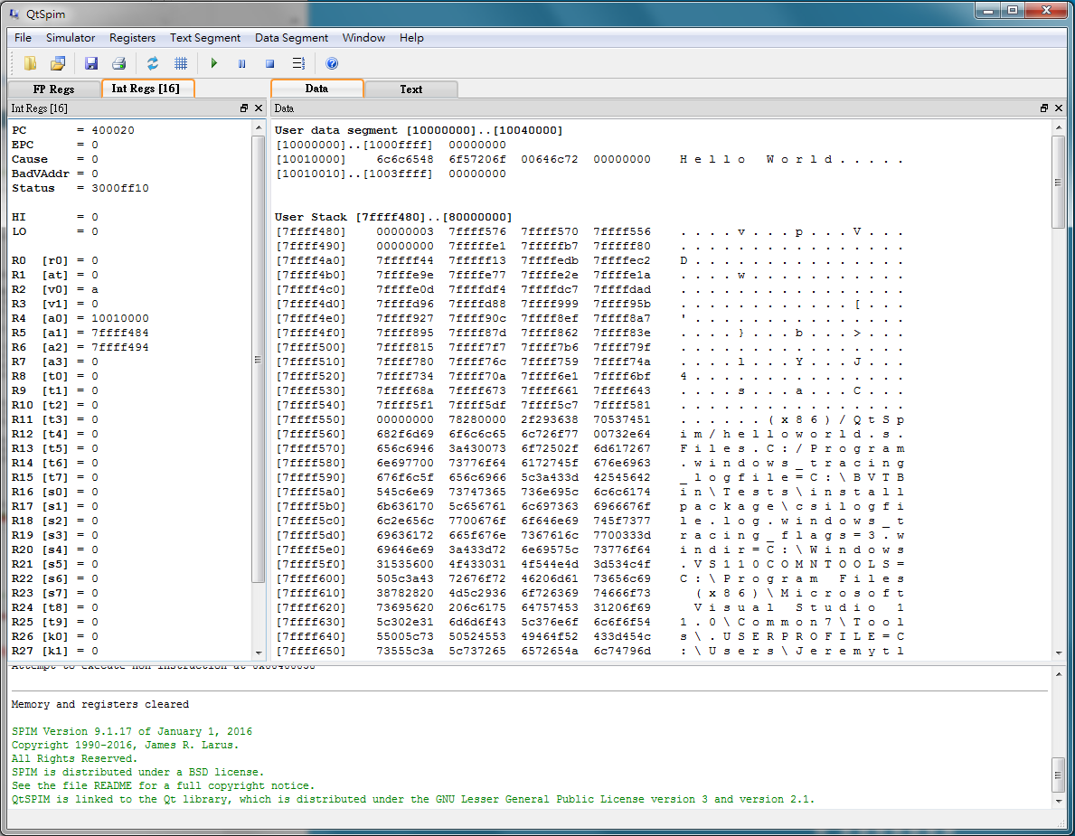
QtSPIM
Data Segment

Slide 5
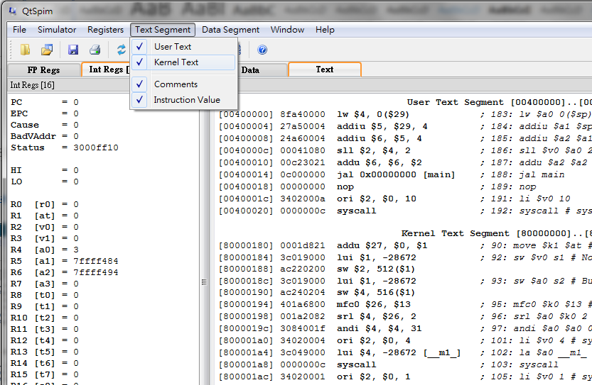
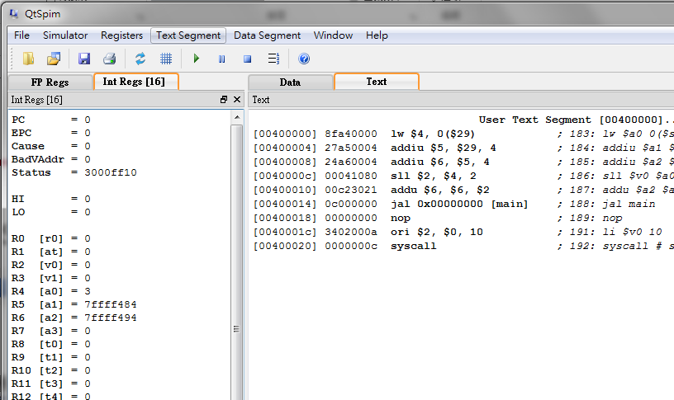
QtSPIM
環境Setup
Text Segment >取消勾選Kernel Text
再點 reinitialize simulator

Slide 6
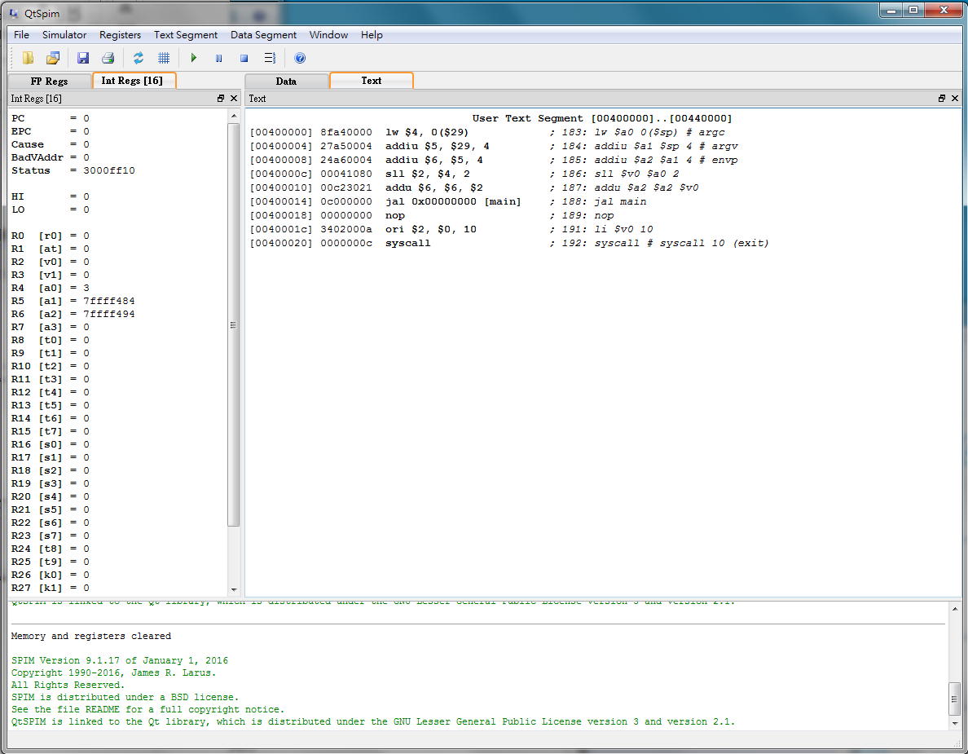
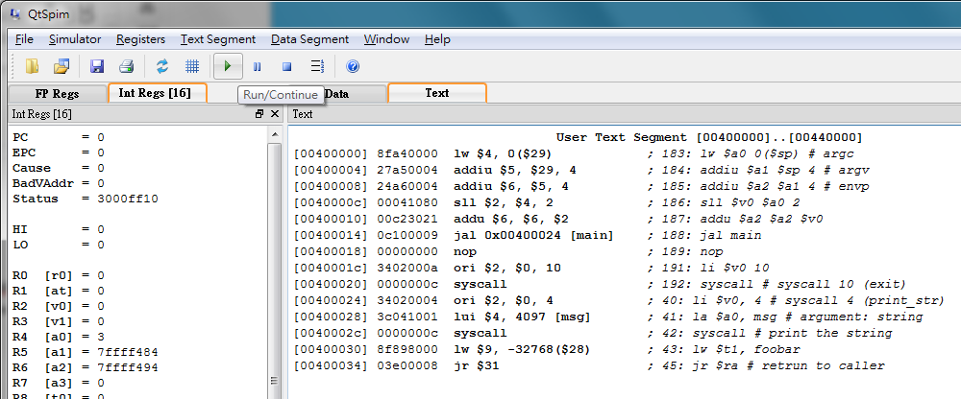

QtSPIM
Load file
點選 reinitialize and load file，選擇要編的assembly code file
範例:QSPIM資料夾內的helloworld.s
點選 Run/Continue
Console output: Hello World
*若出現Attempt to execute non-instruction ，直接按OK即可

Slide 7
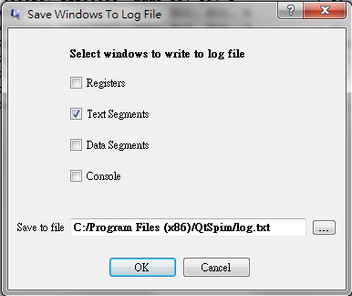
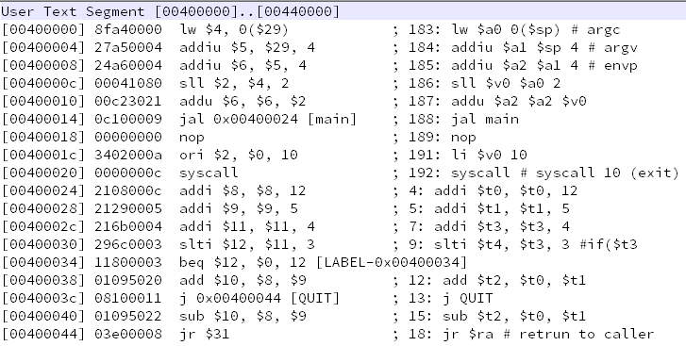
QtSPIM
Output machine code
點選 勾選Text Segment
選擇要存的folder並命名xxx.txt
PC
Machine code(hex)
assembly
comment

Slide 8
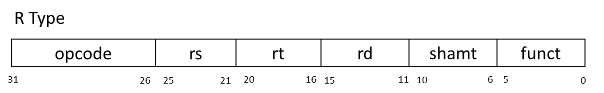
MIPS instruction
Assembly syntax:
opcode | Mnemonics | SRC1 | SRC2 | DST | funct | Description
000000 | nop | 00000 | 00000 | 00000 | 000000 | No operation
000000 | add | $Rs | $Rt | $Rd | 100000 | Rd = Rs + Rt
000000 | sub | $Rs | $Rt | $Rd | 100010 | Rd = Rs – Rt
000000 | and | $Rs | $Rt | $Rd | 100100 | Rd = Rs & Rt
000000 | or | $Rs | $Rt | $Rd | 100101 | Rd = Rs | Rt
000000 | xor | $Rs | $Rt | $Rd | 100110 | Rd = Rs ^ Rt
000000 | nor | $Rs | $Rt | $Rd | 100111 | Rd = ~(Rs | Rt)
000000 | slt | $Rs | $Rt | $Rd | 101010 | Rd = ( Rs < Rt )?1:0
000000 | sll |  | $Rt | $Rd | 000000 | Rd = Rt << shamt
000000 | srl |  | $Rt | $Rd | 000010 | Rd = Rt >> shamt
000000 | jr | $Rs |  |  | 001000 | PC=Rs
op | $Rd, | $Rs, | $Rt
※ jr $ra (相等於 return)

Slide 9
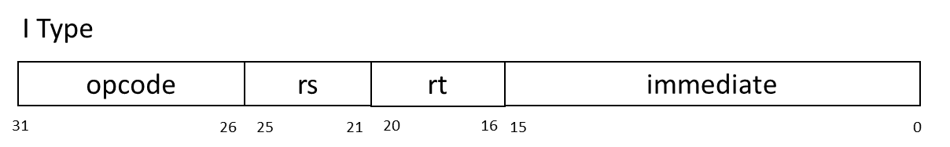
MIPS instruction
opcode | Mnemonics | SRC1 | DST | SRC2 | Description
001000 | addi | $Rs | $Rt | imm | Rt = Rs + imm
001100 | andi | $Rs | $Rt | imm | Rt = Rs & imm
001010 | slti | $Rs | $Rt | imm | Rd = ( Rs < imm ) ? 1 : 0
000100 | beq | $Rs | $Rt | imm | If( Rs == Rt) PC=PC+4+imm
000101 | bne | $Rs | $Rt | imm | If( Rs != Rt) PC=PC+4+imm
100011 | lw | $Rs | $Rt | imm | Rt = Mem[ Rs + imm ]
101011 | sw | $Rs | $Rt | imm | Mem[ Rs + imm ] = Rt
※bne/beq $Rt, $Rs, Label
Assembly syntax:
op | $Rt, | $Rs, | imm

Slide 10
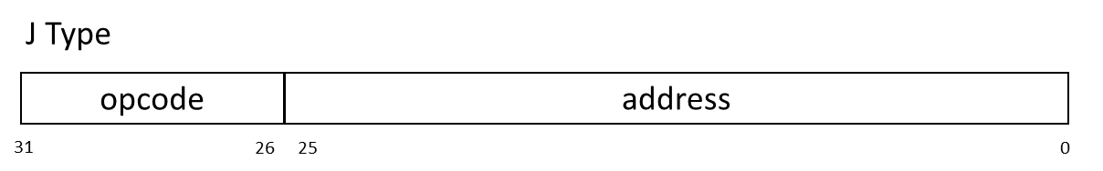
MIPS instruction
opcode | Mnemonics | SRC1 | Description
000010 | j | jumpAddr | PC = jumpAddr
000011 | jal | jumpAddr | R[31] = PC + 8 ; PC = jumpAddr
※R[31]=$ra #return address
Assembly Syntax:
op | jumpAddr/Label

Slide 11
MIPS instruction
Demo
Addition & subtraction
Branch
Debug
Single step
Set Breakpoint

Slide 12
Addition & subtraction
R-type
add $10, $9, $8
sub $11, $10, $8
I-type
addi $12, $0, 5
addi $13, $0, 6

Slide 13
Branch
I-type
beq $12, $13, error
J-type
j exit

Slide 14
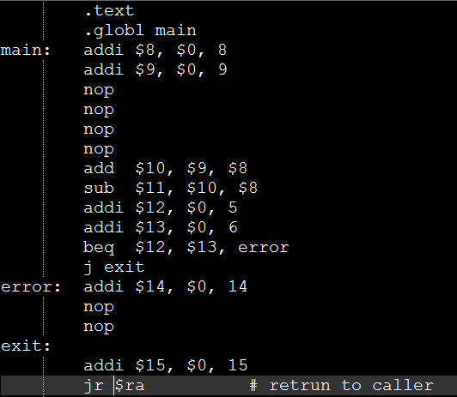
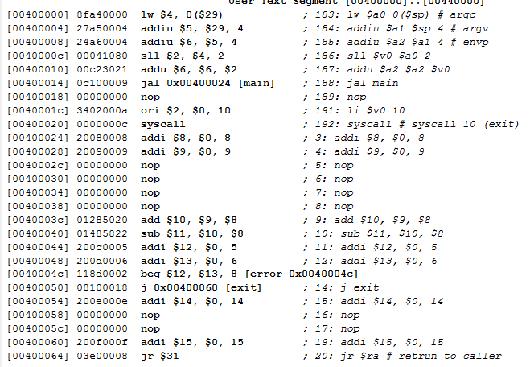
Assembly Code & machine code

Slide 15
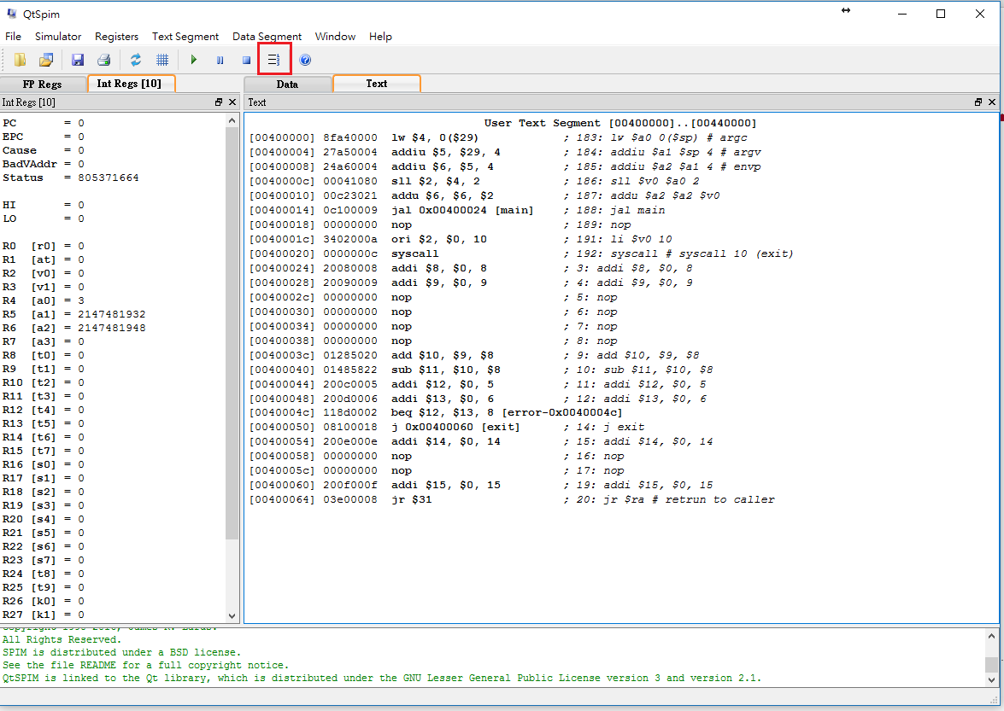
Single step

Slide 16
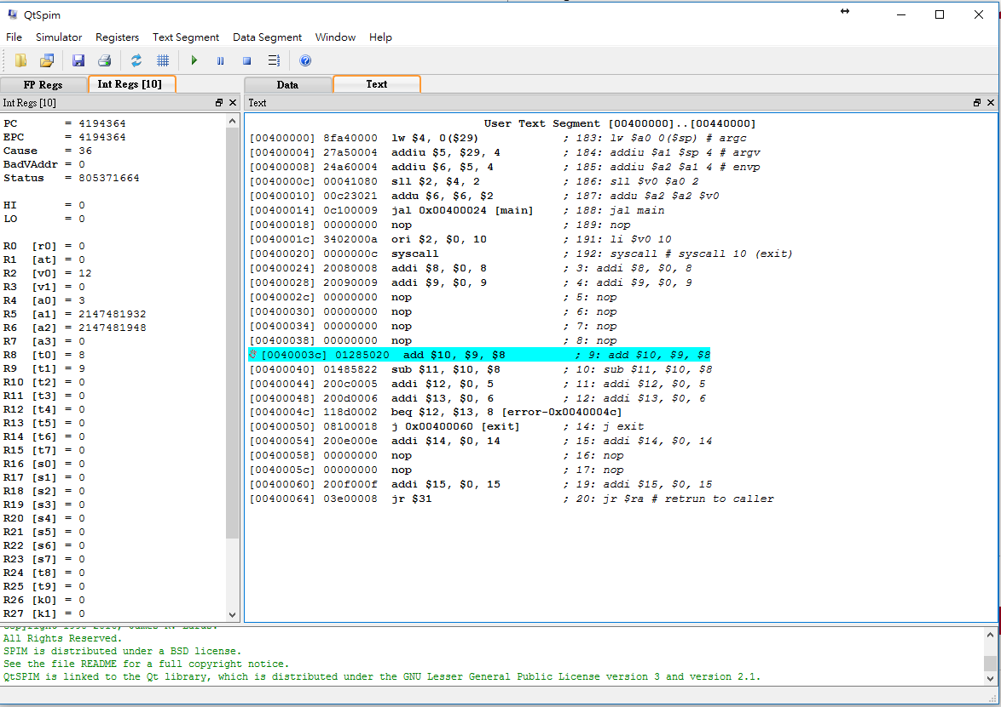
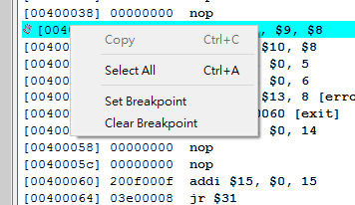
Set Breakpoint
對想要 Break 的 instruction 右鍵>選擇 Set Breakpoint，然後點下Run/continue.

Slide 17
Lab1
實作出1 + 2 + 3 + … + 25並將結果存放在 $t0
Code中必須有iteration (利用Branch) ，不可直接將正確答案放入$t0

