Slide 1
ANALOG-TO-DIGITAL CONVERTER(A/D)
黃呂源

Slide 2
A Data Acquisition System
The example of continuous signal conversion
5V
1023
A/D CONVERISON
0
0V
0s
8s
0s
8s
The signal after Amplifier
The digital code after conversion
Notes:
AD轉換就是將不同時間的類比訊號強度，轉換成數位離散訊號來表示

Slide 3
Light
Temperature
Acceleration
Humidity
Pressure
etc
Convert to voltage
Produce a proper output voltage level
101010111…
W
Transducer
(sensor)
Amplifier
Filter
(optional)
A/D converter
ADC12MEM0
V
V
D
Resistance
Capacitance
Current
Voltage
etc.
Converts voltage to digital number
Store the result in the register
Today’s labs

Slide 4
The basic concept of A/D conversion
A Data Acquisition System
Scaling Circuit
Analog Voltage and Digital Code Characteristic
The description of Characteristic
Accuracy
A/D conversion Algorithms
The description of Algorithms
A method for translating Digital to Voltage
Optimal Voltage Range for A/D conversion
Notes:
AD轉換全名為ANALOG TO DIGITAL CONVERT
為資料採集至數位系統最基本的組成員見
Adc可以用來測量外界類比訊號轉為數位訊號
因此他有將類比訊號對應成特定數位訊號的能力，當然這也會依照ADC的轉換精度而影響到轉換前後的誤差程度
接著會解說AD怎麼轉換的方式，以及在不同電壓區間內，AD轉換該如何最佳化能夠採集的範圍
Scaling Circuit:
an electronic device or circuit that aggregates electric pulses and gives a single output pulse for a predetermined number of input pulses
(電壓轉換)

Slide 5

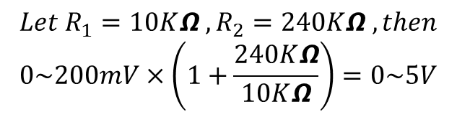
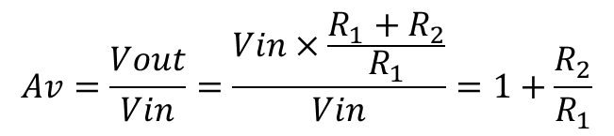

Scaling circuit-
1
Why need the amplifier?
The input voltage ranges come from transducer is 0-200mV when the voltage ranges of A/D converter is 0-5V , the A/D converter can not take advantage of the available full dynamic range . Therefore it will decrease the accurate .
How to overcome it?
Use the amplifier(OPA)
$$Av=\frac{Vout}{Vin}=\frac{Vin×\frac{R_{1}+R_{2}}{R_{1}}}{Vin}=1+\frac{R_{2}}{R_{1}}$$
$$Vin$$
+
_
$$Vout$$
$$Let R_{1}=10KΩ ,R_{2}=240KΩ ,then$$
$$0\sim 200mV×\left(1+\frac{240KΩ}{10KΩ}\right)=0\sim 5V$$
R2
R1
This voltage ranges can be used in the A/D converter .
GND
Notes:
如果外部訊號太小，可以考慮使用OPA進行放大

Slide 6
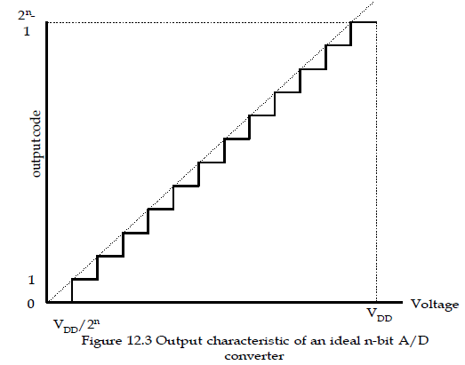

Analog Voltage and Digital Code Characteristic-
4
The purpose of A/D converter
Accuracy=$\frac{V_{DD}}{2^{n}}$
Notes:
而ADC的精確度是這樣算出來的
Vdd為參考電壓上限
2N的N代表是幾位元的ADC
若參考電壓上限為3.3V，為12BIT ADC，則可偵測的精度為3.3/4096≒0.0008V~
代表一個則若轉換後的ADC數位訊號大小2000，則代表測量到0.0008~*2000≒1.6V

Slide 7
A/D Conversion Algorithms-
4
Algorithms
Parallel A/D converter
Slope and double-slope A/D converter
Sigma-delta A/D converter
Successive approximation A/D converter
循序漸進式ADC
Advantage:
IC Area small, low power consumption.
Disadvantage:
Slow transfer.
Low accuracy.
Notes:
ADC分為幾種取樣方式，而我們適用最後一種循序漸進式來處理

Slide 8
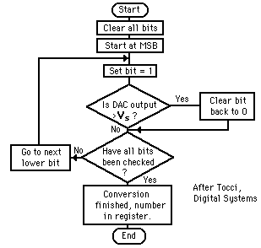
Successiva-Approximation ADC

Slide 9
PIC18F4520 A/D
10 inputs for the 28-pin devices and 13 for the 40/44-pin devices.
This module allows conversion of an analog input signal to a corresponding 10-bit digital number.
The analog reference voltage is software selectable
(RA3/AN3/ VREF+ and RA2/AN2/VREF-/CVREF pins)
The A/D converter has a unique feature of being able to operate while the device is in Sleep mode
Successive approximation
Reset will force A/D turn off and coversion aborted

Slide 10
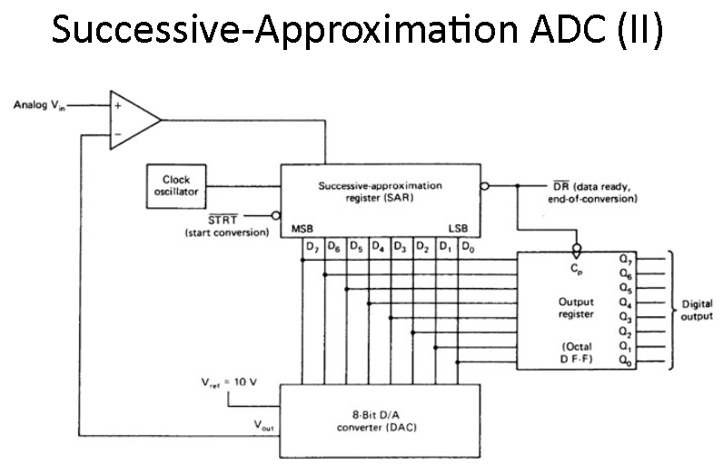
Each bit conversion need time
=T_{ad}
Notes:
Set max digit to D/A D/A > input reset else set

Slide 11
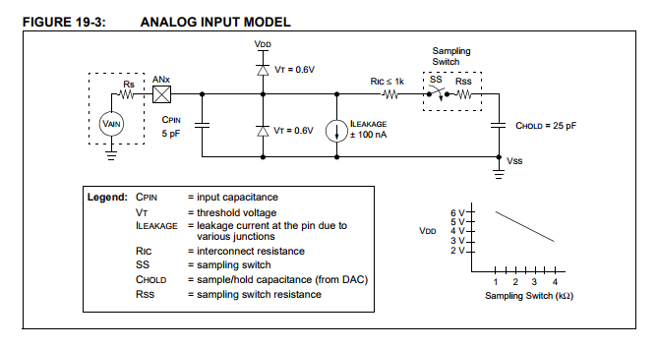
Input Model

Slide 12
A/D Hint
GO/DONE bit trigger can manual trigger A/D
Capacitor need time to charge(T_{acq})
A/D need clock source to work
T_{a/d} > minimum T_{ad}(if less than,bit conversion may error)

Slide 13
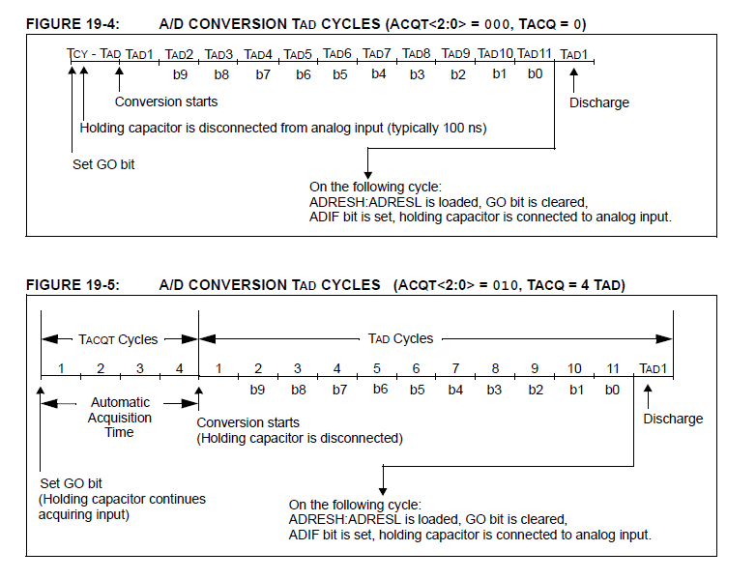
A/D Conversion time

Slide 14
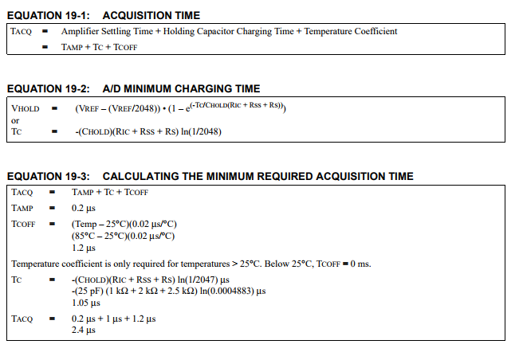

Slide 15
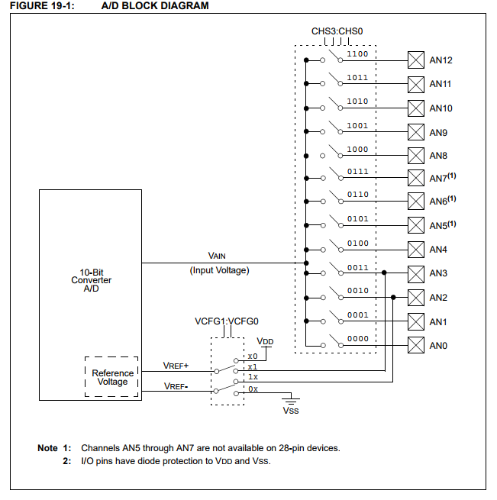
A/D BLOCK DIAGRAM

Slide 16
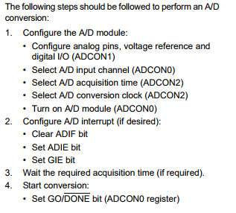
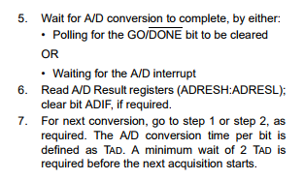
ADC Setting
Notes:
Page 227
1.Setting Pin , Vref , Adc channel
configure Pin
setting input channel
2.

Slide 17
ADC Init
Setting input Channel
Setting T_{acq} (= ??T_{ad} )
Setting Conversion clock ( =T_{ad} )
For correct A/D conversions, the A/D conversion clock (TAD) must be as short as possible, but greater than the minimum TAD
Turn on A/D(enable)

Slide 18
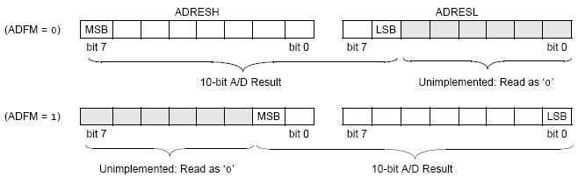
Right /left justified

Slide 19
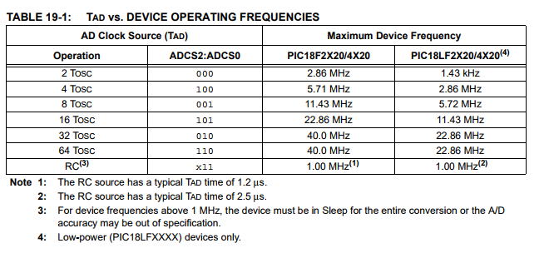

Slide 20
Setting Conversion clock(T_{ad} ) / T_{acq}
The maximum recommended impedance for analog sources is 2.5 kΩ
T_{ad} minimum = ??? (your lab)
T_{acq}
CHOLD = 25 pF
Rs = 2.5 kΩ
Conversion Error ≤ 1/2
LSb VDD = 5V → Rss = 2 kΩ
Temperature = 85°C (system max.)

Slide 22
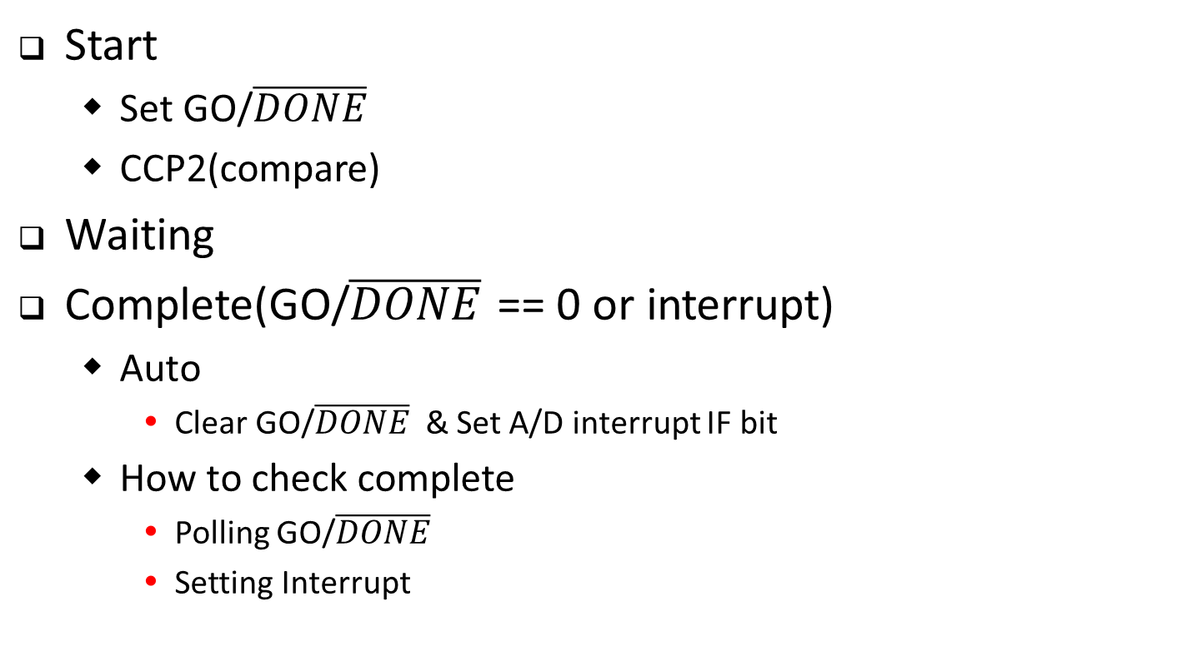
A/D Conversion Go & Done
Start
Set GO/$\overline{DONE}$
CCP2(compare)
Waiting
Complete(GO/$\overline{DONE}$ == 0 or interrupt)
Auto
Clear GO/$\overline{DONE}$ & Set A/D interrupt IF bit
How to check complete
Polling GO/$\overline{DONE}$
Setting Interrupt

Slide 23
A/D Register
A/D Result High Register (ADRESH)
A/D Result Low Register (ADRESL)
A/D Control Register 0 (ADCON0)
Setting channel
Set A/D Go & Check A/D Done
Enable
A/D Control Register 1 (ADCON1)
Setting Vref(+,-)
Setting pin mode
A/D Control Register 2 (ADCON2)
Setting T_{ad} & Clock cource

Slide 24
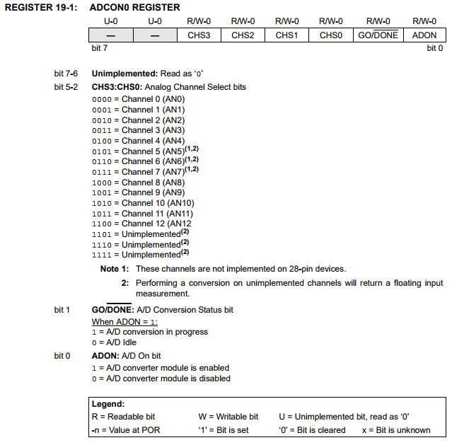
A/D Control Register 0 (ADCON0)

Slide 25
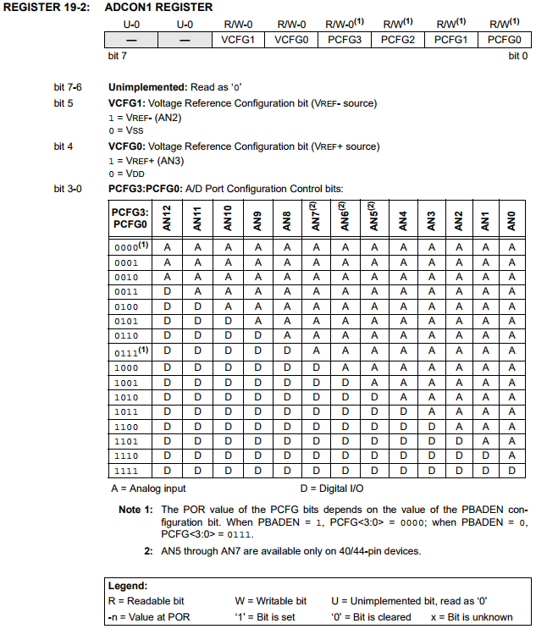
A/D Control Register 1 (ADCON1)

Slide 26
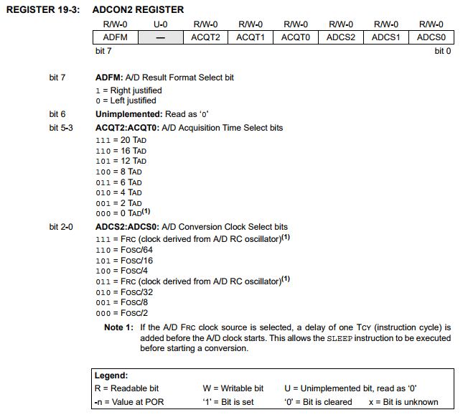
A/D Control Register 2 (ADCON2)

Slide 27
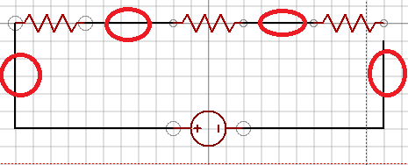
Lab
Connect three 300ohms resistors in series
Test point between resistors and determine the voltage from A/D(store in Ram(file register),explain why value it is?

Slide 28
REF
http://slideplayer.com/slide/4584351/
http://hyperphysics.phy-astr.gsu.edu/hbase/Electronic/adc.html
http://ww1.microchip.com/downloads/en/devicedoc/39631a.pdf

