Slide 1
UART
Serial Com

Slide 2
Outline
Uart introduce
Baud-rate Introduction
Parity Bit Introduction
Uart setting

Slide 3
Uart(I)
What the UART do on the communication
UART(Universal Asynchronous Receiver Transmitter)
all sequence interface transform from Parallel to Serial on transmitter (Tx)
all sequence interface transform from Serial to Parallel on receiver(Rx)
UART provide some status information
receiver full or not
Transmitter empty or not

Slide 4
Microcontroller
UART
Rx
Tx
Serial input
Parallel output
User
CPU
match baud rate
Rx full
Serial output
Parallel input
match baud rate
Tx empty

Slide 5
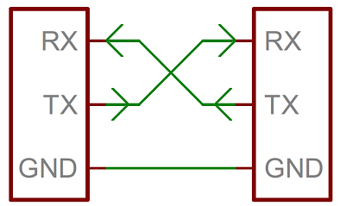

Slide 6
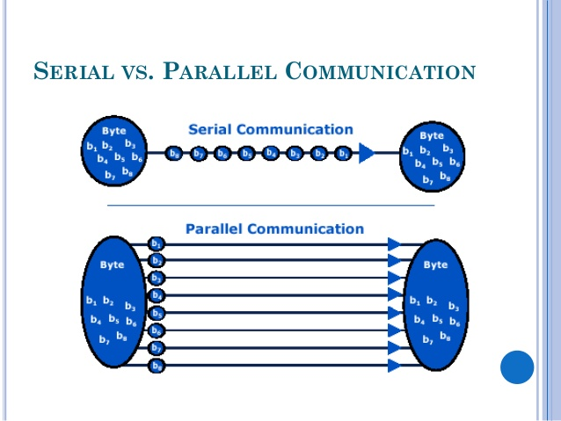
Serial vs Parallel

Slide 7
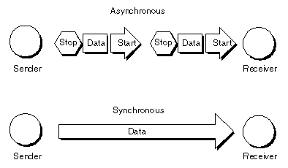
Asynchronous vs Synchronous

Slide 8
Serial port
Baud rate(Speed)
the unit for symbol rate or modulation rate in symbols per second or pulses per second
Data bits
Between start bit & stop bit for content
High for no data/stop bit
Low for data/start bit
Parity
detecting errors in transmission
extra data bit

Slide 9
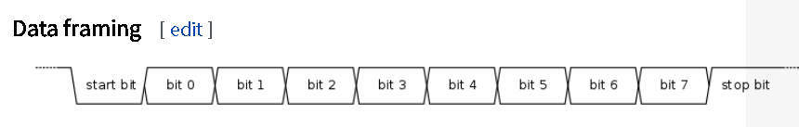
Data framing

Slide 10
Baud-rate Introduction
What is baud-rate
baud rate gives the frequency at which bits are transmitted on the line
Why we need baud-rate
no clock is transmitted in asynchronous communication
the transmitter and receiver must run independently at nearly the same baud rates
A
B
C
D
E
F
G
H
I
J
Transmitter :
A B C D E F G I J
Receiver :
A C E G I

Slide 11
Parity Bit Introduction
What is odd/even/non parity bit
the number of bit 1 in an word either even or odd
even parity : we add a parity bit that number of bit 1 are even
odd parity : we add a parity bit that number of bit 1 are odd
What is parity bit function
UART of transmitter will calculate parity bit and send it
UART of receiver will calculate parity bit from the data it receive
compare two parity bit are same or not

Slide 12
Example : parity bit
假設傳送 word : 0100 0000
odd parity bit : 0
even parity bit : 1
假設傳送word : 1111 1111
odd parity bit : 1
even parity bit : 0
Example : how to work (odd parity)
Tx
Rx
1110 0110 1

Slide 13
UART in Pic18
EUSART mode features include
8/9 bit mode
Automatic baud rate detection
Calibration
Automatic wake-up on Sync Break reception
12-bit Break character transmit
No hardware parity
Notes:
parity bit make 1bit even odd

Slide 14
USART Register
Transmit Status and Control (TXSTA)
Receive Status and Control (RCSTA)
Baud Rate Control (BAUDCON)

Slide 15
Uart init
The pins of the Enhanced USART are multiplexed with PORTC
bit SPEN (RCSTA) must be set (= 1)
bit TRISC<7> must be set (= 1)
bit TRISC<6> must be set (= 1)
Uart init
Setting baud rate(SPBRGH:SPBRG, BRGH and BRG16)
Enable the asynchronous serial port by clearing bit SYNC and setting bit SPEN

Slide 16
How to set Baud Rate
Baud Rate Generator (BRG)
8-bit or 16-bit generator
The SPBRGH:SPBRG register pair controls the period of a free running timer
BRGH (TXSTA) and BRG16 (BAUDCON)
In Asynchronous mode control the baud rate
In Synchronous mode, BRGH is ignored
Hint: Baud setting table at data sheet

Slide 17
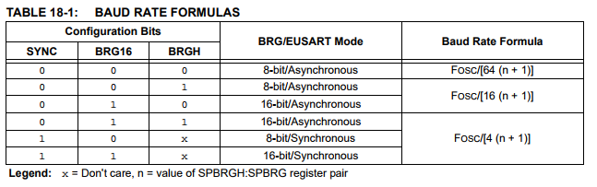
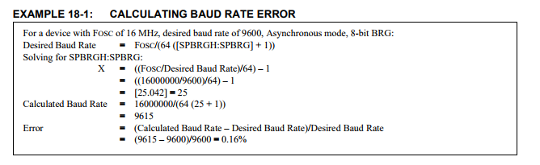

Slide 18
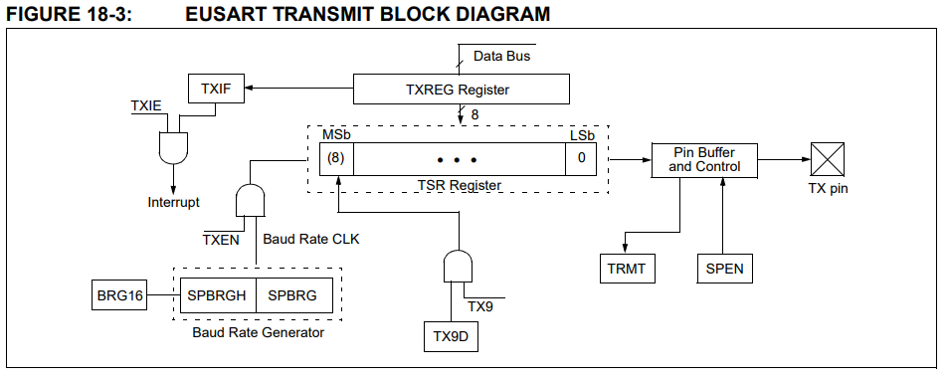
EUSART TRANSMIT BLOCK DIAGRAM
Notes:
The Shift register obtains its data from the Read/Write Transmit Buffer register, TXREG. The TXREG register is loaded with data in software. The TSR register is not loaded until the Stop bit has been transmitted from the previous load
如果上一次Stop bit 還沒送出去 TxReg的data不會被LOAD
Once the TXREG register transfers the data to the TSR register (occurs in one TCY), the TXREG register is empty and the TXIF flag bit (PIR1) is set
(interrupt)TXREG empty
TxREG 放入TSR後會清空 然後觸發interrupt(TXIF會立起 不論有沒有開中斷)
TXIF不能手動clear(software)
當資料load 進去TSR，只有下一個TXIF會被清空
TXIF ➔ txreg
TRMT➔TSR STATUS(read only)(no interrupt)

Slide 19

Uart init(8bit mode)
Send Data
(If interrupts are desired, set enable bit TXIE)(init TXREG empty)
Load data to the TXREG register (starts transmission).
If Tsr is stop bit.Auto load TXREG and trigger interrupt(TXIF)
Hint
TXIF cannot be cleared in software
Status
TXIF for TXREG
TRMT for TSR(no interrupt)

Slide 20
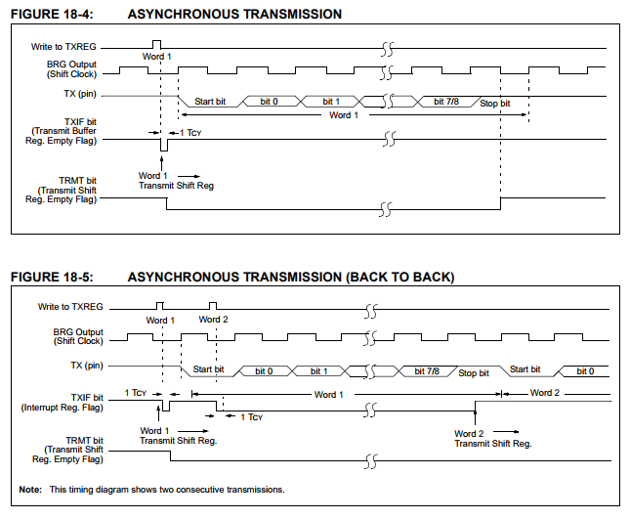
Notice TXIF
Notes:
TXREG empty then TXIF set
TX busy TRMT is clear

Slide 21
Uart init(8bit mode)
Rx Setting
Enable the reception by setting bit CREN
Flag bit, RCIF, will be set when reception is complete (optional interrupt)
Reading TCTEG(you can use file register to be buffer

Slide 22
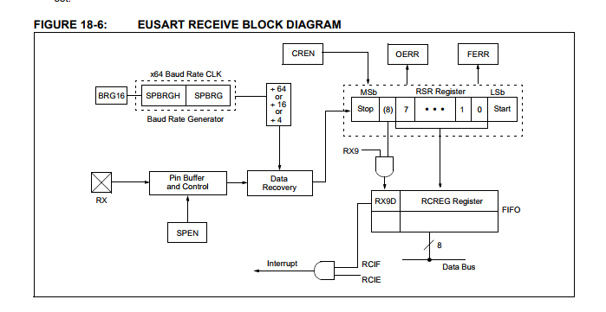
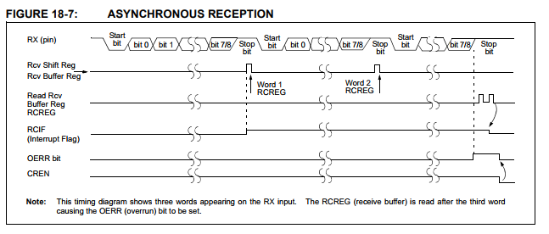
Two level fifo
If no reading cause fifo full
The third word will cause exception
Clear CREN will make OERR clear

Slide 23
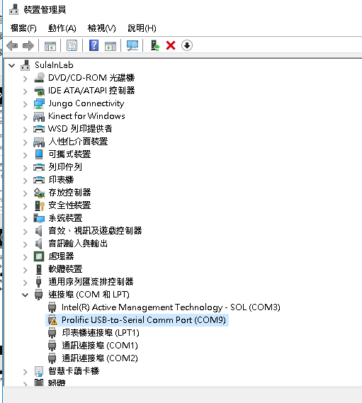
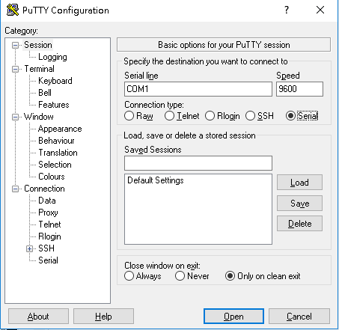
Lab1(fix sample code)
Return word with uart from putty
Hint

Slide 24
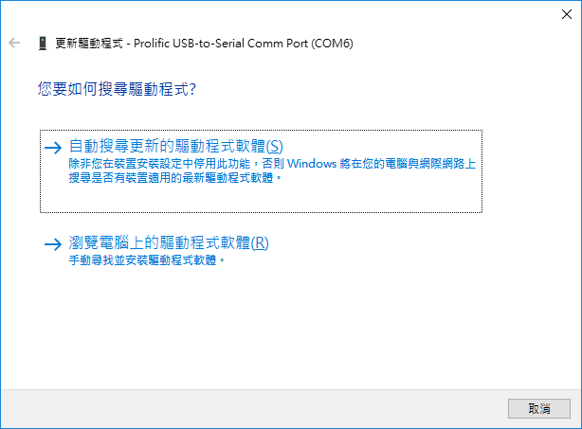
Driver question
Install old driver (on moodle or web)
Update driver

Slide 25
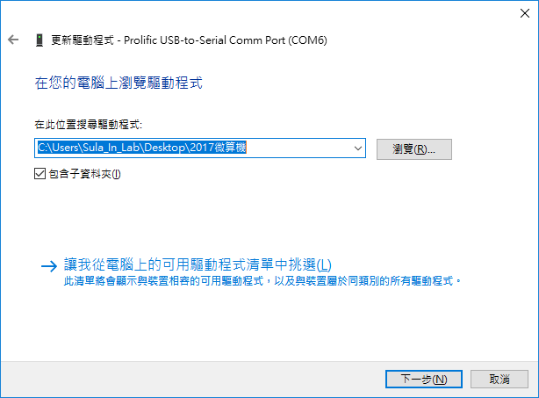

Slide 26
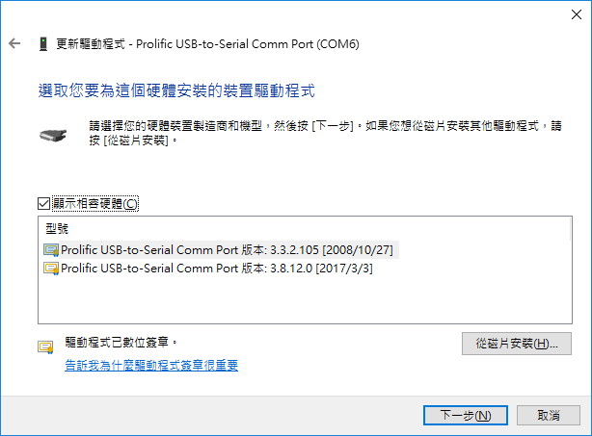

Slide 27
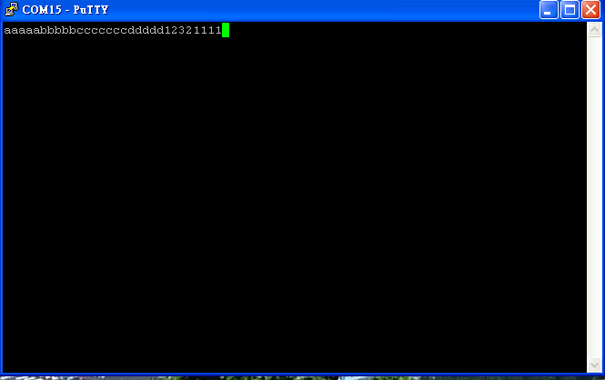

Slide 28
Lab2(add something in sample)
設計簡單指令:
設計字串處理利用電腦下指令給Pic18
當輸入下列字串的時候，會饋顯示給terminal並且給予相對應的動作(可以設計回應字串作Debug)(LED pin腳自行決定)
“Control1”:亮LED1
“Control2”:關LED1
“Control3”:開LED2
“Control4”:關LED2

Slide 29
References
https://en.wikipedia.org/wiki/Asynchronous_serial_communication
https://microcontrollerpicavr.blogspot.tw/2017/08/pic-microcontroller-serial.html
http://ww1.microchip.com/downloads/en/devicedoc/39631a.pdf
https://en.wikipedia.org/wiki/Serial_port

