Slide 1
PIC18F4520
Assembly language programming (I)
Architecture & Addressing mode
Hong-hen Lin
林弘恆

Slide 2
Outline
PIC18F4520 Architecture
Instruction set
Addressing mode
Lab

Slide 3
  PIC18F4520 Architecture
  Instruction set
  Addressing mode
  Lab

Slide 4
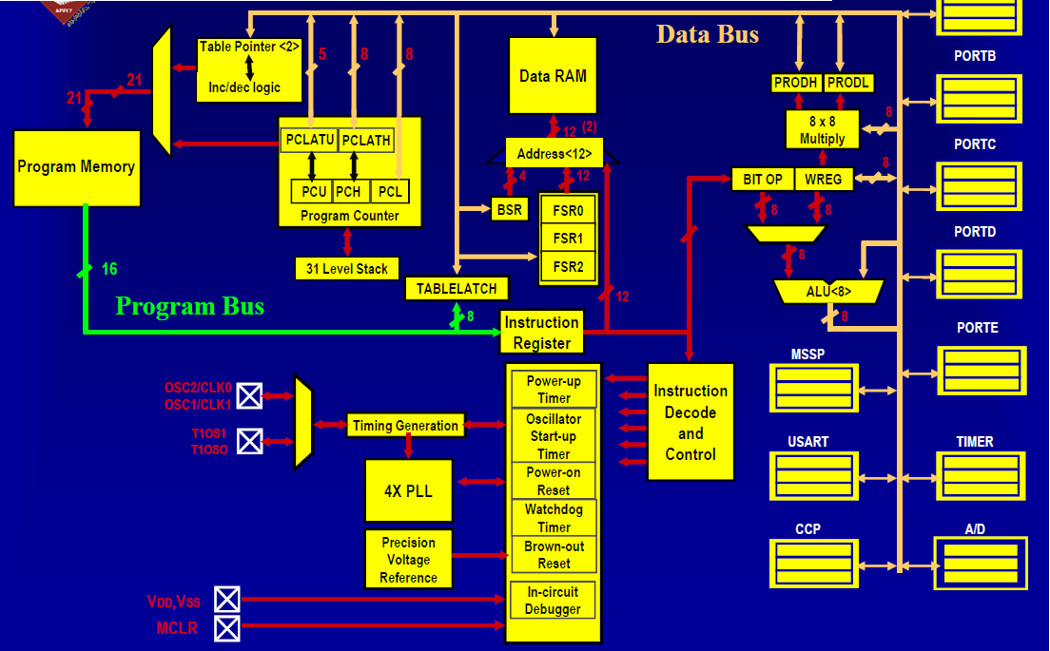
Block Diagram
Notes:
PIC18F4520基本架構圖

Slide 5
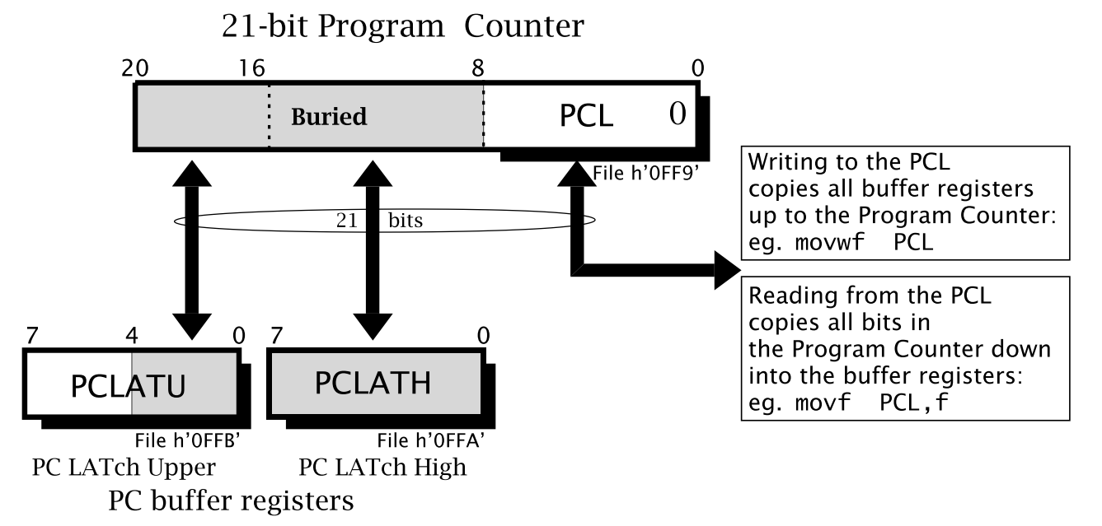
Program Memory-Program counter
The PC is 21 bits wide and is contained in three separate 8-bit registers.
PCL register is both readable and writable.
PCH register is not directly readable or writable. Updates to the PCH register are performed through the PCLATH register. And PCU is the same, too.
PCU
PCH

Slide 6
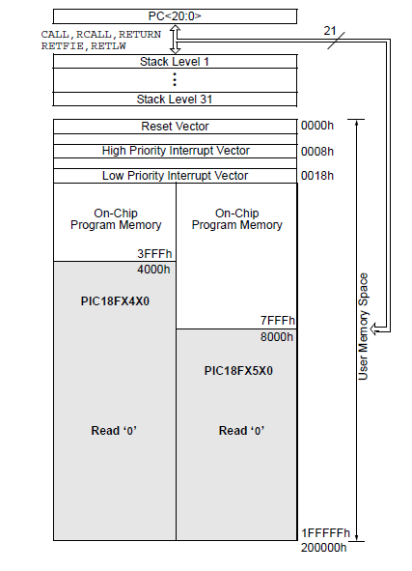
Program Memory Map
PIC18 microcontrollers implement a 21-bit program counter, which is capable of addressing a 2-M byte program memory space. (2²¹ =2M)
The PIC18F4520 have 32 Kbytes of on-chip program memory and can store up to 16,384 single-word instructions.
( 1word = 2bytes, 32K=2¹⁵ =32768 bytes
32768/2 = 16384 words )

Slide 7
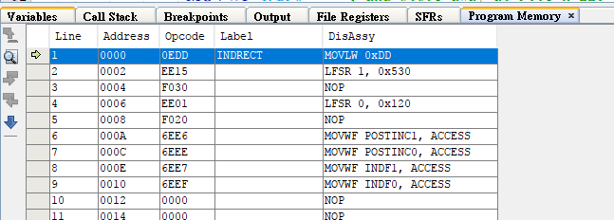
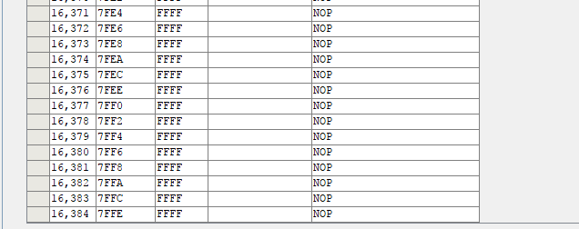
MPLABX-Program Memory
MPLAB X IDE>windows>pic memory views>program memory

Slide 8
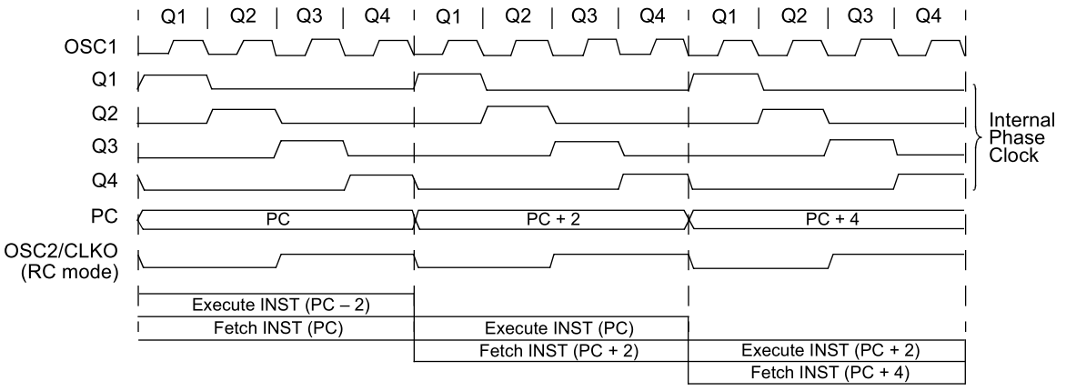
PIC18 Instruction Cycle
The instruction fetch and execute are pipelined in such a
manner that a fetch takes one instruction cycle, while the
decode and execute take another instruction cycle.

Slide 9
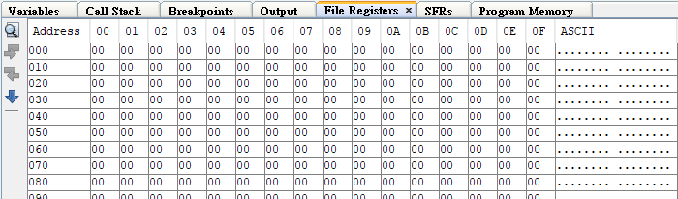
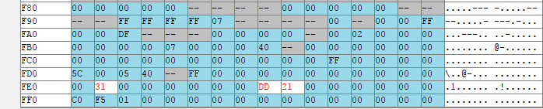
Data Memory-File Registers
MPLAB X IDE>windows>pic memory views>File Registers
Effective File Register address : 12bits
Notes:
Data Memory 總共有效位址為12 Bits

Slide 10
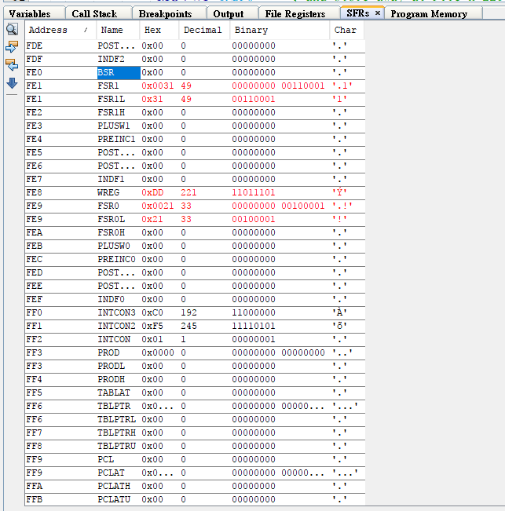
Data Memory-SFRs(Special Function Registers)
MPLAB X IDE>windows>pic memory views>SFRs
SFRs (Special Function registers)
Notes:
Data Memory 總共有效位址為12 Bits

Slide 11
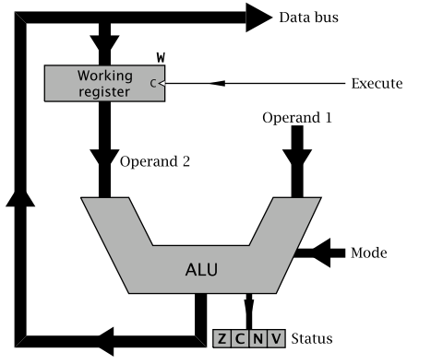
Data memory-Working register (WREG)
WREG is the ALU’s Working register, generally holding one of an instruction’s operands, either source or destination.

Slide 12
Data memory-Bank Select Register(BSR)
BSR can hold four additional address bits, making up the required total of 12 bits as (a₁₁a₁₀a₉a₈)a₇a₆a₅a₄a₃a₂a₁a₀ .
The Data store appears as 16 banks, each of which contains up to 256 Files(0X00-0XFF).
e.g.
movlb 2 ; Move (copy) the constant 2 to the BSR
movf h’220’,w,1 ; Copy the datum in File h’220’ into the
; Working register using the Banking mode
BSR is so frequent an operation, the special instruction MOVe Literal to BSR (movlb) is provided (rather than the movlw 2, movwf BSR equivalent)

Slide 13
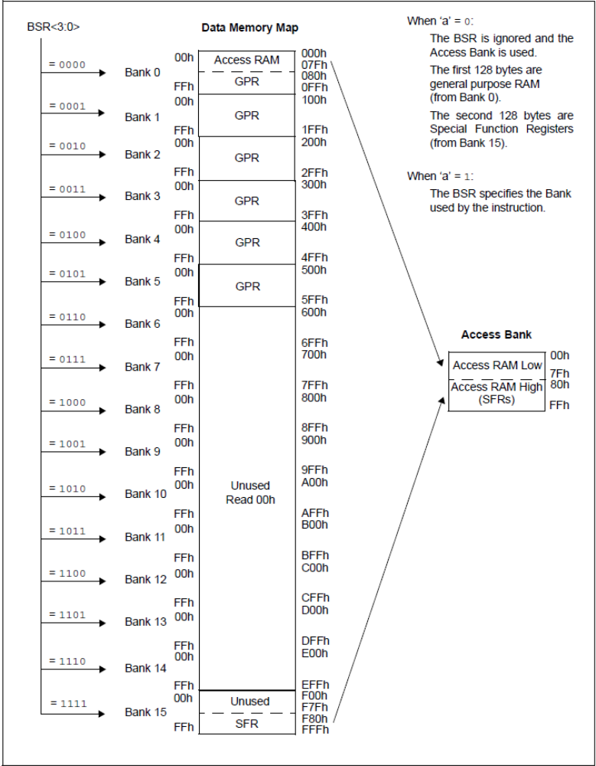
Data Memory-Map
The data memory contains Special Function Registers (SFRs) and General Purpose Registers (GPRs).
PIC18 devices implement an Access Bank. This is a 256-byte memory space that provides fast access to SFRs and the lower portion of GPR Bank 0 without using the BSR.

Slide 14
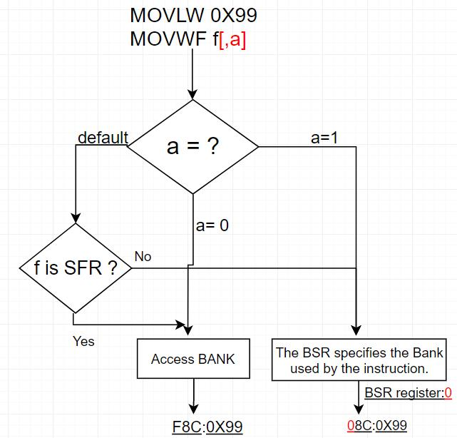
Try it (sample1.asm)
What value is LATD(0XF8C) about the three case ?
  1. a = 0
  2. a = 1
  3. default

Slide 15
  PIC18F4520
  Architecture
  Instruction set
  Addressing mode
  Lab

Slide 16
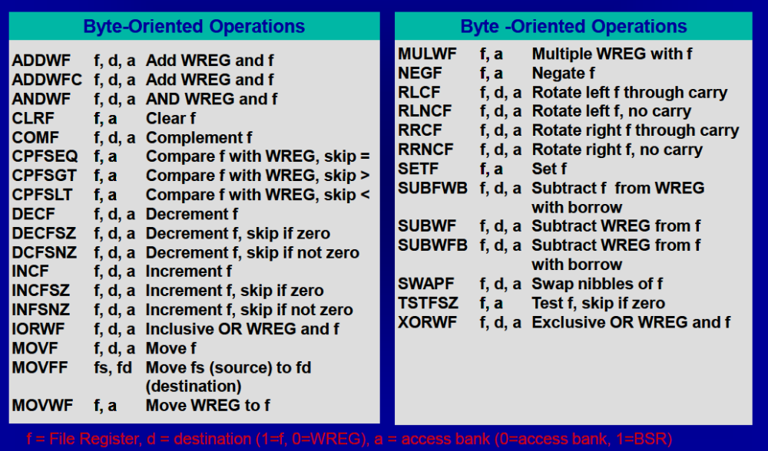
Instruction set

Slide 17
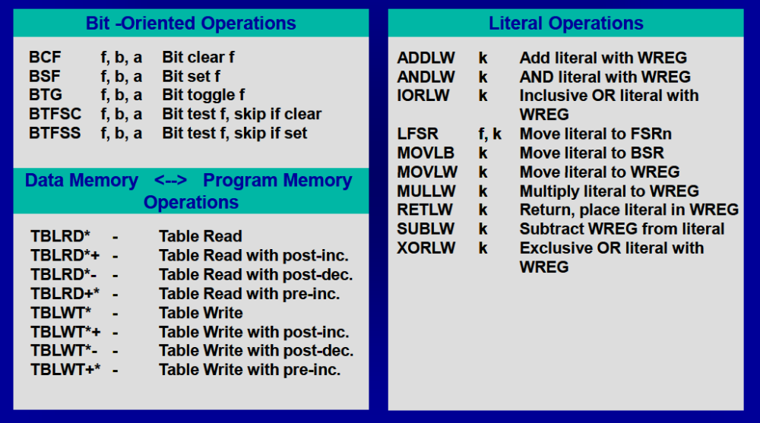
Instruction set
Notes:
b:
k -定義將被載入暫存器的常數
f -常數將被載入的FSR

Slide 18
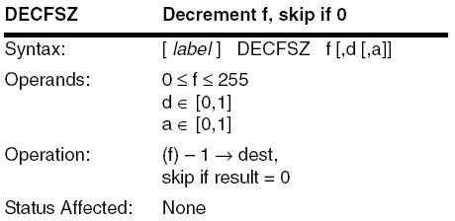
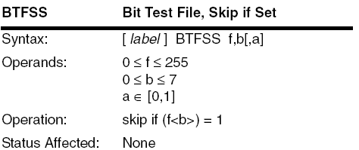
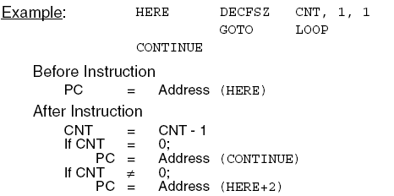
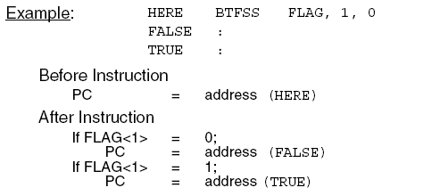
Instruction set-(e.g.DECFSZ&BTFSS)
剩下指令及詳細內容請參閱附檔或最後一張投影片之網址

Slide 19
  PIC18F4520
  Architecture
  Instruction set
  Addressing mode
  Lab

Slide 20
The fundamental concept
What is addressing mode?
  The way of acquiring the operand or calculating the target address to where we want to branch
4 fundamental addressing modes
  Literal addressing mode
  Direct addressing mode
  Indirect addressing mode
  Relative addressing mode
Notes:
addressing mode: 程式用來指定某一個記憶體位址(memory address) 的方式
立即定址模式
直接定址模式
間接定址模式
相對定址模式

Slide 21
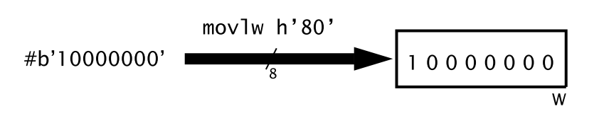
Literal addressing mode
8-bit 的常數值(literal value) 被包含於程式碼之中
使用於literal instructions , 例如
  movlw, addlw, andlw, etc.
  E.g.MOVLW 0X80

Slide 22
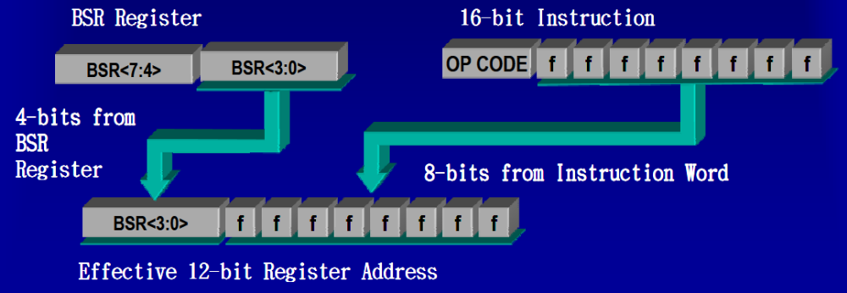
Direct addressing(Banked)
8-bit 的直接位址由指令中得到
其他高位的4-bits 由BSR<3:0> 獲得
    E.g., BSR:1, f:0x220

Slide 23
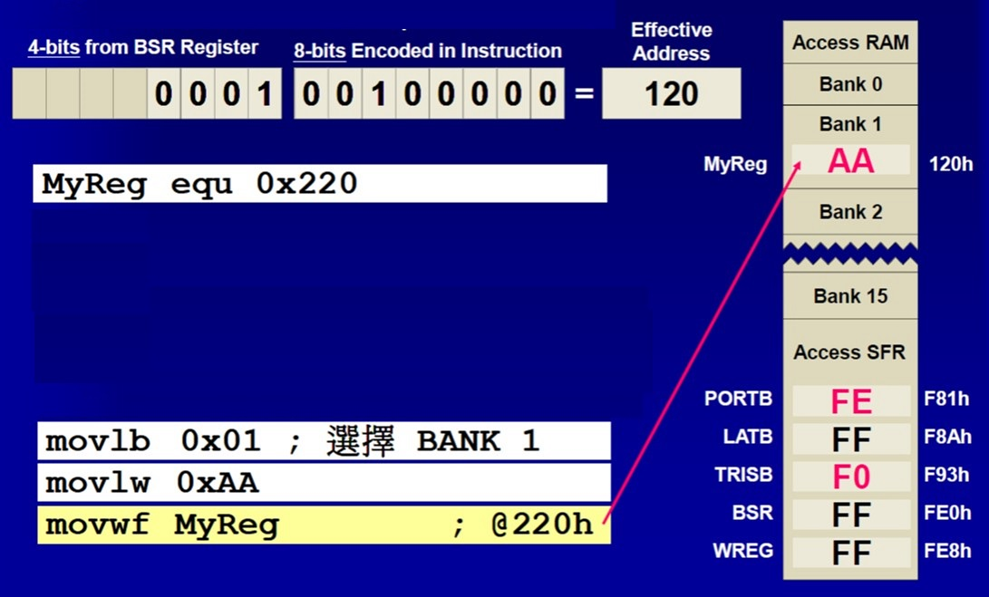
Direct addressing (e.g.)
Notes:
Wreg 要再介紹為什麼用這個 為什麼這樣用
Myreg要再改0X220

Slide 24
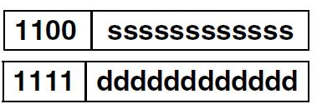
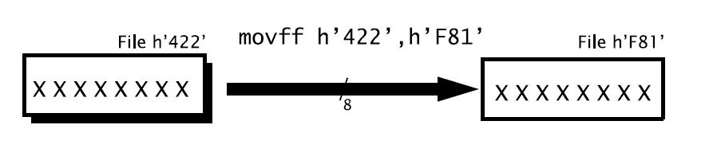
Direct addressing(Non Banked)
MOVFF src, dest
The MOVFF instruction can move a byte from anywhere in RAM to nearly anywhere else.
There is no resort to banking or the Access RAM mechanism for this.

Slide 25
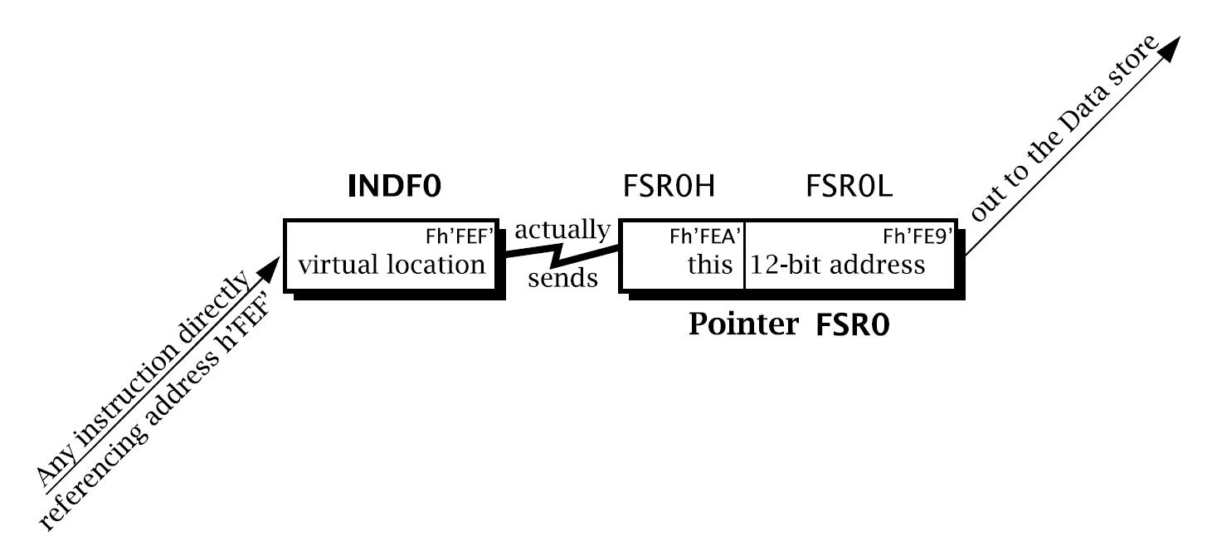
Indirect addressing
三個12-bit 寬的間接定址暫存器
  FSR0, FSR1, FSR2 ex:FSR0:0X220
FSRn (File Select Register) 的內容可做以下調整:
  Pre-Incremented : (PREINCn) 先被加一再存取其內容
  Post-Incremented : (POSTINCn) 存取完FSRn 所指內容後將FSRn 加1
  Post-Decremented : (POSTDECn) 存取完FSRn 所指內容後將FSRn 減1
  Offset by WREG value (signed)：(PLUSWn) FSRn 不變，以W 為偏移值相加後以產生新的索引指標
  FSRn保持不變: (INDFn)

Slide 26
Indirect addressing(e.g.)
E.g. Clear content of Fh’20’ to Fh’23’.
LFSR 0, 0X020 ; Move 0x020 to FSR0
LOOP: CLRF POSTINC0 ; Clear contents of FSR0 to address ; data memory and FSR0L’s value+1
BTFSS FSR0L,2 ; FSR0<2> = 1 ?
GOTO LOOP ; NO
CONTINUE: ; YES
FSR0
0X20
POSTINC0
Notes:
Clear content of Fh’20’ to Fh’23’

Slide 27
Indirect addressing(e.g.)
E.g. Clear content of Fh’20’ to Fh’23’.
LFSR 0, 0X020 ; Move 0x020 to FSR0
LOOP: CLRF POSTINC0 ; Clear contents of FSR0 to address ; data memory and FSR0L’s value+1
BTFSS FSR0L,2 ; FSR0<2> = 1 ?
GOTO LOOP ; NO
CONTINUE: ; YES
FSR0
0X20
0X20
0
POSTINC0
Notes:
Clear content of Fh’20’ to Fh’23’

Slide 28
Indirect addressing(e.g.)
E.g. Clear content of Fh’20’ to Fh’23’.
LFSR 0, 0X020 ; Move 0x020 to FSR0
LOOP: CLRF POSTINC0 ; Clear contents of FSR0 to address ; data memory and FSR0L’s value+1
BTFSS FSR0L,2 ; FSR0<2> = 1 ?
GOTO LOOP ; NO
CONTINUE: ; YES
FSR0
0X21
POSTINC0
Notes:
Clear content of Fh’20’ to Fh’23’

Slide 29
Indirect addressing(e.g.)
E.g. Clear content of Fh’20’ to Fh’23’.
LFSR 0, 0X020 ; Move 0x020 to FSR0
LOOP: CLRF POSTINC0 ; Clear contents of FSR0 to address ; data memory and FSR0L’s value+1
BTFSS FSR0L,2 ; FSR0<2> = 1 ?
GOTO LOOP ; NO
CONTINUE: ; YES
FSR0
0X21
POSTINC0
FSR0L<2>!=1 ->GOTO LOOP
Notes:
Clear content of Fh’20’ to Fh’23’

Slide 30
Indirect addressing(e.g.)
E.g. Clear content of Fh’20’ to Fh’23’.
LFSR 0, 0X020 ; Move 0x020 to FSR0
LOOP: CLRF POSTINC0 ; Clear contents of FSR0 to address ; data memory and FSR0L’s value+1
BTFSS FSR0L,2 ; FSR0<2> = 1 ?
GOTO LOOP ; NO
CONTINUE: ; YES
FSR0
0X21
0X21
0
POSTINC0
Notes:
Clear content of Fh’20’ to Fh’23’

Slide 31
Indirect addressing(e.g.)
E.g. Clear content of Fh’20’ to Fh’23’.
LFSR 0, 0X020 ; Move 0x020 to FSR0
LOOP: CLRF POSTINC0 ; Clear contents of FSR0 to address ; data memory and FSR0L’s value+1
BTFSS FSR0L,2 ; FSR0<2> = 1 ?
GOTO LOOP ; NO
CONTINUE: ; YES
FSR0
0X22
POSTINC0
Notes:
Clear content of Fh’20’ to Fh’23’

Slide 32
Indirect addressing(e.g.)
E.g. Clear content of Fh’20’ to Fh’23’.
LFSR 0, 0X020 ; Move 0x020 to FSR0
LOOP: CLRF POSTINC0 ; Clear contents of FSR0 to address ; data memory and FSR0L’s value+1
BTFSS FSR0L,2 ; FSR0<2> = 1 ?
GOTO LOOP ; NO
CONTINUE: ; YES
FSR0
0X22
POSTINC0
FSR0L<2>!=1 ->GOTO LOOP
Notes:
Clear content of Fh’20’ to Fh’23’

Slide 33
Indirect addressing(e.g.)
E.g. Clear content of Fh’20’ to Fh’23’.
LFSR 0, 0X020 ; Move 0x020 to FSR0
LOOP: CLRF POSTINC0 ; Clear contents of FSR0 to address ; data memory and FSR0L’s value+1
BTFSS FSR0L,2 ; FSR0<2> = 1 ?
GOTO LOOP ; NO
CONTINUE: ; YES
FSR0
0X22
0X22
0
POSTINC0
Notes:
Clear content of Fh’20’ to Fh’23’

Slide 34
Indirect addressing(e.g.)
E.g. Clear content of Fh’20’ to Fh’23’.
LFSR 0, 0X020 ; Move 0x020 to FSR0
LOOP: CLRF POSTINC0 ; Clear contents of FSR0 to address ; data memory and FSR0L’s value+1
BTFSS FSR0L,2 ; FSR0<2> = 1 ?
GOTO LOOP ; NO
CONTINUE: ; YES
FSR0
0X23
POSTINC0
Notes:
Clear content of Fh’20’ to Fh’23’

Slide 35
Indirect addressing(e.g.)
E.g. Clear content of Fh’20’ to Fh’23’.
LFSR 0, 0X020 ; Move 0x020 to FSR0
LOOP: CLRF POSTINC0 ; Clear contents of FSR0 to address ; data memory and FSR0L’s value+1
BTFSS FSR0L,2 ; FSR0<2> = 1 ?
GOTO LOOP ; NO
CONTINUE: ; YES
FSR0
0X23
POSTINC0
FSR0L<2>!=1 ->GOTO LOOP
Notes:
Clear content of Fh’20’ to Fh’23’

Slide 36
Indirect addressing(e.g.)
E.g. Clear content of Fh’20’ to Fh’23’.
LFSR 0, 0X020 ; Move 0x020 to FSR0
LOOP: CLRF POSTINC0 ; Clear contents of FSR0 to address ; data memory and FSR0L’s value+1
BTFSS FSR0L,2 ; FSR0<2> = 1 ?
GOTO LOOP ; NO
CONTINUE: ; YES
FSR0
0X23
0X23
0
POSTINC0
Notes:
Clear content of Fh’20’ to Fh’23’

Slide 37
Indirect addressing(e.g.)
E.g. Clear content of Fh’20’ to Fh’23’.
LFSR 0, 0X020 ; Move 0x020 to FSR0
LOOP: CLRF POSTINC0 ; Clear contents of FSR0 to address ; data memory and FSR0L’s value+1
BTFSS FSR0L,2 ; FSR0<2> = 1 ?
GOTO LOOP ; NO
CONTINUE: ; YES
FSR0
0X24
POSTINC0
Notes:
Clear content of Fh’20’ to Fh’23’

Slide 38
Indirect addressing(e.g.)
E.g. Clear content of Fh’20’ to Fh’23’.
LFSR 0, 0X020 ; Move 0x020 to FSR0
LOOP: CLRF POSTINC0 ; Clear contents of FSR0 to address ; data memory and FSR0L’s value+1
BTFSS FSR0L,2 ; FSR0<2> = 1 ?
GOTO LOOP ; NO
CONTINUE: ; YES
FSR0
0X24
POSTINC0
FSR0L<2>=1 -> CONTINUE
Notes:
Clear content of Fh’20’ to Fh’23’

Slide 39
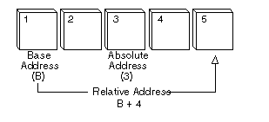
Relative addressing
In the mode the content of the program counter is added to the address part of the instruction to obtain the effective address.
正常狀況一個指令2Bytes,
MOVFF,LFSR,GOTO,..4Bytes
Notes:
p.74
http://www.webopedia.com/TERM/R/relative_address.html

Slide 40
Relative addressing(e.g.)
How to go to 5th NOP by relative addressing?
LIST p=18f4520
#include<p18f4520.inc>
ORG 0x00 ; setting initial address
S2: NOP
NOP
MOVLW 0X04
ADDWF PCL ; (W)+PCL ->PCL
NOP ; PCL+2
NOP
NOP ; final destination
NOP
END

Slide 41
  PIC18F4520
  Architecture
  Instruction set
  Addressing mode
  Lab

Slide 42
Lab2
Step1 請利用立即定值法將值0X77放至WREG,再將WREG值 放至LATD,然後將值0X77加至值0X99 (結果一樣在 LATD)
Step2 請利用直接定值法將值0XFF放至位址0X28C
    ( 請勿直接使用MOVFF!! )
Step3 請利用間接定址法將位址為0X28C的值遞減為0
Step4 請利用相對定址法以PC取代GOTO跳至
第三個LABEL(STEP3)的第一道指令
Notes:
觀察STEP2的

Slide 43
參考資料
PIC18F4520 datasheet
  http://ww1.microchip.com/downloads/en/devicedoc/39631a.pdf
PIC18F4520 instruction set
  http://technology.niagarac.on.ca/staff/mboldin/18F_Instruction_Set/
Microchip 教材 102ASP
  http://www.microchip.com.tw/Data_CD/Workshop/8-Bits/102ASP%20PIC18F452.zip

