Slide 1
PIC18F4520 Digital I/O
Wei Jhen Kao
高威震

Slide 2
Outline
Digital I/O Introduction
I/O ports of PIC18F4520
Bit Field Manipulation
LAB

Slide 3
Digital I/O Introduction

Slide 4
What is a “digital I/O”?
It is an interface in which each electrical pin may have two
states:
Logical 0 (it means 0V)
Logical 1 (it means 5V on the basis of the VDD)
Each line can be programmer as:
an output (it “generates” current and can be used, for example, to lit a LED)
an input (it “receives” current and can be used, for example, to read a pushbutton)
Notes:
TTL
1.輸出高電平Uoh和輸出低電平Uol
Uoh≥2.4V,Uol≤0.4V
2.輸入高電平和輸入低電平
Uih≥2.0V，Uil≤0.8V
CMOS
.輸出高電平Uoh和輸出低電平Uol
Uoh≈VCC，Uol≈GND
2.輸入高電平Uoh和輸入低電平Uol
Uih≥0.7VCC,Uil≤0.2VCC （VCC為電源電壓，GND為地）

Slide 5
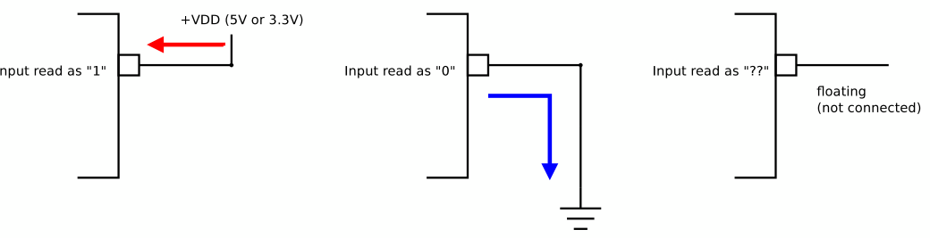
Digital Input: Electrical consideration
An input connected to VDD is read (by software) as “1”
An input connected to Ground is read (by software) as “0”
If the input is ﬂoating (not connected) the value read cannot be
determined!

Slide 6
Prevent floating state: use pull-up or pull-down resistor
Their function is the same, to create a default value for a circuit, but one pulls the line high, the other pulls it low.
The typical pull-up resistor value is 1-10kΩ. If in doubt, a good starting point when using a switch is 5kΩ.
Some digital circuits, such as CMOS families, have a small input leakage current, allowing much higher resistance values, from around 10kΩ up to 1MΩ.
The disadvantage when using a larger resistance value is that the input pin responses to voltage changes slower.
Notes:
If pull up without resistor:The problem with short circuits is they allow too much current to flow from Vcc to GND. This causes heat to be generated

Slide 7
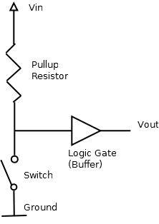
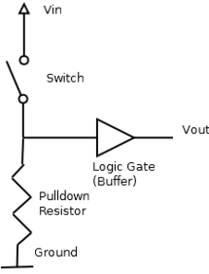
not pressed (open), the value read is “1”.
pressed (closed), the value read is “0”.
not pressed (closed), the value read is “0”.
pressed (open), the value read is “1”.

Slide 8
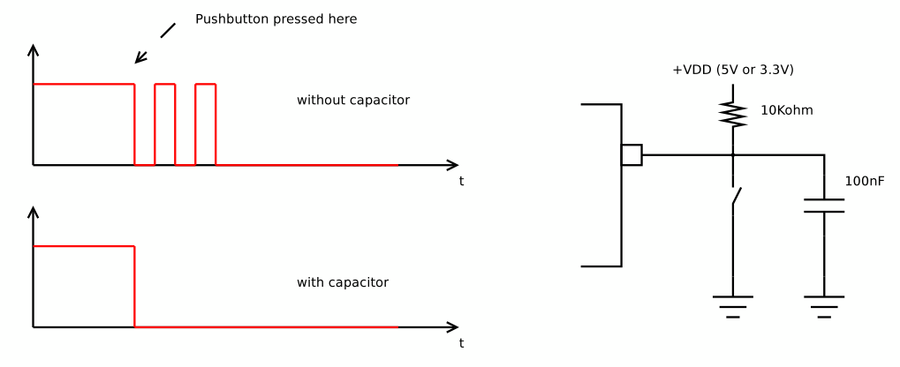
Bouncing problem!
Due to mechanical reasons, pushbuttons and switches (which have a spring inside) typically generate a bouncing signal when pressed or released.
The bouncing signal is read by the software, thus causing malfunctioning.

Slide 9
Button debounce
Hardware solution
Add a capacitor, in parallel with the button, in order to ﬁlter the bouncing signal.
Refer http://puppyodie.blogspot.tw/2016/04/button-debounce.html
Software solution
Use delay or interrupt on change function to check input signal again, if the signal stay the same, then considered as press.
Notes:
http://billsuen.pixnet.net/blog/post/100228247 interrupt on change

Slide 10
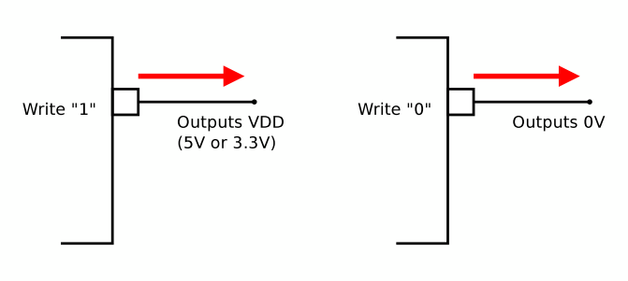
Digital Output: Electrical consideration
Writing “1” implies to drive the output to generate VDD
Writing “0” implies to drive the output to generate 0V

Slide 11
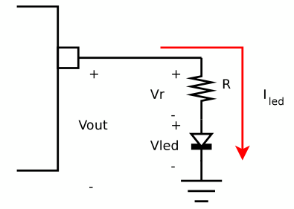
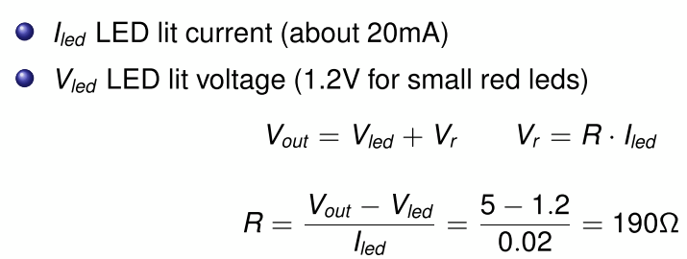
Connecting a LED: calculating the limiting resistor

Slide 12
I/O ports of PIC18F4520

Slide 13
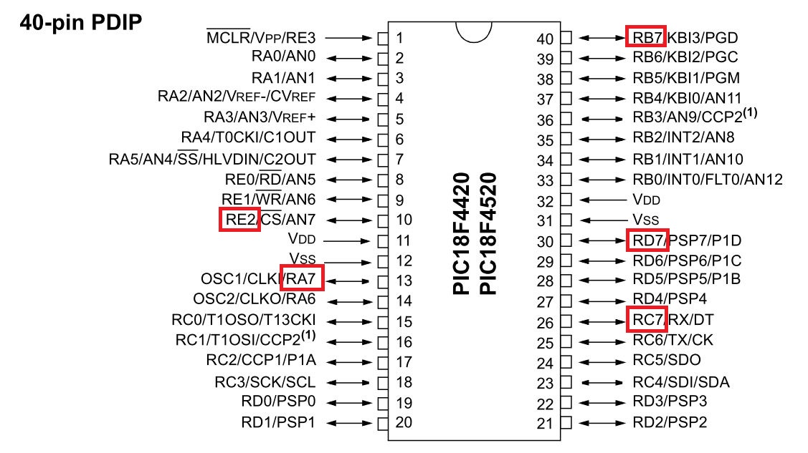
The pinout of PIC18F4520

Slide 14
I/O ports of PIC18F4520
PIC184520 has five I/O ports, called PORTA,PORTB,…,PORTE.
Each port has 8 bits and thus 8 electrical pins
Pins are referred as Rxy, where x is the port name (A, B, ..., E) and y is the bit (0, 1, ..., 7).
Some pins of the I/O ports are multiplexed with an alternate function from the peripheral features on the device. In general, when a peripheral is enabled, that pin may not be used as a general purpose I/O pin.
However, not all bits are mapped to electrical pins. This is a choice “by-design”.

Slide 15
SFR of PIC18F4520 I/O ports
Each port has three registers for its operation. These registers are:
• TRIS register (data direction register)
• PORT register (reads the levels on the pins of the device)
• LAT register (output latch)
The Data Latch (LAT register) is useful for read-modify-write operations on the value that the I/O pins are driving.

Slide 16
SFR of PIC18F4520 I/O ports
TRISx: each bit of this SFR programs the relevant PIN as input or output:
A 0 means output
A 1 means input
Example:
TRISC = 0x30; // 0x30 = 0011 0000
RC0 to RC3:outputs;
RC4, RC5: inputs;
RC6, RC7:outputs;

Slide 17
SFR of PIC18F4520 I/O ports
LATx: each bit of this SFR programs the output status of the relevant PIN (if it is programmed as output, otherwise itis ignored).
Example:
LATB = 0xe0; // 0xe0 = 1110 0000
RB0 to RB4 output 0;
RB5 to RB7 output 1.

Slide 18
SFR of PIC18F4520 I/O ports
PORTx: each bit of this SFR reﬂects the input status of the relevant PIN (if the pin is conﬁgured as input, otherwise it replies the bit of the LATx register):
Example:
Let us read into button variable, the status of the RA5 input pin:
int button = (PORTA & 0x20) ;

Slide 19
SFR of PIC18F4520 I/O ports : Summary
TRISx: programs the relevant PIN as input or output:
A 0 means output
A 1 means input
LATx: output status of the relevant PIN (if it is programmed as output, otherwise it is ignored).
PORTx: input status of the relevant PINs (if the pin is conﬁgured as input, otherwise it replies the bit of the LATx register)

Slide 20
Features of PORTA register
The RA4 pin is multiplexed with the Timer0 module.
Pins RA6 and RA7 are multiplexed with the main oscillator pins.
The other PORTA pins are multiplexed with analog inputs(RA3:RA0 and RA5)
Notes:
CONFIG OSC = INTIO67

Slide 21
Features of PORTB register
Each of the PORTB pins has a weak internal pull-up. The weak pull-up is automatically turned off when the port pin is configured as an output.
Four of the PORTB pins (RB7:RB4) have an interrupt-on-change feature. Only pins configured as inputs can cause this interrupt to occur.
RB3 can be configured by the configuration bit,CCP2MX, as the alternate peripheral pin for the CCP2 module (CCP2MX = 0).
Notes:
CCP2 module: 15.0 CAPTURE/COMPARE/PWM (CCP) MODULES CCP 模組是一個允許使用者測量事件的時間和控制事件的周邊

Slide 22
Features of PORTC register
PORTC is multiplexed with several peripheral functions, like timer1, USART, MSSP(Refer data sheet Table 10-5).
When enabling peripheral functions, care should be taken in defining TRIS bits for each PORTC pin.
Notes:
Some peripherals override the TRIS bit to make a pin an output,
while other peripherals override the TRIS bit to make a
pin an input. The user should refer to the corresponding
peripheral section for additional information.

Slide 23
Parallel Slave Port
A parallel slave port (PSP) is an interface allows 8-bit asynchronous bidirectional data transfer between the PIC and external devices, The external microprocessor can read or write the PORTD latch as an 8-bit latch.
TRISE register (TRISE<2:0>) must be configured as inputs (set).
Notes:
TRISE register (TRISE<2:0>) used to judge read or write operation

Slide 24
Features of PORTD register
Three of the PORTD pins are multiplexed with outputs P1B, P1C and P1D(RD5,RD6 and RD7) of the enhanced CCP module.
PORTD can also be configured as an 8-bit wide micro-processor port (Parallel Slave Port) by setting control bit, PSPMODE(TRISE<4>).
Notes:
CCP ->PWM related

Slide 25
Features of PORTE register
For 40 pin devices, PORTE is a 4-bit wide port.
Three pins (RE0/RD/AN5, RE1/WR/AN6 and RE2/CS/AN7) are individually configurable as inputs or outputs.
The fourth pin of PORTE (MCLR/VPP/RE3) is an input only pin, RE3 also functions as the programming voltage input during programming.
The upper four bits of the TRISE register also control the operation of the Parallel Slave Port.

Slide 26
Bit Field Manipulation

Slide 27
Bit Field Manipulation in assembly
For single bit manipulation
BCF f, b, a ; clear bit b of register f ; BCF LATB,0,0 //will clear LATB bit 0
BSF f, b, a ; set bit b of register f ; BSF TRISA,5,0 //will set TRISA bit5 to 1
BTG f, b, a ; toggle bit b of register f ; BTG LATC,3,0//will toggle LATC bit 3
For multiple bit manipulation
Clear bit: use AND operation
Set bit: use OR operation
Toggle bit: use XOR operation

Slide 28
Bit Field Manipulation in C
The processor-specific header file includes a structure definition that allows the user to access individual bits of a register by
appending bits to the register name
appending a period to the symbol resulted in step 1
specifying the bit name after the period
Example
PORTBbits.RB0 = 1; /* pull PORTB bit 0 to high */
LATBbits.LATB0 = 0;/* pull LATB bit 0 to low*/
TRISBbits.TRISB0 = 0; ;/* pull TRISB bit 0 to low*/
STATUSbits.C = 0; /* clear the C flag to 0 */

Slide 29
LAB

Slide 30
LAB6
Sequence LED blinking
Requirement
Use assembly.
Connect a push button and pull-up resistor to RA4 pin.
Connect LED to RD0~RD4.
LED blinking sequence: RD0 on/off, RD1 on/off, RD2 on/off, RD3 on/off.
Use push button to switch LED on/off.
Note: add delay to cause blinking.
Hint: use RLNCF to change on/off LED
Notes:
Hint: use a bit to store on/off state

