Slide 1
Interrupts
Hua-Hsi Tseng
曾華璽

Slide 2
Outline
Introduction to interrupt
Interrupt in PIC18F4520
Implementation in C
Lab

Slide 3
  Introduction to interrupt
  Interrupt in PIC18F4520
  Implementation in C
  Lab

Slide 4
What is interrupt
What is “Interrupt”?
  An event that requires the CPU to stop normal process execution and perform some service.
  Usually generated by hardware (although they can be initiated by software).
  Often indicate that an event has occurred that needs an urgent response.
  Interrupts may occur at any time.
Notes:
需要CPU停下手邊正在做的事情 轉而去處理其他事件
硬/軟體可觸發
通常為必須馬上處理/回應的請求

Slide 5
What is interrupt
Before we have interrupts, the technique we used is:
  Busy Waiting.(Polling)
    - A process repeatedly checks to see if a condition is true.
But now we use interrupts.
  In systems programming, an interrupt is a signal to the processor emitted by hardware or software indicating an event that needs immediate attention.
-Wikipedia, the savior of teaching assistants
Notes:
或者又叫 polling
可以由硬體或軟體來觸發
目的是處理必須馬上處理的事件

Slide 6


What is interrupt
Busy waiting is just like…
The keypad
And it’s our CPU

Slide 7


What is interrupt
An interrupt is just like…
An emergency happened, Your Majesty
Ok, I’m going to handle it.

Slide 8
Introduction to interrupt
When an interrupt occurs, the processor :
  The global interrupt enable bit is cleared to disable further interrupts.
  If interrupt priority feature is enabled, high priority interrupt sources can interrupt a low priority interrupt. IPEN bit (RCON<7>).
  The return address is pushed onto the stack and the PC is loaded with the interrupt vector address. (0008h or 0018h).
  The interrupt flag bits must be cleared in software before re-enabling interrupts to avoid recursive interrupts.
  The “return from interrupt” instruction, RETFIE, exits the interrupt routine and sets the GIE bit (GIEH or GIEL if priority levels are used)
Notes:
Low priority interrupts are not processed while high priority interrupts are in progress.

Slide 9


Introduction to interrupt
main( ){
Interrupt service routine(ISR)
while(true){
Interrupt
program
}

Slide 10

Introduction to interrupt

Slide 11
  Introduction to interrupt
  Interrupt in PIC18F4520
  Implementation in C
  Lab

Slide 12
Interrupt in PIC18F4520
In general, interrupt sources have three bits to control their operation. They are:
  Flag bit to indicate that an interrupt event occurred.
  Enable bit that allows program execution to branch to the interrupt vector address when the flag bit is set.
  Priority bit to select high priority or low priority
There are ten registers which are used to control interrupt operation. These registers are:
  RCON
  INTCON, INTCON2, INTCON3
  PIR1, PIR2 (for the peripheral interrupts.)
  PIE1, PIE2 (enable bits for the peripheral interrupts.)
  IPR1, IPR2 (priority bits for the peripheral interrupts.)

Slide 13
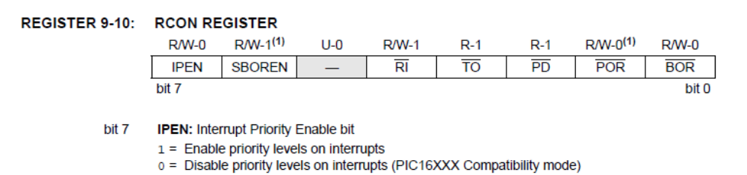
RCON REGISTER

Slide 14
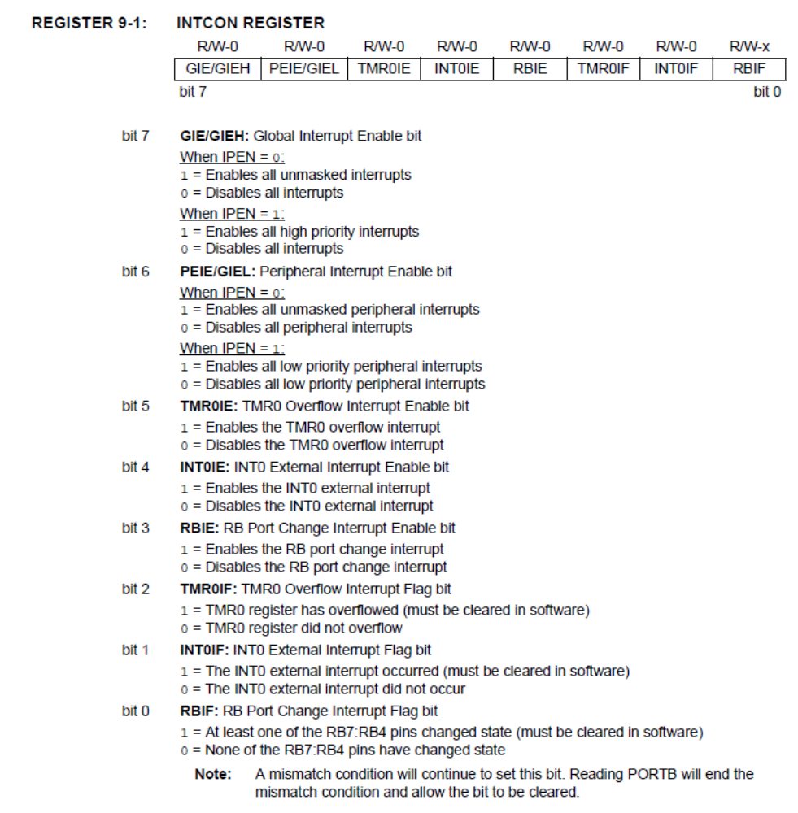
INTCON REGISTER

Slide 15
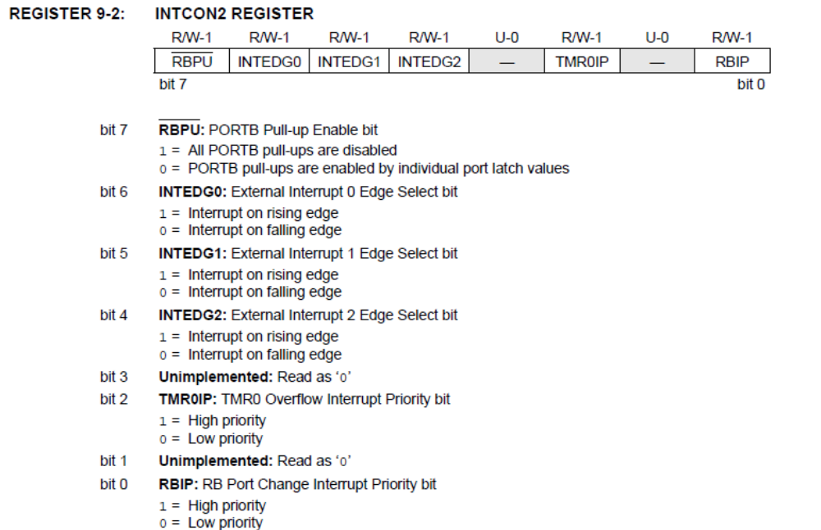
INTCON2 REGISTER

Slide 16
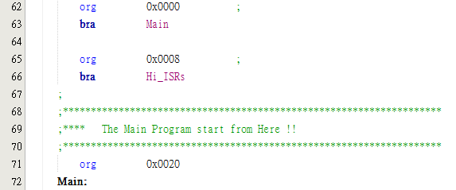

Interrupt service routine(ISR)
During interrupts, the return PC address is saved on the stack.
Additionally, the WREG, Status and BSR registers are saved on the fast return stack.

Slide 17
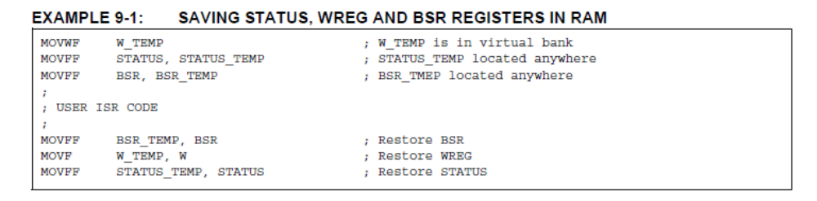
Interrupt service routine(ISR)
If a fast return from interrupt is not used, the user may need to save the WREG, Status and BSR registers on entry to the Interrupt Service Routine.

Slide 18
Try it
1. 觀察Lab7，加入movlw #20並將中斷點設在ISR內並仔細看WREG的變化，特別是在離開ISR後。
2. 修改Lab7的程式碼從
  org 0x0008
  bra Hi_ISRs
更改成如下:
  org 0x0008
  call Hi_ISRs,FAST
程式執行的順序將如何跳動？為什麼會那樣跳?

Slide 19
  Introduction to interrupt
  Interrupt in PIC18F4520
  Implementation in C
  Lab

Slide 20
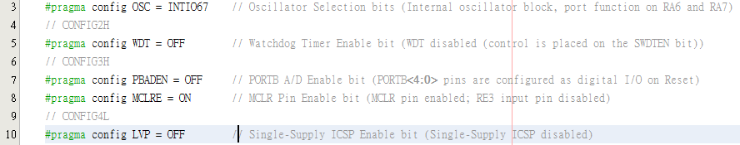
Implementation in C
Configuration Bits setting:
  In MPLABXIDE >>Window >> PIC Memory Views >> Configuration Bits

Slide 21
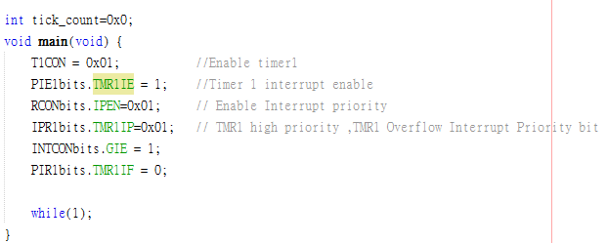
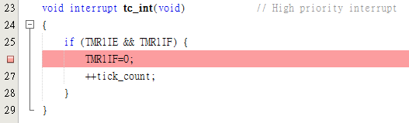
Implementation in C
Main function: (Timer interrupt example next week.)
Interrupt function:

Slide 22
  Introduction to interrupt
  Interrupt in PIC18F4520
  Implementation in C
  Lab

Slide 23
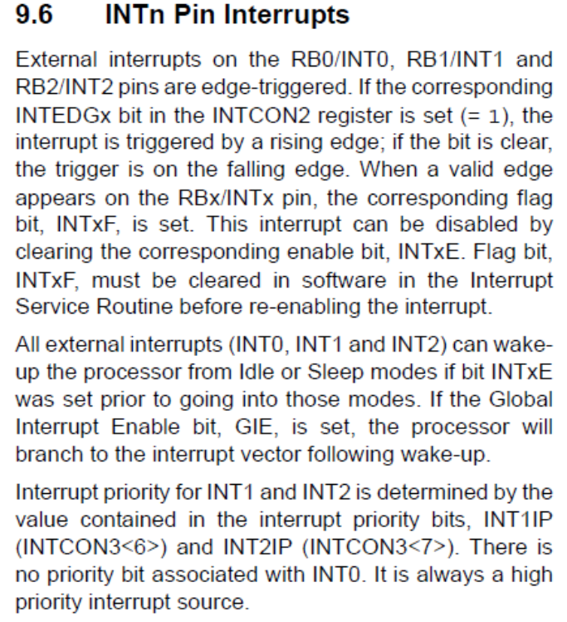
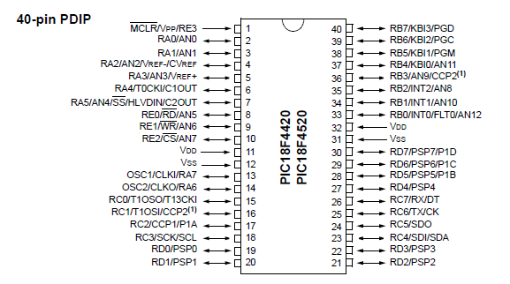
Lab
使用interrupt，讓按鍵按下去(INT0改變時)之後點亮一個LED(在PORTD0)一段時間。(Use C or Assembly)
  Hint: 利用external interrupt, RD port and software delay

Slide 24
參考資料
PIC18F4520 datasheet
  http://ww1.microchip.com/downloads/en/devicedoc/39631a.pdf
Microchip 教材 102ASP Example code
  http://www.microchip.com.tw/Data_CD/Workshop/8-Bits/102ASP%20PIC18F452.zip
How do I write interrupt routines in XC8?
  http://microchipdeveloper.com/faq:31

