Slide 1
PIC18F4520
CCP and Motor
Wei-Xun Chen
陳韋勳

Slide 2
CCP
(CAPTURE/COMPARE/PWM)

Slide 3
Introduction of CCP
PIC18F4520 devices all have two CCP (Capture/Compare/PWM) modules.
Each module contains a 16-bit register which can operate as a 16-bit Capture register, a 16-bit Compare register or a PWM Duty Cycle register.
Each Capture/Compare/PWM module is associated with a control register (generically, CCPxCON) and a data register (CCPRx).
The data register, in turn, is comprised of two 8-bit registers: CCPRxL (low byte) and CCPRxH (high byte).

Slide 4
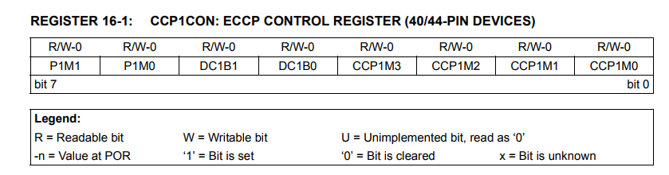

Slide 5
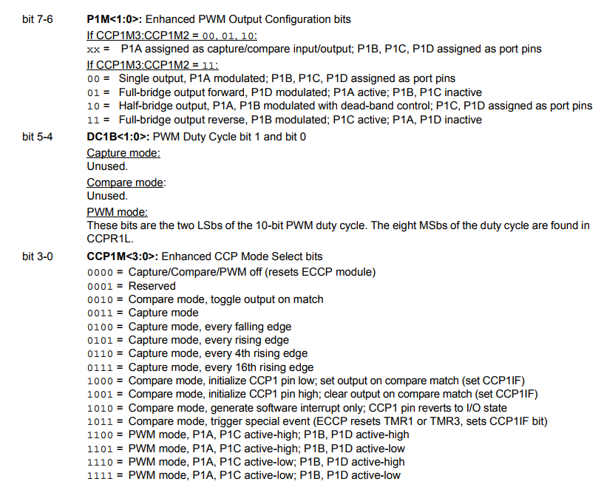

Slide 6
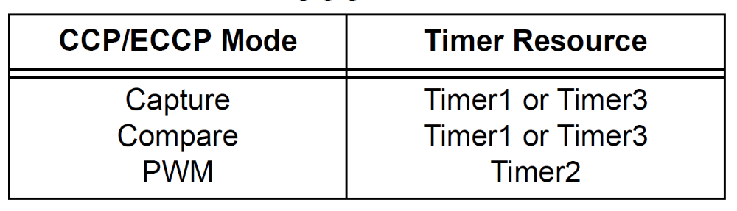
Timer1 and Timer3 are available to modules in Capture or Compare modes
Timer2 is available for modules in PWM mode.
The assignment of a particular timer to a module is determined by the Timer to CCP enable bits in the T3CON (T3CCP2:T3CCP1) register.
T3CCP2:T3CCP1: Timer3 and Timer1 to CCPx Enable bits
  1x = Timer3 is the capture/compare clock source for the CCP modules
  01 = Timer3 is the capture/compare clock source for CCP2; Timer1 is the capture/compare clock source for CCP1
  00 = Timer1 is the capture/compare clock source for the CCP modules

Slide 7
Capture and Compare
Same :
  The event is selected by the mode select bits, CCPxM3:CCPxM0 (CCPxCON<3:0>).
  When the Capture/Compare is made, interrupt request flag bit CCPxIF is set while the CCPxIE bit is set; it must be cleared in software.
  The timer that are to be used with the capture/compare feature (Timer1 and/or Timer3) must be running in Timer mode or Synchronized Counter mode. In Asynchronous Counter mode, the capture operation will not work.
  timer to be used with each CCP module is selected in the T3CON register

Slide 8
Different :
  A capture event is defined as one of the following:
    every falling edge
    every rising edge
    every 4th rising edge
    every 16th rising edge
  When a compare match occurs, CCPx pin can be:
    driven high or driven low
    toggled (high-to-low or low-to-high)
    remain unchanged (that is, reflects the state of the I/O latch)

Slide 9
  In Capture mode, the appropriate CCPx pin should be configured as an input by setting the corresponding TRIS direction bit.
  In Compare mode, the appropriate CCPx pin should be configured as an output by setting the corresponding TRIS direction bit.

Slide 10
Capture circuit block diagram

Slide 11
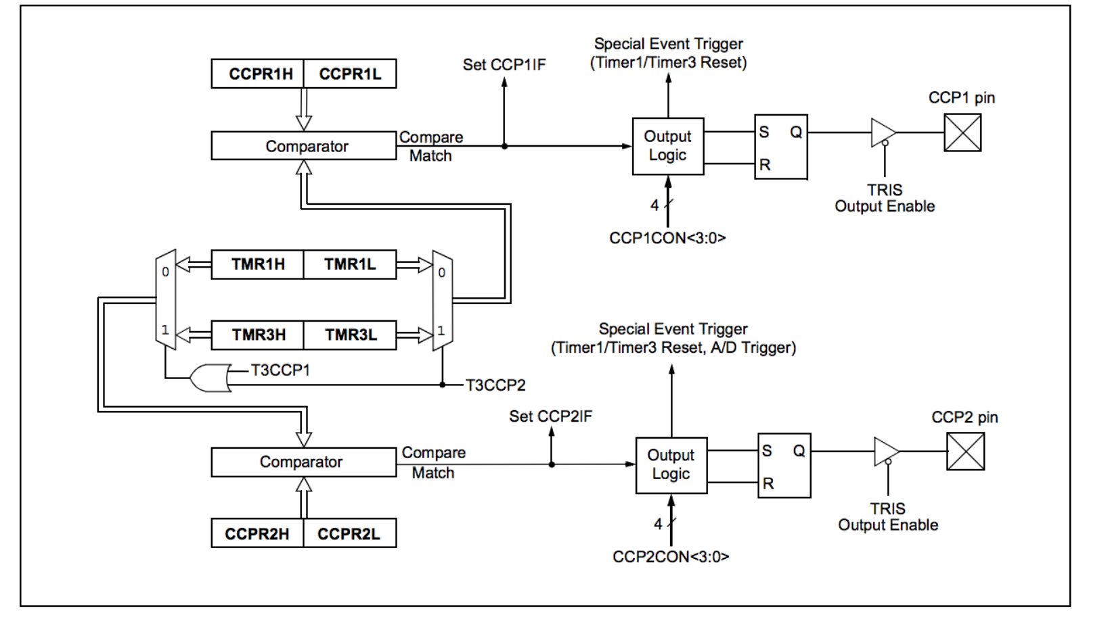
Compare circuit block diagram

Slide 12
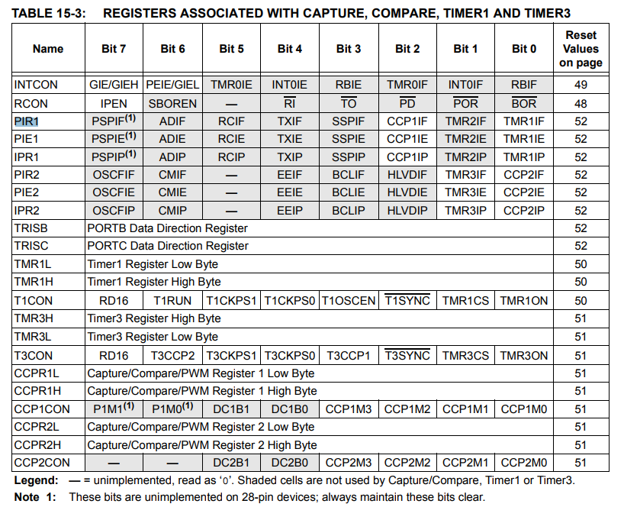
Operation for Capture and Compare
Timer
CCP1 data
register
CCP1 control
register

Slide 13
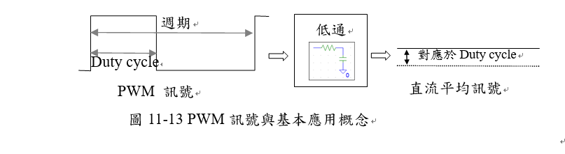
PWM

Slide 14

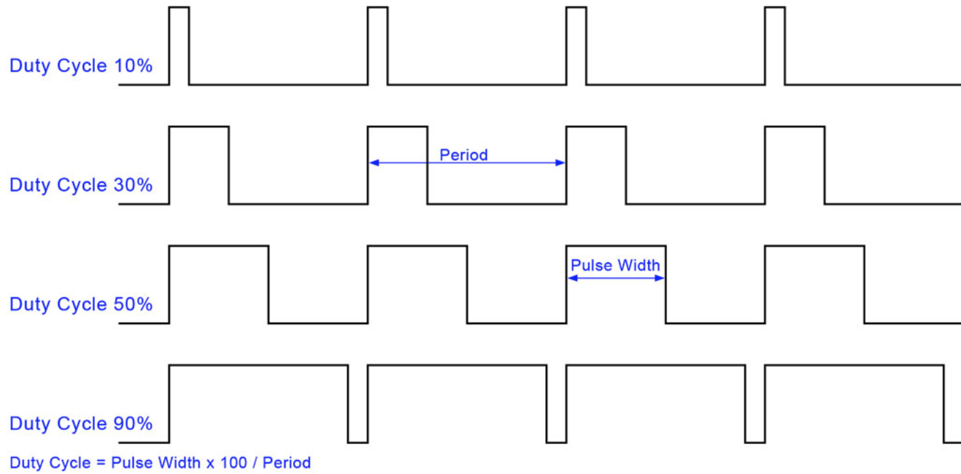

呼吸燈
9V
4.5V
100ms

Slide 15

The PWM period is specified by writing to the PR2 register

Slide 16
When the TMR2 is equal to PR2, the following three events occur on the next increment cycle:
  TMR2 is cleared
  The CCPx pin is set(exception: if PWM duty cycle=0%, the CCPx pin will not be set)
  The PWM duty cycle is latched from CCPRxL into CCPRxH

Slide 17
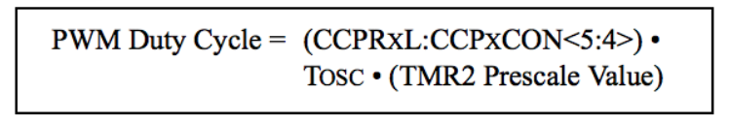
The PWM duty cycle is specified by writing to the CCPRxL register and to the CCPxCON<5:4> bits. Up to 10-bit resolution is available

Slide 18
CCPRxL and CCPxCON<5:4> can be written to at any time, but the duty cycle value is not latched into CCPRxH until after a match between PR2 and TMR2 occurs (i.e., the period is complete).

Slide 19
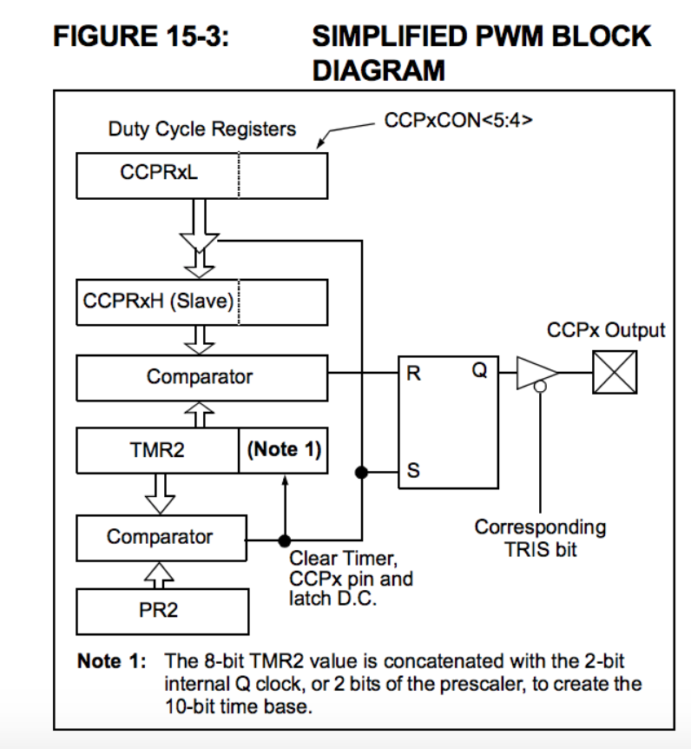

Slide 20
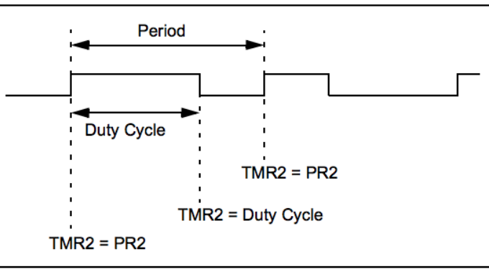

Slide 21
The following steps should be taken when configuring the CCP module for PWM operation:
  1. Set the PWM period by writing to the PR2 register.
  2. Set the PWM duty cycle by writing to the CCPRxL register and CCPxCON<5:4> bits.
  3. Make the CCPx pin an output by clearing the appropriate TRIS bit.
  4.. Set the TMR2 prescale value, then enable Timer2 by writing to T2CON.
  5. Configure the CCPx module for PWM operation.

Slide 22
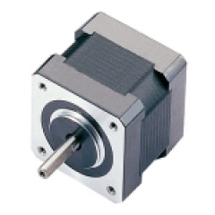
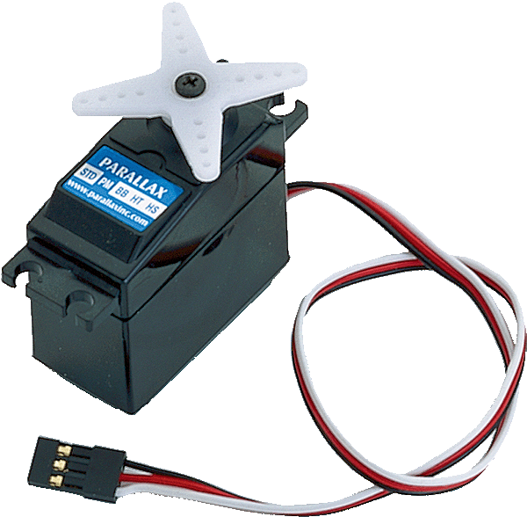
Motor
分類：
  伺服馬達_x001a__x0018__x0006__x0016__x0006__x0006_
  步進馬達
  直流馬達
  交流馬達

Slide 23
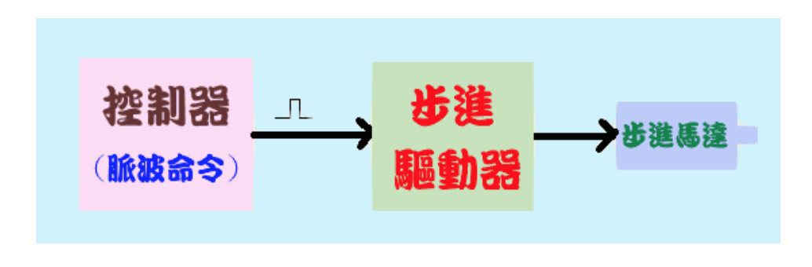
Step motor
旋轉角度：
  2相
  3相
  5相
Type:
  永久磁鐵PM式
  可變磁組VR式
  複合卡匣

Slide 24
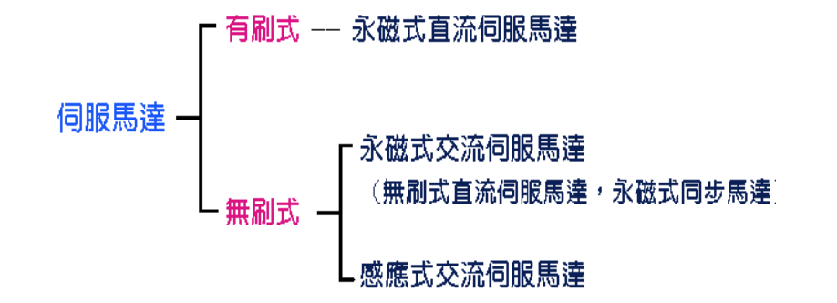
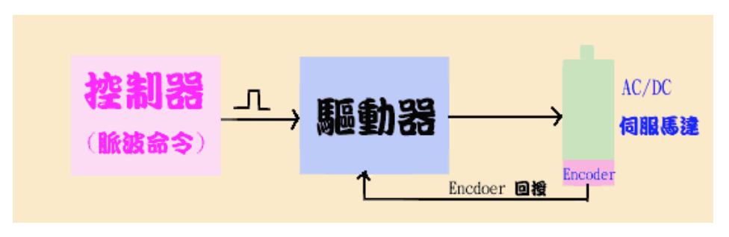
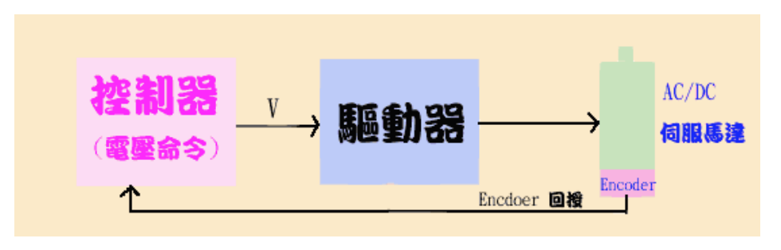
Servo motor
Type:
脈波命令式伺服系統
(半閉迴路)
電壓命令式伺服系統
(全閉迴路)

Slide 25
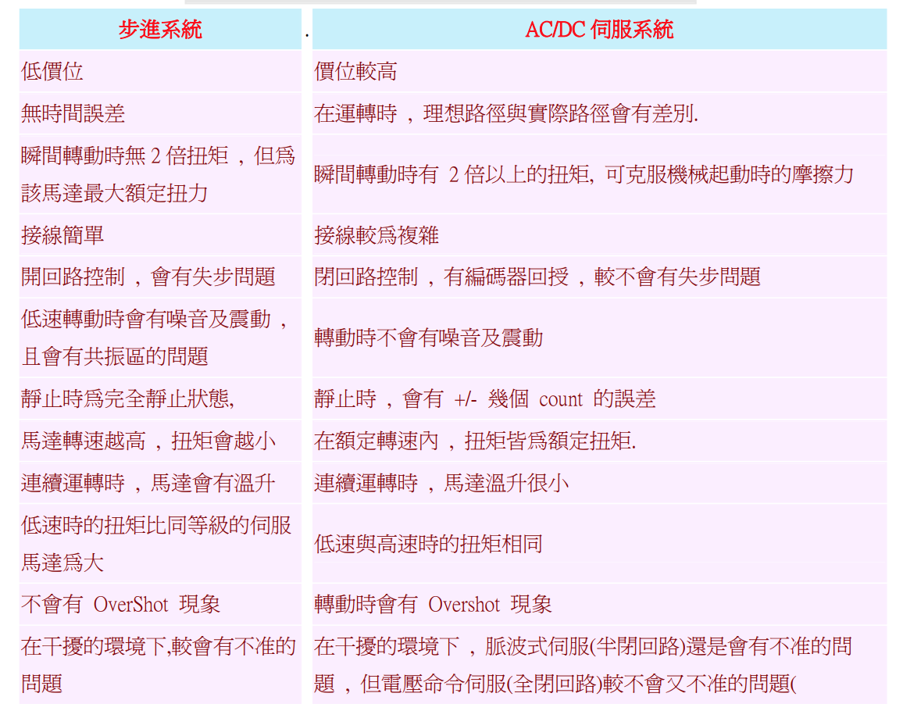
Step motor vs Servo motor

Slide 26
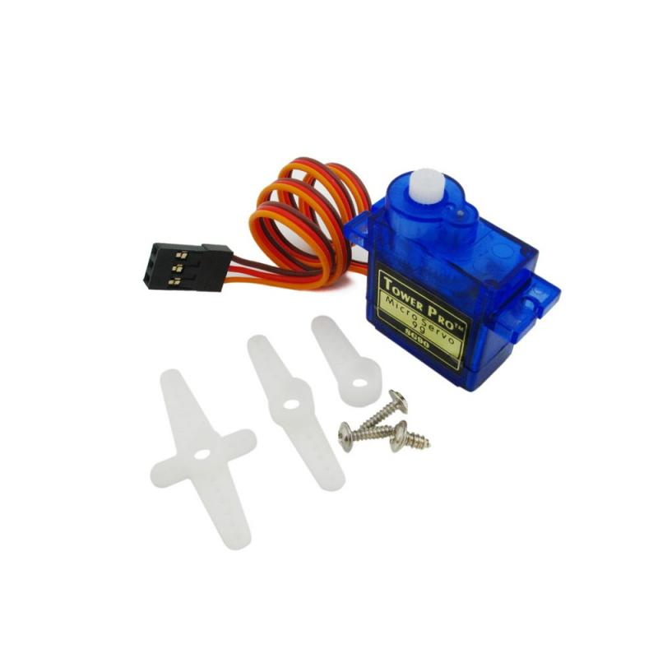

Tower Pro SG90
Servo motor

Slide 27
重量：9g
尺寸：23*12.2*29mm
工作電壓：4.8V
轉矩：1.8kg-cm，當工作電壓為4.8V時
運轉速度：0.1秒 ∕ 60度 ，當工作電壓為4.8V時
脈衝寬度範圍：500~2400µs (1500µs 為0度)
死頻帶寬度（dead band width）：10µs

Slide 28
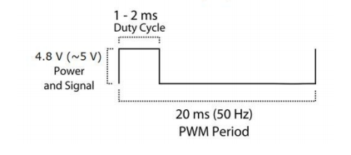
示意圖

Slide 29
LAB
請利用剛剛所學的PWM相關公式、CCP模組control register、pwm相關register和上週所學的timer知識，調整出此Tower Pro SG90 servo motor所需的PWM period 並持續改變Duty cycle。並且利用按鈕控制旋轉:
  起始位置為-90度，按鈕按住時旋轉角度由-90→0→+90
  Demo注意事項:
    需告知助教pwm period如何設定，套入公式其週期時間為何
    需告知助教-90度、0度、+90度時其PR2 register及CCP1CON<5:4>值為何

