Slide 1
Apache Storm 0.9 basic training
Michael G. Noll, Verisign
mnoll@verisign.com / @miguno
July 2014

Slide 2
Storm?
Part 1: Introducing Storm
“Why should I stay awake for the full duration of this workshop?”
Part 2: Storm core concepts
Topologies, tuples, spouts, bolts, groupings, parallelism
Part 3: Operating Storm
Architecture, hardware specs, deploying, monitoring
Part 4: Developing Storm apps
Bolts and topologies, Kafka integration, testing, serialization, example apps, P&S tuning
Part 5: Playing with Storm using Wirbelsturm
Wrapping up

Slide 3
NOT covered in this workshop (too little time)
Storm Trident
High-level abstraction on top of Storm, which intermixes high throughput and stateful stream processing with low latency distributed querying.
Joins, aggregations, grouping, functions, filters.
Adds primitives for doing stateful, incremental processing on top of any database or persistence store.
Has consistent, exactly-once semantics.
Processes a stream as small batches of messages
(cf. Spark Streaming)
Storm DRPC
Parallelizes the computation of really intense functions on the fly.
Input is a stream of function arguments, and output is a stream of the results for each of those function calls.

Slide 4
Part 1: Introducing Storm

Slide 5
Overview of Part 1: Introducing Storm
Storm?
Storm adoption and use cases in the wild
Storm in a nutshell
Motivation behind Storm

Slide 6

Storm?
“Distributed and fault-tolerant real-time computation”
http://storm.incubator.apache.org/
Originated at BackType/Twitter, open sourced in late 2011
Implemented in Clojure, some Java
12 core committers, plus ~ 70 contributors
https://github.com/apache/incubator-storm/#committers
https://github.com/apache/incubator-storm/graphs/contributors

Slide 7
Storm adoption and use cases
Twitter: personalization, search, revenue optimization, …
200 nodes, 30 topos, 50B msg/day, avg latency <50ms, Jun 2013
Yahoo: user events, content feeds, and application logs
320 nodes (YARN), 130k msg/s, June 2013
Spotify: recommendation, ads, monitoring, …
v0.8.0, 22 nodes, 15+ topos, 200k msg/s, Mar 2014
Alibaba, Cisco, Flickr, PARC, WeatherChannel, …
Netflix is looking at Storm and Samza, too.
https://github.com/nathanmarz/storm/wiki/Powered-By

Slide 8


“A Storm in a Nutshell”

Slide 9
Engineers can solve tricky problems
…as long as we have the right tools.

Slide 10
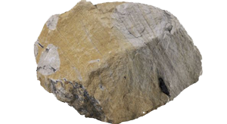



Slide 11



Slide 12

But without shooting ourselves in the foot.

Slide 13
The Motivation of Storm

Slide 14
“Show me your code and conceal your data structures,
and I shall continue to be mystified. Show me your
data structures, and I won't usually need your code;
it'll be obvious.”
-- Eric S. Raymond, The Cathedral and the Bazaar

Slide 15
Data

Slide 16
WordCount example
(1.1.1.1, “foo.com”)
(2.2.2.2, “bar.net”)
(3.3.3.3, “foo.com”)
(4.4.4.4, “foo.com”)
(5.5.5.5, “bar.net”)
DNS queries
?
( (“foo.com”, 3)
(“bar.net”, 2) )
Top queried
domains

Slide 17
Functional
Programming
Functions

Slide 18
( (1.1.1.1, “foo.com”)
(2.2.2.2, “bar.net”)
(3.3.3.3, “foo.com”)
(4.4.4.4, “foo.com”)
(5.5.5.5, “bar.net”) )
DNS queries
(“foo.com”, “bar.net”, “foo.com”,
“foo.com”, “bar.net”)
f
g
{“bar.net” -> 2, “foo.com” -> 3}
( (“foo.com”, 3)
(“bar.net”, 2) )
h

Slide 19
h(g(f(data)))
→ λ-calculus

Slide 20

λ here

Slide 21
Clojure
Is a dialect of Lisp that targets the JVM (and JavaScript)
clojure-1.5.1.jar

Slide 22
Wait a minute – LISP??
(me? (kidding (you (are))))
Yeah, those parentheses are annoying. At first.
Think: Like Python’s significant whitespace.

Slide 23
Clojure
Is a dialect of Lisp that targets the JVM (and JavaScript)
clojure-1.5.1.jar
"Dynamic, compiled programming language"
Predominantly functional programming
Many interesting characteristics and value propositions for software development, notably for concurrent applications
Storm’s core is implemented in Clojure
And you will see why they match so well.

Slide 24
Previous WordCount example in Clojure
h
g
f
(sort-by val > (frequencies (map second queries)))
Alternative, left-to-right syntax with ->>:
(->> queries (map second) frequencies (sort-by val >))
$ cat input.txt | awk | sort # kinda

Slide 25
Clojure REPL
user> queries
(("1.1.1.1" "foo.com") ("2.2.2.2" "bar.net")
("3.3.3.3" "foo.com") ("4.4.4.4" "foo.com")
("5.5.5.5" "bar.net"))
user> (map second queries)
("foo.com" "bar.net" "foo.com" "foo.com" "bar.net")
user> (frequencies (map second queries))
{"bar.net" 2, "foo.com" 3}
user> (sort-by val > (frequencies (map second queries)))
(["foo.com" 3] ["bar.net" 2])

Slide 26

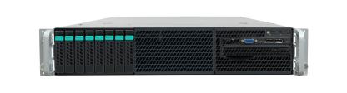
Scaling up
Clojure, Java, <your-pick> can turn the
previous code into a multi-threaded app
that utilizes all cores on your server.

Slide 27

But what if even a very big machine is not enough for your Internet-scale app?

Slide 28
And remember.

Slide 29
Enter:

Slide 30
Part 2: Storm core concepts

Slide 31
Overview of Part 2: Storm core concepts
A first look
Topology
Data model
Spouts and bolts
Groupings
Parallelism

Slide 32
A first look
Storm is distributed FP-like
processing of data streams.
Same idea, many machines.
(but there’s more of course)

Slide 33
Overview of Part 2: Storm core concepts
A first look
Topology
Data model
Spouts and bolts
Groupings
Parallelism

Slide 34
A topology in Storm wires data and functions via a DAG.
Executes on many machines like a MR job in Hadoop.

Slide 35
Topology

Slide 36
Topology
Spout 1
data
Spout 2

Slide 37
Topology
functions
Bolt 1
Bolt 4
Spout 1
Bolt 2
data
Spout 2
Bolt 3

Slide 38
Topology
functions
Bolt 1
Bolt 4
Spout 1
Bolt 2
data
DAG
Spout 2
Bolt 3

Slide 39
Relation of topologies to FP
f
h
Bolt 1
Bolt 4
data
Spout 1
Bolt 2
g
Spout 2
Bolt 3

Slide 40
Relation of topologies to FP
f
h
Bolt 1
Bolt 4
data
Spout 1
Bolt 2
g
DAG:
f(data)
g(data)
h( , )

Slide 41
Previous WordCount example in Storm (high-level)
Remember?
(->> queries (map second) frequencies (sort-by val >) )
queries
f
g
h
Spout
Bolt 1
Bolt 2
Bolt 3

Slide 42
Overview of Part 2: Storm core concepts
A first look
Topology
Data model
Spouts and bolts
Groupings
Parallelism

Slide 43
Data model
Tuple = datum containing 1+ fields
(1.1.1.1, “foo.com”)
Values can be of any type such as Java primitive types, String, byte[].
Custom objects should provide their own Kryo serializer though.
Stream = unbounded sequence of tuples
...
(1.1.1.1, “foo.com”)
(2.2.2.2, “bar.net”)
(3.3.3.3, “foo.com”)
...
http://storm.incubator.apache.org/documentation/Concepts.html

Slide 44
Overview of Part 2: Storm core concepts
A first look
Topology
Data model
Spouts and bolts
Groupings
Parallelism

Slide 45
Spouts and bolts
Spout = source of data streams
Spout 1
Bolt 1
Can be “unreliable” (fire-and-forget) or “reliable” (can replay failed tuples).
Example: Connect to the Twitter API and emit a stream of decoded URLs.
Bolt = consumes 1+ streams and potentially produces new streams
Spout 1
Bolt 1
Bolt 2
Can do anything from running functions, filter tuples, joins, talk to DB, etc.
Complex stream transformations often require multiple steps and thus multiple bolts.
http://storm.incubator.apache.org/documentation/Concepts.html

Slide 46
Overview of Part 2: Storm core concepts
A first look
Topology
Data model
Spouts and bolts
Groupings
Parallelism

Slide 47
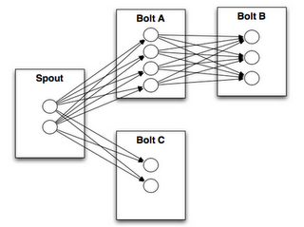
Stream groupings control the data flow in the DAG
Bolt A
Bolt B
Spout
Bolt C
Shuffle grouping = random; typically used to distribute load evenly to downstream bolts
Fields grouping = GROUP BY field(s)
All grouping = replicates stream across all the bolt’s tasks; use with care
Global grouping = stream goes to a single one of the bolt’s tasks; don’t overwhelm the target bolt!
Direct grouping = producer of the tuple decides which task of the consumer will receive the tuple
LocalOrShuffle = If the target bolt has one or more tasks in the same worker process, tuples will be shuffled to just those in-process tasks. Otherwise, same as normal shuffle.
Custom groupings are possible, too.

Slide 48
Overview of Part 2: Storm core concepts
A first look
Topology
Data model
Spouts and bolts
Groupings
Parallelism – worker, executors, tasks

Slide 49
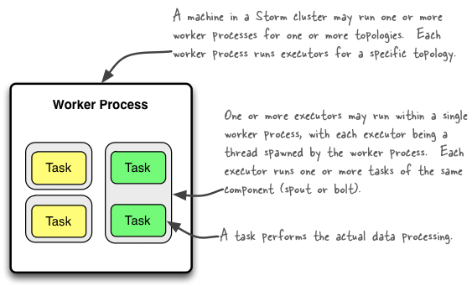
Worker processes vs. Executors vs. Tasks
Invariant: #threads ≤ #tasks
A worker process is either idle or being used by a single topology, and it is never
shared across topologies. The same applies to its child executors and tasks.
http://storm.incubator.apache.org/documentation/Understanding-the-parallelism-of-a-Storm-topology.html

Slide 50
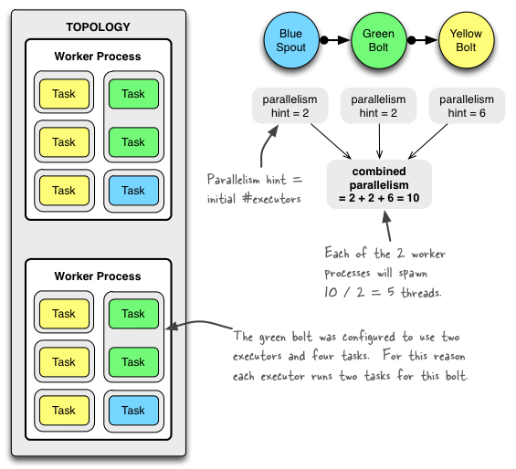
Example of a running topology

Slide 51
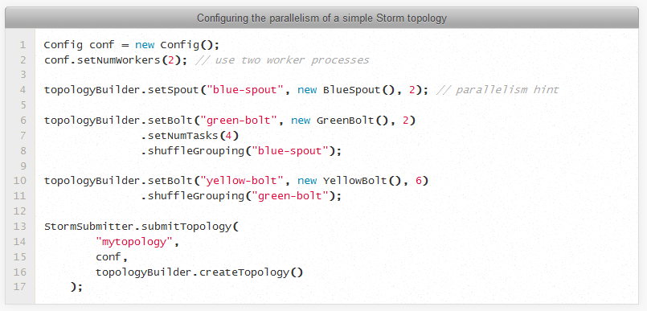
Code to configure this topology

Slide 52
Part 3: Operating Storm

Slide 53
Overview of Part 3: Operating Storm
Storm architecture
Storm hardware specs
Deploying Storm
Monitoring Storm
Storm topologies
Storm itself
ZooKeeper
Ops-related references

Slide 54
Storm architecture
Supervisor
ZooKeeper
Supervisor
Nimbus
ZooKeeper
Supervisor
ZooKeeper
Supervisor
Supervisor
Hadoop v1 | Storm
JobTracker | Nimbus (only 1) | distributes code around cluster assigns tasks to machines/supervisors failure monitoring is fail-fast and stateless (you can “kill -9” it)
TaskTracker | Supervisor (many) | listens for work assigned to its machine starts and stops worker processes as necessary based on Nimbus is fail-fast and stateless (you can “kill -9” it) shuts down worker processes with “kill -9”, too
MR job | Topology | processes messages forever (or until you kill it) a running topology consists of many worker processes spread across many machines

Slide 55
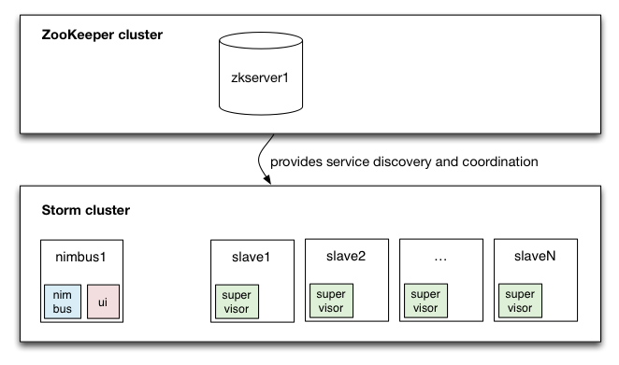
Storm architecture

Slide 56
Storm architecture: ZooKeeper
Storm requires ZooKeeper
0.9.2+ uses ZK 3.4.5
Storm typically puts less load on ZK than Kafka (but ZK is still a bottleneck), but caution: often you have many more Storm nodes than Kafka nodes
ZooKeeper
NOT used for message passing, which is done via Netty in 0.9
Used for coordination purposes, and to store state and statistics
Register + discover Supervisors, detect failed nodes, …
Example: To add a new Supervisor node, just start it.
This allows Storm’s components to be stateless. “kill -9” away!
Example: Supervisors/Nimbus can be restarted without affecting running topologies.
Used for heartbeats
Workers heartbeat the status of child executor threads to Nimbus via ZK.
Supervisor processes heartbeat their own status to Nimbus via ZK.
Stores recent task errors (deleted on topology shutdown)

Slide 57
Storm architecture: fault tolerance
What happens when Nimbus dies (master node)?
If Nimbus is run under process supervision as recommended (e.g. via supervisord), it will restart like nothing happened.
While Nimbus is down:
Existing topologies will continue to run, but you cannot submit new topologies.
Running worker processes will not be affected. Also, Supervisors will restart their (local) workers if needed. However, failed tasks will not be reassigned to other machines, as this is the responsibility of Nimbus.
What happens when a Supervisor dies (slave node)?
If Supervisor run under process supervision as recommended (e.g. via supervisord), will restart like nothing happened.
Running worker processes will not be affected.
What happens when a worker process dies?
It's parent Supervisor will restart it. If it continuously fails on startup and is unable to heartbeat to Nimbus, Nimbus will reassign the worker to another machine.

Slide 58
Storm hardware specs
ZooKeeper
Preferably use dedicated machines because ZK is a bottleneck for Storm
1 ZK instance per machine
Using VMs may work in some situations. Keep in mind other VMs or processes running on the shared host machine may impact ZK performance, particularly if they cause I/O load. (source)
I/O is a bottleneck for ZooKeeper
Put ZK storage on its own disk device
SSD’s dramatically improve performance
Normally, ZK will sync to disk on every write, and that causes two seeks (1x for the data, 1x for the data log). This may add up significantly when all the workers are heartbeating to ZK. (source)
Monitor I/O load on the ZK nodes
Preferably run ZK ensembles with nodes >= 3 in production environments so that you can tolerate the failure of 1 ZK server (incl. e.g. maintenance)

Slide 59
Storm hardware specs
Nimbus aka master node
Comparatively little load on Nimbus, so a medium-sized machine suffices
EC2 example: m1.xlarge @ $0.27/hour
Check monitoring stats to see if the machine can keep up

Slide 60
Storm hardware specs
Storm Supervisor aka slave nodes
Exact specs depend on anticipated usage – e.g. CPU heavy, I/O heavy, …
CPU heavy: e.g. machine learning
CPU light: e.g. rolling windows, pre-aggregation (here: get more RAM)
CPU cores
More is usually better – the more you have the more threads you can support (i.e. parallelism). And Storm potentially uses a lot of threads.
Memory
Highly specific to actual use case
Considerations: #workers (= JVMs) per node? Are you caching and/or holding in-memory state?
Network: 1GigE
Use bonded NICs or 10GigE if needed
EC2 examples: c1.xlarge @ $0.36/hour, c3.2xlarges @ $0.42/hour

Slide 61
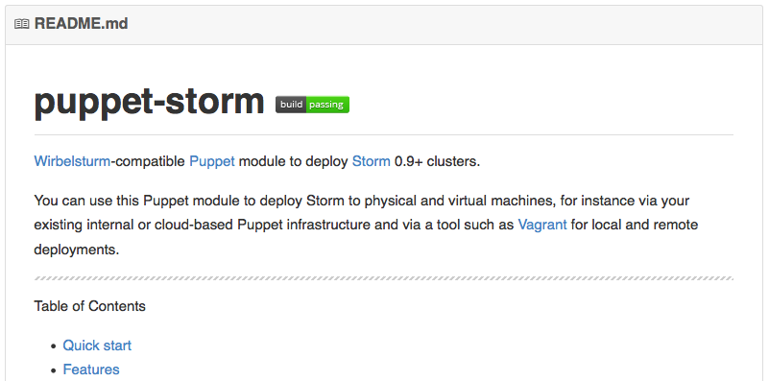
Deploying Storm
Puppet module
https://github.com/miguno/puppet-storm
Hiera-compatible, rspec tests, Travis CI setup (e.g. to test against multiple versions of Puppet and Ruby, Puppet style checker/lint, etc.)
RPM packaging script for RHEL 6
https://github.com/miguno/wirbelsturm-rpm-storm
Digitally signed by yum@michael-noll.com
RPM is built on a Wirbelsturm-managed build server
See later slides on Wirbelsturm for 1-click off-the-shelf cluster setups.

Slide 62
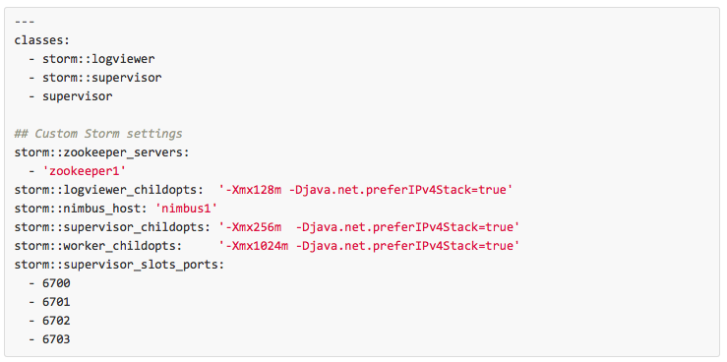
Deploying Storm
Hiera example for a Storm slave node

Slide 63
Operating Storm
Typical operations tasks include:
Monitoring topologies for P&S (“Don’t let our pipes blow up!”)
Tackling P&S in Storm is a joint Ops-Dev effort.
Adding or removing slave nodes, i.e. nodes that run Supervisors
Apps management: new topologies, swapping topologies, …
See Ops-related references at the end of this part

Slide 64
Storm security
Original design was not created with security in mind.
Security features are now being added, e.g. from Yahoo!’s fork.
State of security in Storm 0.9.x:
No authentication, no authorization.
No encryption of data in transit, i.e. between workers.
No access restrictions on data stored in ZooKeeper.
Arbitrary user code can be run on nodes if Nimbus’ Thrift port is not locked down.
This list goes on.
Further details plus recommendations on hardening Storm:
https://github.com/apache/incubator-storm/blob/master/SECURITY.md

Slide 65
Monitoring Storm

Slide 66
Monitoring Storm
Storm UI
Use standard monitoring tools such as Graphite & friends
Graphite
https://github.com/miguno/puppet-graphite
Java API, also used by Kafka: http://metrics.codahale.com/
Consider Storm's built-in metrics feature
Collect logging files into a central place
Logstash/Kibana and friends
Helps with troubleshooting, debugging, etc. – notably if you can correlate logging data with numeric metrics

Slide 67
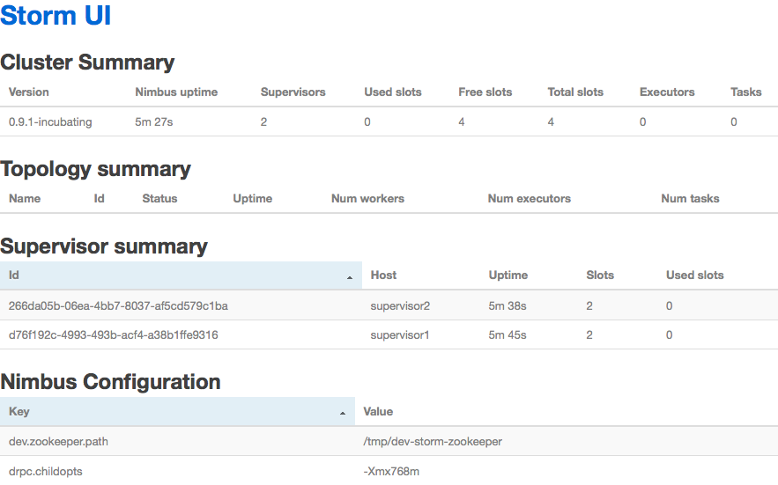
Monitoring Storm
Built-in Storm UI, listens on 8080/tcp by default
Storm REST API (new since in 0.9.2)
https://github.com/apache/incubator-storm/blob/master/STORM-UI-REST-API.md
Third-party tools
https://github.com/otoolep/stormkafkamon

Slide 68
Monitoring Storm topologies
Wait – why does the Storm UI report seemingly incorrect numbers?
Storm samples incoming tuples when computing statistics in order to increase performance.
Sample rate is configured via topology.stats.sample.rate.
0.05 is the default value
Here, Storm will pick a random event of the next 20 events in which to increase the metric count by 20. So if you have 20 tasks for that bolt, your stats could be off by +/- 380.
1.00 forces Storm to count everything exactly
This gives you accurate numbers at the cost of a big performance hit. For testing purposes however this is acceptable and often quite helpful.

Slide 69
Monitoring ZooKeeper
Ensemble (= cluster) availability
LinkedIn run 5-node ensembles = tolerates 2 dead
Twitter run 13-node ensembles = tolerates 6 dead
Latency of requests
Metric target is 0 ms when using SSD’s in ZooKeeper machines.
Why? Because SSD’s are so fast they typically bring down latency below ZK’s metric granularity (which is per-ms).
Outstanding requests
Metric target is 0.
Why? Because ZK processes all incoming requests serially. Non-zero values mean that requests are backing up.

Slide 70
Ops-related references
Storm documentation
http://storm.incubator.apache.org/documentation/Home.html
Storm FAQ
http://storm.incubator.apache.org/documentation/FAQ.html
Storm CLI
http://storm.incubator.apache.org/documentation/Command-line-client.html
Storm fault-tolerance
http://storm.incubator.apache.org/documentation/Fault-tolerance.html
Storm metrics
http://storm.incubator.apache.org/documentation/Metrics.html
http://www.michael-noll.com/blog/2013/11/06/sending-metrics-from-storm-to-graphite/
Storm tutorials
http://storm.incubator.apache.org/documentation/Tutorial.html
http://www.michael-noll.com/tutorials/running-multi-node-storm-cluster/

Slide 71
Part 4: Developing Storm apps

Slide 72
Overview of Part 4: Developing Storm apps
Hello, Storm!
Creating a bolt
Creating a topology
Running a topology
Integrating Storm and Kafka
Testing Storm topologies
Serialization in Storm (Avro, Kryo)
Example Storm apps
P&S tuning

Slide 73
A trivial “Hello, Storm” topology
Spout
Bolt
“emit random number < 100”
“multiply by 2”
(74)
(148)

Slide 74

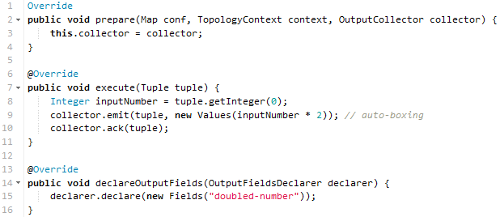
Code
Spout
Bolt

Slide 75
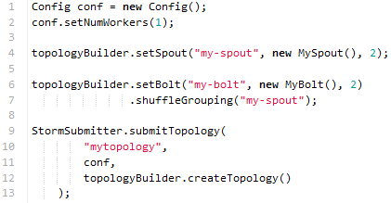
Code
Topology config – for running on your local laptop

Slide 76
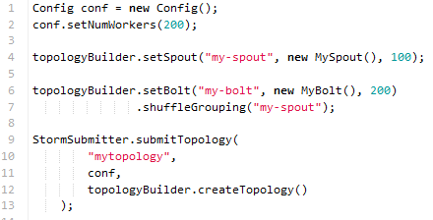
Code
Topology config – for running on a production Storm cluster

Slide 77
Creating a spout
Won’t cover implementing a spout in this workshop.
This is because you typically use an existing spout (Kafka spout, Redis spout, etc). But you will definitely implement your own bolts.

Slide 78
Creating a bolt
Storm is polyglot – but in this workshop we focus on JVM languages.
Two main options for JVM users:
Implement the IRichBolt or IBasicBolt interfaces
Extend the BaseRichBolt or BaseBasicBolt abstract classes
BaseRichBolt
You must – and are able to – manually ack() an incoming tuple.
Can be used to delay acking a tuple, e.g. for algorithms that need to work across multiple incoming tuples.
BaseBasicBolt
Auto-acks the incoming tuple at the end of its execute() method.
These bolts are typically simple functions or filters.

Slide 79
Extending BaseRichBolt
Let’s re-use our previous example bolt.

Slide 80
Extending BaseRichBolt
execute() is the heart of the bolt.
This is where you will focus most of your attention when implementing your bolt or when trying to understand somebody else’s bolt.

Slide 81
Extending BaseRichBolt
prepare() acts as a “second constructor” for the bolt’s class.
Because of Storm’s distributed execution model and serialization, prepare() is often needed to fully initialize the bolt on the target JVM.

Slide 82
Extending BaseRichBolt
declareOutputFields() tells downstream bolts about this bolt’s output. What you declare must match what you actually emit().
You will use this information in downstream bolts to “extract” the data from the emitted tuples.
If your bolt only performs side effects (e.g. talk to a DB) but does not emit an actual tuple, override this method with an empty {} method.

Slide 83
Common spout/bolt gotchas
NotSerializableException at run-time of your topology
Typically you will run into this because your bolt has fields (instance or class members) that are not serializable. This recursively applies to each field.
The root cause is Storm’s distributed execution model and serialization: Storm code will be shipped – first serialized and then deserialized – to a different machine/JVM, and then executed. (see docs for details)
How to fix?
Solution 1: Make the culprit class serializable, if possible.
Solution 2: Register a custom Kryo serializer for the class.
Solution 3a (Java): Make the field transient. If needed, initialize it in prepare().
Solution 3b (Scala): Make the field @transient lazy val (Scala). If needed, turn it into a var and initialize it in in prepare().
For example, the var/prepare() approach may be needed if you use the factory pattern to create a specific type of a collaborator within a bolt. Factories come in handy to make the code testable. See AvroKafkaSinkBolt in kafka-storm-starter for such a case.

Slide 84
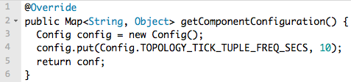
Common spout/bolt gotchas
Tick tuples are configured per-component, i.e. per bolt
Idiomatic approach to trigger periodic activities in your bolts: “Every 10s do XYZ.”
Don't configure them per-topology as this will throw a RuntimeException.
Tick tuples are not 100% guaranteed to arrive in time
They are sent to a bolt just like any other tuples, and will enter the same queues and buffers. Congestion, for example, may cause tick tuples to arrive too late.
Across different bolts, tick tuples are not guaranteed to arrive at the same time, even if the bolts are configured to use the same tick tuple frequency.
Currently, tick tuples for the same bolt will arrive at the same time at the bolt's various task instances. However, this property is not guaranteed for the future.
http://www.michael-noll.com/blog/2013/01/18/implementing-real-time-trending-topics-in-storm/

Slide 85
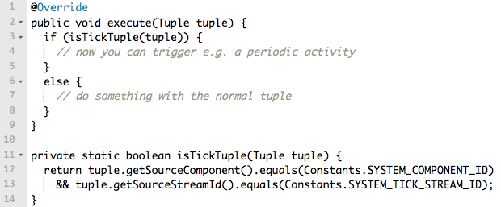
Common spout/bolt gotchas
When using tick tuples, forgetting to handle them "in a special way"
Trying to run your normal business logic on tick tuples – e.g. extracting a certain data field – will usually only work for normal tuples but fail for a tick tuple.
When using tick tuples, forgetting to ack() them
Tick tuples must be acked like any other tuple.
http://www.michael-noll.com/blog/2013/01/18/implementing-real-time-trending-topics-in-storm/

Slide 86
Common spout/bolt gotchas
Outputcollector#emit() can only be called from the "original" thread that runs a bolt
You can start additional threads in your bolt, but only the bolt's own thread may call emit() on the collector to write output tuples. If you try to emit tuples from any of the other threads, Storm will throw a NullPointerException.
If you need the additional-threads pattern, use e.g. a thread-safe queue to communicate between the threads and to collect [pun intended] the output tuples across threads.
This limitation is only relevant for output tuples, i.e. output that you want to send within the Storm framework to downstream consumer bolts.
If you want to write data to (say) Kafka instead – think of this as a side effect of your bolt – then you don't need the emit() anyways and can thus write the side-effect output in any way you want, and from any thread.

Slide 87
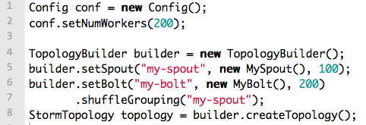
Creating a topology
When creating a topology you’re essentially defining the DAG – that is, which spouts and bolts to use, and how they interconnect.
TopologyBuilder#setSpout() and TopologyBuilder#setBolt()
Groupings between spouts and bolts, e.g. shuffleGrouping()

Slide 88
Creating a topology
You must specify the initial parallelism of the topology.
Crucial for P&S but no rule of thumb. We talk about tuning later.
You must understand concepts such as workers/executors/tasks.
Only some aspects of parallelism can be changed later, i.e. at run-time.
You can change the #executors (threads).
You cannot change #tasks, which remains static during the topology’s lifetime.

Slide 89
Creating a topology
You submit a topology either to a “local” cluster or to a real cluster.
LocalCluster#submitTopology
StormSubmitter#submitTopology() and #submitTopologyWithProgressBar()
In your code you may want to use both approaches, e.g. to facilitate local testing.
Notes
A StormTopology is a static, serializable Thrift data structure. It contains instructions that tell Storm how to deploy and run the topology in a cluster.
The StormTopology object will be serialized, including all the components in the topology's DAG. See later slides on serialization.
Only when the topology is deployed (and serialized in the process) and initialized (i.e. prepare() and other life cycle methods are called on components such as bolts) does it perform any actual message processing.

Slide 90
Running a topology
To run a topology you must first package your code into a “fat jar”.
You must includes all your code’s dependencies but:
Exclude the Storm dependency itself, as the Storm cluster will provide this.
Sbt: "org.apache.storm" % "storm-core" % "0.9.2-incubating" % "provided"
Maven: <scope>provided</scope>
Gradle with gradle-fatjar-plugin: compile '...', { ext { fatJarExclude = true } }
Note: You may need to tweak your build script so that your local tests do include the Storm dependency. See e.g. assembly.sbt in kafka-storm-starter for an example.
A topology is run via the storm jar command.
Will connects to Nimbus, upload your jar, and run the topology.
Use any machine that can run "storm jar" and talk to Nimbus' Thrift port.
You can pass additional JVM options via $STORM_JAR_JVM_OPTS.
$ storm jar all-my-code.jar com.miguno.MyTopology arg1 arg2

Slide 91
Alright, my topology runs – now what?
The topology will run forever or until you kill it.
Check the status of your topology
Storm UI (default: 8080/tcp)
Storm CLI, e.g. storm [list | kill | rebalance | deactivate | ...]
Storm REST API
FYI:
Storm will guarantee that no data is lost, even if machines go down and messages are dropped (as long as you don’t disable this feature).
Storm will automatically restart failed tasks, and even re-assign tasks to different machines if e.g. a machine dies.
See Storm docs for further details.

Slide 92
Integrating Storm and Kafka

Slide 93
Reading from Kafka
Use the official Kafka spout that ships in Storm 0.9.2
https://github.com/apache/incubator-storm/tree/master/external/storm-kafka
Compatible with Kafka 0.8, available on Maven Central
Based on wurstmeister's spout, now part of Storm https://github.com/wurstmeister/storm-kafka-0.8-plus
Alternatives to official Kafka spout
NFI: https://github.com/HolmesNL/kafka-spout
A detailed comparison is beyond the scope of this workshop, but:
Official Kafka spout uses Kafka’s Simple Consumer API, NFI uses High-level API.
Official spout can read from multiple topics, NFI can’t.
Official spout's replay-failed-tuples functionality is better than NFI’s.
"org.apache.storm" % "storm-kafka" % "0.9.2-incubating"

Slide 94
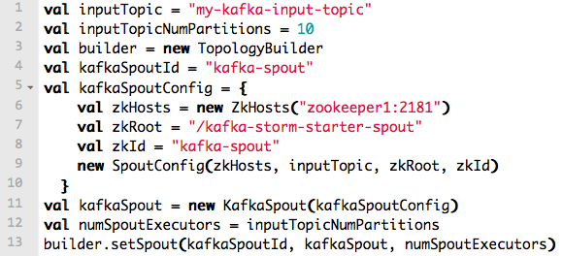
Reading from Kafka
Spout configuration via KafkaConfig
In the following example:
Connect to the target Kafka cluster via the ZK ensemble at zookeeper1:2181.
We want to read from the Kafka topic “my-kafka-input-topic”, which has 10 partitions.
By default, the spout stores its own state incl. Kafka offsets in the Storm cluster's ZK.
Can be changed by setting the field SpoutConfig.zkServers. See source, no docs yet.
Full example at KafkaStormSpec in kafka-storm-starter

Slide 95
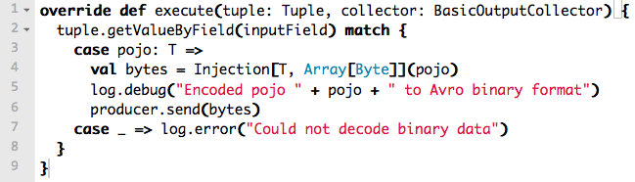
Writing to Kafka
Use a normal Kafka producer in your bolt, no special magic needed
Base setup:
Serialize the desired output data in the way you need, e.g. via Avro.
Write to Kafka, typically in your bolt’s emit() method.
If you are not emitting any Storm tuples, i.e. if you write to Kafka only, make sure you override declareOutputFields() with an empty {} method
Full example at AvroKafkaSinkBolt in kafka-storm-starter

Slide 96
Testing Storm topologies

Slide 97
Testing Storm topologies
Won’t have the time to cover testing in this workshop.
Some hints:
Unit-test your individual classes like usual, e.g. bolts
When integration testing, use in-memory instances of Storm and ZK
Try Storm’s built-in testing API (cf. kafka-storm-starter below)
Test-drive topologies in virtual Storm clusters via Wirbelsturm
Starting points:
storm-core test suite
https://github.com/apache/incubator-storm/tree/master/storm-core/test/
storm-kafka test suite
https://github.com/apache/incubator-storm/tree/master/external/storm-kafka/src/test
kafka-storm-starter tests related to Storm
https://github.com/miguno/kafka-storm-starter/

Slide 98
Serialization in Storm

Slide 99
Serialization in Storm
Required because Storm processes data across JVMs and machines
When/where/how serialization happens is often critical for P&S tuning
Storm uses Kryo for serialization, falls back on Java serialization
By default, Storm can serialize primitive types, strings, byte arrays, ArrayList, HashMap, HashSet, and the Clojure collection types.
Anything else needs a custom Kryo serializer, which must be “registered” with Storm.
Storm falls back on Java serialization if needed. But this serialization is slow.
Tip: Disable topology.fall.back.on.java.serialization to spot missing serializers.
Examples in kafka-storm-starter, all of which make use of Twitter Bijection/Chill
AvroScheme[T] – enable automatic Avro-decoding in Kafka spout
AvroDecoderBolt[T] – decode Avro data in a bolt
AvroKafkaSinkBolt[T] – encode Avro data in a bolt
TweetAvroKryoDecorator – a custom Kryo serializer
KafkaStormSpec – shows how to register a custom Kryo serializer
More details at Storm serialization

Slide 100
Example Storm apps

Slide 101
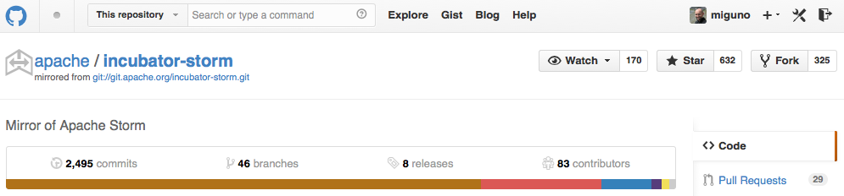
storm-starter
storm-starter is part of core Storm project since 0.9.2
https://github.com/apache/incubator-storm/tree/master/examples/storm-starter
Since 0.9.2 also published to Maven Central = you can re-use its spouts/bolts
$ git clone https://github.com/apache/incubator-storm.git
$ cd incubator-storm/
$ mvn clean install -DskipTests=true # build Storm locally
$ cd examples/storm-starter # go to storm-starter
(Must have Maven 3.x and JDK installed.)

Slide 102
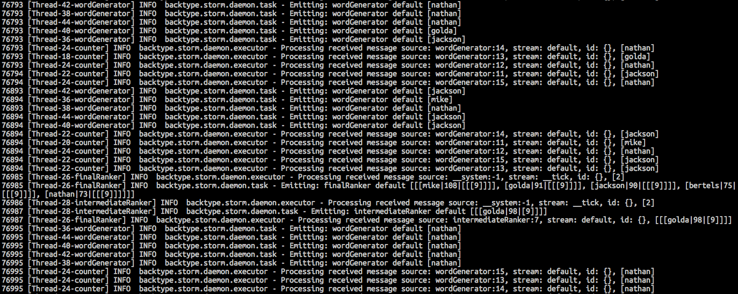
storm-starter: RollingTopWords
$ mvn compile exec:java -Dstorm.topology=storm.starter.RollingTopWords
Will run a topology that implements trending topics.
http://www.michael-noll.com/blog/2013/01/18/implementing-real-time-trending-topics-in-storm/

Slide 103
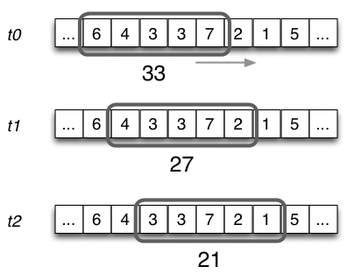
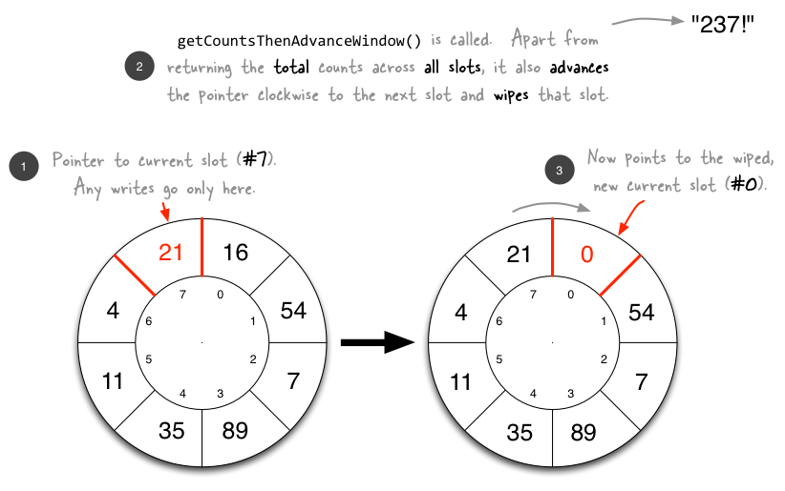
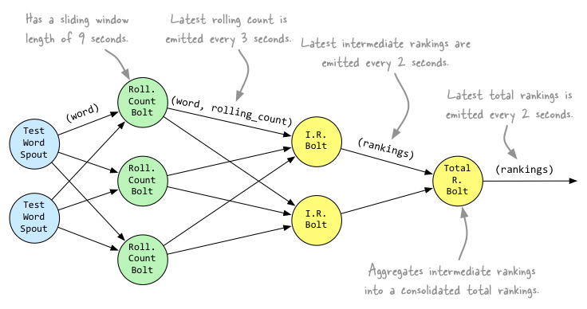
Behind the scenes of RollingTopWords
http://www.michael-noll.com/blog/2013/01/18/implementing-real-time-trending-topics-in-storm/

Slide 104
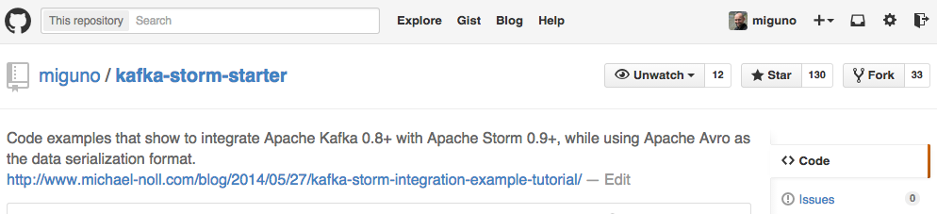
kafka-storm-starter
Written by yours truly
https://github.com/miguno/kafka-storm-starter
$ git clone https://github.com/miguno/kafka-storm-starter
$ cd kafka-storm-starter
# Now ready for mayhem!
(Must have JDK 7 installed.)

Slide 105
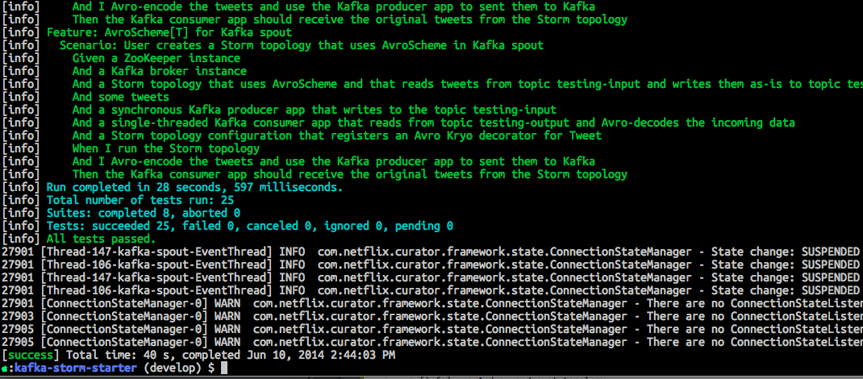
kafka-storm-starter: run the test suite
$ ./sbt test
Will run unit tests plus end-to-end tests of Kafka, Storm, and Kafka-Storm integration.

Slide 106
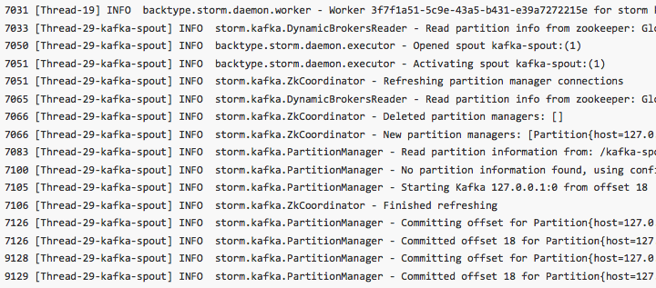
kafka-storm-starter: run the KafkaStormDemo app
$ ./sbt run
Starts in-memory instances of ZooKeeper, Kafka, and Storm. Then runs a Storm topology that reads from Kafka.

Slide 107
Storm related code in kafka-storm-starter
AvroDecoderBolt[T]
https://github.com/miguno/kafka-storm-starter/blob/develop/src/main/scala/com/miguno/kafkastorm/storm/AvroDecoderBolt.scala
AvroScheme[T]
https://github.com/miguno/kafka-storm-starter/blob/develop/src/main/scala/com/miguno/kafkastorm/storm/AvroScheme.scala
AvroKafkaSinkBolt[T]
https://github.com/miguno/kafka-storm-starter/blob/develop/src/main/scala/com/miguno/kafkastorm/storm/AvroKafkaSinkBolt.scala
StormSpec: test-drives Storm topologies
https://github.com/miguno/kafka-storm-starter/blob/develop/src/test/scala/com/miguno/kafkastorm/integration/StormSpec.scala

Slide 108
Storm performance tuning

Slide 109
Storm performance tuning
Unfortunately, no silver bullet and no free lunch. Witchcraft?
And what is “the best” performance in the first place?
Some users require a low latency, and are willing to let most of the cluster sit idle as long they can process a new event quickly once it happens.
Other users are willing to sacrifice latency for minimizing the hardware footprint to save $$$. And so on.
P&S tuning depends very much on the actual use cases
Hardware specs, data volume/velocity/…, etc.
Which means in practice:
What works with sampled data may not work with production-scale data.
What works for topology A may not work for topology B.
What works for team A may not work for team B.
Tip: Be careful when adopting other people’s recommendations if you don’t fully understand what’s being tuned, why, and in which context.

Slide 110
General considerations
Test + measure: use Storm UI, Graphite & friends
Understand your topology’s DAG on a macro level
Where and how data flows, its volume, joins/splits, etc.
Trivial example: Shoveling 1Gbps into a “singleton” bolt = WHOOPS
Understand … on a micro level
How your data flows between machines, workers, executors, tasks.
Where and when serialization happens.
Which queues and buffers your data will hit.
We talk about this in detail in the next slides!
Best performance optimization is often to stop doing something.
Example: If you can cut out (de-)serialization and sending tuples to another process, even over the loopback device, then that is potentially a big win.
http://www.slideshare.net/ptgoetz/scaling-storm-hadoop-summit-2014
http://www.slideshare.net/JamesSirota/cisco-opensoc

Slide 111
How to approach P&S tuning
Optimize locally before trying to optimize globally
Tune individual spouts/bolts before tuning entire topology.
Write simple data generator spouts and no-op bolts to facilitate this.
Even small things count at scale
A simple string operation can slowdown throughput when processing 1M tuples/s
Turn knobs slowly, one at a time
A common advice when fiddling with a complex system.
Add your own knobs
It helps to make as many things configurable as possible.
Error handling is critical
Poorly handled errors can lead to topology failure, data loss or data duplication.
Particularly important when interfacing Storm with other systems such as Kafka.
http://www.slideshare.net/ptgoetz/scaling-storm-hadoop-summit-2014
http://www.slideshare.net/JamesSirota/cisco-opensoc

Slide 112
Some rules of thumb, for guidance
CPU-bound topology?
Try to spread and parallelize the load across cores (think: workers).
Local cores: may incur serialization/deserialization costs, see later slides.
Remote cores: will incur serialization/deserialization costs, plus network I/O and additional Storm coordination work.
Network I/O bound topology?
Collocate your cores, e.g. try to perform more logical operations per bolt.
Breaks single responsibility principle (SRP) in favor of performance.
But what if topology is CPU-bound and I/O-bound and …?
It becomes very tricky when parts of your topology are CPU-bound, other parts are I/O bound, and other parts are constrained by memory (which has it's own limitations).
Grab a lot of coffee, and good luck!

Slide 113
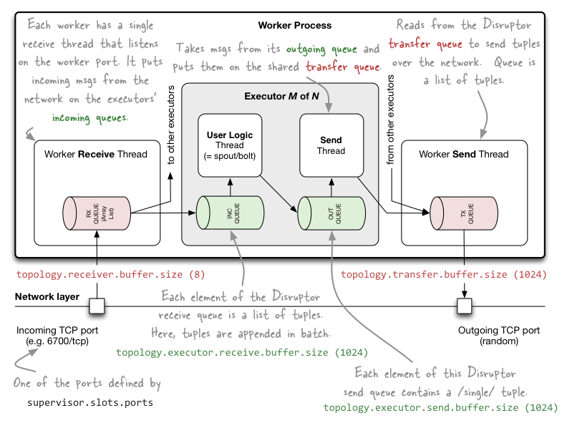
Internal message buffers of Storm (as of 0.9.1)
Update August 2014: This setup may have changed due to recent P&S work in STORM-297.
http://www.michael-noll.com/blog/2013/06/21/understanding-storm-internal-message-buffers/

Slide 114
Communication within a Storm cluster
Intra-worker communication: LMAX Disruptor <<< awesome library!
Between local threads within the same worker process (JVM), e.g. between local tasks/executors of same topology
Flow is: emit() -> executor A’s send buffer -> executor B’s receive buffer.
Does not hit the parent worker’s transfer buffer. Does not incur serialization because it’s in the same JVM.
Inter-worker communication: Netty in Storm 0.9+, ZeroMQ in 0.8
Different JVMs/workers on same machine
emit() -> exec send buffer -> worker A’s transfer queue -> local socket -> worker B’s recv queue -> exec recv buffer
Different machines.
Same as above, but uses a network socket and thus also hits the NIC. Incurs additional latency because of network.
Inter-worker communication incurs serialization overhead (passes JVM boundaries), cf. Storm serialization with Kryo
Inter-topology communication:
Nothing built into Storm – up to you! Common choices are a messaging system such as Kafka or Redis, an RDBMS or NOSQL database, etc.
Inter-topology communication incurs serialization overhead, details depend on your setup

Slide 115
Tuning internal message buffers
Start with the following settings if you think the defaults aren’t adequate
Helpful references
Storm default configuration (defaults.yaml)
Tuning and Productionization of Storm, by Nathan Marz
Notes on Storm+Trident Tuning, by Philip Kromer
Understanding the Internal Message Buffers of Storm, by /me
Config | Default | Tuning guess | Notes
topology.receiver.buffer.size | 8 | 8
topology.transfer.buffer.size | 1,024 | 32 | Batches of messages
topology.executor.receive.buffer.size | 1,024 | 16,384 | Batches of messages
topology.executor.send.buffer.size | 1,024 | 16,384 | Individual messages

Slide 116
JVM garbage collection and RAM
Garbage collection woes
If you are GC’ing too much and failing a lot of tuples (which may be in part due to GCs) it is possible that you are out of memory.
Try to increase the JVM heap size (-Xmx) that is allocated for each worker.
Try the G1 garbage collector in JDK7u4 and later.
But: A larger JVM heap size is not always better.
When the JVM will eventually garbage-collect, the GC pause may take much longer for larger heaps.
Example: A GC pause will also temporarily stop those threads in Storm that perform the heartbeating. So GC pauses can potentially make Storm think that workers have died, which will trigger “recovery” actions etc. This can cause cascading effects.

Slide 117
Rate-limiting topologies
topology.max.spout.pending
Max number of tuples that can be pending on a single spout task at once. “Pending” means the tuple has either failed or has not been acked yet.
Typically, increasing max pending tuples will increase the throughput of your topology. But in some cases decreasing the value may be required to increase throughput.
Caveats:
This setting has no effect for unreliable spouts, which don't tag their tuples with a message id.
For Trident, maxSpoutPending refers to the number of pipelined batches of tuples.
Recommended to not setting this parameter very high for Trident topologies (start testing with ~ 10).
Primarily used a) to throttle your spouts and b) to make sure your spouts don't emit more than your topology can handle.
If the complete latency of your topology is increasing then your tuples are getting backed up (bottlenecked) somewhere downstream in the topology.
If some tasks run into “OOM: GC overhead limit exceeded” exception, then typically your upstream spouts/bolts are outpacing your downstream bolts.
Apart from throttling your spouts with this setting you can of course also try to increase the topology’s parallelism (maybe you actually need to combine the two).

Slide 118
Acking strategies
topology.acker.executors
Determines the number of executor threads (or tasks?) that will track tuple trees and detect when a tuple has been fully processed.
Disabling acking trades reliability for performance.
If you want to enable acking and thus guaranteed message processing
Rule of thumb: 1 acker/worker (which is also the default in Storm 0.9)
If you want to disable acking and thus guaranteed message processing
Set value to 0. Here, Storm will immediately ack tuples as soon as they come off the spout, effectively disabling acking and thus reliability.
Note that there are two additional ways to fine-tune acking behavior, and notably to disable acking:
Turn off acking for an individual spout by omitting a message id in the SpoutOutputCollector.emit() method.
If you don't care if a particular subset of tuples is failed to be processed downstream in the topology, you can emit them as unanchored tuples. Since they're not anchored to any spout tuples, they won't cause any spout tuples to fail if they aren't acked.

Slide 119
Miscellaneous
A worker process is never shared across topologies.
If you have Storm configured to run only a single worker on a machine, then you can’t run multiple topologies on that machine.
Spare worker capacity can’t be used by other topos. All the worker’s child executors and tasks will only ever be used to run code for a single topology.
All executors/tasks on a worker run in the same JVM.
In some cases – e.g. a localOrShuffleGrouping() – this improves performance.
In other cases this can cause issues.
If a task crashes the JVM/worker or causes the JVM to run out of memory, then all other tasks/executors of the worker die, too.
Some applications may malfunction if they co-exist as multiple instances in the same JVM, e.g. when relying on static variables.

Slide 120
Miscellaneous
Consider the use of Trident to increase throughput
Trident inherently operates on batches of tuples.
Drawback is typically a higher latency.
Trident is not covered in this workshop. ☺
Experiment with batching messages/tuples manually
Keep in mind that here a failed tuple actually corresponds to multiple data records.
For instance, if a batch “tuple” fails and gets replayed, all the batched data records will be replayed, which may lead to data duplication.
If you don’t like the idea of manual batching, try Trident!

Slide 121
When using Storm with Kafka
Storm’s parallelism is controlled by Kafka’s “parallelism”
Set Kafka spout’s parallelism to #partitions of source topic.
Other key parameters that determine performance
KafkaConfig.fetchSizeBytes (default: 1 MB)
KafkaConfig.bufferSizeBytes (default: 1 MB)

Slide 122
TL;DR: Start with this, then measure/improve/repeat
1 worker / machine / topology
Minimize unnecessary network transfer
1 acker / worker
This is also the default in Storm 0.9
CPU-bound use cases:
1 executor thread / CPU core, to optimize thread and CPU usage
I/O-bound use cases:
10-100 executor threads / CPU core
http://www.slideshare.net/ptgoetz/scaling-storm-hadoop-summit-2014

Slide 123
Part 5: Playing with Storm using Wirbelsturm
1-click Storm deployments

Slide 124
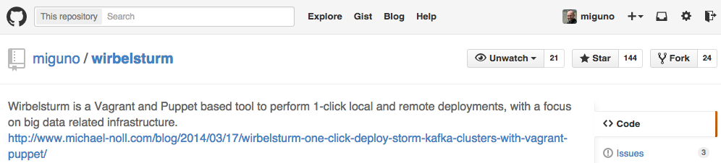
Deploying Storm via Wirbelsturm
Written by yours truly
https://github.com/miguno/wirbelsturm
$ git clone https://github.com/miguno/wirbelsturm.git
$ cd wirbelsturm
$ ./bootstrap
$ vagrant up zookeeper1 nimbus1 supervisor1 supervisor2
(Must have Vagrant 1.6.1+ and VirtualBox 4.3+ installed.)

Slide 125
Deploying Storm via Wirbelsturm
By default, the Storm UI runs on nimbus1 at:
http://localhost:28080/
You can build and run a topology:
Beyond the scope of this workshop.
Use e.g. an Ansible playbook to submit topologies to make this task simple, easy, and fun.

Slide 126
What can I do with Wirbelsturm?
Get a first impression of Storm
Test-drive your topologies
Test failure handling
Stop/kill Nimbus, check what happens to Supervisors.
Stop/kill ZooKeeper instances, check what happens to topology.
Use as sandbox environment to test/validate deployments
“What will actually happen when I deactivate this topology?”
“Will my Hiera changes actually work?”
Reproduce production issues, share results with Dev
Also helpful when reporting back to Storm project and mailing lists.
Any further cool ideas? ☺

Slide 127
Wrapping up

Slide 128
Where to go from here
A few Storm books are already available.
Storm documentation
http://storm.incubator.apache.org/documentation/Home.html
storm-kafka
https://github.com/apache/incubator-storm/tree/master/external/storm-kafka
Mailing lists
http://storm.incubator.apache.org/community.html
Code examples
https://github.com/apache/incubator-storm/tree/master/examples/storm-starter
https://github.com/miguno/kafka-storm-starter/
Related work aka tools that are similar to Storm – try them, too!
Spark Streaming
See comparison Apache Storm vs. Apache Spark Streaming, by P. Taylor Goetz (Storm committer)

