Slide 1


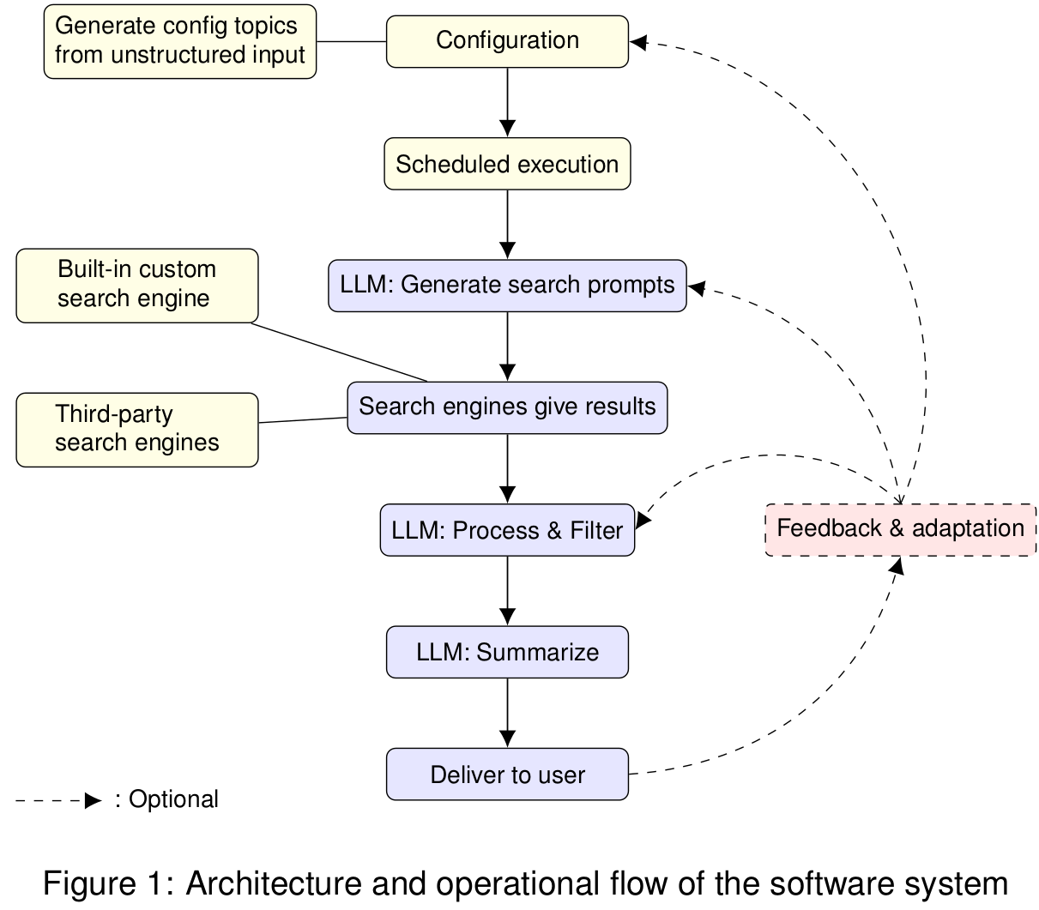
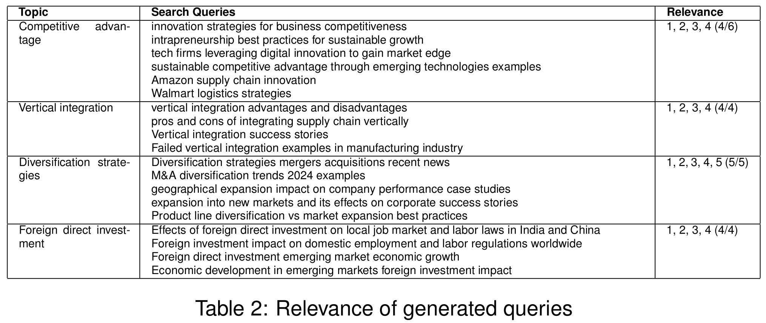
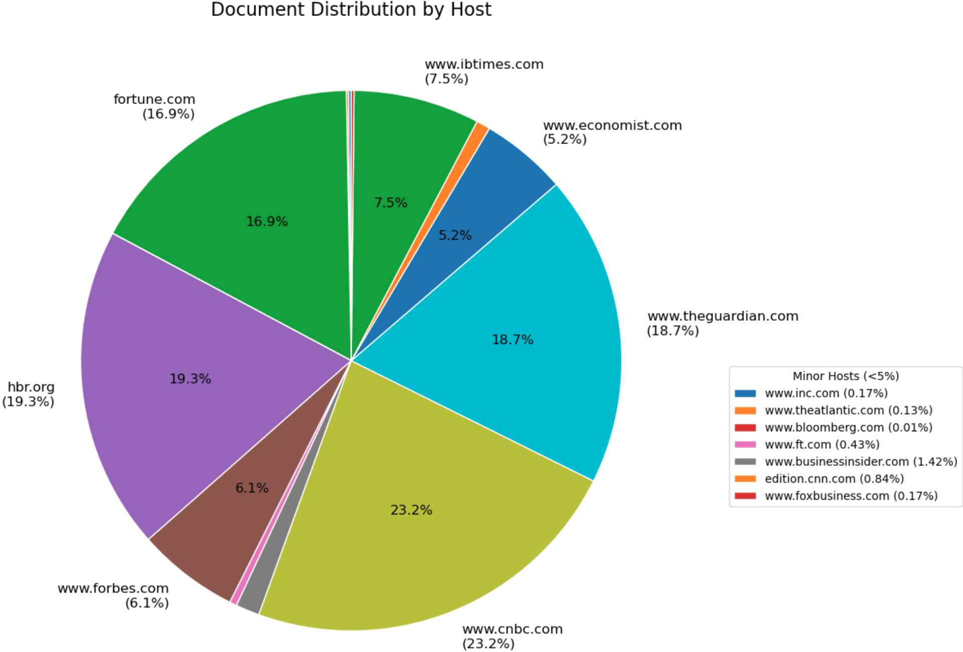
Current Content Discovery for Business Module Teaching
Guanyuming He, Sean O'Grady(1), Rhodri Nelson(2)
Business School, Imperial College London
Department of Earth Science and Engineering,
Imperial College London
Abstract
Business school teaching using the famous case method requires a large amount of information about latest business events to keep the course relevant. Digital technologies like web search engines and large languages models can offer substantial assistance to this process, yet a few challenges are still present: 1) search engines struggle to process unstructured search queries. 2) while LLMs excel in understanding unstructured input, they often hallucinate and cannot ensure the retrieval of very recent information. 3) these tools still require manual invocation. In this project, I aim to address these challenges by developing a software system which combines search engines and LLMs in clever ways and also support automatic execution of the whole process and the delivery of the results to users, requiring minimal user configuration.
Problem description
1. Roland Christensen, an influential Harvard Business School professor and an authority on the case method, points out that instructors need to conduct “extensive preparation” for it [1].
2. Two mainstream personal info-retrieval tools, search engines and LLMs, both are powerful but have certain significant flaws. In contrast to most current studies that combine them, surveyed by [2], use one for another, I aim to create a framework where they are combined more neutrally, and implement the framework as working software.
Aims & Methodology
1. An automatic system that only requires occasional user configuration through GUI. Automatic delivery of results via email. Scheduled automatic execution.
2. Invoke LLMs as the bridge between rigid search engine and non-rigid human understanding: From human to search engine (search prompt generation from business topics); from search engine to human (search result filtering, reranking, and summary)
3. Combine both commercial search engine (Google) and a custom one. The latter only indexes reputable Business news websites to avoid off-topic search results.
4. The retrieval of latest documents is ensured by date range limits when searching via the search engines, which is deterministic.
Results & Discussion
I successfully designed a pipeline and developed a corresponding system that combines LLMs with search engines to supply current content in business school teaching. The methods worked considerably well in fulfilling my project goals. The table and the pie chart demonstrates that it can generate very relevant search queries and that all indexed documents are from reputable sources.
However, the system faces significant challenges to become a mature tool for general usage. While many of them could be mitigated by more resources, the system’s design choices exhibit some inflexibility, leaning towards Business topics. It also does not address the theoretical limits of LLMs and search engines. My vision is that by making the project free software and easy to extend, others can extend its source code to their needs.
Comparison with related works
RAG is a general approach to fine-tune a trained model with non-parametric memory [3]. It was designed to enrich a trained LLM with a pre-trained retriever. Addressing hallucination is its major concern. It also does not require search engine in building the augment database.
Beside RAG, numerous studies were conducted to augment pre-trained LLMs with external knowledge. Compared with my work, they focus on question-answering tasks, and none of them had getting the latest information as a requirement.
Various works are also committed to improve search engines.
Some of them rewrite and improve search queries with LLMs; some turn to assist ranking of search results. My work has both elements.
Commercial products: Compared with ChatGPT, my system successfully eliminated search results of non-reputable sites. However, my system produced a few irrelavant search queries and could not compete with ChatGPT in summary quality. Compared with Google, my system retrieved more reputable and current information, but lacked
in breadth. When Google’s AI overview was triggered, its summary quality also appeared to be superior.
However, note that my system can be run entirely on a personal computer as a personal information retrieval solution. It can also run without the Google search engine component, thus without relying on any online service.
References
[1] C Roland Christensen. Teaching and the case method harvard business school. https://www.hbs.edu/teaching/case-method/Pages/default.aspx, 1987.
[2] Haoyi Xiong, Jiang Bian, Yuchen Li, Xuhong Li, Mengnan Du, Shuaiqiang Wang, Dawei Yin, and Sumi Helal. When search engine services meet large language models: Visions and challenges. IEEE Transactions on Services Computing, 17(6):4558–4577, 2024.
[3] Patrick Lewis, Ethan Perez, Aleksandra Piktus, Fabio Petroni, Vladimir Karpukhin, Naman Goyal, Heinrich Küttler, Mike Lewis, Wen-tau Yih, Tim Rocktäschel, Sebastian Riedel, and Douwe Kiela. Retrieval-augmented generation for knowledge-intensive nlp tasks. In H. Larochelle, M. Ranzato, R. Hadsell, M.F. Balcan, and H. Lin, editors, Advances in Neural Information Processing Systems, volume 33, pages 9459–9474. Curran Associates, Inc., 2020.

