Slide 1


The Guardian Project
Checkpoint: Q4 2011

Slide 2

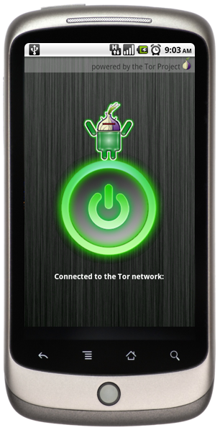
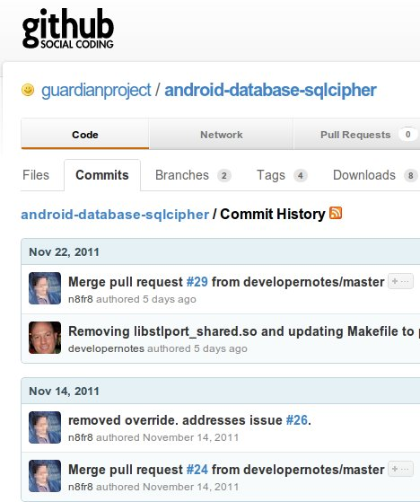
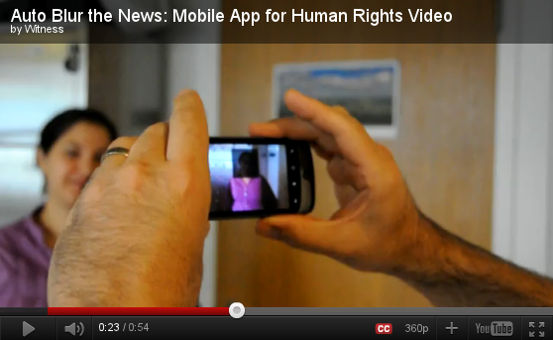



Open-Source
Mobile Security R&D
Consumer Apps and customized HW+SW for NGOs, Activists & Journalists
Partnerships, Training & Advocacy

Slide 3










Guardian is a research and development effort powered by technology-focused activists, concerned citizen users, and open-source security software hackers. It is built upon real world experience and feedback, and our process is transparent, inclusive and responsible.

Slide 4

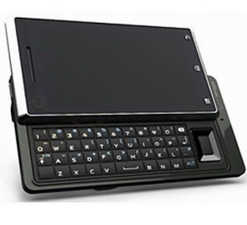
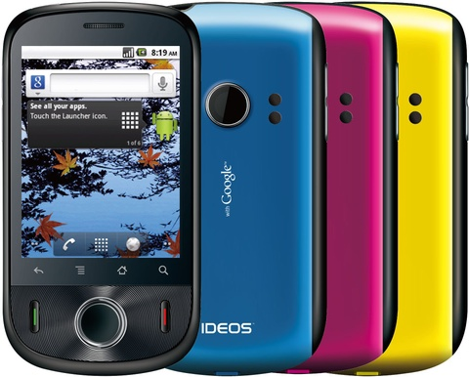

Since 2009, Android phones and tablets of all shapes, sizes, capability and price entered the worldwide market, with carriers from AT&T and Verizon, to India Airtel and China Mobile launching devices. As of July 2011, approximately 500,000 Android devices are activated daily.

Slide 5
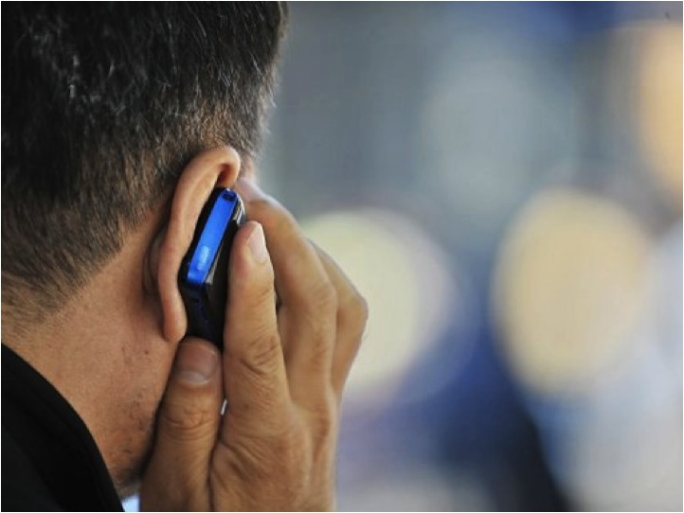

Everyday Mobile Internet Freedom
Mobile users in censorship states can use Guardian apps to get around the content filters, firewalls and monitors. Everyday citizens use the apps to watch online video, read blogs, communicate safely with friends, and otherwise access whatever content they would like, encouraging open society and culture.

Slide 6


Activists + Citizen Journalists
Tech savvy citizen journalists and activists in the street use Guardian apps to share updates, photos and videos without interception or monitoring by the authorities.

Slide 7
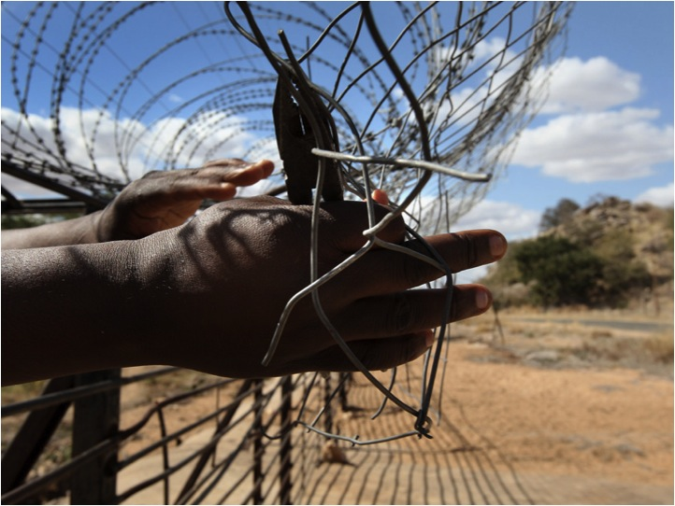

Human Rights Defenders
An undercover human rights researcher traveling through a remote region without mobile data service is able to use Guardian to document local conditions using secured video, audio and photo capture. Data is stored encrypted on the device, and if necessary, it can be safely and quickly erased.

Slide 8
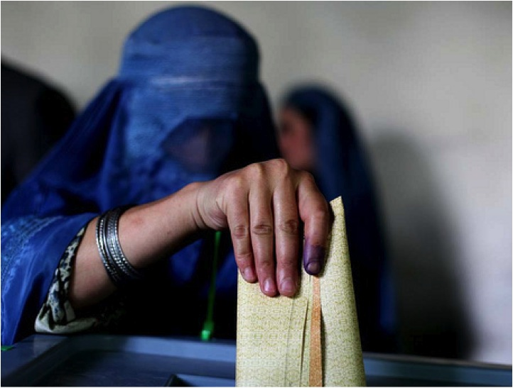

Election monitoring teams distribute low cost Android phones to community organizations to report on issues. Guardian apps assure reports are sent without being tampered with and provides the ability to coordinate via secure instant messaging on low bandwidth networks.
Election Monitors

Slide 9


Reporters in the field can use Guardian apps to stay in touch with their safety networks, while safeguarding information on contacts, story notes and captured digital media, enabling a new, secure "reporter's notepad". In addition, high-resolution cameras of new Android hardware meet the quality standards for broadcast, print and online production.
Frontline Reporters

Slide 10

The Guardian Project aims to create easy to use mobile apps, open-source firmwares, and customized, commercial mobile phones that can be used and deployed around the world, by any person looking to protect their communications from unjust intrusion.
Whether your are an average citizen looking to affirm your rights or an activist, journalist or humanitarian organization looking to safeguard your work in this age of global communication, Guardian is the solution for your mobile security needs.

Slide 11
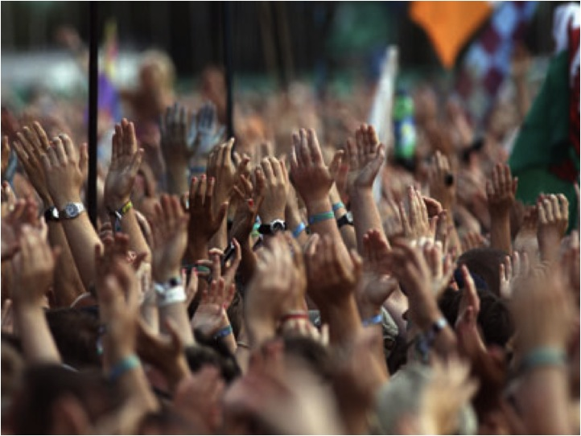

Design Goals
  Protect the user and their human networks
  Simplify security through good UI+UX
  Consider physical and network threats
  Know the user & think local
  Work for everyday needs and in crisis
  Provide free software & be freely licensed
  Support wide range of hw & networks

Slide 12

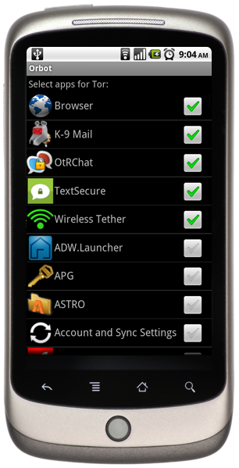
Orbot
Orbot brings Tor to Android, providing free software and an open network that helps you defend against network traffic analysis - a form of surveillance that threatens personal freedom and privacy
  With root access, proxy all application traffic through Tor
  Firefox on Android integration through ProxyMob Add-on
  Works on 2.5G, 3G and Wifi nets
  Supports running servers on hidden services for advanced applications
  Enables devices to be a Tor hotspot

Slide 13
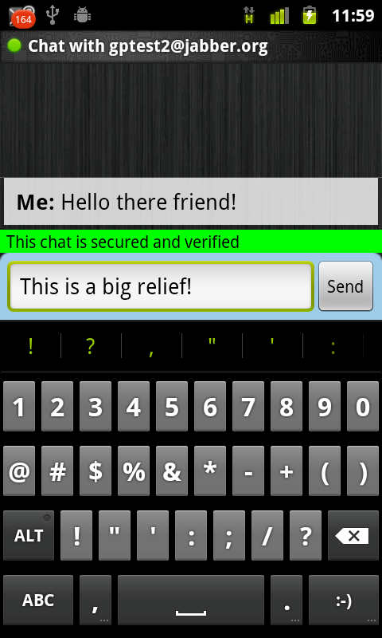
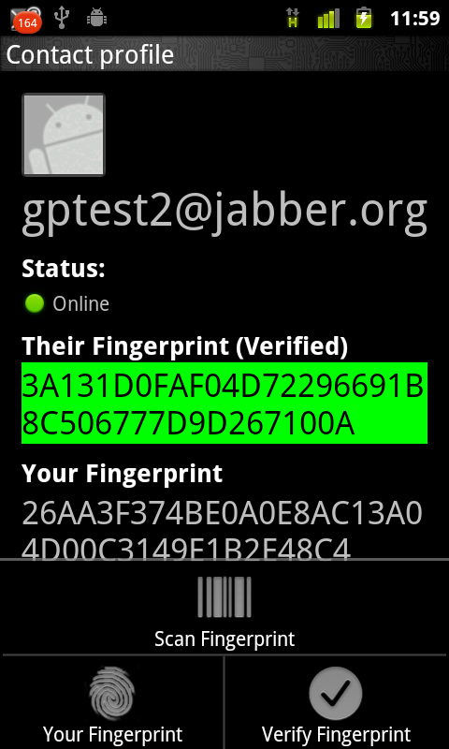
Gibberbot
Gibberbot is a secure, no logging instant messaging app for Android, supporting open standard chat and encryption protocols
  Uses industry standard chat encryption scheme (OTR), compatible with Pidgin, Adium, Jitsi and other desktop IM apps
  XMPP protocols enables use with GTalk, Facebook, as well as any self-hosted, secured server
  Can work with Orbot (over Tor) to circumvent firewalls and monitors

Slide 14

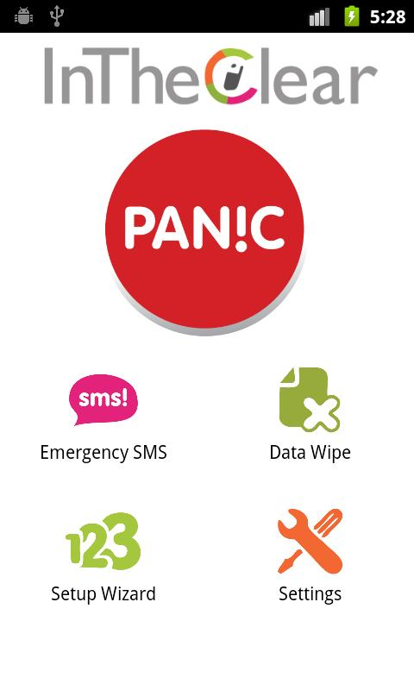
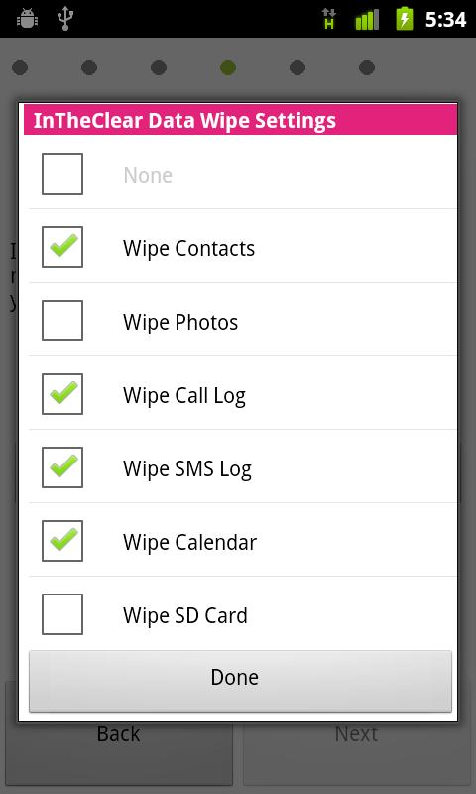
InTheClear
Developed for SaferMobile.org, InTheClear provides data wipe and an emergency SMS distress beacon.
  Quick, one-touch activate
  Wipe data across different Android apps and external storage / SD Card
  Emergency SMS sends in background repeatedly with location and cell network data
  Also available on Blackberry and Java (Nokia, etc) phones

Slide 15
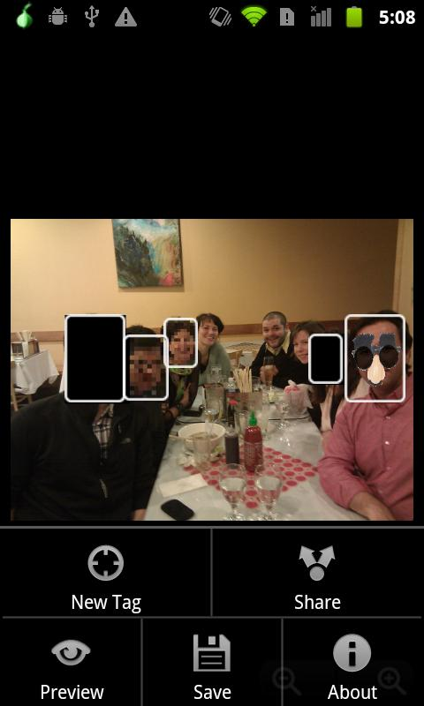
SecureSmartCam
A secure camera application being developed with WITNESS, to help improve visual privacy, secure human rights media content, and innovate in software camera tools for activists.
  Obscura & Informa modes
  Advanced meta-data capture
  Encrypted local storage
  Secure remote sync of media over slow networks
  Face detection and blurring
  Built-in public key encryption

Slide 16
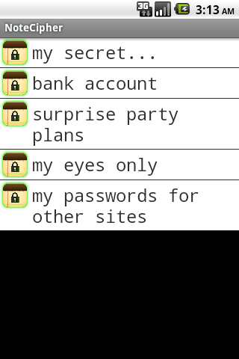
SQLCipher for Android
SQLCipher is an SQLite extension that provides encryption of per-app database files.
  Symmetric, 256-bit AES
  Existing open-source project, ported to Android
  Simple process to enable encryption on existing apps
  Cross-device and desktop portable data compatibility
  Robust, tested and performs well on mobile devices
"NoteCipher" sample app

Slide 17
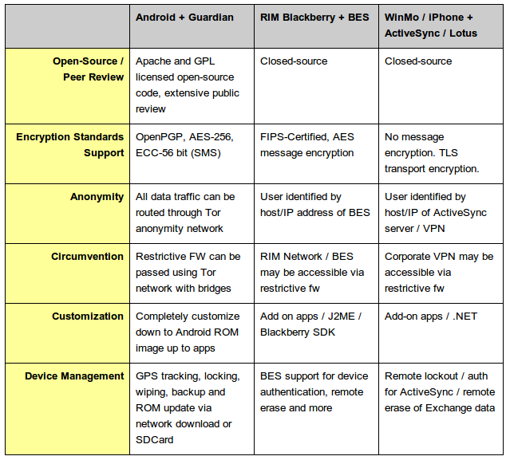
Capability Comparison

Slide 18
Partnerships & Services
  Partner with other organizations for joint research, development and solution creation
  Contract to customize and integrate open-source code for specific needs
  Provide auditing, review and advice on mobile security architectures and deployments
  Plan, purchase, and configure off-the-shelf mobile hardware solutions for a nominal fee
  Provide general and specialized mobile security training and curriculum development
  Partner in advocacy and awareness campaigns on mobile security & privacy

Slide 19

The Guardian Project is under active development, with beta stage deployments of software and hardware with partner organizations underway.
Our apps are available through our site, through partners sites (torproject.org) and in the Android Market, and in total have been downloaded over 250,000 times.
We are actively seeking developers, designers, users, partners and funders for our work.
Please visit https://guardianproject.info for more information.

