Slide 1
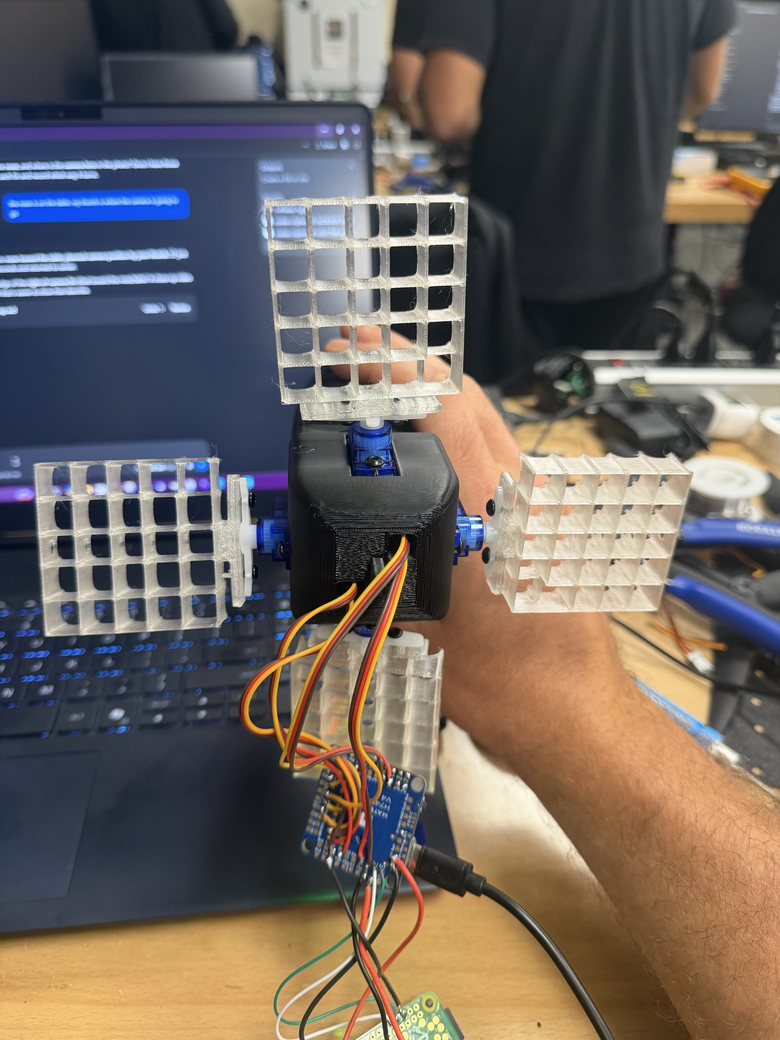
AUTONOMOUS GRID-FIN LANDING GUIDANCE
From bare hardware to autonomous guidance
01
Hardware integrated
Pi Zero 2 W + AI camera, Matek H743 flight controller, and four SG90 grid-fin servos on S7–S10.
02
Fins mapped and calibrated
Opposite fins move together for two-axis steering. Every channel is centered and verified through the full ±400 µs range.
03
Vision guidance running
Orange-pad tracking centers the target through a 5% dead zone and 100 / 200 / 300 / 400 µs correction bands at about 15 FPS.
04
Autonomous startup and logging
Guidance starts at power-on and records one-minute clips with detection rings, lock state, UTC time, and live servo commands.
CURRENT STATUS
Bench guidance works; the first drone-drop test recorded successfully and exposed the next field challenge: stronger pad contrast and a steadier release.
Notes:
Project summary based on the bench calibration, camera-guidance testing, automatic startup setup, and the 21 Sep 2026 drone-drop recording in this workspace.

Slide 2
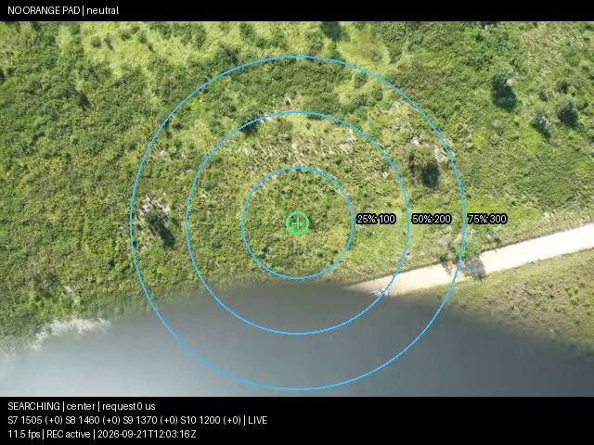
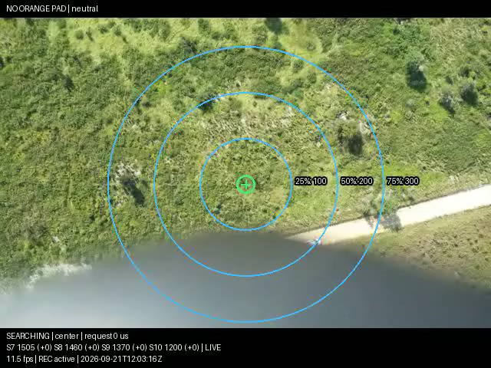
Practice drop review
00:35–01:00
WHAT THE CLIP SHOWS
Camera stayed ground-facing
The vehicle rolled slowly after release, but the camera continued to cover the ground below.
Guidance remained in SEARCHING
The pad did not lock in this segment, so S7–S10 correctly stayed at their saved neutral positions.
NEXT FIELD CHANGE
Increase target contrast
Use a larger matte-orange pad with a continuous black border, then reduce swing with a steadier drop fixture.
Notes:
Embedded source: outputs/guidance-20260921T120242Z-55c2.mp4. Requested playback interval: 00:35 through 01:00. The video itself carries the guidance rings, lock state, FPS, UTC timestamp, and S7–S10 servo telemetry.

