Slide 1


Slide 2



Raspberry Pi

Slide 3
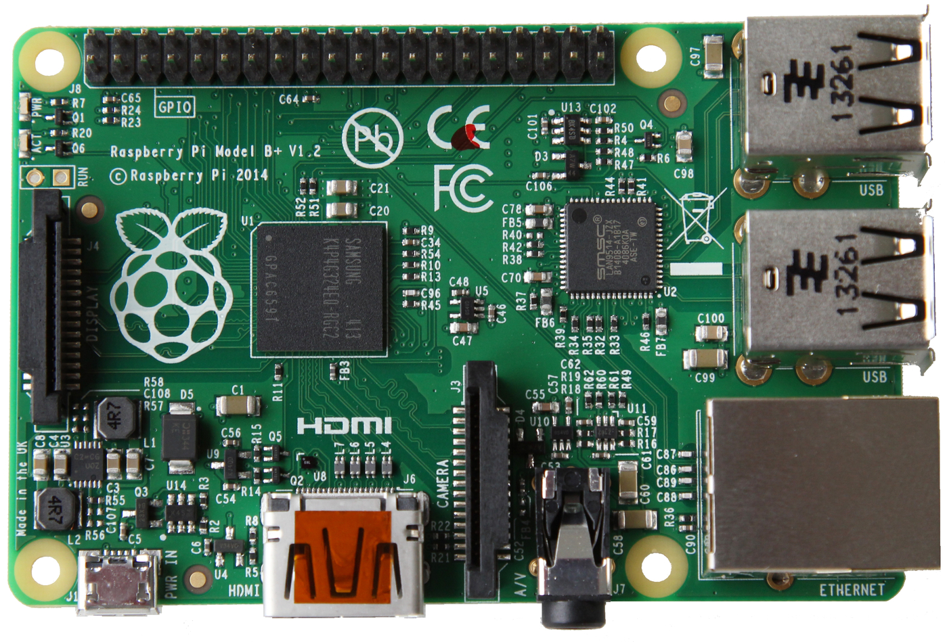
Raspberry Pi

Slide 4
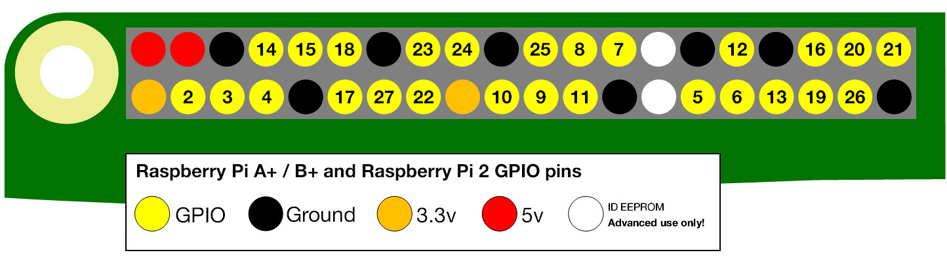
GPIO
(General Purpose Input/Output)

Slide 5
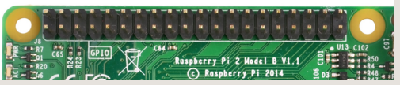
GPIO
(General Purpose Input/Output)

Slide 6
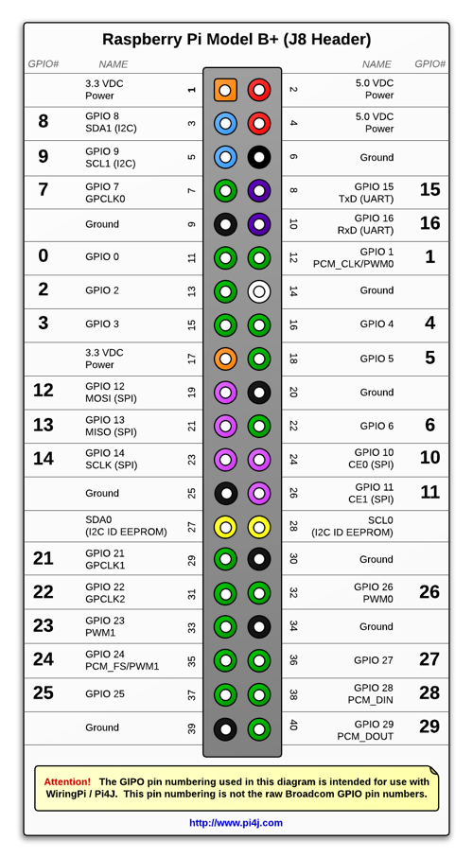
GPIO
(General Purpose Input/Output)

Slide 7
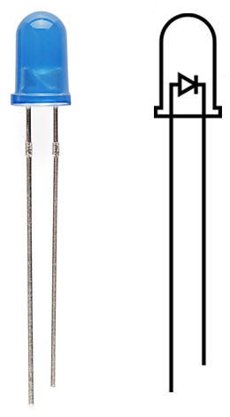
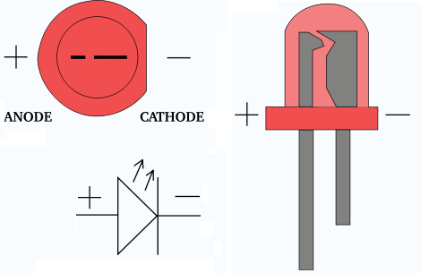
LED
( Light Emitting Diode)

Slide 8
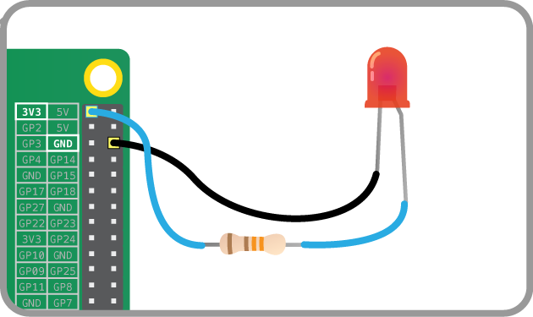
Conexiones

Slide 9

Software

Slide 10
CC BY-SA 3.0
Gracias

