Slide 1
SAT/ACT Data Analysis 2017/2018
Findings & Recommendations

Slide 2
Background
Both SAT and ACT are used as standardized testing for high school seniors to gain college admissions
Different states have different policies on test taking
Required SAT
Required ACT
Required Either
Optional
Some states offer Free Exam to all test takers

Slide 3
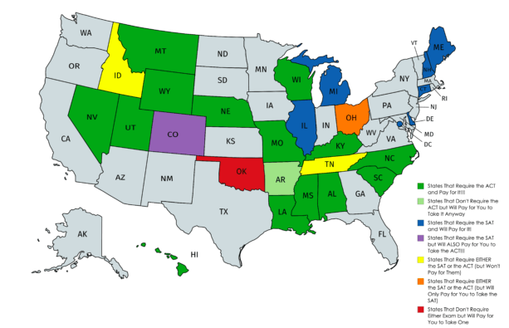

Slide 4
Problem Statement
The new format for the SAT was released in March 2016. With the given data on the performance of SAT/ACT in year 2017/18, analyse and identify key factors that affect SAT participation and make recommendations on how participation rates can be improved in a state with low participation rate.

Slide 5
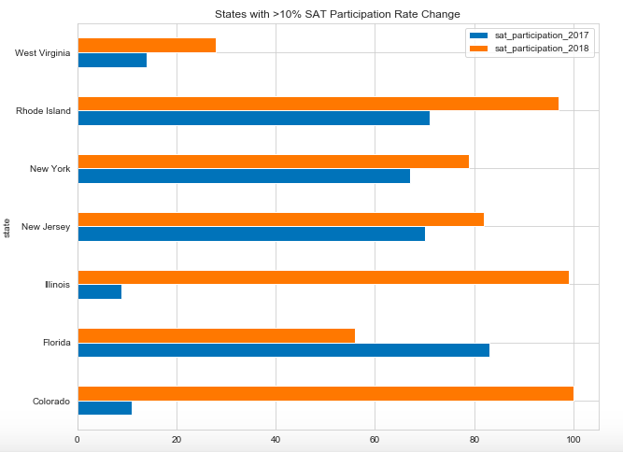
SAT Participation Rate (2017 vs 2018)
SAT : 71% to 97%
ACT: 21% to 15%
State policy change
Exam is free
SAT School Day
SAT : 19% to 99%
ACT: 93% to 43%
SAT : 11% to 100%
ACT: 100% to 30%

Slide 6
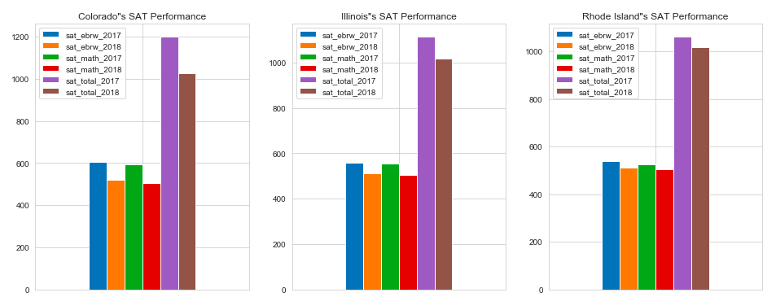
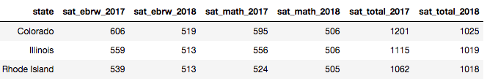
Colorado / Illinois/ Rhode Island

Slide 7
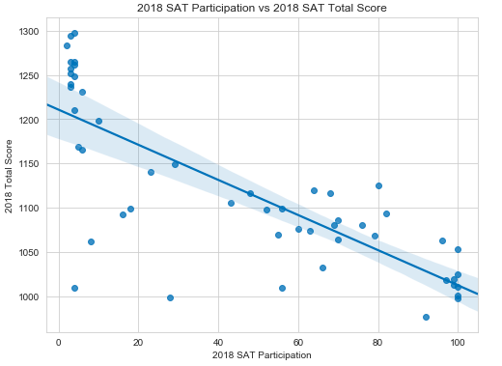
SAT Participation vs Total Score
Highest Score: Minnesota (SAT Score: 1298)
(SAT Participation: 4%)
Higher participation rate but lower total score

Slide 8
Recommendations
Mandating the completion of the SAT for all high school students
Covering all of part of the exam fees
Offering the SAT during regular school hours to make student participation as convenient as possible
AND
Offering free test preparation program. eg have access to the Official SAT Online Course, Khan Academy’s free online practice problems and instructional videos.
Provide additional academic support for students who may need it

