Slide 1


AMES Housing Price Prediction

Slide 2
Problem Statement
Use the well known Ames housing data to create a regression model that predicts the price of houses in Ames, IA.

Slide 3
Housing Variables
81 features describing 1,460 homes sold between 2006 and 2010.
Example:
Square footage: Living Area..
Time: Year Built..
Room and amenties: Bathroom..
Condition and quality: rated from 1–10.
Neighourhood, Roof Type …

Slide 4
Data Cleaning & Pre-Processing
Impute missing values (with 0, ‘NA’, …)
Map categorical variables to discrete values (nominal)
Handle outliers
#Columns with large no. of missing values: Pool QC, Misc Feature, Alley, Fence, Fireplace Qu
#These are data missing at random for houses without these facilities.
#Let's filled them with NA
na_list = ['Pool QC', 'Misc Feature', 'Alley', 'Fence','Fireplace Qu']
train_clean[na_list] = train_clean[na_list].fillna('NA')
test_clean[na_list] = test_clean[na_list].fillna('NA')
#converting ordinal columns to numeric value
mapdict = {'Ex': 5,'Gd': 4,'TA': 3, 'Fa': 2, 'Po': 1, 'NA':0}
cols = ['Exter Qual','Exter Cond','Heating QC','Bsmt Qual','Bsmt Cond','Kitchen Qual','Garage Qual','Garage Cond']
for c in cols:
map_ordinal_col(train_clean,c,mapdict)
map_ordinal_col(test_clean,c,mapdict)

Slide 5
Exploratory Data Analysis

Slide 6
Feature Selection Goals
It enables the machine learning algorithm to train faster.
It reduces the complexity of a model and makes it easier to interpret.
It improves the accuracy of a model if the right subset is chosen.
It reduces Overfitting.

Slide 7
Feature Selection Approach (Filter Method)
Round 1 (14 Features)
based on corr() > 0.5
Train and Evaluate using MLR, LASSO, RIDGE
Predict using RIDGE
Round 2 (Select Top 8 Features based on LASSO Coef)
Train and Evaluate using MLR, LASSO, RIDGE
Predict using LASSO
Round 3 (Add interaction term : total_score)
Train and Evaluate using MLR, LASSO, RIDGE
Predict using LASSO

Slide 8
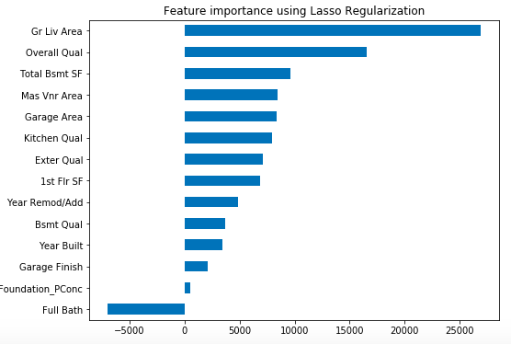
Round 1 (Top 14 features based on corr())

Slide 9
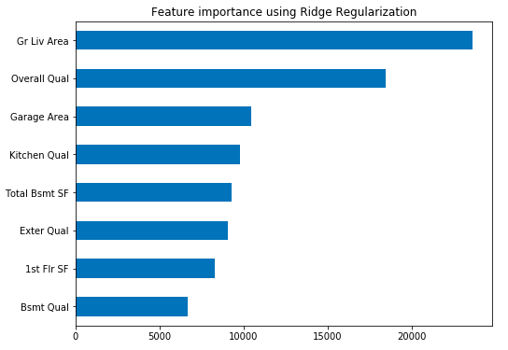
Round 2 (Select 8 based on LASSO/RIDGE Coef)

Slide 10
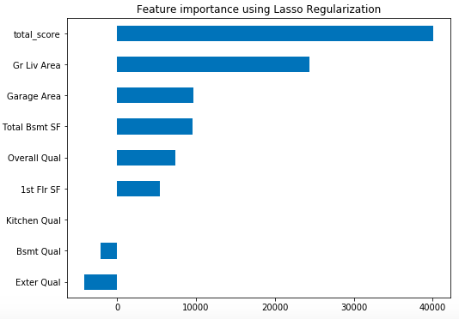
Round 3 (Add interaction term total_score)

Slide 11
Model RMSE Summary
Round | MLR | LASSO | RIDGE | KAGGLE Public | KAGGLE Private
1 | 29739 | 29704 | 29589 | 33650 | 35593
2 | 29686 | 29675 | 29557 | 31668 | 34034
3 | 26926 | 26913 | 26934 | 31355 | 33857
Round | Features
1 | Top 14 features based on corr()
2 | Top 8 selected by LASSO
3 | Top 8 + 1 interaction term total_score

Slide 12
https://datascienceplus.com/lasso-regression-in-python/
https://www.datacamp.com/community/tutorials/feature-selection-python

