Slide 1
SoftLayer Storage Overview
Michael Fork
Storage Product Manager
SoftLayer, an IBM Company

Slide 2
Agenda
Introduction
Why we are here
Types of Cloud Storage
How they fit
SoftLayer Storage Services At-a-Glance
Why SoftLayer
Storage Services
Block and File
Endurance
Performance
Mass Storage Servers
Backup
Object Storage and Delivery
Object Storage
CDN
Data Ingest
Data Transfer Service
Aspera

Slide 3
Agenda
Introduction
Why we are here
Types of Cloud Storage
How they fit
SoftLayer Storage Services At-a-Glance
Why SoftLayer
Storage Services
Block and File
Endurance
Performance
Mass Storage Servers
Backup
Object Storage and Delivery
Object Storage
CDN
Data Ingest
Data Transfer Service
Aspera

Slide 4
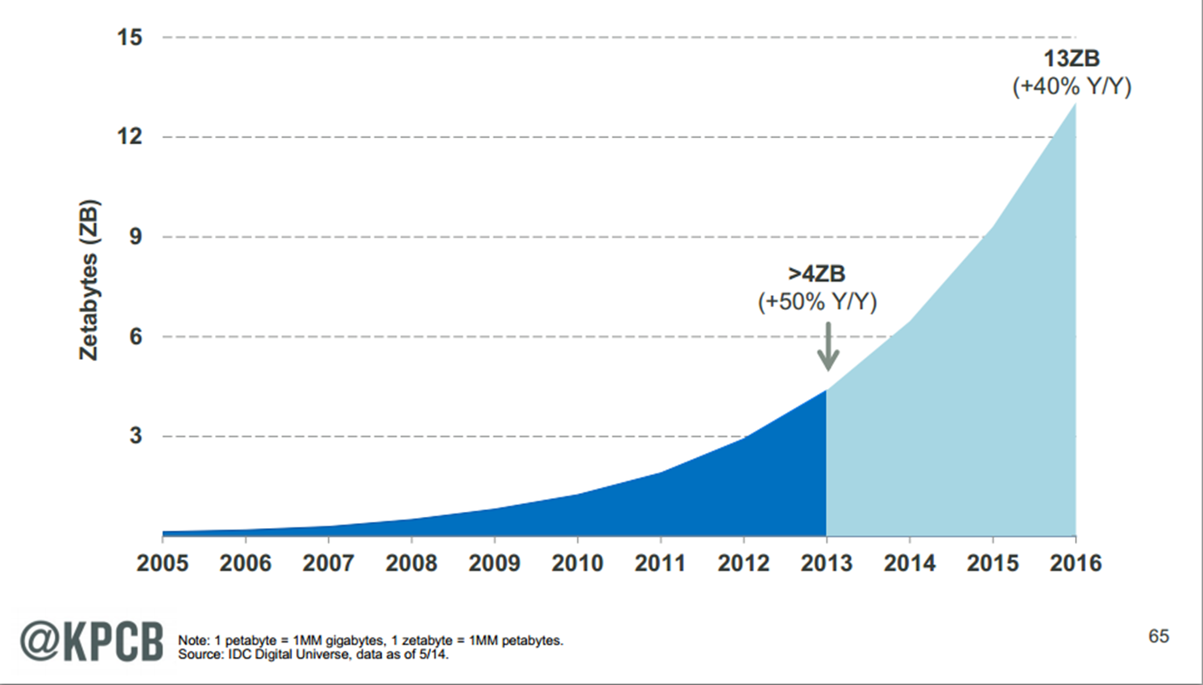
Why are we here? Data growth is exploding!
Source: Internet Trends 2014 – Code Conference

Slide 5
Types of Cloud Storage
Ephemeral Block Storage
Block volume with lifecycle tied to compute instance.
Latency < 10 ms Access blocks via “local” disk
Examples local disk in SoftLayer Bare-Metal, Amazon Instance Store
Persistent Block Storage
Block volume with independent lifecycle that can be moved between compute instances.
Latency < 10 ms Access blocks through hypervisor or via iSCSI
Examples SoftLayer Block Storage, Amazon EBS, Google Persistent Disk, Azure Page Blobs
File Storage
Mountable file share.
Latency < 10 ms Access files via NFS, CIFS, SMB
Examples SoftLayer File Storage, Azure File Share
Object Storage
HTTP-based PUT/GET store
Latency < 100 ms Access objects via HTTP
Examples SoftLayer Object Storage, Amazon S3, Google Cloud Storage, Azure Blob Storage
Archive Storage
Long-term storage for infrequently accessed data.
Latency minutes or hours Access collections of objects via HTTP
Examples Amazon Glacier, Google Durable Reduced Availability

Slide 6
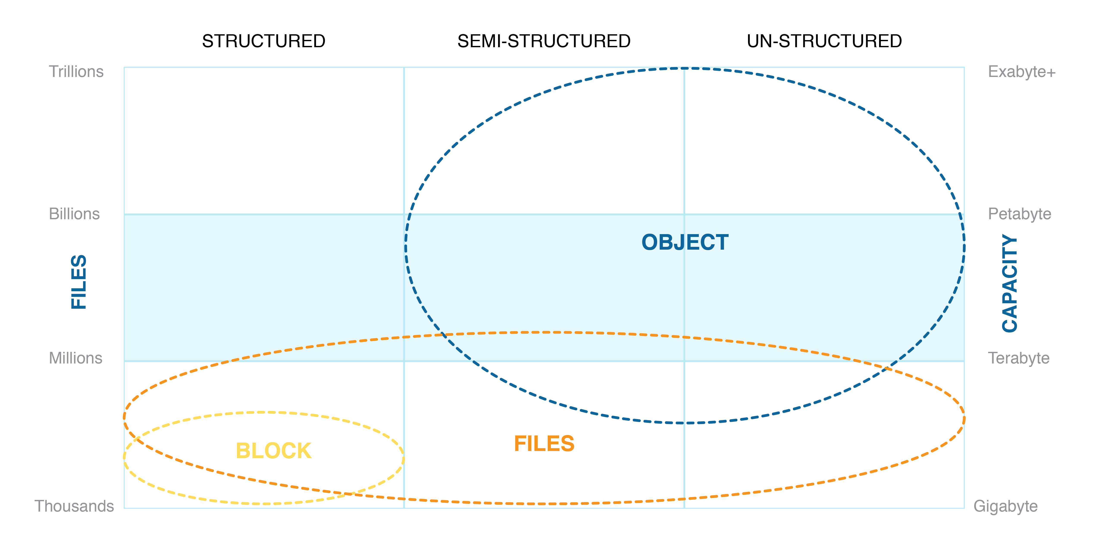
Where do they fit?

Slide 7
SoftLayer Storage Services At-a-Glance
Block and File Services
Endurance: performance, durability and features expected by the enterprise
Performance: ultimate control over price / performance
Mass Storage Servers: isolated, dedicated SAN / NAS solution
Backup: automatically backup data with an enterprise-level storage and disaster recovery solution.
Object Storage and Delivery
Object Storage: inexpensive, scalable, durable storage for massive amounts of unstructured data.
Content Delivery Network (CDN): access global delivery network offering low latency speeds and pay-as-you-go bandwidth pricing
Data Ingest
Data Transfer Service: send a USB device, CD, or DVD to be directly connected to the SoftLayer network for high-speed transfer
Aspera: securely move data directly into cloud-based storage at line-speed

Slide 8
Why SoftLayer?
API
Infrastructure Management System (IMS)
Bare Metal Servers BYO Stack Software Appliances
Virtual Servers
Shared Hardware
Dedicated Hardware
Block, File, Object Storage
Triple Network Architecture
Any combination of compute, storage, and network, any time.
Hourly or monthly. Physical or virtual. Dedicated or shared.
All API driven. Securely. With fine-grained access control

Slide 9
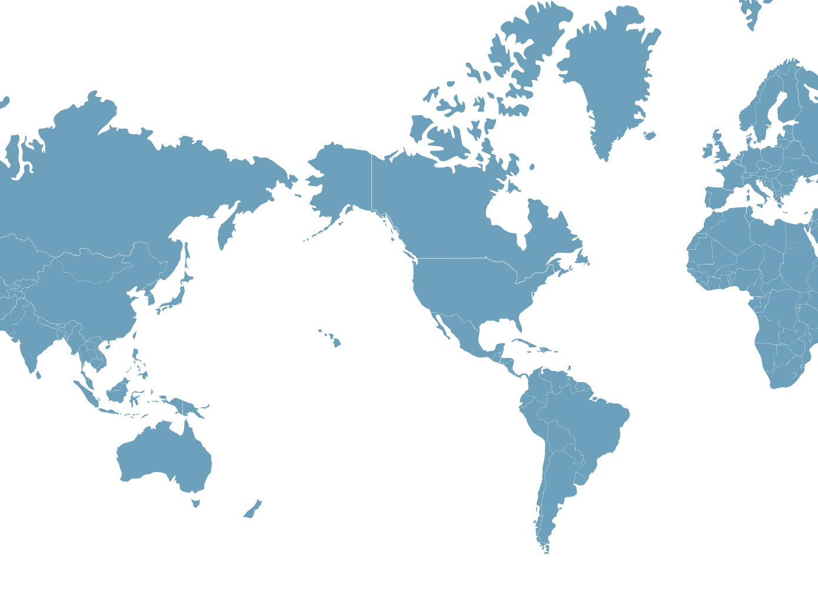
…SoftLayer’s Global Reach
Amsterdam
London
Frankfurt
Paris
Toronto
Montreal
Seattle
Chicago
San Jose
Denver
Dallas
New York City
China
Tokyo
Washington D.C.
India
Los Angeles
Atlanta
Hong Kong
Houston
Miami
Mexico City
Singapore
Brazil
Melbourne
Sydney

Slide 10
Agenda
Introduction
Why we are here
Types of Cloud Storage
How they fit
SoftLayer Storage Services At-a-Glance
Why SoftLayer
Storage Services
Block and File
Endurance
Performance
Mass Storage Servers
Backup
Object Storage and Delivery
Object Storage
CDN
Data Ingest
Data Transfer Service
Aspera

Slide 11
"Codename: Prime"
Performance, durability and features expected by the enterprise.
Resilient & Durable – designed to be available and protect data from loss during maintenance and failures | Globally Available - available in virtually all data centers
Large Volume Sizes – from 20GB up to 12TB | Concurrent Access - multiple hosts can simultaneously access same block or file volume
Tiered Performance – 256, 2048, and 4096 IOPS per TB. | Snapshots - captured non-disruptively and restored near instantaneously
Block & File-based - available as MPIO iSCSI LUN or NFS-based file share | Replication – copy snapshots to selected data centers for reduced RTO

Slide 12
Consistent Performance
Ultimate control over price / performance.
Resilient – designed to be available during maintenance events and unexpected failures | Globally Available - available in virtually all data centers
Large Volume Sizes – from 20GB up to 12TB | Concurrent Access - multiple hosts can simultaneously access same block or file volume
Selectable Performance – from 100 to 6000 IOPS.
Block & File-based - available as MPIO iSCSI LUN or NFS-based file share

Slide 13
Mass Storage Servers
Isolated, dedicated SAN / NAS solution
Dedicated – hosted on dedicated customer-managed bare-metal server | Globally Available - available in all data centers
Isolated - complete data isolation from other customers | Concurrent Access - multiple hosts can simultaneously access same block or file volume
Control over Capacity / Performance – mix and match SATA, SAS, and SSD drives to deliver up to 128TB storage or 100,000+ IOPS | QuantaStor – full-featured storage manager offering snapshots, thin provisioning, replication, and SSD cache management
Block & File-based – expose volumes as iSCSI LUN or CIFS / NFS-based file share

Slide 14
Block Storage Use Cases
“Codename: Prime”
Select for … most general purpose workloads requiring durable, available, persistent block-based storage with a consistent performance profile
Use Cases …
256 IOPS / TB
Backup and archiving targets
Email and hosting
File shares
2048 IOPS / TB
general-purpose databases
virtualization platforms
analytics
4096 IOPS / TB
transactional database
Consistent Performance
Select for ... well understood workload with performance profile that does not fit “Codename: Prime” tier
Use Cases …
small, highly utilized transactional database
Mass Storage Servers
Select for ... workloads requiring isolation for compliance / regulatory; administrators desiring control over underlying storage subsystem
Use Cases …
regulatory compliance in financial, insurance, etc.

Slide 15


Backup
Automatically backup data with an enterprise-level storage and disaster recovery solution.
EVault Backup
Automated backup to SoftLayer-managed shared service
Backups can be set to follow hourly, daily, weekly, or custom schedules with user-defined retention periods
WebCC-based management provides full control over the solution, including schedules and data.
R1Soft Server Backup Manager
Automated backup to customer-managed dedicated server
Cost effective, high-performance disk to disk backup that can span multiple servers
Continuous data protection protects data at block level
De-dupe across recovery points increases storage efficiency

Slide 16
Backup Use Cases
Evault Backup
Select for ... file-level backups of systems running SoftLayer-provided operating systems
Use Cases …
backup bare-metal server boot volume
backup virtual server boot volume
backup “Codename: Prime” or Consistent Performance volume
R1Soft Server Backup Manager
Select for ... applications requiring continuous block-based backups
non-SoftLayer provided operating systems
Use Cases …
backing up databases
backup virtual machines on customer-supplied hypervisors

Slide 17
Agenda
Introduction
Why we are here
Types of Cloud Storage
How they fit
SoftLayer Storage Services At-a-Glance
Why SoftLayer
Storage Services
Block and File
Endurance
Performance
Mass Storage Servers
Backup
Object Storage and Delivery
Object Storage
CDN
Data Ingest
Data Transfer Service
Aspera

Slide 18
Object Storage
Inexpensive, scalable, durable storage for massive amounts of unstructured data
Durable – designed to withstand multiple hardware failures by storing data across multiple devices | Massively Scalable - store PBs of data easily
Open – built on OpenStack Swift | Pay-go Pricing – only pay for what you use
Highly Elastic – no capacity management, just use what you need, when you need | CDN – distribute content via world-class CDN with single button click
SFTP Access – no need for special tooling, access using native SFTP clients | Metadata Search – object metadata automatically indexed and searchable

Slide 19
Object Storage Use Cases
SoftLayer Object Storage
Select for ... durably storing semi-structured or unstructured data
Use Cases …
Social / Mobile App Storage ... user generated content requiring elasticity and durability via simple API
Analytics Data Store … rapidly expanding data sets demanding read/write capacity that scale with the data
Offsite Backup / Archive … backup or archive data off site for business continuity or disaster recovery purposes.
NAS Filer Consolidation … pair with Cloud Storage Gateway to simplify management and reduce costs by eliminating localized “storage islands”

Slide 20
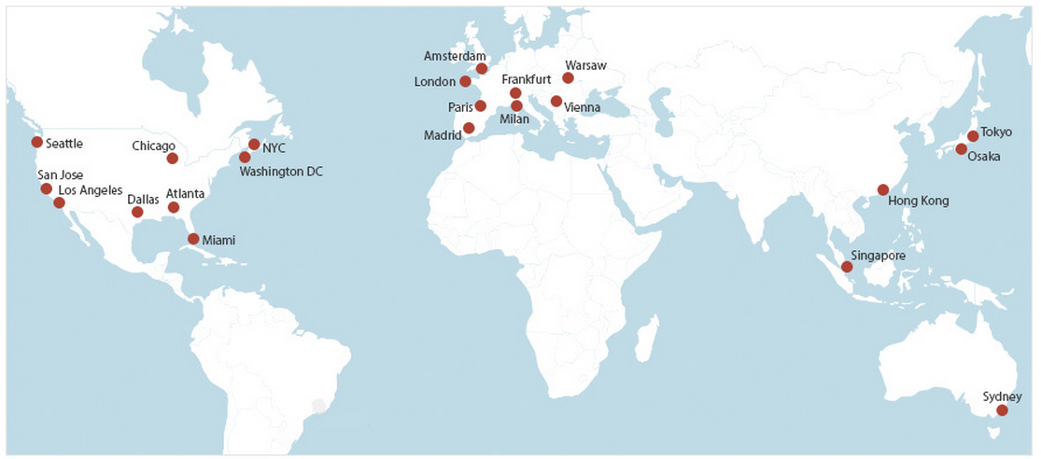

CDN
Access global delivery network offering low latency speeds and pay-as-you-go bandwidth pricing
Overview
Integrated into SoftLayer Object Storage to accelerate content delivery with the click of a button
Partnered with EdgeCast to offer one of the world’s fastest and most reliable content delivery networks
Distribute content in 24 geographically diverse nodes
Pay-as-you-go bandwidth with no extra fees
Use Cases
Static content delivered at lightning fast speeds
Personalized web applications that require fast discovery of products such as travel and e-commerce applications
Localized cache for varying applications that have a geographical focus such as weather, local news, or advertising
Social media applications requiring personalized, interactive content involving frequent trips origin servers.

Slide 21
Agenda
Introduction
Why we are here
Types of Cloud Storage
How they fit
SoftLayer Storage Services At-a-Glance
Why SoftLayer
Storage Services
Block and File
"Codename: Prime”
Consistent Performance
Mass Storage Servers
Backup
Object Storage and Delivery
Object Storage
CDN
Data Ingest
Data Transfer Service
Aspera

Slide 22
Data Transfer Service
Send a USB device, CD, or DVD to be directly connected to the SoftLayer network for high-speed transfer
Overview
Ship a USB device, CD, or DVD to a selected data center where it is presented as an iSCSI target as alternative to lengthy upload over public internet or Direct Link
Default two (2) week period can be extended
Hardware returned to the customer
Free of charge
Use Cases
Rapid Ingest of large datasets: deliver large analytics datasets for processing
On-boarding: deliver initial copy of VMs and other data
Disaster Recovery: copy backup/archive data to mounted device and ship to customer premises

Slide 23
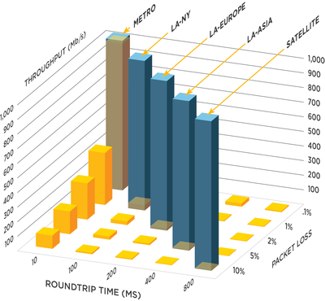
Aspera: High-Speed File Transfer
Aspera On Demand
Aspera On Demand leverages Aspera’s patented fasp transport technology, to deliver reliable, ultra-fast transfers, enterprise-grade security, and precise control over transfer speed and priority. The Aspera fasp transport enables users to achieve line speed transfer rates, resume of partial transfers, and encryption in transit over the wire and at rest.
Aspera's software moves the world’s data at maximum speed, regardless of file size, transfer distance or network conditions.

Slide 24
Agenda
Introduction
Why we are here
Types of Cloud Storage
How they fit
SoftLayer Storage Services At-a-Glance
Why SoftLayer
Storage Services
Block and File
Endurance
Performance
Mass Storage Servers
Backup
Object Storage and Delivery
Object Storage
CDN
Data Ingest
Data Transfer Service
Aspera

Slide 25
Notices and Disclaimers
Copyright © 2015 by International Business Machines Corporation (IBM). No part of this document may be reproduced or transmitted in any form without written permission from IBM.
U.S. Government Users Restricted Rights - Use, duplication or disclosure restricted by GSA ADP Schedule Contract with IBM.
Information in these presentations (including information relating to products that have not yet been announced by IBM) has been reviewed for accuracy as of the date of initial publication and could include unintentional technical or typographical errors. IBM shall have no responsibility to update this information. THIS document is distributed "AS IS" without any warranty, either express or implied. In no event shall IBM be liable for any damage arising from the use of this information, including but not limited to, loss of data, business interruption, loss of profit or loss of opportunity. IBM products and services are warranted according to the terms and conditions of the agreements under which they are provided.
Any statements regarding IBM's future direction, intent or product plans are subject to change or withdrawal without notice.
Performance data contained herein was generally obtained in a controlled, isolated environments. Customer examples are presented as illustrations of how those customers have used IBM products and the results they may have achieved. Actual performance, cost, savings or other results in other operating environments may vary.
References in this document to IBM products, programs, or services does not imply that IBM intends to make such products, programs or services available in all countries in which IBM operates or does business.
Workshops, sessions and associated materials may have been prepared by independent session speakers, and do not necessarily reflect the views of IBM. All materials and discussions are provided for informational purposes only, and are neither intended to, nor shall constitute legal or other guidance or advice to any individual participant or their specific situation.
It is the customer’s responsibility to insure its own compliance with legal requirements and to obtain advice of competent legal counsel as to the identification and interpretation of any relevant laws and regulatory requirements that may affect the customer’s business and any actions the customer may need to take to comply with such laws. IBM does not provide legal advice or represent or warrant that its services or products will ensure that the customer is in compliance with any law.

Slide 26
Notices and Disclaimers (con’t)
Information concerning non-IBM products was obtained from the suppliers of those products, their published announcements or other publicly available sources. IBM has not tested those products in connection with this publication and cannot confirm the accuracy of performance, compatibility or any other claims related to non-IBM products. Questions on the capabilities of non-IBM products should be addressed to the suppliers of those products. IBM does not warrant the quality of any third-party products, or the ability of any such third-party products to interoperate with IBM’s products. IBM expressly disclaims all warranties, expressed or implied, including but not limited to, the implied warranties of merchantability and fitness for a particular purpose.
The provision of the information contained herein is not intended to, and does not, grant any right or license under any IBM patents, copyrights, trademarks or other intellectual property right.
IBM, the IBM logo, ibm.com, Bluemix, Blueworks Live, CICS, Clearcase, DOORS®, Enterprise Document Management System™, Global Business Services ®, Global Technology Services ®, Information on Demand, ILOG, Maximo®, MQIntegrator®, MQSeries®, Netcool®, OMEGAMON, OpenPower, PureAnalytics™, PureApplication®, pureCluster™, PureCoverage®, PureData®, PureExperience®, PureFlex®, pureQuery®, pureScale®, PureSystems®, QRadar®, Rational®, Rhapsody®, SoDA, SPSS, StoredIQ, Tivoli®, Trusteer®, urban{code}®, Watson, WebSphere®, Worklight®, X-Force® and System z® Z/OS, are trademarks of International Business Machines Corporation, registered in many jurisdictions worldwide. Other product and service names might be trademarks of IBM or other companies. A current list of IBM trademarks is available on the Web at "Copyright and trademark information" at: www.ibm.com/legal/copytrade.shtml.

Slide 27
Thank You
Your Feedback is Important!
Access the InterConnect 2015 Conference CONNECT Attendee Portal to complete your session surveys from your smartphone,
laptop or conference kiosk.

