Slide 1
ONOS
Open Network Operating System
An Open-Source Distributed SDN OS
Pankaj Berde, Jonathan Hart, Masayoshi Kobayashi, Pavlin Radoslavov, Pingping Lin, Rachel Sverdlov, Suibin Zhang, William Snow, Guru Parulkar
Notes:
Introduction:
Acronym ONOS -> Open Network Operating System -> Platform to open networks to realize pure SDN

Slide 2
Software Defined Network (SDN)
Control
Program
Control
Program
Control
Program
Global Network Map
Network OS
Abstract
Forwarding
Model
(e.g. OpenFlow)
Packet
Forwarding
Packet
Forwarding
Packet
Forwarding
Packet
Forwarding
Packet
Forwarding
Notes:
Separate control plane and data plane.
All control functions are consolidated within one control plane.
Control plane an abstract forwarding model to talk to forwarding plane/devices and OpenFlow is that abstraction
Provide a global view of the network to control program
Each control program is a function of global network map and programs the data plane on the network map abstraction.
Network OS converts these intentions into OpenFlow forwarding rules and pushes onto the physical network.

Slide 3
Match-Action Forwarding Abstraction
Action Primitives
“Forward to ports 4 & 5”
“Push header Y after bit 12”
“Pop header bits 8-12”
“Decrement bits 13-18”
“Drop packet”
…
“Plumbing primitives”
H
H’
Match | Action
F | Action(F)
G | Action(G)
H | Action(H)
Notes:
OpenFlow provides a simple forwarding abstraction by create rules on the data plane. A packet is matched against a rule and action of the rule is determined. The packet takes the path determined by the this simple match/action rules.

Slide 4
Software Defined Network (SDN)
firewall.c
…
if( TCP_port == SMTP)
dropPacket();
…
Control
Program
Control
Program
Control
Program
Global Network Map
Network OS
Match | Action
A | Action(A)
B | Action(B)
C | Action(C)
Match | Action
A | Action(A)
G | Action(G)
H | Action(H)
Packet
Forwarding
Packet
Forwarding
Match | Action
X | Action(X)
Y | Action(Y)
Z | Action(Z)
Match | Action
F | Action(F)
G | Action(G)
H | Action(H)
Packet
Forwarding
Packet
Forwarding
Match | Action
A | Action(A)
G | Action(G)
D | Action(D)
Packet
Forwarding
Notes:
A control program, say “firewall” writes a rule on the network map. The Network OS looks up all the rules on the devices. Then the NOS translates the control programs intention into appropriate match/action rules. Next it adds this rule to the forwarding table of the devices.

Slide 5
ONOS Use Cases For Service Provider Networks
WAN core backbone
Multiprotocol Label Switching (MPLS) with Traffic Engineering (TE)
Cellular access network
LTE for a metro area
Metro Ethernets
Access network for enterprises
Wired access/aggregation
Access network for homes
DSL/Cable
Cellular
Core
Metro
Access
Notes:
----- Meeting Notes (11/20/13 22:24) -----
The focus for ONOS has been service provider networks.
A service provider network is has a core back bone network and various access networks attached to them.
The typical WAN core backbone is programmed using MPLS and a application to allocate resources and capacity to various traffic needs is called Traffic Engineering.
Similarly the various access networks like cellular, metro or wired access network have their own characteristics and applications.
For this discussion we will drill down a bit on Traffic Engineering

Slide 6
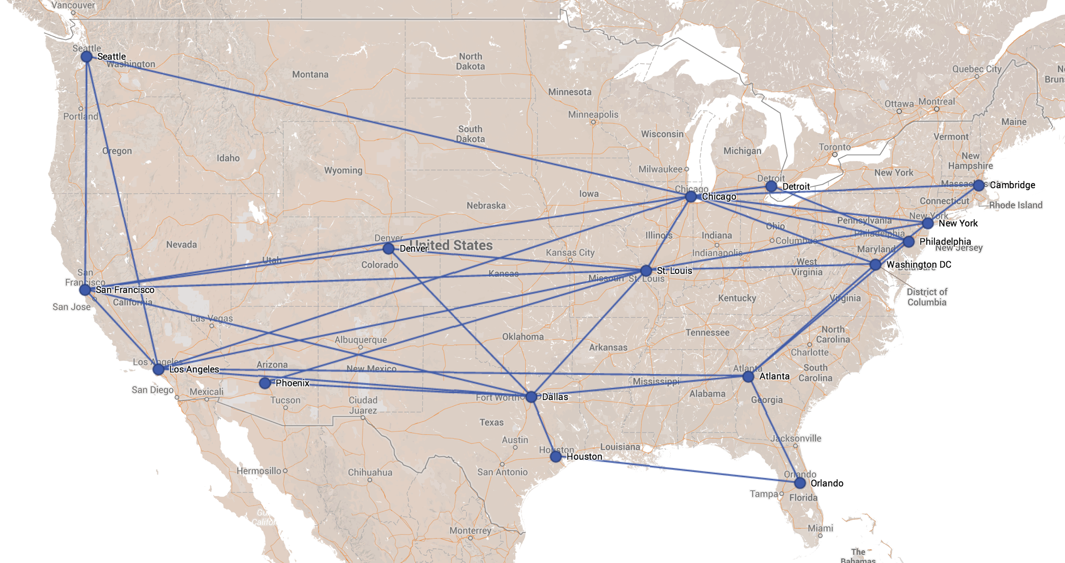
WAN Traffic Engineering Use Case Scenario
ONOS instances
Single ONOS Cluster in a Data Center*
8-16 ONOS instances max for storage/compute capacity
Single DC
Out-of-band connection between ONOS and Switches
O(10)ms delay
AT&T Backbone Network
(*) Other configurations possible with tradeoffs: e.g., ONOS cluster per region
Notes:
----- Meeting Notes (11/20/13 23:20) -----
This is a picture of AT&T backbone network
Here you see various metro regions are connected with high bandwidth connectivity. Lets assume that we are controlling the complete core network using a single cluster of ONOS servers. Typically we will need 8-16 servers to control similar network. ONOS controls the core switches using an out-of-band connection. Typical latency between the switch and ONOS is around 10-50 ms.

Slide 7
WAN Traffic Engineering Use Case Scenario
ONOS instances
Single ONOS Cluster in a Data Center*
8-16 ONOS instances max
Single DC
Out-of-band connection between ONOS and Switches
O(10)ms delay
150 Core Switches (AT&T/Global Crossing)
300 Edge Switches (AT&T/Global Crossing)
50K edge-to-edge tunnels (Global Crossing)
400K IP prefixes (current BGP table size)
AT&T Backbone Network
(Numbers based on Stanford Ph.D thesis (Saurav Das) and interview with Google & Global Crossing)
Notes:
----- Meeting Notes (11/20/13 23:20) -----
Lets see some sizing information on a core backbone bases on prior research on AT&T and Global Crossing's core networks.

Slide 8

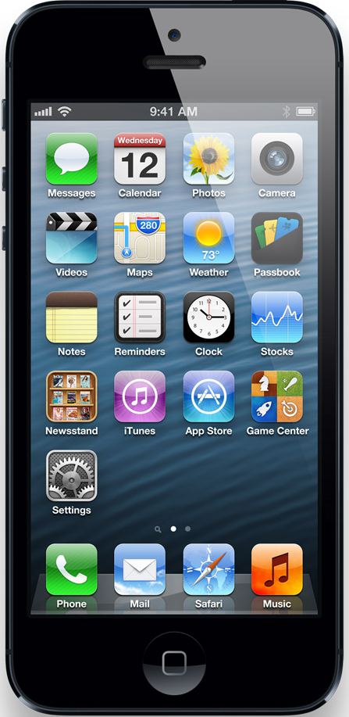
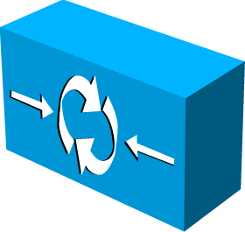
Cellular Core Network Use Case*
(*) Based on Jen Rexford’s study at Princeton
ONOS nodes
Single DC
Base
Station
O(1) ms delay
~100 Switches, 1000 Base Stations
Access Edge
~1 million UEs
~10 million flows
~400 Gbps – 2 Tbps
Cellular Core Network
Internet
Gateway
Edge
~1K Ues per BS
~10K flows per BS
~1 – 10 Gbps per BS
Middle boxes
(firewall, IDS, etc.)
Notes:
----- Meeting Notes (11/20/13 23:20) -----
Just like the Core network we are trying to understand the control plane needs for a Cellular core network. We are working closely with Jen Rexford and her student from Princeton.
Based on their study we can show a cellular core network and how ONOS would control it. On a cellular network the end devices are shown as user agents on this network which initiate all the requests. The user agent or the end devices connect to a base station and intiates the traffic request. There are several base stations spread across the metro and these base stations aggregate into a cellular cell network which forwards the traffic out to internet on edge gateways. All the traffic eventually aggregates into these gateway edges. ONOS can control all these swtiches using a single cluster with out-of-band connection to the swtiches.
Here are some effort to size this network.

Slide 9

ONOS: Open Network OS
Global network view
Routing
TE
Mobility
Global Network View
ONOS
Scale-out
Design
Openflow
Packet
Forwarding
Fault Tolerance
Packet
Forwarding
Programmable
Base Station
Packet
Forwarding
Notes:
This is a clean SDN reference architecture. There are three questions we still need to answer.
Number 1, will the Network OS become a performance bottleneck? Or can we scale the Network OS horizontally as we need more horse power?
Number 2, will the Network OS become a single point of failure? Or can we make the Network OS and the control plane fault tolerant?
The third question has to do with Northbound API. What is the best abstraction the Network OS can offer to application writers that enables reusable and pluggable network control and management applications?
ONOS attempts to address exactly these issues…

Slide 10
Prior Work
Single Instance
NOX, POX, Beacon, Floodlight, Trema controllers
Helios, Midonet, Hyperflow, Maestro, Kandoo, …
Distributed:
ONIX
Distributed control platform for large-scale networks
ONIX: closed source; datacenter + virtualization focus
ONOS design influenced by ONIX
Community needs an open source distributed network OS
Notes:
ONIX did attempt to solve these issues. There are few more efforts. To enable more research in this area community needs an open distributed NOS.

Slide 11
ONOS Phase 1: Goals December 2012 – December 2013
Demo Key Functionality
Fault-Tolerance: Highly Available control plane
Scale-out: Using distributed architecture
Global Network View: Network Graph abstraction
Non Goals
Performance optimization
Stress testing
Notes:
Started in December with a primary goal to demonstrate we can build ONOS with scale-out distributed architecture which has high-availability and global network view as network graph.
----- Meeting Notes (11/20/13 17:23) -----
reactive flows should be dropped

Slide 12
ONOS – Architecture Overview

Slide 13



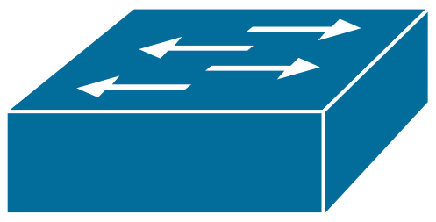

ONOS High Level Architecture
Applications
Control Application
Control Application
Network Graph Eventually consistent
Titan Graph DB
Distributed Network
Graph/State
Cassandra In-Memory DHT
Distributed Registry Strongly Consistent
Coordination
Zookeeper
Instance 1
Instance 2
Instance 3
OpenFlow Controller+
OpenFlow Controller+
OpenFlow Controller+
Scale-out
Host
+Floodlight Drivers
Host
Host
Notes:
Built on two distributed data constructs
1> Network Graph which is the global network view containing the network state represented as a graph which is eventually consistent
2> Distributed Registry is the global cluster management state stored in Zookeeper using transactional consistency.
Multiple instances of ONOS control different parts of network and help realize a single global network view by cooperatively using these two distributed data constructs.
----- Meeting Notes (5/15/13 14:21) -----
Distribruted Registry keeps information on who is in control of the switch objects and has write permissions to update the network graph. In general it stores the resource ownership in a strongly consistent way.
----- Meeting Notes (7/29/13 12:57) -----
order animation
remove floodlight

Slide 14
Scale-out & HA

Slide 15
ONOS Scale-Out
Network Graph
Global network view
Distributed Network OS
Instance 1
Instance 2
Instance 3
Data plane
An instance is responsible for maintaining a part of network graph
Control capacity can grow with network size or application need
Notes:
A part of network is solely controlled by a single ONOS instance and the same instance is also solely responsible for maintaining the state of the partition into the network graph.
[We also refer this as Control isolation.]
This enables simpler scale-out design.
As the network grows beyond the control capacity one can add another instance which will be responsible for a new part of network . As this part is realized into Network Graph, applications will get a global network view.
----- Meeting Notes (7/29/13 12:57) -----
Fix animation

Slide 16
ONOS Control Plane Failover
Master
Switch A = ONOS 1
Candidates = ONOS 2, ONOS 3
Master
Switch A = NONE
Candidates = ONOS 2, ONOS 3
Master
Switch A = ONOS 2
Candidates = ONOS 3
Master
Switch A = ONOS 2
Candidates = ONOS 3
Master
Switch A = NONE
Candidates = ONOS 2, ONOS 3
Master
Switch A = ONOS 1
Candidates = ONOS 2, ONOS 3
Master
Switch A = ONOS 1
Candidates = ONOS 2, ONOS 3
Master
Switch A = NONE
Candidates = ONOS 2, ONOS 3
Distributed Registry
Master
Switch A = ONOS 2
Candidates = ONOS 3
Distributed Network OS
Instance 1
Instance 2
Instance 3
Host
A
C
E
B
D
F
Host
Host
Notes:
Switch A is being controlled by Instance 1 and the registry shows it as master for switch A.
Instance 1 has a failure and dies.
Registry detects that instance 1 is down and release the mastership for Switch A.
Remaining candidates join the mastership election within registry. Lets say Instance 2 wins the election and is marked in registry as the master for Switch A.
The channel with Instance 2 becomes the active channel and other channel becomes passive.
This enables a quick failover of switch when there is a control plane failure.
----- Meeting Notes (7/29/13 12:57) -----
Mention strong consistency and elegent coordination

Slide 17
Network Graph

Slide 18
ONOS Network Graph Abstraction
Network Graph
Id: 106, Label
Id: 1
A
Id: 105, Label
Id: 102, Label
Id: 2
C
Id: 101, Label
Titan Graph DB
Id: 104, Label
Id: 3
B
Id: 103, Label
Cassandra Key/Value Store
Notes:
Network graph is organized as a graph database. Vertices as network objects and connected by edges as relation between the vertices.
We use Titan as graph DB with Cassandra as its backend.
Cassandra is eventually consistent

Slide 19
Network Graph
port
port
switch
on
port
link
port
on
switch
port
port
host
host
device
device
Network state is naturally represented as a graph
Graph has basic network objects like switch, port, device and links
Application writes to this graph & programs the data plane
Notes:
Network is naturally a graph with switches, ports, devices as objects as vertices. Similarly links and attachment points are modeled as edges.
Applications can traverse and write to this graph to program the data plane.
How? Lets look at this example application

Slide 20
Example: Path Computation App on Network Graph
Flow path
flow
flow
Flow entry
Flow entry
inport
outport
switch
switch
port
port
switch
on
port
link
port
on
switch
port
port
host
host
device
device
Application computes path by traversing the links from source to destination
Application writes each flow entry for the path
Thus path computation app does not need to worry about topology maintenance
Notes:
Path Computation is an application which is using Network Graph.
The application can find a path from source to destination by traversing links and program this path with flow entries to create a flow-path.
These flow-entries are translated by ONOS core into flow table rules and pushed onto the topology.
Last bullet: Application is made simple and stateless. It does not need to worry about topology maintenance.
----- Meeting Notes (5/14/13 14:16) -----
start without text. Bring in text at end and make one point

Slide 21
Example: A simpler abstraction on network graph?
Virtual network objects
Logical Crossbar
Edge Port
Edge Port
physical
physical
Real network objects
port
port
switch
on
port
link
port
on
switch
port
port
host
host
device
device
App or service on top of ONOS
Maintains mapping from simpler to complex
Thus makes applications even simpler and enables new abstractions
Notes:
Network graph simplifies applications but can it be used to accelerate innovations of simpler abstractions in control plane?
Here is an example of Logical Crossbar. The complexity of network state and topology is hidden.
One can build hierarchy of these abstractions further hiding the complexity.
Last bullet: We feel network graph will unlock innovations.
7 minute Marker

Slide 22
Network Graph and Switches
Network Graph: Switches
Switch Manager
Switch Manager
Switch Manager
OF
OF
OF
OF
OF
OF
Notes:
Let us see how ONOS builds the network graph. Each ONOS node has a switch manager. When switches connect, switches and ports are get added as switches register with an ONOS node. When switches disconnect, they get marked as inactive in the network graph.

Slide 23
Network Graph and Link Discovery
Network Graph: Links
Link Discovery
Link Discovery
Link Discovery
SM
LLDP
SM
LLDP
SM
Notes:
Each node sends out LLDP on the switches connected to it. Links with source and destination port controlled by different ONOS nodes can also be discovered using the network graph.

Slide 24
Devices and Network Graph
Network Graph: Devices
Device Manager
Device Manager
Device Manager
SM
LD
SM
LD
SM
LD
PKTIN
Host
PKTIN
Host
PKTIN
Host
Notes:
Host packet Ins are used to learn about devices, their attachment points. The network graph is updated with this information.

Slide 25
Path Computation with Network Graph
Path Computation
Path Computation
Path Computation
Network Graph: Flow Paths
Flow 1
Flow 2
Flow entries
Flow 3
Flow entries
Flow entries
Flow entries
Flow entries
Flow entries
Flow entries
Flow entries
Flow entries
Flow 4
Flow 5
Flow entries
Flow 6
Flow entries
Flow entries
Flow entries
Flow entries
Flow entries
Flow entries
Flow entries
Flow entries
Flow 7
Flow 8
Flow entries
Flow entries
Flow entries
Flow entries
Flow entries
Flow entries
SM
LD
DM
SM
LD
DM
SM
LD
DM
Host
Host
Host
Notes:
Flow paths are provisioned in ONOS.
The source dpid of a flow is used to partition which node will compute the path. Computed paths and flow entries are also stored in the network graph.
Flow entries have relationship to the switches.

Slide 26
Network Graph and Flow Manager
Path Computation
Path Computation
Path Computation
Network Graph: Flows
Flow 1
Flow 2
Flow entries
Flow 3
Flow entries
Flow entries
Flow entries
Flow entries
Flow entries
Flow entries
Flow entries
Flow entries
Flow 4
Flow 5
Flow entries
Flow 6
Flow entries
Flow entries
Flow entries
Flow entries
Flow entries
Flow entries
Flow entries
Flow entries
Flow 7
Flow 8
Flow entries
Flow entries
Flow entries
Flow entries
Flow entries
Flow entries
Flow Manager
Flowmod
Flow Manager
Flow Manager
Flowmod
Flowmod
SM
LD
DM
SM
LD
DM
SM
LD
DM
Host
Host
Host
Notes:
Each flow manager programs the switches connected to it using the state in the network graph.
When a link fails, PC will recompute a new path and Flow Manager will push new flow entries.

Slide 27
ONOS High Level Architecture
Applications
Control Application
Control Application
Network Graph Eventually consistent
Titan Graph DB
Distributed Network
Graph/State
Cassandra In-Memory DHT
Distributed Registry Strongly Consistent
Coordination
Zookeeper
Instance 1
Instance 2
Instance 3
OpenFlow Controller+
OpenFlow Controller+
OpenFlow Controller+
Scale-out
Host
+Floodlight Drivers
Host
Host
Notes:
Built on two distributed data constructs
1> Network Graph which is the global network view containing the network state represented as a graph which is eventually consistent
2> Distributed Registry is the global cluster management state stored in Zookeeper using transactional consistency.
Multiple instances of ONOS control different parts of network and help realize a single global network view by cooperatively using these two distributed data constructs.
----- Meeting Notes (5/15/13 14:21) -----
Distribruted Registry keeps information on who is in control of the switch objects and has write permissions to update the network graph. In general it stores the resource ownership in a strongly consistent way.
----- Meeting Notes (7/29/13 12:57) -----
order animation
remove floodlight

Slide 28
Reflections/Lessons Learned: Things we got right
Control isolation (sharding)
Divide network into parts and control them exclusively
Load balancing -> we can do more
Distributed data store
That scales with controller nodes with HA -> though we need low latency distributed data store
Dynamic controller assignment to parts of network
Dynamically assign which part of network is controlled by which controller instance -> we can do better with sophisticated algorithms
Graph abstraction of network state
Easy to visualize and correlate with topology
Enables several standard graph algorithms
Notes:
----- Meeting Notes (11/20/13 23:20) -----
We got few things right. Partitioning the network into parts to be controlled exclusively helps in basic load balancing. And ofcourse we could do better.
Scalability and HA was weill handled using distributed data stores.
Dynamic fail-over and assignment of part of network to controller helps very well in HA. We could have done better using sophisticated algorithms.
Network Graph as northbound abstraction is appealing to many and we can do better by formalizing a graph model for ONOS.

Slide 29
Reflections/Lessons Learned: Limitations
Performance
Several layers of open source sw means lower performance
Very little visibility under-the-hood
Different types of network state treated the same way
Debuggability
Debugging for performance as well as correctness is difficult due to lack of visibility
Cannot customize to our needs
Heavyweight building blocks
Spectrum of use cases
Routing, TE, and BGP are the only use cases tried – need more
Features
Meant to be a prototype and so didn’t consider config, measurements, …
Notes:
----- Meeting Notes (11/20/13 17:49) -----
Limitations:
1> Performance
2> Debuggability
3> Lack of use cases
4> several features are miissing
Next phase:
architectural directions
1> state usage pattern
2> control over sharding
3> Customizing to data model to our sharding (Maximize local reads/writes)
3> Using lean and high perfomance open source
4> Engaging network providers and vendors for use cases
----- Meeting Notes (11/20/13 23:20) -----
ONOS has few limitations
First we have several features missing and as we learn we will add them.
Open source tools are good for rapid prototype but do not help in customizng to our performance needs.
While designing and developing we lacked several use cases and may have incorrect assumptions on network state. Now we are investigating different types of network states and their usage patterns.
Debugging ONOS is not easy due to lack of visibility of open source tools under-the-hood.

Slide 30
Next Phase: Architectural Directions
Optimize for different types of network state
Identify different types of network state and usage patterns
Quantify the requirements for each type of state
Understand the performance needs and strategize for optimal usage
Control over sharding
Optimize for different types of network states
Lockless concurrent operations on network state
Customize our data model to our sharding
Maximize local reads/writes
Reduce need for remote read/writes as far as possible
Use lean and high performance open source if possible
For example reduce dependency on general purpose open source DHT
Engage network providers and vendors
Feature set and use cases
Notes:
Started in December with a primary goal to demonstrate we can build ONOS with scale-out distributed architecture which has high-availability and global network view as network graph.
----- Meeting Notes (11/20/13 17:33) -----
drop the non-goals
demonstrate service provider use cases

Slide 31
ONOS: Many Challenges Ahead …
Goal: Functionality with performance, visibility, customization
Modular building blocks
Swap-in and out with commercial or different open-source components
Low latency distributed data store and state synchronization
Low latency events and notifications
Distributed state management
Choice of consistency models for different network state
CAP theorem implications on applications programming
Sharding and replication of network state
Optimize handling different types of network states (replicate/shard)
Optimize data models for our purpose
Lockless concurrent operation on the network states
Northbound Abstraction
Network Graph API for applications
Hierarchical control - Recursive SDN (with Berkeley)
Notes:
----- Meeting Notes (11/20/13 17:49) -----
hierarchical control plane at the end
combine under
-> Modular building blocks
-> Distributed state management
-> Sharding and repllication
-> Northbound abstraction

Slide 32
ONOS Open Source Initiative … stay tuned…

Slide 33
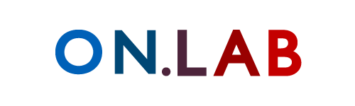
onos.onlab.us
The ONOS team:
Pankaj Berde
Masayoshi Kobayashi
Brian O’Conner
Rachel Sverdlov
Naoki Shiota
William Snow
Pavlin Radoslavov
Jonathan Hart
Pingping Lin
Suibin Zhang
Yuta Higuchi
Guru Parulkar
Notes:
In this demo we will create isolated virtual networks, each with their own topology. Each virtual network is connected to its own network operating system. Finally, we show demonstrate the resiliency features of OVX.

