Slide 1


Apache Flink™ deep-dive Unified Batch and Stream Processing
Hadoop Summit 2015,
San Jose, CA
Robert Metzger
@rmetzger_
Notes:
40 minutes

Slide 2
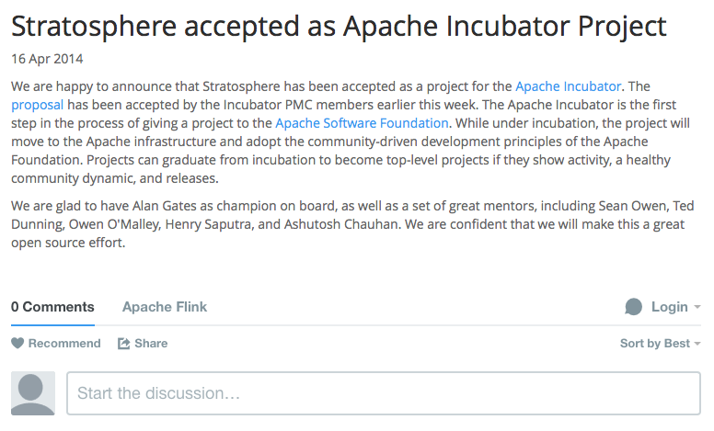
Flink’s Recent History
April 2014
Dec 2014
April 2015
0.5
0.6
0.7
Top Level Project Graduation
0.9-m1
0.9

Slide 3
What is Flink
Cascading (WiP)
Gelly
MRQL
Table
ML
Dataflow (WiP)
Dataflow
Zeppelin
Table
Hadoop M/R
SAMOA
DataSet (Java/Scala)
DataStream
Streaming dataflow runtime
Local
Remote
YARN
Tez
Embedded
Notes:
Flink is an entire software stack
the heart: streaming dataflow engine:
think of programs as operators and data flows
Kappa architecture: run batch programs on a streaming system
Table API: logical representation, sql-style
Samoa “on-line learners”

Slide 4

Program compilation
case class Path (from: Long, to: Long)
val tc = edges.iterate(10) {
paths: DataSet[Path] =>
val next = paths
.join(edges)
.where("to")
.equalTo("from") {
(path, edge) =>
Path(path.from, edge.to)
}
.union(paths)
.distinct()
next
}
GroupRed
Dataflow Graph
→Independent of batch or streaming job
Type extraction stack
sort
forward
Optimizer
Join
Hybrid Hash
buildHT
probe
Pre-flight (Client)
hash-part [0]
hash-part [0]
Program
Map
DataSource
lineitem.tbl
Filter
Data Source
orders.tbl
Layered Architecture allows plugging of components
deploy operators
Dataflow metadata
Task scheduling
track intermediate results
Master
Workers
Notes:
toy program: native transitive closure
type extraction: types that go in and out of each operator

Slide 5
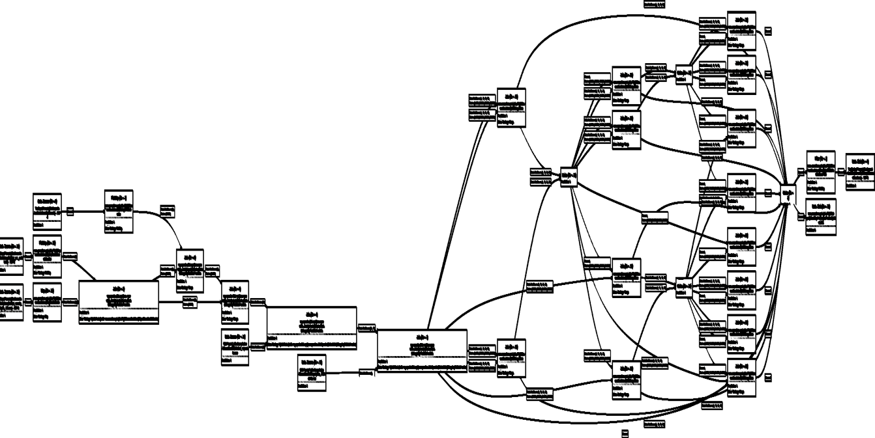
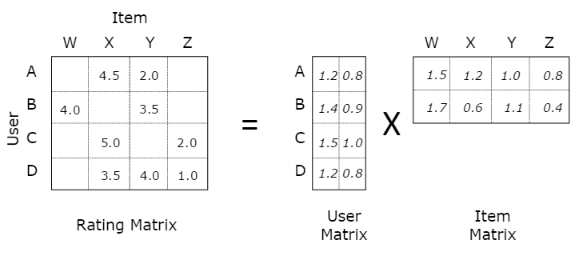
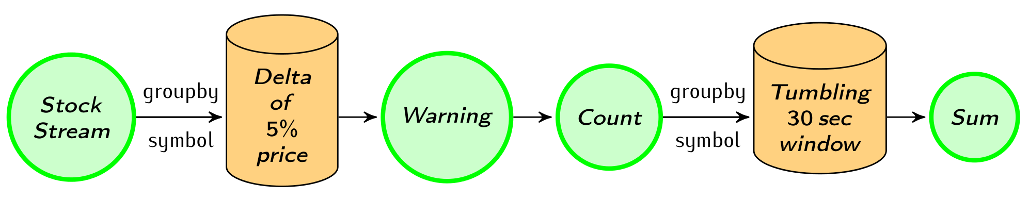
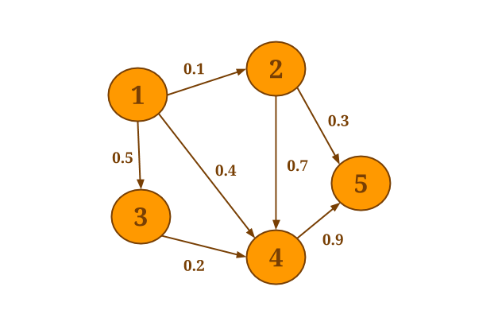
Native workload support
Long batch pipelines
Machine Learning at scale
Streaming
topologies
→ resource utilization
→ iterative algorithms
Graph Analysis
→ Low latency
Flink
→ Mutable state
How can an engine natively support all these workloads?
And what does "native" mean?
Notes:
Flink is an analytical system
streaming topology: real-time; low latency
“native”: build-in support in the system, no working around, no black-box
next slide: define native by some “non-native” examples

Slide 6



E.g.: Non-native iterations
Teaching an old elephant new tricks
Treat system as a black box
for (int i = 0; i < maxIterations; i++) {
// Execute MapReduce job
}
Client
Step
Step
Step
Step
Step
Notes:
Used for Machine Learning
run the same job over the data multiple times to come up with parameters for a ml model
this is how you do it when treating the engine as a black box

Slide 7
E.g.: Non-native streaming
Simulate stream processor with batch system
Data Stream
stream
discretizer
while (true) {
// get next few records
// issue batch job
}
Job
Job
Job
Job
Notes:
If you only have a batch processor:
do a lot of small batch jobs
LIMITATION: state across the small jobs (batches)

Slide 8
Native workload support
Long batch pipelines
Machine Learning at scale
Streaming
topologies
→ resource utilization
→ iterative algorithms
Graph Analysis
→ Low latency
Flink
→ Mutable state
How can an engine natively support all these workloads?
And what does "native" mean?
Notes:
Flink is an analytical system
streaming topology: real-time; low latency
“native”: build-in support in the system, no working around, no black-box
next slide: define native by some “non-native” examples

Slide 9
Ingredients for “native” support
Execute everything as streams
Pipelined execution, push model
Special code paths for batch
Automatic job optimization, fault tolerance
Allow some iterative (cyclic) dataflows
Allow some mutable state
Operate on managed memory
Make data processing on the JVM robust
Notes:
Corner points / requirements for flink
keep data in motion, avoid materialization
even though it’s a streaming runtime, have special paths for batch: OPTIMIZER, CHECKPOINTING
make the system aware of cyclic data flows, in a controlled way
allow operators to have some state, in a controlled way (DELTA-ITERATIONS). relax “traditional” batch assumption
flink runs in the jvm, but we want control over memory, not rely on GC

Slide 10

Flink by Use Case
Notes:
Explain flink by use case

Slide 11
Stream data processing
Full talk tomorrow:
3:10PM, Grand Ballroom 220A
Stream processing with Flink
streaming dataflows

Slide 12
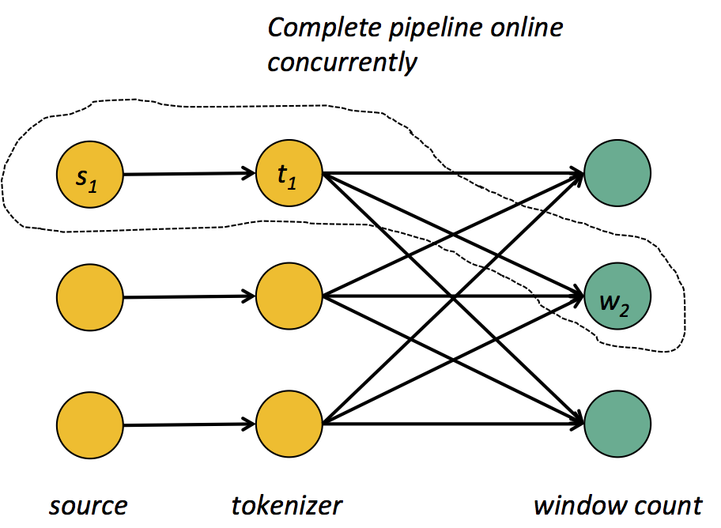
Pipelined stream processor
Low latency
Operators push data forward
Streaming
Shuffle!
Notes:
pipelined execution: logical way you would go for low latency.
no synchronization barriers, records keep flowing
streaming shuffle (for example w/ hash code)
push model
maintain state inside long lived operators (!= mini batch)

Slide 13
Expressive APIs
case class Word (word: String, frequency: Int)
DataSet API (batch):
val lines: DataSet[String] = env.readTextFile(...)
lines.flatMap {line => line.split(" ").map(word => Word(word,1))}
.groupBy("word").sum("frequency")
.print()
DataStream API (streaming):
val lines: DataStream[String] = env.fromSocketStream(...)
lines.flatMap {line => line.split(" ").map(word => Word(word,1))}
.window(Time.of(5,SECONDS)).every(Time.of(1,SECONDS))
.groupBy("word").sum("frequency")
.print()
Notes:
nice, fluent APIs known from the batch world
window definitions

Slide 14
Checkpointing / Recovery
Pushes checkpoint barriers through the data flow
barrier
Data Stream
After barrier =
Not in snapshot
Before barrier =
part of the snapshot
(backup till next snapshot)
→ Guarantees exactly-once processing
Chandy-Lamport Algorithm for consistent asynchronous distributed snapshots
Notes:
Low overhead snapshots using “batched” snapshots
Exactly once processing guarantees (without doing mini batches)
How does it work:
periodically push barriers through the streams.
when a barrier reaches an operator, snapshot state
when barrier reaches sinks, a checkpoint is completed (secured)
multiple parallel checkpoints
chop stream into generations (pre checkpointed, post checkpointed)

Slide 15
Batch processing
Batch on Streaming
Notes:
structure,
different title

Slide 16
Batch on an streaming engine
Result 1
Filter
Map
File in HDFS
Result 2
Map
Batch program, completely pipelined
Data is never materialized anywhere (in this example)

Slide 17
Batch on an streaming engine
in parallel
Data Sink
Map Operator
Stream
Data Source (small)
Data Sink
Stream
Map Operator
Stream
Map Operator
Data Sink
Stream build side
Join Operator
Data Source (large)
Map
Data Sink
Stream probe side
in parallel (once build side finished)
Notes:
Measure effect of pipeline parallelism
blocking happens in operators (join build side)

Slide 18
Batch processing requirements
Get the data processed as fast as possible
Automatic job optimizer
Efficient memory management
Robust processing
provide fault-tolerance
again, memory management

Slide 19
Optimizer
Cost-based optimizer
Select data shipping strategy (forward, partition, broadcast)
Local execution (sort merge join/hash join)
Caching of loop invariant data (iterations)
case class Path (from: Long, to: Long)
val tc = edges.iterate(10) {
paths: DataSet[Path] =>
val next = paths
.join(edges)
.where("to")
.equalTo("from") {
(path, edge) =>
Path(path.from, edge.to)
}
.union(paths)
.distinct()
next
}
Type extraction stack
GroupRed
sort
Dataflow Graph
forward
Join
Hybrid Hash
Optimizer
buildHT
probe
hash-part [0]
hash-part [0]
Map
DataSource
lineitem.tbl
Pre-flight (Client)
Filter
Data Source
orders.tbl
Program

Slide 20
Two execution plans
GroupRed
GroupRed
sort
sort
hash-part [0,1]
Best plan
depends on
relative sizes of input files
Combine
forward
Join
Hybrid Hash
Join
Hybrid Hash
buildHT
probe
buildHT
probe
broadcast
forward
hash-part [0]
hash-part [0]
Map
DataSource
lineitem.tbl
Map
DataSource
lineitem.tbl
Filter
Filter
DataSource
orders.tbl
DataSource
orders.tbl

Slide 21
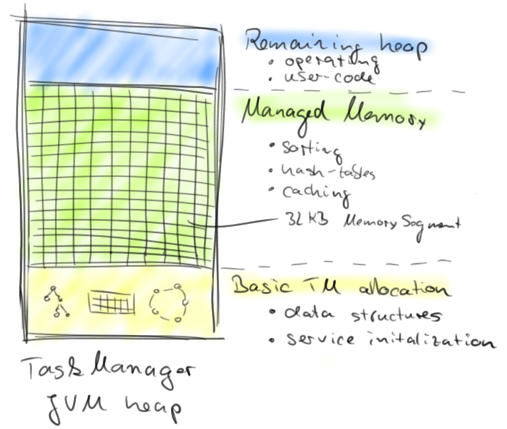
Memory Management
Notes:
in flink operators are running at the same time → need to control memory

Slide 22
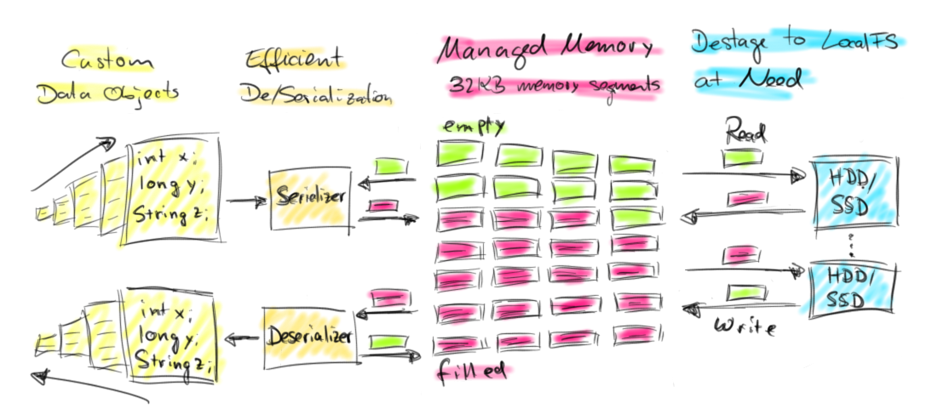
Operators on managed memory

Slide 23
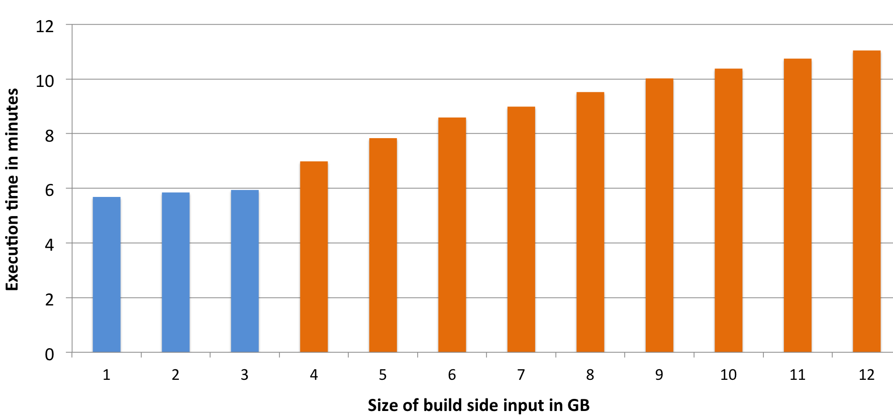
Smooth out-of-core performance
Blue bars are in-memory, orange bars (partially) out-of-core
More at: http://flink.apache.org/news/2015/03/13/peeking-into-Apache-Flinks-Engine-Room.html
Notes:
example: hash join
robust in memory
graceful behavior

Slide 24
Machine Learning Algorithms
Iterative data flows

Slide 25
Iterate by looping
Client
Step
Step
Step
Step
Step
for/while loop in client submits one job per iteration step
Data reuse by caching in memory and/or disk
Notes:
needed for machine learning

Slide 26
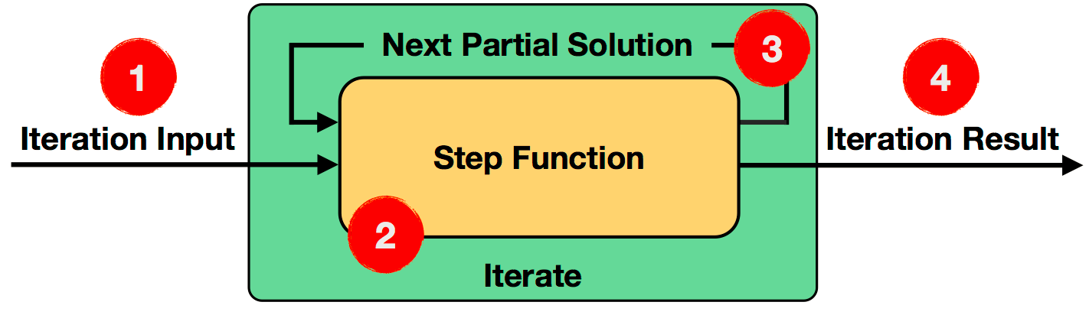
Iterate in the Dataflow
API and runtime support
Automatic caching of loop invariant data
IterationState state = getInitialState();
while (!terminationCriterion()) {
state = step(state);
}
setFinalState(state);
Notes:
function that encapsulate the transformation “Hadoop job”
deploy this once, keep running across iterations (also you can keep state)
allow to feed back data to the beginning

Slide 27
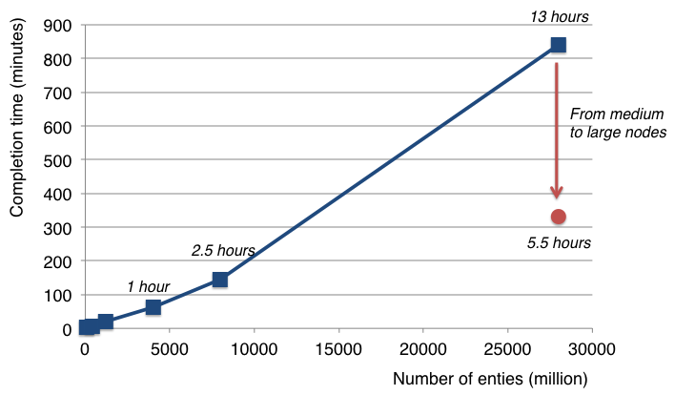
Example: Matrix Factorization
Factorizing a matrix with 28 billion ratings for recommendations
Setups:
40 medium instances ("n1-highmem-8" - 8 cores, 52 GB)
40 large instances ("n1-highmem-16" - 16 cores, 104 GB)
More at: http://data-artisans.com/computing-recommendations-with-flink.html
Notes:
1 Tb of input data
many terabytes of intermediate data
40 machines cluster @ google compute

Slide 28
Flink ML – Machine Learning
Provide a complete toolchain
scikit-learn style pipelining
Data pre-processing
various algorithms
Recommendations: ALS
Supervised learning: Support Vector Machines
…
ML on streams: SAMOA. We are planning to add support for streaming into ML
Notes:
SVM = supervised learning
ALS = Recommendation

Slide 29
Graph Analysis
Stateful Iterations

Slide 30
Graph processing characteristics
# of elements updated
iteration

Slide 31
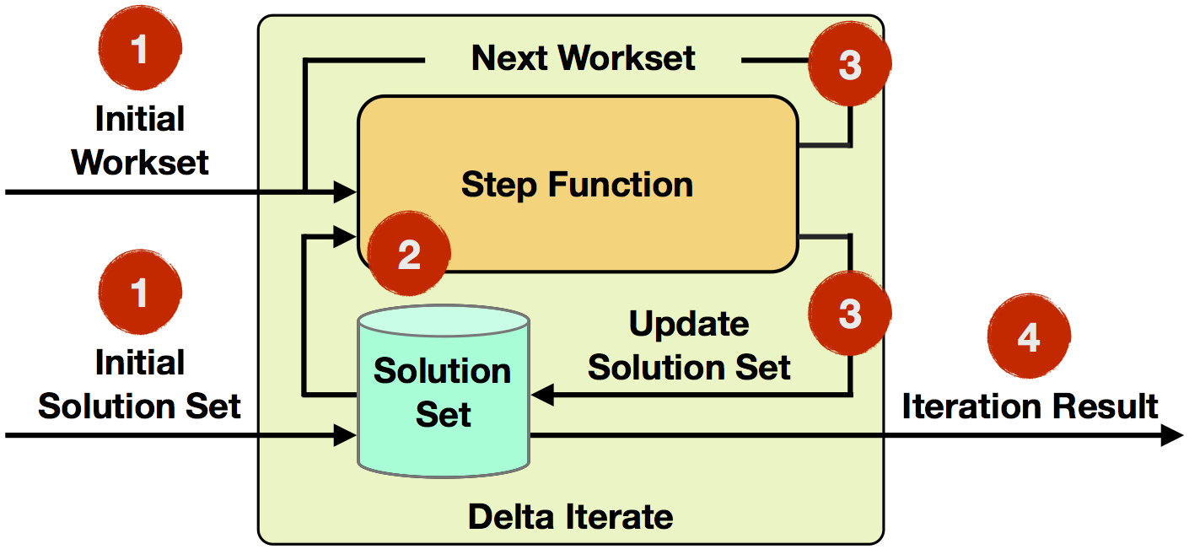
Iterate natively with state/deltas
Keep state in an controlled way by having a partitioned hash-map
Relax immutability assumption of batch processing
Notes:
keep mutable state in a controlled way
by having a hash map locally on each machine
great documentation on flink website

Slide 32
… fast graph analysis
More at: http://data-artisans.com/data-analysis-with-flink.html

Slide 33
Gelly – Graph Processing API
Transformations: map, filter, subgraph, union, reverse, undirected
Mutations: add vertex/edge, remove …
Pregel style vertex centric iterations
Library of algorithms
Utilities: Special data types, loading, graph properties
Notes:
Weakly connected components, page rank, label propagation,

Slide 34
Gelly and Flink ML:
Available in Flink 0.9 (so far only beta release)
Still under heavy development
Seamlessly integrate with DataSet abstraction
Preprocess data as needed
Use results as needed
Easy entry point for new contributors

Slide 35
Closing

Slide 36
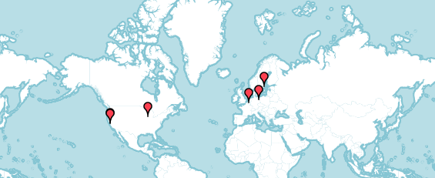
Flink Meetup Groups
SF Spark and Friends
June 16, San Francisco
Bay Area Flink Meetup
June 17, Redwood City
Chicago Flink Meetup
June 30
Stockholm, Sweden
Berlin, Germany

Slide 37

Flink Forward registration & call for abstracts is open now
12/13 October 2015
Meet developers and users of Flink!
With Flink Workshops / Trainings!

Slide 38

flink.apache.org @ApacheFlink

