Slide 1


Approximate Queries on Very Large Data
Sameer Agarwal
Joint work with Ariel Kleiner, Henry Milner, Barzan Mozafari, Ameet Talwalkar, Michael Jordan, Samuel Madden, Ion Stoica
UC Berkeley

Slide 2
Our Goal
Support interactive SQL-like aggregate queries over massive sets of data

Slide 3
Our Goal
Support interactive SQL-like aggregate queries over massive sets of data
blinkdb> SELECT AVG(jobtime)
FROM very_big_log
AVG, COUNT, SUM, STDEV, PERCENTILE etc.

Slide 4
Our Goal
Support interactive SQL-like aggregate queries over massive sets of data
blinkdb> SELECT AVG(jobtime)
FROM very_big_log
WHERE src = ‘hadoop’
FILTERS, GROUP BY clauses

Slide 5
Our Goal
Support interactive SQL-like aggregate queries over massive sets of data
blinkdb> SELECT AVG(jobtime)
FROM very_big_log
WHERE src = ‘hadoop’
LEFT OUTER JOIN logs2
ON very_big_log.id = logs.id
JOINS, Nested Queries etc.

Slide 6
Our Goal
Support interactive SQL-like aggregate queries over massive sets of data
blinkdb> SELECT my_function(jobtime)
FROM very_big_log
WHERE src = ‘hadoop’
LEFT OUTER JOIN logs2
ON very_big_log.id = logs.id
ML Primitives,
User Defined Functions

Slide 7


100 TB on 1000 machines
½ - 1 Hour
1 - 5 Minutes
1 second
?
Hard Disks
Memory
Query Execution on Samples

Slide 8
Query Execution on Samples
ID | City | Buff Ratio
1 | NYC | 0.78
2 | NYC | 0.13
3 | Berkeley | 0.25
4 | NYC | 0.19
5 | NYC | 0.11
6 | Berkeley | 0.09
7 | NYC | 0.18
8 | NYC | 0.15
9 | Berkeley | 0.13
10 | Berkeley | 0.49
11 | NYC | 0.19
12 | Berkeley | 0.10
What is the average buffering ratio in the table?
0.2325

Slide 9
Query Execution on Samples
ID | City | Buff Ratio
1 | NYC | 0.78
2 | NYC | 0.13
3 | Berkeley | 0.25
4 | NYC | 0.19
5 | NYC | 0.11
6 | Berkeley | 0.09
7 | NYC | 0.18
8 | NYC | 0.15
9 | Berkeley | 0.13
10 | Berkeley | 0.49
11 | NYC | 0.19
12 | Berkeley | 0.10
What is the average buffering ratio in the table?
ID | City | Buff Ratio | Sampling Rate
2 | NYC | 0.13 | 1/4
6 | Berkeley | 0.25 | 1/4
8 | NYC | 0.19 | 1/4
Uniform
Sample
0.2325
0.19

Slide 10
Query Execution on Samples
ID | City | Buff Ratio
1 | NYC | 0.78
2 | NYC | 0.13
3 | Berkeley | 0.25
4 | NYC | 0.19
5 | NYC | 0.11
6 | Berkeley | 0.09
7 | NYC | 0.18
8 | NYC | 0.15
9 | Berkeley | 0.13
10 | Berkeley | 0.49
11 | NYC | 0.19
12 | Berkeley | 0.10
What is the average buffering ratio in the table?
ID | City | Buff Ratio | Sampling Rate
2 | NYC | 0.13 | 1/4
6 | Berkeley | 0.25 | 1/4
8 | NYC | 0.19 | 1/4
Uniform
Sample
0.2325
0.19 +/- 0.05

Slide 11
Query Execution on Samples
ID | City | Buff Ratio
1 | NYC | 0.78
2 | NYC | 0.13
3 | Berkeley | 0.25
4 | NYC | 0.19
5 | NYC | 0.11
6 | Berkeley | 0.09
7 | NYC | 0.18
8 | NYC | 0.15
9 | Berkeley | 0.13
10 | Berkeley | 0.49
11 | NYC | 0.19
12 | Berkeley | 0.10
What is the average buffering ratio in the table?
ID | City | Buff Ratio | Sampling Rate
2 | NYC | 0.13 | 1/2
3 | Berkeley | 0.25 | 1/2
5 | NYC | 0.19 | 1/2
6 | Berkeley | 0.09 | 1/2
8 | NYC | 0.18 | 1/2
12 | Berkeley | 0.49 | 1/2
Uniform
Sample
0.2325
0.19 +/- 0.05
$0.22 +/- 0.02

Slide 12
Speed/Accuracy Trade-off
Interactive
Queries
Error
Time to Execute on
Entire Dataset
2 sec
30 mins
Execution Time (Sample Size)

Slide 13
Speed/Accuracy Trade-off
Interactive
Queries
Error
Time to Execute on
Entire Dataset
Pre-Existing
Noise
2 sec
30 mins
Execution Time (Sample Size)

Slide 14
Sampling Vs. No Sampling
1020
10x as response time
is dominated by I/O
Query Response Time (Seconds)
103
18
13
10
8
1
10⁻¹
10⁻²
10⁻³
10⁻⁴
10⁻⁵
Fraction of full data

Slide 15
Sampling Vs. No Sampling
1020
Error Bars
Query Response Time (Seconds)
(0.02%)
103
(0.07%)
(1.1%)
(3.4%)
(11%)
18
13
10
8
1
10⁻¹
10⁻²
10⁻³
10⁻⁴
10⁻⁵
Fraction of full data

Slide 16
What is BlinkDB?
A framework built on Shark and Spark that …
creates and maintains a variety of uniform and stratified samples from underlying data
returns fast, approximate answers with error bars by executing queries on samples of data
verifies the correctness of the error bars that it returns at runtime

Slide 17
What is BlinkDB?
A framework built on Shark and Spark that …
creates and maintains a variety of uniform and stratified samples from underlying data
returns fast, approximate answers with error bars by executing queries on samples of data
verifies the correctness of the error bars that it returns at runtime

Slide 18
Uniform Samples
4
3
1
2

Slide 19
Uniform Samples
4
U
3
1
2

Slide 20
Uniform Samples
ID | City | Data
1 | NYC | 0.78
2 | NYC | 0.13
3 | Berkeley | 0.25
4 | NYC | 0.19
5 | NYC | 0.11
6 | Berkeley | 0.09
7 | NYC | 0.18
8 | NYC | 0.15
9 | Berkeley | 0.13
10 | Berkeley | 0.49
11 | NYC | 0.19
12 | Berkeley | 0.10
4
U
3
1
2

Slide 21
Uniform Samples
ID | City | Data
1 | NYC | 0.78
2 | NYC | 0.13
3 | Berkeley | 0.25
4 | NYC | 0.19
5 | NYC | 0.11
6 | Berkeley | 0.09
7 | NYC | 0.18
8 | NYC | 0.15
9 | Berkeley | 0.13
10 | Berkeley | 0.49
11 | NYC | 0.19
12 | Berkeley | 0.10
4
FILTER rand() < 1/3
Adds per-row Weights
(Optional) ORDER BY rand()
U
3
1
2

Slide 22
Uniform Samples
ID | City | Data | Weight
2 | NYC | 0.13 | 1/3
8 | NYC | 0.25 | 1/3
6 | Berkeley | 0.09 | 1/3
11 | NYC | 0.19 | 1/3
ID | City | Data
1 | NYC | 0.78
2 | NYC | 0.13
3 | Berkeley | 0.25
4 | NYC | 0.19
5 | NYC | 0.11
6 | Berkeley | 0.09
7 | NYC | 0.18
8 | NYC | 0.15
9 | Berkeley | 0.13
10 | Berkeley | 0.49
11 | NYC | 0.19
12 | Berkeley | 0.10
4
U
Doesn’t change Shark RDD Semantics
3
1
2

Slide 23
Stratified Samples
4
3
1
2

Slide 24
Stratified Samples
4
S
3
1
2

Slide 25
Stratified Samples
ID | City | Data
1 | NYC | 0.78
2 | NYC | 0.13
3 | Berkeley | 0.25
4 | NYC | 0.19
5 | NYC | 0.11
6 | Berkeley | 0.09
7 | NYC | 0.18
8 | NYC | 0.15
9 | Berkeley | 0.13
10 | Berkeley | 0.49
11 | NYC | 0.19
12 | Berkeley | 0.10
4
S
3
1
2

Slide 26
Stratified Samples
ID | City | Data
1 | NYC | 0.78
2 | NYC | 0.13
3 | Berkeley | 0.25
4 | NYC | 0.19
5 | NYC | 0.11
6 | Berkeley | 0.09
7 | NYC | 0.18
8 | NYC | 0.15
9 | Berkeley | 0.13
10 | Berkeley | 0.49
11 | NYC | 0.19
12 | Berkeley | 0.10
ID | City | Data
1 | NYC | 0.78
2 | NYC | 0.13
3 | Berkeley | 0.25
4 | NYC | 0.19
5 | NYC | 0.11
6 | Berkeley | 0.09
7 | NYC | 0.18
8 | NYC | 0.15
9 | Berkeley | 0.13
10 | Berkeley | 0.49
11 | NYC | 0.19
12 | Berkeley | 0.10
4
S₁
SPLIT
3
1
2

Slide 27
Stratified Samples
ID | City | Data
1 | NYC | 0.78
2 | NYC | 0.13
3 | Berkeley | 0.25
4 | NYC | 0.19
5 | NYC | 0.11
6 | Berkeley | 0.09
7 | NYC | 0.18
8 | NYC | 0.15
9 | Berkeley | 0.13
10 | Berkeley | 0.49
11 | NYC | 0.19
12 | Berkeley | 0.10
4
City | Count
NYC | 7
Berkeley | 5
S₂
S₁
GROUP
3
1
2

Slide 28
Stratified Samples
ID | City | Data
1 | NYC | 0.78
2 | NYC | 0.13
3 | Berkeley | 0.25
4 | NYC | 0.19
5 | NYC | 0.11
6 | Berkeley | 0.09
7 | NYC | 0.18
8 | NYC | 0.15
9 | Berkeley | 0.13
10 | Berkeley | 0.49
11 | NYC | 0.19
12 | Berkeley | 0.10
4
City | Count | Ratio
NYC | 7 | 2/7
Berkeley | 5 | 2/5
S₂
S₁
GROUP
3
1
2

Slide 29
Stratified Samples
4
ID | City | Data
1 | NYC | 0.78
2 | NYC | 0.13
3 | Berkeley | 0.25
4 | NYC | 0.19
5 | NYC | 0.11
6 | Berkeley | 0.09
7 | NYC | 0.18
8 | NYC | 0.15
9 | Berkeley | 0.13
10 | Berkeley | 0.49
11 | NYC | 0.19
12 | Berkeley | 0.10
City | Count | Ratio
NYC | 7 | 2/7
Berkeley | 5 | 2/5
S₂
JOIN
S₂
S₁
3
1
2

Slide 30
Stratified Samples
4
ID | City | Data | Weight
2 | NYC | 0.13 | 2/7
8 | NYC | 0.25 | 2/7
6 | Berkeley | 0.09 | 2/5
12 | Berkeley | 0.49 | 2/5
U
S₂
S₂
S₁
Doesn’t change Shark RDD Semantics
3
1
2

Slide 31
What is BlinkDB?
A framework built on Shark and Spark that …
creates and maintains a variety of uniform and stratified samples from underlying data
returns fast, approximate answers with error bars by executing queries on samples of data
verifies the correctness of the error bars that it returns at runtime

Slide 32
Error Estimation
Closed Form Aggregate Functions
Central Limit Theorem
Applicable to AVG, COUNT, SUM, VARIANCE and STDEV

Slide 33
Error Estimation
Closed Form Aggregate Functions
Central Limit Theorem
Applicable to AVG, COUNT, SUM, VARIANCE and STDEV

Slide 34
Error Estimation
Closed Form Aggregate Functions
Central Limit Theorem
Applicable to AVG, COUNT, SUM, VARIANCE and STDEV
A
A
AVG
SUM
COUNT
STDEV
VARIANCE
A
±ε
A
2
2
1
1
Sample
Sample

Slide 35
Error Estimation
Generalized Aggregate Functions
Statistical Bootstrap
Applicable to complex and nested queries, UDFs, joins etc.

Slide 36
Error Estimation
Generalized Aggregate Functions
Statistical Bootstrap
Applicable to complex and nested queries, UDFs, joins etc.
±ε
B
A
A
A₁₀₀
A₂
A₁
…
…
R
Sample
Sample

Slide 37
What is BlinkDB?
A framework built on Shark and Spark that …
creates and maintains a variety of random and stratified samples from underlying data
returns fast, approximate answers with error bars by executing queries on samples of data
verifies the correctness of the error bars that it returns at runtime

Slide 38

Kleiner’s Diagnostics
More Data → Higher Accuracy
300 Data Points → 97% Accuracy
Error
[KDD 13]
Sample Size

Slide 39
What is BlinkDB?
A framework built on Shark and Spark that …
creates and maintains a variety of random and stratified samples from underlying data
returns fast, approximate answers with error bars by executing queries on samples of data
verifies the correctness of the error bars that it returns at runtime

Slide 40
Single Pass Execution
A
Approximate Query on a Sample
Sample

Slide 41
Single Pass Execution
A
State | Age | Metric | Weight
CA | 20 | 1971 | 1/4
CA | 22 | 2819 | 1/4
MA | 22 | 3819 | 1/4
MA | 30 | 3091 | 1/4
Sample

Slide 42
Single Pass Execution
A
Resampling Operator
State | Age | Metric | Weight
CA | 20 | 1971 | 1/4
CA | 22 | 2819 | 1/4
MA | 22 | 3819 | 1/4
MA | 30 | 3091 | 1/4
R
Sample

Slide 43
Single Pass Execution
A
Sample “Pushdown”
R
State | Age | Metric | Weight
CA | 20 | 1971 | 1/4
CA | 22 | 2819 | 1/4
MA | 22 | 3819 | 1/4
MA | 30 | 3091 | 1/4
Sample

Slide 44
Single Pass Execution
A
Sample “Pushdown”
Metric | Weight
1971 | 1/4
3819 | 1/4
R
Sample

Slide 45
Single Pass Execution
A
Resampling Operator
Metric | Weight
1971 | 1/4
3819 | 1/4
R
Sample

Slide 46
Single Pass Execution
A
Resampling Operator
Metric | Weight
1971 | 1/4
3819 | 1/4
Metric | Weight
1971 | 1/4
1971 | 1/4
Metric | Weight
3819 | 1/4
3819 | 1/4
R
Sample

Slide 47
Single Pass Execution
A
A₁
A_{n}
A
…
Metric | Weight
1971 | 1/4
3819 | 1/4
Metric | Weight
1971 | 1/4
1971 | 1/4
Metric | Weight
3819 | 1/4
3819 | 1/4
R
Sample

Slide 48
Single Pass Execution
A
A₁
A_{n}
A
…
Metric | Weight
1971 | 1/4
3819 | 1/4
Metric | Weight
1971 | 1/4
1971 | 1/4
Metric | Weight
3819 | 1/4
3819 | 1/4
R
Sample

Slide 49
Single Pass Execution
A
Leverage Poissonized Resampling to generate samples with replacement
Metric | Weight
1971 | 1/4
3819 | 1/4
R
Sample

Slide 50
Single Pass Execution
A
A₁
Sample from a
Poisson (1) Distribution
Metric | Weight | S₁
1971 | 1/4 | 2
3819 | 1/4 | 1
R
Sample

Slide 51
Single Pass Execution
A
A₁
A_{k}
Construct all Resamples
in Single Pass
Metric | Weight | S₁ | S_{k}
1971 | 1/4 | 2 | 1
3819 | 1/4 | 1 | 0
R
Sample

Slide 52
Single Pass Execution
A
S
S₁
…
S₁₀₀
D_{a1}
…
D_{a100}
D_{b1}
…
D_{b100}
D_{c1}
…
D_{c100}
R
SAMPLE
BOOTSTRAP
WEIGHTS
DIAGNOSTICS
WEIGHTS
Sample

Slide 53
Single Pass Execution
Additional Overhead: 200 bytes/row
A
S
S₁
…
S₁₀₀
D_{a1}
…
D_{a100}
D_{b1}
…
D_{b100}
D_{c1}
…
D_{c100}
R
SAMPLE
BOOTSTRAP
WEIGHTS
DIAGNOSTICS
WEIGHTS
Sample

Slide 54
Single Pass Execution
Embarrassingly Parallel
A
S
S₁
…
S₁₀₀
D_{a1}
…
D_{a100}
D_{b1}
…
D_{b100}
D_{c1}
…
D_{c100}
R
Sample
SAMPLE
BOOTSTRAP
WEIGHTS
DIAGNOSTICS
WEIGHTS

Slide 55
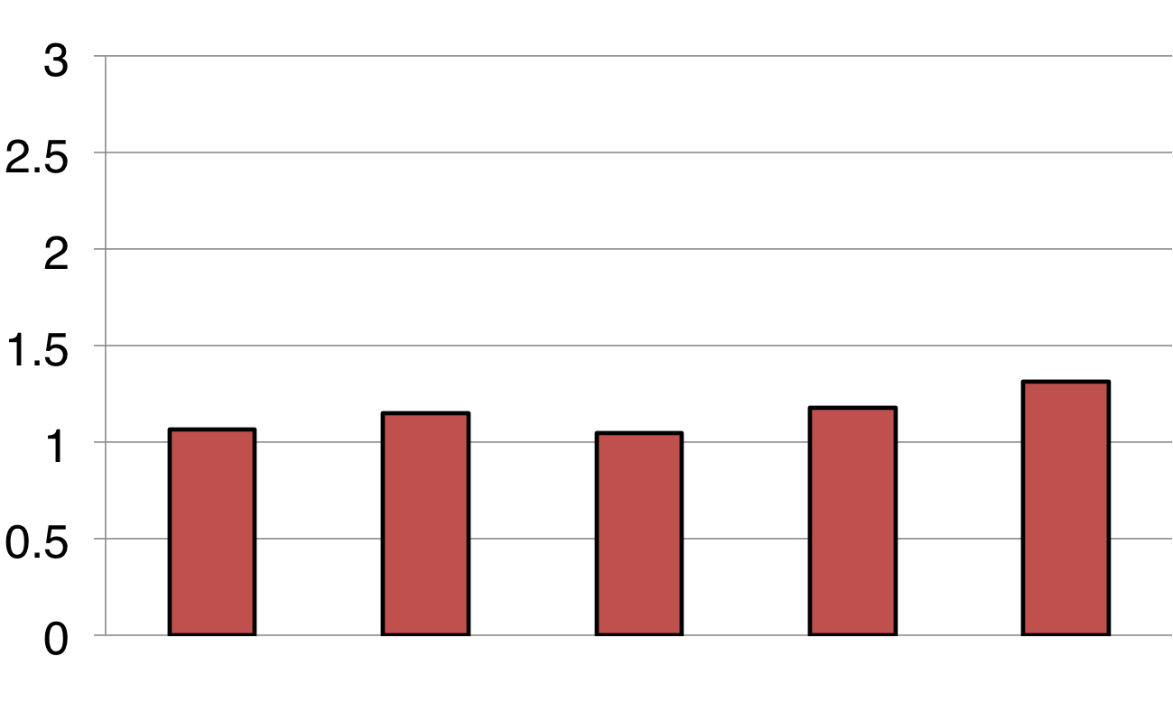

Single Pass Execution
Query Execution
Response Time (s)

Slide 56
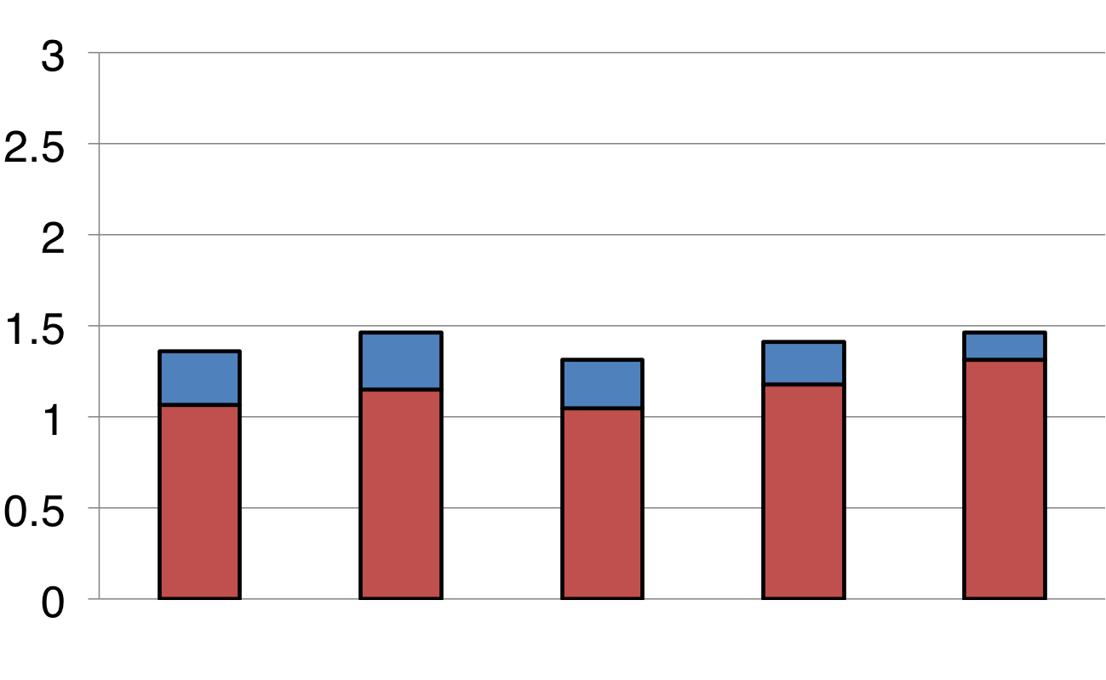
Single Pass Execution
Error Estimation
Overhead
Response Time (s)

Slide 57
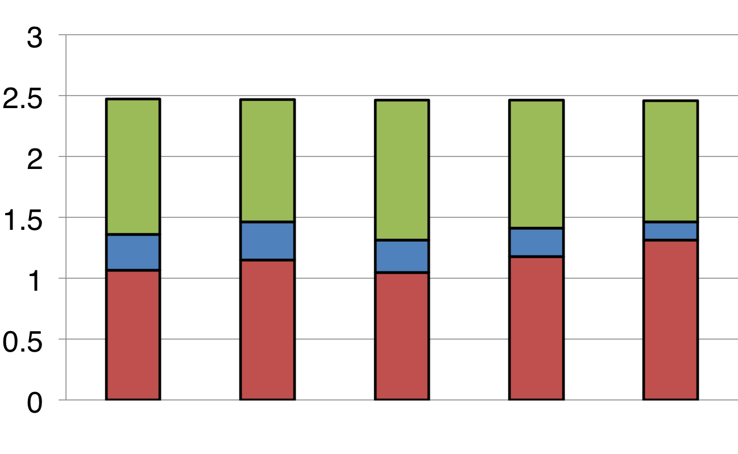
Single Pass Execution
Diagnostics
Overhead
Response Time (s)

Slide 58
BlinkDB Architecture
Command-line Shell
Thrift/JDBC
Meta
store
Driver
SQL Parser
Query Optimizer
Physical Plan
SerDes, UDFs
Execution
Hadoop/Spark/Presto
Hadoop Storage (e.g., HDFS, Hbase, Presto)

Slide 59
Getting Started
Alpha 0.1.1 released and available at http://blinkdb.org
Allows you to create random and stratified samples on native tables and materialized views
Adds approximate aggregate functions with statistical closed forms to HiveQL
Compatible with Apache Hive, AMP Lab’s Shark and Facebook’s Presto (storage, serdes, UDFs, types, metadata)

Slide 60
Feature Roadmap
Support a majority of Hive Aggregates and User-Defined Functions
Runtime Correctness Tests
Integrating BlinkDB with Shark and Facebook’s Presto as an experimental feature
Automatic Sample Management
Streaming Support

Slide 61
Summary
Approximate queries is an important means to achieve interactivity in processing large datasets
BlinkDB..
approximate answers with error bars by executing queries on small samples of data
supports existing Hive/Shark/Presto queries
For more information, please check out our EuroSys 2013 (http://bit.ly/blinkdb-1) and KDD 2014 (http://bit.ly/blinkdb-2) papers
Thanks!

