Slide 1

Apache Flink
Kostas Tzoumas
Flink committer
co-founder, data Artisans
kostas@data-artisans.com
@kostas_tzoumas

Slide 2
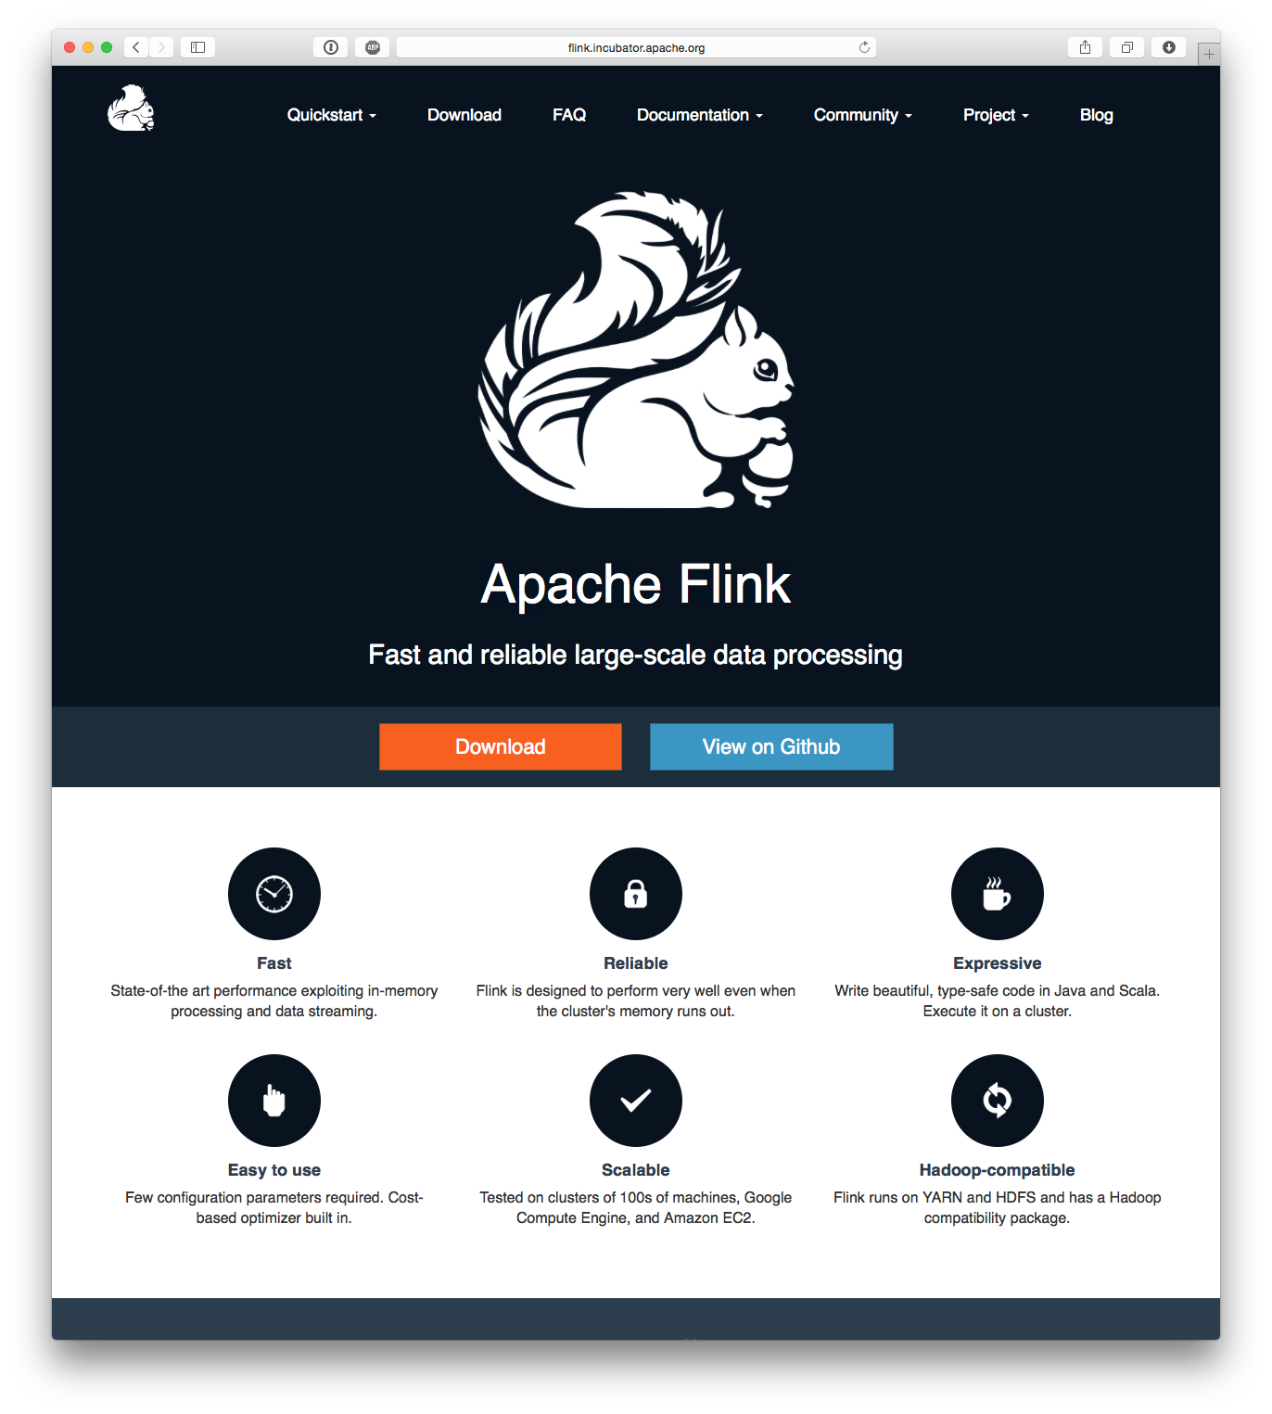
Apache Flink
flink.apache.org
github.com/apache/flink
user@flink.apache.org
Cool squirrel logo (also open source)

Slide 3
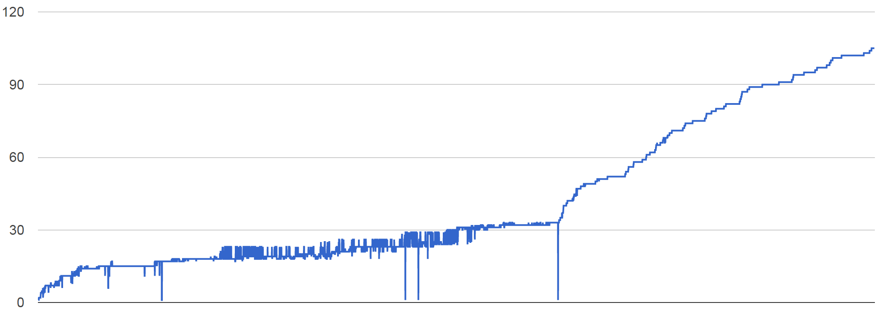
The Flink Community
Over 70 contributors from academia & industry; growing fast
Apache Top-Level Project since December

Slide 4

Using Flink

Slide 5
DataSet and transformations
Input
X
First
Y
Second
Operator X
Operator Y
ExecutionEnvironment env =
ExecutionEnvironment.getExecutionEnvironment();
DataSet<String> input = env.readTextFile(input);
DataSet<String> first = input
.filter (str -> str.contains(“Apache Flink“));
DataSet<String> second = first
.filter (str -> str.length() > 40);
second.print();
env.execute();

Slide 6
DataSet
Central notion of the programming API
Files and other data sources are read into DataSets
DataSet<String> text = env.readTextFile(…)
Transformations on DataSets produce DataSets
DataSet<String> first = text.map(…)
DataSets are printed to files or on stdout
first.writeAsCsv(…)
Execution is triggered with env.execute()

Slide 7
WordCount
text
.flatMap((line,out) -> {
String[] tokens = value.toLowerCase().split(“ “); for (String token : tokens) { if (token.length() > 0) { out.collect(new Tuple2<String, Integer>(token, 1)); } }
}) .groupBy(0) .sum(1);

Slide 8
Transitive Closure
IterativeDataSet<Tuple2<Long,Long>> paths = edges.iterate (10); DataSet<Tuple2<Long,Long>> nextPaths = paths .join(edges).where(1).equalTo(0) .with((left, right) -> return new Tuple2<Long, Long>(left.f0, right.f1);) .union(paths) .distinct(); DataSet<Tuple2<Long, Long>> tc = paths.closeWith(nextPaths);

Slide 9
Scala API
WordCount
text
.flatMap {line => line.split(" ").map(word => Word(word,1)}
.groupBy("word").sum("frequency")
Transitive Closure
case class Path (from: Long, to: Long)
val tc = edges.iterate(10) { paths: DataSet[Path] =>
val next = paths
.join(edges).where("to").equalTo("from") {
(path, edge) => Path(path.from, edge.to)
}
.union(paths).distinct()
next
}

Slide 10
Data sources
Batch API
Stream API
Files
HDFS, Local file system, MapR file system
Text, Csv, Avro, Hadoop input formats
JDBC
HBase
Collections
Files
Socket streams
Kafka
RabbitMQ
Flume
Collections
Implement your own
SourceFunction.collect

Slide 11
Available transformations
map
flatMap
filter
reduce
reduceGroup
join
coGroup
aggregate
cross
project
distinct
union
iterate
iterateDelta
repartition
…

Slide 12
Data types and grouping
public static class Access {
public int userId;
public String url;
...
}
public static class User {
public int userId;
public int region;
public Date customerSince;
...
}
DataSet<Tuple2<Access,User>> campaign = access.join(users)
.where(“userId“).equalTo(“userId“)
DataSet<Tuple3<Integer,String,String> someLog;
someLog.groupBy(0,1).reduceGroup(...);
Bean-style Java classes & field names
Tuples and position addressing
Any data type with key selector function

Slide 13
Real-time stream processing
DataStream instead of DataSet
StreamExecutionEnvironment instead of ExecutionEnvironment
StreamExecutionEnvironment env =
StreamExecutionEnvironment.getExecutionEnvironment();
DataStream<String> tweets = env.socketTextStream(host,port);
DataStream<Tuple2<String,Integer>> filteredTweets = tweets
.flatMap(new SelectLanguageAndTokenize())
.partition(0)
.map(s -> new Tuple2<String,Integer>(s, 1))
.groupBy(0).sum(1)
.flatMap(new SelectMaxOccurence());
tweets.print();
env.execute();

Slide 14
Streaming operators
Most DataSet operators can be used
map, filter, flatMap, reduce, reduceGroup, join, cross, coGroup, iterate, project, grouping, partitioning, aggregations, union (merge), …
DataStream-specific operators (snip)
CoMap, CoReduce, etc: share state between streams
Temporal binary ops: join, cross, …
Windows: policy-based flexible windowing
Time, Count, Delta

Slide 15
Windowing
Trigger policy
When to trigger the computation on current window
Eviction policy
When data points should leave the window
Defines window width/size
E.g., count-based policy
evict when #elements > n
start a new window every n-th element
Built-in: Count, Time, Delta policies

Slide 16
Windowing example
//Build new model every minute on the last 5 minutes
//worth of data
val model = trainingData
.window(Time.of(5,TimeUnit.MINUTES))
.every(Time.of(1,TimeUnit.MINUTES))
.reduceGroup(buildModel)
//Predict new data using the most up-to-date model
val prediction = newData
.connect(model)
.map(predict);
Training Data
M
New Data
P
Prediction

Slide 17
Window Join example
case class Name(id: Long, name: String)
case class Age(id: Long, age: Int)
case class Person(name: String, age: Int)
val names = ...
val ages = ...
names.join(ages)
.onWindow(5, TimeUnit.SECONDS)
.where("id")
.equalTo("id") {(n, a) => Person(n.name, a.age)}

Slide 18
Iterative processing example
val env = StreamExecutionEnvironment.getExecutionEnvironment
env.generateSequence(1, 10).iterate(incrementToTen, 1000)
.print
env.execute("Iterative example")
def incrementToTen(input: DataStream[Long]) = {
val incremented = input.map {_ + 1}
val split = incremented.split
{x => if (x >= 10) "out" else "feedback"}
(split.select("feedback"), split.select("out"))
}
Number stream
Map
“out”
Output stream
Reduce
“feedback”

Slide 19
Spargel: Flink’s Graph API
DataSet<Tuple2<Long, Long>> result = vertices
.runOperation(VertexCentricIteration.withPlainEdges(
edges, new CCUpdater(), new CCMessager(), 100));
class CCUpdater extends VertexUpdateFunction …
class CCMessenger extends MessagingFunction …
Spargel is a very thin layer (~500 LOC) on top of Flink’s delta iterations

Slide 20
Other API elements & tools
Accumulators and counters
Int, Long, Double counters
Histogram accumulator
Define your own
Broadcast variables
Plan visualization
Local debugging/testing mode

Slide 21
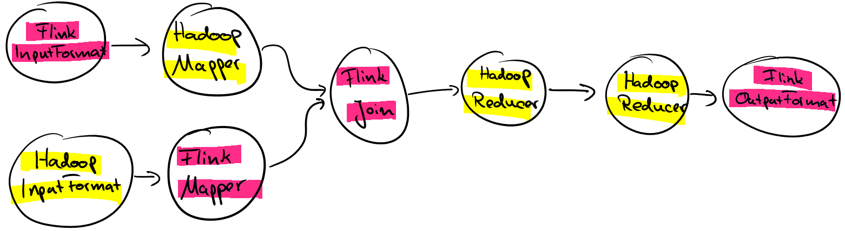
Hadoop Compatibility
Flink runs on YARN, can read from HDFS, HBase
Can use all Hadoop input and output formats
Can use unmodified Hadoop Mappers and Reducers and mix-and-match them with Flink operators
Coming up: can run unmodified Hadoop jobs (faster)

Slide 22
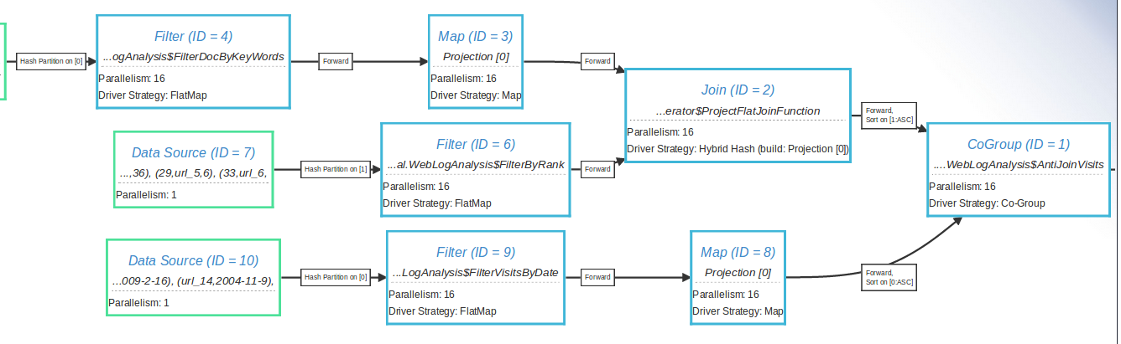
Visualization tools

Slide 23
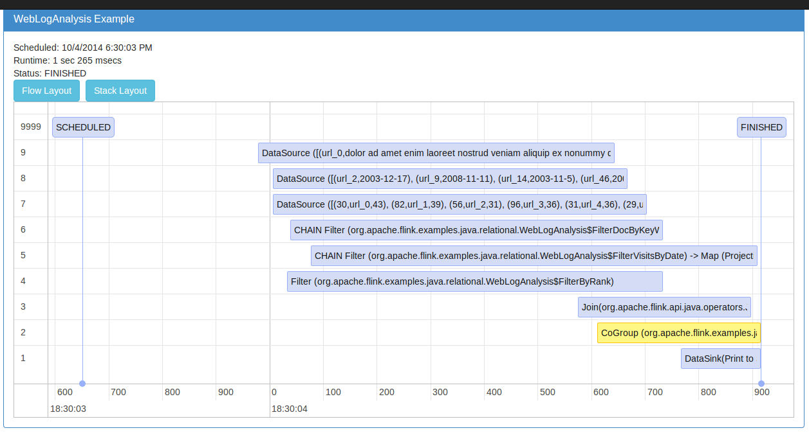
Visualization tools

Slide 24
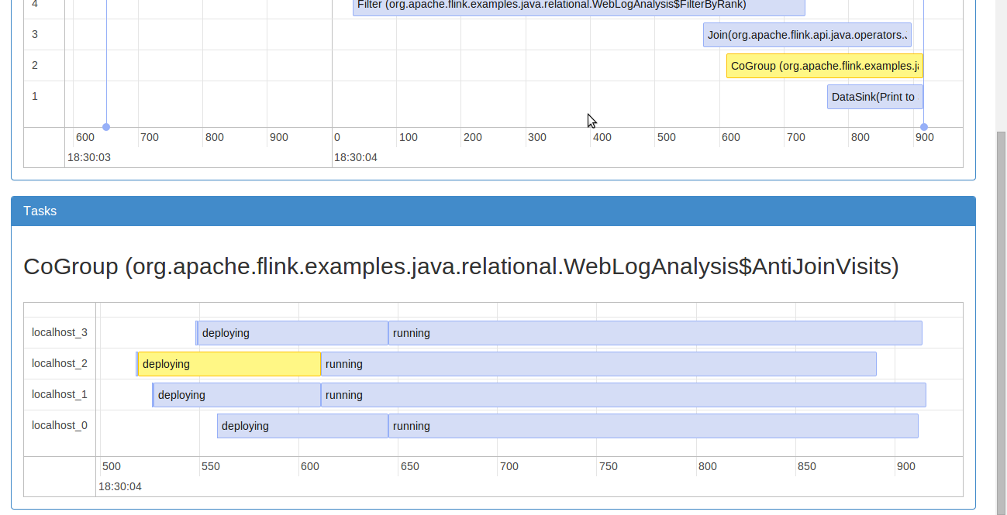
Visualization tools

Slide 25
Flink runtime features

Slide 26

DataSet<String> text = env.readTextFile(input);
DataSet<Tuple2<String, Integer>> result = text
.flatMap((str, out) -> {
for (String token : value.split("\\W")) {
out.collect(new Tuple2<>(token, 1));
})
.groupBy(0)
.aggregate(SUM, 1);
O, 1
Romeo, 3
wherefore, 1
art, 1
thou, 1
Task Manager
O Romeo, Romeo, wherefore art thou Romeo?
Flink Client & Optimizer
Job Manager
nor, 3
arm, 1
face, 1,
any, 1,
other, 1
part, 1
Task Manager
Nor arm, nor face, nor any other part
Apache Flink

Slide 27
If you need to know one thing about Flink is that you don’t need to know the internals of Flink.

Slide 28
Philosophy
Flink “hides” its internal workings from the user
This is good
User does not worry about how jobs are executed
Internals can be changed without breaking changes
… and bad
Execution model more complicated to explain compared to MapReduce or Spark RDD

Slide 29
Recap: DataSet
Input
X
First
Y
Second
Operator X
Operator Y
ExecutionEnvironment env =
ExecutionEnvironment.getExecutionEnvironment();
DataSet<String> input = env.readTextFile(input);
DataSet<String> first = input
.filter (str -> str.contains(“Apache Flink“));
DataSet<String> second = first
.filter (str -> str.length() > 40);
second.print()
env.execute();

Slide 30
Common misconception
Input
X
First
Y
Second
Programs are not executed eagerly
Instead, system compiles program to an execution plan and executes that plan

Slide 31
DataSet<String>
Think of it as a PCollection<String>, or a Spark RDD[String]
With a major difference: it can be produced/recovered in several ways
… like a Java collection
… like an RDD
… perhaps it is never fully materialized (because the program does not need it to)
… implicitly updated in an iteration
And this is transparent to the user

Slide 32
Example: grep
Search for str1
Grep 1
Romeo, Romeo, where art thou Romeo?
Load
Log
Search for str2
Grep 2
Search for str3
Grep 3

Slide 33


Staged (batch) execution
Subseqent stages:
Grep log for matches
Stage 1:
Create/cache Log
Search for str1
Grep 1
Romeo, Romeo, where art thou Romeo?
Load
Log
Search for str2
Grep 2
Search for str3
Grep 3
Caching in-memory and disk if needed

Slide 34
Pipelined execution
Stage 1:
Deploy and start operators
Note: Log DataSet is never “created”!
Search for str1
Grep 1
Romeo, Romeo, where art thou Romeo?
00110011
00110011
00110011
Load
Log
Search for str2
Grep 2
Search for str3
Grep 3
Data transfer in-memory and disk if needed

Slide 35
Benefits of pipelining
25 node cluster
Grep log for 3 terms
Scale data size from 100GB to 1TB
Time to complete grep (sec)
Staged execution with Spark
Pipelined with Flink
Cluster memory
exceeded
Data size (GB)

Slide 36
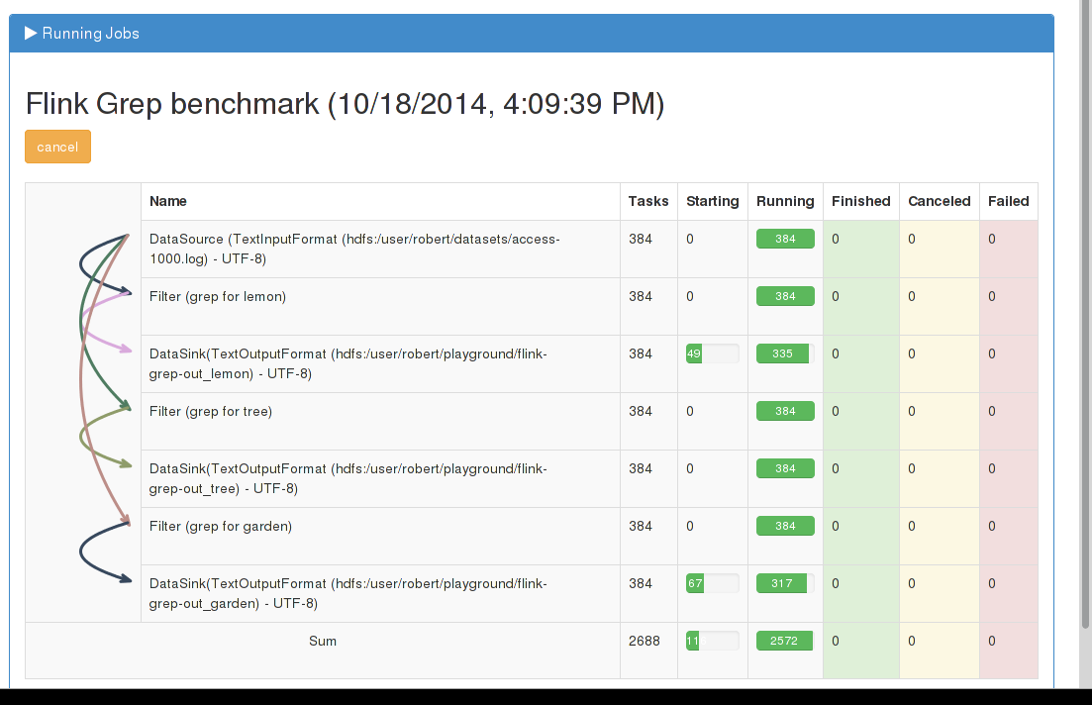

Slide 37
Drawbacks of pipelining
Long pipelines may be active at the same time leading to memory fragmentation
FLINK-1101: Changes memory allocation from static to adaptive
Fault-tolerance harder to get right
FLINK-986: Adds intermediate data sets (similar to RDDS) as first-class citizen to Flink Runtime. Will lead to fine-grained fault-tolerance among other features.

Slide 38
Example: Iterative processing
DataSet<Page> pages = ...
DataSet<Neighborhood> edges = ...
DataSet<Page> oldRanks = pages; DataSet<Page> newRanks;
for (i = 0; i < maxIterations; i++) {
newRanks = update(oldRanks, edges)
oldRanks = newRanks
}
DataSet<Page> result = newRanks;
DataSet<Page> update (DataSet<Page> ranks, DataSet<Neighborhood> adjacency) {
return oldRanks
.join(adjacency)
.where(“id“).equalTo(“id“)
.with ( (page, adj, out) -> {
for (long n : adj.neighbors)
out.collect(new Page(n, df * page.rank / adj.neighbors.length))
})
.groupBy(“id“)
.reduce ( (a, b) -> new Page(a.id, a.rank + b.rank) );

Slide 39



Iterate by unrolling
Client
Step
Step
Step
Step
Step
for/while loop in client submits one job per iteration step
Data reuse by caching in memory and/or disk

Slide 40
Iterate natively
DataSet<Page> pages = ...
DataSet<Neighborhood> edges = ...
IterativeDataSet<Page> pagesIter = pages.iterate(maxIterations);
DataSet<Page> newRanks = update (pagesIter, edges);
DataSet<Page> result = pagesIter.closeWith(newRanks)

Slide 41
Iterate natively with deltas
DeltaIteration<...> pagesIter = pages.iterateDelta(initialDeltas, maxIterations, 0);
DataSet<...> newRanks = update (pagesIter, edges);
DataSet<...> newRanks = ...
DataSet<...> result = pagesIter.closeWith(newRanks, deltas)
See http://data-artisans.com/data-analysis-with-flink.html

Slide 42
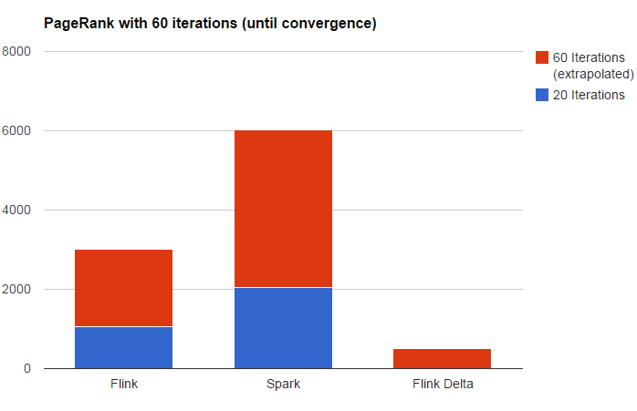
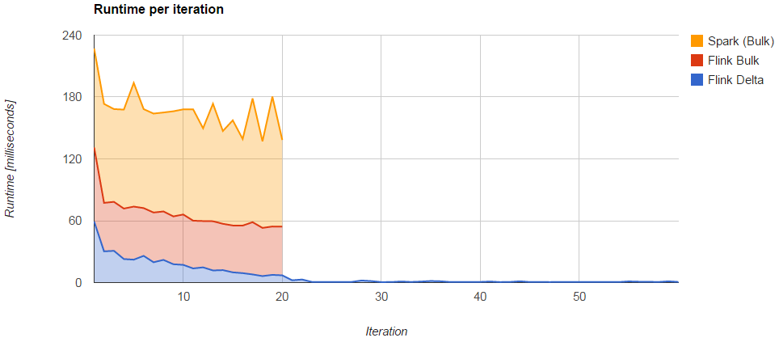
Native, unrolling, and delta

Slide 43
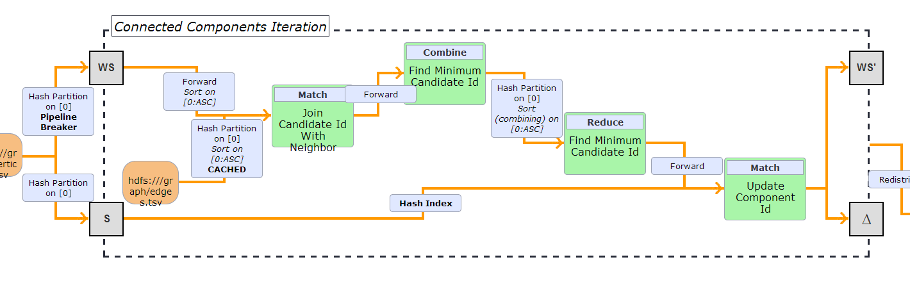
Optimization of iterative algorithms
Pushing work „out of the loop“
Maintain state as index
Caching Loop-invariant Data

Slide 44
Dissecting
Flink

Slide 45


Slide 46
The growing Flink stack
Python API
(upcoming)
Graph API
Apache
MRQL
Scala API
Java API
Common API
Flink Optimizer
Flink Stream Builder
Flink Local Runtime
Embedded
environment
(Java collections)
Local
Environment
(for debugging)
Remote environment
(Regular cluster execution)
Apache Tez
Single node execution
Standalone or YARN cluster
Data
storage
Files
HDFS
S3
JDBC
Azure
tables
Kafka
Rabbit MQ
Redis
…

Slide 47
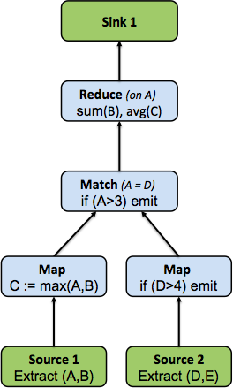
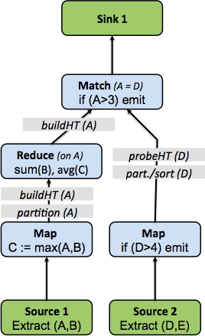
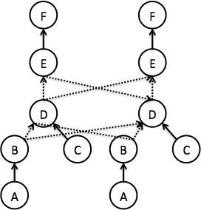
Program lifecycle
val source1 = …
val source2 = …
val maxed = source1
.map(v => (v._1,v._2,
math.max(v._1,v._2))
val filtered = source2
.filter(v => (v._1 > 4))
val result = maxed
.join(filtered).where(0).equalTo(0)
.filter(_1 > 3)
.groupBy(0)
.reduceGroup {……}
1
2
3
4
5

Slide 48
Flink Optimizer
The optimizer is the component that selects an execution plan for a Common API program
Think of an AI system manipulating your program for you ☺
But don’t be scared – it works
Relational databases have been doing this for decades – Flink ports the technology to API-based systems

Slide 49
A simple program
DataSet<Tuple5<Integer, String, String, String, Integer>> orders = …
DataSet<Tuple2<Integer, Double>> lineitems = … DataSet<Tuple2<Integer, Integer>> filteredOrders = orders
.filter(. . .)
.project(0,4).types(Integer.class, Integer.class); DataSet<Tuple3<Integer, Integer, Double>> lineitemsOfOrders = filteredOrders
.join(lineitems) .where(0).equalTo(0) .projectFirst(0,1).projectSecond(1) .types(Integer.class, Integer.class, Double.class); DataSet<Tuple3<Integer, Integer, Double>> priceSums = lineitemsOfOrders
.groupBy(0,1).aggregate(Aggregations.SUM, 2); priceSums.writeAsCsv(outputPath);

Slide 50
Two execution plans
GroupRed
GroupRed
sort
sort
hash-part [0,1]
Combine
Best plan
depends on
relative sizes of input files
forward
Join
Hybrid Hash
Join
Hybrid Hash
buildHT
probe
buildHT
probe
broadcast
forward
hash-part [0]
hash-part [0]
Map
DataSource
lineitem.tbl
Map
DataSource
lineitem.tbl
Filter
Filter
DataSource
orders.tbl
DataSource
orders.tbl

Slide 51
Flink Local Runtime
Local runtime, not the distributed execution engine
Aka: what happens inside every parallel task

Slide 52
Flink runtime operators
Sorting and hashing data
Necessary for grouping, aggregation, reduce, join, cogroup, delta iterations
Flink contains tailored implementations of hybrid hashing and external sorting in Java
Scale well with both abundant and restricted memory sizes

Slide 53
Internal data representation
How is intermediate data internally represented?
JVM Heap
JVM Heap
reduce
O Romeo, Romeo, wherefore art thou Romeo?
map
art, 1
O, 1
Romeo, 1
Romeo, 1
Local sort
00110011
00010111
01110001
01111010
00010111
00110011
00110011
Network transfer

Slide 54
Internal data representation
Two options: Java objects or raw bytes
Java objects
Easier to program
Can suffer from GC overhead
Hard to de-stage data to disk, may suffer from “out of memory exceptions”
Raw bytes
Harder to program (customer serialization stack, more involved runtime operators)
Solves most of memory and GC problems
Overhead from object (de)serialization
Flink follows the raw byte approach

Slide 55
Memory in Flink
JVM Heap
User code objects
Unmanaged
heap
public class WC {
public String word;
public int count;
}
Sorting, hashing, caching
Managed
heap
empty
page
Network
buffers
Shuffling, broadcasts
Pool of Memory Pages

Slide 56
Memory in Flink (2)
Internal memory management
Flink initially allocates 70% of the free heap as byte[] segments
Internal operators allocate() and release() these segments
Flink has its own serialization stack
All accepted data types serialized to data segments
Easy to reason about memory, (almost) no OutOfMemory errors, reduces the pressure to the GC (smooth performance)

Slide 57
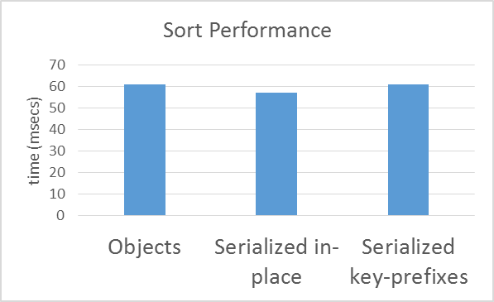
Operating on serialized data
Microbenchmark
Sorting 1GB worth of (long, double) tuples
67,108,864 elements
Simple quicksort

Slide 58
Flink distributed execution
Pipelined
Same engine for Flink and Flink streaming
Pluggable
Local runtime can be executed on other engines
E.g., Java collections and Apache Tez
Coordination built on Akka library

Slide 59
Streaming overview
Streaming and batch use same code paths in runtime
Differences
Streaming does not use Flink’s memory management right now
Streaming uses its own compiler/optimizer

Slide 60
Roadmap

Slide 61
Flink Roadmap
Currently being discussed by the Flink community
Flink has a major release every 3 months, and one or more bug-fixing releases between major releases
Caveat: rough roadmap, depends on volunteer work, outcome of community discussion, and Apache open source processes

Slide 62
Roadmap for 2015 (highlights)
 | Q1 |  | Q2 |  | Q3
APIs | Logical Query integration | Additional operators | Interactive programs | Interactive Scala shell | SQL-on-Flink
Optimizer | Semantic annotations |  | HCatalog integration | Optimizer hints
Runtime | Dual engine (blocking & pipelining) | Fine-grained fault tolerance |  | Dynamic memory allocation
Streaming | Better memory management | More operators in API | At-least-once processing guarantees | Unify batch and streaming | Exactly-once processing guarantees
ML library | First version |  | Additional algorithms | Mahout integration
Graph library | First version
Integration | Tez, Samoa |  |  | Mahout

Slide 63
Dual streaming and batch engine
Runtime will support
Current pipelined execution mode
Blocking (RDD-like) execution
Batch programs use a combination
Stream programs use pipelining
Interactive programs need blocking
Expected Q1 2015
 | Blocking runtime execution | Pipelined runtime execution
Batch API (DataSet) | ✔ | ✔
Stream API (DataStream) |  | ✔

Slide 64
Fault tolerance improvements
Fine-grained fault tolerance for batch programs
Currently lineage goes back to sources unless user explicitly persists intermediate data set
In the future replay will restart from automatically checkpointed intermediate data set
Expected Q1 2015

Slide 65
Streaming fault tolerance
At-least-once guarantees
Reset of operator state
Source in-memory replication
Expected Q1 2015
Exactly-once guarantees
Checkpoint operator state
Rest similar to batch fine-grained recovery
Expected Q2 2015

Slide 66
Interactive programs & shells
Support interactive ad-hoc data analysis
Programs that are executed partially in the cluster and partially in the client
Needs same runtime code as fine-grained batch fault tolerance
Expected Q1 2015
Interactive Scala shell
Needs to transfer class files between shell and master
Expected Q2 2015
Want to contribute?

Slide 67
Machine Learning
Machine learning capabilities on Flink will stand on two legs
Dedicated Machine Learning library
Optimized algorithms
First version (with infrastructure code, ALS, k-means, logistic regression) open for contributions in Q1 2015
Mahout linear algebra DSL integration
Expected Q2 2015

Slide 68
Graph Library
Codename “Gelly”
Library with graph operations
Common graph stats, PageRank, SSSP, Connected Components, label propagation
Vertex-centric API
Gather-apply-scatter API
Expected Q1 2015

Slide 69
Logical Query Integration
DataSet<Row> dates = env.readCsv(...).as("order_id", "date");
dates.filter("date < 2010-7-14")
.join(other).where("order_id").equalto("id");
Define queries in SQL style inside Scala/Java similar to Microsoft LINQ
Expected Q1 2015

Slide 70
SQL on Flink
Allow HiveQL queries to run on Flink directly, both standalone and embedded in batch programs
Approach: translate SQL to Logical Query Interface
Hey, Flink already has an optimizer ☺
Currently in design phase
Expected Q3/Q4 2015

Slide 71
Integration with other projects
Apache Tez
Expected Q1 2015
Apache Mahout
Expected Q2 2015
Tachyon
Basic integration available, waiting for Tachyon API
Apache Zepelin (inc.)
Interest from both communities
Apache Samoa (inc.)
Expected Q1 2015
Interest from both communities
H2O
In consideration
Apache Hive
Expected Q3/Q4 2015

Slide 72
And many more…
Runtime: even better performance and robustness
Using off-heap memory, dynamic memory allocation
Improvements to the Flink optimizer
Integration with HCatalog, better statistics
Runtime optimization
Streaming graph and ML pipeline libraries

Slide 73
Closing

Slide 74
Stay informed
flink. apache.org
Subscribe to the mailing lists!
http://flink.apache.org/community.html#mailing-lists
Blogs
flink.apache.org/blog
data-artisans.com/blog
Twitter
follow @ApacheFlink

Slide 75
flink.apache.org

