Slide 1


Stream processing with Apache Flink™
Kostas Tzoumas
@kostas_tzoumas

Slide 2
The rise of stream processing

Slide 3
Why streaming
Data availability
Streaming
- Which data?
- When?
- Who?
- Some schema
- Ingestion rate
- Programmable
Batch
- Some schema
- Load rate
- Programmable
Data
Warehouse
- Strict schema
- Load rate
- BI access
2000
2008
2015

Slide 4
What does streaming enable?
1. Data integration
2. Low latency applications
Fresh recommendations, fraud detection, etc
Internet of Things, intelligent manufacturing
Results “right here, right now”
cf. Kleppmann: "Turning the DB inside out with Samza"
3. Batch < Streaming

Slide 5
New stack next to/inside Hadoop
High-latency apps
Low-latency apps
Batch processors
Stream processors
Files
Event streams

Slide 6
Streaming data architectures

Slide 7


Stream platform architecture
Server
logs
Upstream
systems
Trxn
logs
Sensor
logs
Gather and backup streams
Offer streams for consumption
Provide stream recovery
Analyze and correlate streams
Create derived streams and state
Provide these to upstream systems
Notes:
What are the technologies that enable streaming? The open source leaders in this space is Apache Kafka (that solves the integration problem), and Apache Flink (that solves the analytics problem, removing the final barrier). Kafka and Flink combined can remove the batch barriers from the infrastructure, creating a truly real-time analytics platform.

Slide 8
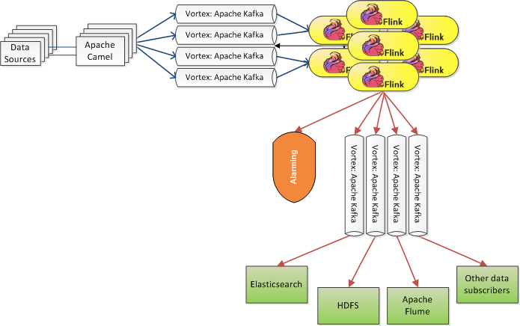

Example: Bouygues Telecom

Slide 9
Apache Flink primer

Slide 10
What is Flink
Zeppelin
Storm (WiP)
Cascading (WiP)
Table
Dataflow (WiP)
Gelly
MRQL
SAMOA
Table
ML
Hadoop M/R
Dataflow
DataSet (Java/Scala)
DataStream (Java/Scala)
Streaming dataflow runtime
Embedded
Tez
Local
Cluster
Yarn

Slide 11
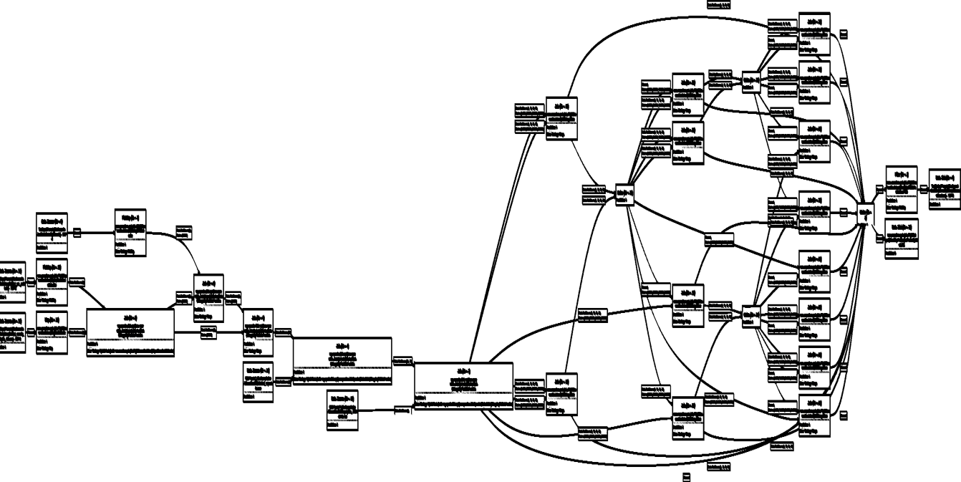
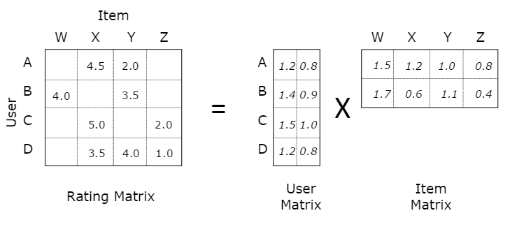
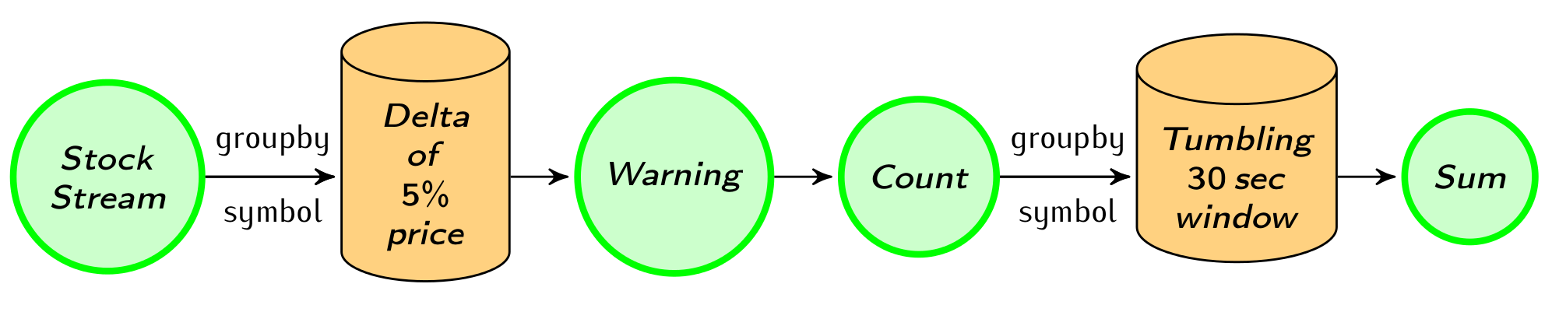
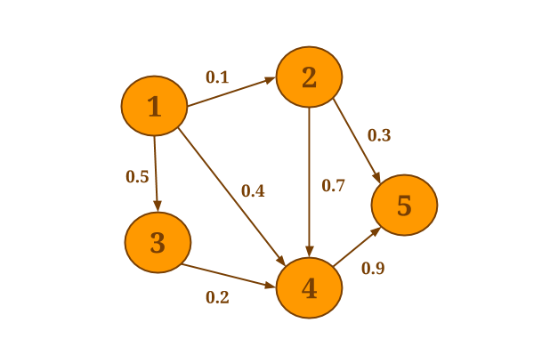
Motivation for Flink
Batch
processing
Machine Learning at scale
Stream
processing
Graph Analysis
Flink
An engine that can natively support all these workloads.

Slide 12
Stream processing in Flink

Slide 13
What is a stream processor?
Pipelining
Stream replay
Operator state
Backup and restore
High-level APIs
Integration with batch
High availability
Scale-in and scale-out
Basics
State
App development
Large deployments
See http://data-artisans.com/stream-processing-with-flink.html

Slide 14
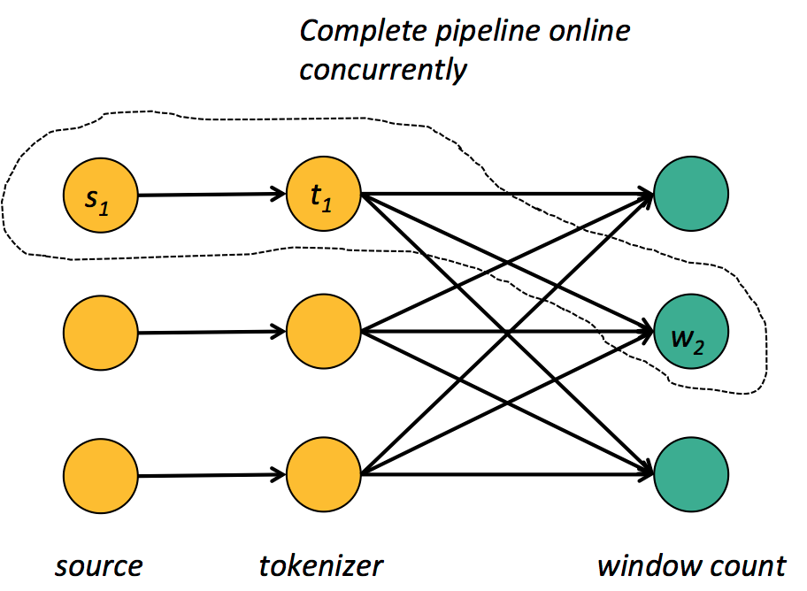
Pipelining
Basic building block to “keep the data moving”
Note: pipelined systems do not usually transfer individual tuples, but buffers that batch several tuples!

Slide 15
Operator state
User-defined state
Flink transformations (map/reduce/etc) are long-running operators, feel free to keep around objects
Hooks to include in system's checkpoint
Windowed streams
Time, count, data-driven windows
Managed by the system (currently WiP)
Managed state (WiP)
State interface for operators
Backed up and restored by the system with pluggable state backend (HDFS, Ignite, Cassandra, …)

Slide 16
Streaming fault tolerance
Ensure that operators see all events
“At least once”
Solved by replaying a stream from a checkpoint, e.g., from a past Kafka offset
Ensure that operators do not perform duplicate updates to their state
“Exactly once”
Several solutions

Slide 17
Exactly once approaches
Discretized streams (Spark Streaming)
Treat streaming as a series of small atomic computations
“Fast track” to fault tolerance, but does not separate business logic from recovery
MillWheel (Google Cloud Dataflow)
State update and derived events committed as atomic transaction to a high-throughput transactional store
Needs a very high-throughput transactional store ☺
Chandy-Lamport distributed snapshots (Flink)

Slide 18
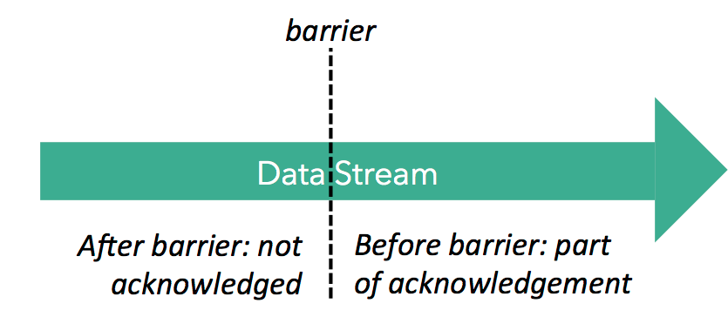
Distributed snapshots in Flink
Super-impose checkpointing mechanism on execution instead of using execution as the checkpointing mechanism

Slide 19
JobManager
Register checkpoint
barrier on master
Replay will start from here

Slide 20
JobManager
Barriers “push” prior events (assumes in-order delivery in individual channels)
Operator checkpointing starting
Operator checkpointing in progress
Operator checkpointing finished

Slide 21
Pluggable mechanism. Currently either JobManager (for small state) or file system (HDFS/Tachyon). WiP for in-memory grids
JobManager
Operator checkpointing takes snapshot of state after data prior to barrier have updated the state. Checkpoints currently one-off and synchronous, WiP for incremental and asynchronous
State backup

Slide 22
JobManager
Operators with many inputs need to wait for all barriers to pass before they checkpoint their state

Slide 23
JobManager
State backup
State snapshots at sinks signal successful end of this checkpoint
At failure, recover last checkpointed state and restart sources from last barrier guarantees at least once

Slide 24
Benefits of Flink’s approach
Data processing does not block
Can checkpoint at any interval you like to balance overhead/recovery time
Separates business logic from recovery
Checkpointing interval is a config parameter, not a variable in the program (as in discretization)
Can support richer windows
Session windows, event time, etc
Best of all worlds: true streaming latency, exactly-once semantics, and low overhead for recovery

Slide 25
DataStream API
case class Word (word: String, frequency: Int)
DataSet API (batch):
val lines: DataSet[String] = env.readTextFile(...)
lines.flatMap {line => line.split(" ")
.map(word => Word(word,1))}
.groupBy("word").sum("frequency")
.print()
DataStream API (streaming):
val lines: DataStream[String] = env.fromSocketStream(...)
lines.flatMap {line => line.split(" ")
.map(word => Word(word,1))}
.window(Time.of(5,SECONDS)).every(Time.of(1,SECONDS))
.groupBy("word").sum("frequency")
.print()

Slide 26
Roadmap
Short-term (3-6 months)
Graduate DataStream API from beta
Fully managed window and user-defined state with pluggable backends
Table API for streams (towards StreamSQL)
Long-term (6+ months)
Highly available master
Dynamic scale in/out
FlinkML and Gelly for streams
Full batch + stream unification

Slide 27
Closing

Slide 28
tl;dr: what was this about?
Streaming is the next logical step in data infrastructure
Many new "fast data" platforms are being built next to or inside Hadoop – will need a stream processor
The case for Flink as a stream processor
Proper engine foundation
Attractive APIs and libraries
Integration with batch
Large (and growing!) community

Slide 29
Apache Flink: community
One of the most active big data projects after one year in the Apache Software Foundation
Notes:
Other data points
Google (cloud dataflow)
Hortonworks
Cloudera
Adatao
Concurrent
Confluent
We have been part of this open source movement with Apache Flink. Flink is a streaming dataflow engine that can run in Hadoop clusters. Flink has grown a lot over the past year both in terms of code and community. We have added domain-specific libraries, a streaming API with streaming backend support, etc, etc. Tremendous growth. Flink has also grown in community. The project is by now a very established Apache project, it has more than 140 contributors (placing it at the top 5 of Apache big data projects), and several companies are starting to experiment with it. At data Artisans we are supporting two production installations (ResearchGate and Bouygues Telecom), and are helping a number of companies that are testing Flink (e.g., Spotify, King.com, Amadeus, and a group at Yahoo). Huawei and Intel have started contributing to Flink, and interest in vendors is picking up (e.g., Adatao, Huawei, Hadoop vendors). All of this is the result of purely organic growth with very little marketing investment from data Artisans.

Slide 30
I Flink, do you? ☺
If you find this exciting,
get involved and start a discussion on Flink‘s mailing list,
or stay tuned by
subscribing to news@flink.apache.org,
following flink.apache.org/blog, and
@ApacheFlink on Twitter

Slide 31

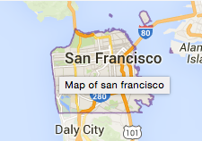

flink-forward.org
Spark & Friends meetup
June 16
Bay Area Flink meetup
June 17

