Slide 1



Hands on Apache Flink
How to run, debug and speed up
Flink applications
Robert Metzger
rmetzger@apache.org
@rmetzger_

Slide 2
This talk
Frequently asked questions + their answers
An overview over the tooling in Flink
An outlook into the future
Notes:
My goal: Everybody finds a new, useful feature of flink in this talk!

Slide 3
“One week of trials and errors can save up to half an hour of reading the documentation.”
– Paris Hilton

Slide 4
Write and test your JOB
The first step

Slide 5
Get started with an empty project
Generate a skeleton project with Maven
you can also put “quickstart-scala” here
mvn archetype:generate /
-DarchetypeGroupId=org.apache.flink /
-DarchetypeArtifactId=flink-quickstart-java /
-DarchetypeVersion=0.9-SNAPSHOT
or “0.8.1”
No need for manually downloading any .tgz or .jar files for now
Notes:
scripts, no typing required

Slide 6
Local Development
Start Flink in your IDE for local development & debugging.
final ExecutionEnvironment env =
ExecutionEnvironment.createLocalEnvironment();
Use our testing framework
@RunWith(Parameterized.class)
class YourTest extends MultipleProgramsTestBase {
@Test
public void testRunWithConfiguration(){
expectedResult = "1 11\n“;
}}

Slide 7
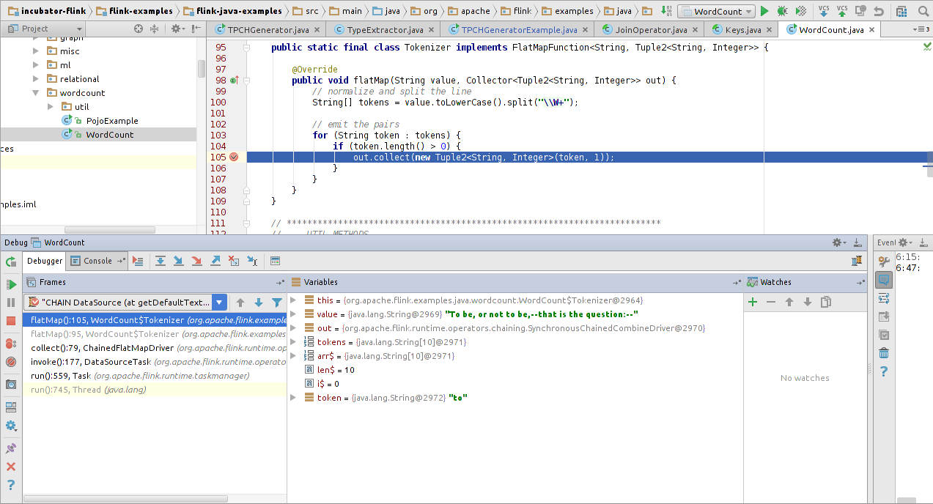
Debugging with the IDE

Slide 8
Run your JOB on a (FAKE) Cluster
Get your hands dirty

Slide 9
Got no cluster? – Renting options
Google Compute Engine [1]
Amazon EMR or any other cloud provider with preinstalled Hadoop YARN [2]
Install Flink yourself on the machines
./bdutil -e extensions/flink/flink_env.sh deploy
wget http://stratosphere-bin.amazonaws.com/flink-0.9-SNAPSHOT-bin-hadoop2.tgz
tar xvzf flink-0.9-SNAPSHOT-bin-hadoop2.tgz
cd flink-0.9-SNAPSHOT/
./bin/yarn-session.sh -n 4 -jm 1024 -tm 4096
[1] http://ci.apache.org/projects/flink/flink-docs-master/setup/gce_setup.html
[2] http://ci.apache.org/projects/flink/flink-docs-master/setup/yarn_setup.html
Notes:
An entire slide about cloud computing without having “cloud” on it

Slide 10
Got no money?
Listen closely to this talk and become a freelance “Big Data Consultant”
Start a cluster locally in the meantime
$ tar xzf flink-*.tgz
$ cd flink
$ bin/start-cluster.sh
Starting Job Manager
Starting task manager on host
$ jps
5158 JobManager
5262 TaskManager
Notes:
bin/start-cluster.sh is also the option for those with Flink “on premise”

Slide 11
assert hasCluster;
Submitting a job
/bin/flink (Command Line)
RemoteExecutionEnvironment
(From a local or remote java app)
Web Frontend (GUI)
Per job on YARN (Command Line, directly to YARN)
Scala Shell

Slide 12
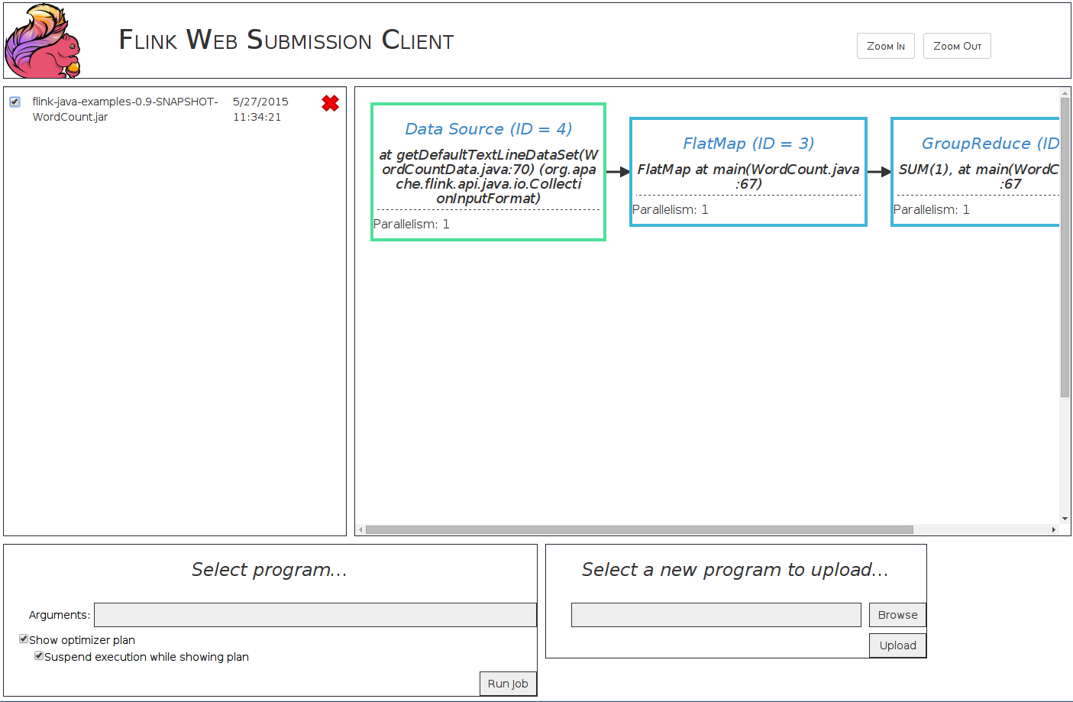
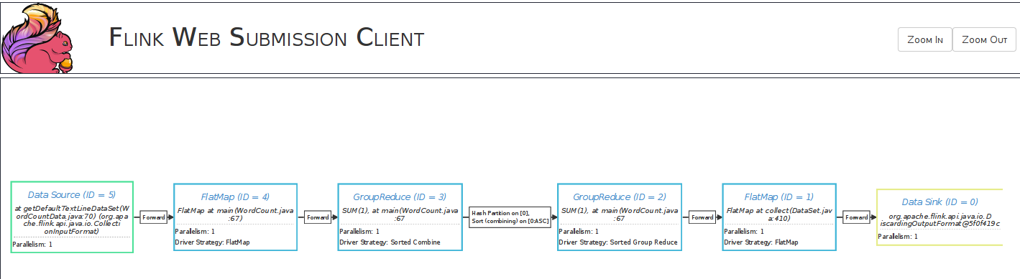
Web Frontends – Web Job Client
Select jobs and preview plan
Understand Optimizer choices

Slide 13
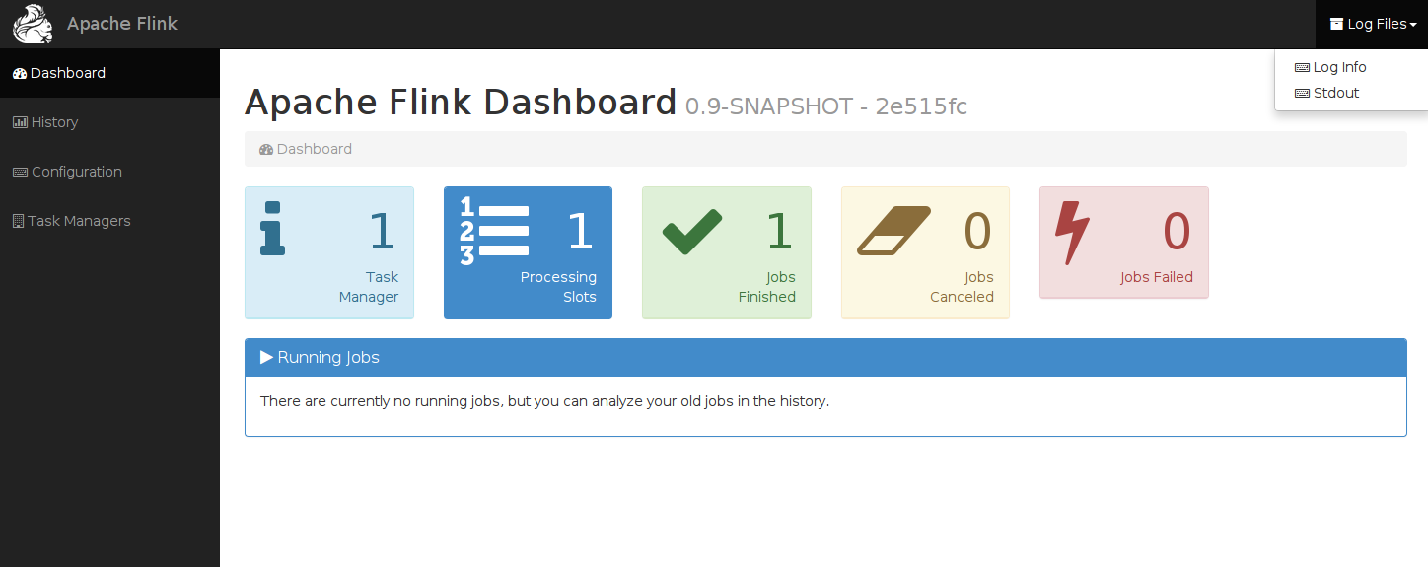
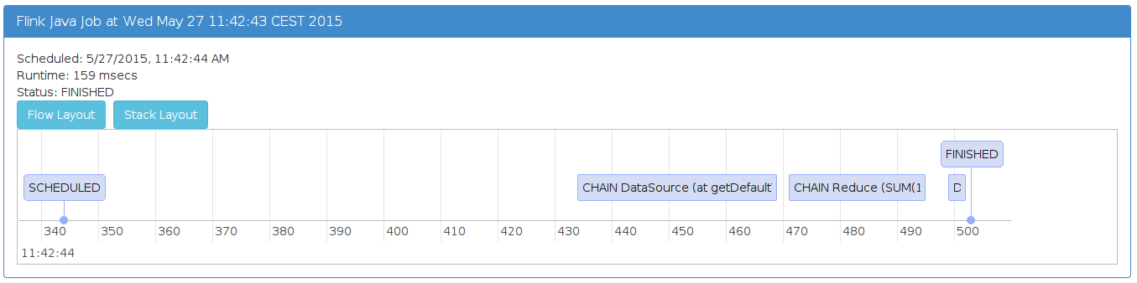
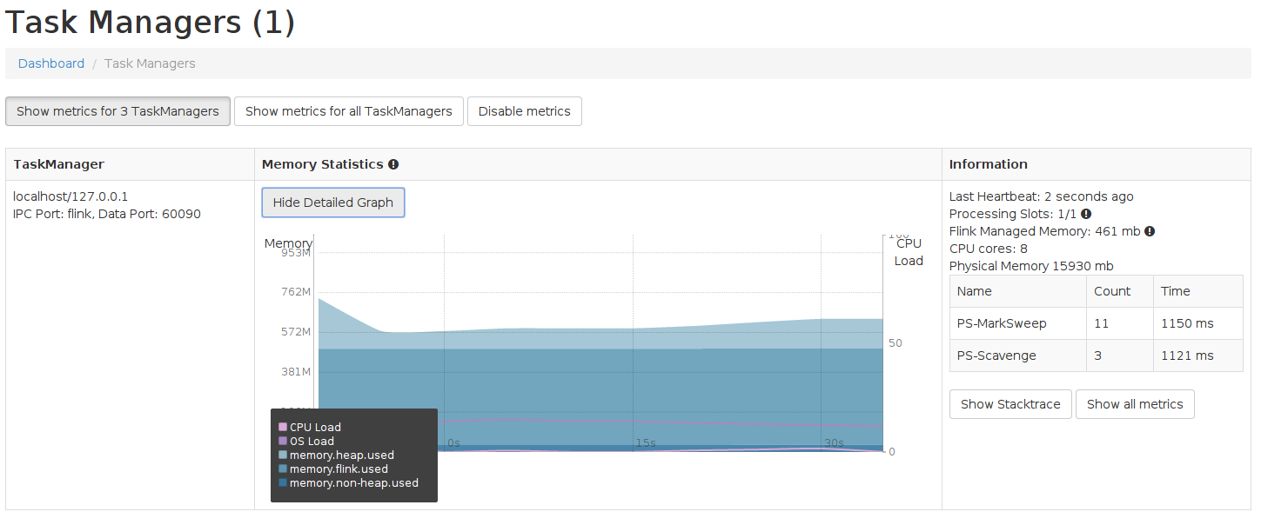
Web Frontends – Job Manager
Overall system status
Job execution details
Task Manager resource
utilization

Slide 14
Debugging on a cluster
Good old system out debugging
Get a logger
Start logging
You can also use System.out.println().
private static final Logger LOG = LoggerFactory.getLogger(YourJob.class);
LOG.info("elementCount = {}", elementCount);

Slide 15
Getting logs on a cluster
Non-YARN (=bare metal installation)
The logs are located in each TaskManager’s log/ directory.
ssh there and read the logs.
YARN
Make sure YARN log aggregation is enabled
Retrieve logs from YARN (once app is finished)
$ yarn logs -applicationId <application ID>

Slide 16
Flink Logs
Build Information
11:42:39,233 INFO org.apache.flink.runtime.jobmanager.JobManager - --------------------------------------------------------------------------------
11:42:39,233 INFO org.apache.flink.runtime.jobmanager.JobManager - Starting JobManager (Version: 0.9-SNAPSHOT, Rev:2e515fc, Date:27.05.2015 @ 11:24:23 CEST)
11:42:39,233 INFO org.apache.flink.runtime.jobmanager.JobManager - Current user: robert
11:42:39,233 INFO org.apache.flink.runtime.jobmanager.JobManager - JVM: OpenJDK 64-Bit Server VM - Oracle Corporation - 1.7/24.75-b04
11:42:39,233 INFO org.apache.flink.runtime.jobmanager.JobManager - Maximum heap size: 736 MiBytes
11:42:39,233 INFO org.apache.flink.runtime.jobmanager.JobManager - JAVA_HOME: (not set)
11:42:39,233 INFO org.apache.flink.runtime.jobmanager.JobManager - JVM Options:
11:42:39,233 INFO org.apache.flink.runtime.jobmanager.JobManager - -XX:MaxPermSize=256m
11:42:39,233 INFO org.apache.flink.runtime.jobmanager.JobManager - -Xms768m
11:42:39,233 INFO org.apache.flink.runtime.jobmanager.JobManager - -Xmx768m
11:42:39,233 INFO org.apache.flink.runtime.jobmanager.JobManager - -Dlog.file=/home/robert/incubator-flink/build-target/bin/../log/flink-robert-jobmanager-robert-da.log
11:42:39,233 INFO org.apache.flink.runtime.jobmanager.JobManager - -Dlog4j.configuration=file:/home/robert/incubator-flink/build-target/bin/../conf/log4j.properties
11:42:39,233 INFO org.apache.flink.runtime.jobmanager.JobManager - -Dlogback.configurationFile=file:/home/robert/incubator-flink/build-target/bin/../conf/logback.xml
11:42:39,233 INFO org.apache.flink.runtime.jobmanager.JobManager - Program Arguments:
11:42:39,233 INFO org.apache.flink.runtime.jobmanager.JobManager - --configDir
11:42:39,233 INFO org.apache.flink.runtime.jobmanager.JobManager - /home/robert/incubator-flink/build-target/bin/../conf
11:42:39,234 INFO org.apache.flink.runtime.jobmanager.JobManager - --executionMode
11:42:39,234 INFO org.apache.flink.runtime.jobmanager.JobManager - local
11:42:39,234 INFO org.apache.flink.runtime.jobmanager.JobManager - --streamingMode
11:42:39,234 INFO org.apache.flink.runtime.jobmanager.JobManager - batch
11:42:39,234 INFO org.apache.flink.runtime.jobmanager.JobManager - --------------------------------------------------------------------------------
11:42:39,469 INFO org.apache.flink.runtime.jobmanager.JobManager - Loading configuration from /home/robert/incubator-flink/build-target/bin/../conf
11:42:39,525 INFO org.apache.flink.runtime.jobmanager.JobManager - Security is not enabled. Starting non-authenticated JobManager.
11:42:39,525 INFO org.apache.flink.runtime.jobmanager.JobManager - Starting JobManager
11:42:39,527 INFO org.apache.flink.runtime.jobmanager.JobManager - Starting JobManager actor system at localhost:6123.
11:42:40,189 INFO akka.event.slf4j.Slf4jLogger - Slf4jLogger started
11:42:40,316 INFO Remoting - Starting remoting
11:42:40,569 INFO Remoting - Remoting started; listening on addresses :[akka.tcp://flink@127.0.0.1:6123]
11:42:40,573 INFO org.apache.flink.runtime.jobmanager.JobManager - Starting JobManager actor
11:42:40,580 INFO org.apache.flink.runtime.blob.BlobServer - Created BLOB server storage directory /tmp/blobStore-50f75dc9-3001-4c1b-bc2a-6658ac21322b
11:42:40,581 INFO org.apache.flink.runtime.blob.BlobServer - Started BLOB server at 0.0.0.0:51194 - max concurrent requests: 50 - max backlog: 1000
11:42:40,613 INFO org.apache.flink.runtime.jobmanager.JobManager - Starting embedded TaskManager for JobManager's LOCAL execution mode
11:42:40,615 INFO org.apache.flink.runtime.jobmanager.JobManager - Starting JobManager at akka://flink/user/jobmanager#205521910.
11:42:40,663 INFO org.apache.flink.runtime.taskmanager.TaskManager - Messages between TaskManager and JobManager have a max timeout of 100000 milliseconds
11:42:40,666 INFO org.apache.flink.runtime.taskmanager.TaskManager - Temporary file directory '/tmp': total 7 GB, usable 7 GB (100.00% usable)
11:42:41,092 INFO org.apache.flink.runtime.io.network.buffer.NetworkBufferPool - Allocated 64 MB for network buffer pool (number of memory segments: 2048, bytes per segment: 32768).
11:42:41,511 INFO org.apache.flink.runtime.taskmanager.TaskManager - Using 0.7 of the currently free heap space for Flink managed memory (461 MB).
11:42:42,520 INFO org.apache.flink.runtime.io.disk.iomanager.IOManager - I/O manager uses directory /tmp/flink-io-4c6f4364-1975-48b7-99d9-a74e4edb7103 for spill files.
11:42:42,523 INFO org.apache.flink.runtime.jobmanager.JobManager - Starting JobManger web frontend
JVM details
Init messages

Slide 17
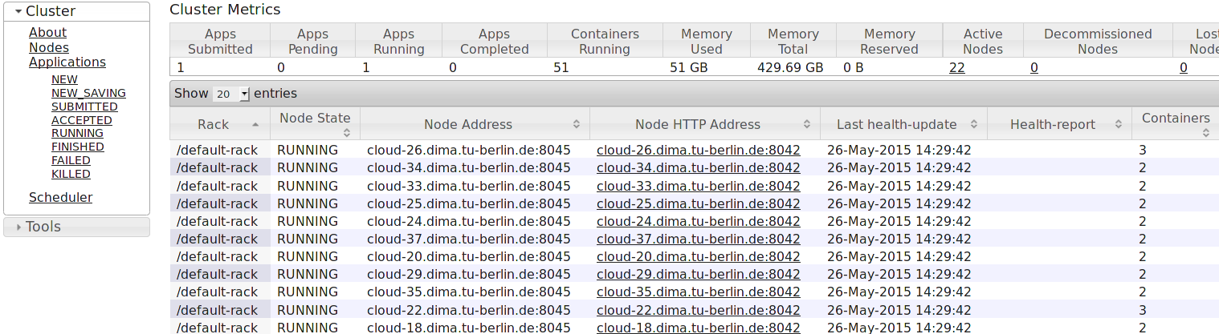
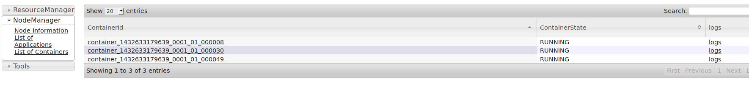
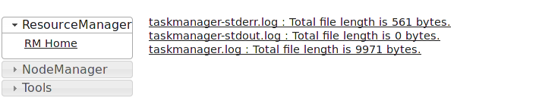
Get logs of a running YARN application

Slide 18
Debugging on a cluster - Accumulators
Useful to verify your assumptions about the data
class Tokenizer extends RichFlatMapFunction<String, String>> {
@Override
public void flatMap(String value, Collector<String> out) {
getRuntimeContext()
.getLongCounter("elementCount").add(1L);
// do more stuff.
} }
Use “Rich*Functions” to get RuntimeContext

Slide 19
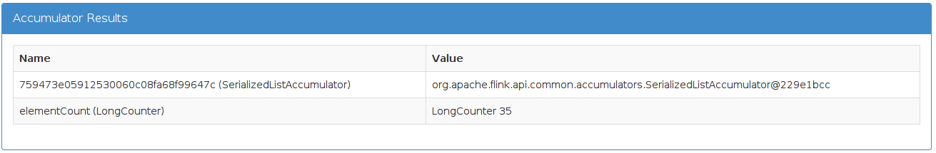
Debugging on a cluster - Accumulators
Where can I get the accumulator results?
returned by env.execute()
displayed when executed with /bin/flink
in the JobManager web frontend
JobExecutionResult result = env.execute("WordCount");
long ec = result.getAccumulatorResult("elementCount");

Slide 20
Excursion: RichFunctions
The default functions are SAMs (Single abstract method). Interfaces with one method (for Java8 Lambdas)
There is a “Rich” variant for each function.
RichFlatMapFunction, …
Methods
open(Configuration c) & close()
getRuntimeContext()

Slide 21
Excursion: RichFunctions & RuntimeContext
The RuntimeContext provides some useful methods
getIndexOfThisSubtask () / getNumberOfParallelSubtasks() – who am I, and if yes how many?
getExecutionConfig()
Accumulators
DistributedCache

Slide 22
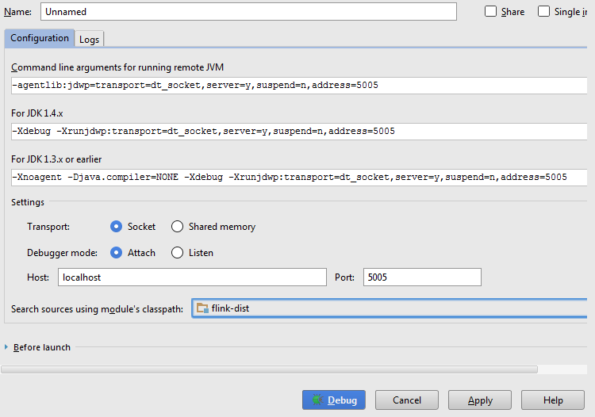
Attaching a remote debugger to Flink in a Cluster

Slide 23
Attaching a debugger to Flink in a cluster
Add JVM start option in flink-conf.yaml
env.java.opts: “-agentlib:jdwp=….”
Open an SSH tunnel to the machine:
ssh -f -N -L 5005:127.0.0.1:5005 user@host
Use your IDE to start a remote debugging session

Slide 24
Job Tuning
Make it run faster

Slide 25
Tuning options
CPU
Processing slots, threads, …
Memory
How to adjust memory usage on the TaskManager
I/O
Specifying temporary directories for spilling

Slide 26
Tell Flink how many CPUs you have
taskmanager.numberOfTaskSlots
number of parallel job instances
number of pipelines per TaskManager
recommended: number of CPU cores
Map
Reduce
Map
Reduce
Map
Reduce
Map
Reduce
Map
Reduce
Map
Reduce
Map
Reduce

Slide 27
Processing slots
flink-config.yaml:
taskmanager.numberOfTaskSlots: 3
(Recommended value: Number of CPU cores)
or
/bin/yarn-session.sh –slots 3 –n 3
Task Managers: 3
Total number of processing slots: 9
Task Manager 1
Task Manager 2
Task Manager 3
Slot 1
Slot 1
Slot 1
Slot 2
Slot 2
Slot 2
Slot 3
Slot 3
Slot 3

Slide 28
Slots – Wordcount with parallelism=1
Task Manager 1
Task Manager 2
Task Manager 3
Slot 1
Slot 1
Slot 1
Source -> flatMap
Reduce
Sink
Slot 2
Slot 2
Slot 2
Slot 3
Slot 3
Slot 3
When no argument given, parallelism.default from flink-config.yaml is used.
Default value = 1

Slide 29
Slots – Wordcount with higher parallelism (= 2 here)
Task Manager 1
Task Manager 2
Task Manager 3
Slot 1
Slot 1
Slot 1
Source -> flatMap
Reduce
Sink
Source -> flatMap
Reduce
Sink
Slot 2
Slot 2
Slot 2
Slot 3
Slot 3
Slot 3
Places to set parallelism for a job
flink-config.yaml
parallelism.default: 2
or Flink Client:
./bin/flink -p 2
or ExecutionEnvironment:
env.setParallelism(2)

Slide 30
Slots – Wordcount using all resources (parallelism = 9)
Task Manager 1
Task Manager 2
Task Manager 3
Slot 1
Slot 1
Slot 1
Source -> flatMap
Reduce
Sink
Source -> flatMap
Reduce
Sink
Source -> flatMap
Reduce
Sink
Slot 2
Slot 2
Slot 2
Source -> flatMap
Reduce
Sink
Source -> flatMap
Reduce
Sink
Source -> flatMap
Reduce
Sink
Slot 3
Slot 3
Slot 3
Source -> flatMap
Reduce
Sink
Source -> flatMap
Reduce
Sink
Source -> flatMap
Reduce
Sink

Slide 31
Slots – Setting parallelism on a per operator basis
The parallelism of each operator can be set individually in the APIs
counts.writeAsCsv(outputPath, "\n", " ").setParallelism(1);
Task Manager 1
Task Manager 2
Task Manager 3
Slot 1
Slot 1
Slot 1
Source -> flatMap
Reduce
Source -> flatMap
Reduce
Source -> flatMap
Reduce
Sink
Slot 2
Slot 2
Slot 2
Source -> flatMap
Reduce
Source -> flatMap
Reduce
Source -> flatMap
Reduce
Slot 3
Slot 3
Slot 3
Source -> flatMap
Reduce
Source -> flatMap
Reduce
Source -> flatMap
Reduce

Slide 32
Slots – Setting parallelism on a per operator basis
Task Manager 1
Task Manager 2
Task Manager 3
Slot 1
Slot 1
Slot 1
Source -> flatMap
Reduce
Source -> flatMap
Reduce
Source -> flatMap
Reduce
Sink
Slot 2
Slot 2
Slot 2
Source -> flatMap
Reduce
Source -> flatMap
Reduce
Source -> flatMap
Reduce
Slot 3
Slot 3
Slot 3
Source -> flatMap
Reduce
Source -> flatMap
Reduce
Source -> flatMap
Reduce
The data is streamed to this Sink from all the other slots on the other TaskManagers

Slide 33
Tuning options
CPU
Processing slots, threads, …
Memory
How to adjust memory usage on the TaskManager
I/O
Specifying temporary directories for spilling

Slide 34
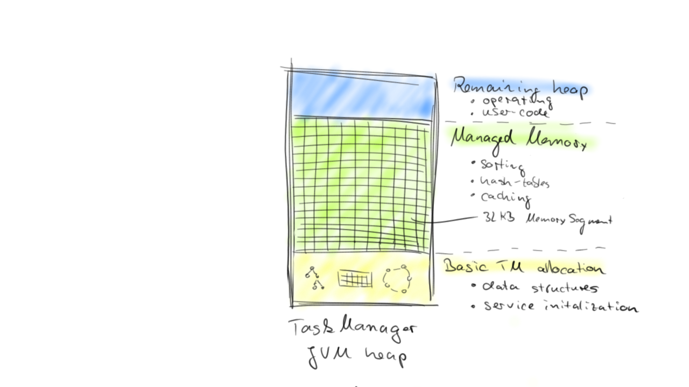
Memory in Flink - Theory

Slide 35
Memory in Flink - Configuration
relative: taskmanager.memory.fraction
absolute: taskmanager.memory.size
taskmanager.network.numberOfBuffers
taskmanager.heap.mb
or „-tm“ argument for bin/yarn-session.sh

Slide 36
Memory in Flink - OOM
Memory is missing here
2015-02-20 11:22:54 INFO JobClient:345 - java.lang.OutOfMemoryError: Java heap space
at org.apache.flink.runtime.io.network.serialization.DataOutputSerializer.resize(DataOutputSerializer.java:249)
at org.apache.flink.runtime.io.network.serialization.DataOutputSerializer.write(DataOutputSerializer.java:93)
at org.apache.flink.api.java.typeutils.runtime.DataOutputViewStream.write(DataOutputViewStream.java:39)
at com.esotericsoftware.kryo.io.Output.flush(Output.java:163)
at com.esotericsoftware.kryo.io.Output.require(Output.java:142)
at com.esotericsoftware.kryo.io.Output.writeBoolean(Output.java:613)
at com.twitter.chill.java.BitSetSerializer.write(BitSetSerializer.java:42)
at com.twitter.chill.java.BitSetSerializer.write(BitSetSerializer.java:29)
at com.esotericsoftware.kryo.Kryo.writeClassAndObject(Kryo.java:599)
at org.apache.flink.api.java.typeutils.runtime.KryoSerializer.serialize(KryoSerializer.java:155)
at org.apache.flink.api.scala.typeutils.CaseClassSerializer.serialize(CaseClassSerializer.scala:91)
at org.apache.flink.api.scala.typeutils.CaseClassSerializer.serialize(CaseClassSerializer.scala:30)
at org.apache.flink.runtime.plugable.SerializationDelegate.write(SerializationDelegate.java:51)
at org.apache.flink.runtime.io.network.serialization.SpanningRecordSerializer.addRecord(SpanningRecordSerializer.java:76)
at org.apache.flink.runtime.io.network.api.RecordWriter.emit(RecordWriter.java:82)
at org.apache.flink.runtime.operators.shipping.OutputCollector.collect(OutputCollector.java:88)
at org.apache.flink.api.scala.GroupedDataSet$$anon$2.reduce(GroupedDataSet.scala:262)
at org.apache.flink.runtime.operators.GroupReduceDriver.run(GroupReduceDriver.java:124)
at org.apache.flink.runtime.operators.RegularPactTask.run(RegularPactTask.java:493)
at org.apache.flink.runtime.operators.RegularPactTask.invoke(RegularPactTask.java:360)
at org.apache.flink.runtime.execution.RuntimeEnvironment.run(RuntimeEnvironment.java:257)
at java.lang.Thread.run(Thread.java:745)
Reduce managed memory
reduce taskmanager.
memory.fraction

Slide 37
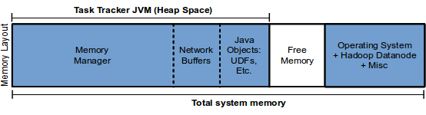
Memory in Flink – Network buffers
Error: java.lang.Exception: Failed to deploy the task CHAIN Reduce(org.okkam.flink.maintenance.deduplication.blocking.RemoveDuplicateReduceGroupFunction) -> Combine(org.apache.flink.api.java.operators.DistinctOperator$DistinctFunction) (15/28) - execution #0 to slot SubSlot 5 (cab978f80c0cb7071136cd755e971be9 (5) - ALLOCATED/ALIVE): org.apache.flink.runtime.io.network.InsufficientResourcesException: okkam-nano-2.okkam.it has not enough buffers to safely execute CHAIN Reduce(org.okkam.flink.maintenance.deduplication.blocking.RemoveDuplicateReduceGroupFunction) -> Combine(org.apache.flink.api.java.operators.DistinctOperator$DistinctFunction) (36 buffers missing)
Managed memory will shrink automatically
increase „taskmanager.network.numberOfBuffers“
Memory is missing here

Slide 38
What are these buffers needed for?
A simple MapReduce Job in Flink:
Map
Reduce
A small Flink cluster with 4 processing slots (on 2 Task Managers)
Slot 1
Slot 1
Slot 2
Slot 2
TaskManager 1
TaskManager 2

Slide 39
What are these buffers needed for?
Map Reduce job with a parallelism of 2 and 2 processing slots per Machine
Network buffer
Map
Reduce
Map
Reduce
Slot 2
Slot 2
Map
Reduce
Map
Reduce
Map
Reduce
Map
Reduce
Slot 1
Slot 1
Map
Reduce
Map
Reduce
TaskManager 1
TaskManager 2
8 buffers for outgoing data
8 buffers for incoming data

Slide 40
What are these buffers needed for?
Map Reduce job with a parallelism of 2 and 2 processing slots per Machine
Map
Reduce
Map
Reduce
Slot 2
Map
Reduce
Map
Reduce
Each mapper has a logical connection to a reducer
Map
Reduce
Map
Reduce
Slot 1
Map
Reduce
Map
Reduce
TaskManager 1
TaskManager 2

Slide 41
Tuning options
CPU
Processing slots, threads, …
Memory
How to adjust memory usage on the TaskManager
I/O
Specifying temporary directories for spilling

Slide 42
Tuning options
Memory
How to adjust memory usage on the TaskManager
CPU
Processing slots, threads, …
I/O
Specifying temporary directories for spilling

Slide 43
Disk I/O
Sometimes your data doesn’t fit into main memory, so we have to spill to disk
taskmanager.tmp.dirs: /mnt/disk1,/mnt/disk2
Use real local disks only (no tmpfs or NAS)
Task Manager
Reader Thread
Writer Thread
Reader Thread
Writer Thread
Disk 1
Disk 2
Notes:
this way you can also start multiple threads per disk

Slide 44
Outlook
Per job monitoring & metrics
Less configuration values with dynamic memory management
Download operator results to debug them locally

Slide 45
Join our community
RTFM (= read the documentation)
Mailing lists
Subscribe: user-subscribe@flink.apache.org
Ask: user@flink.apache.org
Stack Overflow
tag with “flink” so that we get an email notification ;)
IRC: freenode#flink
Read the code, its open source ☺

Slide 46

Flink Forward registration & call for abstracts is open now
12/13 October 2015
Kulturbrauerei Berlin
With Flink Workshops / Trainings!

