Slide 1
Spark Webinar
Vinay Shukla & Ram Venkatesh
October 2nd, 2014

Slide 2
Agenda
What is Spark?
What have we done with Spark so far
Tech Previews
Brief on Spark 1.1.0 Tech Preview
Multi tenant & multi workload with YARN
Introducing Spark-3561
Get Involved

Slide 3

Let’s Talk About Apache Spark
What is Spark?
Spark is a general-purpose big data engine that provides simple APIs for data scientists and engineers familiar with Scala, Python and Java to build ad-hoc interactive analytics, iterative machine-learning, and other use cases well-suited to interactive, in-memory data processing of GB to TB sized datasets.

Slide 4
What is Spark?
Spark API
(Hadoop|FlatMapped|Filter|MapPartitions|Shuffled)RDD
Client
Spark
Compiler / Optimizer
stage0: (Hadoop|FlatMapped|Filter|MapPartitions)RDD
stage1: ShuffledRDD
ShuffleMapTask: (flatMap | map)
ShuffleMapTask: (flatMap | map)
DAG Runtime
Execution Engine
Task
Task
Cluster
ResultTask: (reduceByKey)
Task
DAGScheduler, ActiveJob
Spark Cluster
YARN
Mesos
SparkAM

Slide 5
Let’s Talk About Apache Spark (cont’d)
What’s Our Spark Strategy?
Hortonworks is focused on enabling Spark for Enterprise Hadoop so users can deploy Spark-based applications along with their other Hadoop workloads in a consistent, predictable, and robust way.
Leverage Scale, Multi-tenancy provided by “YARN” so its memory and CPU intensive apps can work with predictable performance
Integrate it with HDP’s operations, security, governance, scalability, availability, and multi-tenancy capabilities
Do We Have a Plan to Support Spark? Yes.
Spark is available now as a Technology Preview.
We are working our standard process of Tech Preview -> GA. We did this for Storm, Falcon, etc.
Spark will be added to our HDP Enterprise Plus subscription when it’s GA ready

Slide 6
Spark Timeline
Break-down

Slide 7

Spark Roadmap
2014
JULY
SEPT
DEC
1.0.1 TP Refresh
1.1.0 TP Refresh
1.2.0 GA
Hive 13 support
Limited ORC support
Spark on YARN: Deployment Best Practices
Ambari Support for Spark Install/Stop/Config
Spark on Kerberized Cluster
Authentication against LDAP in Spark UI

Slide 8
What’s in Spark 1.1.0 Tech Preview
Upgrades Spark to Hive .13
Provides Hive .13 features (new Hive UDFs) in Spark
Limited ORC support
Ability to manipulate ORC as HadoopRDD
…..
val inputRead = sc.hadoopFile("hdfs://sandbox.hortonworks.com:8020/apps/hive/warehouse/orc_table",classOf[org.apache.hadoop.hive.ql.io.orc.OrcInputFormat],classOf[org.apache.hadoop.io.NullWritable],classOf[org.apache.hadoop.hive.ql.io.orc.OrcStruct])
val k = inputRead.map(pair =&gt; pair._2.toString)
val c = k.collect
…..

Slide 9
Spark Enterprise Readiness
Enhancements

Slide 10
Spark Investment Phases
Phase 1
Hive 0.13 support
Limited ORC support
Security: Spark certification on Kerberized Cluster
Security: Authentication in Spark UI against LDAP/AD
Operations: Ambari Stack Definition: Install/Start/Stop/Config/Quick links to Spark UI
Phase 2
Improve reliability & Scale of Spark-on-YARN
Enhance ORC support
Improve Debug Capabilities
Security: Wire Encryption and Authorization with XA/Argus
Operations: Spark logs published to YARN Application Timeline Service (ATS)
Operations: Enhanced workload management

Slide 11
Spark on Hadoop
Ram Venkatesh
October 2nd, 2014

Slide 12
Spark-on-Hadoop – End User Benefits
Developer Productivity
Simple, easy to use APIs
Direct and elegant representation of the data processing flow
Focus on application business logic rather than Hadoop internals
Integrated develop-deploy-debug experience through the IDE
Multi-tenancy
Shared infrastructure across workloads – interactive queries by day, batch ETL at night
Better utilization of compute capacity
Move the execution to the data tier instead of the other way around
Reduced load on distributed filesystem (HDFS)
Reduce unnecessary replicated reads and writes
Reduced network usage
Eliminates the need for data transfer in and out of the cluster

Slide 13
Spark-on-Hadoop – Design considerations
Look to the Future with an eye on the Past
Don’t solve problems that have already been solved.
Leverage discrete task based compute model for elasticity, scalability and fault tolerance
Leverage several man years of work in Hadoop Map-Reduce data shuffling operations
Leverage proven resource sharing and multi-tenancy model for Hadoop and YARN
Leverage built-in security mechanisms in Hadoop for privacy and isolation
Don’t create new problems
Preserve the simple developer experience
No changes to Spark programs, all programs run unmodified
Propose simple, mainstream in-the-community extension to the Apache Spark project

Slide 14
Spark on Hadoop – From service model to app model
Spark jobs compile down to a Directed Acyclic Graph (DAG).
Vertices in the graph represent user logic
Edges represent data movement from producers to consumers
Spark DAG executed using Apache Tez at runtime
Preprocessor Stage
Task-1
Task-2
Samples
Sampler
Ranges
Partition Stage
Task-1
Task-2
Distributed Sort
Aggregate Stage
Task-1
Task-2

Slide 15
Spark-on-Hadoop – Simplifying Operations
No deployments to do. No side effects. Easy and safe to try it out!
Completely client side application.
Simply upload to any accessible FileSystem and point to the cluster through configuration files.
Enables running different versions concurrently. Easy to test new functionality while keeping stable versions for production.
Leverages YARN local resources.
HDFS
Spark-v1
Spark-v2
Client
Machine
Node
Manager
Node
Manager
Client
Machine
Spark Client
TezTask
TezTask
Spark Client

Slide 16
Benefits of native Hadoop execution of Spark DAGs
Elastic resource management - dynamic acquisition and release of containers
Works with YARN pre-emption, reservation and headroom calculations
Auto-parallelism based on sampling – you no longer need to guess no. of reducers
Efficient data movement between stages using the Hadoop shuffle
Integrates with resource isolation and governance mechanisms in Hadoop
Classpath and jarfile management through local resources
Detailed job-level metrics through integration with the YARN ATS
Enables large-scale, multi-tenant batch ETL Spark programs

Slide 17
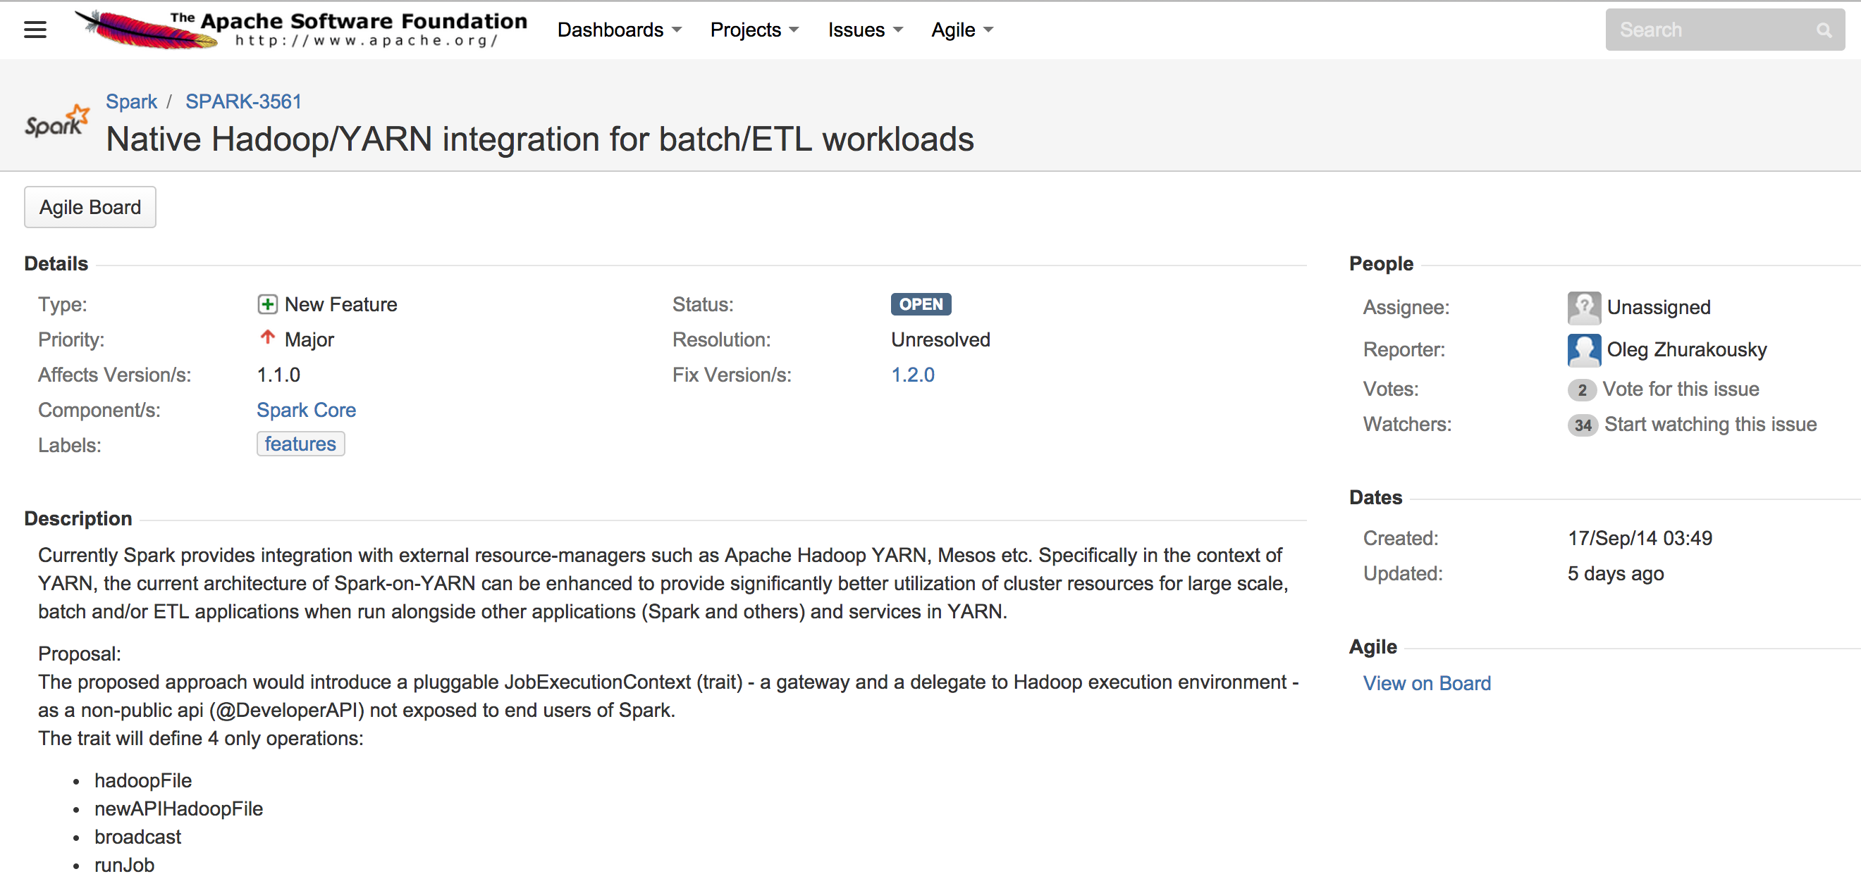
Introducing SPARK-3561

Slide 18
DEMO: SPARK-3561 in action

Slide 19
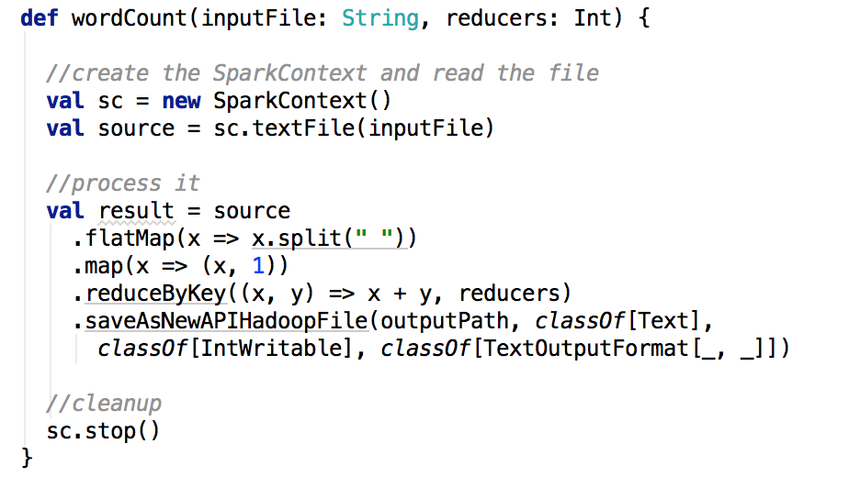
SPARK-3561 under the hood
Example program:

Slide 20
SPARK-3561 Demo – contd.
Execute program using spark-submit
spark-submit --class dev.demo.WordCount
--master execution-context:org.apache.spark.tez.TezJobExecutionContext
spark-on-hadoop-1.0.jar 1 test.txt
Execute interactive Spark commands through spark-shell
spark-shell --master execution-context:org.apache.spark.tez.TezJobExecutionContext
INFO main spark.SparkContext:59 - Will use custom job execution context org.apache.spark.tez.TezJobExecutionContext
INFO main adapter.SparkToTezAdapter:59 - Adapting PairRDDFunctions.saveAsNewAPIHadoopDataset for Tez
INFO main repl.SparkILoop:59 - Created spark context..
Spark context available as sc.
scala>

Slide 21
SPARK-3561 – feedback requested
Provide feedback on your ETL/batch scenarios
Participate in the discussion on the JIRA
Try it out when it becomes available
Looking for early adopters to run and validate at scale

Slide 22
Resources
Spark Labs Page : http://hortonworks.com/hadoop/spark/
Spark Roadmap Blog : http://hortonworks.com/blog/extending-spark-yarn-enterprise-hadoop/
Spark 1.1.0 Tech Preview : http://hortonworks.com/kb/spark-1-1-0-technical-preview-hdp-2-1-5/
Public Spark Forums : http://hortonworks.com/community/forums/forum/spark/
Spark-3561 : https://issues.apache.org/jira/browse/SPARK-3561

Slide 23
Q&A…
Discussion

