Slide 1
NETS 212: Scalable and Cloud Computing
Beyond MapReduce
November 19, 2013

Slide 2
Announcements
HW4MS2 is due on November 25th
How is the PennBook project going?
svn repositories are available
Check/review sessions this week ('soft' deadline is 11/22; 'hard' deadline is the day before Thanksgiving)
Final project timeline
Code 'due' on December 10th
Demos between December 16th and 19th
No extensions of any kind (letter grades will be due!)

Slide 3
Final project
By now you should have a design and, ideally, some working code (e.g., login)
What should be in the 'design'?
Database schema: How many tables? What do they contain?
Example: "Users"=(login,password,firstname,lastname,...), "Posts"=...
Page structure: How many pages will there be? What will they contain? How does the user interact with them?
Example: Login page (draw a sketch), profile page, feed page, ...
Routes: What routes will you need? What will they do?
Example: /, /checklogin, /profile, /getposts, /addpost, ... (parameters?)
Deployment plan: Where will the server run? How about friend recommendation? How does data get back & forth?
Division of labor: Who will be responsible for doing what?
Example: Teammate 1 will implement X, Y, and Z; teammate 2 will ...

Slide 4
What is the 'right' programming model?
We've now done a tour of the major cloud infrastructure
From IaaS to PaaS (Hadoop, SimpleDB) and SaaS (GWT)
For the remainder of the semester:
Loop back and revisit the question of the “right” programming model:
MapReduce is interesting and popular, but by no means the last word!
… especially for ad-hoc queries
"Alternative" model: SQL

Slide 5
Data processing and analysis
MapReduce processes key-(multi)value pairs
i.e., tuples of typed data
The basic operations are, in some pipeline:
Filtering
Remapping / renaming / reorganizing
Intersecting
Sorting
Aggregating
Databases have been doing these for decades!
(… And they have a story for consistent updates, too!)

Slide 6

Goals for today
Basic data processing operations
Databases
Overview and roles
Relational model
Querying
Updates and transactions
What happens 'under the covers'
SQL vs. NoSQL
Hive, Hbase, and intermediate models
Data access
JDBC, LINQ
NEXT

Slide 7
Databases in a nutshell
An abstract storage system
Provides access to tables, organized however the database administrator and the system have chosen
A declarative processing model
Query language: SQL or similar
More general than (single-pass) MapReduce
A strong consistency and durability model
Transactions with ACID properties (see later)
But: Not much thought has been given to 1000s of commodity machines

Slide 8
Roles of a DBMS
Online transaction processing (OLTP)
Workload: Mostly updates
Examples: Order processing, flight reservations, banking, …
Online analytic processing (OLAP)
Workload: Mostly queries
Aggregates data on different axes; often step towards mining
May well have combinations of both
Stream / Web
Today not all of the data really needs to be in a database – it can be on the network!

Slide 9
The database approach
Idea: User should work at a level close to the specification – not the implementation
A logical model of the data – a schema
Basically like class definitions, but also includes relationships, constraints
This will help us form a physical representation, i.e., a set of tables
Applications stay the same even if the platform changes
Computations are specified as queries
Again, in terms of logical operations
Gets mapped into a query evaluation plan
How does this compare to MapReduce?
Pros and cons?

Slide 10
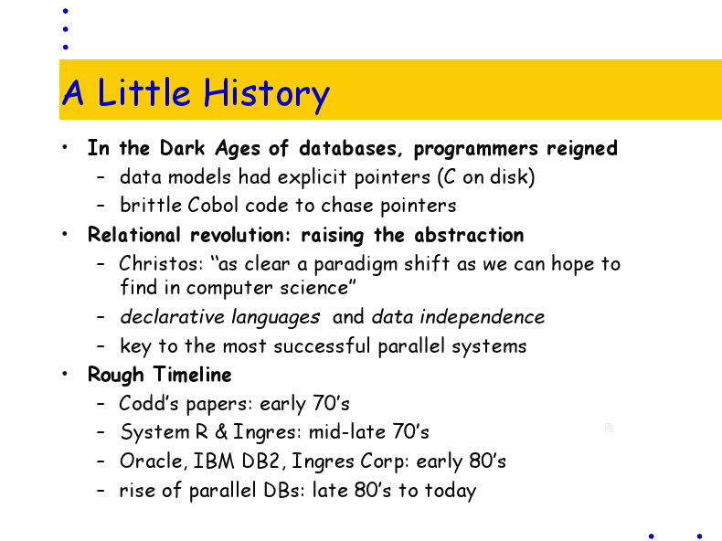
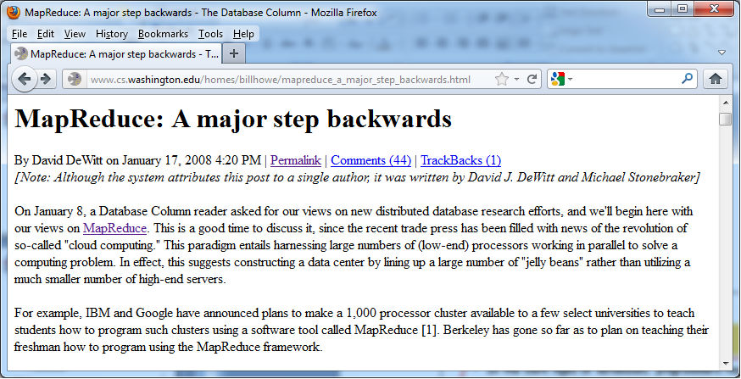
The database-vs-MapReduce controversy
"Parallel Database Primer" (Joe Hellerstein)
DeWitt and Stonebraker blog post

Slide 11



Recall: Our (simplistic) social network
Facebook
fan-of
fan-of
fan-of
0.8
Mikhail
0.5
0.7
0.7
fan-of
fan-of
Magna Carta
friend-of
friend-of
0.3
0.5
Alice
0.9
Jose
Sunita
(Alice, fan-of, 0.5, Facebook)
(Alice, friend-of, 0.9, Sunita)
(Jose, fan-of, 0.5, Magna Carta)
(Jose, friend-of, 0.3, Sunita)
(Mikhail, fan-of, 0.8, Facebook)
(Mikhail, fan-of, 0.7, Magna Carta)
(Sunita, fan-of, 0.7, Facebook)
(Sunita, friend-of, 0.9, Alice)
(Sunita, friend-of, 0.3, Jose)

Slide 12
Logical schema with entity-relationship
FriendOf
type
User
strength
uid
name
bday
FanOf
StatusUpdates
strength
when
Organization
StatusLog
oid
name
sid
msg

Slide 13
Some example tables
User
FriendOf
uid | name | bdate
1 | alice | 1-1-80
2 | jose | 1-1-70
3 | sunita | 6-1-75
uid | fid | strength | type
1 | 3 | 0.9 | fr
2 | 3 | 0.3 | fr
FanOf
StatusUpdates
uid | oid | strength
1 | 99 | 0.5
2 | 100 | 0.5
3 | 99 | 0.7
uid | sid | when
1 | 1 | 10/1
2 | 17 | 11/1
StatusLog
Organization
sid | post
1 | In Rome
17 | Drank a latte
oid | name
99 | Facebook
100 | Magna Carta

Slide 14
Recap: Databases
A more abstract view of the data
Schema formally describes fields, data types, and constraints
Relational model: Data is stored in tables
Declarative: We describe what we want to store or compute, not how it should be done
The implementation (a database management system, or DBMS) takes care of the details
Much higher-level than MapReduce
This has both pros and cons

Slide 15
Goals for today
Basic data processing operations
Databases
Overview and roles
Relational model
Querying
Updates and transactions
What happens 'under the covers'
SQL vs. NoSQL
Hive, Hbase, and intermediate models
Data access
JDBC, LINQ
NEXT

Slide 16
Basics of querying in SQL
At its core, a database query language consists of manipulations of sets of tuples
We bind variables to the tuples within a table, perform tests on each value, and then construct an output set
Java:
ArrayList<String> output …
for (u : Table<User>) { output.add(u.name); }
Map/Reduce:
public void map(LongWritable k, User v) { context.write(new Text(v.name)); }
SQL:
SELECT U.name FROM User U

Slide 17
The SQL standard form
Each block computes a set/bag of tuples
A block looks like this:
SELECT [DISTINCT] {T₁.attrib, …, T₂.attrib} FROM {relation} T₁, {relation} T₂, … WHERE {predicates}
GROUP BY {T₁.attrib, …, T₂.attrib}
HAVING {predicates}
ORDER BY {T₁.attrib, …, T₂.attrib}

Slide 18
Multiple table variables in SQL
Recall from a couple of slides back:
SELECT U.name FROM User U
returns (name) tuples
We can compute all combinations of possible values (Cartesian product of tuples) as:
SELECT U.name, U2.name FROM User U, User U2
Or we can compute a union of tuples as:
(SELECT U.name FROM User U) UNION (SELECT O.name FROM Organization O)

Slide 19
The basic operations
So far, we’ve seen how to combine tables
Let’s see some more sophisticated operations:
Filtering
Remapping / renaming / reorganizing
Intersecting
Sorting
Aggregating

Slide 20
Filtering and remapping
Filtering is very easy – simply add a test in the WHERE clause:
SELECT * FROM User WHERE name LIKE ‘j%’
(Note *, LIKE, %)
We can also reorder, rename, and project:
SELECT name, uid AS id FROM User WHERE name LIKE ‘s%’

Slide 21
Practice
Can we combine the FanOf and FriendOf relations?

Slide 22
Intersection and join
True intersection – “same kind” of tuples:
(SELECT U.name FROM User U) INTERSECT (SELECT O.name FROM Organization O)
Join – merge tuples from different table variables when they satisfy a condition:
SELECT U.name, S.post FROM User U, StatusUpdates P, StatusLog S WHERE U.uid = P.uid AND P.sid = S.sid
If the attribute names are the same:
SELECT U.name, S.post FROM User U NATURAL JOIN StatusUpdates SU NATURAL JOIN StatusLog S

Slide 23
Practice
Who are close friends (strength > 0.5)?

Slide 24
Sorting
Output order is arbitrary in SQL
Unless you specifically ask for it:
SELECT * FROM USER U ORDER BY name
SELECT * FROM USER U ORDER BY name DESC

Slide 25
Aggregating on a key: Group By
What if we wanted to compute the average friendship strength per organization?
Need to group the tuples in FanOf by 'oid', then average
This can be done with Group By:
SELECT {group-attribs}, {aggregate-op} (attrib) FROM {relation} T₁, {relation} T₂, … WHERE {predicates} GROUP BY {group-list}
Built-in aggregation operators:
AVG, COUNT, SUM, MAX, MIN
DISTINCT keyword for AVG, COUNT, SUM

Slide 26
Example: Group By
Recall the k-means algorithm
Suppose we want to compute the new centroids for a set of points, and we already have the points as a table PointGroups(PointID, GroupID, X, Y)
SELECT P.GroupID, AVG(P.X), AVG(P.Y) FROM PointGroups P GROUP BY P.GroupID
Can also write aggregation, e.g., in C, Java
Example: Oracle's Java Stored Procedures
Basically like the Reduce function!
But not as natural as in MapReduce – need to declare them both in SQL and in Java

Slide 27
Composition
The results of SQL are tables
Hence you can query the results of a query!
Let's do k-means in SQL:
SELECT PG.GroupID, AVG(PG.X), AVG(PG.Y) FROM ( SELECT P.ID, P.X, P.Y, ARGMIN(dist(P.X, P.Y, G.X, G.Y), G.ID), MIN(dist(P.X, P.Y, G.X, G.Y)) FROM POINTS P, GROUPS G GROUP BY P.ID ) AS PG GROUP BY PG.GroupID

Slide 28
Recursion
Modern SQL even supports recursion until a termination condition!
… though it’s not standardized in any real-world implementations, so I won’t give a syntax here…

Slide 29
Recap: Querying with SQL
We have seen SQL constructs for:
Projection and remapping/renaming (SELECT)
Cartesian product (FROM x, y, z, …; NATURAL JOIN)
Filtering (WHERE)
Set operations (UNION, INTERSECT)
Aggregation (GROUP BY + MIN, MAX, AVG, …)
Sorting (ORDER BY)
Composition (SELECT … FROM (SELECT … FROM …))
Not a complete list - SQL has more features!

Slide 30
Goals for today
Basic data processing operations
Databases
Overview and roles
Relational model
Querying
Updates and transactions
What happens 'under the covers'
SQL vs. NoSQL
Hive, Hbase, and intermediate models
Data access
JDBC, LINQ
NEXT

Slide 31
Modifying the database
Inserting a new literal tuple is easy, if wordy: INSERT INTO User(uid, name, bdate) VALUES (5, ‘Simpson’,1/1/11)
Can revise the contents of a tuple:
UPDATE User U SET U.uid = 1 + U.uid, U.name = ‘Janet’ WHERE U.name = ‘Jane’

Slide 32
Transactions
Transactions allow for atomic operations
All-or-nothing semantics
Even in the presence of crashes and concurrency
Marked via:
BEGIN TRANSACTION
{ do a series of queries, updates, … }
Followed by either:
ROLLBACK TRANSACTION
COMMIT TRANSACTION

Slide 33
ACID
What do database transactions give you?
Four ACID properties:
Atomicity: Either all the operations in the transaction succeed, or none of the operations persist (all-or-nothing)
Consistency: If the data are consistent before the transaction begins, they will be consistent after the transaction completes
Isolation: The effects of a transaction that is still in progress are hidden from all the other transactions
Durability: Once a transaction finishes, its results are persistent and will survive a system crash
Examples of violations for each property?
http://msdn.microsoft.com/en-us/library/aa366402%28VS.85%29.aspx

Slide 34
Side note: Parallel query execution
In a distributed DBMS, data is partitioned along keys
Think of HDFS, except that the base data’s key is usually a value, not just a line position
Filtering, renaming, projection are done at each node
... just as Map in MapReduce!
JOIN and GROUP BY require us to “shuffle” data so the same keys are at the same nodes
… just as Reduce in MapReduce!

Slide 35
Example: ORCHESTRA system
Node 1 poses query:
SELECT regionName, SUM(pop)
FROM StatePop NATURAL JOIN RegionName
GROUP BY regionName
StatePop(state,pop,regionId)
RegionName(regionId,regionName)
Out(18.3M,Northeast)
Out(9.7M,Northwest)
GROUP-BY
GROUP-BY
5. Collect at originator
RNSP(12.6M,Northeast)
RNSP(5.7M,Northeast)
RNSP(3M,Northwest)
RNSP(6.7M,Northwest)
4. Group by regionName
⋈
⋈
3. Join SP&RN
2. Rehash SP on regionId
SP(MD,5.7M,1)
1. Scan SP&RN
SP(PA,12.6M,1)
SP(WA,6.7M,2)
RN(1,Northeast)
SP(OR,3M,2)
RN(2,Northwest)
Node 1: Keys 1-12
Node 2: Keys 13-40
PhD thesis, Nicholas Taylor

Slide 36
Side note: Query optimization
The “magic” of the DBMS lies in query optimization
Here’s where Oracle, DB2 beat MySQL
Many different ways of doing a JOIN
Consider sorted data
Consider an index on the join key
Doing JOINs in different orders has different costs

Slide 37
Summary: Advantages of SQL
A set-oriented language for composing, mani-pulating, transforming data in different forms
Includes map and reduce-like functionality
Supports composition
One can treat query results as tables, and query over those
Supports embedding
... of Java and other functions
Parallel computation should look similar to MapReduce
Can take advantage of a query optimizer, exploit data independence

Slide 38
Goals for today
Basic data processing operations
Databases
Overview and roles
Relational model
Querying
Updates and transactions
What happens 'under the covers'
SQL vs. NoSQL
Hive, Hbase, and intermediate models
Data access
JDBC, LINQ
NEXT

Slide 39

Why not SQL for everything?
Database systems support a lot of functionality – “one size fits all”
This leads to overhead in all sorts of computations
And DBMSs only tend to use their own storage
Hence a feeling that DBMSes can’t scale!
DBMSs never tried to reach the scale of 1000s of commodity nodes
Parallel DBMSs used special hardware
Traditional implementations couldn’t handle the failure cases as smoothly as MapReduce/GFS or Key/Value Stores
Hence a feeling that DBMSes can’t scale!
Today: SQL for small clusters / ad hoc queries, MapReduce for large, compute-intensive batch jobs
But the technologies are merging!

Slide 40
Hive: SQL for HDFS
SQL is a higher-level language than MapReduce
Problem: Company may have lots of people with SQL skills, but few with Java/MapReduce skills
See Facebook example in White Chapter 12
Can we 'bridge the gap' somehow?
Idea: SQL frontend for MapReduce
Abstract delimited files as tables (give them schemas)
Compile (approximately) SQL to MapReduce jobs!
SELECT a.campaign_id, count(*), count(DISTINCT b.user_id) FROM dim_ads a JOIN impression_logs b ON(b.ad_id=a.ad_id) WHERE b.dateid = ‘2008-12-01’ GROUP BY a.campaign_id

Slide 41
The Hive project
Now an Apache subproject along with Hadoop
Used, e.g., by Netflix
Another related project, HBase, implements a key/value store over HDFS
Can feed these into Hadoop MapReduce
… and can easily combine with Hive

Slide 42
Recap: SQL vs. NoSQL
Much of the discussion of SQL vs. non-SQL is really based on perceptions of DBMSs, not necessarily the language
Dozens of different NoSQL projects, with different goals but a claim of better performance for some apps
Over time we are seeing the gaps bridged
SQL is very convenient for joins and cross-format operations – hence Hive
Random access storage can be faster than flat files
Hence Hive (and Google’s BigTable, Amazon SimpleDB, etc.)

Slide 43
Goals for today
Basic data processing operations
Databases
Overview and roles
Relational model
Querying
Updates and transactions
What happens 'under the covers'
SQL vs. NoSQL
Hive, Hbase, and intermediate models
Data access
JDBC, LINQ
NEXT

Slide 44
SQL from the outside
Suppose you are building a Java application that needs to talk to a DBMS…
How do you get data out of SQL and into (server-side) Java?
Requires embedding SQL into Java
Various conversions, marshalling happen under the covers
The results get returned a tuple at a time

Slide 45
JDBC: Dynamic SQL
import java.sql.*;
Connection conn = DriverManager.getConnection(…);
Statement s = conn.createStatement();
int uid = 5;
String name = "Jim";
s.executeUpdate("INSERT INTO USER VALUES(" + uid + ", '" + name + "')");
// or equivalently
s.executeUpdate(" INSERT INTO USER VALUES(5, 'Jim')");

Slide 46
Cursors and the impedance mismatch
SQL is set-oriented – it returns relations
But there’s no relation type in most languages!
Solution: cursor that can be opened and read
ResultSet rs = stmt.executeQuery("SELECT * FROM USER");
while (rs.next()) {
int sid = rs.getInt(“uid");
String name = rs.getString("name");
System.out.println(uid + ": " + name);
}

Slide 47
JDBC: Prepared statements (1/2)
int[] users = {1, 2, 4, 7, 9};
for (int i = 0; i < students.length; ++i) { ResultSet rs = stmt.executeQuery("SELECT * " + "FROM USER WHERE uid = " + users[i]); while (rs.next()) { … } }
Why is the above example inefficient?
Query compilation takes a (relatively) long time!

Slide 48
JDBC: Prepared statements (2/2)
PreparedStatement stmt = conn.prepareStatement("SELECT * FROM USER WHERE uid = ?"); int[] users = {1, 2, 4, 7, 9}; for (int i = 0; i < users.length; ++i) { stmt.setInt(1, users[i]); ResultSet rs = stmt.executeQuery(); while (rs.next()) { …
} }
To speed things up, prepare statements and bind arguments to them
This also means you don’t have to worry about escaping strings, formatting dates, etc.
These tend to cause a lot of security holes
Remember SQL injection attack from earlier slide set?

Slide 49
Language Integrated Query (LINQ)
Idea: Query is an integrated feature of the developer's primary programming language (here, MS .NET languages, e.g., C#)
Represent a table as a collection (e.g., a list)
Integrate SQL-style select-from-where and allow for iterators
List products = GetProductList();
var expensiveInStockProducts =
from p in products
where p.UnitsInStock > 0 && p.UnitPrice > 3.00M
select p;
Console.WriteLine("In-stock products costing > 3.00:");
foreach (var product in expensiveInStockProducts) {
Console.WriteLine("{0} in stock and costs > 3.00.", product.ProductName);
}

Slide 50
Recap: Embedding SQL
SQL is generally oriented only around data access, not procedural logic, so it’s typically coupled with a host language
(Though refer to PL/SQL and other extensions)
Common models:
JDBC (and its predecessor ODBC) rely on cursors, mapping between object types
Can “precompile” with prepared statements
New model, LINQ, takes advantage of generics and collections to integrate a subset of SQL with host language

Slide 51
Summary: SQL vs. MapReduce
We’ve considered the relationships between MapReduce and SQL-based DBMSes
Query languages are implemented using similar techniques
But SQL is compositional, higher-level
A variety of hybrid strategies exist between Hadoop and SQL
Interfacing between a server-side app and a DBMS requires JDBC, LINQ, or a similar technology

Slide 52

Stay tuned
http://www.flickr.com/photos/3dking/2573905313/sizes/l/in/photostream/
Next time you will learn about: Hierarchical data

