Slide 1

Artificial Intelligence and Symbolic Computation
Youngwhan Lee, Ph. D.
전화: 010-7997-0345
이메일: nicklee@konkuk.ac.kr
Facebook: Youngwhan Lee
Twitter: nicklee002
2015년 2학기

Slide 2
Challenges of Artificial Intelligence
- Can machines think?
Solve math problems
Play games
Play chess, play go, play quiz games
Understand human language
Sense things
Learn from experience
Write a plan to achieve a goal

Slide 3
AI in the past
Many Failures.
A Few Successes

Slide 4
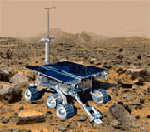

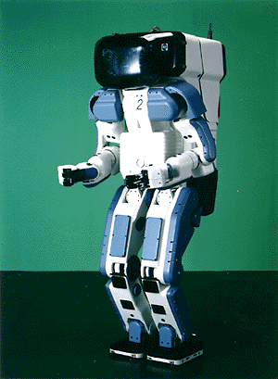

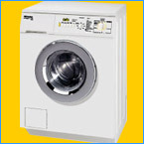


AI in many different fields
Search engines
Science
Medicine/
Diagnosis
Labor
Appliances
What else?

Slide 5
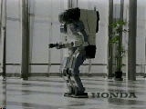
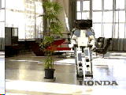
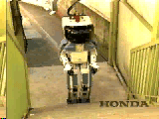
Honda Humanoid Robot
Walk
Turn
http://world.honda.com/robot/
Stairs

Slide 6


Slide 7
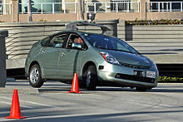
Autonomous Driving

Slide 8
Natural Language Question Answering
http://www.ai.mit.edu/projects/infolab/
https://www.wolframalpha.com/

Slide 9
AI: Rationalistic Approach
An agent must have
A world model
Enough knowledge about the domain it is in
Ability to reason about the world
Ability to understand natural language
Ability to learn from experience

Slide 10
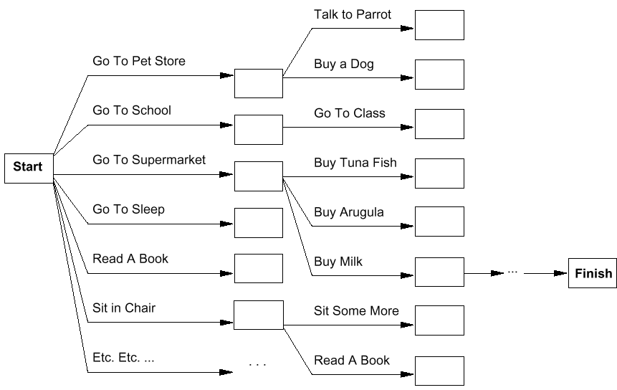
Planning

Slide 11
Planning

Slide 12
AI in First Order Logic
Simple Logic Explained

Slide 13
What is an Argument?
From premises (assumptions), derive (calculate, prove) a conclusion.
Example: two premises:
“All men are mortal (eventually die).”
“Socrates is a man.”
We want to derive the conclusion:
“Socrates is mortal.”

Slide 14

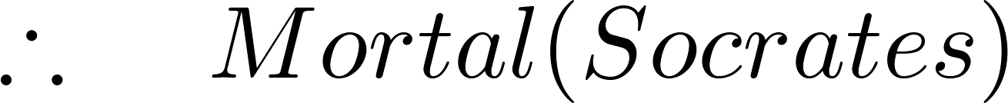
The Argument written in Logic
Premises (above the line) and the conclusion (below the line) in predicate logic:
Is this a correct (valid) argument?

Slide 15
If the premises are p₁ ,p₂, …,p_{n} and the conclusion is q, then a valid argument can be written as:
(p₁ ∧ p₂ ∧ … ∧ p_{n} ) → q
This implication is called a tautology
Rules of inference are used to build (create) a valid argument.

Slide 16
Rules of Inference
For arguments using propositional logic:
Modus Ponens
Modus Tollens
Hypothetical Syllogism
Disjunctive Syllogism
Disjunctive Syllogism
Addition
Simplification
Conjunction
Resolution

Slide 17
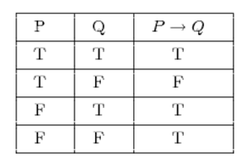
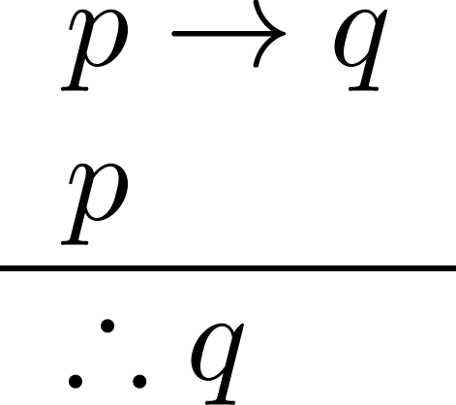
Modus Ponens
Corresponding Tautology:
(p ∧ (p →q)) → q
Example:
Let p be “It is rainy.”
Let q be “I will study ICTMOT.”
“If it is rainy, then I will study study ICTMOT.”
“It is rainy.”
“Therefore , I will study ICTMOT.”

Slide 18
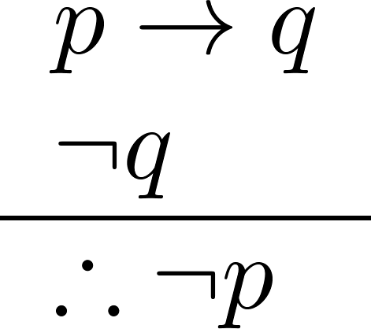
Modus Tollens
Corresponding Tautology:
(¬q ∧ (p →q)) → ¬p
Example:
Let p be “It is rainy.”
Let q be “I will study ICT and MOT.”
“If it is rainy, then I will study ICT and MOT.”
“I will not study ICT and MOT.”
“Therefore, it is not rainy.”

Slide 19
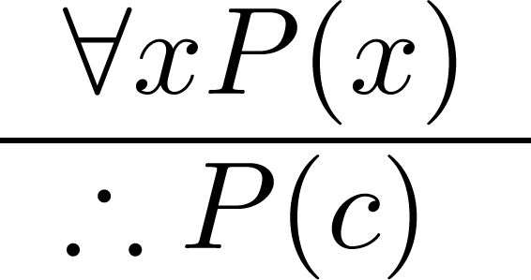
Universal Instantiation (UI)
Example:
Our domain consists of all dogs. (x is the set of dogs)
“All dogs are cute.” (P() means "is cute")
“Therefore, Fido is cute.” ('Fido the dog' is c)

Slide 20
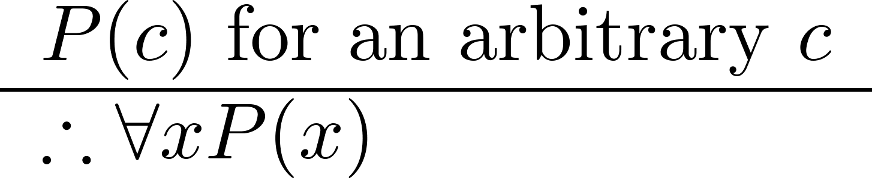
Universal Generalization (UG)
Example:
If you always choose a dog that is cute.
“Therefore, all dogs are cute.”

Slide 21
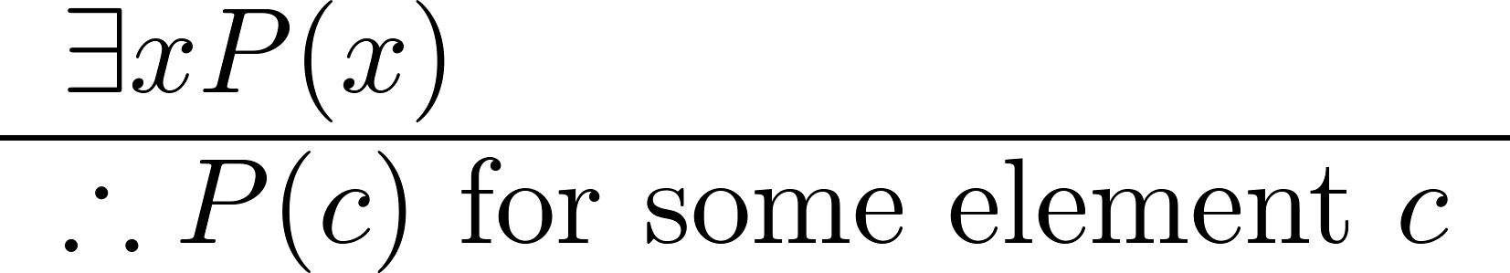
Existential Instantiation (EI)
Example:
“There is someone who got an A in the course.”
“Let’s call her a and say that a got an A”

Slide 22
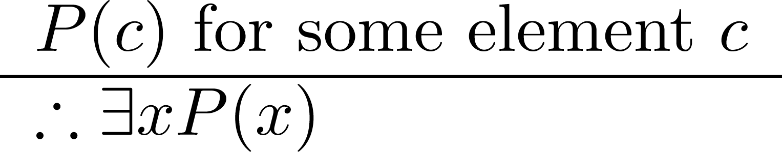
Existential Generalization (EG)
Example:
“Michelle got an A in the class.”
“Therefore, someone got an A in the class.”

Slide 23
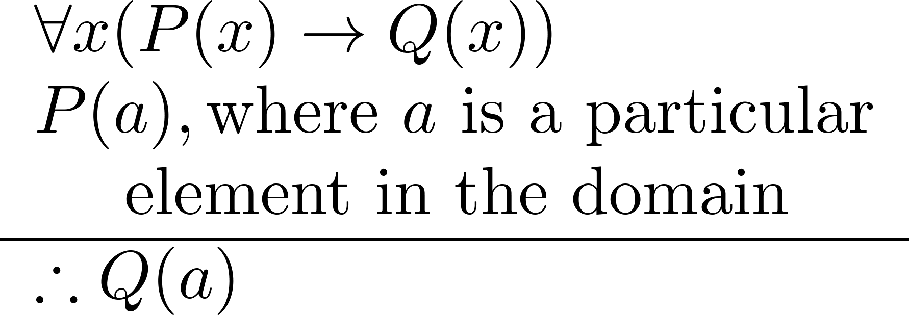
Universal Modus Ponens (MP)
Universal Modus Ponens combines universal instantiation and modus ponens.
See the Socrates example , in the next few slides.

Slide 24
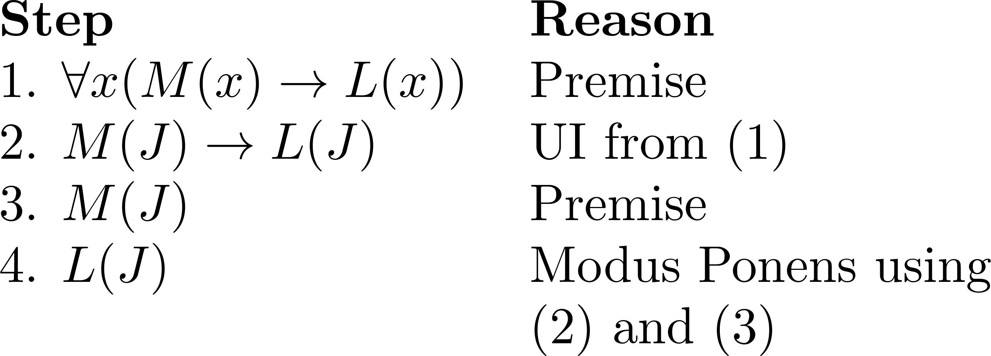
Example 1
Show that the conclusion
“John Smith has two legs”
is a valid argument of the premises:
“Every man has two legs.” “John Smith is a man.”
Solution: Let M(x) denote “x is a man” and L(x) “ x has two legs” and let John Smith (J) be a member of the domain.
Valid Argument:

Slide 25
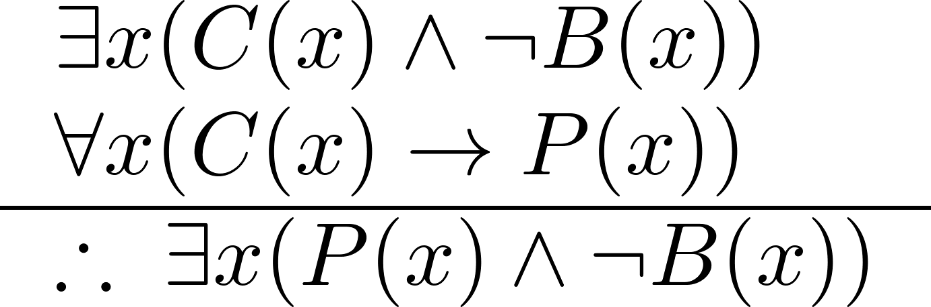
Example 2
Show that the conclusion
“Someone who passed the first exam has not read the book.”
follows from the premises
“A student in this class has not read the book.”
“Everyone in this class passed the first exam.”
Solution: Let C(x) denote “x is in this class,” B(x) denote “ x has read the book,” and P(x) denote “x passed the first exam.”
Translate premises and conclusion into symbolic form:
continued

Slide 26
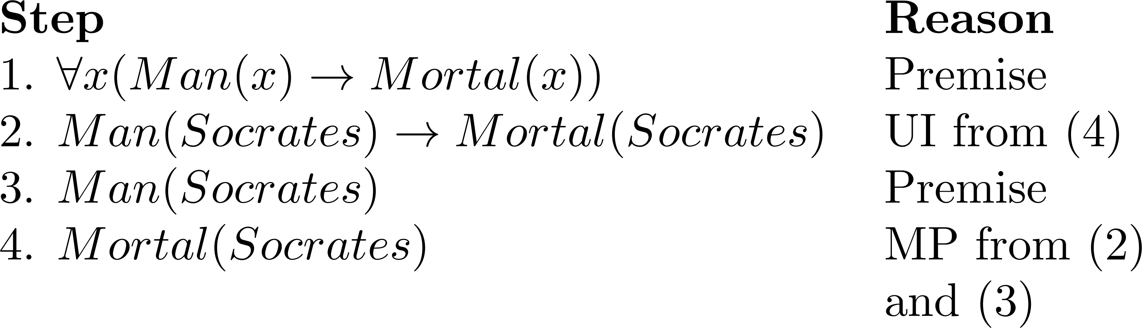
The Socrates Example
Valid Argument

Slide 27
Some Successful Application Fields

Slide 28
Algebraic Expressions and Equations
Simplify
21 + 79
(7x² – x – 4) + (x² – 2x – 3) + (–2x² + 3x + 5)
[ x(x + 3) - 2(x + 3) ] / (x + 3)
Solve
x + 6 = 3
(x – 1)² = 0
x – 4 < 0
–x² + 4 < 0

Slide 29



Calculus Expressions
Evaluate

Slide 30
Problems with First Order Logic in AI
1. Complexity Issue 2. Undecidability Issue
3. Uncertainty Issue

Slide 31
Can a program write a program to solve a problem?
Question:
Can a program make a plan to change its environment to achieve a given goal and then take the series of actions in the plan?

Slide 32
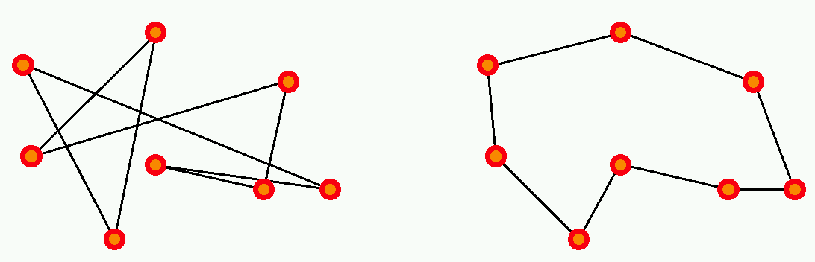
1. Complexity Issue Example: Traveling Salesman Problem
There are n cities, with a road of length L_{ij} joining
city i to city j.
The salesman wishes to find a way to visit all cities that
is optimal in two ways:
each city is visited only once, and
the total route is as short as possible.

Slide 33
Why is exponential complexity “hard”?
It means that the number of operations necessary to compute the exact solution of the problem grows exponentially with the size of the problem (here, the number of cities).
exp(1) = 2.72
exp(10) = 2.20 10⁴ (daily salesman trip)
exp(100) = 2.69 10⁴³ (monthly salesman planning)
exp(500) = 1.40 10²¹⁷ (music band worldwide tour)
exp(250,000) = 10^{108,573} (fedex, postal services)
Fastest
computer = 10¹² operations/second

Slide 34
So…
In general, exponential-complexity problems cannot be solved for any but the smallest instances!

Slide 35
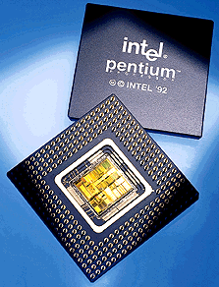
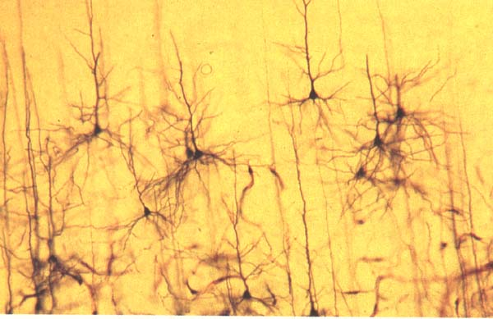
Complexity and the human brain
Are computers close to human brain power?
Current computer chip (CPU):
10^3 inputs (pins)
10^7 processing elements (gates)
2 inputs per processing element (fan-in = 2)
processing elements compute boolean logic (OR, AND, NOT, etc)
Typical human brain:
10^7 inputs (sensors)
10^10 processing elements (neurons)
fan-in = 10^3
processing elements compute complicated functions
Still a lot of improvement needed for computers; but computer clusters come close!

Slide 36
2. Undecidability Issue
Undecidable
Decidable

Slide 37
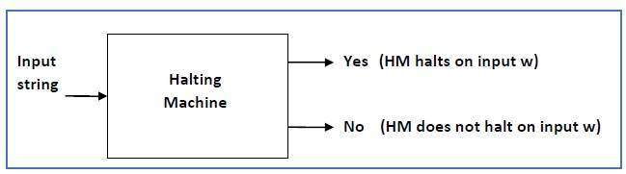
Halting Machine
Suppose we can build a machine (program) that determines a program will halt, aka Halting Machine.
Source from: http://www.tutorialspoint.com/automata_theory/turing_machine_halting_problem.htm

Slide 38
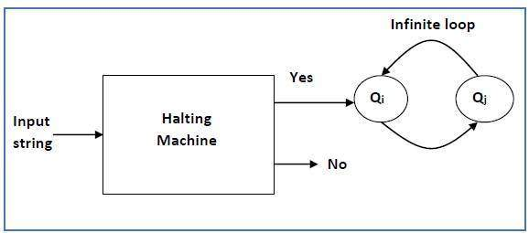
Halting Machine
Halting machine is undecidable
Source from: http://www.tutorialspoint.com/automata_theory/turing_machine_halting_problem.htm

Slide 39
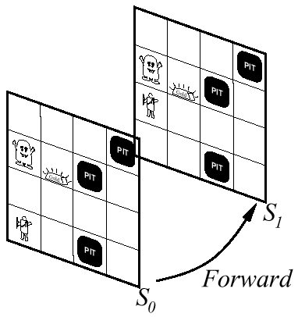
3. Uncertainty

Slide 40
Applying Known Tricks (a.k.a. Heuristics)

Slide 41
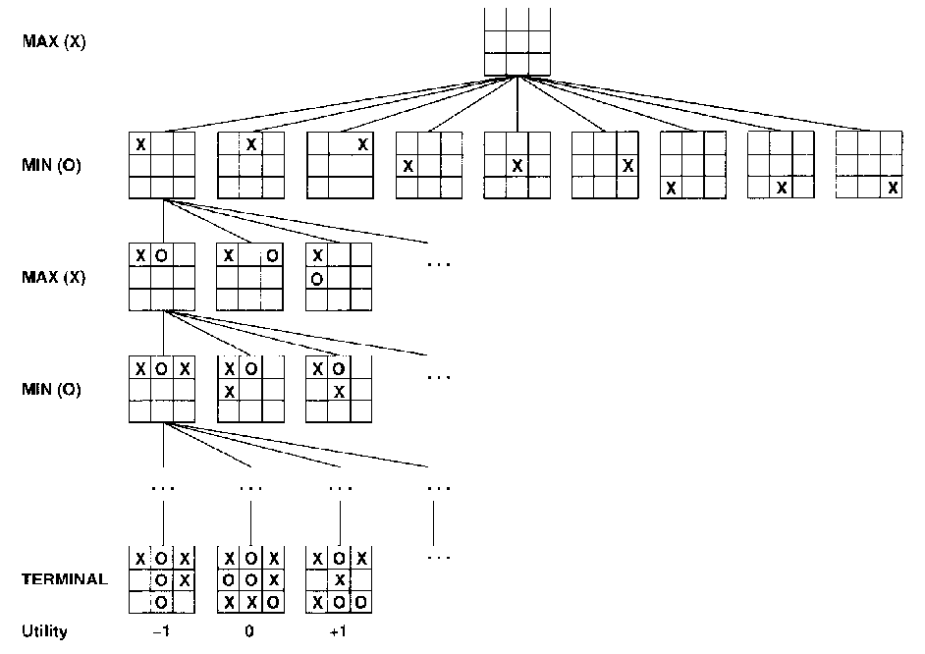
Game Playing
tic-tac-toe

Slide 42
Knowledge Representation

Slide 43
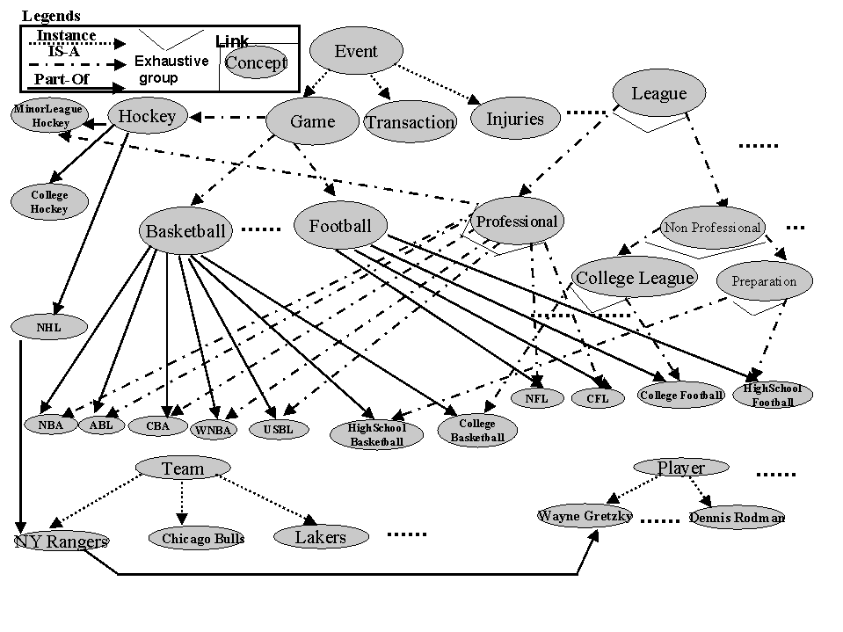
Knowledge – Ontology
Kahn & Mcleod, 2000
An ontology for the sports domain

Slide 44
Cyc Ontology
Cyc contains:
>15,000 Predicates
>300,000 Concepts
>3,500,000 Assertions
Thing
Intangible
Thing
Individual
Sets
Relations
Spatial
Thing
Temporal
Thing
Space
Paths
Partially
Tangible
Thing
Time
Spatial
Paths
Logic
Math
Events
Scripts
Physical
Objects
Borders
Geometry
Artifacts
Agents
Living
Things
Materials
Parts
Statics
Movement
Actors
Actions
Organ-
ization
Ecology
Life
Forms
State Change
Dynamics
Plans
Goals
Organizational
Actions
Types of
Organizations
Natural
Geography
Human
Beings
Plants
Physical
Agents
Organizational
Plans
Human
Activities
Human
Organizations
Political
Geography
Human
Artifacts
Human
Anatomy &
Physiology
Animals
Agent
Organizations
Business &
Commerce
Politics
Warfare
Nations
Governments
Geo-Politics
Weather
Products
Devices
Conceptual
Works
Emotion
Perception
Belief
Human
Behavior &
Actions
Social
Behavior
Purchasing
Shopping
Sports
Recreation
Entertainment
Professions
Occupations
Law
Earth &
Solar System
Vehicles
Buildings
Weapons
Mechanical
& Electrical
Devices
Software
Literature
Works of Art
Language
Social
Relations,
Culture
Social
Activities
Transportation
& Logistics
Travel
Communication
Everyday
Living
Business,
Military
Organizations
The Cyc Knowledge Base
General Knowledge about Various Domains
Specific data, facts, and observations
Cycorp © 2007

Slide 45
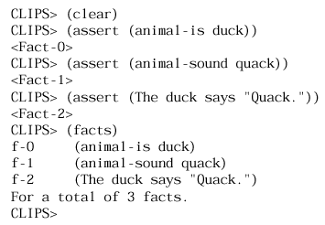
Expert Systems
CLIPS expert system shell

Slide 46
Financial Expert System
R4: if
amount of risk is medium or high and
6 month outlook is up
then
buy aggressive money market fund
R5: if
amount of risk is medium or high and
6 month outlook is down
then
invest mostly in stocks and bonds and
small amount in money market fund

Slide 47
Fuzzy Logic

Slide 48
Tipping example
The Basic Tipping Problem: Given a number between 0 and 10 that represents the quality of service at a restaurant what should the tip be? Cultural footnote: An average tip for a meal in the U.S. is 15%, which may vary depending on the quality of the service provided.

Slide 49
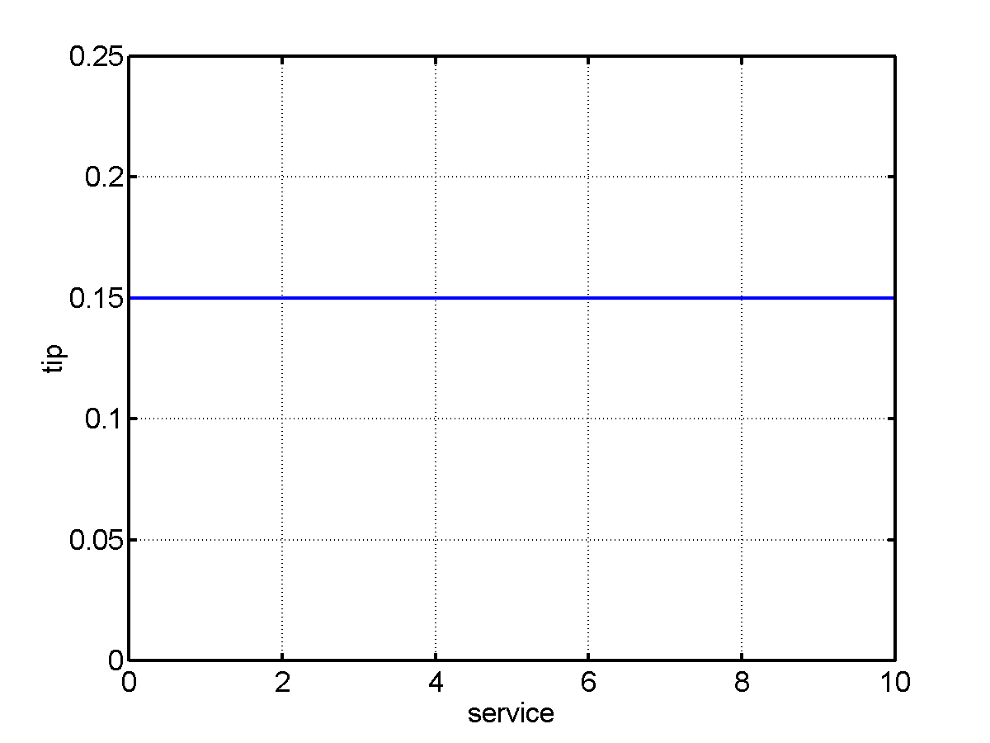
Tipping example: The non-fuzzy approach
Tip = 15% of total bill
What about quality of service?

Slide 50
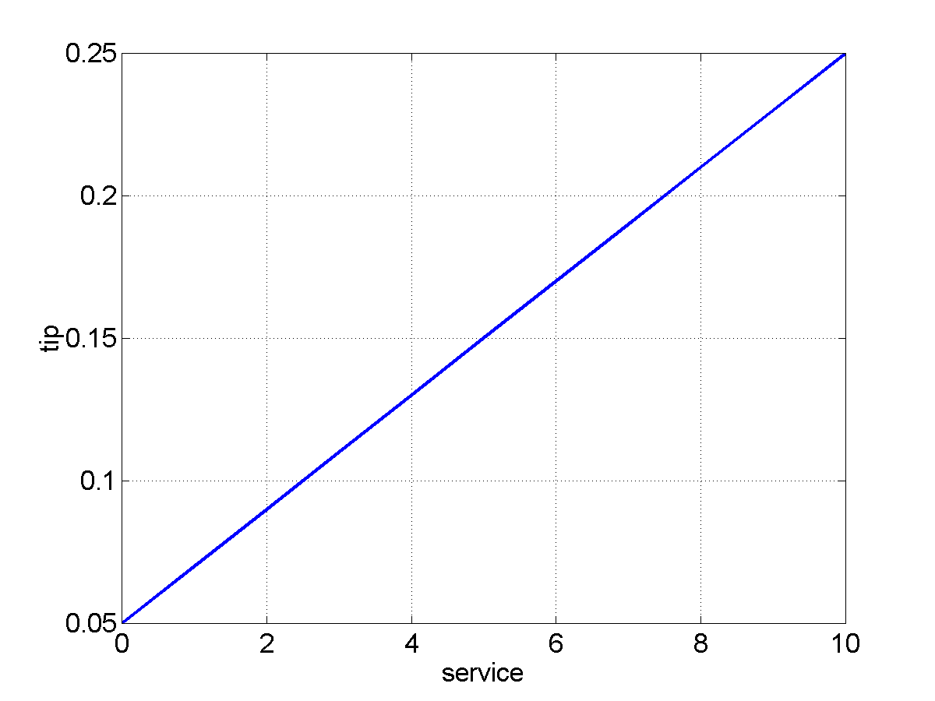
Tipping example: The non-fuzzy approach
Tip = linearly proportional to service from 5% to 25%
tip = 0.20/10*service+0.05
What about quality of the food?

Slide 51
Tipping problem: the fuzzy approach
What we want to express is:
If service is poor then tip is cheap
If service is good the tip is average
If service is excellent then tip is generous
If food is rancid then tip is cheap
If food is delicious then tip is generous
or
If service is poor or the food is rancid then tip is cheap
If service is good then tip is average
If service is excellent or food is delicious then tip is generous
We have just defined the rules for a fuzzy logic system.

Slide 52
Why use fuzzy logic?
Pros:
Conceptually easy to understand w/ “natural” maths
Tolerant of imprecise data
Universal approximation: can model arbitrary nonlinear functions
Intuitive
Based on linguistic terms
Convenient way to express expert and common sense knowledge
Cons:
Not a cure-all
Crisp/precise models can be more efficient and even convenient
Other approaches might be formally verified to work

Slide 53
Non-symbolic Computation

Slide 54
Genetic Algorithm
Add Random Solutions
Mutate
Cross over

Slide 55
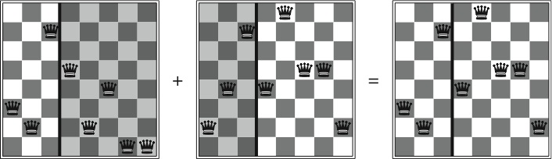
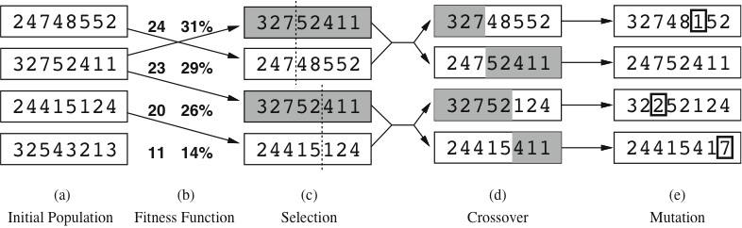
Genetic algorithm: 8-queens example

Slide 56
Bayesian Networks
Based on the Tutorials and Presentations:
(1) Dennis M. Buede Joseph A. Tatman, Terry A. Bresnick;
(2) Jack Breese and Daphne Koller;
(3) Scott Davies and Andrew Moore;
(4) Thomas Richardson
(5) Roldano Cattoni
(6) Irina Rich

Slide 57
Bayes Classifier
A probabilistic framework for solving classification problems
Conditional Probability:
Bayes theorem:

Slide 58
Example of Bayes Theorem (1)
Given:
A doctor knows that meningitis causes stiff neck 50% of the time
Prior probability of any patient having meningitis is 1/50,000
Prior probability of any patient having stiff neck is 1/20
If a patient has stiff neck, what’s the probability he/she has meningitis?

Slide 59
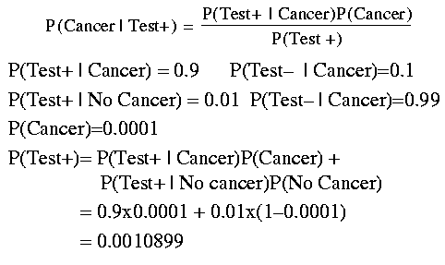
Example of Bayes Theorem (2)
No Cancer)

Slide 60
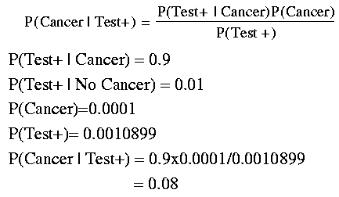
Example of Bayes Theorem(3)

Slide 61
Bayesian (Belief) Networks
Provides graphical representation of probabilistic relationships among a set of random variables
Consists of:
A directed acyclic graph (dag)
Node corresponds to a variable
Arc corresponds to dependence relationship between a pair of variables
A probability table associating each node to its immediate parent

Slide 62
Probability Tables
If X does not have any parents, table contains prior probability P(X)
If X has only one parent (Y), table contains conditional probability P(X|Y)
If X has multiple parents (Y₁, Y₂,…, Y_{k}), table contains conditional probability P(X|Y₁, Y₂,…, Y_{k})

Slide 63
Example of Bayesian Belief Network

Slide 64
Applications of BBN
Medical diagnostic systems
Spam filters and classification
Sports result prediction
Identify missing persons
Decision Support in Business Environment
cause
cause
symptom
symptom
Medicine
Speech
recognition
Bio-informatics
Text
Classification
Stock market
Computer
troubleshooting

Slide 65
Basic References
Pearl, J. (1988). Probabilistic Reasoning in Intelligent Systems. San Mateo, CA: Morgan Kauffman.
Oliver, R.M. and Smith, J.Q. (eds.) (1990). Influence Diagrams, Belief Nets, and Decision Analysis, Chichester, Wiley.
Neapolitan, R.E. (1990). Probabilistic Reasoning in Expert Systems, New York: Wiley.
Schum, D.A. (1994). The Evidential Foundations of Probabilistic Reasoning, New York: Wiley.
Jensen, F.V. (1996). An Introduction to Bayesian Networks, New York: Springer.

Slide 66
Algorithm References
Chang, K.C. and Fung, R. (1995). Symbolic Probabilistic Inference with Both Discrete and Continuous Variables, IEEE SMC, 25(6), 910-916.
Cooper, G.F. (1990) The computational complexity of probabilistic inference using Bayesian belief networks. Artificial Intelligence, 42, 393-405,
Jensen, F.V, Lauritzen, S.L., and Olesen, K.G. (1990). Bayesian Updating in Causal Probabilistic Networks by Local Computations. Computational Statistics Quarterly, 269-282.
Lauritzen, S.L. and Spiegelhalter, D.J. (1988). Local computations with probabilities on graphical structures and their application to expert systems. J. Royal Statistical Society B, 50(2), 157-224.
Pearl, J. (1988). Probabilistic Reasoning in Intelligent Systems. San Mateo, CA: Morgan Kauffman.
Shachter, R. (1988). Probabilistic Inference and Influence Diagrams. Operations Research, 36(July-August), 589-605.
Suermondt, H.J. and Cooper, G.F. (1990). Probabilistic inference in multiply connected belief networks using loop cutsets. International Journal of Approximate Reasoning, 4, 283-306.

Slide 67
Homework
Read and Summarize Breiman,
“Statistical Modeling: The Two Cultures”

Slide 68
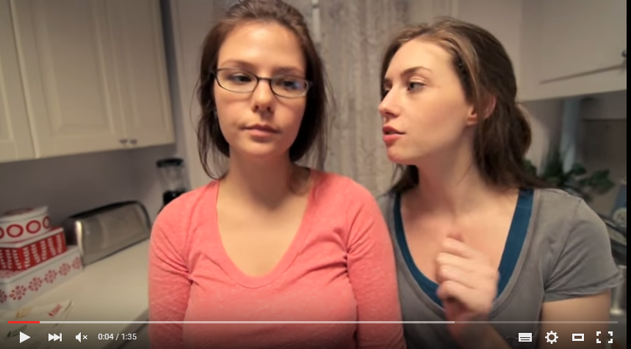
Google Translator Example
https://www.youtube.com/watch?v=wxDRburxwz8

