Slide 1
Slider: Applications on YARN
Provisioning, Managing, and Monitoring YARN Applications
Steve Loughran
@steveloughran (@hortonworks)
Sumit Mohanty
@smohanty (@hortonworks)

Slide 2


Hadoop 1.0: MR only

Slide 3

YARN: run whatever you want

Slide 4
Your code
Knuth
YARN
Lamport
HDFS
Swinehart et al.
Network
Cerf
Host OS
Kernighan

Slide 5
Modern applications
web
front end
database
front end
front end
phones
stream processing
devices
feeds
log
log
log
analytics

Slide 6
Fun operational problems
Resource Allocation: where to run?
Installation
Configuration & Binding
Client configuration
Lifecycle
Start/Stop
Reconfigure
Scale up/down
Rolling-restart
Decommission/Recommission
Failure handing and recovery
Logging
Upgrading
Metrics & Monitoring

Slide 7
Getting your code to work across a set of fairly reliable machines

Slide 8
YARN runs code across the cluster
Servers run YARN Node Managers
NM's heartbeat to Resource Manager
RM schedules work over cluster
RM allocates containers to apps
NMs start containers
NMs report container health
YARN Resource Manager “The RM”
YARN Node Manager
HDFS
HDFS
YARN Node Manager
YARN Node Manager
HDFS
HDFS

Slide 9
Client creates App Master
YARN Resource Manager “The RM”
Client
YARN Node Manager
Application Master
HDFS
HDFS
YARN Node Manager
YARN Node Manager
HDFS
HDFS

Slide 10
“AM” requests containers
YARN Resource Manager
YARN Node Manager
Application Master
HDFS
Container
HDFS
YARN Node Manager
YARN Node Manager
Container
Container
HDFS
HDFS

Slide 11
Application on YARN
Do I need to re-write parts of my application?
How do I package my application for YARN?
How do I configure my application?
How do I debug my application?
Can I still manage my application?
Can I monitor my application?
Can I manage inter-/intra-application dependencies?
How will the external clients communicate?
What does it take to secure the application?

Slide 12
Apache Slider
deploying and managing existing apps on YARN
http://slider.incubator.apache.org/

Slide 13
Components of Slider
AppMaster
AgentProvider
Agent
AppPackage
CLI
Registry
Slider
App Package
Slider
CLI
YARN Resource Manager “The RM”
YARN Node Manager
HDFS
Slider App Master
Agent
Component
HDFS
YARN Node Manager
Registry
Agent
Component
HDFS

Slide 14
Starting
CLI starts an instance of the AM
AM requests containers
Containers activate with an Agent
Agent gets application definition
Agent registers with Slider AM
AM issues commands
Agent reports back, status, configuration, etc.
AM publishes endpoints, configurations
Slider
App Package
Slider
CLI
YARN Resource Manager “The RM”
1
2
YARN Node Manager
HDFS
7
Slider App Master
5
7
5
6
Agent
Component
3
HDFS
YARN Node Manager
4
8
Registry
6
Agent
Component
3
HDFS
4

Slide 15
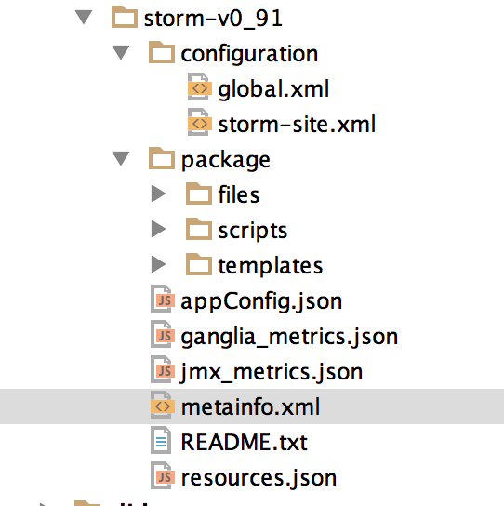
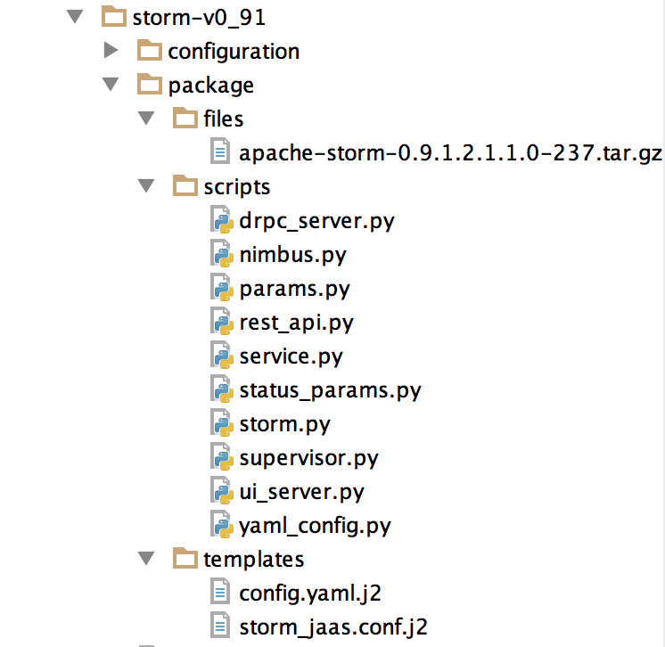
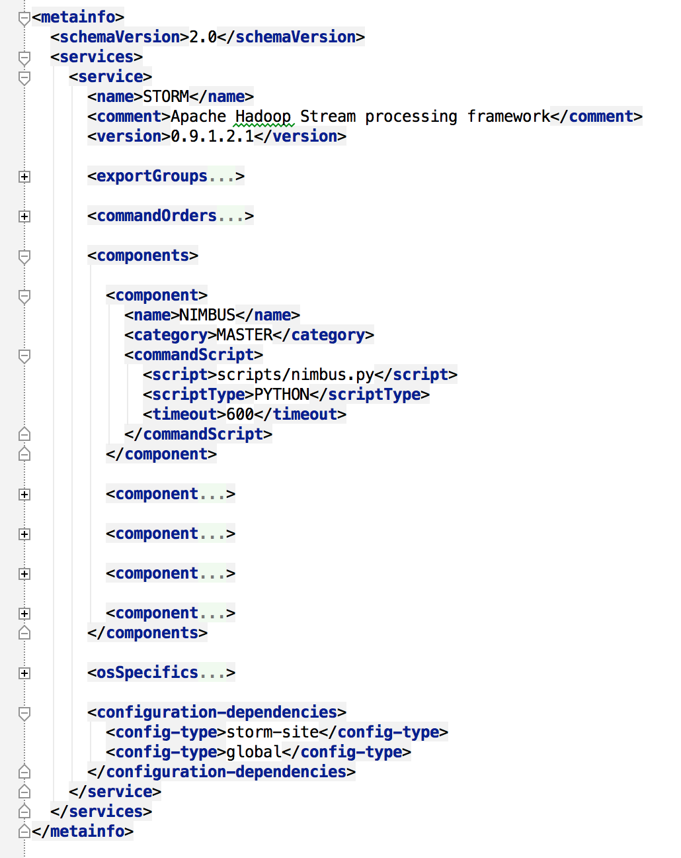
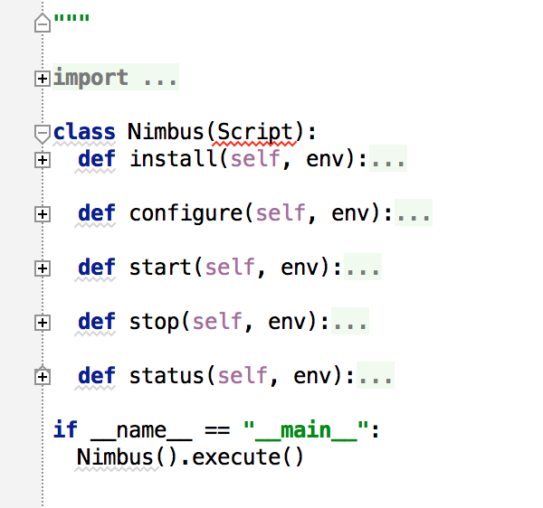
App Package: zip + XML + .py + bin

Slide 16
Slider Metainfo
<metainfo><services><service>
<name>HBASE</name>
<version>0.96.0.2.1.1</version>
<exportGroups><exportGroup>
<name>QuickLinks</name>
<exports><export>
<name>org.apache.slider.jmx</name>
<value>http://${HBASE_MASTER_HOST}:${site.hbase-site.hbase.master.info.port}/jmx</value>
</export></exports></exportGroup></exportGroups>
<commandOrders><commandOrder>
<command>HBASE_REGIONSERVER-START</command>
<requires>HBASE_MASTER-STARTED</requires>
</commandOrder></commandOrders>
<components><component>
<name>HBASE_MASTER</name>
<category>MASTER</category>
<minInstanceCount>1</minInstanceCount>
<commandScript>
<script>scripts/hbase_master.py</script>
</commandScript></component></components>
</service></services></metainfo>
Application Info
Publish an URI
Commands have dependencies
Contains components
Commands are implemented as scripts

Slide 17
resource.json (in HDFS)
{
"schema": "http://example.org/specification/v2.0.0",
"metadata": {
},
"global": {
},
"components": {
"HBASE_MASTER": {
"yarn.role.priority": "1",
"yarn.component.instances": "1",
"yarn.memory": "1024",
"yarn.vcores": "1",
},
"slider-appmaster": {
},
"HBASE_REGIONSERVER": {
"yarn.role.priority": "2",
"yarn.component.instances": "1"
}
}
}
YARN resource requirements
Unique priorities

Slide 18
app_config.json
{
"application.def": "/slider/hbase_v096.zip",
"java_home": "/usr/jdk64/jdk1.7.0_45",
"site.global.app_log_dir": "${AGENT_LOG_ROOT}/app/log",
"site.global.app_pid_dir": "${AGENT_WORK_ROOT}/app/run",
"site.global.hbase_master_heapsize": "1024m",
"site.global.ganglia_server_host": "${NN_HOST}",
"site.global.ganglia_server_port": "8667",
"site.global.ganglia_server_id": "Application1",
"site.hbase-site.hbase.tmp.dir": "${AGENT_WORK_ROOT}/work/app/tmp",
"site.hbase-site.hfile.block.cache.size": "0.40",
"site.hbase-site.hbase.security.authentication": "simple",
"site.hbase-site.hbase.master.info.port": "${HBASE_MASTER.ALLOCATED_PORT}",
"site.hbase-site.hbase.regionserver.port": "0",
"site.hbase-site.hbase.zookeeper.quorum": "${ZK_HOST}",
"site.core-site.fs.defaultFS": "${NN_URI}",
}
Configurations needed by Slider
Named variables
Variables for the application scripts
Site variables for application
Allocate and advertise
Named variables for cluster details

Slide 19
Failures: YARN notifies Slider AM
YARN Resource Manager
YARN Node Manager
Slider Application Master
HDFS
HDFS
YARN Node Manager
YARN Node Manager
Container
Container
Container
HDFS
HDFS

Slide 20
YARN-913 Application Registry
Zookeeper-based registry, hadoop-yarn-registry.jar
lists internal & external service endpoints (REST, ZK, IPC, …)
Registry is world-readable, could offer as DNS?
Slider uses to publish REST & Web views
…including REST API to serve up application configurations
RM sets up secure paths; cleans up records on completion events
Any Hadoop app can publish their bindings
clients can query it (today: Java, python)
TODO: REST, CLI, off-cluster (via Apache Knox)
Call to Action: embrace the registry

Slide 21
Slider View for Apache Ambari
http://ambari.apache.org/

Slide 22
Slider “Bound” to a Mgmt. Infrastructure
Slider
App Package
Registry
YARN Resource Manager “The RM”
Ambari
YARN Node Manager
HDFS
Ambari imports app packages
Starts the AM
Interacts with AM to start containers
Agents register with Ambari
Ambari sends commands/ receives results
YARN maintains ownership of containers
Ambari interacts with Registry
Slider App Master
Agent
Component
HDFS
YARN Node Manager
Registry
Agent
Component
HDFS
Notes:
We recently integrated the ambari agent into Slider. Currently the heart beat and registration messages are identical to the ones that are exchanged between the host agent and ambari server. The agent is hosted within each application component container and communicates with the slider App Master. The app master currently has a simple state machine implementation for guiding the components through install and start. I imagine this means that the integration between an Ambari server and slider container hosted components should be relatively straightforward, though moving forward I imagine the nature of the messages exchanged may be modified and the fact that the agent is per-container as opposed to per-host may require some modifications on the server side.

Slide 23
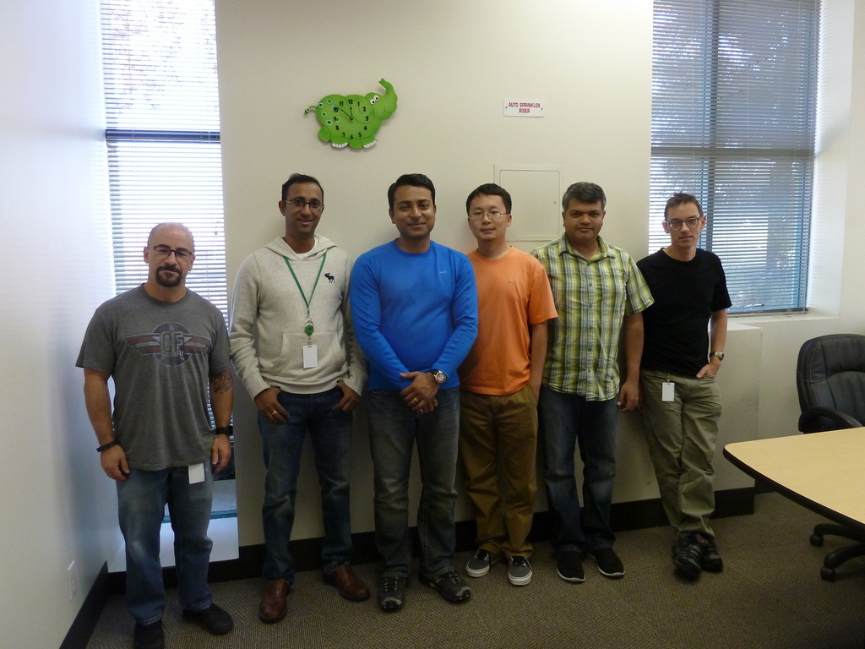
Come and Play
Bring your favorite Applications to YARN
http://slider.incubator.apache.org/
mailto: dev@slider.incubator.apache.org

Slide 24
Other strategies for in-cluster apps?
Apache Helix
Apache Twill: distributed runnables.
Workflows: Tez

