Slide 1

Emergence of SQL over Hadoop
Sudheesh Narayanan
Chief Architect – Big Data

Slide 2

About Me
Author of
My Expertise
Hadoop and Ecosystem Components
Machine Learning
Text Analytics
Image Analytics
Data Science
Real Time Event Stream Processing
NoSQL Databases
Complex Event Processing

Slide 3
Agenda
Why SQL Over Hadoop ?
Technology Landscape
Fundamentals behind SQL over Hadoop
Understand different type of SQL over Hadoop
Architecture Comparisons
Conclusions

Slide 4
SQL has come full Circle!!
SQL has been ruling since 1970!!
Hadoop came…But little traction…
Facebook open-sourced HIVE in 2008.. Hadoop takes the next leap in adoption
RDBMS and MPP Vendors brought Hadoop Connectors
Niche players used SQL engine to run Distributed Query on Hadoop
In 2012 Cloudera Impala sets the trend for Real time Query over Hadoop
Facebook open sourced Presto in 2013!!

Slide 5










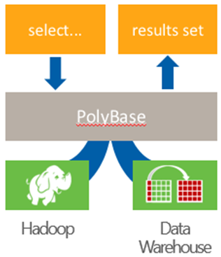





SQL OVER HADOOP IS REALLY CROWDED!!
Which one is better!!

Slide 6
HIVE → First SQL over Hadoop!!
Map Reduce Latency
Storage Formats
Compressions
Schema on Read
Mid-Query Fault Tolerance
HQL
(Hive Query Language)
HIVE
Query Engine
Metastore
Map-Reduce Pipelines
Hadoop
Name Node
Job Tracker/ Resource Manager
Processing Logic(MR)
Processing Logic(MR)
Processing Logic(MR)
Processing Logic(MR)
Data Blocks
Data Blocks
Data Blocks
Data Blocks
Node1
Node 2
Node 3
Node…

Slide 7
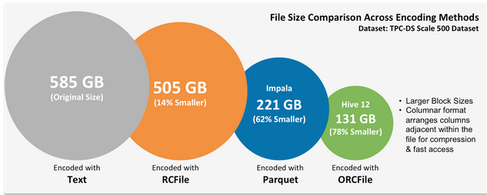
The Fundamentals!!
Processing Logic
App Server
App Server
Data Transfer
Data
Network Switch
Network Latency
Storage Layer
Scalability
File Formats and Compressions
ANSI SQL Compliance
DB Server
Query Engine
Storage Switch
Storage Array
Disk1
Disk2
Disk3
Source: http://hortonworks.com/labs/stinger/

Slide 8
So Lets Understand different types of SQL Over Hadoop!!

Slide 9

Type 1→MapReduce Batch
Map Reduce Latency still exist
File Format Support
Improved Query Optimizer
Vectorized Query Engine
1
2
HQL
(Hive Query Language)
3
HIVE
4
Query Engine
Metastore
Map-Reduce
Pipelines
IBM BigSQL
Hadoop
Node 1
Node 2
Node 3
Stinger Improved Original HIVE Performance by 35%

Slide 10
Type 2:- Pull Data Out of HDFS to Query Engine
RDBMS Vendors supporting Hadoop as External Tables
Oracle Hadoop Connector
DB2 Hadoop Connector
Microsoft PDW Connector
SQL
Database Server
Leverage Database Query Engine
No Data Local Processing
Full ANSI SQL Compliance
Poor Response Time (Limited to Low Volumes)
Query Engine
Pull Data from HDFS
Hadoop
Data Node
Data Node
Data Node

Slide 11
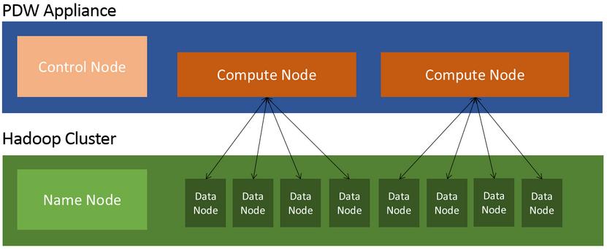
Type 3:- Pull Data Out of HDFS to Parallel Query Engine
Leverage Specialized Query Engine
No Data Local Processing
Full ANSI SQL Compliance
Better Response Time due to Parallel processing
Query Node is separate from Data Node!!
SQL
Polybase

Slide 12
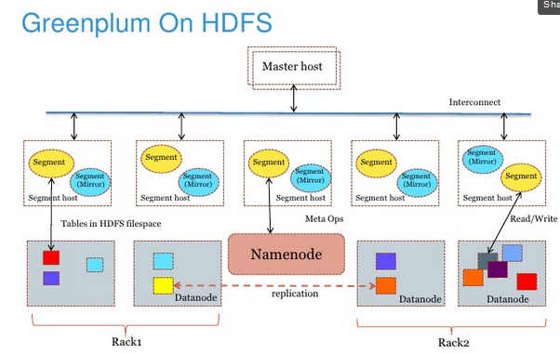
Type 4:- MPP Database using HDFS as Data store
Leverage MPP Query Framework
Data Local Processing but streaming pipeline
ANSI SQL Compliance
Response Time is good
SQL
Example
Example
Example
Greenplum over HDFS
Data is moved out of HDFS to MPP Engine

Slide 13
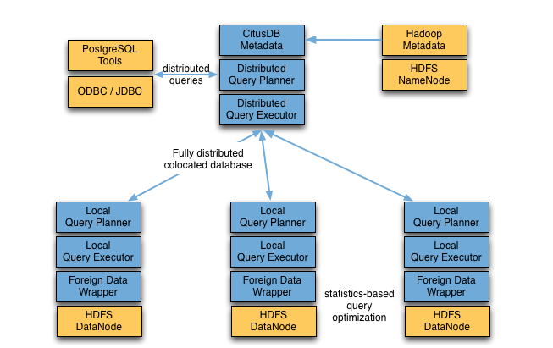
Type 5:- RDBMS Locally on a HDFS Node
Wrapper for access Hadoop data locally on each node
Data Local Processing
Limited ANSI SQL Compliance
Response Time is better than HIVE
Metadata is replicated
Still File Formats and Compression support expected
SQL
Example
Example
Query is pushed down to the local DB Engine on Each Node

Slide 14
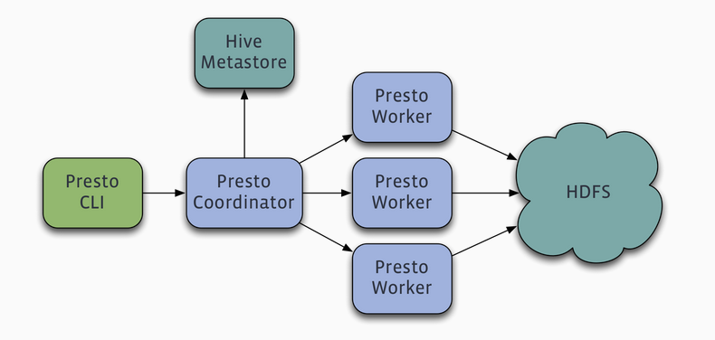
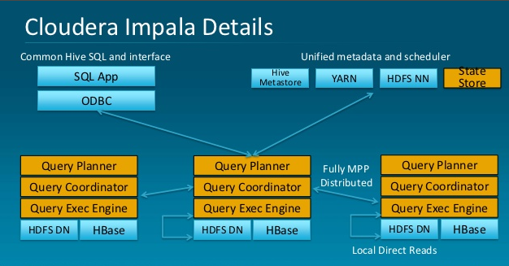
Type 6:- Distributed Native SQL Query on HDFS
Distributed SQL Engine
Data Local Processing with streaming Pipeline
Limited ANSI SQL support
Fast Response Time and Highly Scalable
Different File Format and Compressions

Slide 15
Summary The 6 Types of SQL over Hadoop!!
Batch Map Reduce
RDBMS Connector to HDFS as External Tables
MPP Database using HDFS as storage
Distributed Query Engine
RDBMS Store Locally on HDFS Node
Parallel Query Engine pull data out of HDFS

Slide 16
What should you look for when you choose SQL over Hadoop!!
Standard ANSI SQL Compliance
Support Variety of File Formats including Compressions
Optimized Query Engine
JDBC/ODBC Connectivity
Linear Scalability
Low Latency Query and Cost
Push Down Distributed Data Local Processing

