Slide 1
A Course on Probabilistic Databases

Slide 2
Probabilistic Databases
Data: standard relational data, plus probabilities that measure the degree of uncertainty
Queries: standard SQL queries, whose answers are annotated with output probabilities

Slide 3
A Little History of Probabilistic DBs
Early days
Recent work
Wong’82
Shoshani’82
Cavallo&Pittarelli’87
Barbara’92
Lakshmanan’97,’01
Fuhr&Roellke’97
Zimanyi’97
Stanford (Trio)
UW (MystiQ)
Cornell (MayBMS)
Oxford (MayBMS)
U.of Maryland
IBM Almaden (MCDB)
Rice (MCDB)
U. of Waterloo
UBC
U. of Florida
Purdue University
U. of Wisconsin
Main challenge:
Query Evaluation
(=Probabilistic Inference)
Notes:
Research on prob db is 30 years old. Today there is a lot of interest, because of the demand from a variety of applications. However, despite this long history and recent interest, today there are no usable probabilistic database system. This is because of a core, computational challenge: the challenge of combining relational calculus (FO) with probabilities.

Slide 4
Why?
Many applications need to manage uncertain data
Information extraction
Knowledge representation
Fuzzy matching
Business intelligence
Data integration
Scientific data management
Data anonymization

Slide 5
What?
Probabilistic Databases extend Relational Databases with probabilities
Combine Formal Logic with Probabilistic Inference
Requires a new thinking for both databases and probabilistic inference

Slide 6
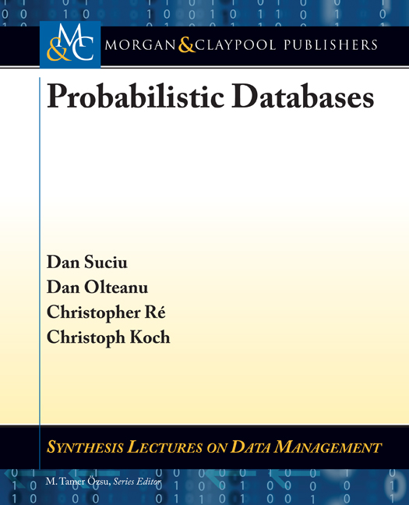
This Course: Query Evaluation
Based on the book:

Slide 7
Outline of the Tutorial
Part 1
Motivating Applications
The Probabilistic Data Model Chapter 2
Extensional Query Plans Chapter 4.2
The Complexity of Query Evaluation Chapter 3
Extensional Evaluation Chapter 4.1
Intensional Evaluation Chapter 5
Conclusions
Part 2
Part 3
Part 4

Slide 8
What You Will Learn
Background:
Relational data model: tables, queries, relational algebra
PTIME, NP, #P
Model counting: DPLL, OBDD, FBDD, d-DNNF
In detail:
Extensional plans, extensional evaluation, running them in postgres
The landscape of query complexity: from PTIME to #P-complete,
Query compilation: Read-Once Formulas, OBDD, FBDD, d-DNNF
Less detail:
The #P-hardness proof, complexity of BDDs
Omitted:
Richer data models: BID, GM, XML, continuous random values)
Approximate query evaluation,
Ranking query answers

Slide 9
Related Work. See book, plus:
These references are not in the book
Wegener: Branching programs and binary decision diagrams: theory and applications, 2000
Dalvi, S.: The dichotomy of probabilistic inference for unions of conjunctive queries, JACM’2012
Huang, Darwiche: DPLL with a Trace: From SAT to Knowledge Compilation, IJCAI 2005
Beame, Li, Roy, S.: Lower Bounds for Exact Model Counting and Applications in Probabilistic Databases, UAI’13
Gatterbauer, S.: Oblivious Bounds on the Probability of Boolean Functions, under review
The applications are from:
Ré, Letchner, Balazinska, S: Event queries on correlated probabilistic streams. SIGMOD Conference 2008
Gupta, Sarawagi: Creating Probabilistic Databases from Information Extraction Models. VLDB 2006
Stoyanovich, Davidson, Milo, Tannen: Deriving probabilistic databases with inference ensembles. ICDE 2011
Beskales, Soliman, Ilyas, Ben-David: Modeling and Querying Possible Repairs in Duplicate Detection. PVLDB 2009
Kumar, Ré: Probabilistic Management of OCR Data using an RDBMS. PVLDB 2011

Slide 10
A Course on Probabilistic Databases
Lecture 1: Motivating Applications

Slide 11
Outline
Part 1
Motivating Applications
The Probabilistic Data Model Chapter 2
Extensional Query Plans Chapter 4.2
The Complexity of Query Evaluation Chapter 3
Extensional Evaluation Chapter 4.1
Intensional Evaluation Chapter 5
Conclusions
Part 2
Part 3
Part 4

Slide 12
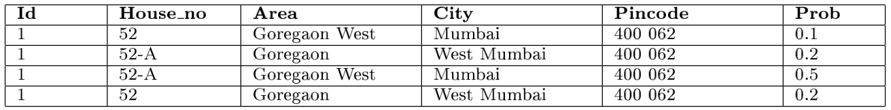
Example 1: Information Extraction
[Gupta’2006]
52-A Goregaon West Mumbai 400 076
CRF
Standard DB: keep the most likely extraction
Probabilistic DB: keep most/all extractions to increase recall
Key finding: the probabilities given by CRFs correlate well with the precision of the extraction.
Notes:
IIT Bombay

Slide 13
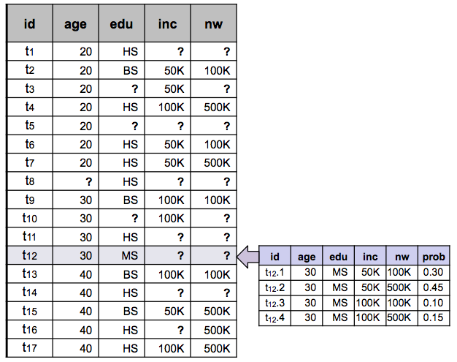
Example 2: Modeling Missing Data
[Stoyanovich’2011]
Standard DB: NULL
Probabilistic DB: distribution on possible values
Key technique: Meta Rule Semi-Lattice for inferring missing attributes.
Notes:
Stoyanovich, Davidson, Milo, Tannen
UPENN

Slide 14
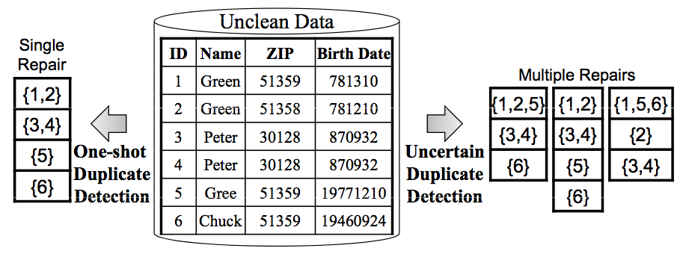
Example 3: Data Cleaning
[Beskales’2009]
Standard DB cleaning data means choosing one possible repair
Probabilistic DB keep many/all possible repairs
Challenge: Representing multiple repairs.
[Beskaes’2009] restrict to hierarchical repairs.
Notes:
Beskales, Soliman, Ilyas, Ben-David
WATERLOO

Slide 15
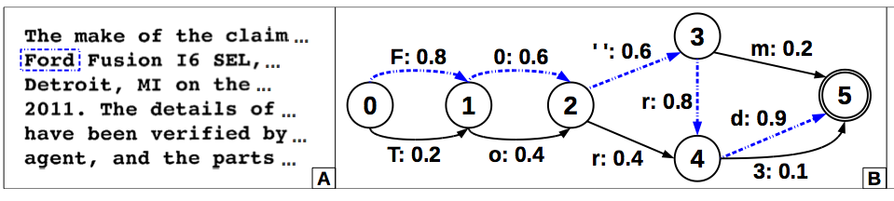
Example 4: OCR
[Kumar’2011]
They use OCRopus from Google Books: output is a stohastic automaton
Traditionally: retain only the Maximum Apriori Estimate (MAP)
With a probabilistic database: may retain several alternative recognitions: increase recall.
SELECT DocId, Loss FROM Claims WHERE Year = 2010 AND DocData LIKE '%Ford%’;
Notes:
WISCONSIN

Slide 16
Summary of Applications
Structured, but uncertain data
Modeled as probabilistic data
Answers to SQL queries annotated with probabilities
Probabilistic database:
Combine data management with probabilistic inference

