Slide 1
A Course on Probabilistic Databases
Dan Suciu
University of Washington

Slide 2
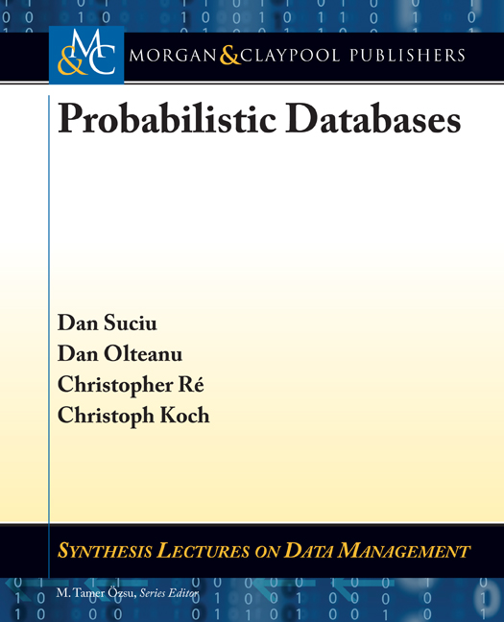
Outline
Part 1
Motivating Applications
The Probabilistic Data Model Chapter 2
Extensional Query Plans Chapter 4.2
The Complexity of Query Evaluation Chapter 3
Extensional Evaluation Chapter 4.1
Intensional Evaluation Chapter 5
Conclusions
Part 2
Part 3
Part 4

Slide 3
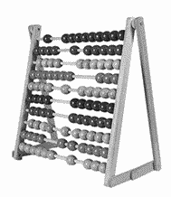
The Model Counting Problem
Given a Boolean Formula F, compute the number of satisfying assignments #F
If F has n Boolean variables, then 0 ≤ #F ≤ 2^{n}
SAT is the problem: Given F, check if there exists a satisfying assignment SAT is NP-complete
#SAT is the model counting problem: Given F, compute #F #SAT is #P-complete
We can reduce SAT to #SAT
Probability computation is the problem: if each Boolean variable X_{i} is set to true with probability p_{i}, compute P(F), the probability that F is true Also #P-complete

Slide 4
Example
F = X₁Y₁ ∨ X₁Y₂ ∨ X₂Y₃ ∨ X₂Y₄
The Model Counting Problem (#SAT): Compute #F

Slide 5
Example
F = X₁Y₁ ∨ X₁Y₂ ∨ X₂Y₃ ∨ X₂Y₄
The Model Counting Problem (#SAT): Compute #F
P(X₁) = p₁, P(X₂) = p₂, P(Y₁) = q₁, P(Y₂) = q₂, P(Y₃) = q₃, P(Y₄) = q₄
The Probability Computation Problem: Compute P(F)

Slide 6
Example
F = X₁Y₁ ∨ X₁Y₂ ∨ X₂Y₃ ∨ X₂Y₄
The Model Counting Problem (#SAT): Compute #F
P(X₁) = p₁, P(X₂) = p₂, P(Y₁) = q₁, P(Y₂) = q₂, P(Y₃) = q₃, P(Y₄) = q₄
The Probability Computation Problem: Compute P(F)
Re-group:
F = [X₁ (Y₁ ∨ Y₂ )] ∨ [X₂ (Y₃ ∨ Y₄)]
P(F)=1 – [1-p₁(1-(1-q₁)(1-q₂))] [1-p₂(1-(1-q₃)(1-q₄))]

Slide 7
Example
F = X₁Y₁ ∨ X₁Y₂ ∨ X₂Y₃ ∨ X₂Y₄
The Model Counting Problem (#SAT): Compute #F
P(X₁) = p₁, P(X₂) = p₂, P(Y₁) = q₁, P(Y₂) = q₂, P(Y₃) = q₃, P(Y₄) = q₄
The Probability Computation Problem: Compute P(F)
Re-group:
F = [X₁ (Y₁ ∨ Y₂ )] ∨ [X₂ (Y₃ ∨ Y₄)]
P(F)=1 – [1-p₁(1-(1-q₁)(1-q₂))] [1-p₂(1-(1-q₃)(1-q₄))]
#F = 2⁶ P(F), when p₁ = … = q₄ = 0.5 #F = 34

Slide 8
Now let’s try this:
F = X₁X₂ ∨ X₁X₃ ∨ X₂X₃

Slide 9
Now let’s try this:
F = X₁X₂ ∨ X₁X₃ ∨ X₂X₃
No clever grouping seems possible.
Use brute force:
X₁ | X₂ | X₃ | F | P
0 | 0 | 0 | 0
0 | 0 | 1 | 0
0 | 1 | 0 | 0
0 | 1 | 1 | 1 | (1-p₁)p₂p₃
1 | 0 | 0 | 0
1 | 0 | 1 | 1 | p₁(1-p₂)p₃
1 | 1 | 0 | 1 | p₁p₂(1-p₃)
1 | 1 | 1 | 1 | p₁p₂p₃

Slide 10
Now let’s try this:
F = X₁X₂ ∨ X₁X₃ ∨ X₂X₃
No clever grouping seems possible.
Use brute force:
X₁ | X₂ | X₃ | F | P
0 | 0 | 0 | 0
0 | 0 | 1 | 0
0 | 1 | 0 | 0
0 | 1 | 1 | 1 | (1-p₁)p₂p₃
1 | 0 | 0 | 0
1 | 0 | 1 | 1 | p₁(1-p₂)p₃
1 | 1 | 0 | 1 | p₁p₂(1-p₃)
1 | 1 | 1 | 1 | p₁p₂p₃
P(F)=(1-p₁)p₂p₃ + p₁(1-p₂)p₃ + p₁p₂(1-p₃) + p₁p₂p₃
#F = 4

Slide 11
Complexity of Model Counting
SAT is the problem: Given F, check if there exists a satisfying assignment
#SAT is the problem: Given F, compute #F
Theorem [Valiant:1979] #SAT is #P-complete
NP = class of problems of the form “is there a witness ?” SAT
#P = class of problems of the form “how many witnesses ?” #SAT
Interesting fact: The decision problem 2CNF is in PTIME The counting problem #2CNF is #P-complete

Slide 12
PP2DNF Formulas
Definition. A Positive, Partitioned 2DNF (PP2DNF) formula is:
F = X_{i1} Y_{j1} ∨ X_{i1} Y_{j1} ∨ … ∨ X_{in} Y_{jn}
Example: F = X₁ Y₃ ∨ X₂ Y₁ ∨ X₂ Y₃ ∨ X₃ Y₂
Theorem [Provan and Ball 1982] Model counting for PP2DNF is #P-complete.
Even for such simple formulas, counting the number of models is #P-complete!

Slide 13
Queries are #P-Complete
Theorem. [Dalvi&S.04] Consider the query H₀ = R(x),S(x,y),T(y)
The problem: given a probabilistic database D, compute P(H₀) is #P-complete in the size of D
Proof: by reduction from #PP2DNF
Example: suppose F = X₁ Y₁ ∨ X₁ Y₂ ∨ X₂ Y₂
R
S
T
X | P
x1 | 0.5
x2 | 0.5
X | Y
x1 | y1
x1 | y2
x2 | y2
Y | P
y1 | 0.5
y2 | 0.5
Then P(F) = P(H₀)

Slide 14
Where We Are
Safe queries have safe plans: in PTIME
Unsafe queries have no safe plans: provably #P-complete
Problem: for a given query, determine if it is safe.
Next: Conjunctive Queries without Self-joins
Later: Unions of Conjunctive Queries

Slide 15
Review: Conjunctive Queries
A conjunctive query:
Q(z) = ∃x ∃t .(Owner(z,x) ∧ Location(x,t,”Office444”))
Same as:
Q(z) = Owner(z,x), Location(x,t,”Office444”)

Slide 16
Review: Conjunctive Queries
A conjunctive query:
Q(z) = ∃x ∃t .(Owner(z,x) ∧ Location(x,t,”Office444”))
Same as:
atom
atom
Q(z) = Owner(z,x), Location(x,t,”Office444”)
z=head variable
x, t = existential variables

Slide 17
Review: Conjunctive Queries
A conjunctive query:
Q(z) = ∃x ∃t .(Owner(z,x) ∧ Location(x,t,”Office444”))
Same as:
atom
atom
Q(z) = Owner(z,x), Location(x,t,”Office444”)
z=head variable
x, t = existential variables
A conjunctive queries has self-joins if it has repeated atoms:
Q() = R(z,x₁),S(z,x₁,y₁), T(z,x₂),S(z,x₂,y₂)
Q() = R(x,y),R(y,z)

Slide 18
Review: Conjunctive Queries
A conjunctive query:
Q(z) = ∃x ∃t .(Owner(z,x) ∧ Location(x,t,”Office444”))
Same as:
atom
atom
Q(z) = Owner(z,x), Location(x,t,”Office444”)
z=head variable
x, t = existential variables
A conjunctive queries has self-joins if it has repeated atoms:
Q() = R(z,x₁),S(z,x₁,y₁), T(z,x₂),S(z,x₂,y₂)
Q() = R(x,y),R(y,z)
Conjunctive queries without self-joins (no repeated atoms):
Q() = R(x),S(x,y)
H₀() = R(x),S(x,y),T(y)

Slide 19
Hierarchical Queries
at(x) = set of atoms containing the variable x in a key position
Definition A query Q is hierarchical if forall existential variables x, y:
at(x) ⊇ at(y) or at(x) ⊇ at(y) or at(x) ∩ at(y) = ∅

Slide 20
Hierarchical Queries
at(x) = set of atoms containing the variable x in a key position
Definition A query Q is hierarchical if forall existential variables x, y:
at(x) ⊇ at(y) or at(x) ⊇ at(y) or at(x) ∩ at(y) = ∅
Hierarchical
Non-hierarchical
Q = R(x,y),S(x,z)
H₀ = R(x), S(x, y), T(y)
x
y
x
z
R
S
T
y
R
S

Slide 21
The Small Dichotomy Theorem
Fix a schema for probabilistic databases where all tuples are independent
Theorem [Dalvi&S.04] For every conjunctive query Q w/o self-joins:
If Q is hierarchical, then computing P(Q) is in PTIME
If Q is not hierarchical then computing P(Q) is #P-complete
Hierarchical
Non-hierarchical
Q = R(x,y),S(x,z)
H₀ = R(x), S(x, y), T(y)
x
y
x
z
R
S
T
y
R
S
PTIME
#P-complete

Slide 22
Proof: Part I
Hierarchical → PTIME
If Q is hierarchical, then use the query’s hierarchy to derive a safe plan.
Π^{i}_{-x}
Example:
➔
⋈_{x}
Q = R(x,y),S(x,z)
x
y
R
S
z
Π^{i}_{-y}
Π^{i}_{-z}
R(x,y)
S(x,z)
Notes:
The plan is constructed by a simple top-down, recursive algorithm:
If there is a root of the hierarchy then generate an independent project; recurs
If there are multiple connected components then generate join(s); recurs

Slide 23
Proof: Part II
Non-hierarchical → #P-hard
If Q is not hierarchical, then there exists x,y:
at(x) ⊈ at(y), at(x) ∩ at(y) ≠ ∅ at(x) ⊉ at(y)
There exists atoms R, S, T:
R ∈at(x) – at(y), S ∈ at(x) ∩ at(y), T ∈ at(y) – at(x)
➔
➔
Q = … R(x, …), S(x,y,…), T(y,…), …
…and we use a reduction from H₀

Slide 24
Summary of the Complexity
Safe queries are in PTIME
Unsafe queries are #P-complete
Small Dichotomy Theorem: classifies every query in one of these two classes, but only applies to Conjunctive Queries without Self-joins
Big Dichotomy Theorem: applies to all Unions of Conjunctive Queries – will discuss next

