Slide 1
A Course on Probabilistic Databases
Dan Suciu
University of Washington

Slide 2
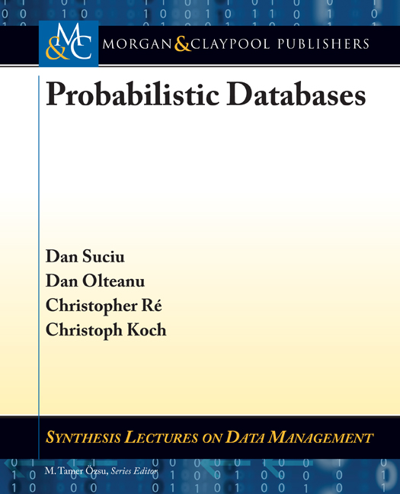
Outline
Part 1
Motivating Applications
The Probabilistic Data Model Chapter 2
Extensional Query Plans Chapter 4.2
The Complexity of Query Evaluation Chapter 3
Extensional Evaluation Chapter 4.1
Intensional Evaluation Chapter 5
Conclusions
Part 2
Part 3
Part 4

Slide 3
Summary (1/2)
There are many applications that require storage/management of uncertain data
Retain data that is not absolutely certain
Retain more than one alternative way to clean
Probabilities are application specific
All we care about is that “bigger is better”
Queries have precise semantics
Important for query optimization
“Bigger probability” means “more certain answer”
“Stop worrying about probabilities and start asking queries”

Slide 4
Summary (2/2)
Extensional query evaluation:
Advantage: can use out of the box DBMS
Disadvantage: can’t handle unsafe queries (but can still give upper/lower bounds on probabilities)
“You don’t need a probabilistic database management system to manage probabilistic data”
Intensional query evaluation:
Advantage: can use out of the box model counting system
Disadvantage: requires expensive “lineage computation” step; none of the model counting approaches seems complete for SPJU queries.

Slide 5
Open Problems
How do we compute the “hard” queries ?
Extensions to:
BID tables
Full FO: ¬ ∀
Independent AND disjoint tuples
Uniform probabilistic structures (MLNs)
Which queries admit efficient FBDDs? Which queries admit efficient d-DNNFs?

