Slide 1
High Availability in YARN
ID2219 Project Presentation
Arinto Murdopo (arinto@gmail.com)
Notes:
Today I am going to present the result of our project, titled High Availability in YARN. The main motivation of this project is shortcomings of YARN in term of availability Although Apache regards YARN as the next gen MR, it still has single point of failure, hence it has some availability problem into certain extent.

Slide 2
The team!
Mário A. (site – 4khnahs #at# gmail)
Arinto M. (site – arinto #at# gmail)
Strahinja L. (strahinja1984 #at# gmail)
Umit C.B. (ucbuyuksahin #at# gmail)
Special thanks
Jim Dowling (SICS, supervisor)
Vasiliki Kalavri (EMJD-DC, supervisor)
Johan Montelius (Course teacher)

Slide 3
Outline
Define: YARN
Why is it not highly available (H.A.)?
Providing H.A in YARN
What storage to use?
Here comes NDB
What we have done so far?
Experiment result
What’s next?
Conclusions

Slide 4
Define: YARN
YARN = Yet Another Resource Negotiator
Is NOT ONLY MapReduce 2.0, but also…
Framework to develop and/or execute distributed processing applications
Example: MapReduce, Spark, Apache HAMA, Apache Giraph
Notes:
MR =
Spark = MR-like cluster computing framework for low-latency iterative jobs and interactive use of interpreter
HAMA = computing framework on top of HDFS -> Matrix, Graph and Network algo
Giraph = Apache’s graph processing platform

Slide 5
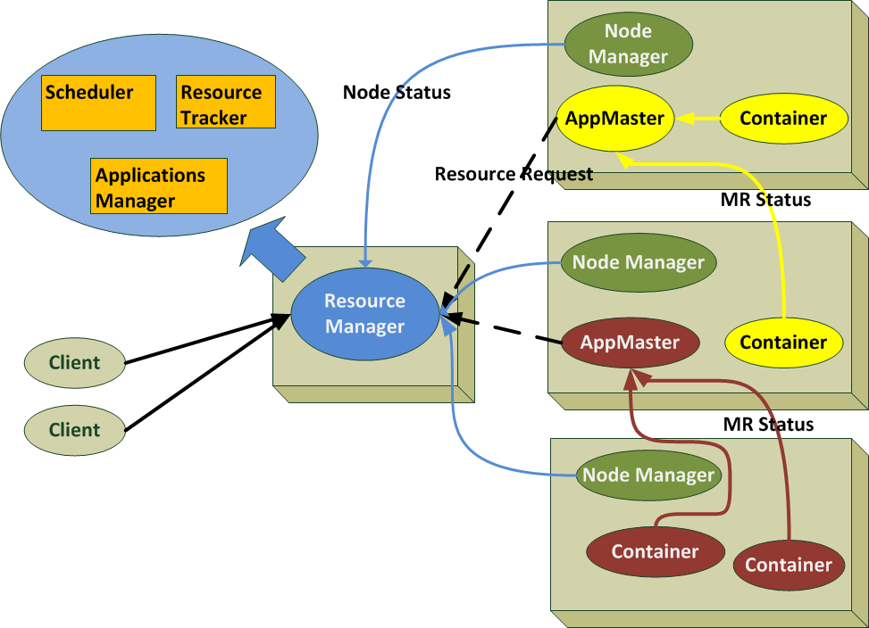
Define: YARN
Generic containers
Split JobTracker’s responsibilities
Per-App AppMaster
Notes:
Split the responsibility of JobTracker:
Resource Management -> Scheduler and ResourceTracker
JobScheduling and Monitoring -> AppMaster
Each application has its own AppMaster
Container nows generic, could be used to execute distributed application ie

Slide 6
What is it not highly available (H.A.)?
ResourceManager is Single Point of Failure (SPoF)
Notes:
When Container fails:
When AppMaster fails:
When NM fails:
When RM fails:

Slide 7
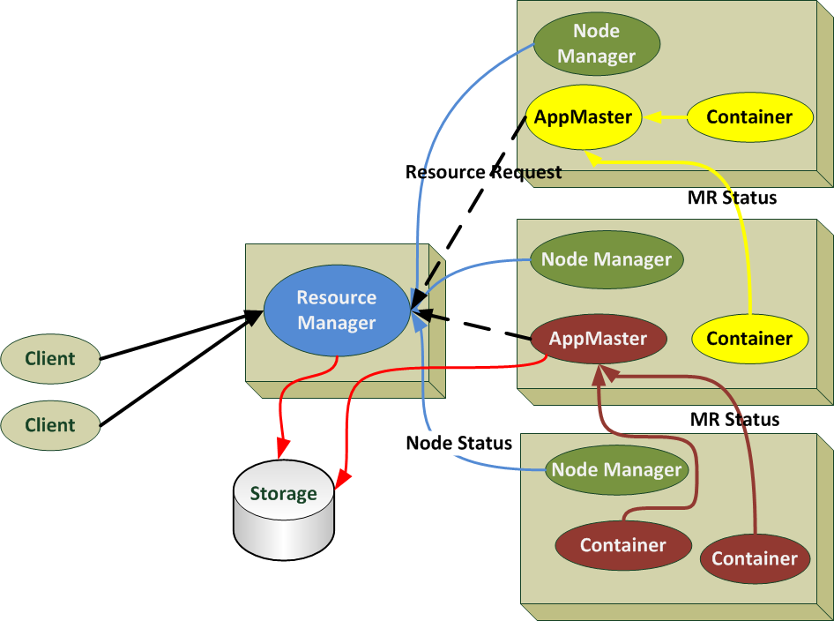
Providing H.A. in YARN
Proposed approach
store and reload state
failure model:
Recovery
Failover
Stateless
Notes:
Persist RM state
1 out of 3 failure models

Slide 8
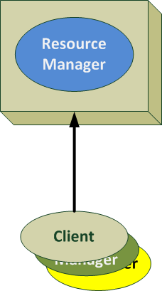
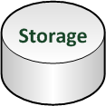
Failure Model#1: Recovery
Store states
Load states
RM stores states when needed
RM failure happens
Clients keep retrying
RM restarts and loads states
Clients successfully connect to resurrected RM
Downtime exists!

Slide 9

Failure Model#2: Failover
Utilize Standby RM
Little Downtime
Store
Load

Slide 10
Failure Model#3: Stateless
Store all states in storage, example:
NM Lists
App Lists

Slide 11
What storage to use?
Apache proposed
Hadoop Distributed File System (HDFS)
Fault-tolerant, large datasets, streaming access to data and more
ZooKeeper
Highly reliable distributed coordination
Wait-free, FIFO client ordering, linearizables writes and more
Notes:
HDFS good for
Fault tolerant -> replicated data into Datanode
Large-dataset -> divide huge data smaller blocks and distribute them into HDFS
Streaming access to file system data
Designed to run on commodity hardware
Zookeeper
Wait-free = lock free + bounded number of steps to finish operation
FIFO client ordering =all requests from a given client are executed in the order they were sent by the client
Linearizables write = all writes are linearizable: all steps can be viewed as valid atomic operation

Slide 12
Here comes NDB
NDB MySQL Cluster is a scalable, ACID-compliant transactional database
Some features
Designed for availability (No SPoF)
In-memory distributed database
Horizontal scalability (auto-sharding, no downtime when adding new node)
Fast R/W rate
Fine grained locking
SQL and NoSQL Interface
Notes:
NDB: MySQL Cluster integrates the standard MySQL server with an in-memory clustered storage engine called NDB.
Designed for availability
In-memory db -> good for session management
Horizontal scalability -> add new node means new capacity
Fast r/w rate -> 4.3 Billion read, 1.2 billion writes (update)
Fine-grained locking -> lock applied to individual row

Slide 13

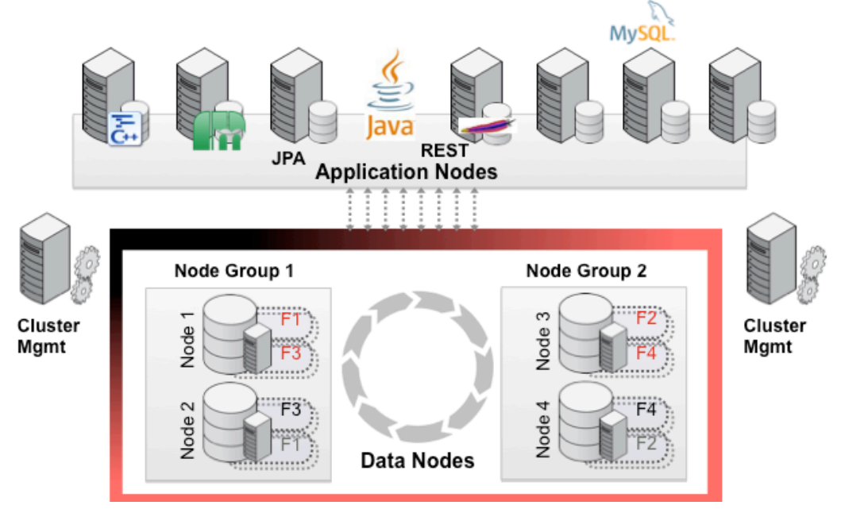
Here comes NDB
Client
Notes:
Application nodes provide connectivity from the application logic to the data nodes. Multiple APIs are presented to the application. MySQL provides a standard SQL interface, including connectivity to all of the leading web development languages and frameworks. There are also a whole range of NoSQL interfaces including Memcached, REST/HTTP, C++ (NDB-API), Java and JPA.
Data nodes manage the storage and access to data. Tables are automatically sharded across the data nodes which also transparently handle load balancing, replication, failover and self-healing
Management nodes are used to configure the cluster and provide arbitration in the event of
network partitioning.

Slide 14
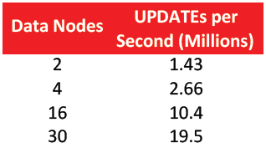
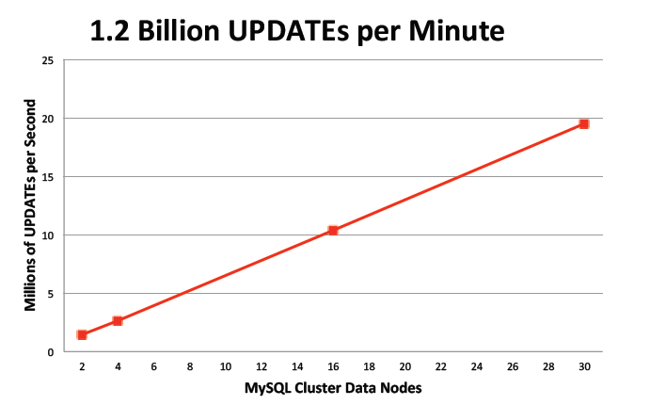
Here comes NDB
MySQL Cluster version 7.2
Linear horizontal scalability
Up to 4.3 Billion reads/minute!
Notes:
20 Million updates per second = 1.2 billion updates/minutes
Experiment settings:
FlexAsynch benchmark suite
The benchmark reads or updates an entire row from the database as part of its test operation. All UPDATE
operations are fully transactional. As part of these tests, each row in this benchmark is 100 bytes total,
comprising 25 columns, each 4 bytes in size, though the size and number of columns are fully configurable.

Slide 15
What we have done so far?
Phase 1: The Ndb-storage-class
Apache proposed failure model
We developed NdbRMStateStore, that has H.A!
Phase 2 : The Framework
Apache created ZK and FS storage classes
We developed a framework for storage benchmarking

Slide 16
Phase 1: The Ndb-storage-class
Apache
implemented Memory Store for Resource Manager (RM) recovery (MemoryRMStateStore)
Application State and Application Attempt are stored
Restart app when RM is resurrected
It’s not really H.A.!
We
Implemented NDB Mysql Cluster Store (NdbRMStateStore)using clusterj
Implemented TestNdbRMRestart, to prove the H.A. in YARN
Notes:
clusterj is up to 10.5x faster than openjpa-jdbc
AppState =
AppId -> Int
ClusterTimeStamp -> Long, AppId + ClusterTimeStamp = ApplicationId class
SubmitTime -> Long
AppSubmissionContext -> Priority, AppName, Queue, User, ContainerLaunchContext (requested resource), some flags
Collection of AppAttempt
AppAttempt =
AppId
AppAttemptId
MasterContainer -> ContainerPBImpl (first allocated container from RM to AM)

Slide 17
Phase 1: The Ndb-storage-class
Create an NDB session
factory = ClusterJHelper.getSessionFactory(props);
session = factory.getSession();
Store application state to NDB
NdbApplicationStateCJ storedApp = session.newInstance(NdbApplicationStateCJ.class);
storedApp.setId(app.getApplicationId().getId());
//set other data
//Write NdbApplicationState to ndb database
session.persist(storedApp);

Slide 18
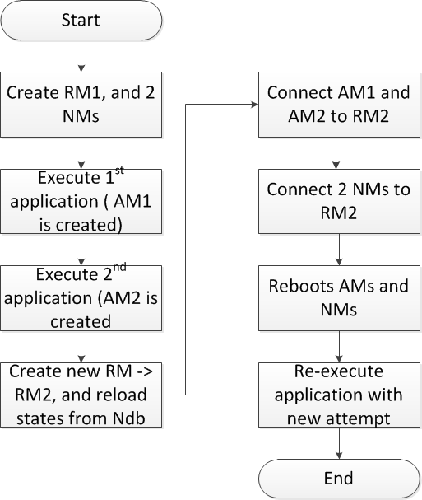
Phase 1: The-Ndb-storage-class
TestNdbRM-
Restart
Restart all unfinished jobs

Slide 19
Phase 2: The Framework
Apache
Implemented Zookeeper Store (ZKRMStateStore)
Implemented File System Store (FileSystemRMStateStore)
We
Developed a storage-benchmark-framework
to benchmark both performances with our store
https://github.com/4knahs/zkndb

Slide 20
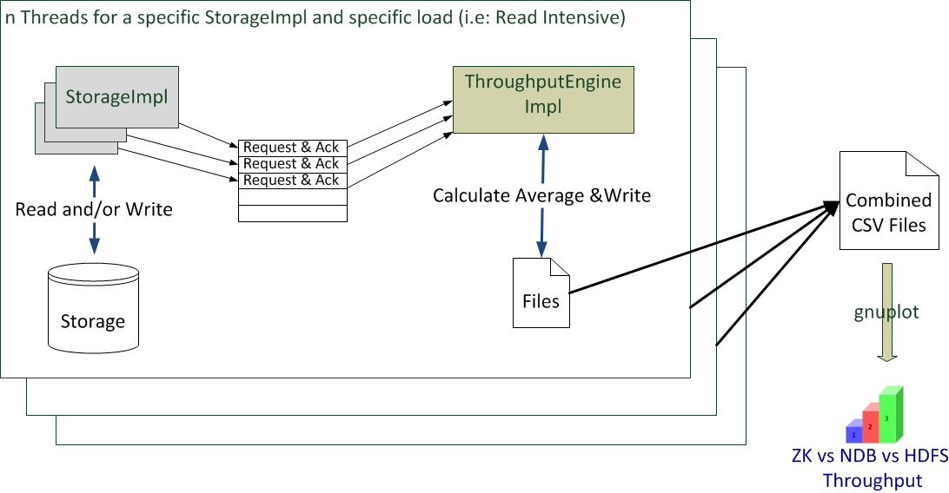
Phase 2: The Framework
zkndb = framework for storage benchmarking
Notes:
Extensibility in implementing the Storage (StorageImpl), defining the metrics, defining how we are going to store the result

Slide 21
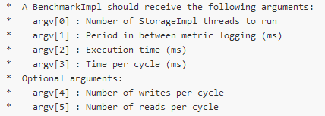
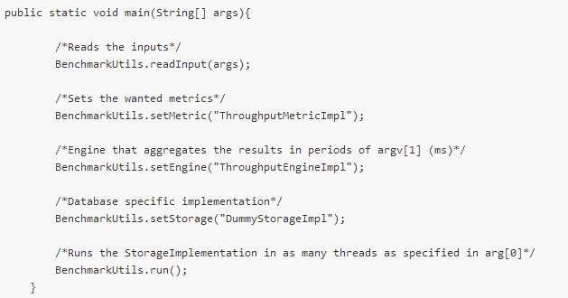
Phase 2: The Framework
zkndb extensibility
Notes:
Flexibility in implementing the Storage (StorageImpl)
Flexibility in defining the metrics
Flexibility in defining how we are going to store the result

Slide 22
Experiment Setup
ZooKeeper
Three nodes in SICS cluster
Each ZK process has max memory of 5GB
HDFS
Three DataNodes and one Namenode
Each HDFS DN and NN process has max memory of 5GB
NDB
Three-node cluster

Slide 23
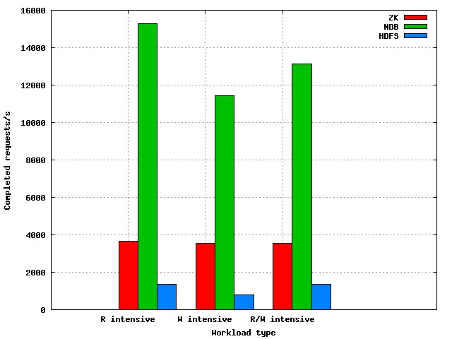
Experiment Result #1
Load Setup#1:
1 node
12 threads
60 seconds
Each node:
Dual six-core CPUs
@2.6Ghz
All clusters consist of 3 nodes
Utilize Hadoop code for ZK and HDFS
ZK is limited by its store implementation
Not good for small files!
Notes:
Store implementation => fixed data access time since our code is synchronous write
HDFS not good for small files -> too many overhead.
Furthermore, HDFS is not geared up to efficiently accessing small files: it is primarily designed for streaming access of large files. Reading through small files normally causes lots of seeks and lots of hopping from datanode to datanode to retrieve each small file, all of which is an inefficient data access patternd in storing small files
http://blog.cloudera.com/blog/2009/02/the-small-files-problem/
NN is bloated in tracking file metadata
3900 15500 1400
3850 11500 1000
3850 13250 1400

Slide 24
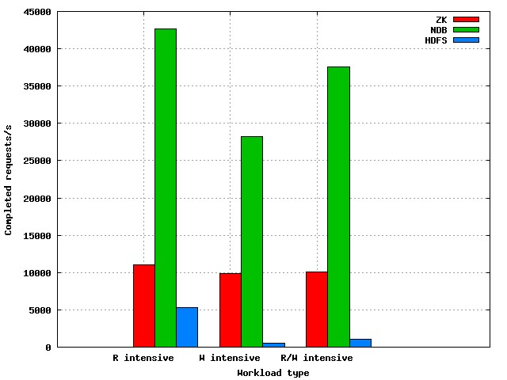
Experiment Result #2
Load Setup#2:
3 nodes
@12 threads
30 seconds
Each node:
Dual six-core CPUs
@2.6Ghz
All clusters consist of 3 nodes
Utilize Hadoop code for ZK and HDFS
ZK could scale a bit more!
Get even worse due to root lock in NameNode!
Notes:
Put number here:
Data Type,Zookeeper,Ndb,Hdfs
10993.69 42665.2 5328.62
9858.92 28256.27 534.692
10035.97 37607.8 1079.077

Slide 25
What’s next?
Scheduler and ResourceTracker Analysis
Stateless Architecture
Study the overhead of writing state to NDB

Slide 26
Conclusions
NDB has higher throughput than ZK and HDFS
NDB is the suitable storage for Stateless Failure Model
but ZK and HDFS are not for Stateless Failure Model!

